Slide 1
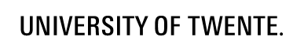
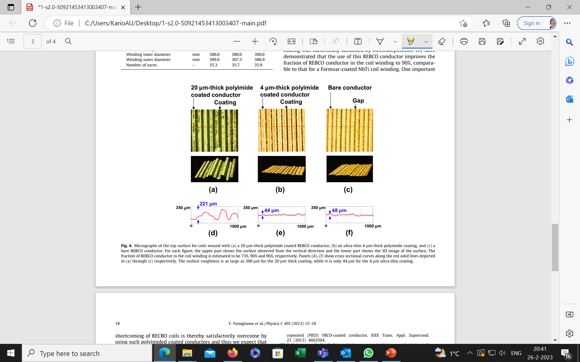
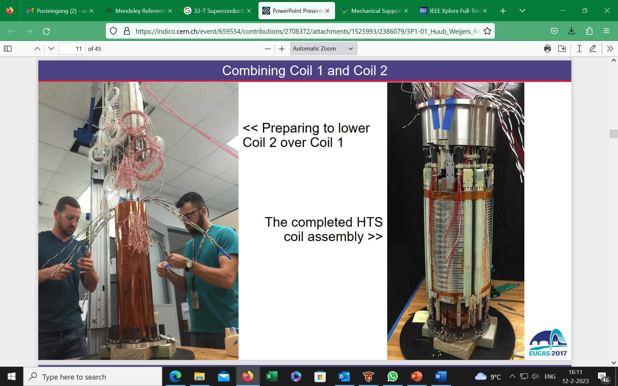
Impregnation of ReBCO tape stacks and cables
A. Kario, S. Otten, H.H.J. ten Kate
Overview based on literature
Focus on insulation approach
Y. Yanagisawa et al.
H. W. Weijers et al.

Slide 2
Impregnate or not ?
Thermal expansion mismatch leading to delamination and Ic degradation
Debonding layer
- Shrink tube
- Polyimide
- Mold release
Decreasing difference in thermal expansion
- Al₂O₃
- SiO₂
Cable examples: Roebel and CORC
1.1 %
S. Otten, master Thesis: https://essay.utwente.nl/66576/ page 24.
C. Barth, “High temperature superconductor cable concepts for fusion magnets”, p. 62, PhD
N. Bagrets, ITEP, KIT

Slide 3
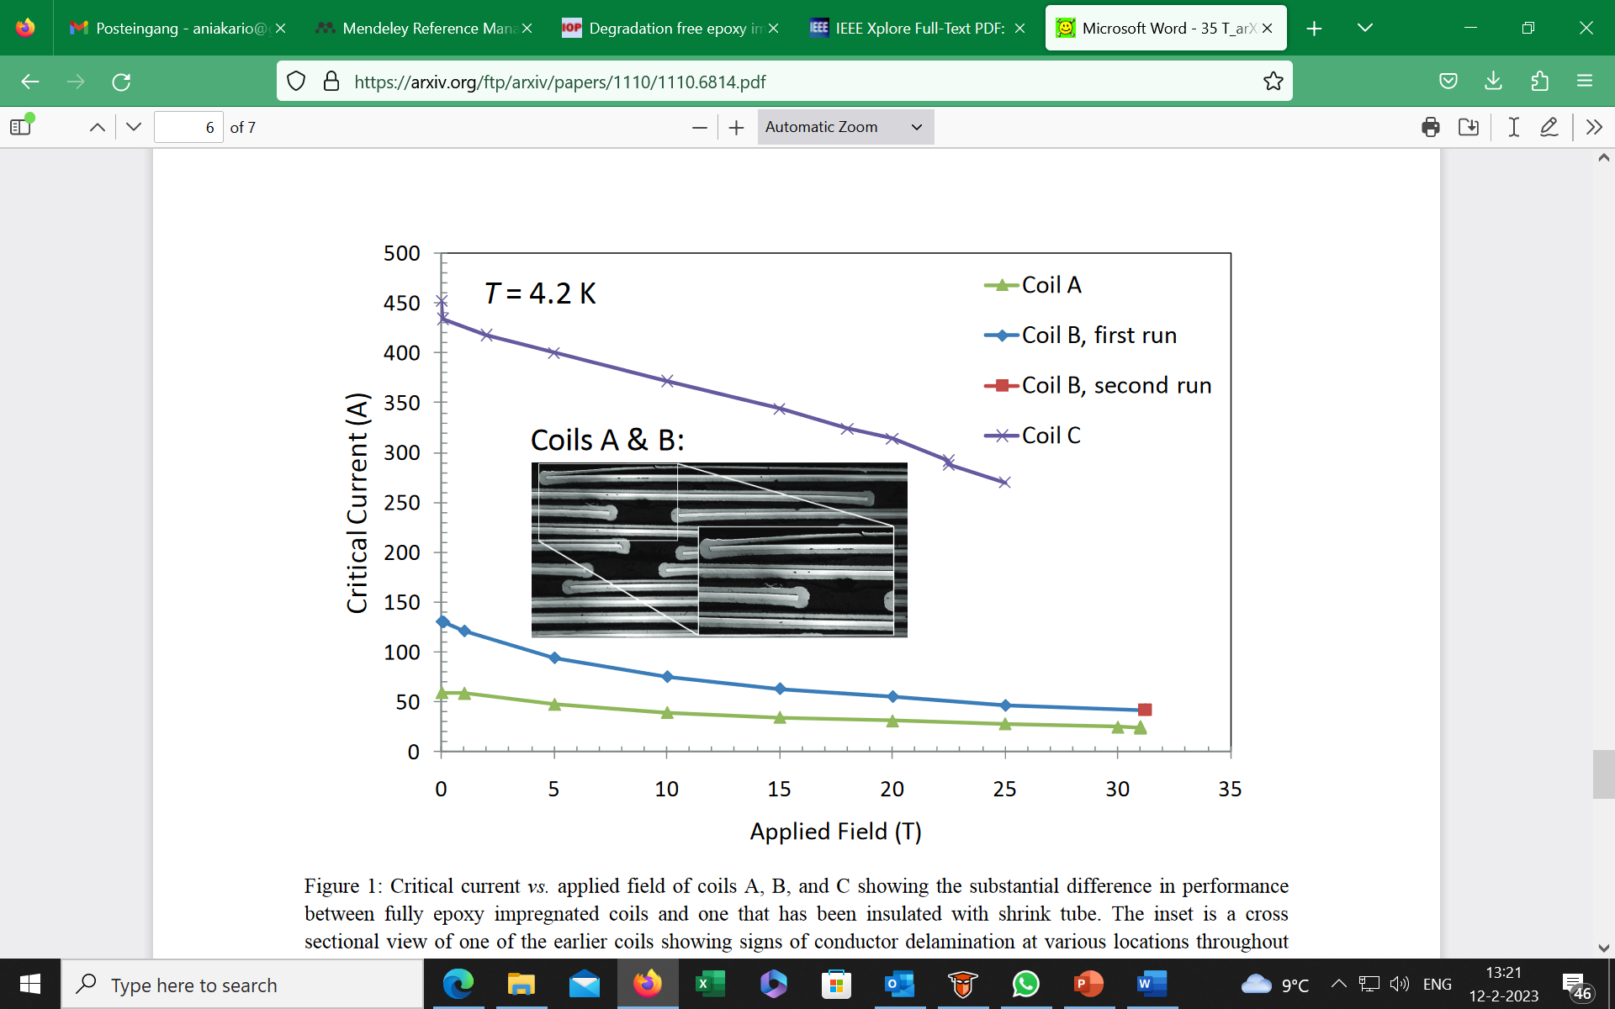
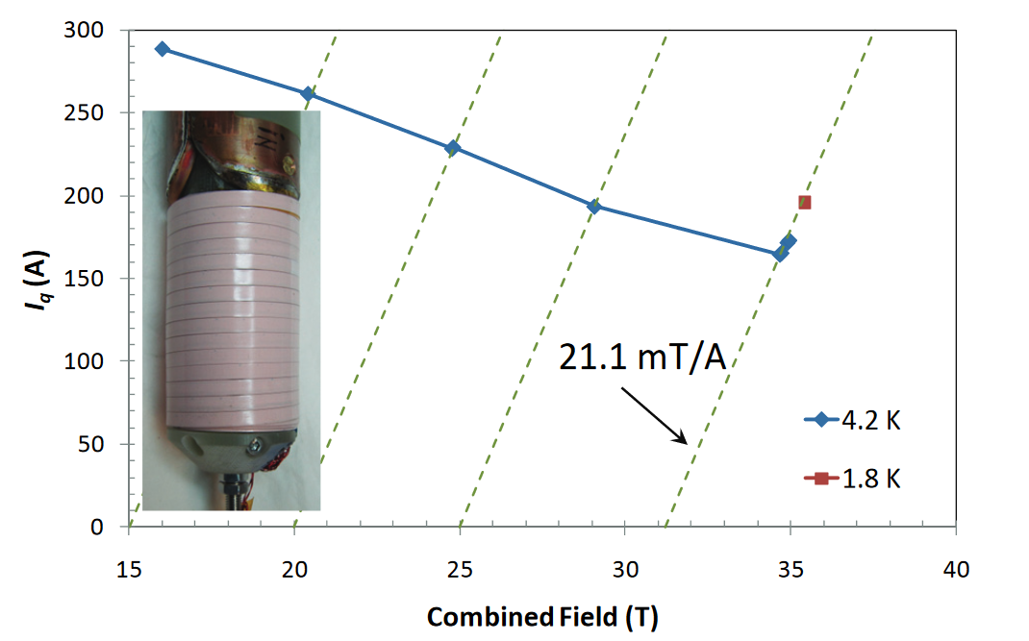
Debonding layer - polyester heat-shrink tube:
Fully epoxy impregnated coils and one that has been insulated with polyester heat-shrink tube (15 μm).
Sectional view of one of the earlier coils showing signs of conductor delamination at various locations throughout the winding pack.
Quench current vs. magnetic field for two bath temperatures: 4.2 K and 1.8 K.
Heating developed close to the terminals due to helium gas trapping in that region, which reduced the quench currents in the field range above 20 T.
Ulf P. Trociewitz et al, 35.4 T field generated using a layer-wound superconducting coil made of (RE)Ba2Cu3O7-x (RE = Rare Earth) coated conductor, Appl. Phys. Lett. 99, 202506 (2011)
Notes:
Hi Anna,
Thanks for reaching out. The shrink tube application, for which we used a cryogen tolerant polyester shrink tube, was actually straight forward and did not create any issues per se. The tubing comes in 8 ft length and we built a rack so that we could successively slide these lengths onto the conductor. The shrinking was then done with a rail-mounted hot air gun and the resulting thickness was rather around 15 um. The reason why we stopped using it, may actually surprise you: Our original intend was to go ahead with wet-wound, layer-wound ReBCO coils of this type. During that year the manufacturer announced an increase in output of continuous length to 300 m, which we tried to purchase but could not get and up to now it appears to be still difficult to get ReBCO in these or longer lengths. At the same time there was increased interest growing in Bi-2212 round wire technology and essentially we switched field. If I see a potential disadvantage with the polyester shrink tubing, it is its thermal conductivity, which being a plastic, is significantly lower than that of e.g. ceramics. In summary, it had worked well for the layer-wound coils we made but we did not explore the impact this material on quench protection in high-field (high stored energy) coils. Hope this helps.
Cheers,
Ulf
Huub Wijers: “I will start with the easier question: why didn’t the 32 T project use the shrink tube as debonding layer? The principle works, as proven via the coil shown on slide 3. The disadvantage is that the shrink tube is somewhat labor-intensive to apply. It was done manually for the coil in slide 3, which took a very long set of tables, several people and a day and a half of work with a lot of handling of the conductor (which is a risk in my opinion). There was an activity (student project) to design and build a machine to make it a reel-reel process but I don’t recall what happened with that. For the 32 T project we preferred to minimize handling of the conductor and chose to apply a coating to a co-wound stainless-steel layer instead. ( I had done this approach before in the “5T” Bi-2212 tape coil of the early 2000’s that reached 25 T central field in a 20 T background)”

Slide 4
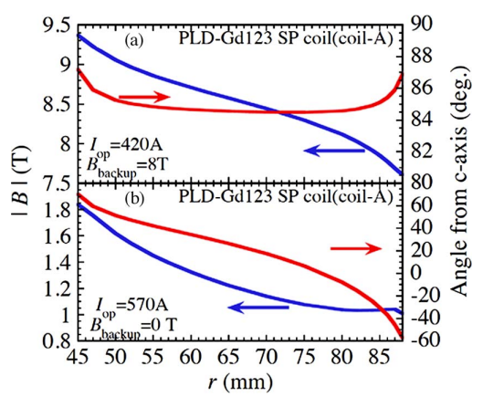
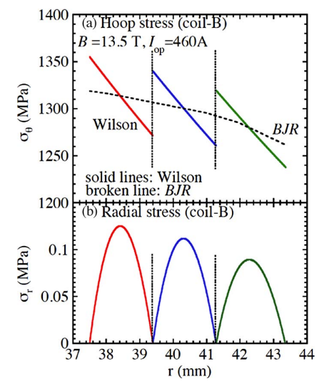
Debonding layer - polyimide:
The 25 μm thick Kapton tapes were co-wound for insulation.
Stable operation of the epoxy impregnated ReBCO pancake coils in high magnetic field and under the large electromagnetic stress more than 1300 MPa per a Hastelloy substrate without degradation.
Y. Yanagisawa et al., An ultra-thin polyimide insulation coating on REBCO conductors by electrodeposition produces a maximum overall current density for REBCO coils, Physica C 495 (2013) 15–18
S. Awaji et al., “Superconducting and mechanical properties of impregnated REBCO pancake coils under large hoop stress,” IEEE Transactions on Applied Superconductivity, vol. 23, no. 3, 2013, doi: 10.1109/TASC.2012.2229775.

Slide 5
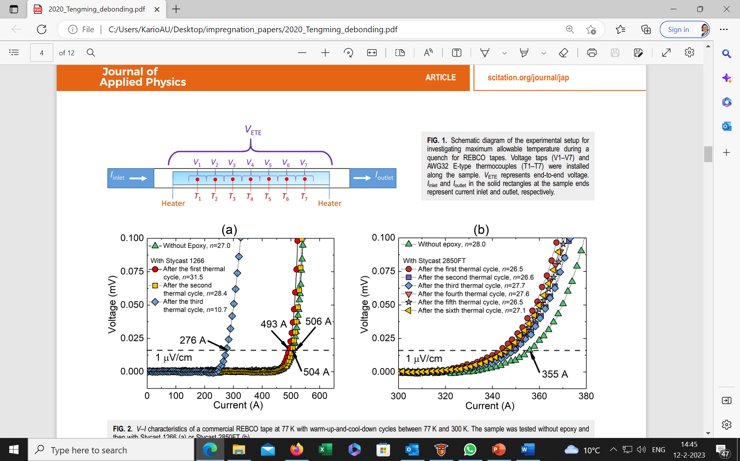
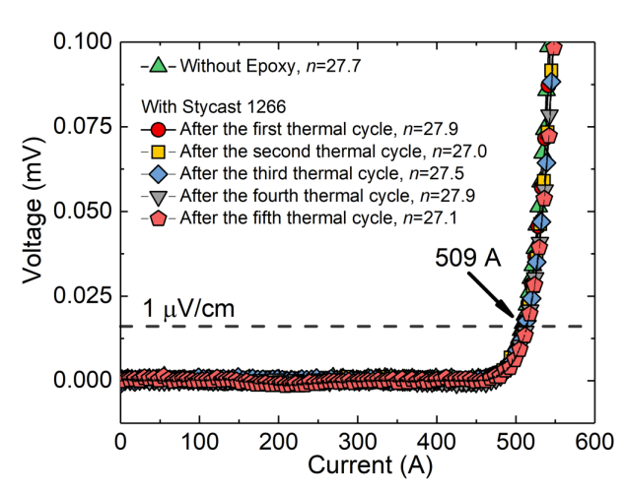
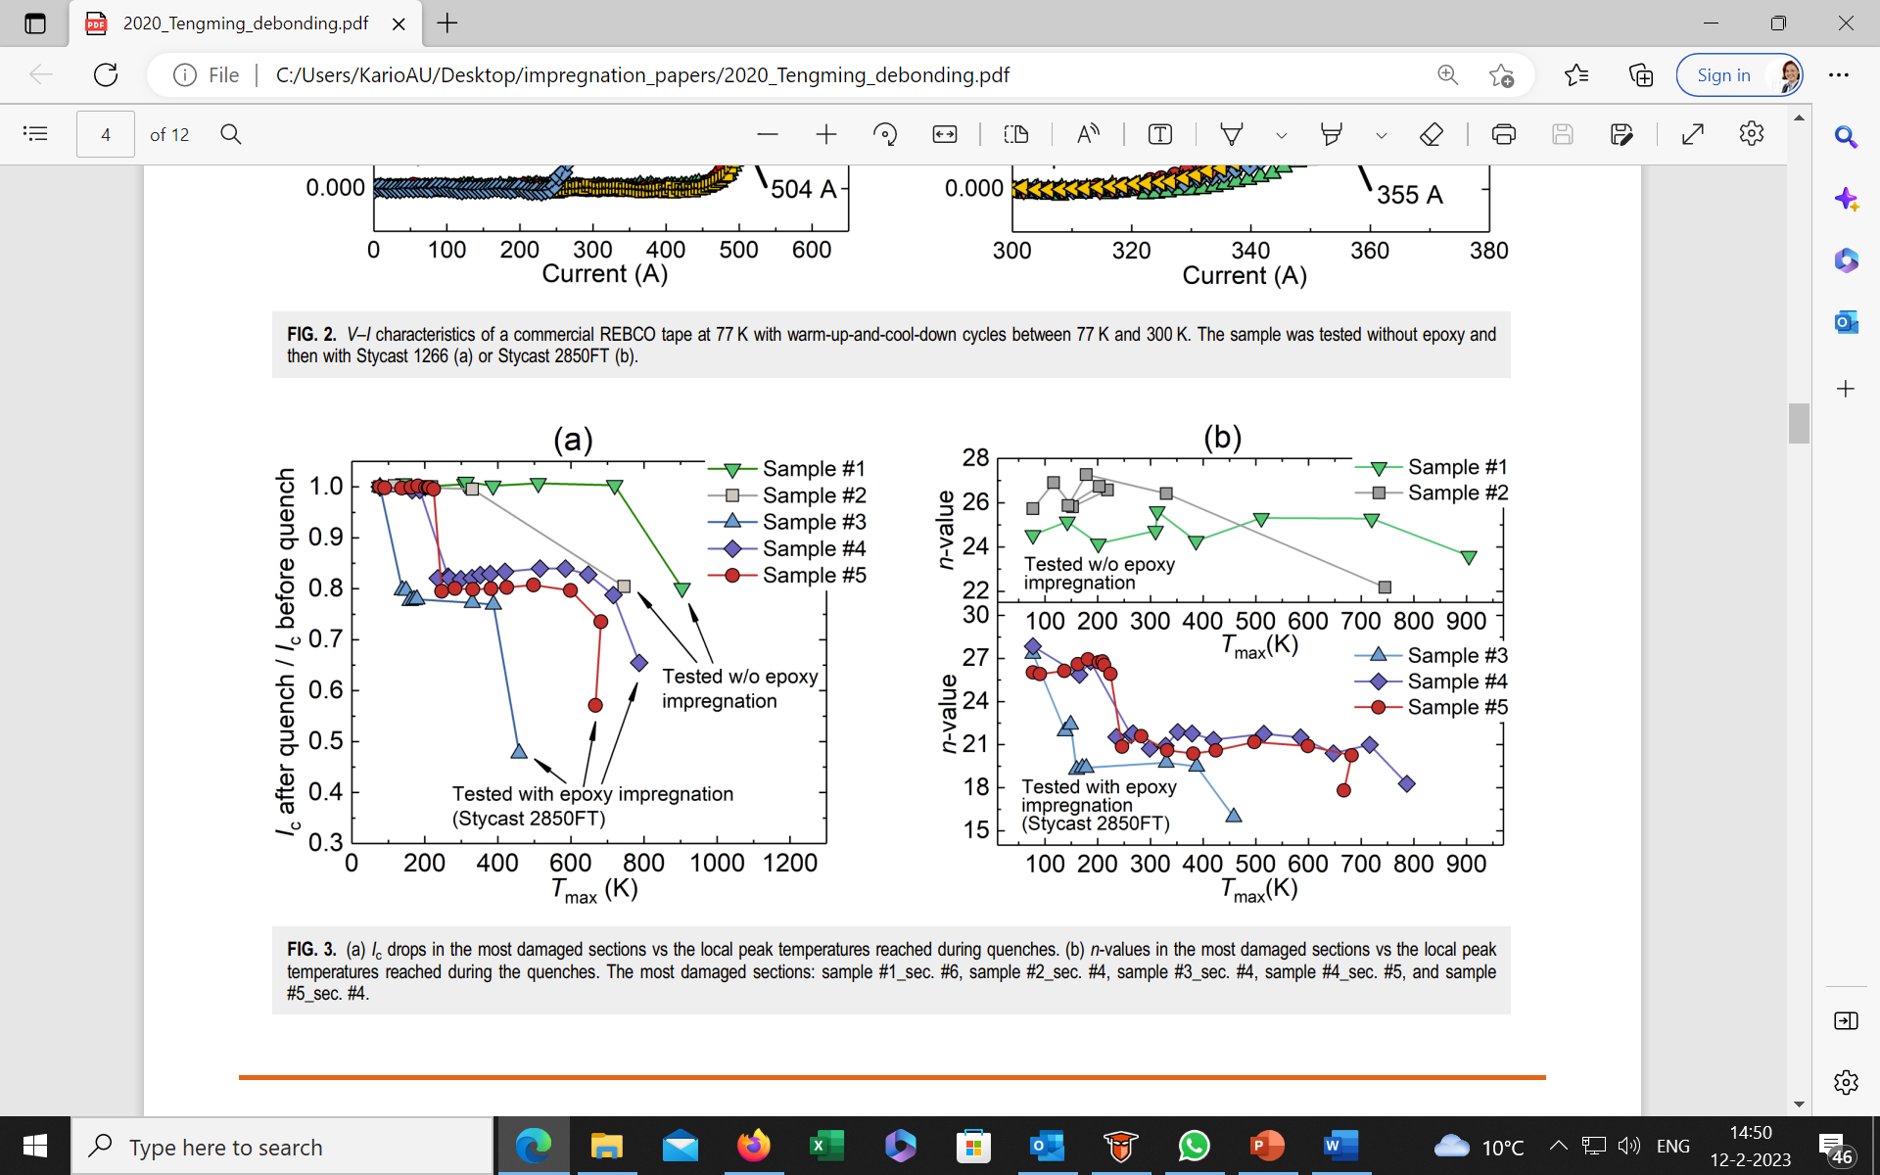
Debonding layer-chemical, mold release agent:
A mold release agent, ZYVAX® + Stycast 1266.
Epoxy debonds from the tape coated with the mold release agent due to the weak interface.
Stycast 2850FT. The thickness of the epoxy layers was 2–3 mm.
All epoxy impregnated samples (#3, #4, and #5) exhibited about 20% Ic degradation when the hot spot temperature was less than 300 K and a second damage above 400 K.
S. Yin et al., “Degradation of REBCO coated conductors due to a combination of epoxy impregnation, thermal cycles, and quench: Characteristics and a method of alleviation,” J Appl Phys, vol. 128, no. 17, Nov. 2020, doi: 10.1063/5.0026000.
Notes:
Tengming Shen “For your question, we didn't do heater-induced quench experiment with mold-released, stycast 2850 impregnated REBCO tapes, or heater-induced quench experiment with mold-released, stycast 1266 impregnated tapes. We should get them done sometimes.”

Slide 6
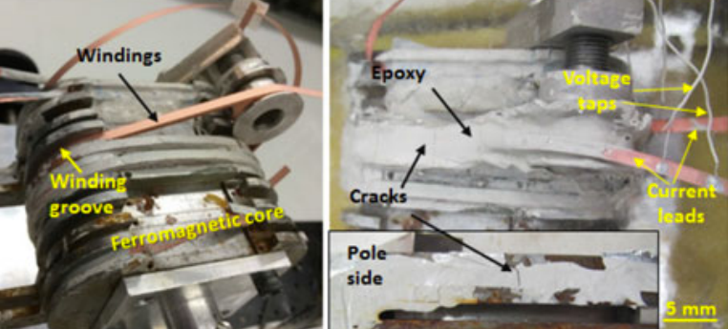
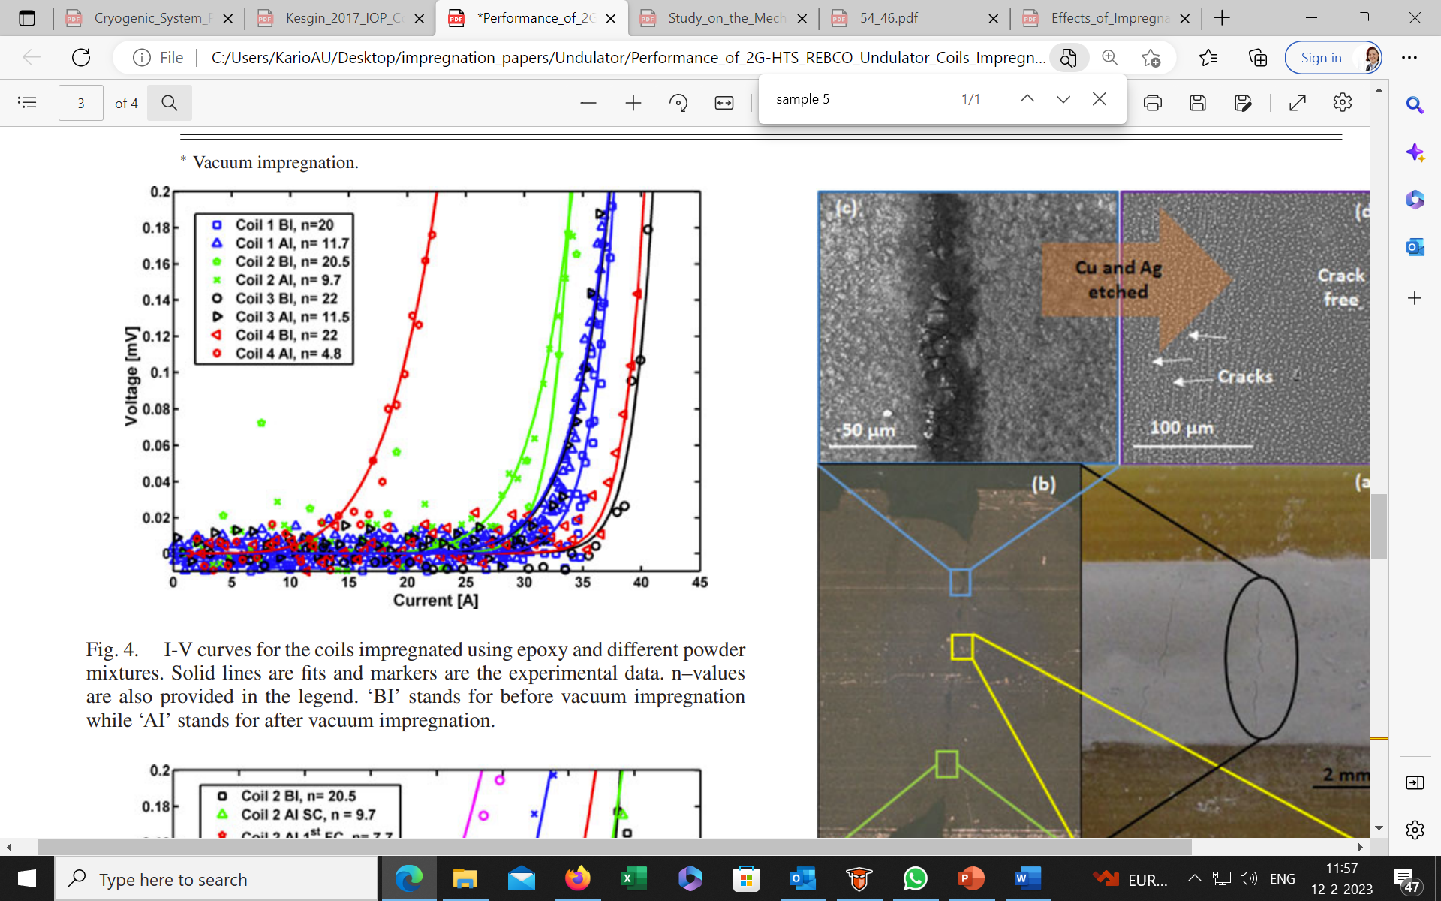
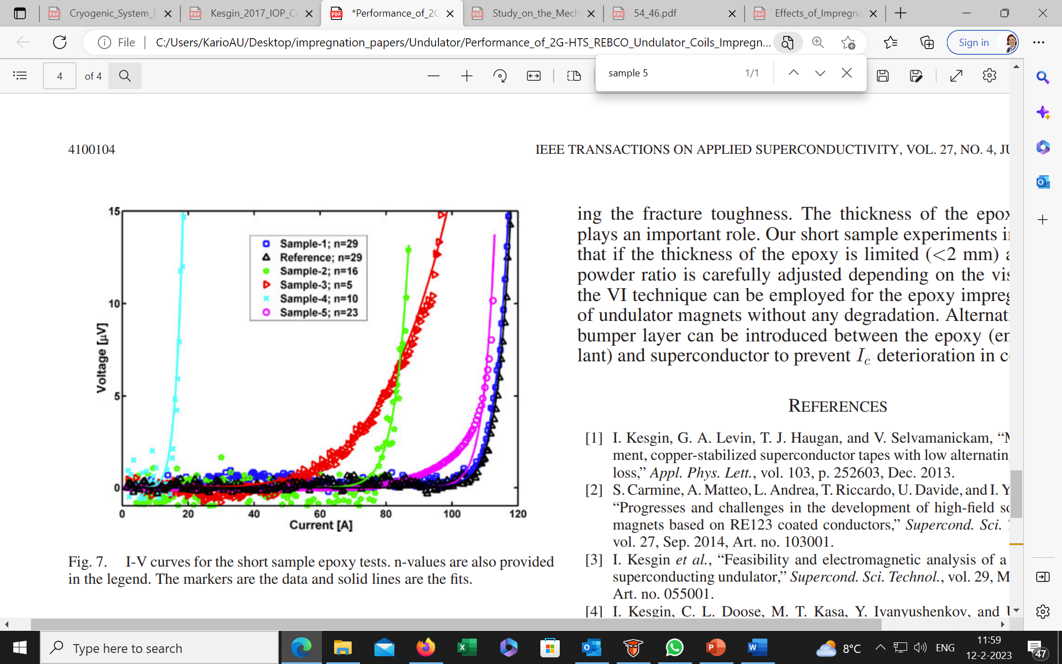

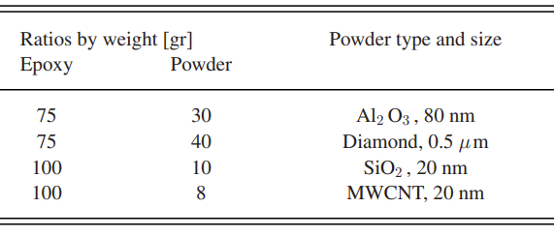
Epoxy with diamond powder addition:
BI: before impregnation
AF: after impregnation
Coil 1: Al₂O₃, 80 nm, 75:30 g
Coil 2: Diamond, 0.5 µm, 75:40 g
Coil 3: SiO₂, 20 nm, 100:10 g
Coil 4: MWCNT, 20 nm,100:8 g
Undulator coil before the epoxy impregnation during winding (a) and after the epoxy impregnation with the epoxy/diamond powder mixture
Microscopy of ReBCO surface after impregnation with
SHORT SAMPLES
Sample 1: epoxy mixed with Al2O3 and diamond, percentage of 80%, very viscous, almost no degradation, epoxy thickness ~2 mm.
I. Kesgin, Q. Hasse, Y. Ivanyushenkov, and U. Welp, “Performance of 2G-HTS REBCO Undulator Coils Impregnated Epoxies Mixed with Different Fillers,” IEEE Transactions on Applied Superconductivity, vol. 27, no. 4, Jun. 2017, doi: 10.1109/TASC.2016.2638431.
Notes:
Hi Anna,
You caught me at a bad time. I'm feeling a little bit under the weather.
The motivation behind the filler was to make the epoxy formulation compatible with the REBCO structure, so that differential thermal contraction would be small and, hopefully, prevent crack formation or delamination. However, this did not work consistently. As a result, I ended up introducing a mechanical de-bounding layer.
Nb3Sn was a nice intermediate step for us. I have finished the Nb3Sn undulator and installed it into the APS's storage ring, running as the first Nb3Sn accelerator magnet operating in an actual Nb3Sn and serving to our users. I am now planning to revisit the 2G-HTS for undulator application. The main obstacle was the screening current-induced field errors.
I hope this helps.
Ibrahim

Slide 7
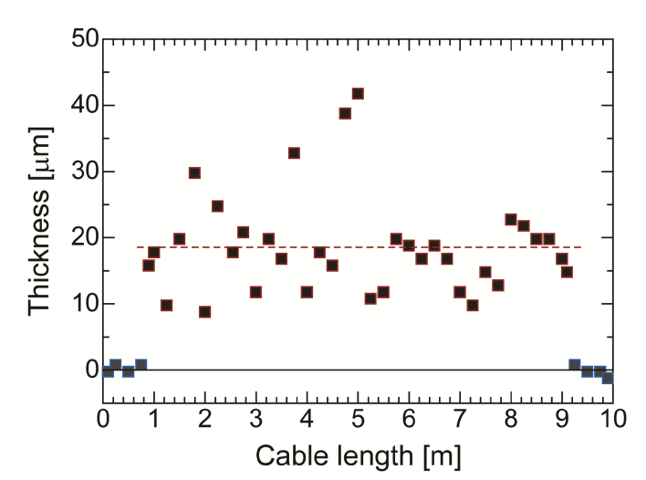
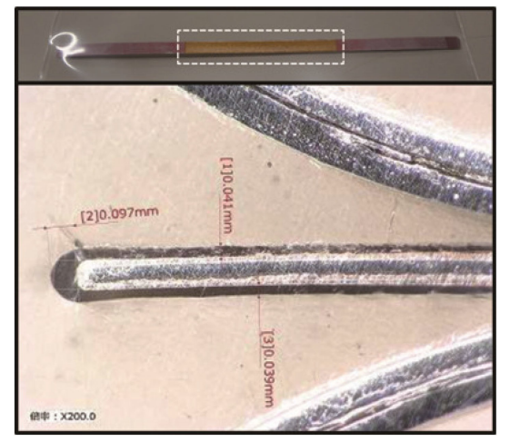
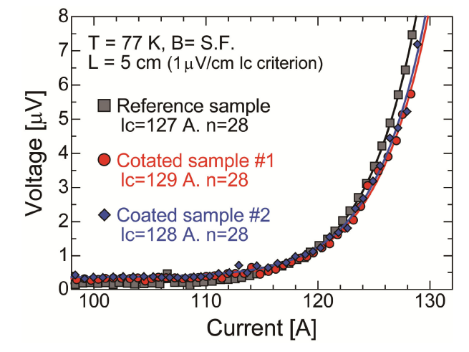
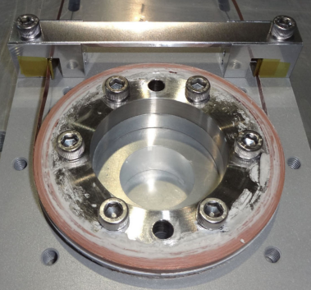
Mineral Insulated ReBCO:
Small-scale demonstration magnet composed of mineral insulated ReBCO coils.
Commercial paint using the sol-gel process.
1:1 ratio of SiO₂ and Al₂O₃
Ceramic coating using the sol-gel process succeeded in forming an insulating film with a thickness of 30 µm on the surface of REBCO tape.
No degradation of the critical current characteristics of the coated REBCO tape is observed.
M. Iio, M. Yoshida, T. Nakamoto, K. Suzuki, M. Sugano, and T. Ogitsu, “Research and Development of Future Radiation-Resistant Superconducting Magnets with Mineral Insulated REBCO Coils,” IEEE Transactions on Applied Superconductivity, vol. 30, no. 4, Jun. 2020, doi: 10.1109/TASC.2020.2966427.

Slide 8
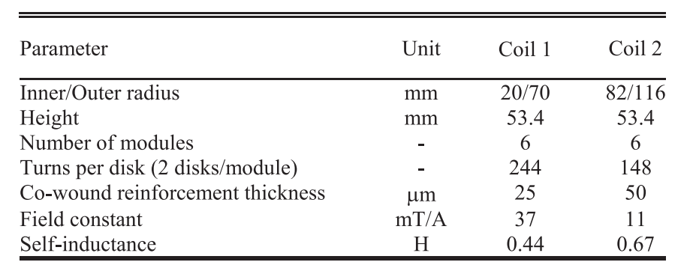
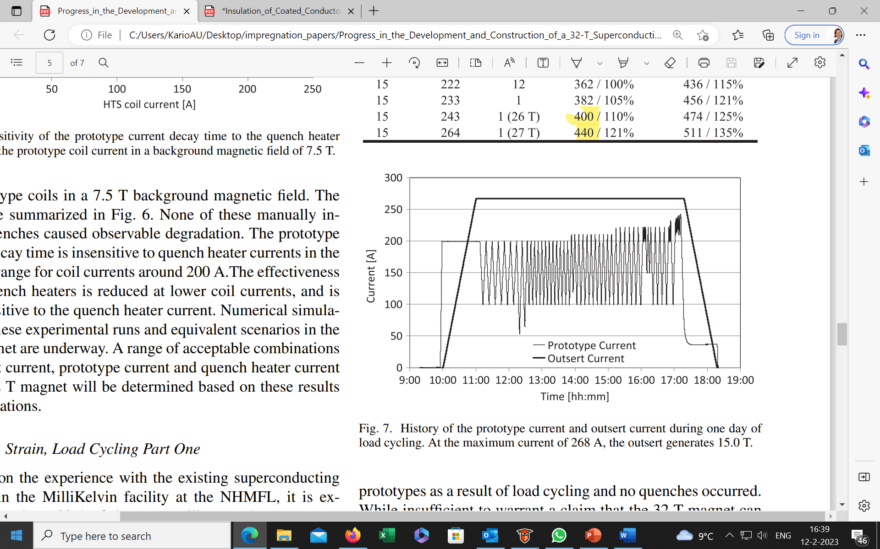
Hybrid impregnation, wax + tapes with debonding:
UV cured epoxy by dip coating technique.
Un-insulated 4-mm wide ReBCO tape co-wound with insulated stainless-steel tape as turn-turn insulation.
Each module is vacuum-impregnated with paraffin.
Load cycling in a 15 T background to 222 A in the prototype.
Excursions to 233 A and 243 A were made.
The central magnetic field reached 26 T at 243 A.
H. W. Weijers et al., “Progress in the Development and Construction of a 32-T Superconducting Magnet,” IEEE Transactions on Applied Superconductivity, vol. 26, no. 4, Jun. 2016, doi: 10.1109/TASC.2016.2517022.v
Notes:
Huub Weijers: “Now to the 32 T magnet:
In one of the earlier test coils in this project we used REBCO conductor with insulated stainless steel co-wind. We called this coil “42-62”, after its inner and outer diameter. Three double pancakes had co-wind UV-cured epoxy ( a process developed by the institute where I am now), three double pancakes used GE varnish. At that time, the coils were dry wound, not impregnated. The purpose of the coating was traditional electrical turn-turn insulation.
Later followed a set of what we called prototype coils (20-70 and 82-116, again named after their diameters), which were subscale 32 T coils. They had all features but had less double-pancakes than the 32 T design. By this time we had re-developed the ceramic insulation coating on stainless steel as used for the 5T Bi-2212 coil. In the first year of testing, the coils were not impregnated. For the second year of testing the original coils were wax impregnated (after disassembly of the coils into individual double-pancake modules). The primary purpose was to give increased rigidity to the coil windings, without risk of delamination as seen with epoxy impregnated coils. We had seen voltage spikes during testing that we thought at the time were possibly related to small movements (tens of um-level) of the conductor. Without clear proof, I now suspect the spikes were related at least in part to screening currents, but we never really learned the cause of the voltage spikes. Wax impregnation changed the nature of the voltage spikes a lot but they were not gone. So the wax impregnation did not do all we had hoped for in that respect, but we did like the increased rigidity of the windings and there was no indication of REBCO delamination so we kept wax impregnating later coils, including the actual 32 T HTS coils. A secondary reason for the wax impregnation was excluding liquid helium from the windings. Due to dog-boning of the Cu plating and other geometric factors, the windings had about 10-11% void space. By filling that with wax, instead of helium, the quench heaters were calculated to be slightly more effective (or requiring less power for the same conductor temperature rise) as the heat capacity of wax is much lower than that of helium. I recall a 6% gain in performance of the quench heaters, but that is from memory so don’t quote me on the precise number.
The actual HTS coils for the 32 T magnet were wax impregnated as double pancakes before assembly. The co-wind stainless steel was insulated with a ceramic layer before coil winding. We did see the wax as mechanically the weakest link, so we did not expect delamination of the REBCO layer and to the best of our knowledge that is indeed correct for the 32 T magnet. It remains in service for the user program at 32 T and has seen more cycles to peak field over the years than any other high field superconducting magnet (the Bruker 28 T NMR magnets don’t cycle, and I think the 25 T magnet at Sendai is the next highest field superconducting magnet in routine use.”

Slide 9
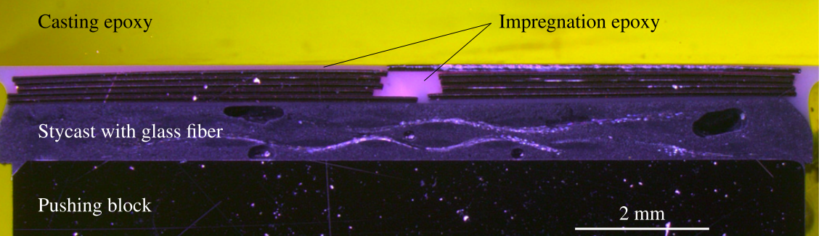
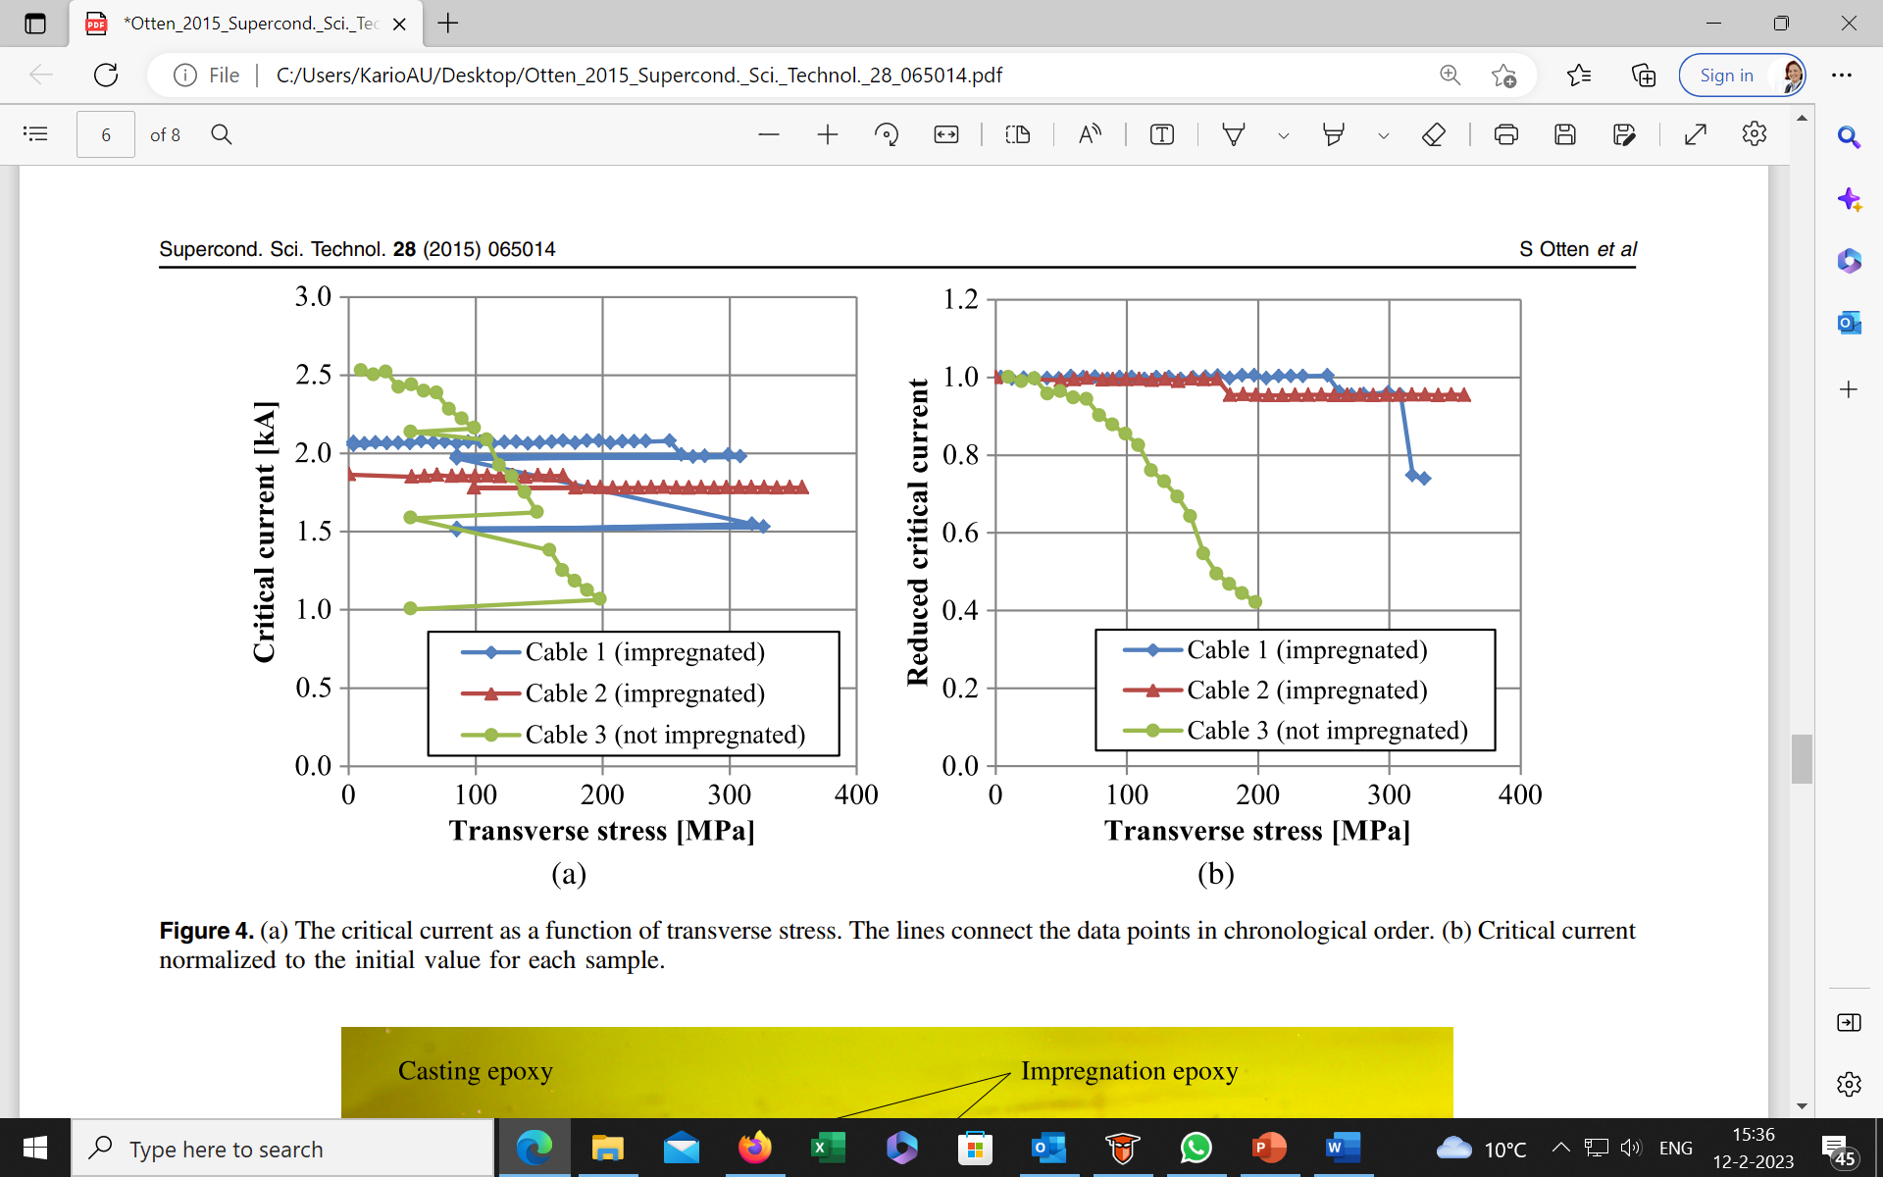
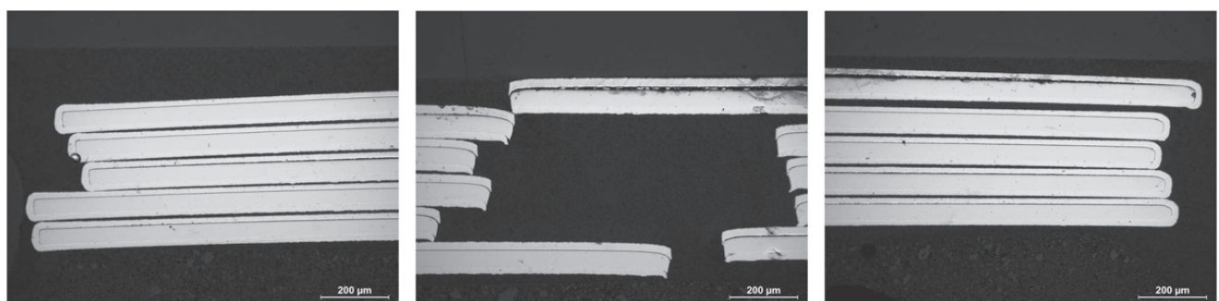
Roebel cable impregnated with epoxy + silica powder:
Vacuum impregnated with a mixture of epoxy resin and fused silica powder (4 μm).
The mixing ratio of resin, hardener, and silica powder is 1:1:2 by weight.
Epoxy bath and sample holder are heated to 80 °C to reduce viscosity.
The Ic reduction of the impregnated samples compared to the cable that was not impregnated may indicate damage due to impregnation.
S. Otten et al., “Enhancement of the transverse stress tolerance of REBCO Roebel cables by epoxy impregnation,” Supercond Sci Technol, vol. 28, no. 6, Jun. 2015, doi: 10.1088/0953-2048/28/6/065014.

Slide 10
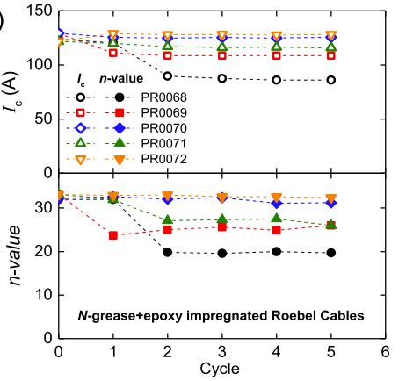
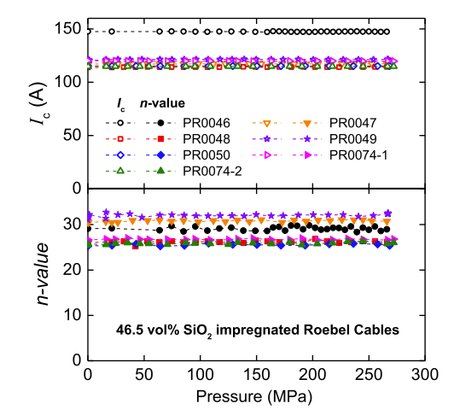
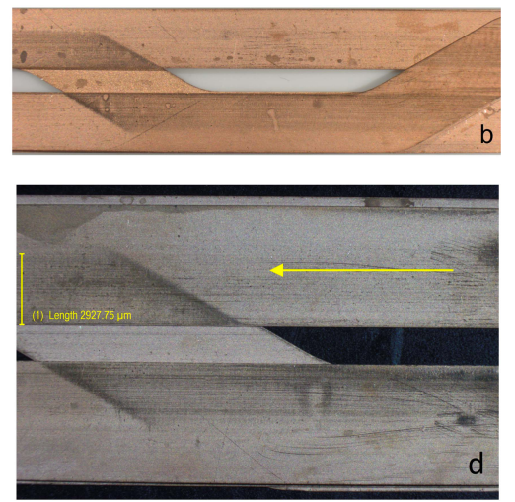
Roebel cable impregnated with epoxy + SiO₂:
For unpotted cable, degradation with transverse pressures occurred at variable but generally low pressures of 3–34 MPa.
For cables impregnated with epoxy filled with 46.5% SiO2 nano-powder, we did not observe any degradation with applied transverse pressure up to 270 MPa.
E. F. Talantsev et al., “Critical current retention of potted and unpotted REBCO Roebel cables under transverse pressure and thermal cycling,” Supercond Sci Technol, vol. 30, no. 4, Mar. 2017, doi: 10.1088/1361-6668/aa604f.

Slide 11
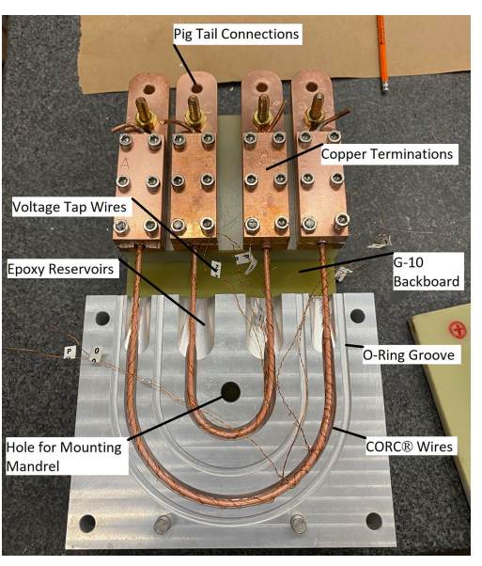
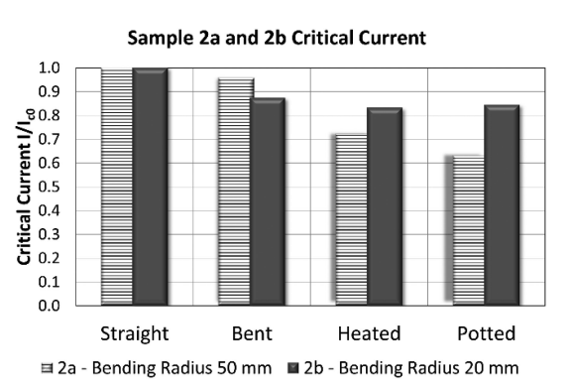
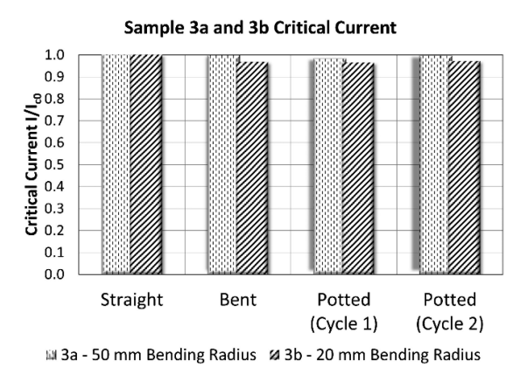
Conductor on Round Core cable:
Mix 61 with a maximum cure at 100 °C caused significant degradation on the CORC wires.
CTD-528 epoxy cured at room temperature caused negligible Ic degradation (<1%).
Six tapes and three layers, two tapes per layer, 2 mm wide with a 30 μm substrate.
Wire diameter was 2.9 mm including the heat shrink tube.
The expected critical current of the wire at 77 K and self-field condition was around 260 A.
J. Stern et al., “Developing a Vacuum Pressure Impregnation Procedure for CORC Wires,” IEEE Transactions on Applied Superconductivity, vol. 32, no. 6, Sep. 2022, doi: 10.1109/TASC.2022.3149733.

Slide 12
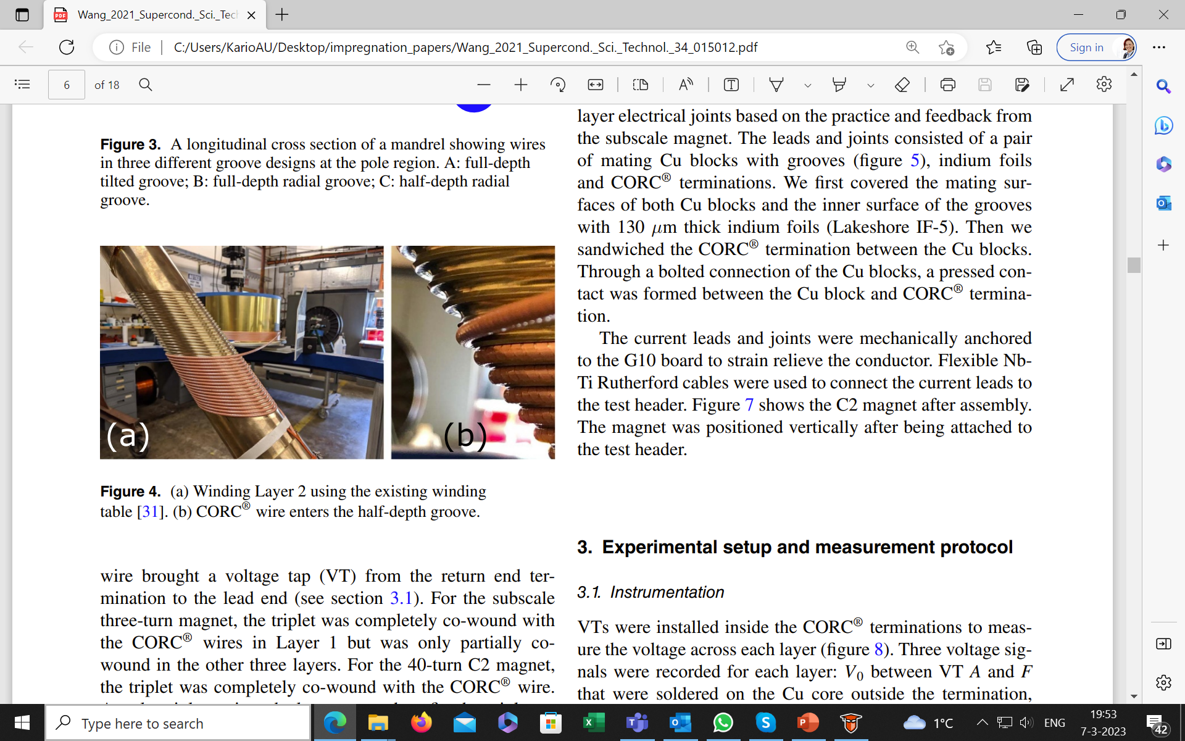
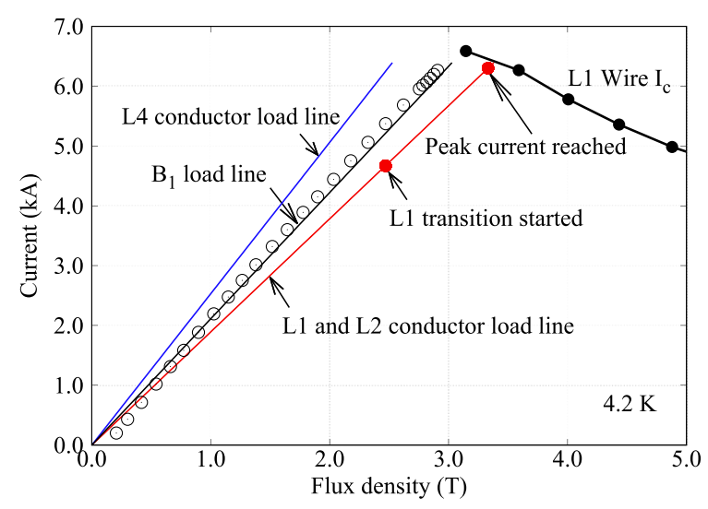
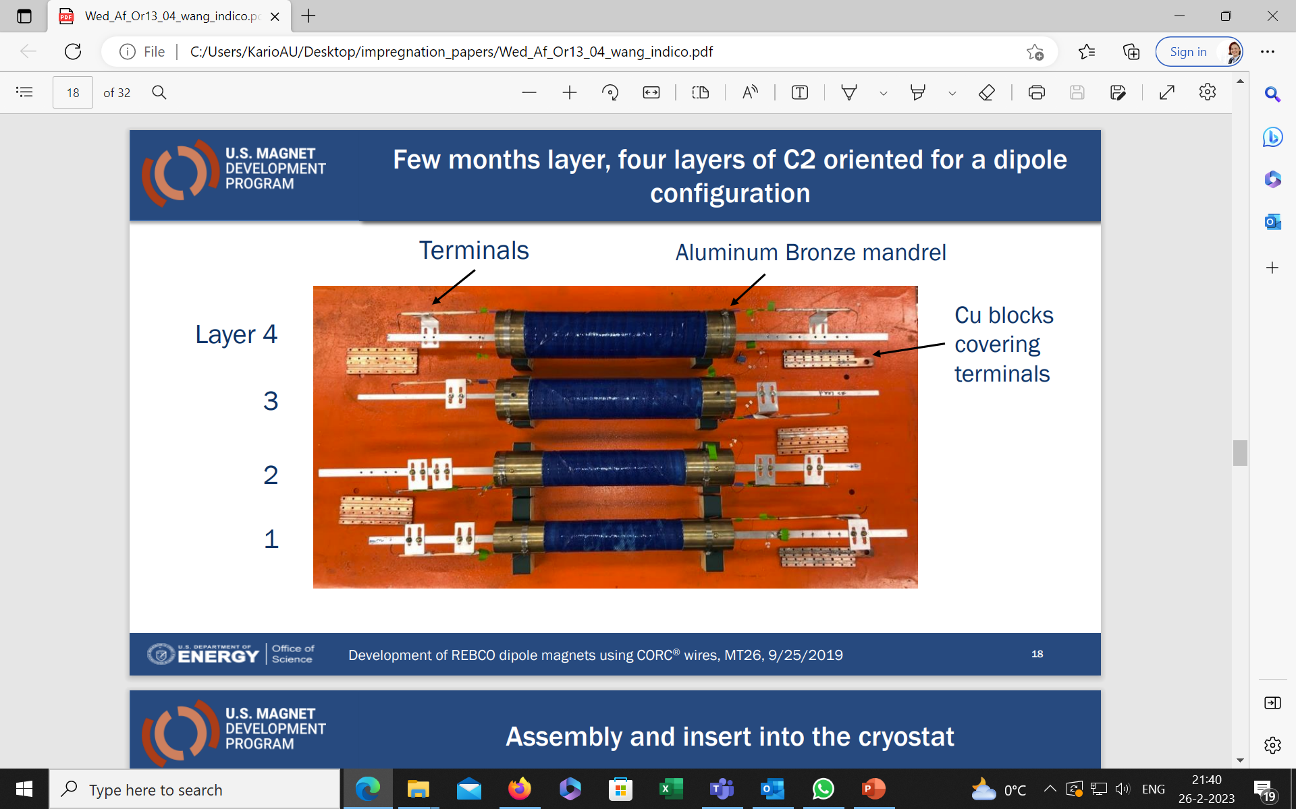
Conductor on Round Core cable – CCT coil:
The magnet reached a maximum dipole field of 2.91 T at 4.2 K. A total of 100 m of 30-tape CORC® wire was manufactured for the C2 magnet.
5 km of ReBCO tape with a 30 µm thick substrate manufactured by SuperPower Inc. was used.
Systematic tests on six coils showed negligible impact of Stycast (< 3% I_{c} reduction).
X. Wang et al, Development and performance of a 2.9 Tesla dipole magnet using high-temperature superconducting CORC® wires, 2021 Supercond. Sci. Technol. 34 015012
Notes:
Hi Anna,
I think you asked an important question on Slide 2: to impregnate or not. My thought is that we need to impregnate for CORC in high-field magnets. There are voids, by definition, inside a CORC or STAR cables. These voids allow tapes to move under high electromagnetic forces. The tapes will strain when they move and hence potential irreversible degradation. Therefore, I think we need to support individual tapes inside a CORC cable. What are your thoughts?
I concur with your summary on the two approaches to avoid the delamination issue in REBCO. For a multi-tape cable such as CORC, I am wondering how to fill the voids inside the cable. Solder impregnate can be interesting to try. Something like VIPER technique? For CORC, it can be a heat treatment after winding given the CORC consists of pre-tinned tapes. The concern is the coupling currents under varying fields. This may eventually necessitate an impregnation medium whose electrical resistance has a negative temperature dependence, like what people have done for the NI rebco coils?
Now, both approaches your summarized deal with existing REBCO tapes. Would it be possible to increase the anti-delamination strength inside a REBCO tape? This gets into material side but if works, they can provide additional solutions from the tape itself?
Regarding your questions on CCT:
- We used Stycast for two reasons. First, to reduce the conductor movement under electromagnetic forces. Second, to support the CORC wire against electromagnetic forces by transferring the forces to the mandrel. We used 2850 MT with Catalyst 24 LV. We used a 30-tape CORC wire to achieve a bending radius of 30 mm. Yes, it has a polyester sleeve that decouples the tapes from Stycast. Here is a report on the magnet.
- A related note is that we painted Stycast around the conductor after winding. We haven't developed a vacuum pressure impregnation procedure yet. The plastic sleeves have overlaps along the wire so it is not vacuum tight. So we are concerned if stycast can get sucked inside the sleeve and then touch the tapes through the overlap. This motivated Jillian Stern's study, as you show on Slide 11, although we haven't completed the study yet. I remember you reported some nice work in Hawaii and look forward to your paper. Here Diego and Jose Luis are developing VPI for 2850 FT, inspired by the BOX work at your group. It can provide a solution for future CORC CCTs.
- We recently made a coil with STAR wire that does not have a plastic sleeve. We saw conductor movement under the electromagnetic forces. We plan to impregnate the next coil with STAR wires with wax, which is your second approach.
Great to hear from you. Twente has been, and continues to be, the best university program on superconducting magnets, generating solid and beautiful work. I visited it once and wish to spend more time in your lab.
Thanks for sharing your talk - thorough and get to the point as always. Please let me know if you have any questions or comments. Always a pleasure to exchange with you.
Best regards,
Xiaorong

Slide 13
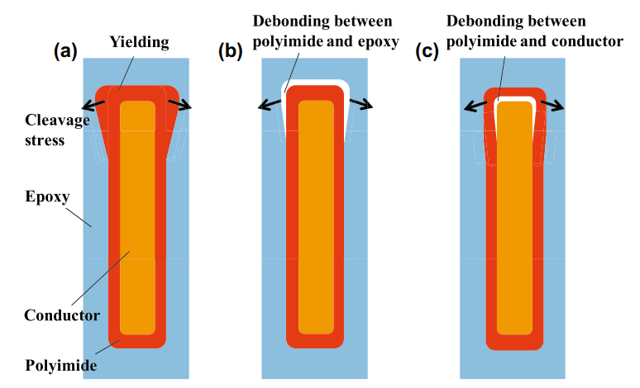
Summary impregnation of ReBCO tapes and cables
Thermal expansion mismatch
Debonding layer
- Shrink tube
- Polyimide
- Mold release
Decreasing difference in thermal expansion
- Al₂O₃
- SiO₂
Cable examples: Roebel and CORC
All working, polyimide the most successful as thickness can be controlled.
In some cases working with high concentration of powders, hard to control powder dispersion in epoxy, wet-winding needed since mixture have high viscosity.
Still work needs to be done!

Slide 14
List of references:
[1] M. Ogata, S. Researcher, K. Nagashima, and E. Director, “An Innovative Superconducting Coil Fabrication Method with YBCO Coated Conductors,” 2013.
[2] C. Barth, N. Bagrets, K. P. Weiss, C. M. Bayer, and T. Bast, “Degradation free epoxy impregnation of REBCO coils and cables,” Supercond Sci Technol, vol. 26, no. 5, May 2013, doi: 10.1088/0953-2048/26/5/055007.
[3] Y. Yanagisawa et al., “An ultra-thin polyimide insulation coating on REBCO conductors by electrodeposition produces a maximum overall current density for REBCO coils,” Physica C: Superconductivity and its Applications, vol. 495, pp. 15–18, 2013, doi: 10.1016/j.physc.2013.07.009.
[4] S. Awaji et al., “Superconducting and mechanical properties of impregnated REBCO pancake coils under large hoop stress,” IEEE Transactions on Applied Superconductivity, vol. 23, no. 3, 2013, doi: 10.1109/TASC.2012.2229775.
[5] Y. Yanagisawa et al., “Removal of degradation of the performance of an epoxy impregnated YBCO-coated conductor double pancake coil by using a polyimide-electrodeposited YBCO-coated conductor,” Physica C: Superconductivity and its Applications, vol. 476, pp. 19–22, Jun. 2012, doi: 10.1016/j.physc.2012.01.025.
[6] J. Lu et al., “Insulation of coated conductors for high field magnet applications,” IEEE Transactions on Applied Superconductivity, vol. 22, no. 3, 2012, doi: 10.1109/TASC.2011.2177230.
[7] X. Wang et al., Development and performance of a 2.9 Tesla dipole magnet using high-temperature superconducting CORC® wires, 2021 Supercond. Sci. Technol. 34 015012
[8] U. P. Trociewitz et al., “35.4 T field generated using a layer-wound superconducting coil made of (RE)Ba 2 Cu 3 O 7-x (RE = Rare Earth) coated conductor.”
[9] Y. Shiroyanagi, A. K. Ghosh, R. Gupta, and W. B. Sampson, “The construction and testing of YBCO pancake coils for a high field solenoid,” IEEE Transactions on Applied Superconductivity, vol. 21, no. 3 PART 2, pp. 1649–1652, Jun. 2011, doi: 10.1109/TASC.2010.2097570.
[10] H. W. Weijers et al., “Progress in the Development and Construction of a 32-T Superconducting Magnet,” IEEE Transactions on Applied Superconductivity, vol. 26, no. 4, Jun. 2016, doi: 10.1109/TASC.2016.2517022.
[11] S. Otten et al., “Enhancement of the transverse stress tolerance of REBCO Roebel cables by epoxy impregnation,” Supercond Sci Technol, vol. 28, no. 6, Jun. 2015, doi: 10.1088/0953-2048/28/6/065014.
[12] K. Mizuno, M. Ogata, and H. Hasegawa, “Manufacturing of a REBCO racetrack coil using thermoplastic resin aiming at Maglev application,” Physica C: Superconductivity and its Applications, vol. 518, pp. 101–105, Jul. 2015, doi: 10.1016/j.physc.2015.06.016.
[13] I. Kesgin, Q. Hasse, Y. Ivanyushenkov, and U. Welp, “Performance of 2G-HTS REBCO Undulator Coils Impregnated Epoxies Mixed with Different Fillers,” IEEE Transactions on Applied Superconductivity, vol. 27, no. 4, Jun. 2017, doi: 10.1109/TASC.2016.2638431.
[14] T. Matsuda et al., “Degradation of the performance of an epoxy-impregnated REBCO solenoid due to electromagnetic forces,” Cryogenics (Guildf), vol. 90, pp. 47–51, Mar. 2018, doi: 10.1016/j.cryogenics.2018.01.002.

Slide 15
List of references:
[15] I. Kesgin, Q. Hasse, Y. Ivanyushenkov, and U. Welp, “Degradation Free Vacuum Epoxy Impregnated short REBCO Undulator Magnets,” in IOP Conference Series: Materials Science and Engineering, Dec. 2017, vol. 279, no. 1. doi: 10.1088/1757-899X/279/1/012009.
[16] E. F. Talantsev et al., “Critical current retention of potted and unpotted REBCO Roebel cables under transverse pressure and thermal cycling,” Supercond Sci Technol, vol. 30, no. 4, Mar. 2017, doi: 10.1088/1361-6668/aa604f.
[17] M. Iio, M. Yoshida, T. Nakamoto, K. Suzuki, M. Sugano, and T. Ogitsu, “Research and Development of Future Radiation-Resistant Superconducting Magnets with Mineral Insulated REBCO Coils,” IEEE Transactions on Applied Superconductivity, vol. 30, no. 4, Jun. 2020, doi: 10.1109/TASC.2020.2966427.
[18] K. Bouloukakis, M. Hunter, N. Long, R. Dykstra, and B. Parkinson, “Discharge Behaviour and Modelling of a 1.5 T REBCO Magnet with Quench Tolerant Coils Impregnated with Conductive Epoxy,” IEEE Transactions on Applied Superconductivity, vol. 31, no. 5, Aug. 2021, doi: 10.1109/TASC.2021.3059975.
[19] T. Yoshida et al., “Performance of Epoxy-Impregnated Intra-Layer No-Insulation (LNI) REBCO Coils at 77 K,” IEEE Transactions on Applied Superconductivity, vol. 31, no. 5, Aug. 2021, doi: 10.1109/TASC.2021.3065875.
[20] E. Cuninková, M. Pekarčíková, M. Skarba, J. Krajčovič, and M. Pašák, “Experimental and numerical analysis of high-temperature superconducting tapes modified by composite thermal stabilization subjected to thermomechanical loading,” Materials, vol. 14, no. 13, Jul. 2021, doi: 10.3390/ma14133579.
[21] S. Yin et al., “Degradation of REBCO coated conductors due to a combination of epoxy impregnation, thermal cycles, and quench: Characteristics and a method of alleviation,” J Appl Phys, vol. 128, no. 17, Nov. 2020, doi: 10.1063/5.0026000.
[22] P. Gao, H. Zhang, and X. Wang, “Mechanical Behavior of Impregnated REBCO Pancake Winding Based on Electromagnetic-Thermoelastic Analysis,” IEEE Transactions on Applied Superconductivity, vol. 31, no. 5, Aug. 2021, doi: 10.1109/TASC.2021.3057036.
[23] S. Fujita et al., “Hoop Stress Tests of an Epoxy-Impregnated REBCO Coil with Fluorine-Coated Polyimide Insulation,” IEEE Transactions on Applied Superconductivity, vol. 31, no. 5, Aug. 2021, doi: 10.1109/TASC.2021.3058924.
[24] P. Gao, H. Zhang, and X. Wang, “Numerical Investigation on Delamination Induced by Thermal Mismatch in Epoxy Impregnated REBCO Pancake Coils,” IEEE Transactions on Applied Superconductivity, vol. 30, no. 4, Jun. 2020, doi: 10.1109/TASC.2020.2987310.
[25] J. W. Levitan, J. Lu, B. Jarvis, and H. Bai, “Effects of Wax Impregnation on Contact Resistivity between REBCO Tapes,” IEEE Transactions on Applied Superconductivity, vol. 32, no. 7, Oct. 2022, doi: 10.1109/TASC.2022.3179809.
[26] J. Stern et al., “Developing a Vacuum Pressure Impregnation Procedure for CORC Wires,” IEEE Transactions on Applied Superconductivity, vol. 32, no. 6, Sep. 2022, doi: 10.1109/TASC.2022.3149733.
[27] A. Badel et al., “First validation of Robust REBCO insert concept on a large 20-pancake prototype reaching up to 25 T.” [Online]. Available: https://hal.science/hal-03881814
[28] P. Gao and Y. Pan, “Delamination model of an epoxy-impregnated REBCO superconducting pancake winding,” Supercond Sci Technol, vol. 35, no. 6, Jun. 2022, doi: 10.1088/1361-6668/ac6988.
[29] X. Jin et al., “Study on the mechanism of preventing degradation in the performance of REBCO Coils,” IEEE Transactions on Applied Superconductivity, vol. 24, no. 3, 2014, doi: 10.1109/TASC.2013.2280714.

Slide 16
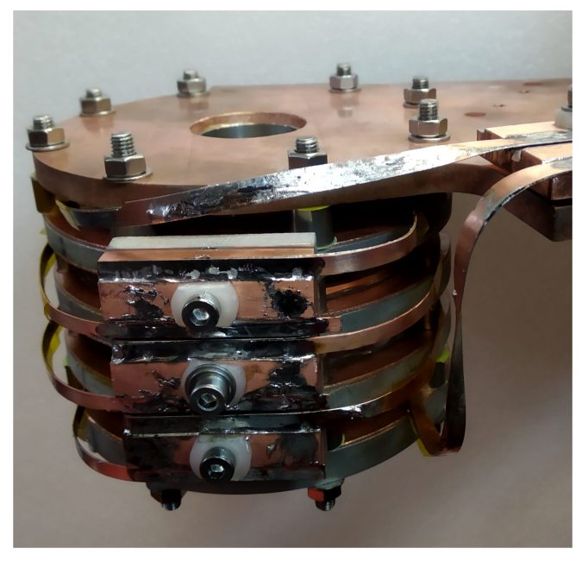
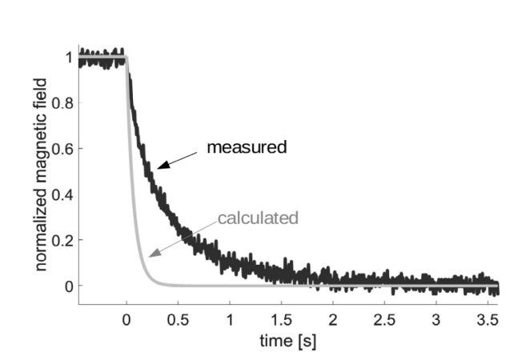
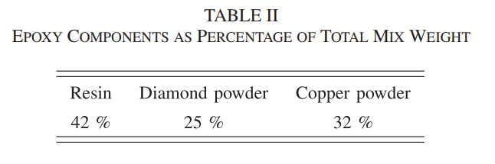
Conductive epoxy:
K. Bouloukakis, M. Hunter, N. Long, R. Dykstra, and B. Parkinson, “Discharge Behaviour and Modelling of a 1.5 T REBCO Magnet with Quench Tolerant Coils Impregnated with Conductive Epoxy,” IEEE Transactions on Applied Superconductivity, vol. 31, no. 5, Aug. 2021, doi: 10.1109/TASC.2021.3059975.
Notes:
Huub Weijers: “On slide 6 you mention modification of epoxy to change its expansion coefficient. We have a PhD student at Robinson working on that topic (Bouloukakis) and have built wet-wound epoxy-impregnated coils for our MRI project (Ben Parkinson is project leader). Both are CC-ed. That is showing promise and works in small coils. The technology is not fully developed and qualified yet for large coils. Their papers are easy to find, and I can send links if needed. The epoxy has additives to control its thermal expansion coefficient, turn-turn spacing and turn-turn electrical resistivity. We are investigating several variations on this theme. “

