Slide 1


High Current ReBCO (CORC) Splices
Experience and lessons learned
March 9-10, 2023
T. Mulder

Slide 2
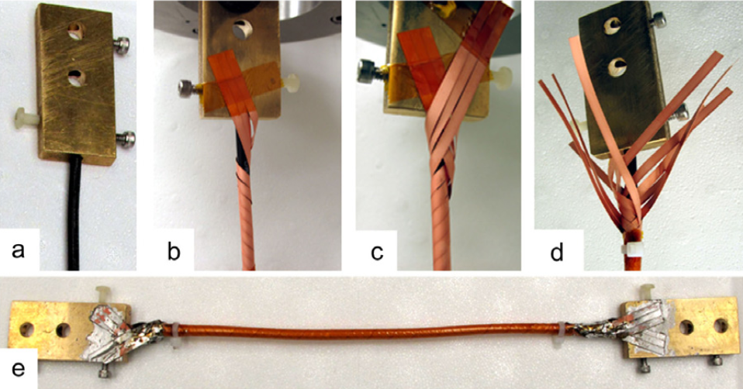
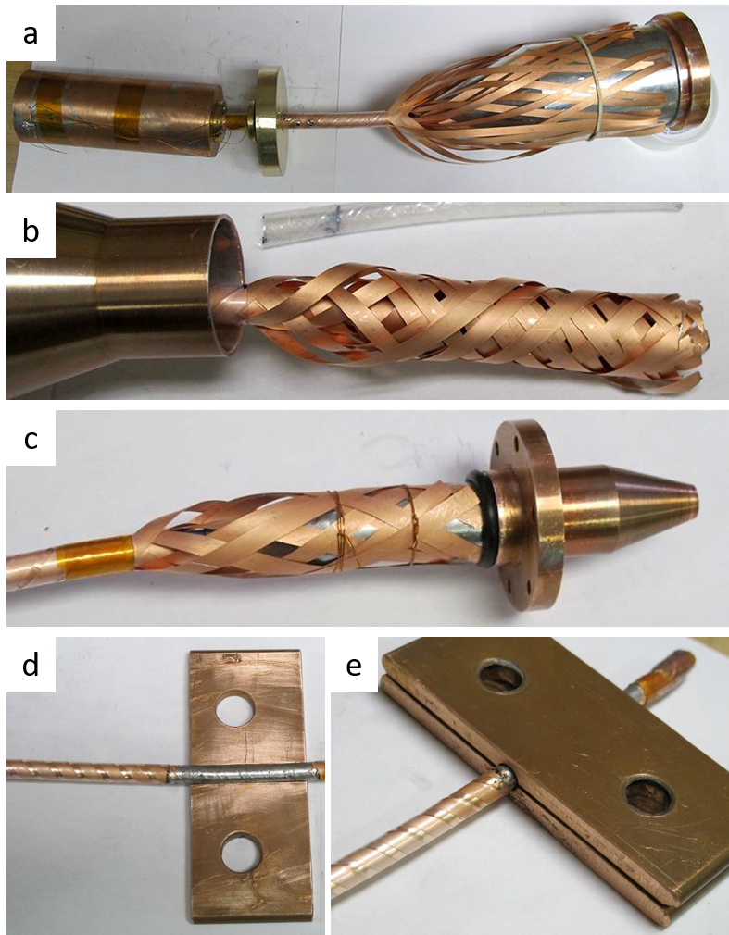
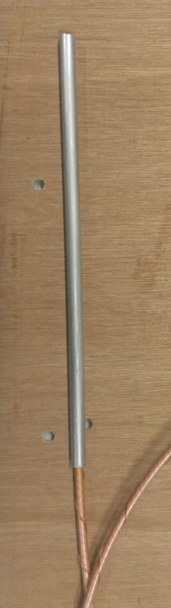
Human resources slide 4
Introduction
(Picture courtesy of ACT)
First demonstrators / test joints for CORC made by ACT.
CORC geometry makes jointing very challenging!
Solder-filled-tube joint terminal
(Picture courtesy of ACT)

Slide 3
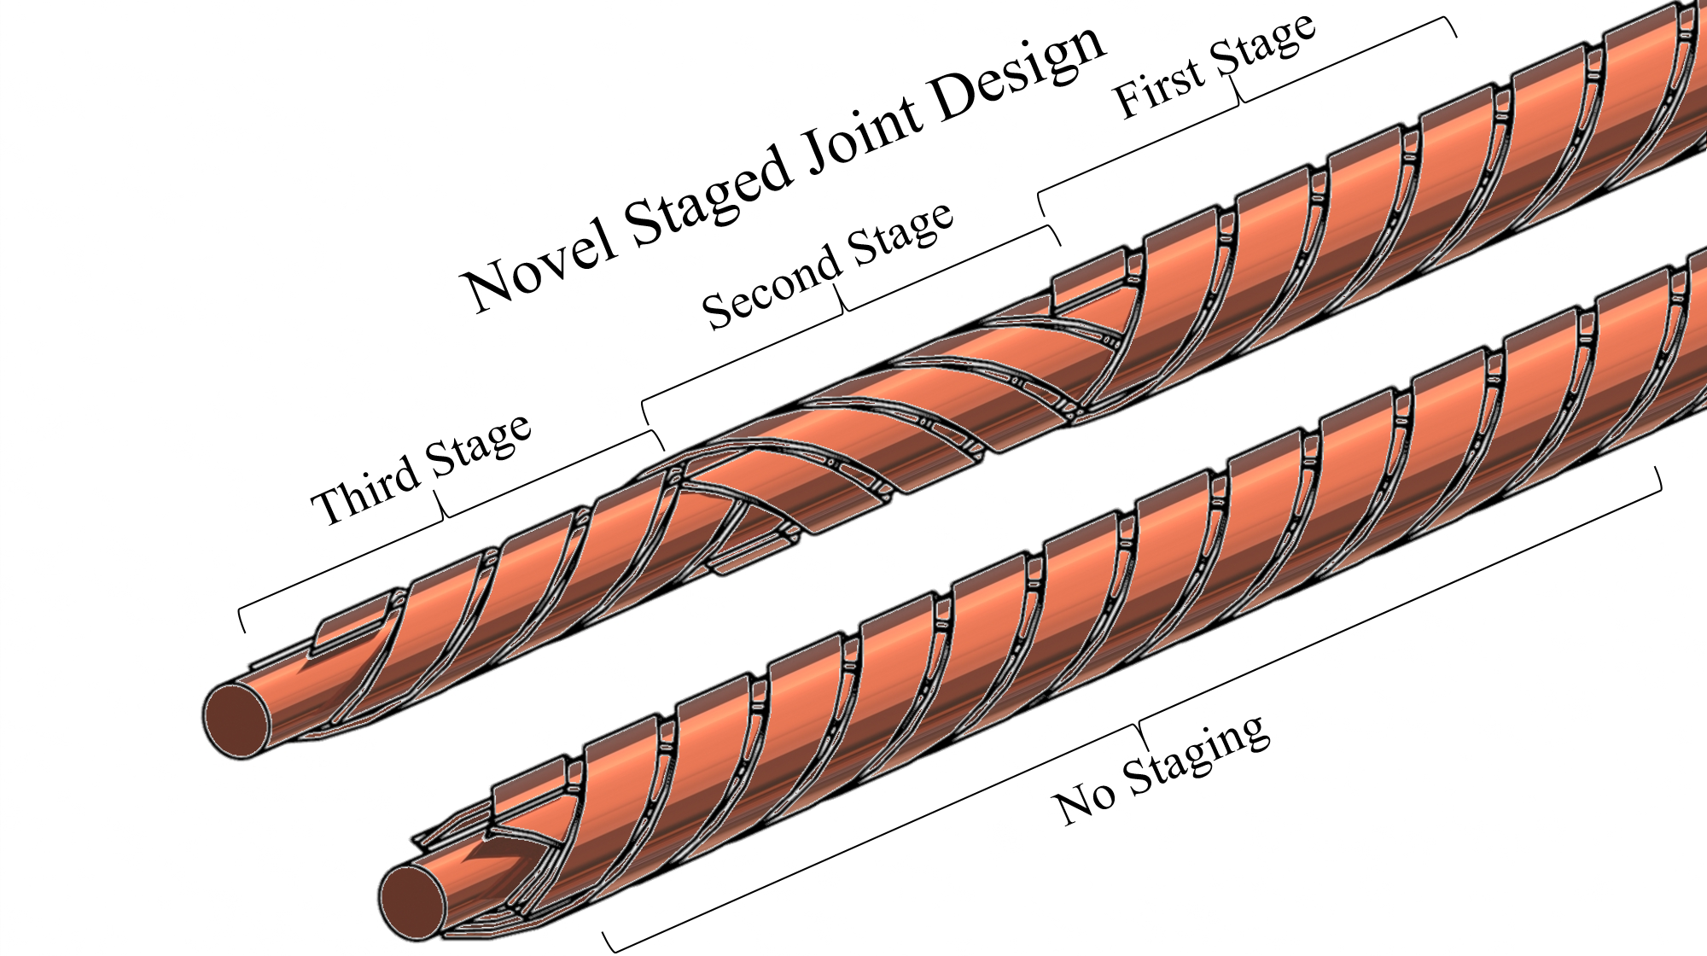
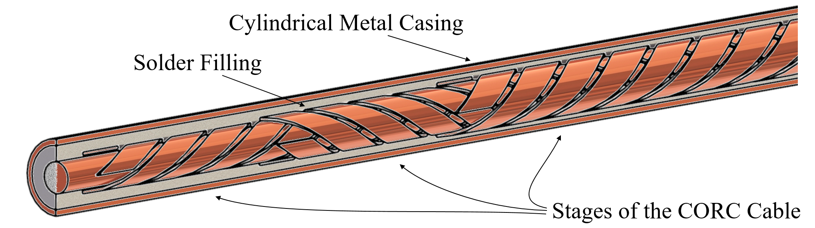
Human resources slide 4
CORC Joints: Staging
Challenges of making joint terminals for CORC:
Layers are spiraled, not practical for soldering.
Layers in the CORC cable are twisted, but not transposed.
No action in the joint region -> current prefers to go in the outer layer.
Results in inhomogeneous current distribution and a non-constant joint resistance.
Solution: staging the layers of the CORC cable in the joint region of the cable to a staircase-like geometry.

Slide 4
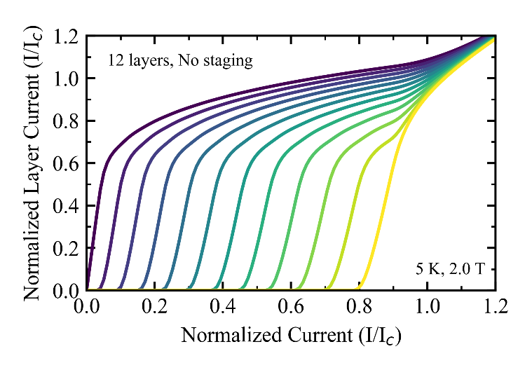
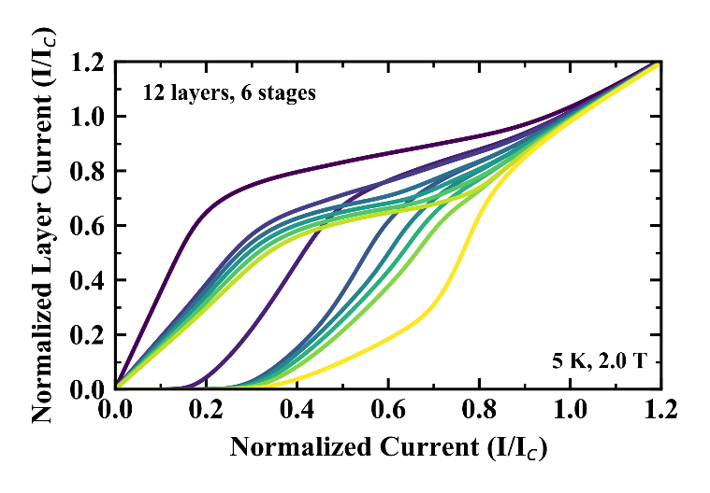
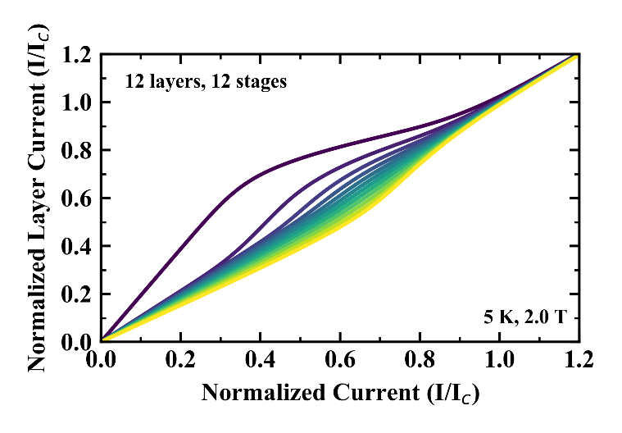
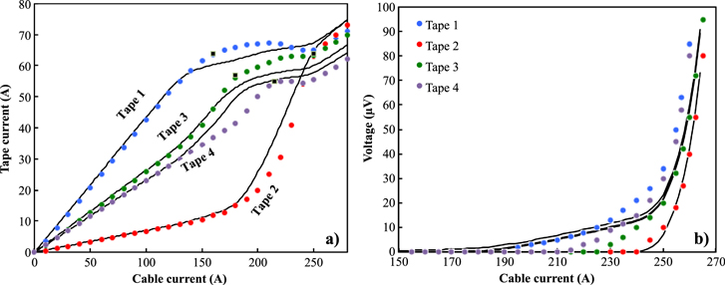
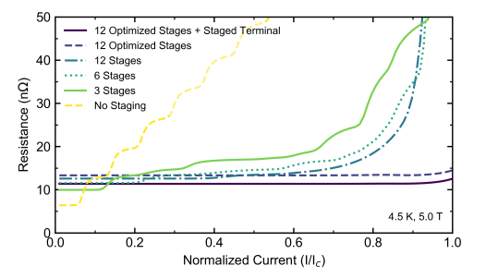
Human resources slide 4
CORC Joints: Effect of Staging
Effect of staging on the current distribution:
No staging: Each layer has to saturate before the layer below receives current.
Staging: Improved current distribution.
Staging + Optimization: Equal current distribution between layers.
Staging makes contact resistance constant.
Effect of variations in terminal contact resistances on the current distribution in high-temperature superconducting cables, G P Willering et al, 2015

Slide 5
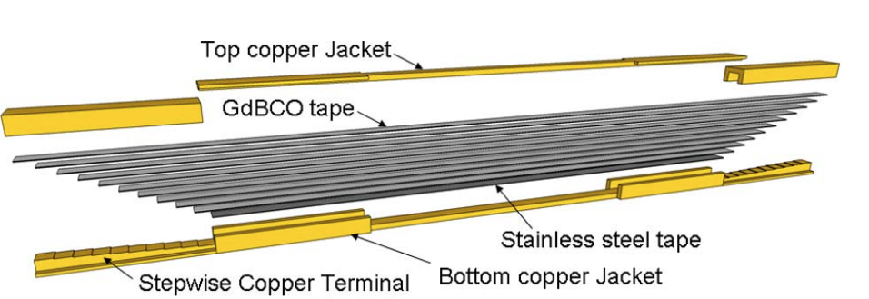
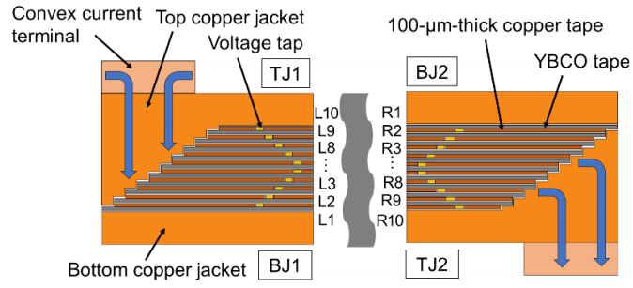
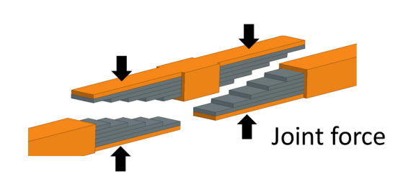
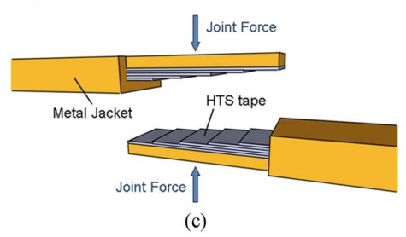
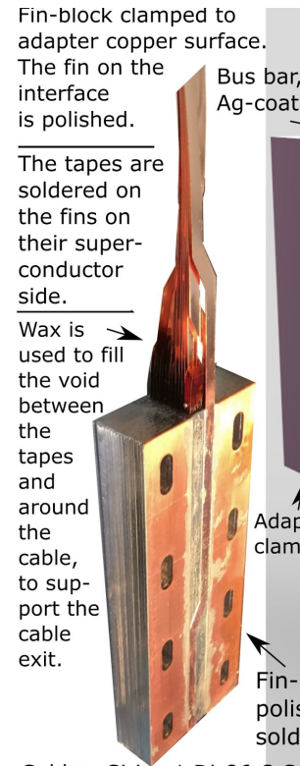
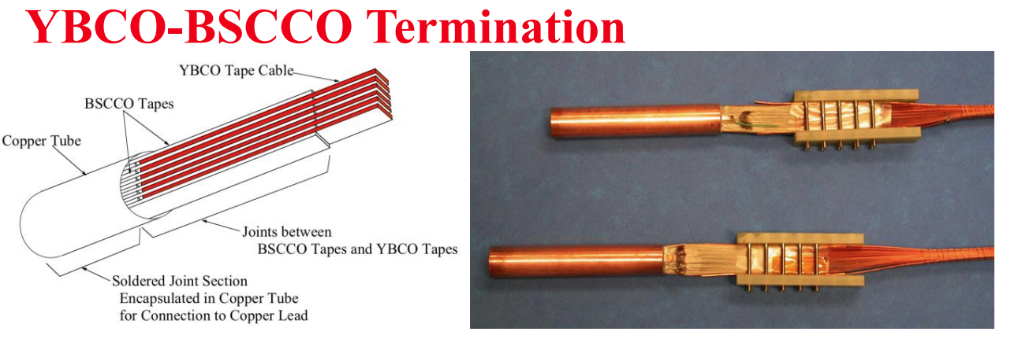
Staging/fanning in other cable concepts
S Sato et al, 2020, J. Phys.: Conf. Ser. 1559 012110
S. Ito et al, 2013, IEEE Trans. Appl. Supercond. 4802408
J. S. Murtomäki, 2017, presented at MT25, the Netherlands
M. Takayasu, 2014, presented at WAMHTS, Germany

Slide 6
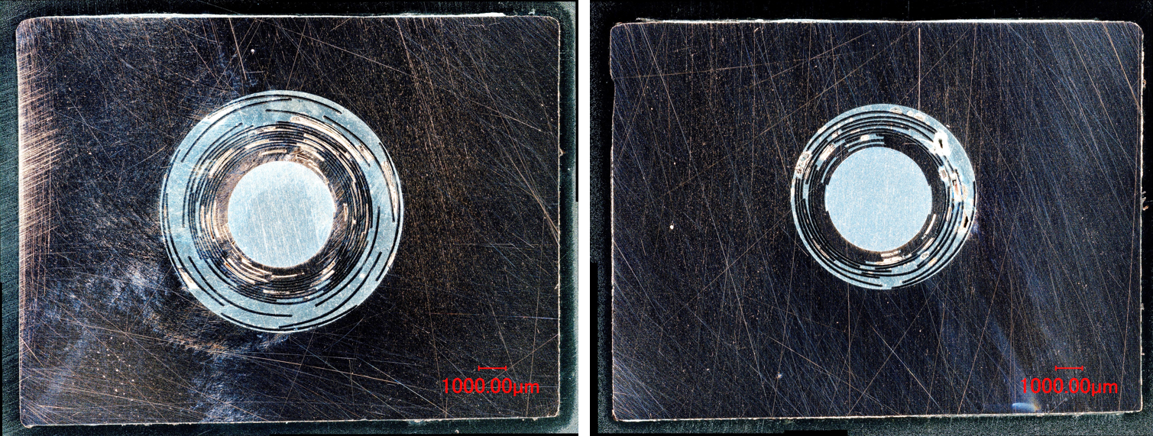
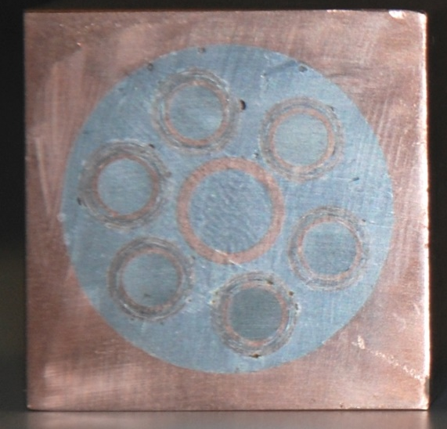
Human resources slide 4
CORC Joints: Solder Filling the Terminals
Rectangular CORC terminal
CORC CICC terminal
Staged and pre-tinned CORC cable is inserted in to a copper terminal.
Heated up, filled with solder metal (SnPb / indium).
Solder on the tapes melts, tapes spring out -> creating larger gap for the solder to flow.
Difficult to properly control -> no access while solder filling.
Cleaning and pre-tinning the tapes is very advantageous for the filling process -> less gas pockets, better contact to the tapes.

Slide 7
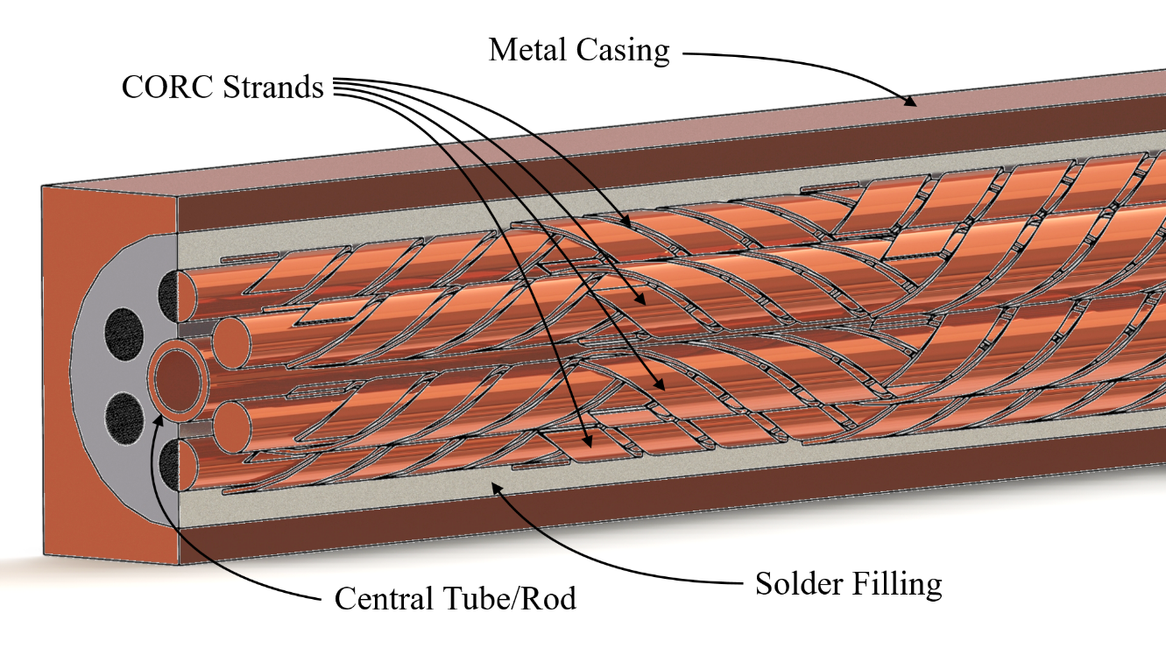
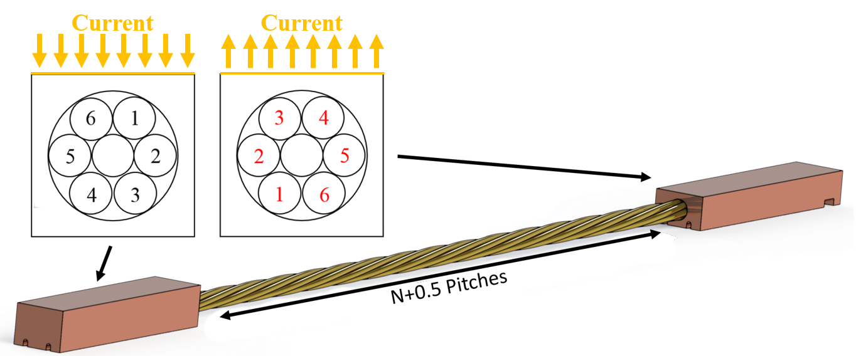
Human resources slide 4
CORC CICC Joints: Current Injection
Tapes of a CORC cable are twisted -> minimum of 1 TP per stage.
Strands in a CORC CICC joint terminal are straight.
Current injected on one side only -> some strands will have lower contact resistance.
Worst case: 20-30 % difference in current between strands at 4 K. Worse at 77 K.
Half a twist difference between terminals provides a solution.
In general: copper resistance should not be forgotten, depending on where you inject current, some tapes/strands will have a lower contact resistance.

Slide 8
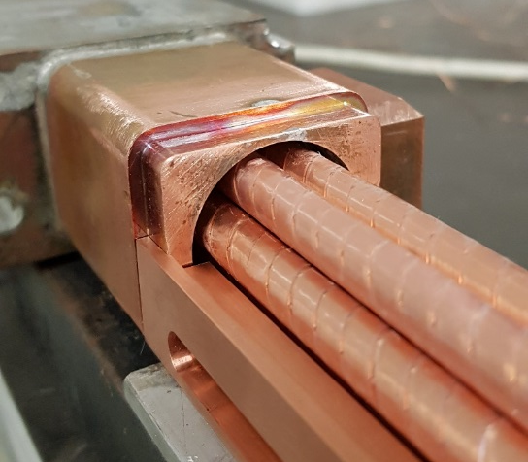
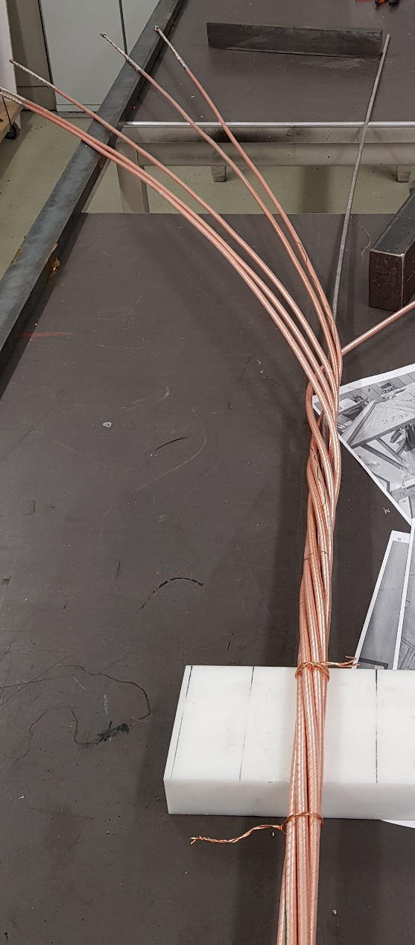
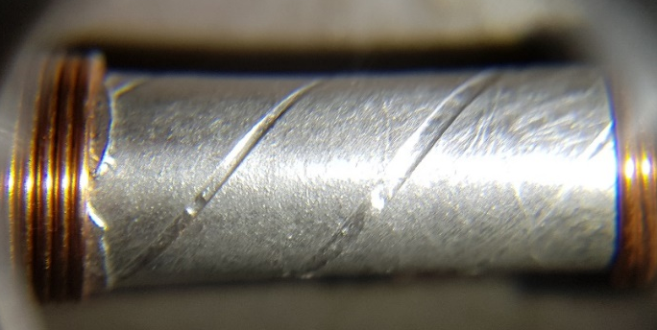
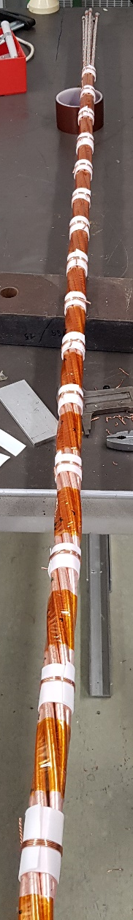
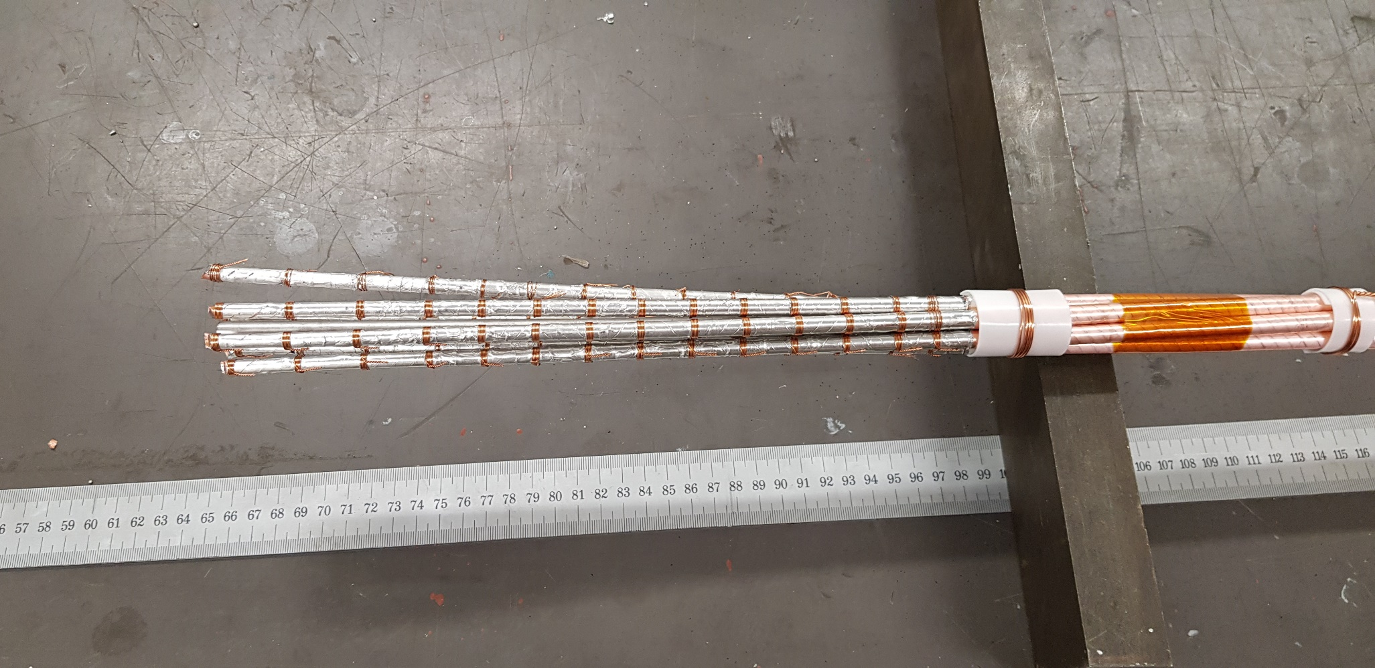
Human resources slide 4
CICC Design and Assembly
The CORC strands are twisted with a cable-pitch of ≈400 mm for a total of 4.5 pitches. Strands are straight in the terminals for practicality.
Terminals are prepared according to the presented joint design. Ends of the CORC strands are made to a stair-case like pattern, that allows current to be directly and homogeneously injected to each ReBCO layer.
Jacket is closed over its entire
length by EB-welding.
Samples with SS and Cu jackets
were manufactured.
Stages

Slide 9
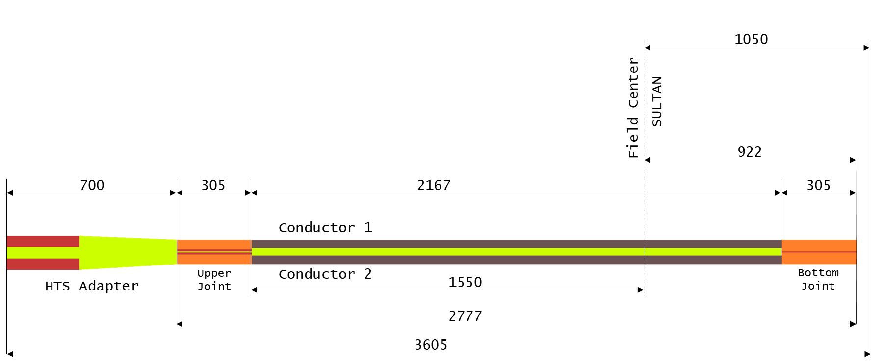
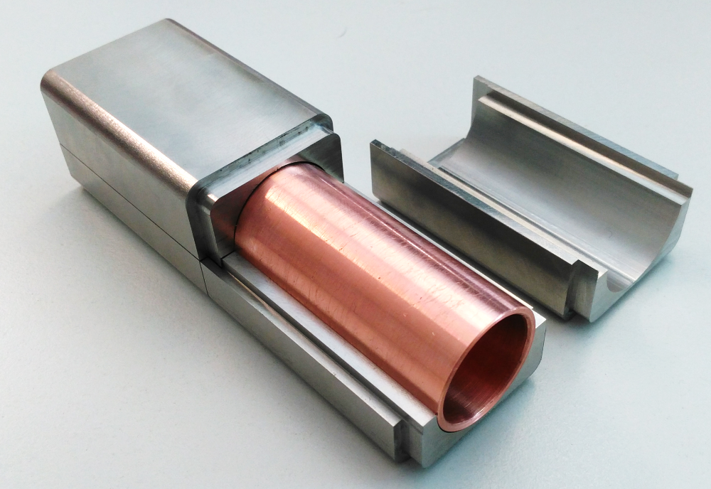
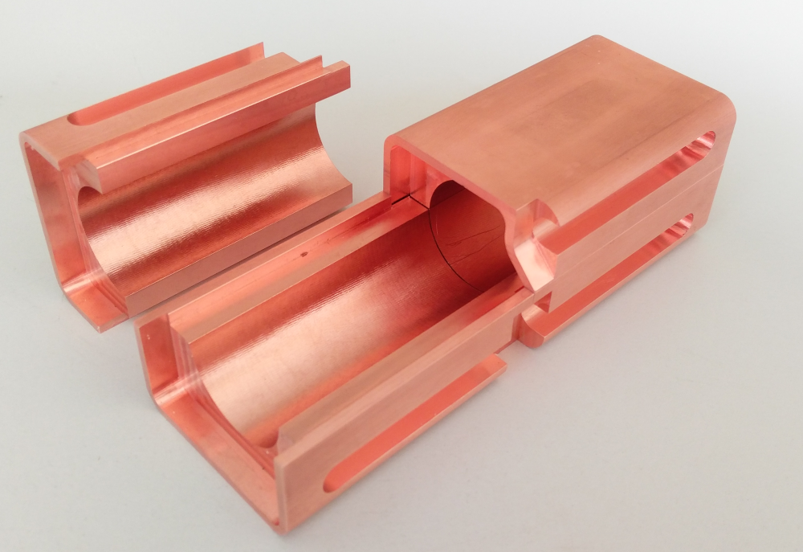
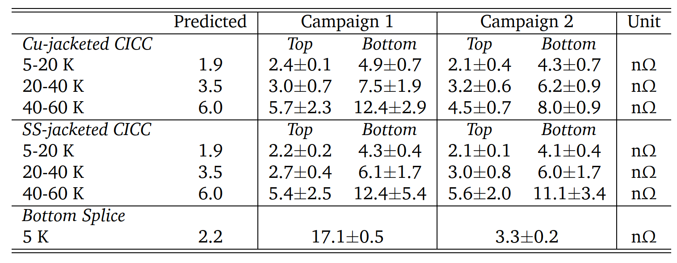
Human resources slide 4
CORC CICC Joints: Results
Shaking hands joint – outside of field
CORC CICC test at PSI.
Praying hands joint – in stray field
Two test campaigns:
Two CICCs connected in series.
Gas cooling, 5-60 K.
Tests up to 80 kA.
We were able to produce predictable CORC CICC joints!

Slide 10
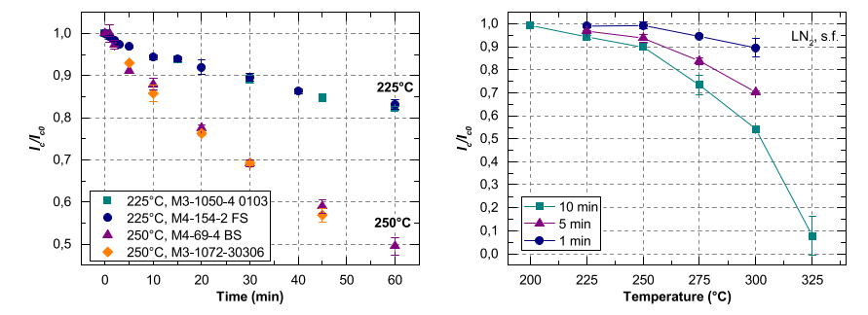
Human resources slide 4
Degradation due to Soldering Temperature
Critical Current Degradation of Coated Conductors Under Soldering Conditions, A. Preuss et al, 2018
Graph from KIT shows degradation of ReBCO tape as function of soldering temperature and time.
Degradation of ReBCO tape may occur at temperatures above 200 °C for long time (t > 1 min).
Limitation on the solder material that can be used.
Similar results obtained:
UniGe: M. Bonura, ACS Appl. Electron. Mater. 2022, 4, 3, 1318–1326
CERN: I. Falorio, MSC Seminar, Jan. 14, 2021 / EDMS 2366622
PSI/EPFL: D. Uglietti, Poster presentation, EUCAS 2017
Many more!

Slide 11
Human resources slide 4
List of Potential Solders
Solder metal (+ also known as) | Melting point (°C)
SnPb (63/37) | 183
SnPbAg | 179
Indium | 157
InAg | 141
BiSn(Ag) | 138
InSn | 118
SnPbCd | 103
BiSnPb (Rose) | 96
BiSnPbCd (Woods) | 76
BiSnPbIn (Low 138) | 58
Wets really well! But….
Comes as a solder paste and the flux residue is difficult to clean.
Wetting is acceptable, good choice if all parts are pre-tinned.
Comes as wire/tape, available without internal flux!
Bismuth based solders tends to partition if Pb is present. These partitions can crack on cool-down to cryogenic temperatures. Not good if used in bulk for low resistance joints.
Indium has a low resistivity and it is soft -> possibly allows yielding before HTS tape delaminates.
SnPb wets slightly better than indium, easy to use and widely available.

Slide 12
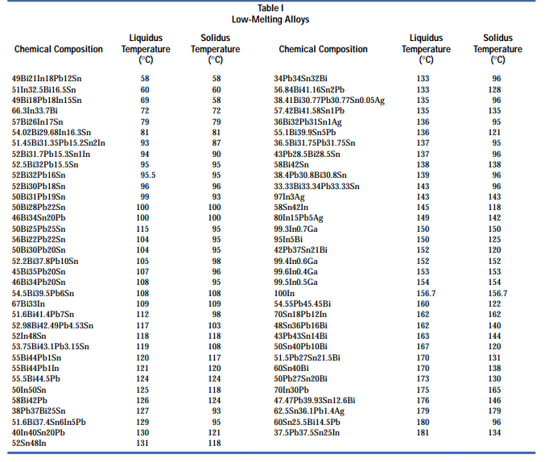
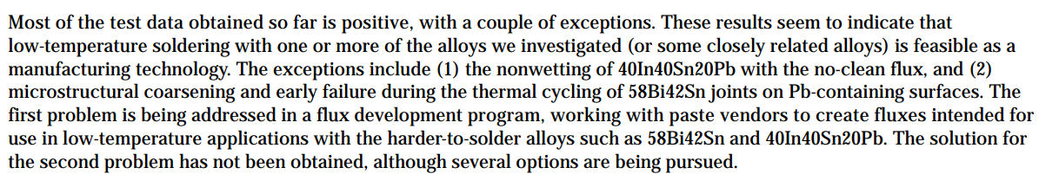
Human resources slide 4
List of Potential Solders
Source:
Zequn Mei, Helen A. Holder, and Hubert A. Vander Plas,
https://www.hpl.hp.com/hpjournal/96aug/aug96a10.pdf

Slide 13
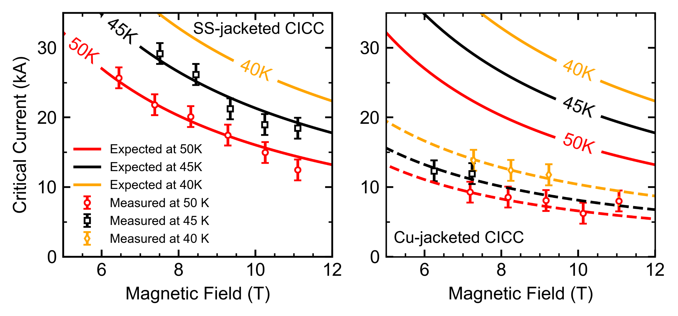
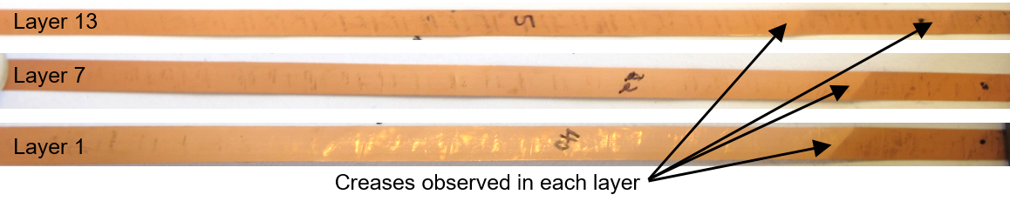
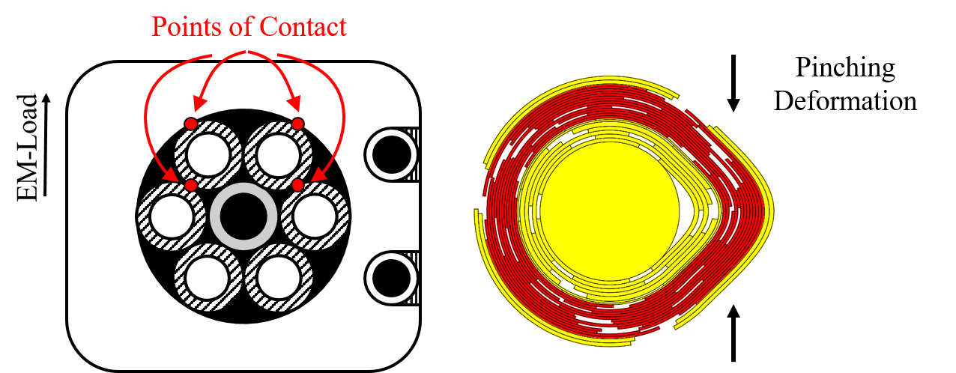
Issue experienced with a CORC CICC joint terminal
Issue observed first CORC CICC test.
Primary failure mode is a pinching effect.
Specific for CORC strand layout/winding
parameters of the Cu-jacketed CICC.
Copper tapes layers around the core do not give sufficient mechanical support.
Next steps:
New CICC to replace the degraded Cu-jacketed CICC.
New strand layout is used with a thicker core.
Mechanical support of CORC strands by solder filling of the voids between strands.
Two stage solder approach:
Solder fill the terminals with indium (157 °C).
Fill the gaps in the body with BiSnPb (96 °C).
ReBCO tapes
Resulted in higher-than-expected splice resistance + inhomogeneous current distribution.
Smaller bending radius, higher strain
Copper tapes
13

Slide 14
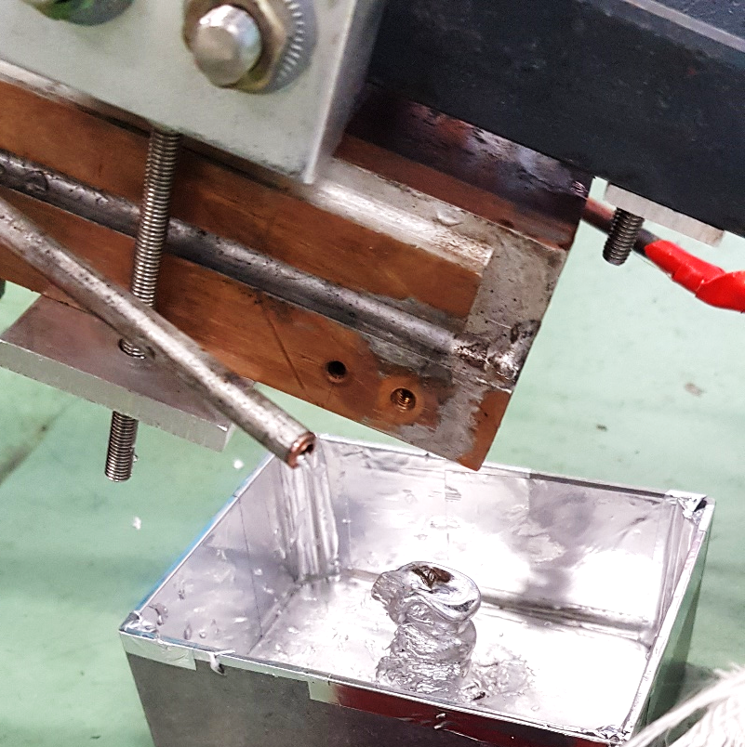
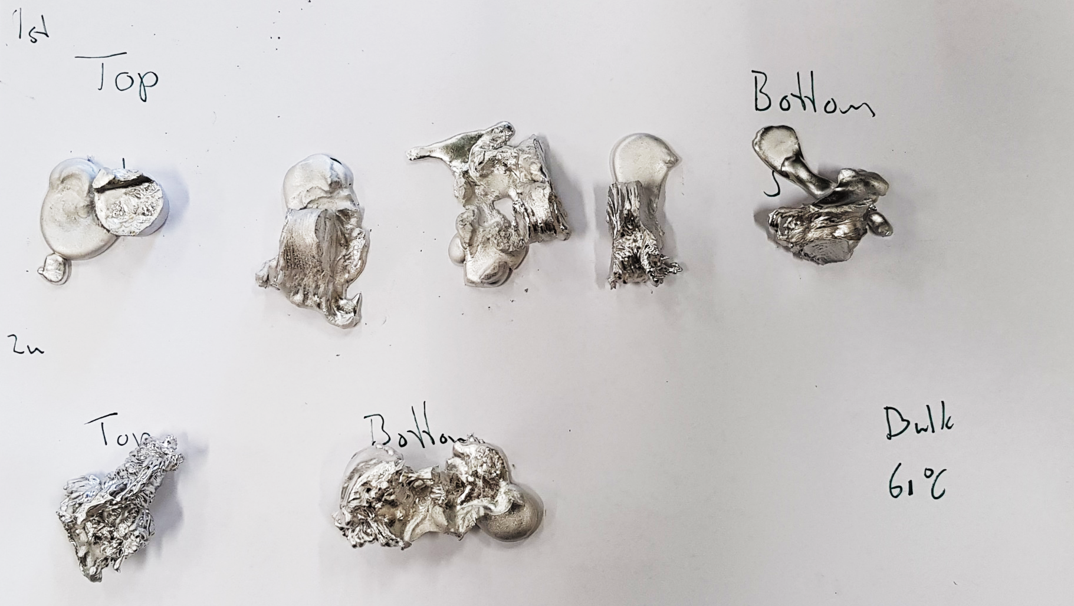
Test of solder metal extracted from the joint terminals
Solder was extracted from the extremities of the joint terminals.
Test of the solder confirms suspicions: alloying throughout the entire terminal.
Result is some In-Bi-Sn-Pb alloy with a highly non-eutectic melting temperature of 60 to 80 °C.
CICC-joint terminal
Oops…
Pillar of solder
Pillars were divided to sections

Slide 15
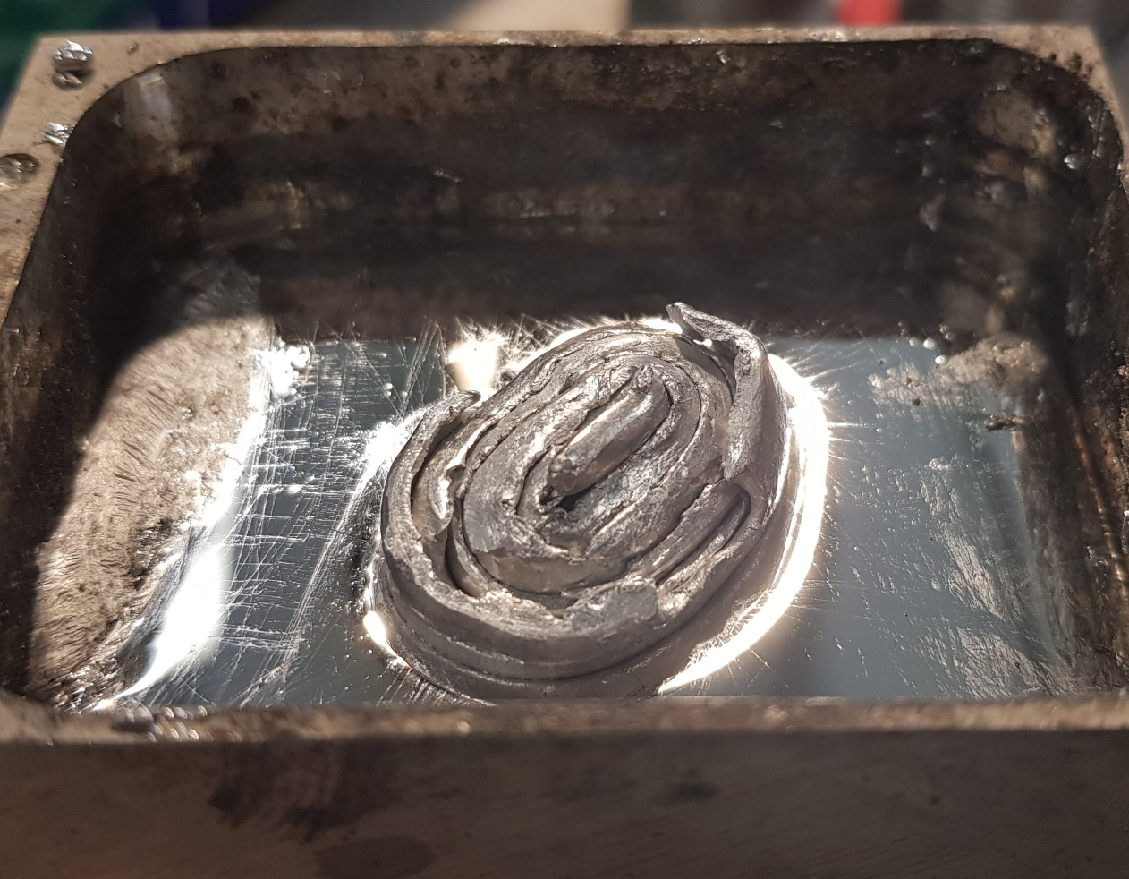
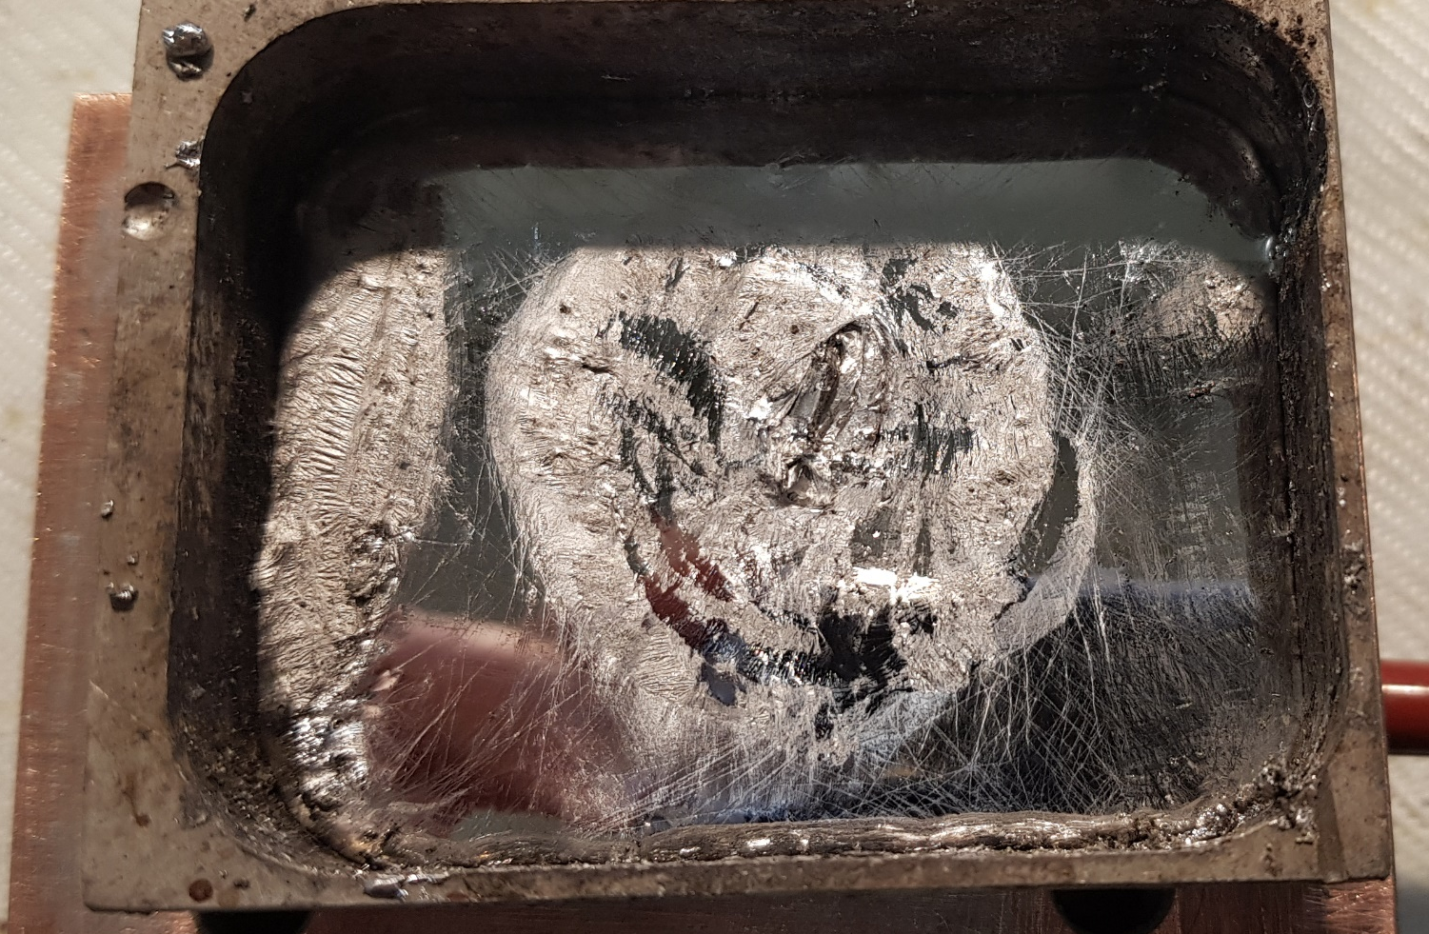
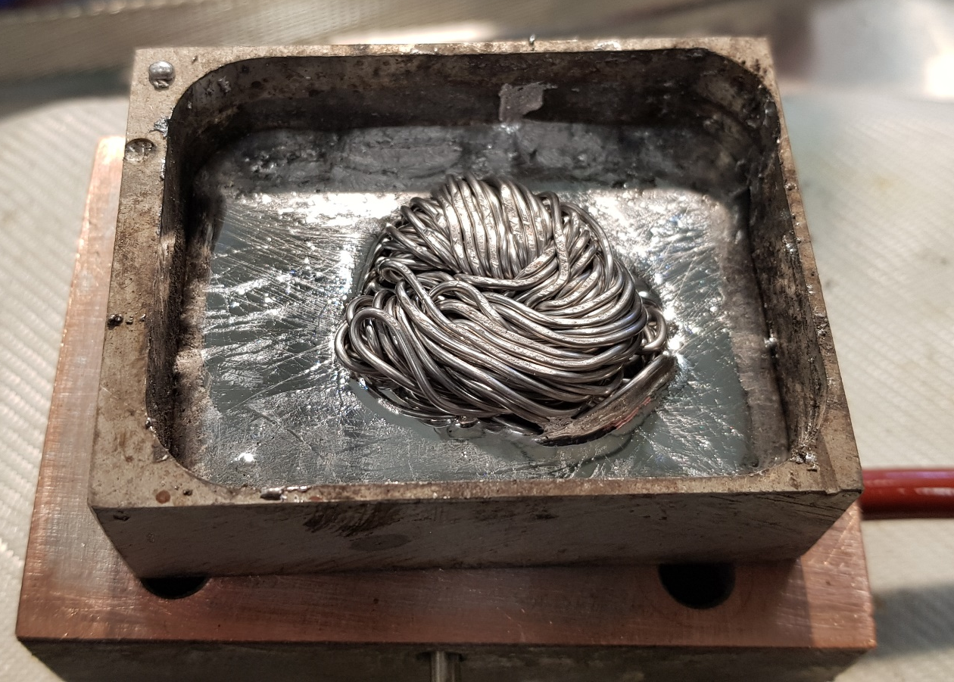
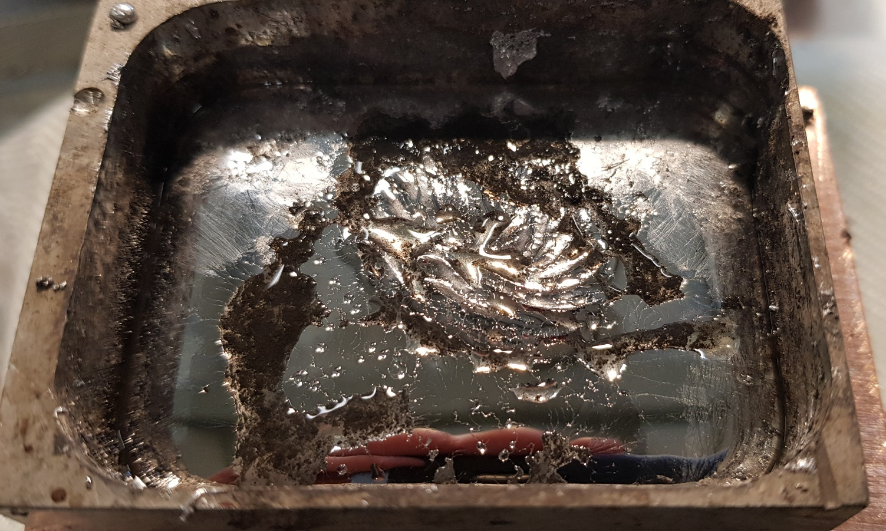
Human resources slide 4
Alloying of Solder Metal
t = 0
Indium
120 °C
t = ~15 min – Melted
Alloy / metal | Melting Temperature (°C)
Indium | 157
95In-5Bi | 150
33In-67Bi | 109
44Bi-42Sn-14Pb | 96
49Bi-21In-18Pb-12Sn | 58
May negatively impact the contact resistance.
Signs that thin Ag/Cu layers may alloy/dissolve when solder/tape ratio is large, Ag layer is exposed & soldering duration is long.
Bath of Bi-Sn-Pb (96 °C)
Using multiple solder metals in 1 joint to solder with different stages might introduce some complications.
Solder metals might alloy and cause the higher T_{melt} solders to melt, even thought you are below its melting temperature.
t = 0
SnPb
120 °C
t = ~15 min – Almost completely melted
Bath of Bi-Sn-Pb (96 °C)

Slide 16
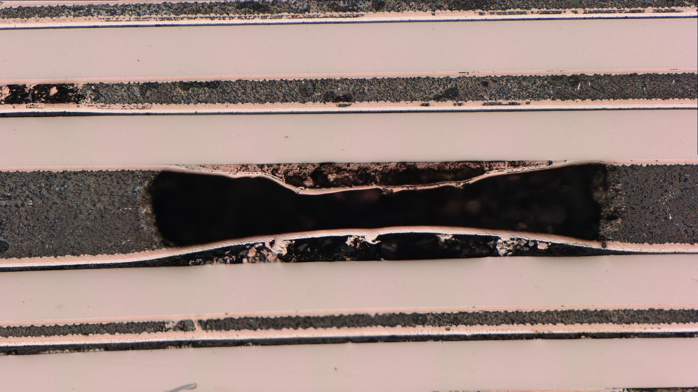
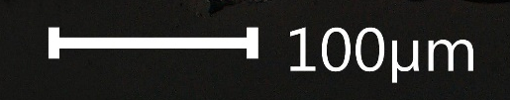
Copper
Silver
HTS/Buffer
Hastelloy
Copper
Solder
Pocket = no mechanical support!
Pockets should be avoided, especially in internal splices.
HTS NI pancake coil, produced by the ATLAS magnet team
Picture by K. Buchanan, CERN

Slide 17
Conclusions
Staging of the HTS tapes reduces contact resistance and improves current distribution.
Using a low T_{melt} solder may reduce temperature related degradation and reduces tape stress on cool down.
Mixing solder alloys to solder in stages may cause alloying of the solder metals and thus related complications.
Consistent thin splices or large gaps between tapes reduce the chance of pockets and pocket related degradation.

