Slide 1
Quench Measurements and Modelling of Frankenstein EuCard-2 Roebel Cable Pancake
Qingbo Zhang, Wendell Bailey, Jorge Pelegrin, Edward Young, Yifeng Yang
University of Southampton
Lorenzo Cavallucci, Marco Breschi
University of Bologna
Anna Kario
KEK and University of Twente
1st High Temperature superconductor Accelerator Technology (HiTAT) Workshop

Slide 2
Contents
Background
Roebel cable and pancake coil construction
Experimental results
Conclusions

Slide 3
Background
Challenges to quench measurement of Roebel cables
  Current sharing at a length scale of the transposition pitch, much longer than the MPZ of a single strand
  The “standard” 1D adiabatic quench measurement requires sample length of multiples pitch length about 1m long: difficult to realise experimentally
  Use pancake as compromise and the quench behaviour becomes 2D: more complex but better relevance to coils
A robust coil construction with insultation is preferred
  Able to withstand multiple thermal cycles
  Uniform current injection with sufficient low contact resistances

Slide 4
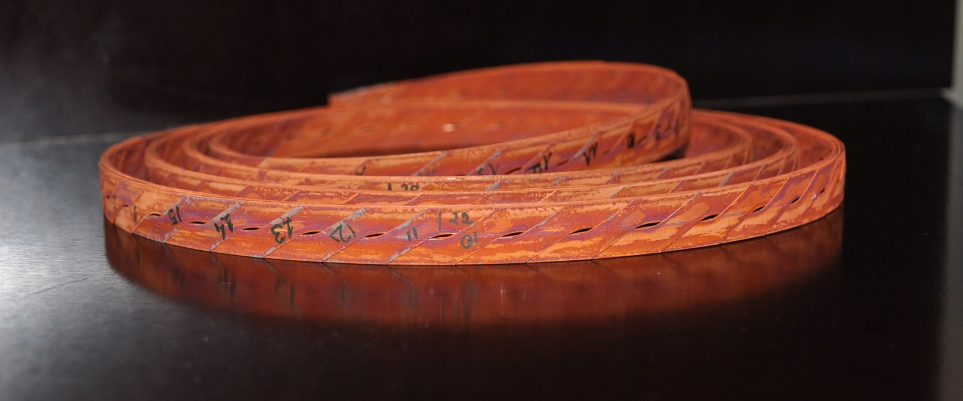
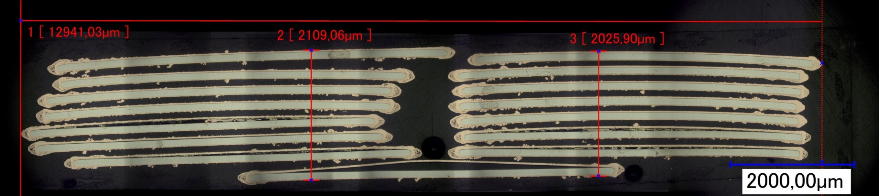
EuCARD2 Frankenstein Roebel Cable
Punch + Coat
Assembled by KIT
2 m long
15 transposed strands at a pitch of 226mm
Earlier development sample, orphaned
Rough surface prevents dense packing
Some delamination occurred during grinding/polishing for cross-section preparation

Slide 5
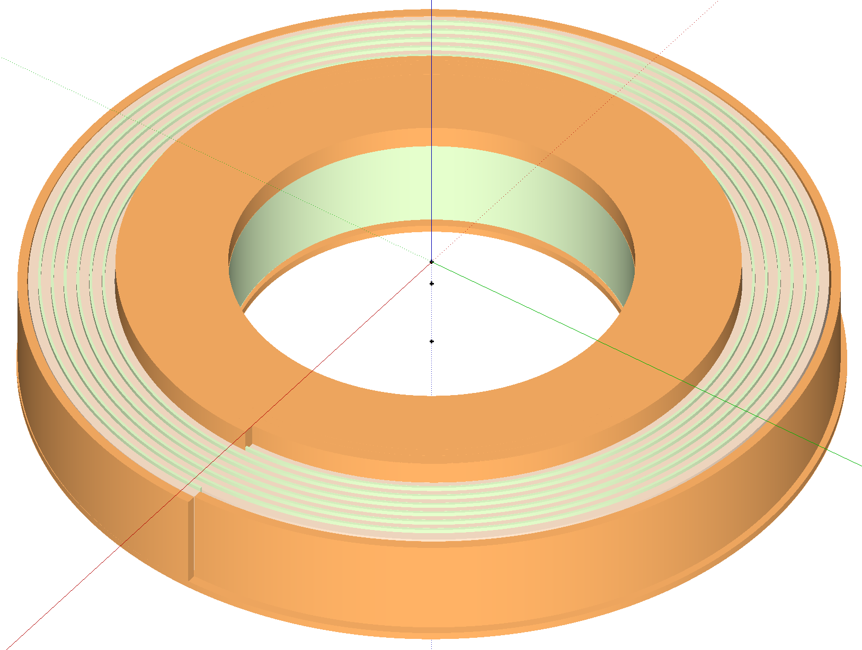
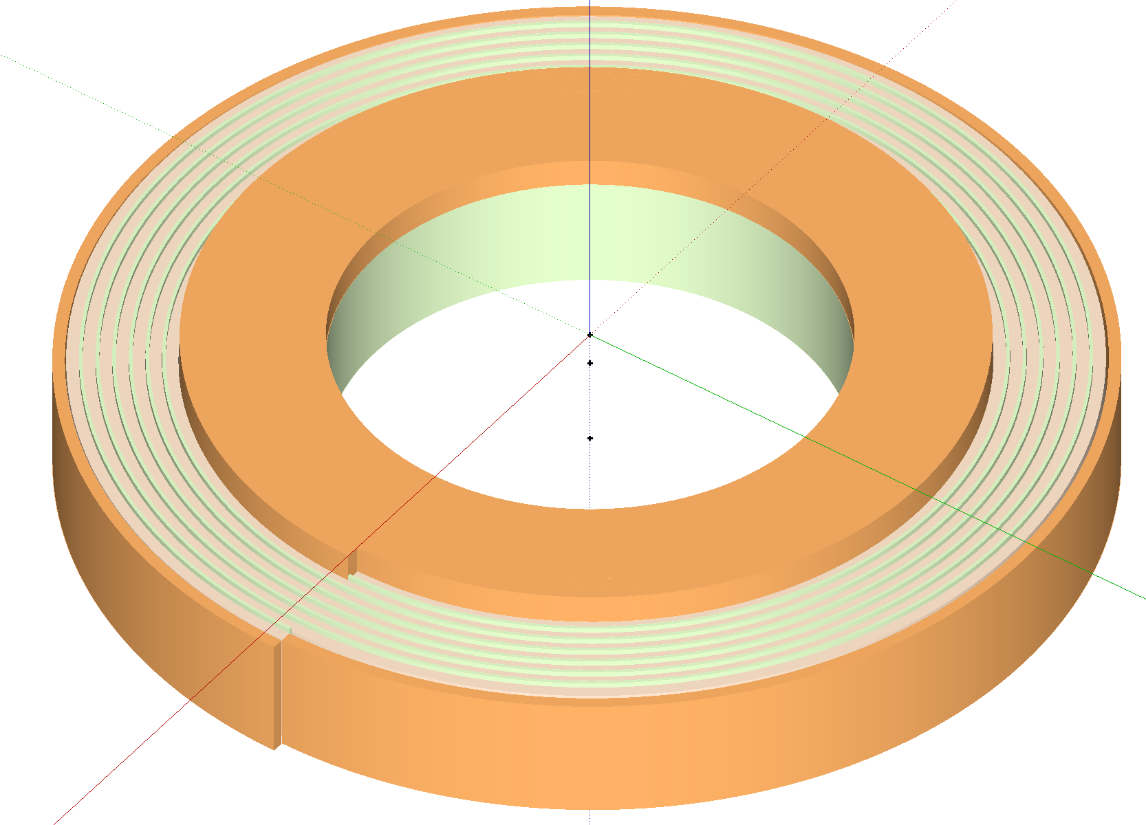
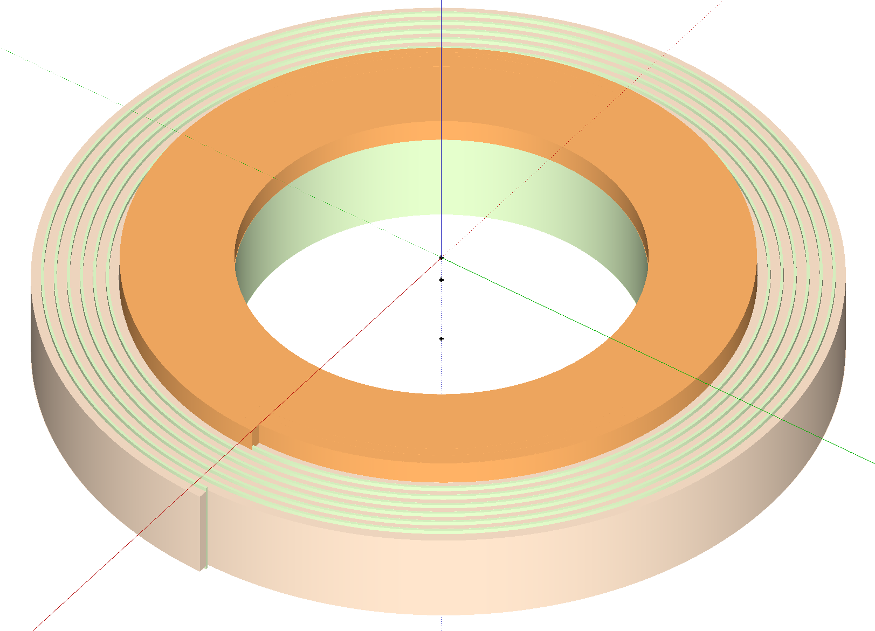
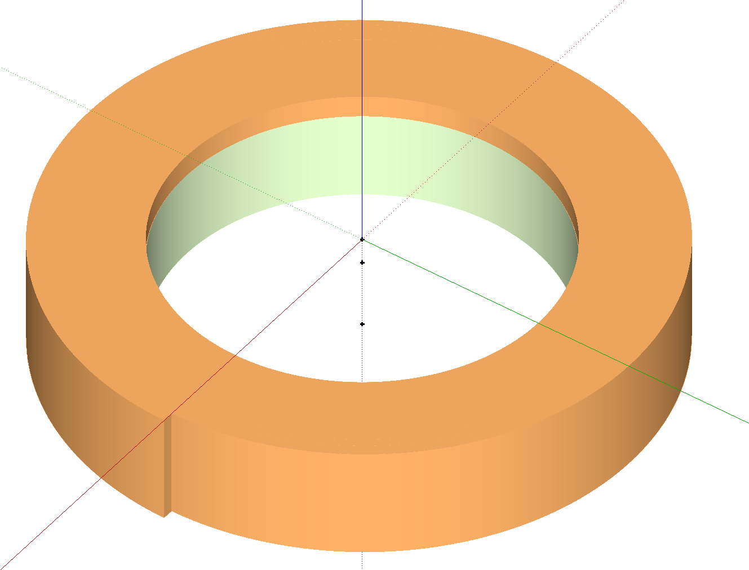
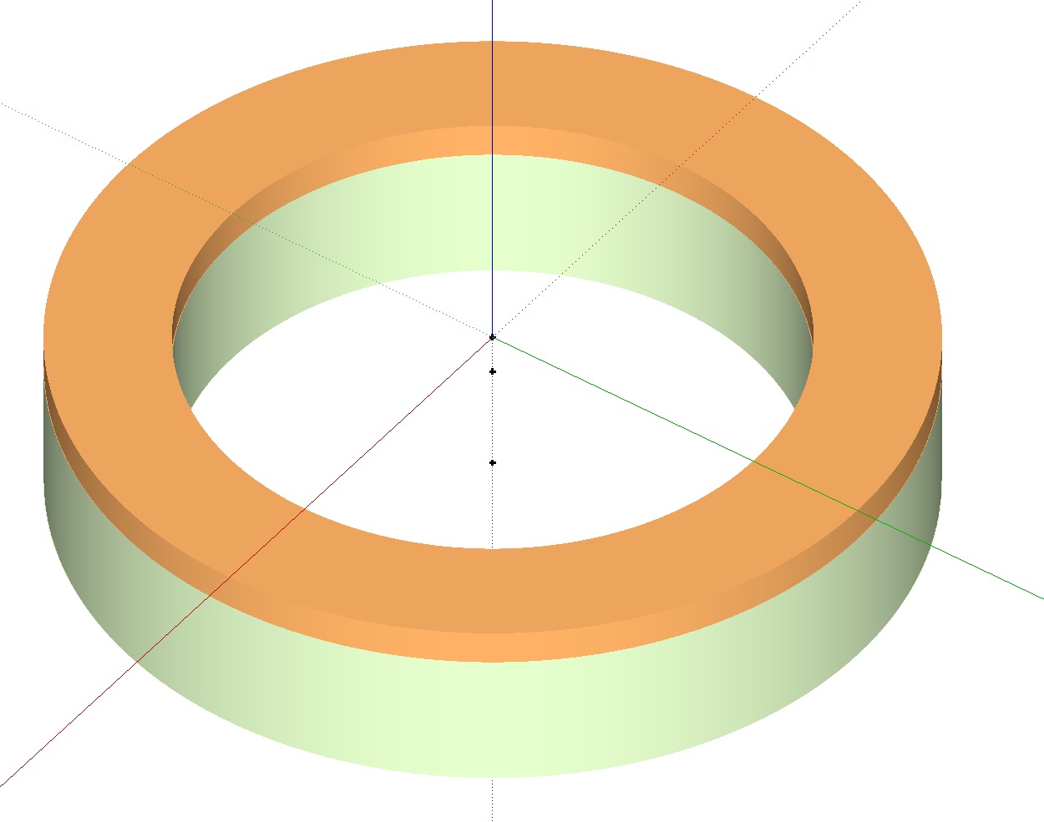
Pancake Coil Construction
G10 former with a cylindrical inner current injection terminal
Insert inner copper contact machined precisely for the first turn of winding
Wind and solder the first turn on the copper contact, every strands with the same exposed contact area to the copper (superconductor on the side facing the copper)
Co-wound with a layer of fibre-glass insulation
Attach instrumentation/heater during winding
Insert the outer copper contact to a whole turn from below
Wind the last turn on the outer copper contact and solder the strands
Epoxy impregnation

Slide 6
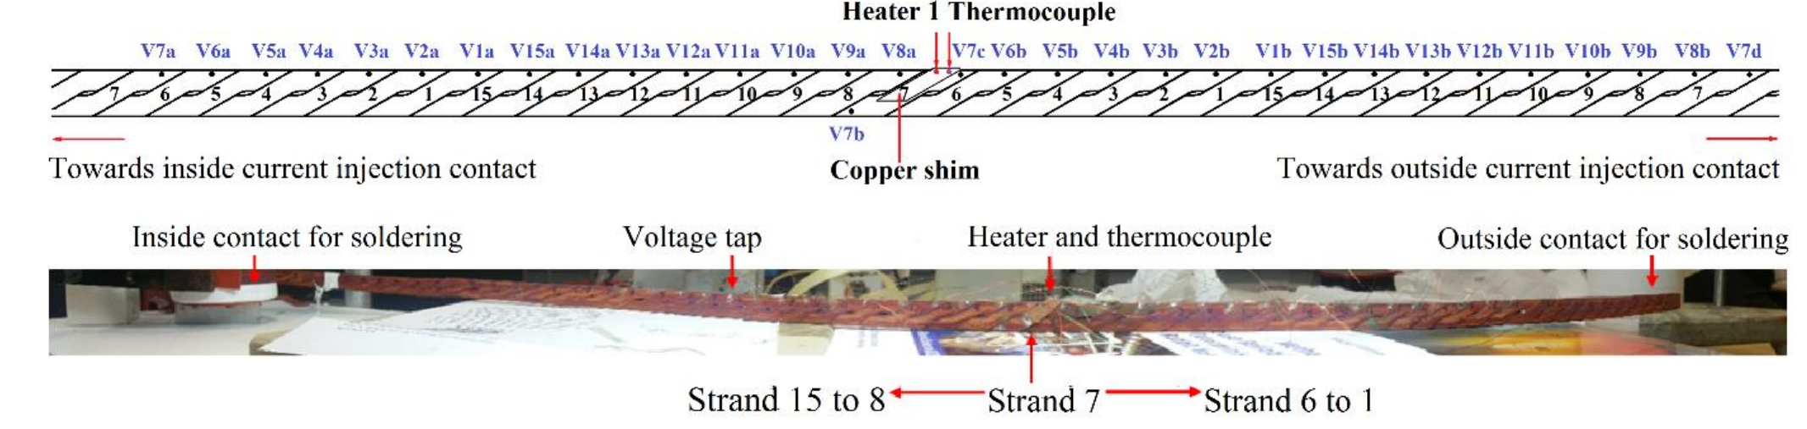
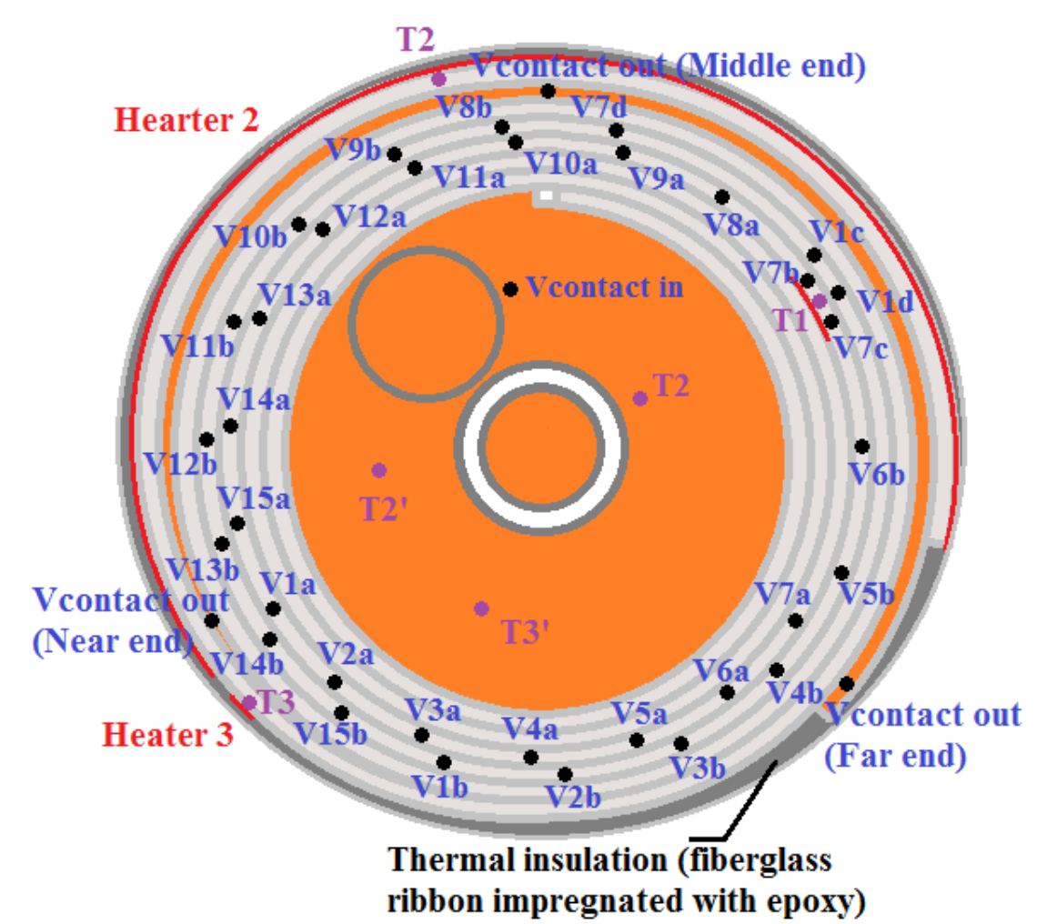
Instrumentation and Experimental Setup
A heater attached to a copper shim solder to the exposed transition section of strand 7
A thermal couple on the heated spot
A pair of voltage taps on every strand enclosing the heated spot
Although not symmetrically distributed about the hot spot, the voltage pairs spread over 2 pitch length and 3 turns
Coil submerged in liquid nitrogen pool for measurement

Slide 7
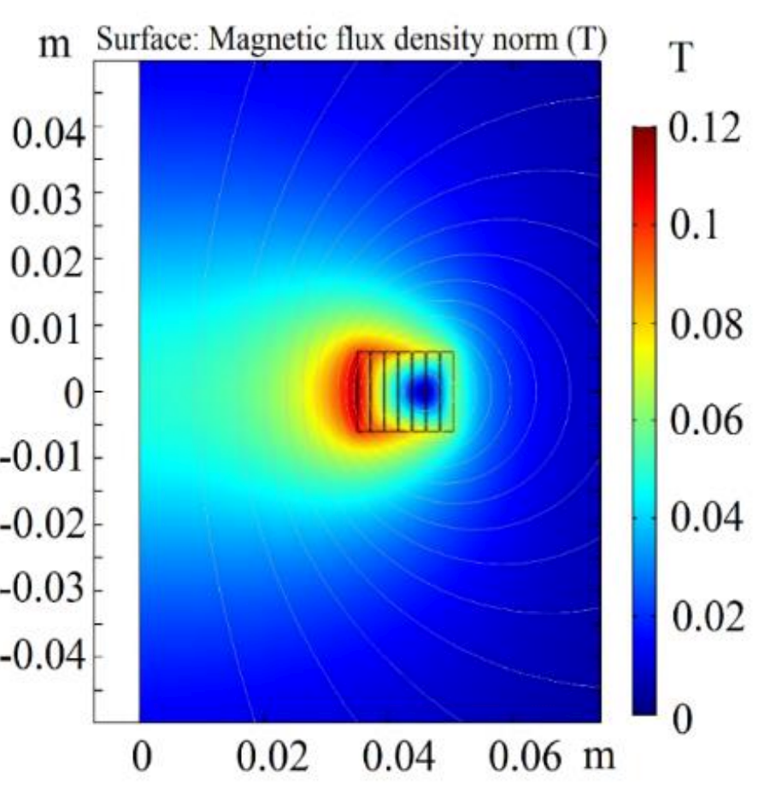
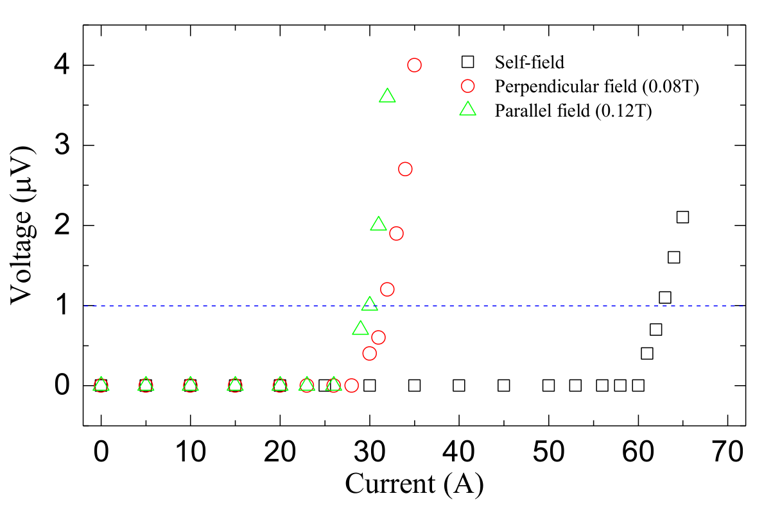
Strands, Conductor and Coil Performance
Bruker 2G YBCO strands with doping for enhanced pinning (and a relative low I_{c}(4mm) = 60A at 77K)
I_{c}~ 30A at 80mT perpendicular and 120mT parallel fields
15 strands assembled into a Roebel cable with a pitch of 226mm
The coil critical current is around 465A with a modest 60mT on the axis and 100mT on the coil

Slide 8
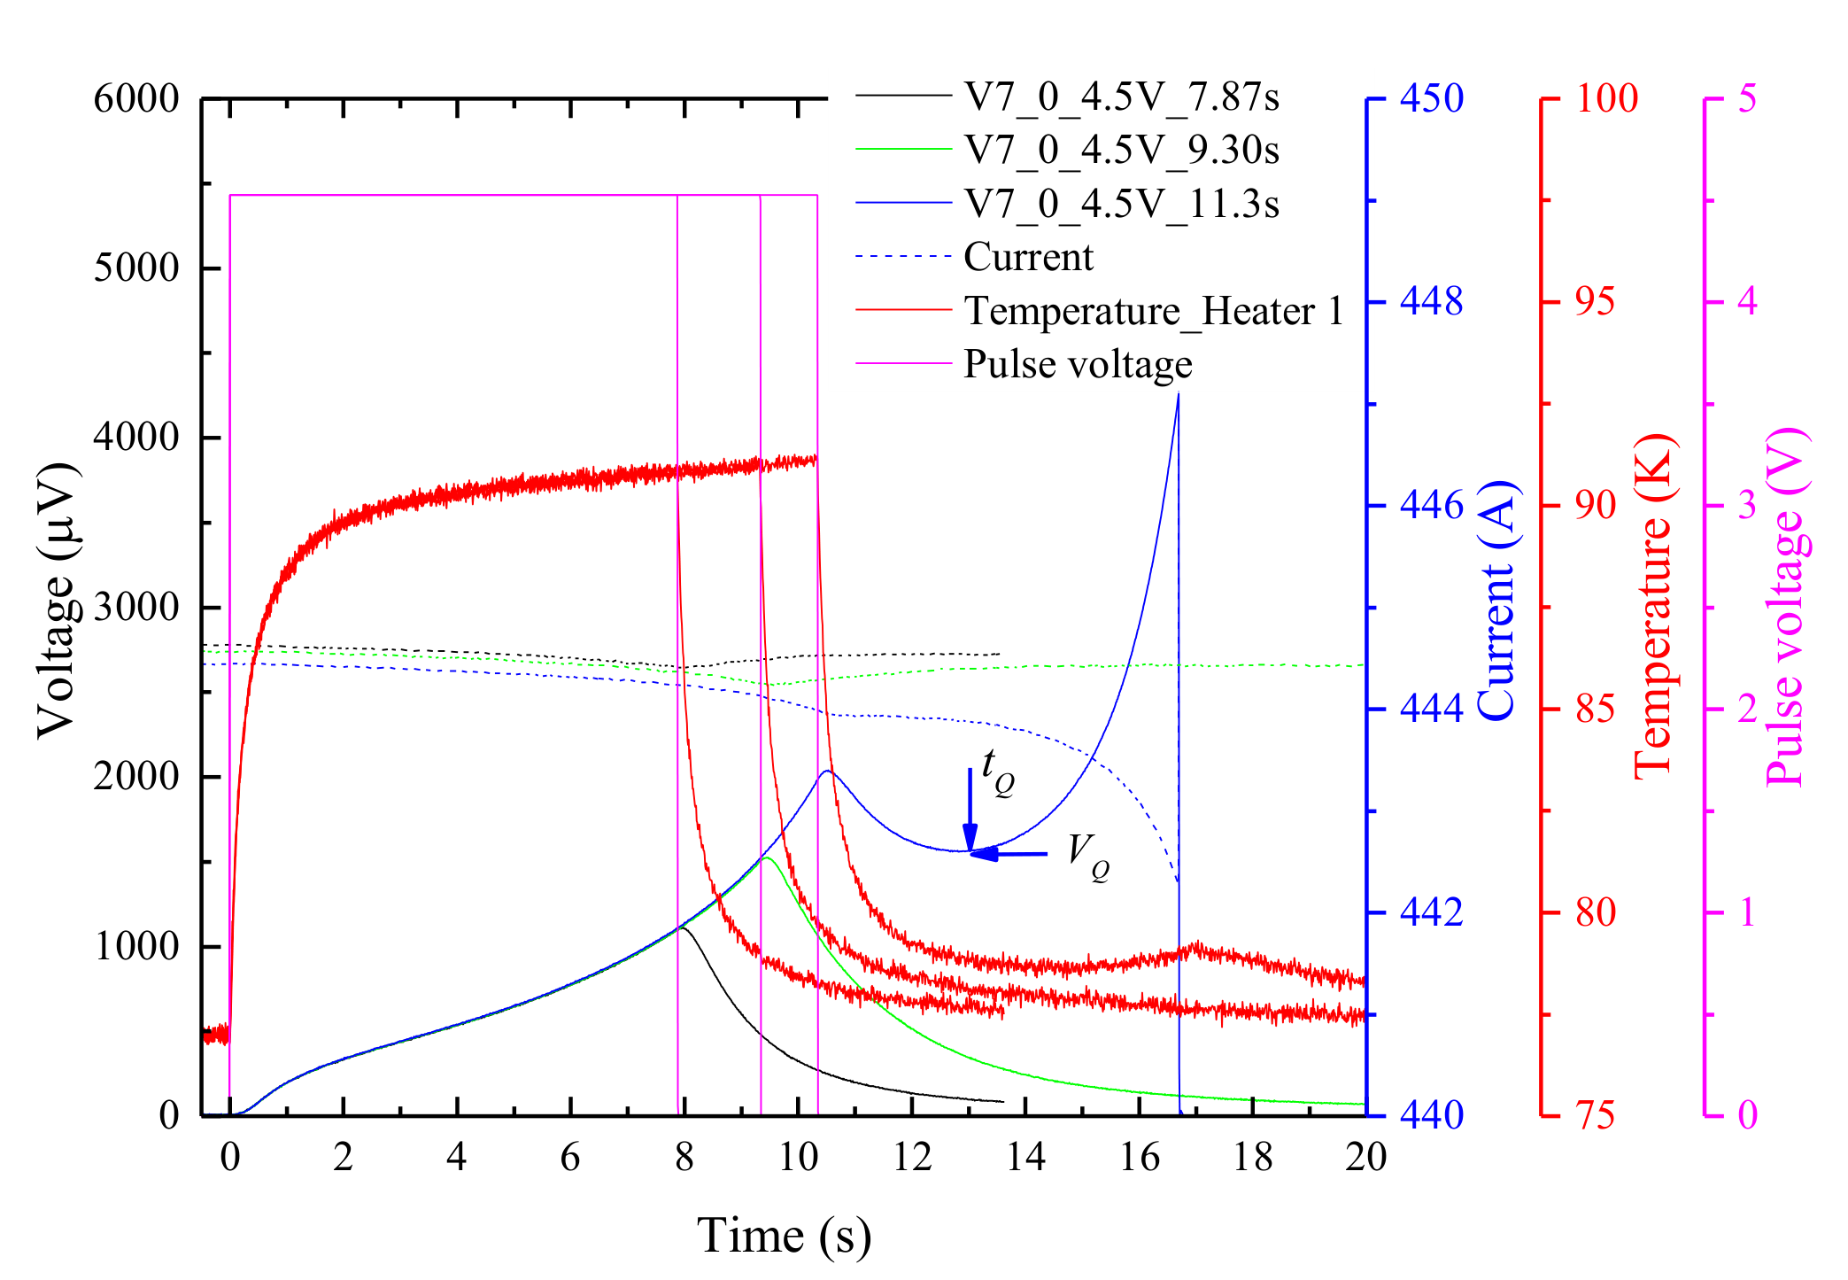
A Typical Quench Measurement in LN₂ Bath
Hot spot voltage and temperature at different pulse length
Heater power limited to ~1.5W
Heater pulse length increased gradually until irreversible quench is reached
Minimum Quench Energy (MQE) is obtained

Slide 9
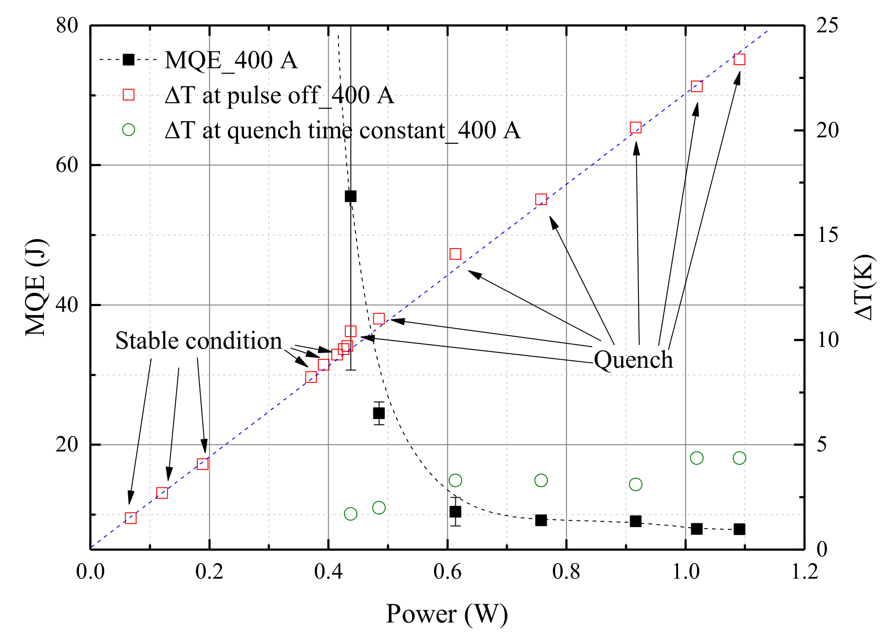
Quench and Stability at 77K with Different Heater Power
Global stability below 0.4W
Transition region
Toward true adiabatic quench
And a well defined T_{Q}
T_{Q}

Slide 10
Measurement at Different Temperatures in Helium Vapour in External Fields
Helium vapour cooled VTI
Helium vapour cooled current leads
OI 10T Cryo-free
Magnet 120mm bore
HTS insert coils
up to 110mm OD
Helium vapour at controlled flow rate and temperature (5K-100K)

Slide 11
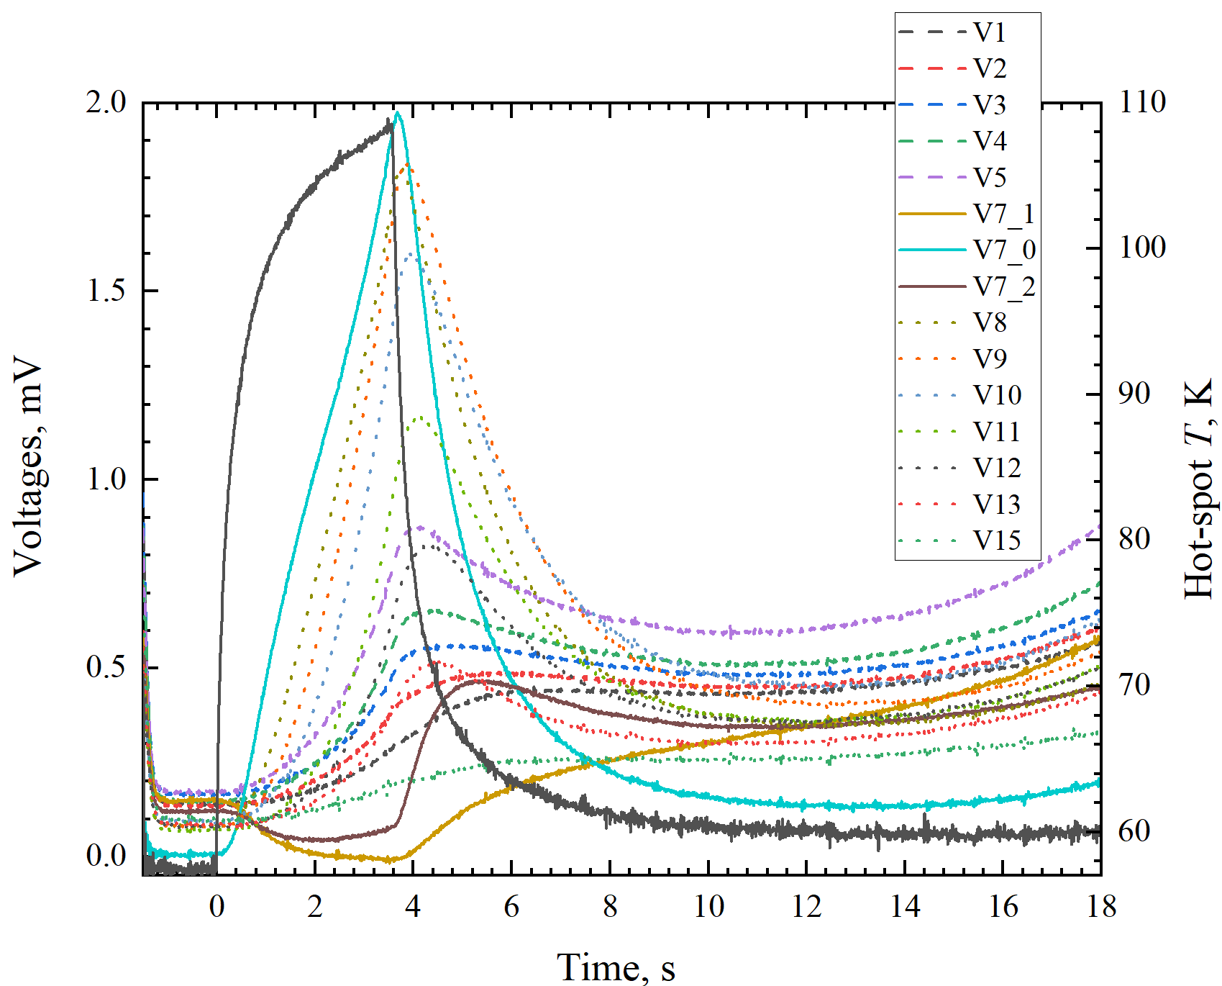
Measurement at Low Temperatures: 1200A at 58K / 3T
Critical Current: ~1250A on inner turns
Quench at 1200A with
6.3J deposited on strand #7 at 1.8W heat power
  Hot spot above 108K
  Hot spot voltage at 1.3mV

Slide 12
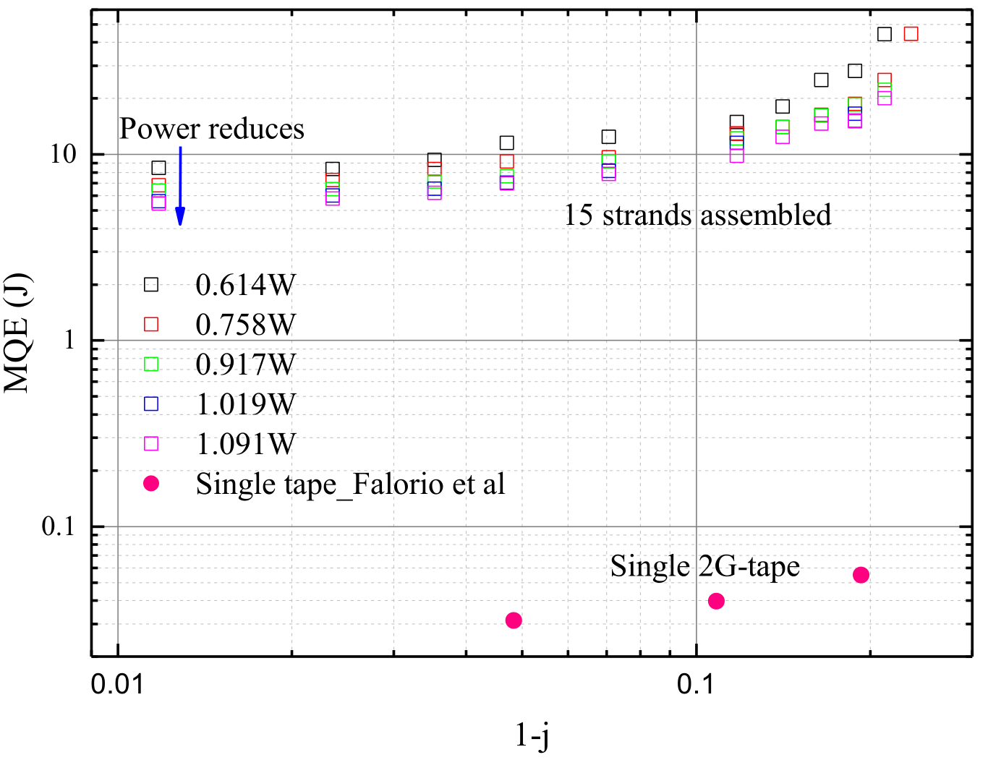
MQE at Different Current
~ 100x single tape’s: in line with 2D with coil composite
77k
58K/3T
pancake
Measured at I_{C}=100A

Slide 13
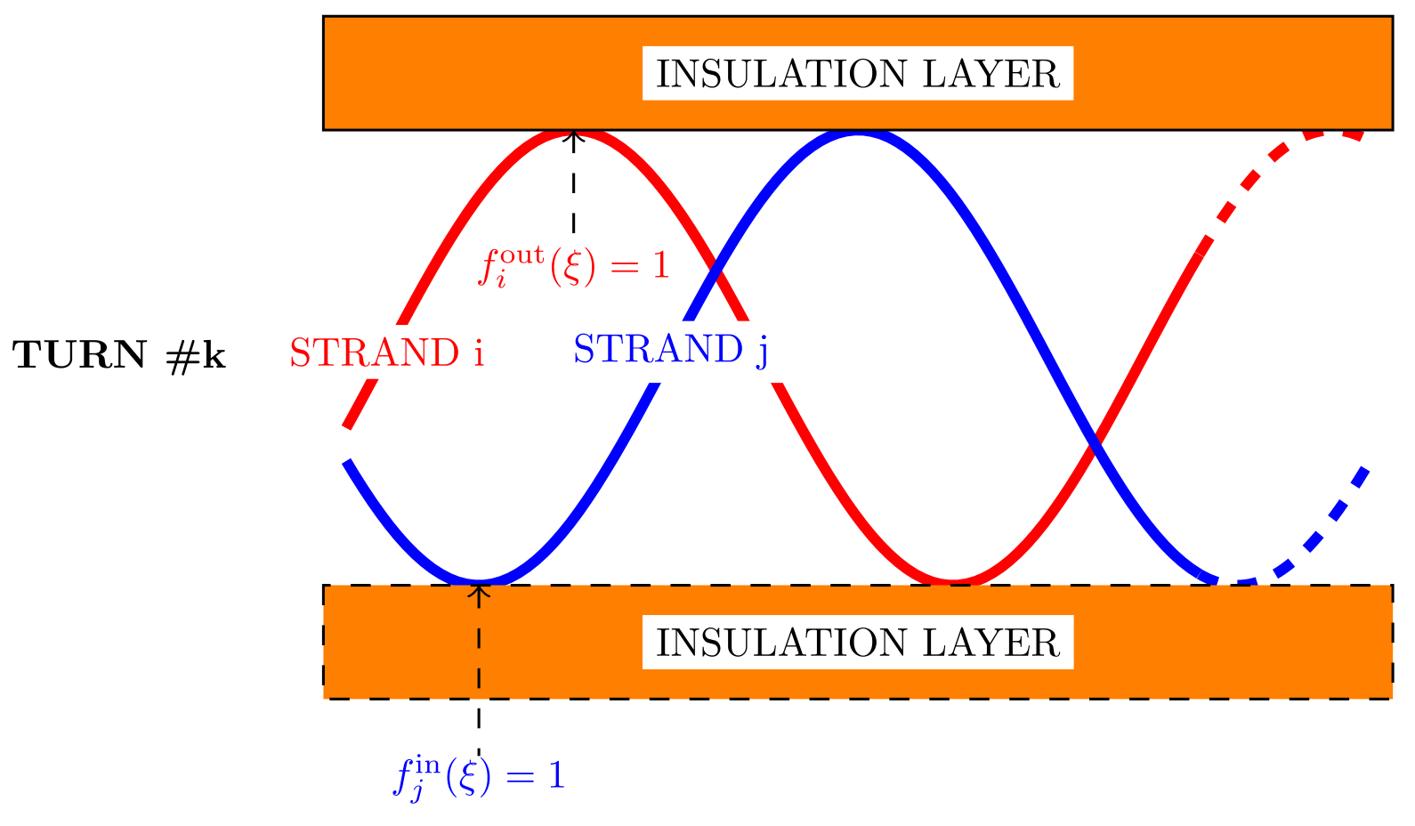
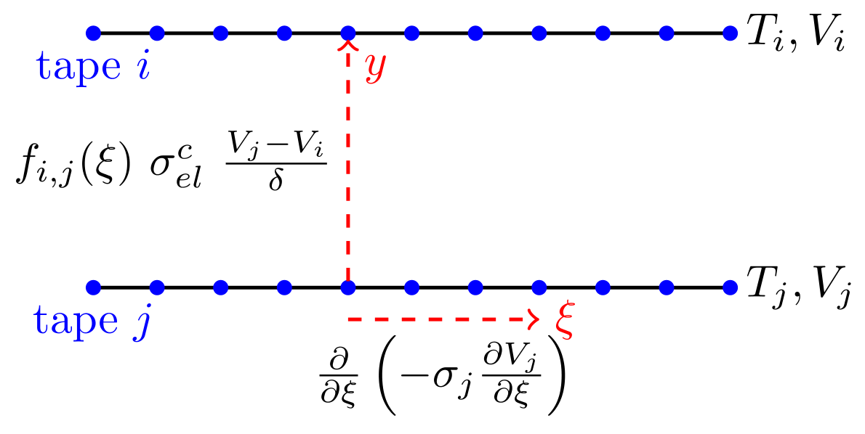
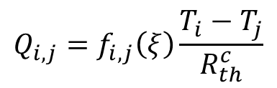
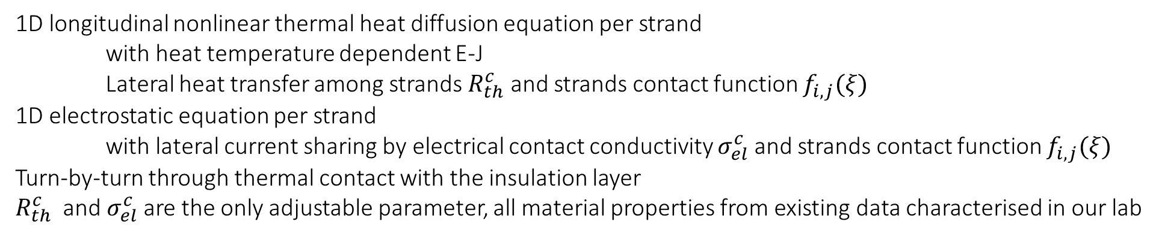
Strand-by-strand and Turn-by-turn Quench Model
$${Q_{i,j}=f}_{i,j}\left(ξ\right)\frac{T_{i}−T_{j}}{R_{th}^{c}}$$
1D longitudinal nonlinear thermal heat diffusion equation per strand
with heat temperature dependent E-J
Lateral heat transfer among strands $R_{th}^{c}$ and strands contact function $f_{i,j}(ξ)$
1D electrostatic equation per strand
with lateral current sharing by electrical contact conductivity $σ_{el}^{c}$ and strands contact function $f_{i,j}(ξ)$
Turn-by-turn through thermal contact with the insulation layer
$R_{th}^{c}$ and $σ_{el}^{c}$are the only adjustable parameter, all material properties from existing data characterised in our lab

Slide 14
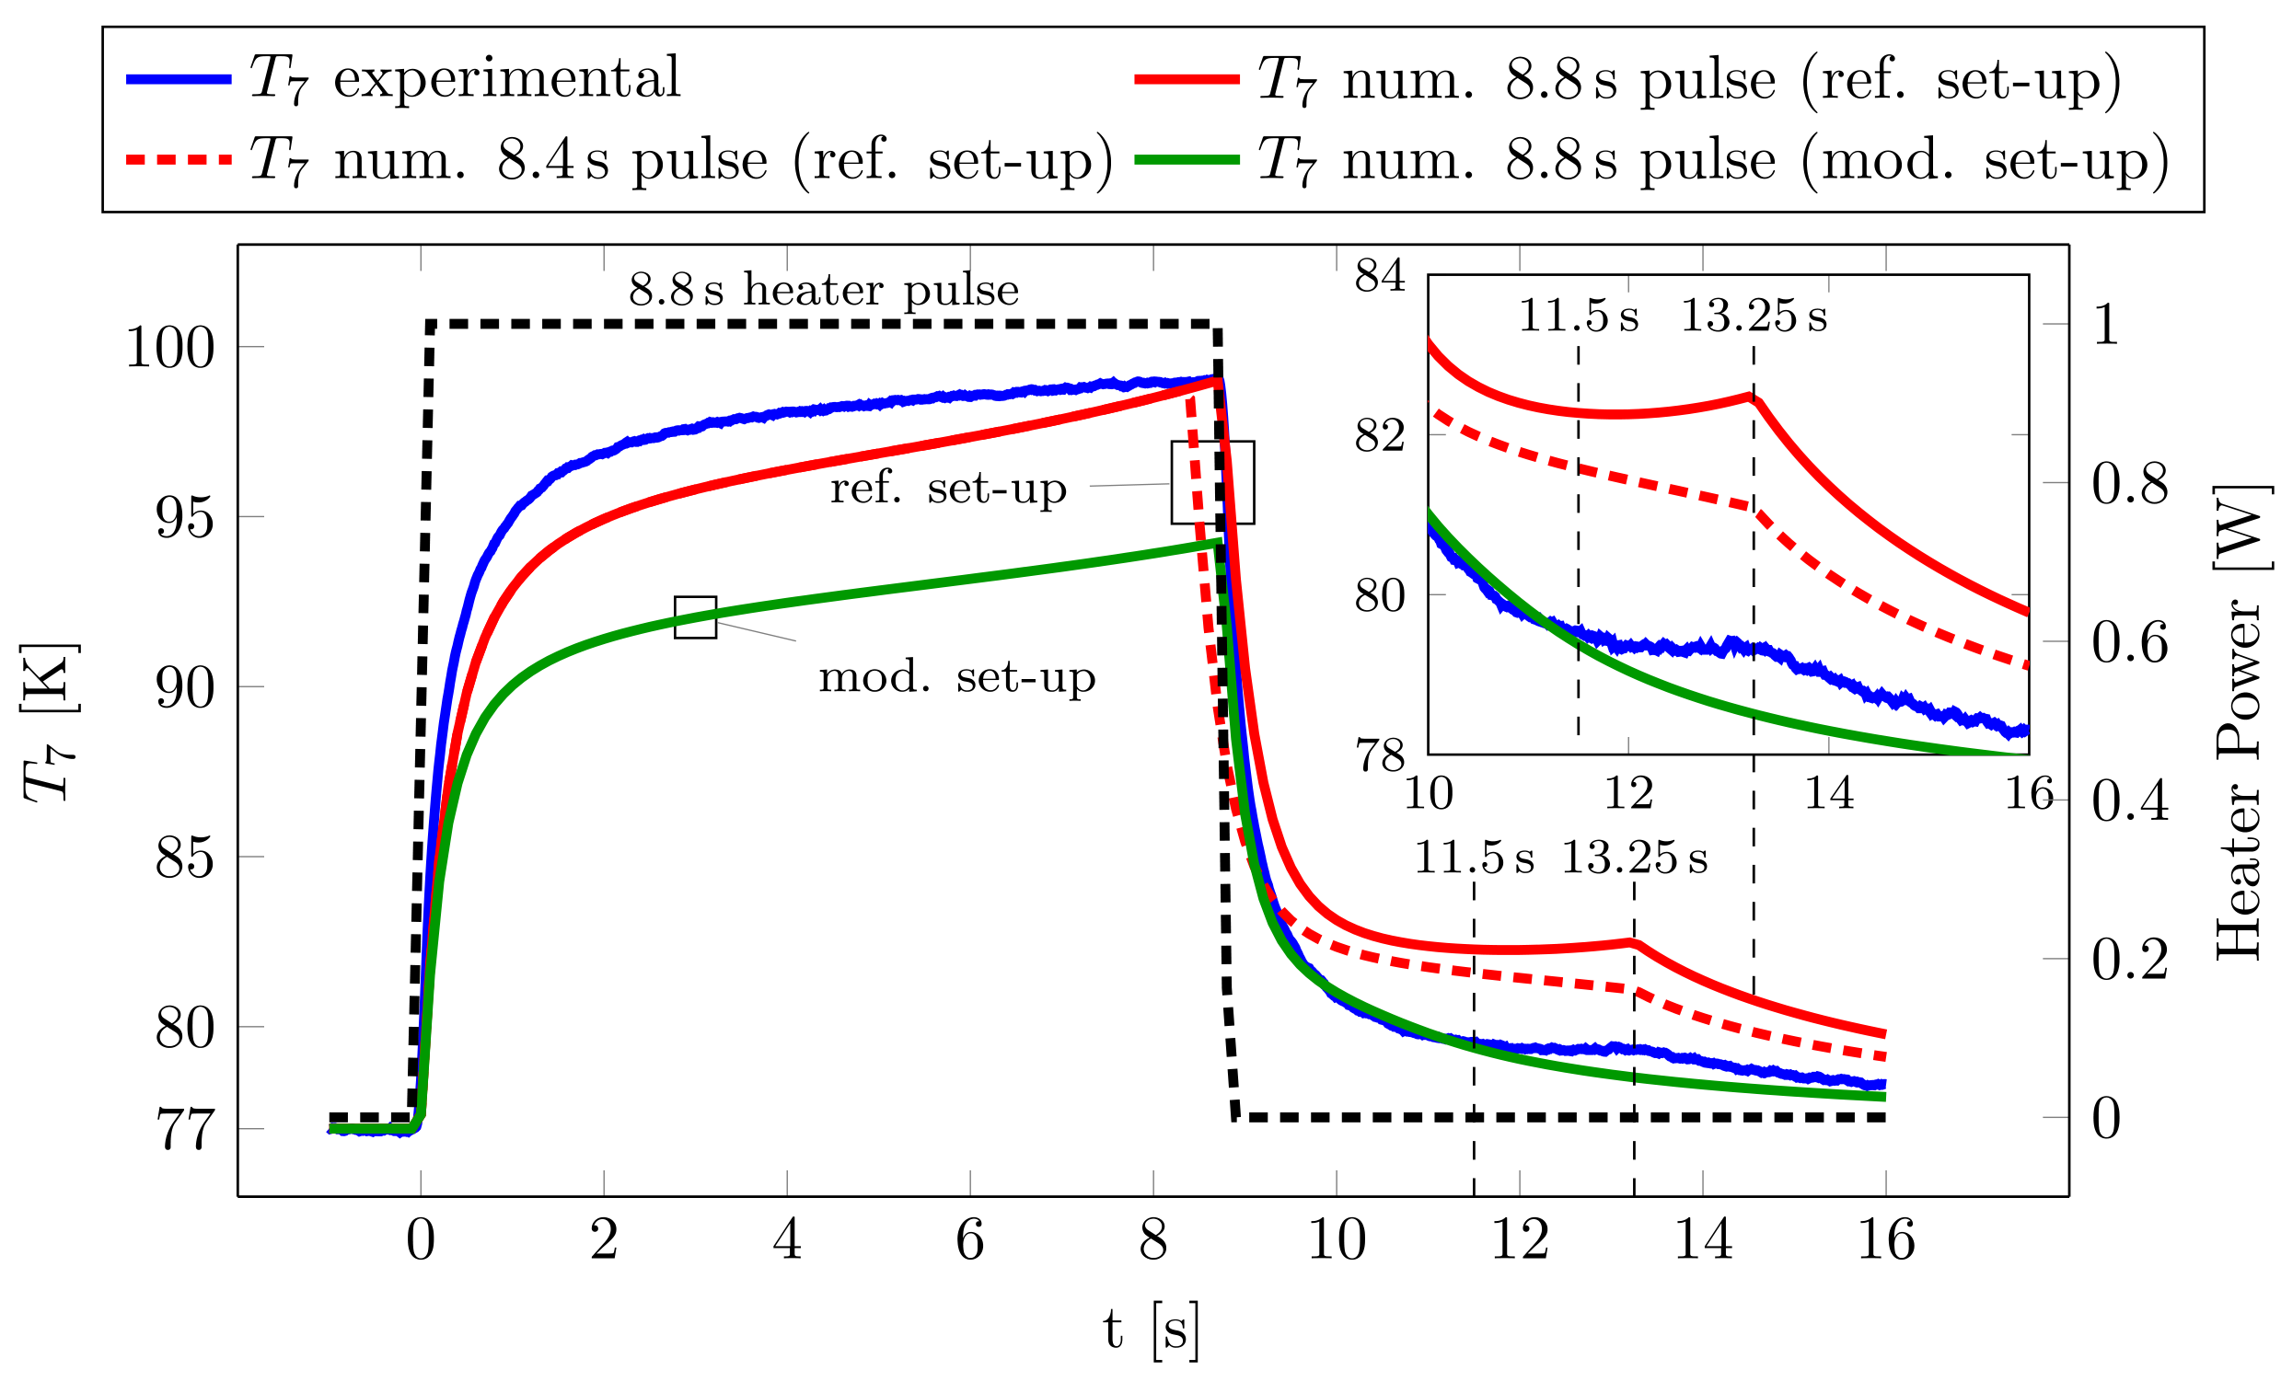
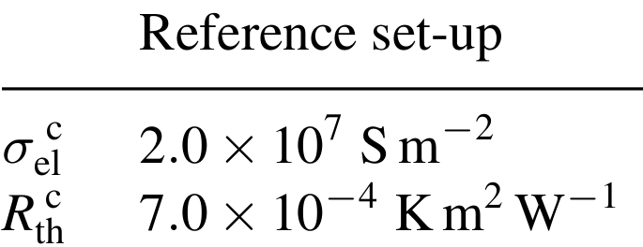
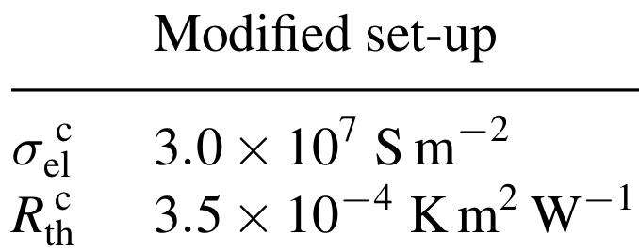


Quench Model and Measurement: Thermal Comparison
=$7 Kcm^{2}W^{−1}$
$$ρ_{el}^{c}=0.5 mΩcm^{2}$$

Slide 15
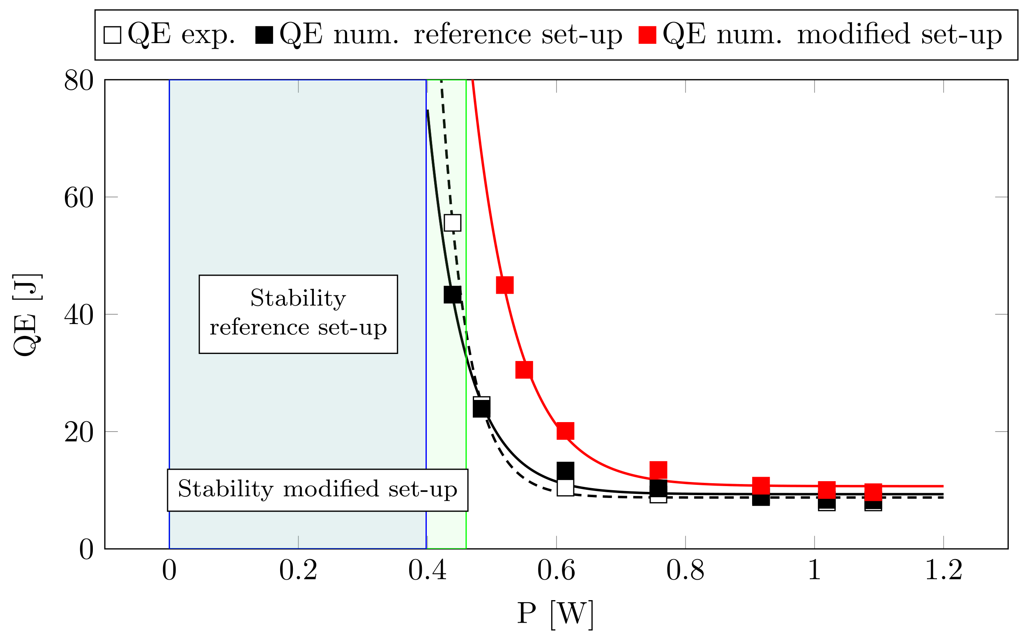
Quench Model and Measurement: MQE Comparison

Slide 16
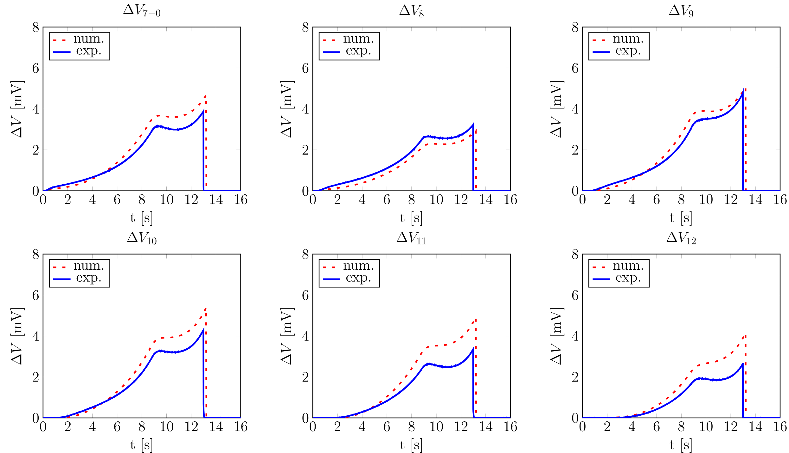
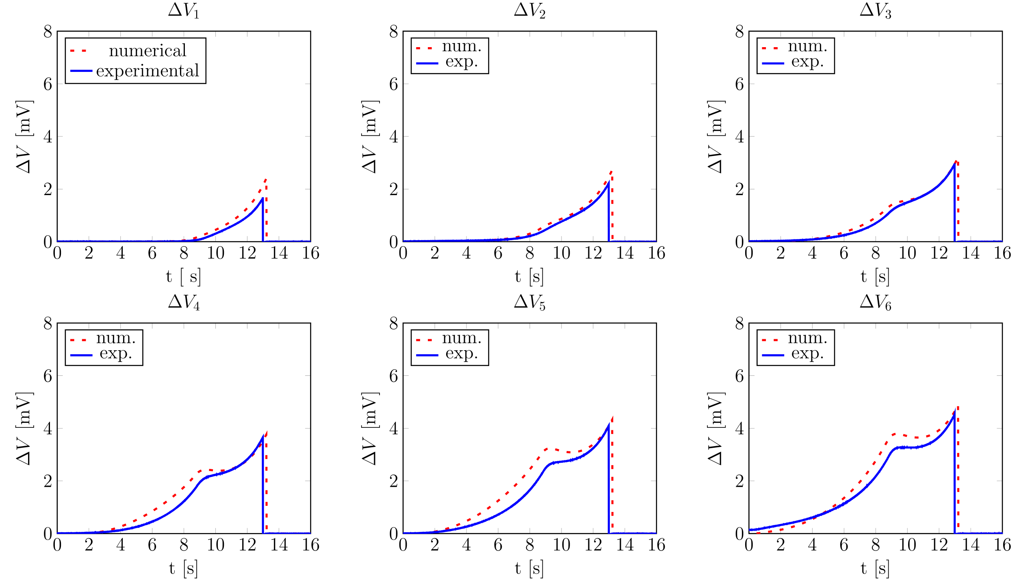
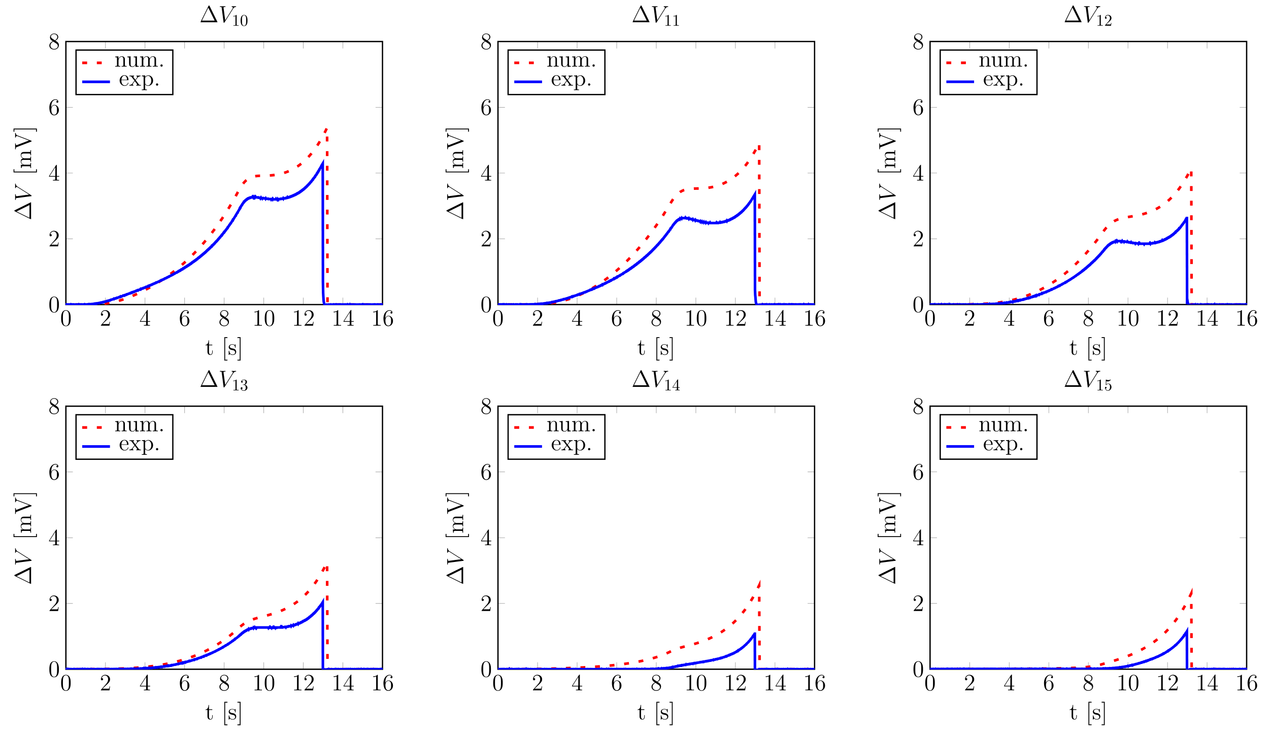
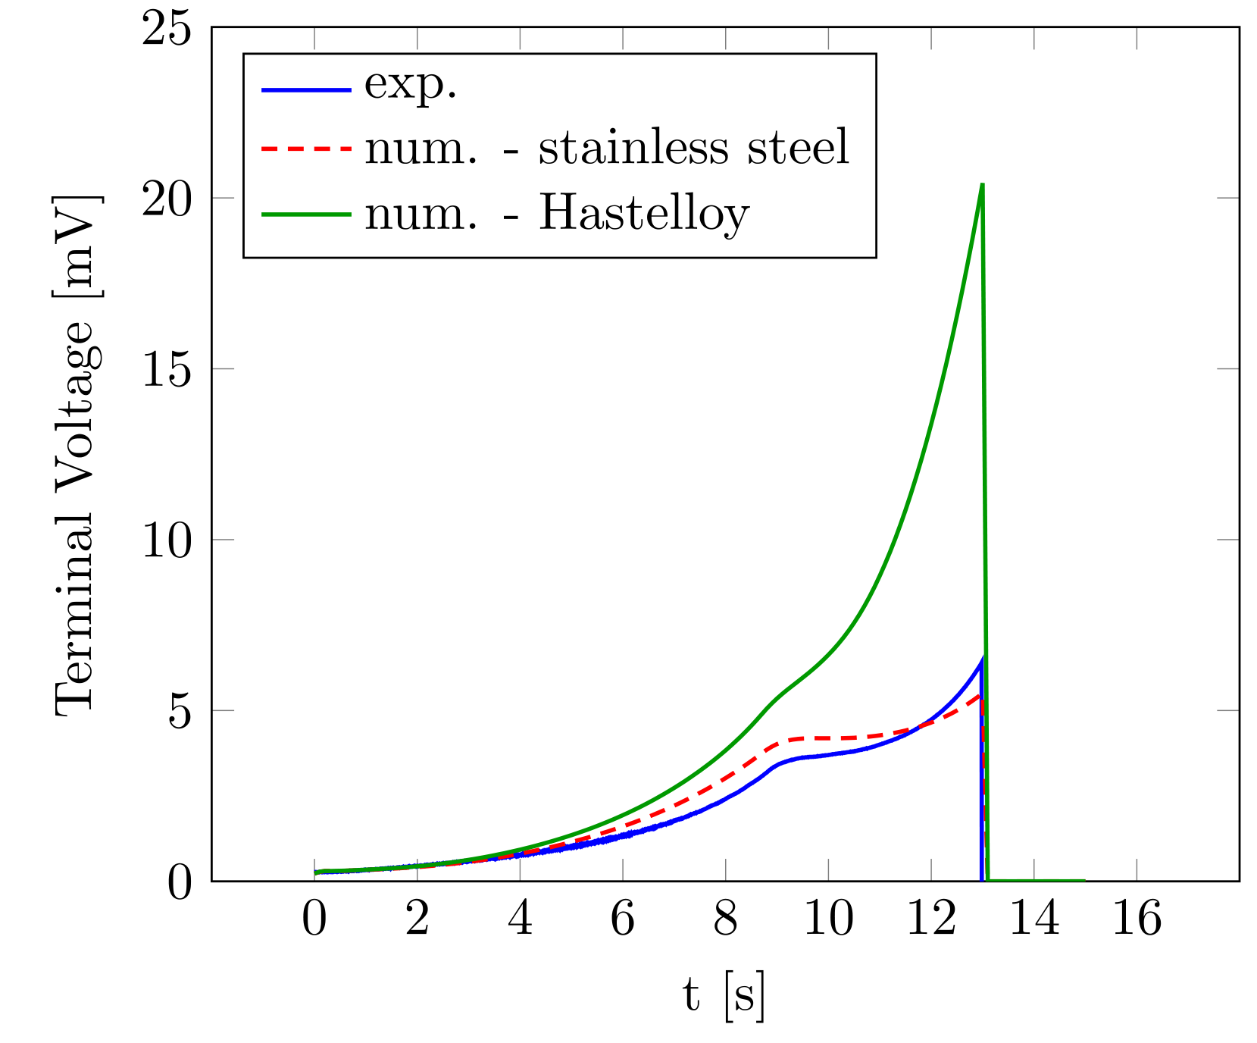
Quench Model and Measurement: Voltages

Slide 17
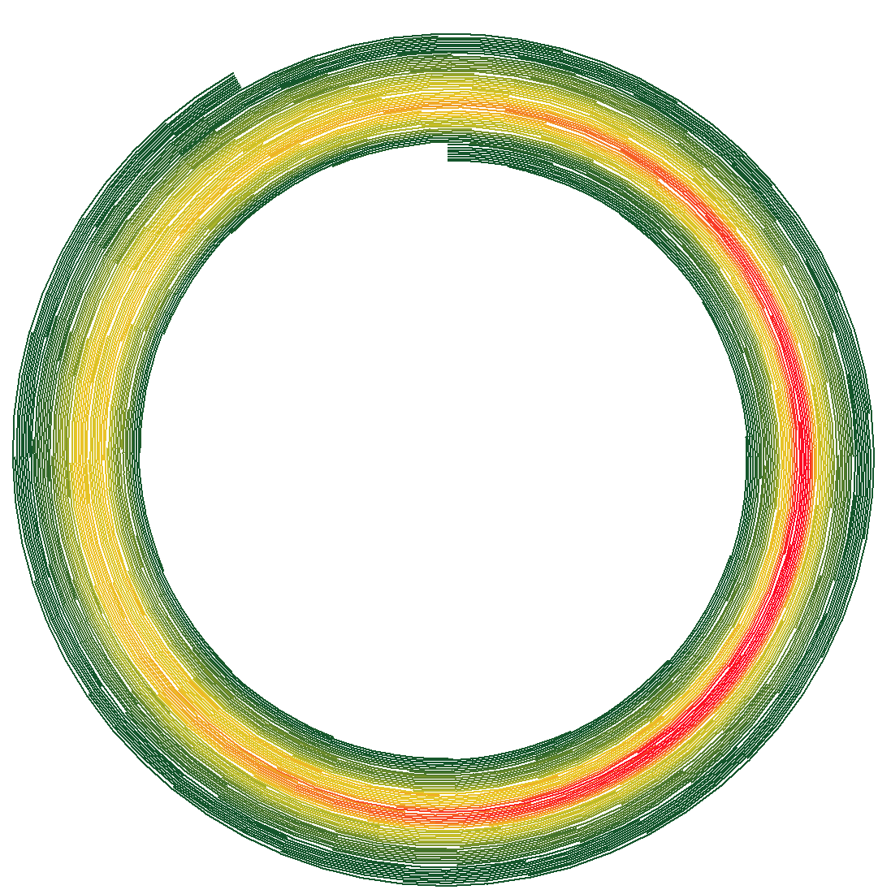
Conclusions
Robust pancake coil construction
2D adiabatic quench realised
Roebel quenches with higher MQE of increased number of tapes and 2D effect
A strand-by-strand and turn-by-turn quench model worked well
Electric and thermal contact resistances obtained
Thanks for
your attention!

