Slide 1

Quench protection techniques for HTS coils
Mariusz Wozniak
10th March 2023

Slide 2
Quench Protection – Goals and increasing complexity
Quench protection is a technique used to prevent any potential damage to a magnet, its circuitry, and surrounding components, when a portion of the magnet undergoes an irreversible transition to a normal state.
This is achieved by managing the stored magnetic energy in a way that mitigates any potential damage.
The scope of “any potential damage” predominantly means:
voltages and temperature (in most cases) -> Nb-Ti
voltages, temperatures, and conductor level stresses -> Nb₃Sn
voltages, temperatures, conductor level stress and often superconductor level stress and for NI coils, a potential for a force density redistribution -> YBCO
Each measure above needs its safe operational range. These are extremely resource intensive to establish, if can be fully established at all.
A proper quench protection analysis of an HTS often exceeds the expertise of a single person and the capabilities of a single software tool. Quench protection of HTS is a multidisciplinary team effort!
Notes:
Explain that quench protection is about managing stored magnetic energy and the fact that this is getting more complex for YBCO as many more additional aspects need to be taken into account.
Emphasize need for team of people with various skills that are needed for proper quench protection simulations.
Emphasize that the limits for the measures are not well establish and it will be lots of work to do so.

Slide 3
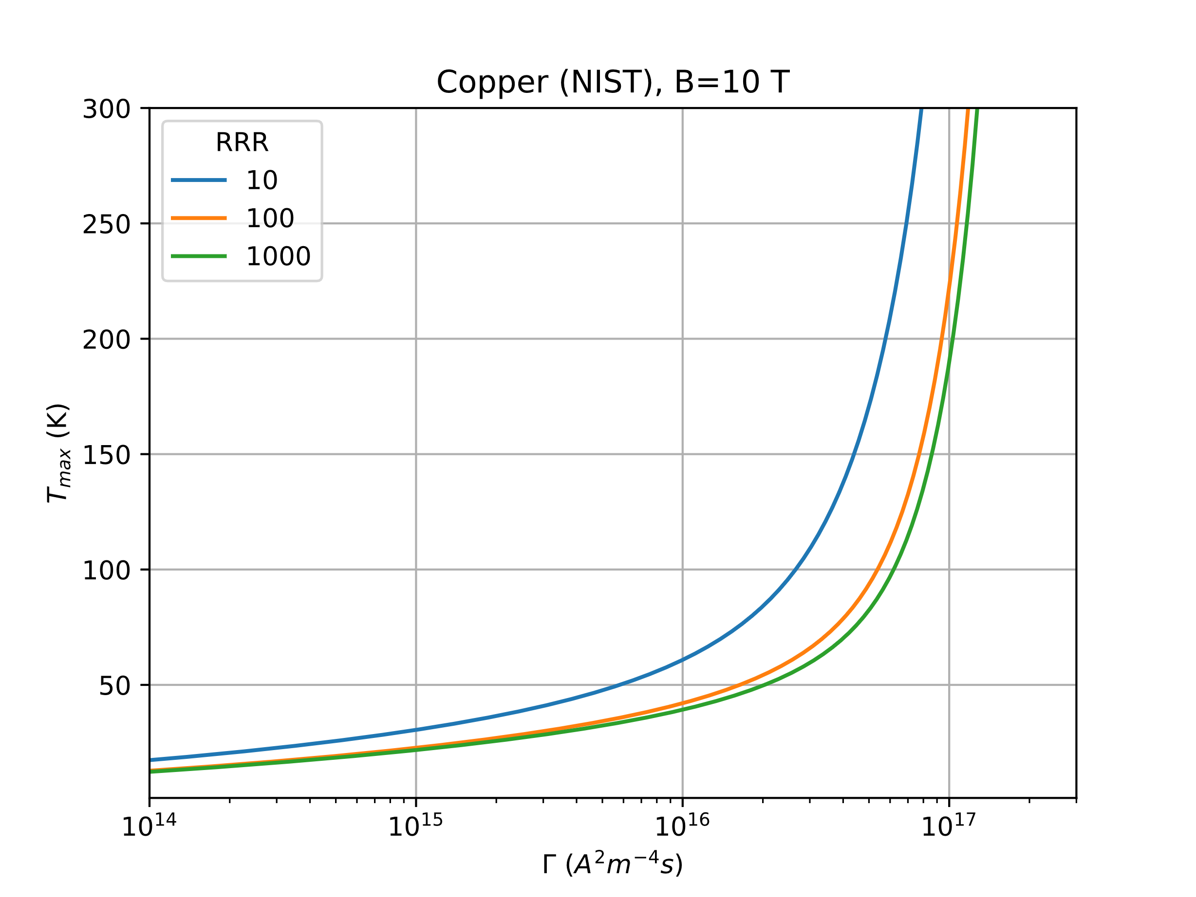
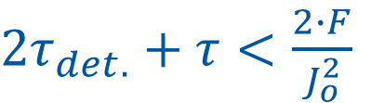

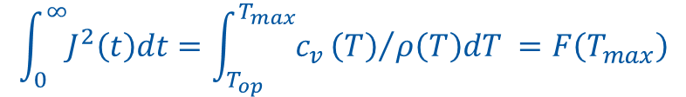





Managing Stored Magnetic Energy - Basics
$$\int_{0}^{∞}{J^{2}\left(t\right)dt}=\int_{T_{op}}^{T_{max}}{c_{v}}{\left(T\right)}/{ρ\left(T\right)dT} =F\left(T_{max}\right)$$
$F_{Cu}\left(300K\right)≈ {1.3∙10}^{17} A^{2}m^{−4}s$
t₁
Quench
R_{Q}
$$J\left(t\right)=\frac{I(t)}{A_{Cu}}=J_{0}e^{{−t}/τ}$$
Power source
R_{E}
I
$$τ=\frac{L}{R_{Q}+R_{E}}\underset{⇒}{HTS} τ≈\frac{L}{R_{E}}$$
L
Required τ for J₀ ≈ J_{Cu} of HTS conductor:
For exponential decay:
For double the initial current density J₀, a quadrupling of R_{E} is roughly expected, so quadrupling of energy extraction initial volage, i.e.:
$2τ_{det.}+τ<\frac{2∙F}{J_{o}^{2}}$
500 A/mm²:
$τ<\frac{2∙F}{J_{o}^{2}}=\frac{2∙1.3∙{10}^{17}}{{\left(500∙{10}^{6}\right)}^{2}}≈1 s$
$$τ_{det.}\sim 0 s$$
1000 A/mm²:
$τ<\frac{2∙F}{J_{o}^{2}}=\frac{2∙1.3∙{10}^{17}}{{\left(1000∙{10}^{6}\right)}^{2}}≈0.25 s$
$$V_{0}\sim J_{0}^{2}$$
Note above assumes adiabatic conditions, no current sharing, and zero NZPV in HTS
Notes:
Introduce the basic of quench protection with the

Slide 4
Managing Stored Magnetic Energy - Approaches
Magnet Stored Energy
Distribute (propagate)
Remove (extract)
Passive
Active (requires quench detection)
Passive
By-pass
Increase resistance of the coil
Electric (via term.)
Magnetic (via coupling)
Turn-to-turn layer
Conductor
Heaters
Coils
Power Sources
Res/Var-istors
Structures
Add. coils
Notes:
After having introduced the energy extraction, Continue through this structure, introduced constant resistance and constant voltage extraction.

Slide 5
Managing Stored Magnetic Energy - Approaches
Magnet Stored Energy
Distribute (propagate)
Remove (extract)
Passive
Active (requires quench detection)
Passive
By-pass
Increase resistance of the coil
Electric (via term.)
Magnetic (via coupling)
Turn-to-turn layer
Conductor
Heaters
Coils
Power Sources
Res/Var-istors
Structures
Add. coils
This indicates that :
magnet energy is predominantly being removed
with active method (Q. detection required)
removal by electric terminals of the magnet
resistor or varistor is used
Notes:
After having introduced the energy extraction, Continue through this structure, introduced constant resistance and constant voltage extraction.

Slide 6

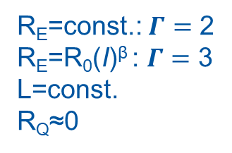
Magnet Stored Energy
Distribute (propagate)
Remove (extract)
Passive
Active (requires quench detection)
Passive
By-pass
Increase resistance of the coil
Electric (via term.)
Magnetic (via coupling)
Turn-to-turn layer
Conductor
Heaters
Coils
Power Sources
Res/Var-istors
Structures
Add. coils
Energy extraction is very effective
Requires quench detection and active system, that are quite involved for HTS and add to the system cost
t₁
R_{Q}
Voltage needed for energy extraction:
Power source
R_{E}
Resistor ->
Varistor ->
R_{E}=const.: $Γ=$ 2
R_{E}=R₀(I)^{β} : $Γ=$ 3
L=const.
R_{Q}≈0
I
$$V_{0}=\frac{I_{0}L}{Γ F(T_{max})}J_{0}^{2}$$
L
Extraction voltage, for a constant voltage EE is 33% lower than a constant-R extraction for the same effect (in principle).
Notes:
After having introduced the energy extraction, Continue through this structure, introduced constant resistance and constant voltage extraction.

Slide 7
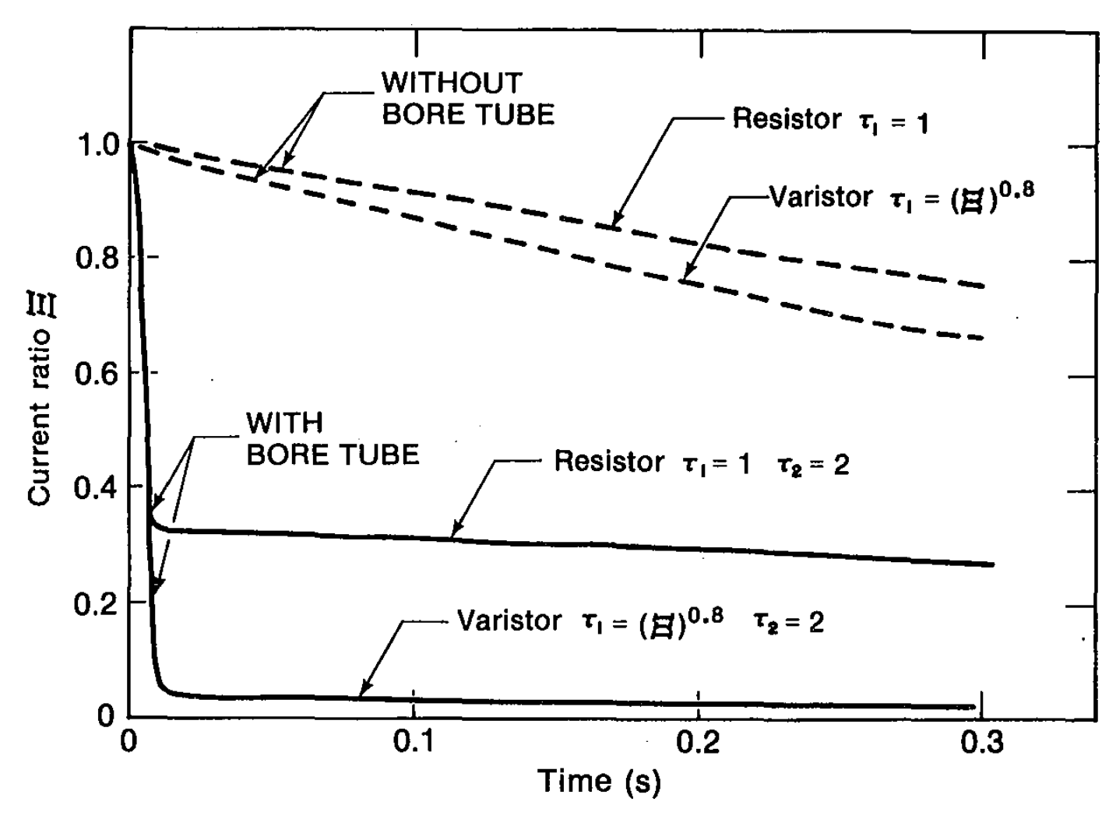
Magnet Stored Energy
Distribute (propagate)
Remove (extract)
Passive
Active (requires quench detection)
Passive
By-pass
Increase resistance of the coil
Electric (via term.)
Magnetic (via coupling)
Turn-to-turn layer
Conductor
Heaters
Coils
Power Sources
Res/Var-istors
Structures
Add. coils
A relatively high dB/dt is needed to remove energy by the magnetic coupling. Electric Energy Extraction can be used to create the high dB/dt.
The effectives of magnetic coupling is higher for varistors than resistors [1]
This might be an interesting avenue for HTS CCT magnets
t₁
R_{Q}
R_{C}
Power source
R_{E}
I
M
L_{C}
L
[1] Eberhard P H et al (1977), “Quenches in large superconducting magnets,” Proceedings of the Sixth International Conference on Magnet Technolgy MT-6, Bratislava, pp 654-661.

Slide 8
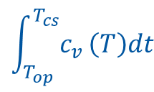
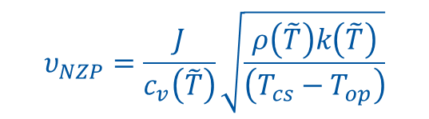
Magnet Stored Energy
Distribute (propagate)
Remove (extract)
Passive
Active (requires quench detection)
Passive
By-pass
Increase resistance of the coil
Electric (via term.)
Magnetic (via coupling)
Turn-to-turn layer
Conductor
Heaters
Coils
Power Sources
Res/Var-istors
Structures
Add. coils
The method works very well for many LTS magnets and is passive and simple
However, due to large enthalpy margin, the quench propagation along the HTS conductor is relatively slow (typically ~ cm/s).
The normal zone does not develop substantial resistance to cause substantial dI/dt (dB/dt) so AC loss contribution is negligible and due to large MQE it is rare for HTS to quench due to AC loss (i.e. like in quench-back of LTS)
In short, this method of protection is not a good idea for HTS
The protection methods for LTS are not ‘just’ extrapolation of LTS technology
Propagation in conductor
(simplifying as adiabatic) [5]:
$$υ_{NZP}=\frac{J}{c_{v}\left(\tilde{T}\right)}\sqrt{\frac{ρ\left(\tilde{T}\right)k\left(\tilde{T}\right)}{\left(T_{cs}−T_{op}\right)}}$$
Large enthalpy margin
$$\int_{T_{op}}^{T_{cs}}{c_{v}}\left(T\right)dt$$
T-t-T = Turn-to-Turn
[5] Superconducting Magnets: M.N. Wilson, pub. Oxford University Press (1983) ISBN 0-019-854805-2

Slide 9
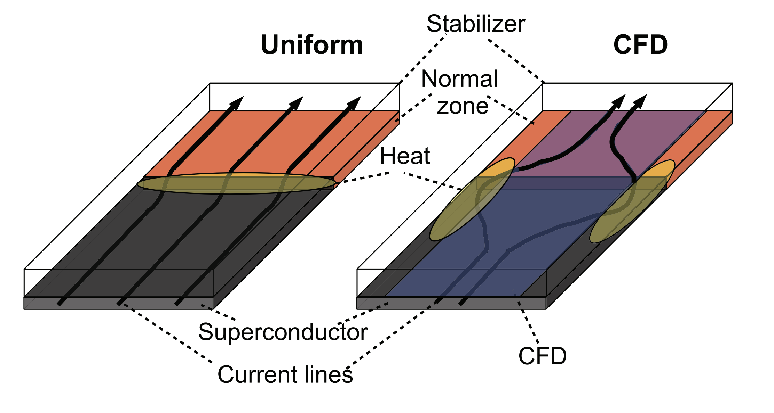

Magnet Stored Energy
Distribute (propagate)
Remove (extract)
Passive
Active (requires quench detection)
Passive
By-pass
Increase resistance of the coil
Electric (via term.)
Magnetic (via coupling)
Turn-to-turn layer
Conductor
Heaters
Coils
Power Sources
Res/Var-istors
Structures
Add. coils
The current flow diverters also belong to this category [1, 2]
They are very effective at speeding up the NZPV and reducing the time constant τ and reducing T_{max}
This helps with distributing the stored energy in the coil structure.
This is completely passive system, very attractive indeed!
$$\int_{0}^{∞}{J^{2}\left(t\right)dt}=\int_{T_{op}}^{T_{max}}{c_{v}}{\left(T\right)}/{ρ\left(T\right)dT} =F\left(T_{max}\right)$$
[1] Christian Lacroix, et al. Supercond. Sci. Technol. 27 (2014) 055013 (6pp)
[2] Frederic Sirois, presentation just before this one.

Slide 10
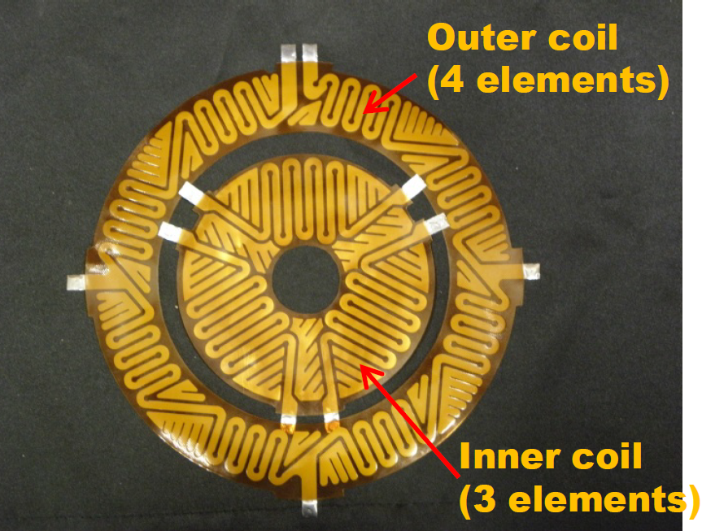
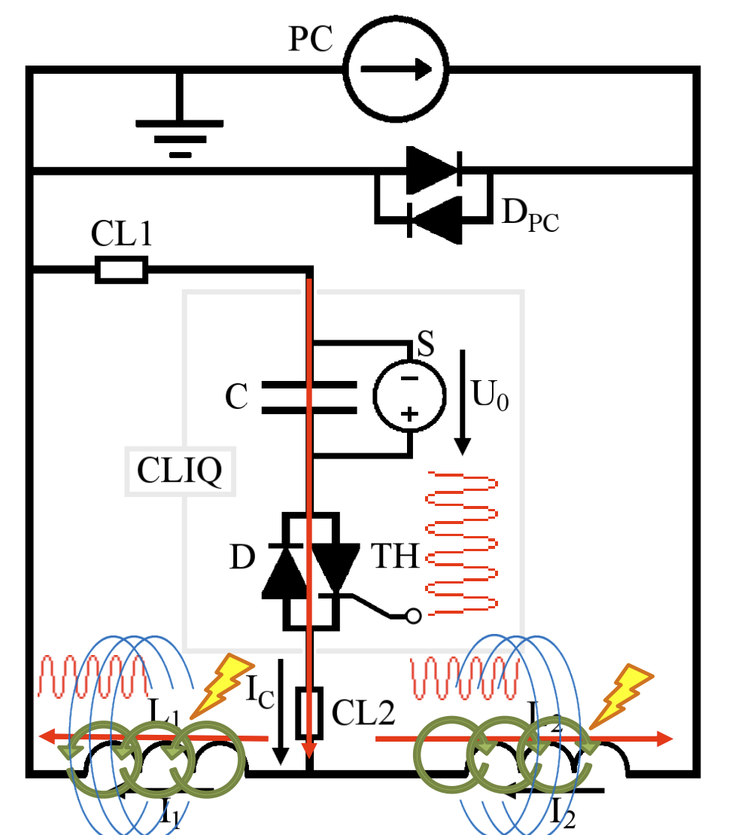
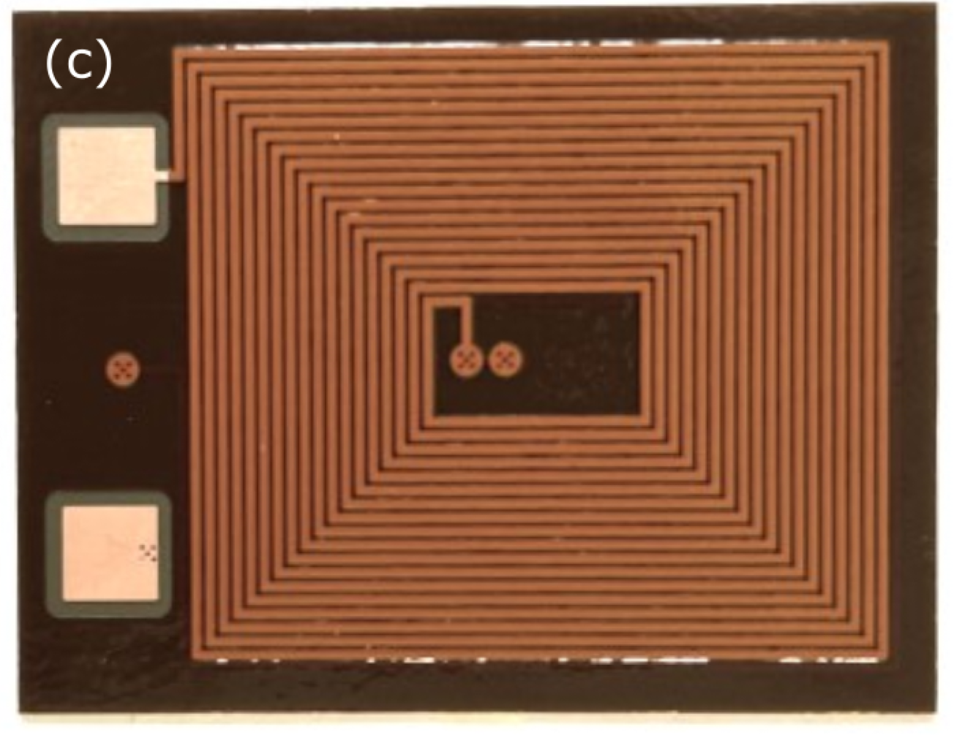
Magnet Stored Energy
Distribute (propagate)
Remove (extract)
Passive
Active (requires quench detection)
Passive
By-pass
Increase resistance of the coil
Electric (via term.)
Magnetic (via coupling)
Turn-to-turn layer
Conductor
Heaters
Coils
Power Sources
Res/Var-istors
Structures
Add. coils
HTS quench heater [1]
Many possibilities to increase resistance of the coil
The practicalities for these methods are coils size depended, for small coils they could work, but for large coils the power required goes quickly into tens of MW.
Quench heaters have been used for HTS, but require a lot of power to quench in the required time [1].
Using external coils to induce a quench (e.g. E-CLIQ [2]) is possible but challenging in practice for HTS due to large enthalpy to quench.
Using external power sources (P Source) like capacitor bank as in CLIQ [3] or PSU as in FLIQ [4] is possible, but again large enthalpy margin and large coils requires large AC loss power for a effective protection.
CLIQ discharge cir. [3]
E-CLIQ coil [2]
[1] A. Gavrilin et al. Comprehensive quench analysis of the NHMFL 32T all-superconducting magnet, CHATS 2015, Bologna, Italy
[2] T. Mulder et al. External Coil Coupled Loss Induced Quench (E-CLIQ) System for the Protection of LTS Magnets, IEEE TAS, Conference proceedings of ASC22.
[3] E. Ravaioli. Optimisation of CLIQ for HTS, WAMHTS-2, 2015, https://indico.cern.ch/event/396905/contributions/1837520
[4] K. Ijagbemi et al. Evaluation of Frequency Loss Induced Quench Protection Prototype at 77 K Using HTS Coils,
IEEE TAS, Early Access, 1 – 6, 2023, https://doi.org/10.1109/TASC.2023.3252497

Slide 11
Some examples of how protection could be done in practice

Slide 12
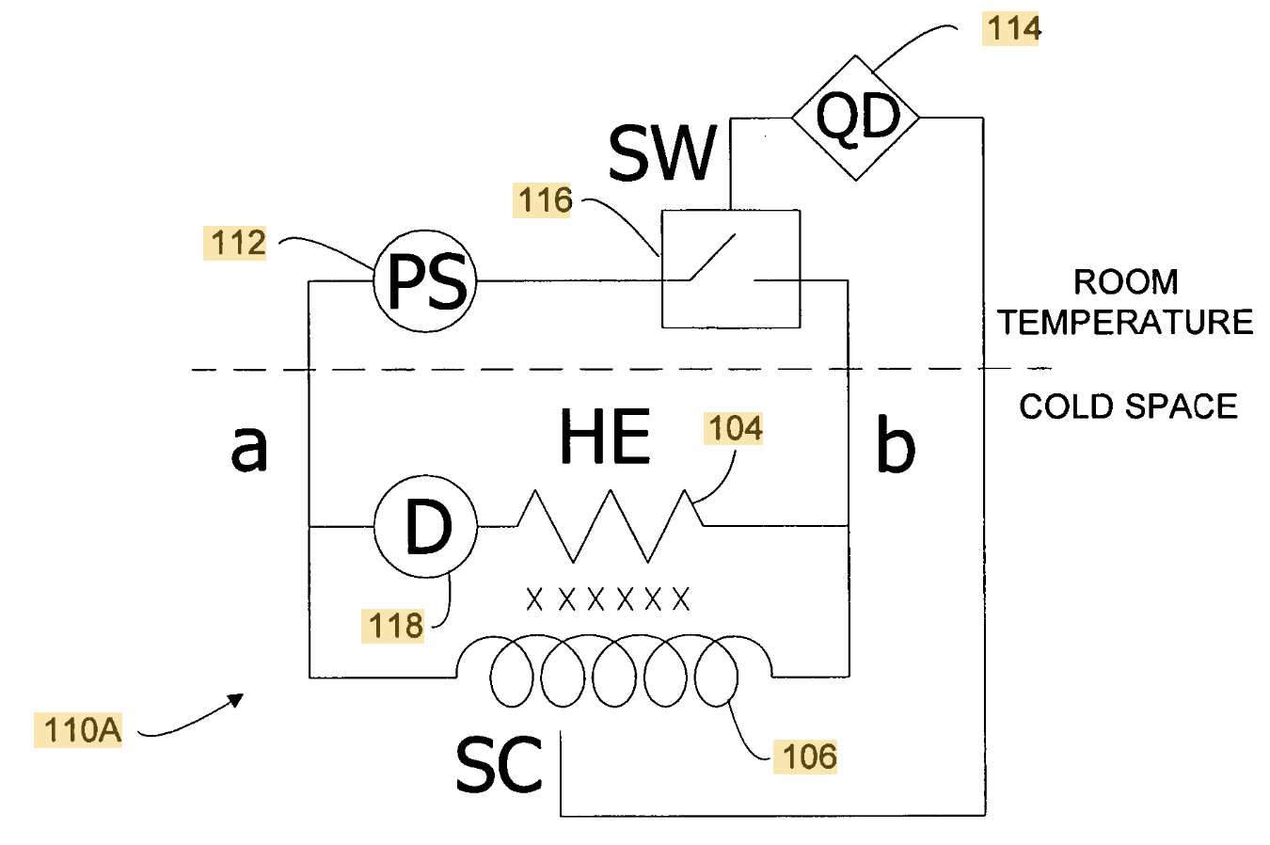
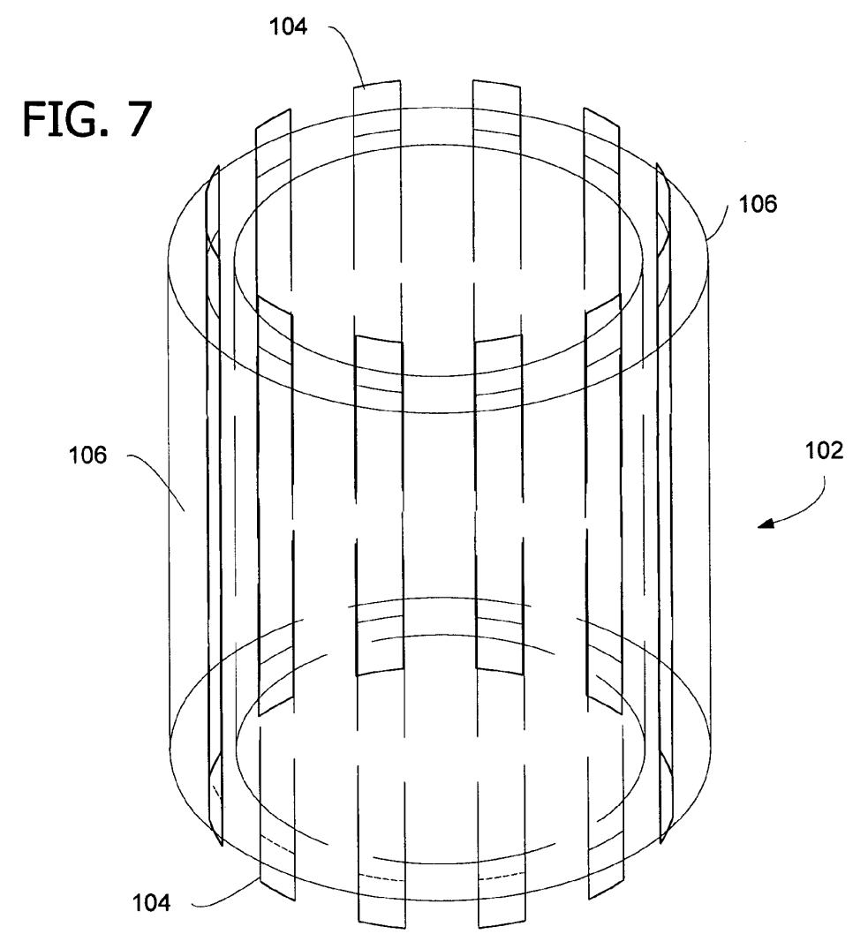
Magnet Stored Energy
Distribute (propagate)
Remove (extract)
Passive
Active (requires quench detection)
Passive
By-pass
Increase resistance of the coil
Electric (via term.)
Magnetic (via coupling)
Turn-to-turn layer
Conductor
Heaters
Coils
Power Sources
Res/Var-istors
Structures
Add. coils
EE switch
Power source
Quench heaters used as energy extraction resistor
Magnet stored energy is used as a power source
Might be challenging for protection at lower magnet currents
Heater and energy extraction resistor
Coil
W. D. Markiewicz - Quench protection of HTS superconducting magnets, US20060291112A1

Slide 13
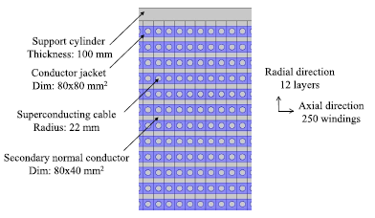
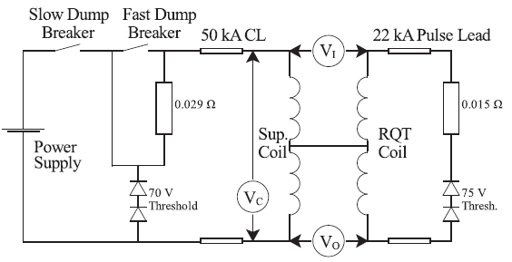
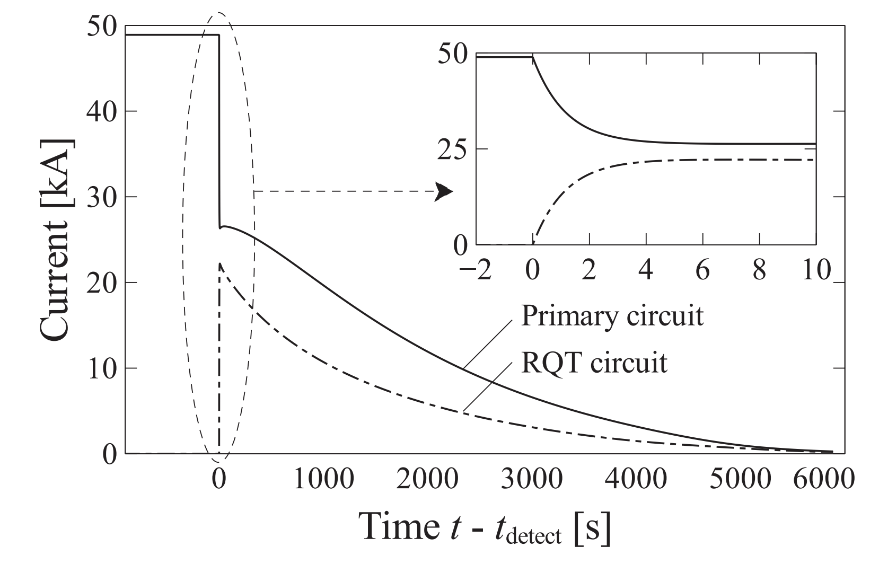

Magnet Stored Energy
Distribute (propagate)
Remove (extract)
Passive
Active (requires quench detection)
Passive
By-pass
Increase resistance of the coil
Electric (via term.)
Magnetic (via coupling)
Turn-to-turn layer
Conductor
Heaters
Coils
Power Sources
Res/Var-istors
Structures
Add. coils
This method uses electrical energy extraction and magnetic coupling to the ‘co-wound’ coils
Such an additional coil works effectively like a quench heater
Step change of transport current is very beneficial for reducing the quench integral
Step change of current
$$\int_{0}^{∞}{J^{2}\left(t\right)dt}$$
Quench protection has strong influence on the conductor design and magnet design
M. Mentink et al. - Quench Protection of Very Large, 50-GJ-Class, and High-Temperature-Superconductor-Based Detector Magnets, IEEE App. SC 26 (2016) 4500608

Slide 14
Magnet Stored Energy
Distribute (propagate)
Remove (extract)
Passive
Active (requires quench detection)
Passive
By-pass
Increase resistance of the coil
Electric (via term.)
Magnetic (via coupling)
Turn-to-turn layer
Conductor
Heaters
Coils
Power Sources
Res/Var-istors
Structures
Add. coils
For HTS magnets that are difficult to protect the best strategy is to use as many methods from the above outlined approaches as applicable.

Slide 15
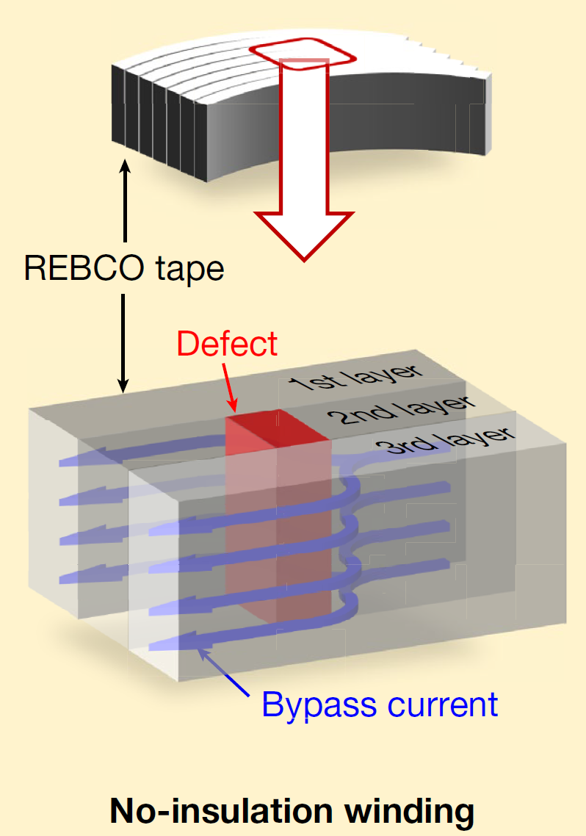
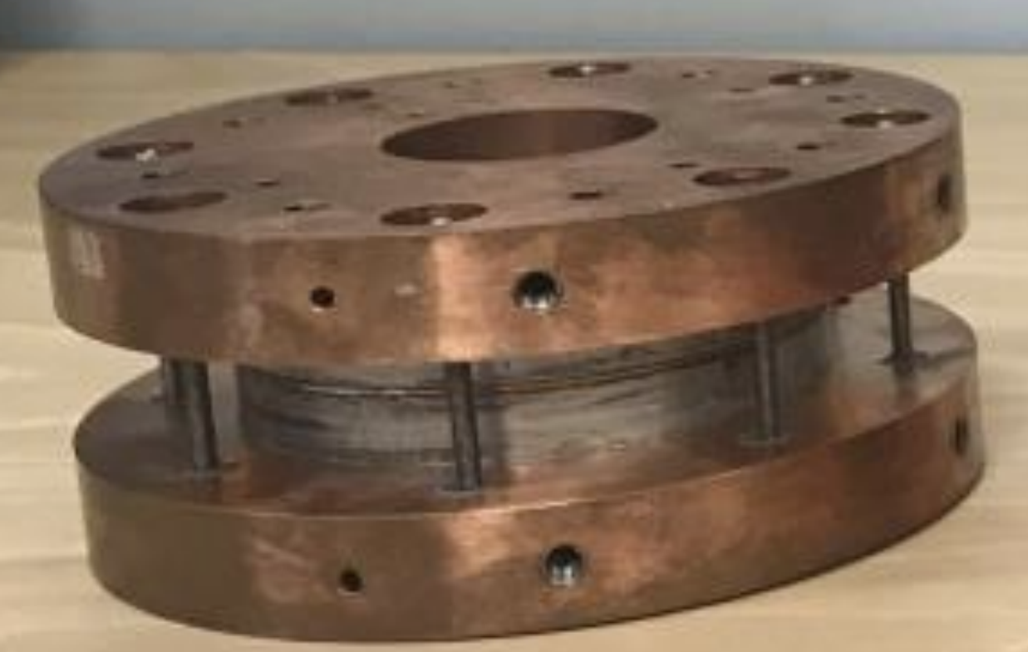
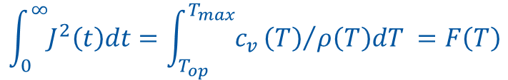
Magnet Stored Energy
Distribute (propagate)
Remove (extract)
Passive
Active (requires quench detection)
Passive
By-pass
Increase resistance of the coil
Electric (via term.)
Magnetic (via coupling)
Turn-to-turn layer
Conductor
Heaters
Coils
Power Sources
Res/Var-istors
Structures
Add. coils
No Insulation / Partial insulation / Metal insulation - single pancake case
Very effective method for decreasing J flowing through a quench region, i.e. the left side integral is low, so resulting temperature increase is low
R_{θ}
Power source
R_{R}
I
L
$$\int_{0}^{∞}{J^{2}\left(t\right)dt}=\int_{T_{op}}^{T_{max}}{c_{v}}{\left(T\right)}/{ρ\left(T\right)dT} =F\left(T\right)$$
or quenched region
Current redistribution can create stress states during quench that are difficult to simulate and design for
Stored energy is predominantly deposited in cold mass
Figure from [1]
Figure from [2]
[1] S. Hahn et al. 45.5-tesla direct-current magnetic field generated with a high-temperature superconducting magnet, Nature, 570, 496–499 (2019).
[2] G. Brittles, R. Bateman, Stability and quench dynamic behaviour of REBCO coils for spherical Tokamaks R&D, WAMHTS-5, 2019, Budapest

Slide 16
Magnet Stored Energy
Distribute (propagate)
Remove (extract)
Passive
Active (requires quench detection)
Passive
By-pass
Increase resistance of the coil
Electric (via term.)
Magnetic (via coupling)
Turn-to-turn layer
Conductor
Heaters
Coils
Power Sources
Res/Var-istors
Structures
Add. coils
No Insulation / Partial insulation / Metal insulation - single pancake case
Very effective method for decreasing J flowing through a quench region, i.e. the left side integral is low, so resulting temperature increase is low
R_{θ}
R_{C}
Power source
R_{R}
I
M
L_{C}
$$\int_{0}^{∞}{J^{2}\left(t\right)dt}=\int_{T_{op}}^{T_{max}}{c_{v}}{\left(T\right)}/{ρ\left(T\right)dT} =F\left(T\right)$$
L
or quenched region
Current redistribution can create stress states during quench that are difficult to simulate and design for
Stored energy is predominantly deposited in cold mass
copper rings are magnetically coupled to the coil
Figure from [1]
Figure from [2]
[1] S. Hahn et al. 45.5-tesla direct-current magnetic field generated with a high-temperature superconducting magnet, Nature, 570, 496–499 (2019).
[2] G. Brittles, R. Bateman, Stability and quench dynamic behaviour of REBCO coils for spherical Tokamaks R&D, WAMHTS-5, 2019, Budapest

Slide 17
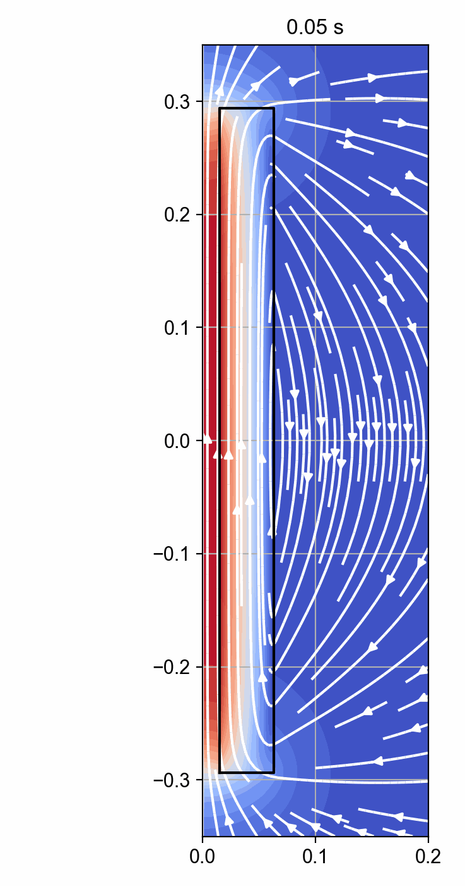
Magnet Stored Energy
Distribute (propagate)
Remove (extract)
Passive
Active (requires quench detection)
Passive
By-pass
Increase resistance of the coil
Electric (via term.)
Magnetic (via coupling)
Turn-to-turn layer
Conductor
Heaters
Coils
Power Sources
Res/Var-istors
Structures
Add. coils
Multiple pancakes case
Pancakes in the stack are mutually coupled.
A decrease of current in one pancake causes increase of current in the others.
This leads to magnetic pumping and redistribution of energy density and force density.
One needs to be careful in limiting the deposited magnet energy or over-stress in the pancake that quenches last.
Placement of conducting elements at the end of the stack or around it (e.g. Cu tubes) is a good solution to absorb some of the stored energy by magnetic coupling.
R_{θ}
R_{R}
I
M_{1c}
R_{C}
L₁
Power source
L_{C}
M_{1n}
R_{θ}
R_{R}
I
M_{nc}
L_{n}
Animation courtesy of T. Mulder

Slide 18
Magnet Stored Energy
Distribute (propagate)
Remove (extract)
Passive
Active (requires quench detection)
Passive
By-pass
Increase resistance of the coil
Electric (via term.)
Magnetic (via coupling)
Turn-to-turn layer
Conductor
Heaters
Coils
Power Sources
Res/Var-istors
Structures
Add. coils
R_{θ}
Multiple pancakes case - mitigations
R_{R}
I
M_{1c}
R_{C}
L₁
Redistribution of energy density and force density
Deliberately quenching parts of the magnet at strategically chosen locations and time could be help with the above issue
Quench heaters or capacitor discharge can be effective
This would require quench detection
This would require external power sources
Power source
L_{C}
M_{1n}
R_{θ}
R_{R}
I
M_{nc}
L_{n}
HTS quench heater [1]
CLIQ connections [2]
[1] A. Gavrilin et al. Comprehensive quench analysis of the NHMFL 32T all-superconducting magnet, CHATS 2015, Bologna, Italy
[2] E. Ravaioli. Optimisation of CLIQ for HTS, WAMHTS-2, 2015, https://indico.cern.ch/event/396905/contributions/1837520

Slide 19
An example of how protection could be done in practice

Slide 20
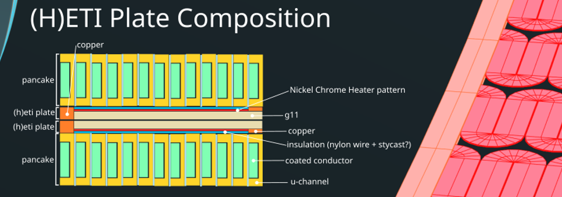
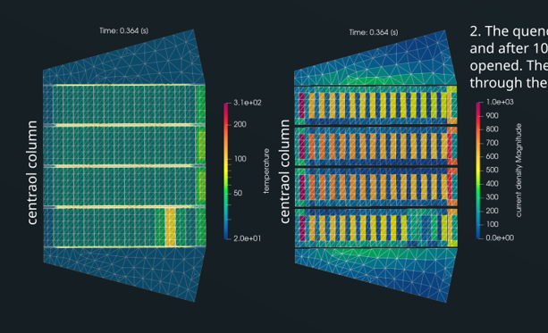
Magnet Stored Energy
Distribute (propagate)
Remove (extract)
Passive
Active (requires quench detection)
Passive
By-pass
Increase resistance of the coil
Electric (via term.)
Magnetic (via coupling)
Turn-to-turn layer
Conductor
Heaters
Coils
Power Sources
Res/Var-istors
Structures
Add. coils
Excellent example was show earlier today by Rob Bateman of Tokamak Energy
Quench protection has strong influence on the conductor design and magnet design
R. Bateman, Overview of the HTS program for the fusion programs, HiTAT 2023, slide 12

Slide 21
Magnet Stored Energy
Distribute (propagate)
Remove (extract)
Passive
Active (requires quench detection)
Passive
By-pass
Increase resistance of the coil
Electric (via term.)
Magnetic (via coupling)
Turn-to-turn layer
Conductor
Heaters
Coils
Power Sources
Res/Var-istors
Structures
Add. coils
Also, for NI HTS magnets that are difficult to protect (suffer from excessive stress or temperature), the best strategy is to add a level of control to the quench process by using some of the above outlined approaches, as applicable.
One needs to understand the issues (e.g. over-stress of the conductor, temperature) to be deliberate using these methods.

Slide 22
Conclusions
There are many approaches that can be followed to protect an HTS magnet.
Broadly, the approaches can be divided into distributing the energy inside the magnet or removing it.
These approaches are often not mutually exclusive and, if needed or required, can be used in conjunction.
This logic can be followed for NI magnets, for which it might be necessary due to the possibility of energy and force density redistribution during a quench.
Conductor design often is driven by a chosen protection scheme
Limits for protection for HTS are becoming increasingly complex and not well understood or defined.
Collaboration, teamwork, experimental data and simulations are needed to maximize progress in HTS protection development.

