Slide 1
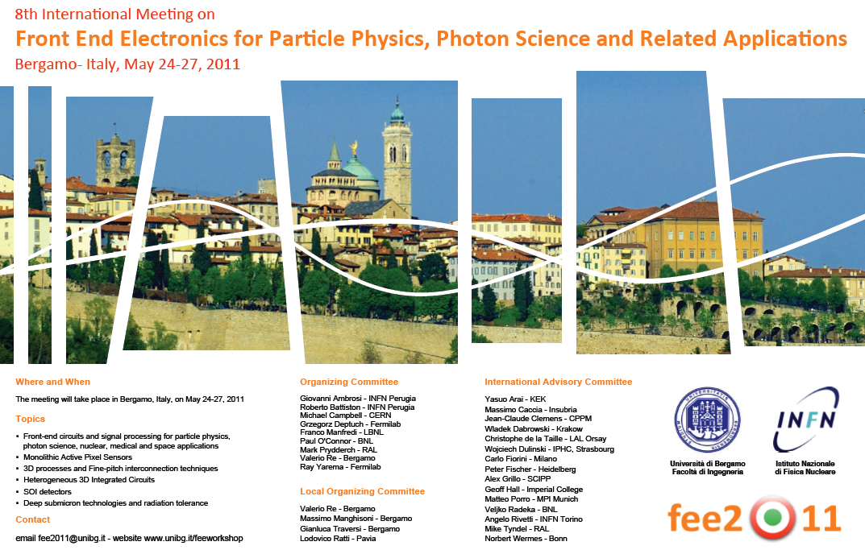

Slide 2
Logistics
Local arrangements committee:
  Massimo Manghisoni, Lodovico Ratti, Valerio Re, Gianluca Traversi
Program:
  Sessions start at 8:30 Wed.- Fri.
  Lunch 13:00 – 14:30 Tuesday: Restaurant “da Franco”
  13:00 – 14:30 Wednesday: Restaurant “da Mimmo”
  13:30 – 15:00 Thursday: Restaurant “da Mimmo”
  13:30 – 15:00 Friday: Restaurant “da Mimmo”
  Breaks at 10:30 and 16:00
  Welcome cocktail: today at 7 pm in Sala Giuristi, Piazza Vecchia (with visit to the painting collection of the Accademia Carrara)
  Thursday 3 pm – 6.30 pm: guided tour of the medieval upper town
  Social dinner: Thursday 7.30 pm at Restaurant “Il Gourmet”

Slide 3
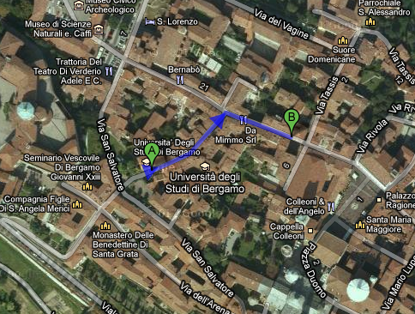
Lunch today: Restaurant “da Franco”

Slide 4
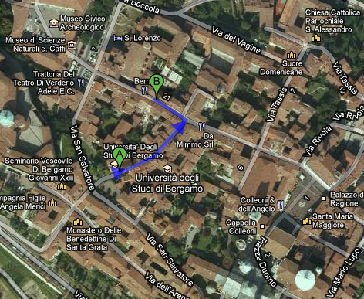
Lunch next days: Restaurant “da Mimmo”

Slide 5
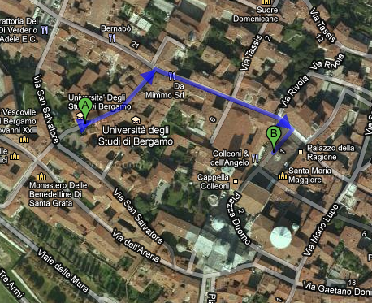
Welcome cocktail this evening: Piazza Vecchia

Slide 6
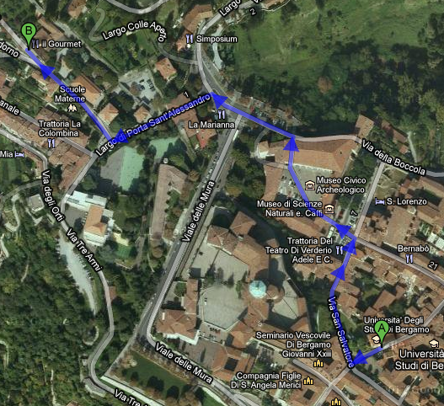
Social dinner: Restaurant “Gourmet”

Slide 7
Presentations
Contributions should be uploaded to the Indico web site prior to start of sessions
Contact session conveners or local organizers if you need help in uploading your presentation
Speakers should plan for 20-25 minutes talks, followed by discussion

Slide 8
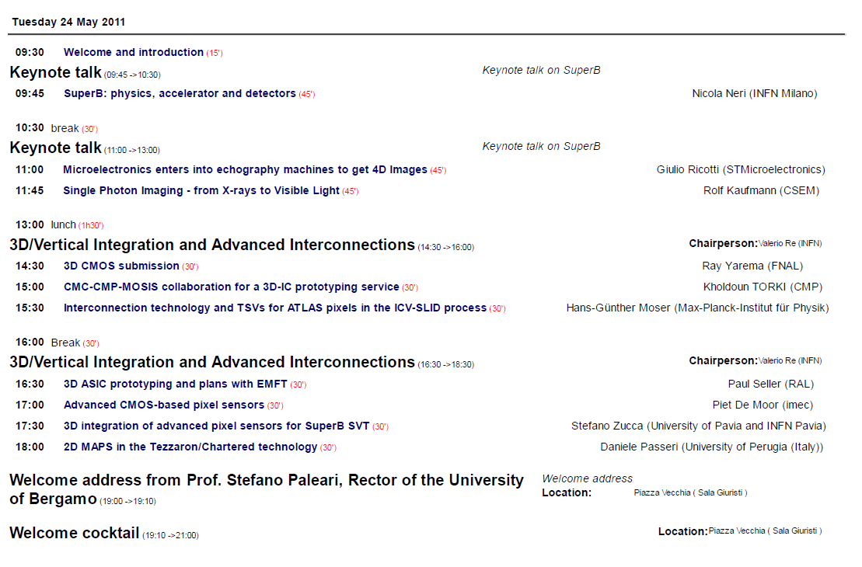
Program Overview

Slide 9
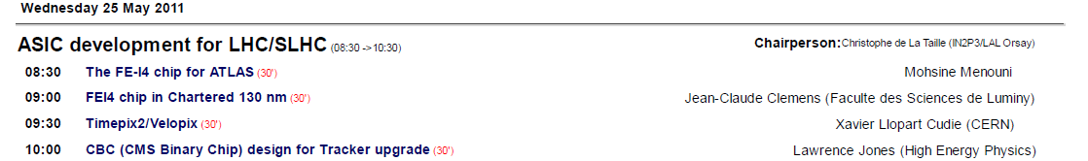
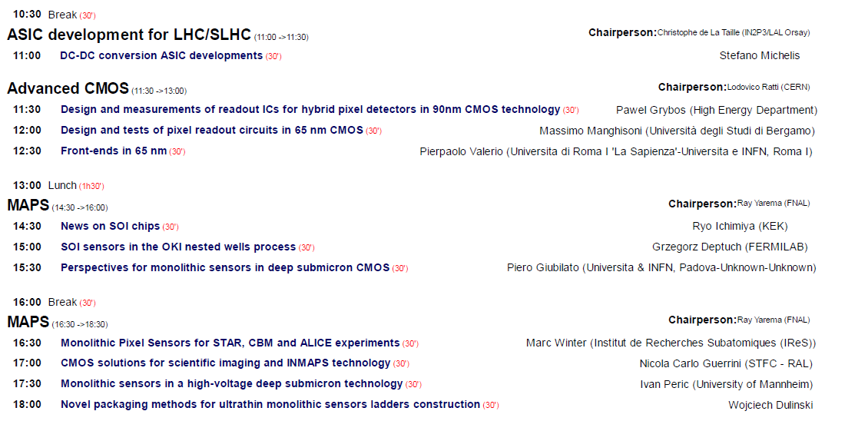

Slide 10
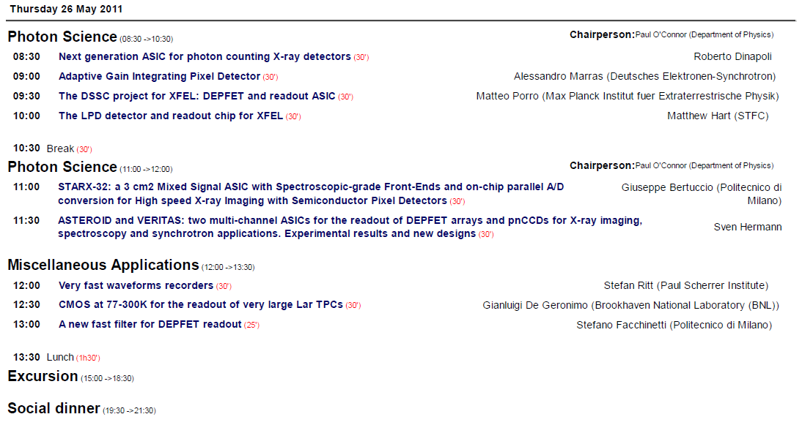

Slide 11
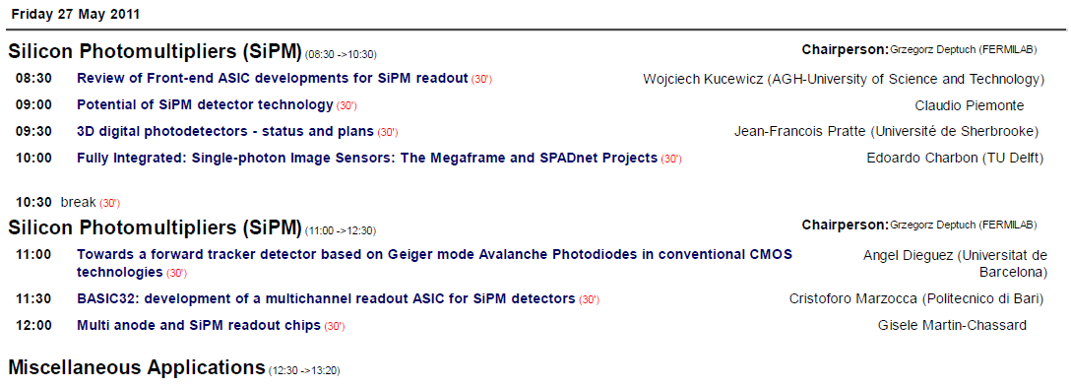
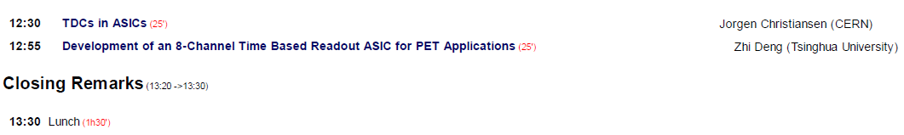

Slide 12
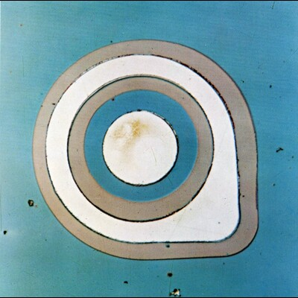
2N1613
First planar transistor
Fairchild Corp. March 1959

Slide 13
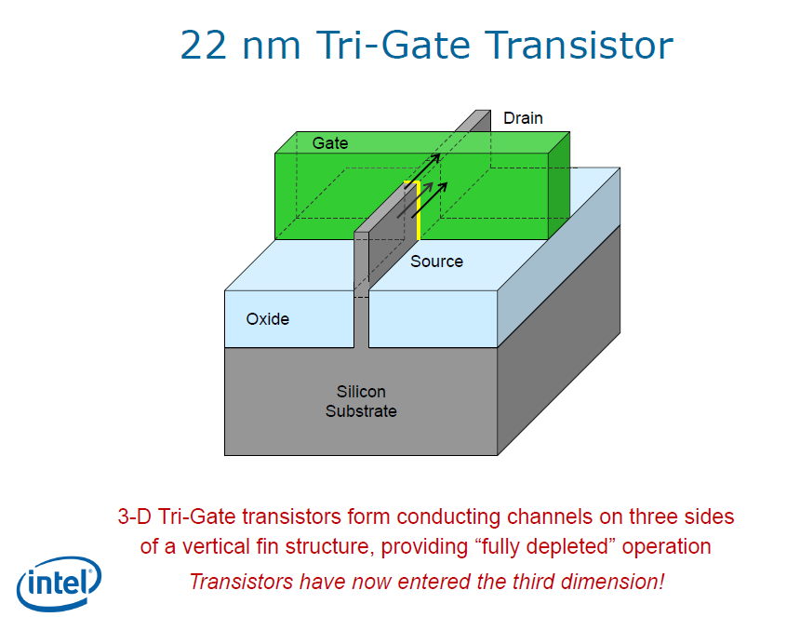

Slide 14

Italy’s 150th anniversary…

Slide 15
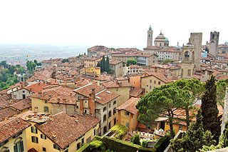
…..in the town that in 1860 contributed 180 patriots to Giuseppe Garibaldi's famous Thousand.

