Slide 1
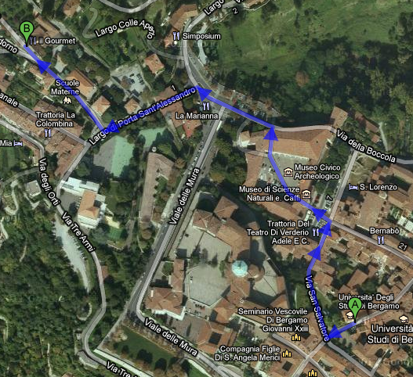
Social dinner: Restaurant “Gourmet”
Via S. Vigilio, 1 – 7.30 pm

