Slide 1
The development of SDHCAL in Mokka--II
Gabriel Musat, Ran Han , Gerald Grenie
2011-01-19

Slide 2
Outline
The Geometry XCheck for implantation (RPC to Scintillator)
The PFO Reconstruction Comparison for single particle with different models

Slide 3
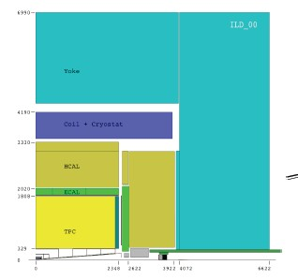
Size changes
SDHCAL
Hcal_total_dim_y=1287
Hcal_outer_radius = 3227
AHCAL
Hcal_total_dim_y=1181.4
Hcal_outer_radius = 3121.4
1287 -1181.4=3227-3121.4= (6.5-4.3)*48
< - Yoke_barrel_inner_radius = 4440.0297851562
> - Yoke_barrel_inner_radius = 4332.3601074219
Hcal_Coil_aditional_gap=29.5
HCAL endcap rings will have 5 layer
HCAL endcap rings will have 6 layers.
The change of size has no influence on outside detector and endcap
Added the RPC geometry to Gear file.

Slide 4
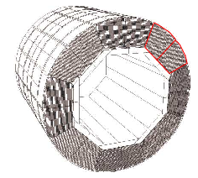
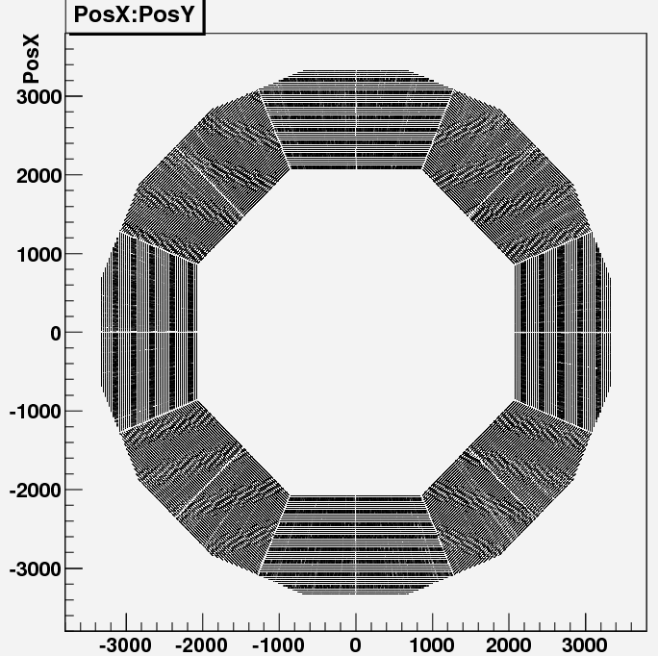
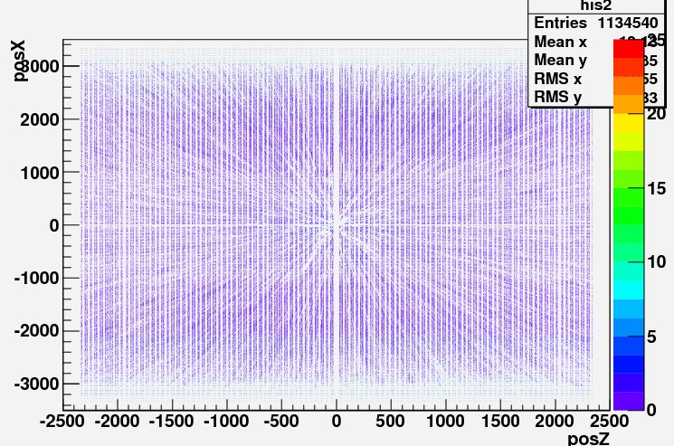
24000_100GeV _Muon Events
Geometry: Stave && Module

Slide 5
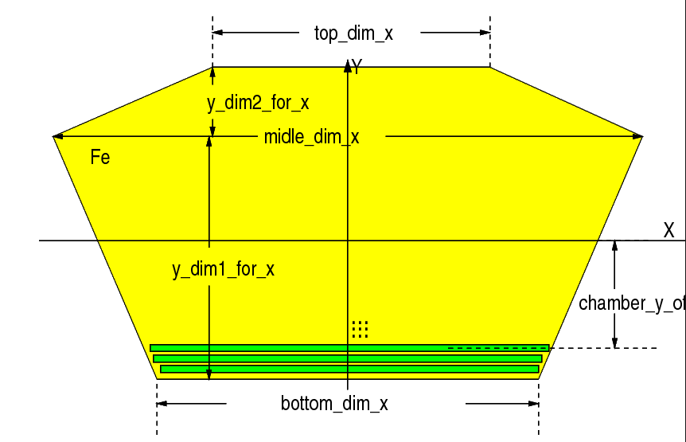
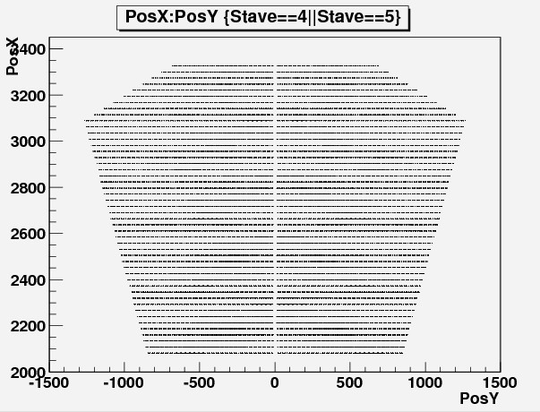
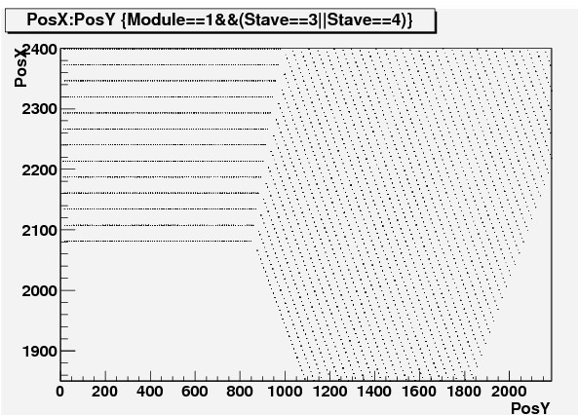
Geometry: Stave

Slide 6
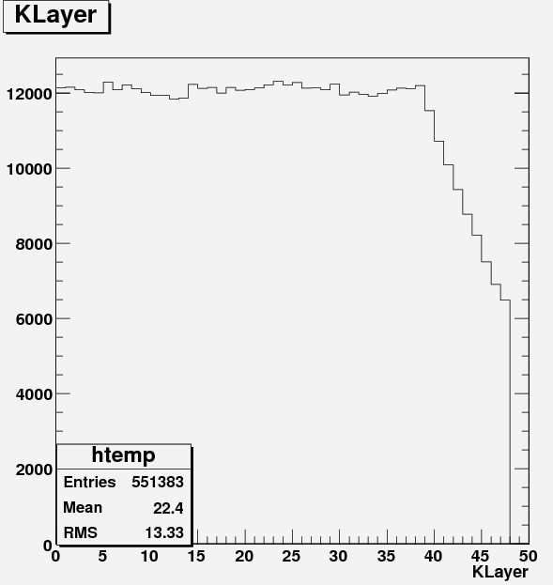
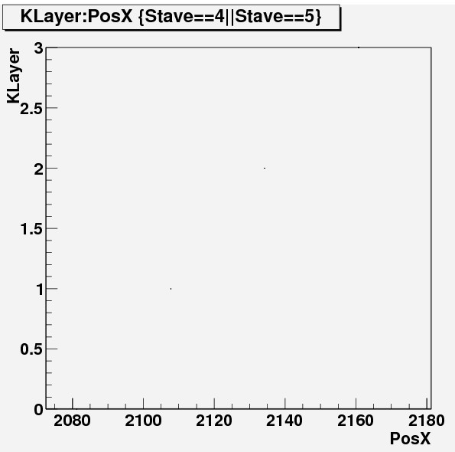
Geometry: Layers
The thickness of SDHCAL fixed to 6.5mm
The 20mm steel absorber
The distance between two Layers=2107.5-2134=26.5mm

Slide 7
What is in Layers (geantino)
1 -844 -1.9e+03 365 4e+04 0 2.11e+03 2.11e+03 BarrelHcalModule Transportation
2 -853 -1.92e+03 369 4e+04 0 21.8 2.13e+03 physiRPCFree Transportation
3 -853 -1.92e+03 369 4e+04 0 0.402 2.13e+03 physiRPCmylarCathode Transportation
4 -853 -1.92e+03 369 4e+04 0 0.196 2.13e+03 physiRPCGraphiteCathode Transportation
-853 -1.92e+03 369 4e+04 0 0.0544 2.13e+03 physiRPCThickGlass Transportation
6 -854 -1.92e+03 369 4e+04 0 1.2 2.13e+03 physiRPCGap Transportation
7 -854 -1.92e+03 370 4e+04 0 1.31 2.14e+03 physiRPCThinGlass Transportation
-855 -1.92e+03 370 4e+04 0 0.761 2.14e+03 physiRPCGraphiteAnode Transportation
-855 -1.92e+03 370 4e+04 0 0.0544 2.14e+03 physiRPCmylar Transportation
10 -855 -1.92e+03 370 4e+04 0 0.0544 2.14e+03 physiRPCPCB Transportation
11 -855 -1.92e+03 370 4e+04 0 1.31 2.14e+03 physiRPCElectronics Transportation
12 -856 -1.93e+03 370 4e+04 0 1.74 2.14e+03 BarrelHcalModule Transportation

Slide 8
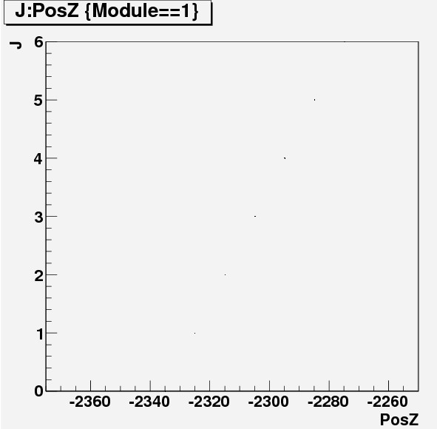
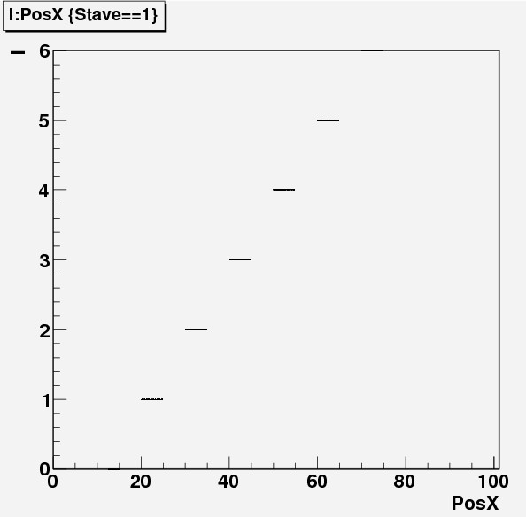
Geometry: I and J (Pad Number)
The Pad number I and J increase with 1cm by 1cm as our Padsize=1cm

Slide 9
PFO Reconstruction for Single Particle
1- 1000_91GeV_Pion Events ( only HcalBarrel Part)
2- 4Models
Tesla SDHCAL Pad size 1cm (Tesla_RPC_1cm)
Pad size 3cm (Tesla_RPC_3cm)
AHCAL Pad size 3cm (Tesla_SCI_3cm)
Videau SDHCAL Pad size 3cm (Videau_RPC_1cm)
3- Digitization
AHCal(New LDC digitization process)
SDHCAL(Ourself’s)
4- Threshold for SDHCAL
0.6pC, 1.5pC, 15pC

Slide 10
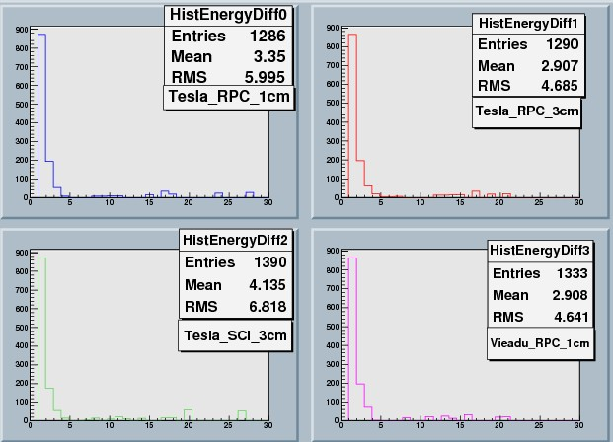
Number of PFOs

Slide 11
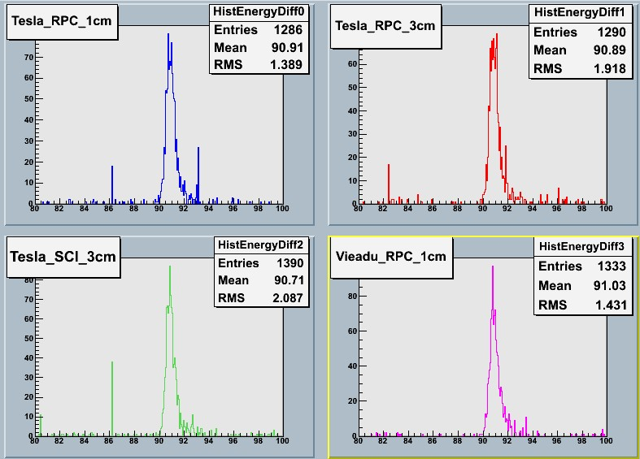
PFO Reconstruction Energy

Slide 12
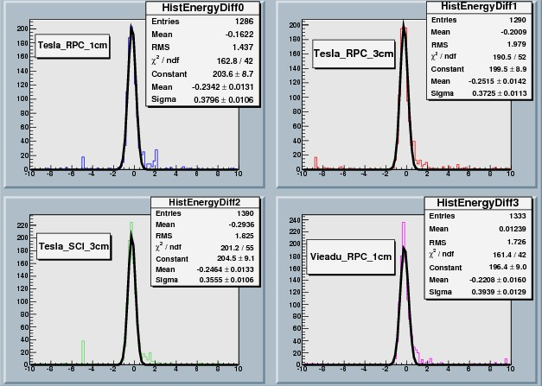
PFO Energy- Input Energy (wo pfocuts)

Slide 13
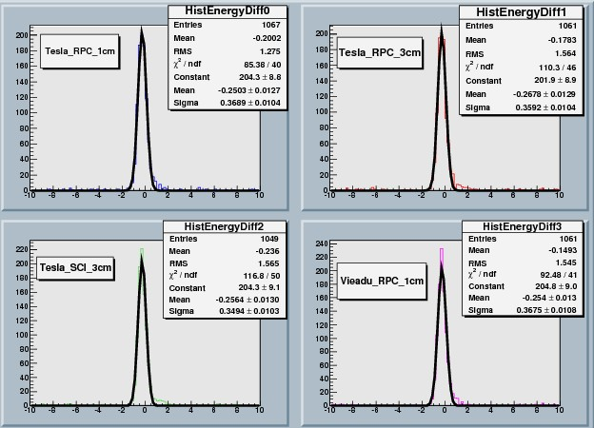
PFO Energy- Input Energy (w pfos<3)

Slide 14
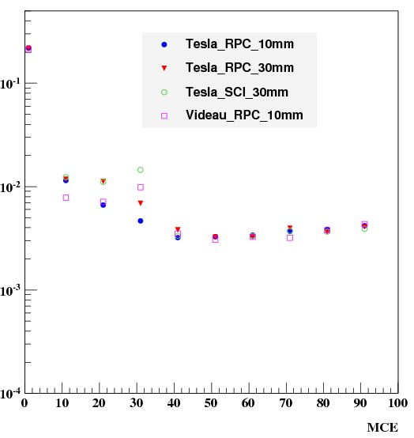
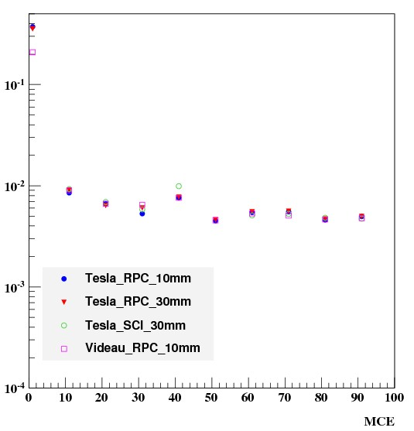
Sigma/Mean vs Input energy
without pfocuts
NPFOs<3

Slide 15
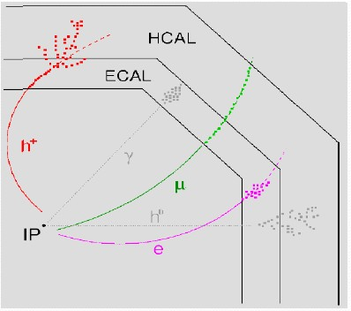
Results Analysis
Track Reconstruction before Calorimeter
Clustering in calorimeters
PFOE get from Track for charged particle
It is normal has no big difference
Only HCAL part change for single charged particle

Slide 16
Summary
All the Barrel Geometry Model for SDHCAL in Mokka has been prepared.
Download from
svn co http://llrforge.in2p3.fr/svn/Mokka/trunk Mokka
The Jet files is going to check PFO with different Hcal model.

Slide 17
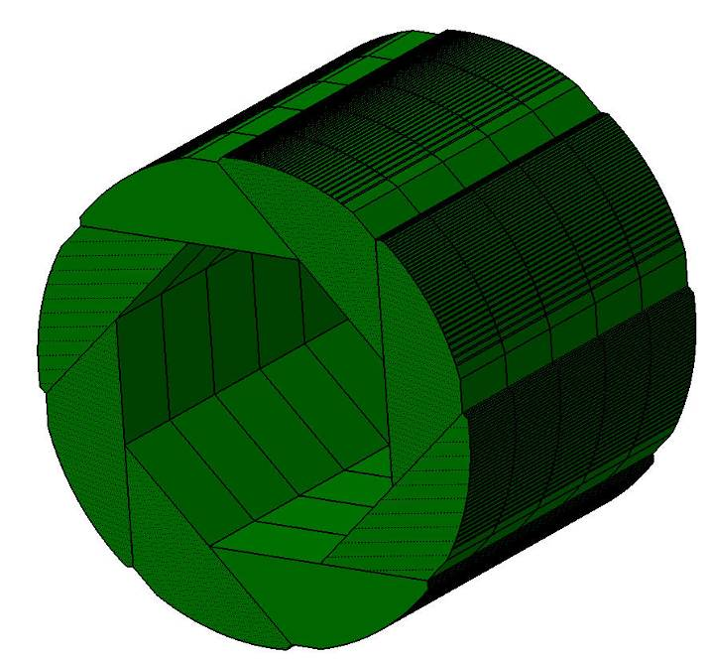
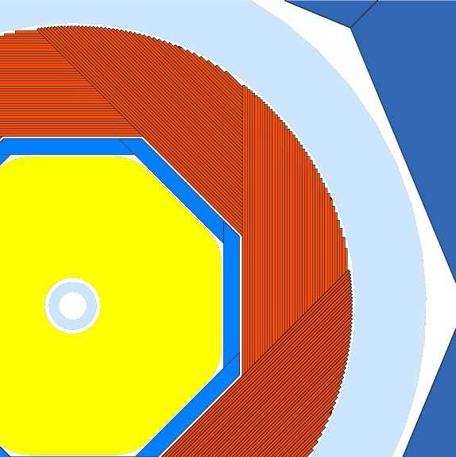
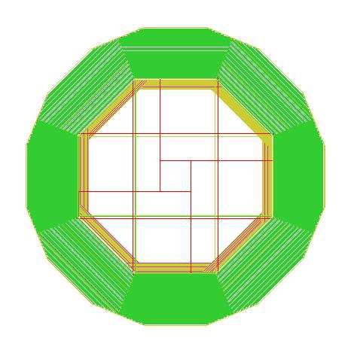
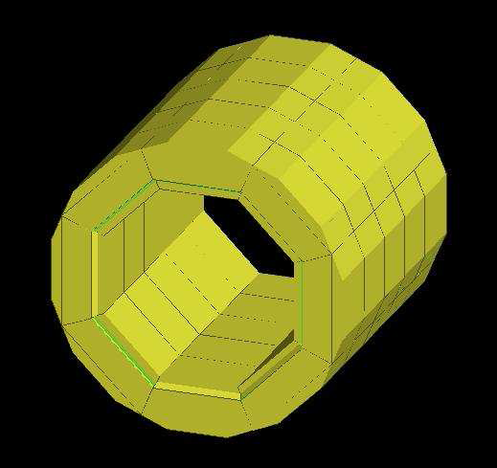
Two SDHcal Mode in Mokka
Videau
Drive: ~/Mokka/source/Geometry/LDC/SHcalRPC01
Tesla
SHcalRPC02:
Keep AHCal information added SDHCal in

