Slide 1
Katharina Henjes-Kunst
APPEC General Assembly 04/2022, Paris

Slide 2
APPEC internal meetings in 2022
4 APPEC GA meetings
5 APPEC JS meetings
SAC meetings
several working meetings between GA chair+ vice chair + General secretary + Julie Epas
Further working groups:
  Town Meeting
  TechForum
  MoU
  ACME
  JENA Symposium Preparation

Slide 3
APPEC external meetings in 2022
JENA Symposium (3-6th of May 2022, Madrid)
160 participants
common computing workshop suggested for 2023
APPEC Multimessenger Workshop I+II (January + October 2022):
Low-latency alerts & Data analysis for Multi-messenger Astrophysics Workshop ➔ report
Multi-Messenger Astrophysics ➔ ACME was discussed
Underground Labs Workshop (28-29th of April 2022, LNGS)
aimed to reinforce the network between EU Underground Laboratories in order to
develop a strong synergy to face next generation experiments
APPEC TechForum (was planned for September in Prague)
„Robotics and operation at large-scale instruments in harsh environments“
was canceled ➔ low participation from communities
Should take place as in person meeting

Slide 4
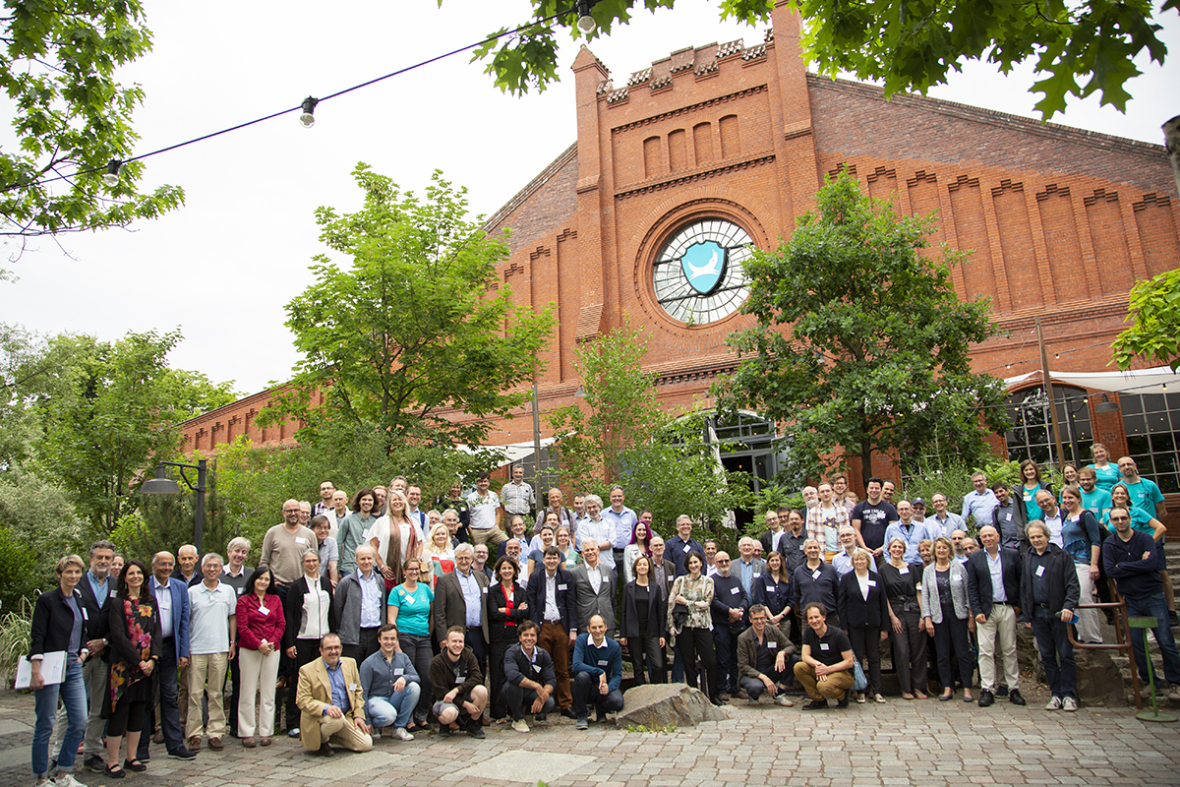
APPEC Town Meeting
100 participants
World coffee style – many working tables in parallel, many changes of tables
Due to the format a lot of preparation and communication was needed beforehand
Aim: To give feedback to the SAC midterm evaluation
Lively, sucessful meeting

Slide 5
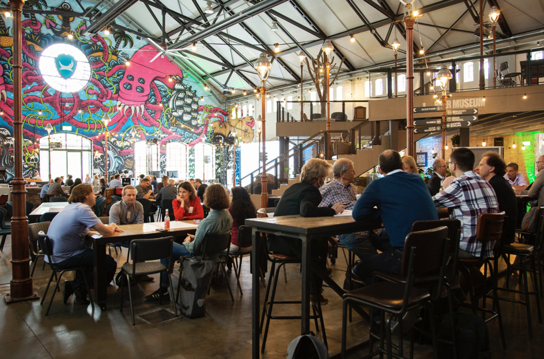
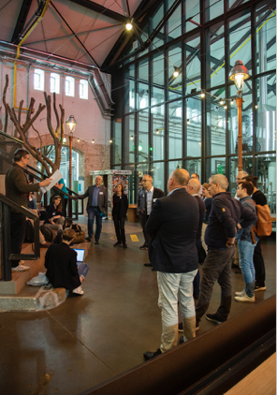
APPEC Town Meeting

Slide 6
APPEC topics in 2022
APPEC Common Fund Update
  move it to DESY Zeuthen
  comparison of receipts from the last 5 years, reminders and issuance of invoices for 2021/2022
  Please take care of the invoices and forward them to responsible persons, if you receive them
APPEC Outreach update
Moving the website to DESY in 2023 (at the moment external host)
Outreach material
Poster with AHEAD, iniated by Stavros

Slide 7
APPEC topics in 2022
ACME
  See report of Antoine later
MoU
See topic before
APPEC CENSUS
  Questionnaire was developed as update of the plots in the roadmap document
  Sent to the major AP experiments

Slide 8
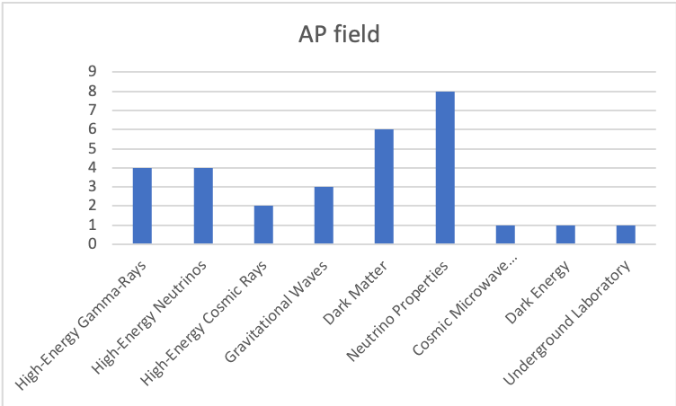
Experiments that entered data
HEGR: HEN: HECR: GW: DM: NP: CMB: DE: UL:
CTA / CTAO, SWGO, TAIGA, VERITAS
Baikal-GVD, IceCube, KM3NET, RNO-G
AUGER, JEM-EUSO (space)
ET, Virgo, GEO600
1x Gran Sasso (PTOLEMY),
3x Germanium/Crystal (SuperCDMS),
2x Liquid Xenon (Xenon1t, DARWIN)
1x Spectrometric (Project 8),
1x Germanium, (LEGEND),
1x Xenon,
3x Reactor,
1x Calorimetric (HOLMES),
1x accelerator based (MicroBooNE)
CMB-S4
1x Ground based
Kamioka Observatory

Slide 9
APPEC finances in 2022
Outgoing:
30.540,08 € APPEC Town Meeting
10.000,00 € IYBSSD
20.000,00 € EuCAPT via INFN and FOM
4.127,30 € APPEC GA 03/2022 Vienna
⍨ 2.000 € Outreach costs (pictures Town Meeting, Web add ons, Census questionnaire programm)
5.000 € Astroparticle Symposium 2022
5.000 € Underground Lab Workshop
1.000€ Sponsorship MODE workshop (+EoI financial support)
➔ 77.667,38 €

Slide 10
APPEC finances in 2022
Incoming:
  APPEC Common Fund contributions 2021 + 2022 (not all received yet)
  In total: 50k€ for 2021 (and older years)
    54k€ for 2022
  + cash balance of 45k€ extra
  ➔ Cash balance could be 71 k€

Slide 11
APPEC Topics in 2023
Finalising MoU
Finalising Roadmap
Agreeing on the further procedure/ Town meetings/ Roadmapping
New SAC members (GA chair and General Secretary?)
INFRA-2023-SERV-01-02: Common Proposal with European Astronomy (ACME)
JENA Computing Workshop, Astroparticle Computing
APPEC TechForum
AP support Ukraine
New APPEC partners: ESA as observer?

Slide 12
APPEC meetings in 2023
4-6 APPEC JS meetings ( 1 in person?)
3-4 APPEC GA meetings (2 in person, summer GA in Poland)
3 APPEC SAC meetings
Multimessenger Workshop
JENA Computing Workshop
APPEC TechForum*
Roadmap Update Presentation*

Slide 13
APPEC finances in 2023
Outgoing:
  2.000€ Outreach (Website, material)
  10.000€ EuCAPT
  8.000€ APPEC General Assembly meetings (4/2022 + 2x2023)
  1.000€ APPEC Joint Secretariat meeting
  1.000€ APPEC SAC meeting
  5.000€ TechForum*
  10.000€ Update Roadmap Presentation*
  5.000€ JENA Computing*
  5.000€ Multimessenger Workshop*
  EoI support
  ➔ 47k€

