Slide 1
SPS-BGI design update

Slide 2
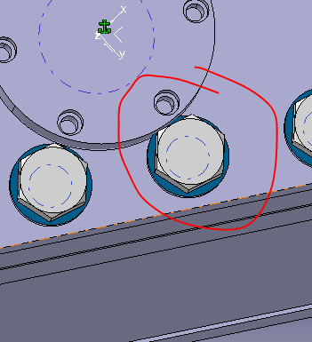
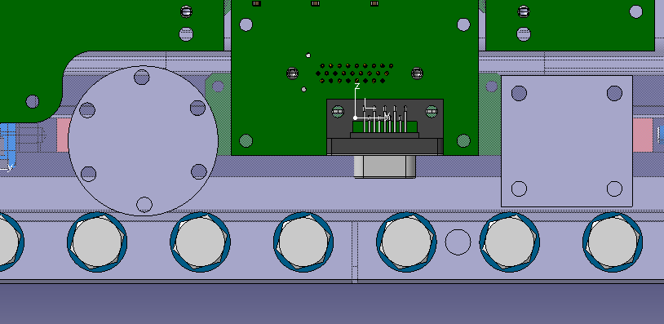
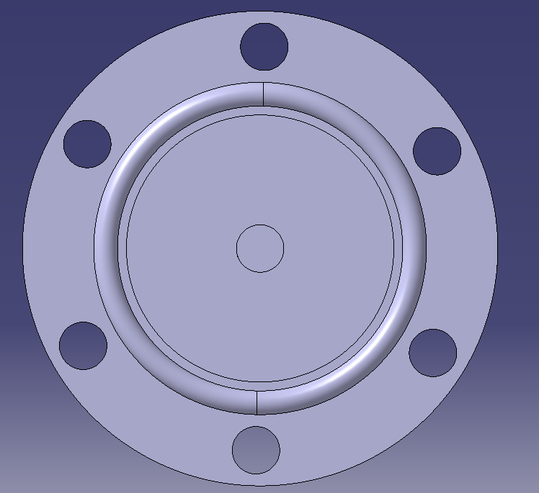
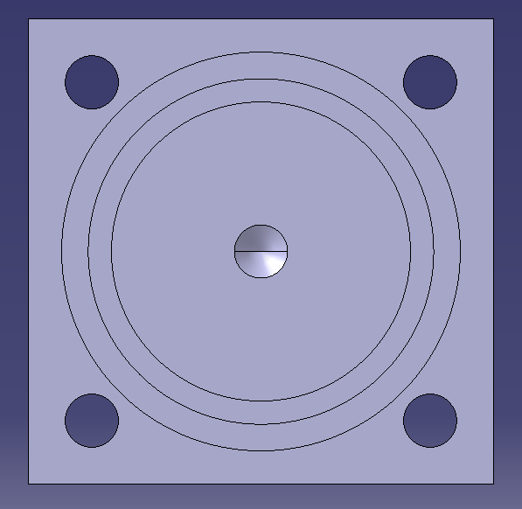
Parts and assembly Cooling 90º adaptor
3D Model | Functionality | Material
ST1612952 | Changes the direction of the water flow | St. Steel EN 1.4404 EDMS 1380627 Tube
Diameter reduced, because of the collision with washers
Square variant as an option
Not much space for the O-ring
O-ring material to be discussed with supplier

Slide 3
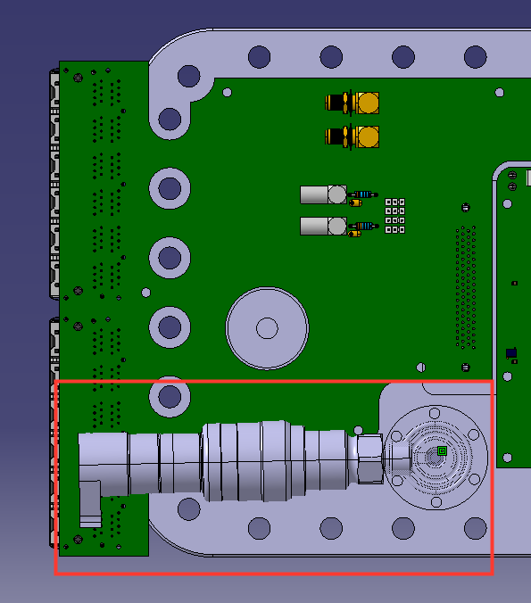
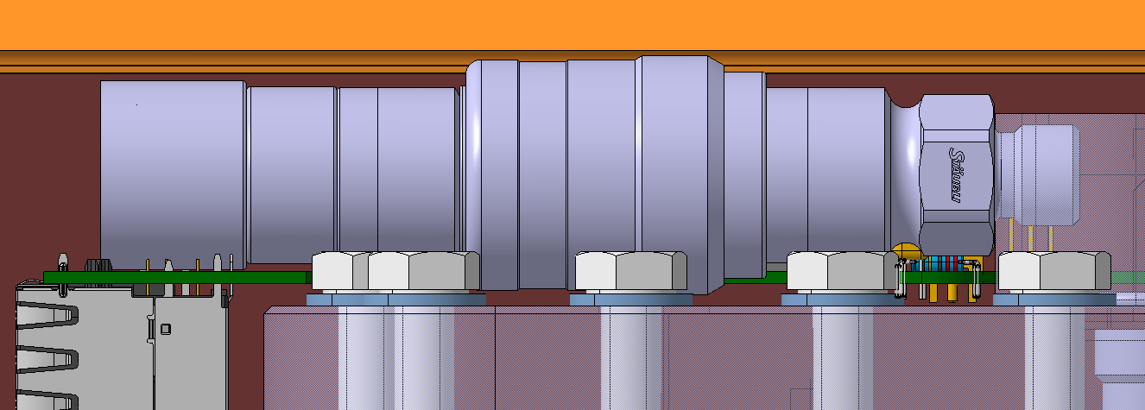
Parts and assembly Cooling 90º adaptor
3D Model | Functionality | Material
ST1612952 | Changes the direction of the water flow | St. Steel EN 1.4404 EDMS 1380627 Tube
Coupling does not fit to the assembly (stud will be used instead of the screws+nuts)
Need to find another solution

Slide 4
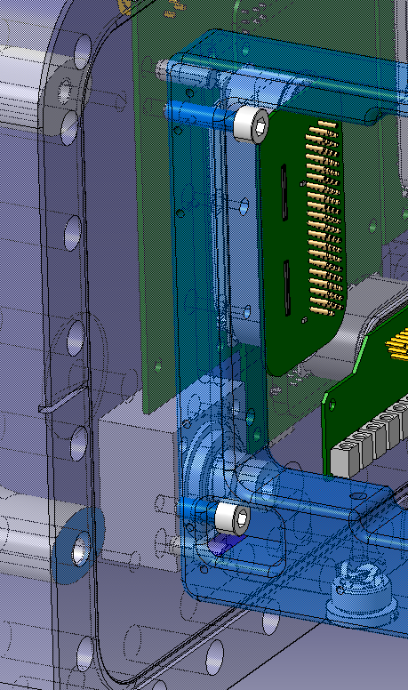
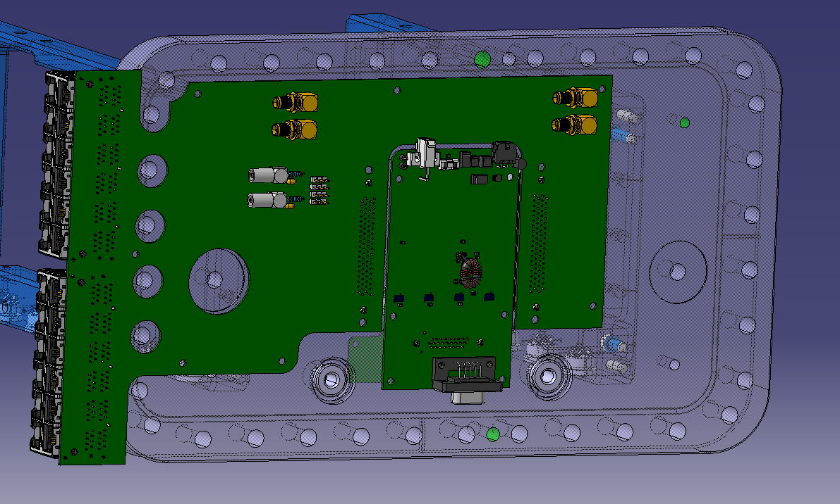
Parts and assembly Rectangular flange assembly
3D Model | Functionality | Material
ST1588145 | Insures vacuum and contains cooling, power and data connectors | St. Steel EN 1.4429 EDMS 790775 Blank and EDMS 790773 Round Bar
Outgassing from inside?
Holes in arm
Pockets in the flange?
Flange updated with new electronics:
ST1637325: Ceramic Power Board
ST1637262: Flange Data Board
ST1637281: Flange Power Board

Slide 5
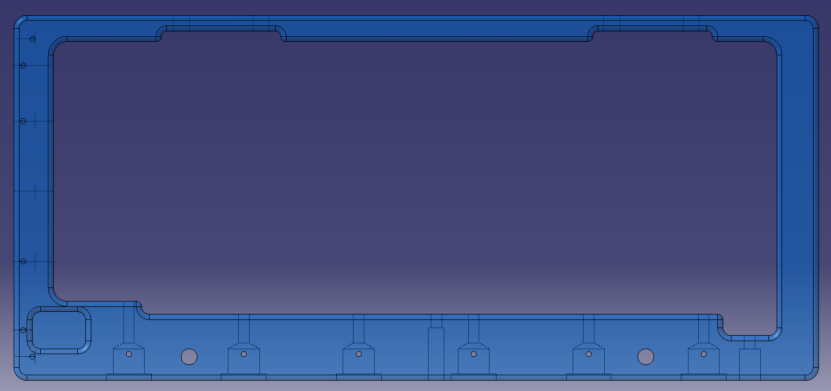
Parts and assembly Support arm
3D Model | Functionality | Material
ST1572023 (L) ST1602416 (R) | Positioning of the ceramic insulators, the faraday cage, the bottom electrode, the front reinforcement, the RF fingers and the cooling plate. Is attached to the flange | St. Steel EN 1.4429 EDMS 790774 Sheet
Both arms re-designed
Inclined part removed
Back column stiffer
Feedback about radiuses expected
Feedback about RF fingers expected

Slide 6
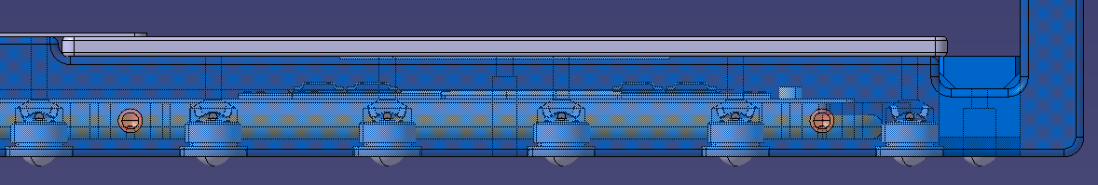
Parts and assembly Support arm
3D Model | Functionality | Material
ST1572023 (L) ST1602416 (R) | Positioning of the ceramic insulators, the faraday cage, the bottom electrode, the front reinforcement, the RF fingers and the cooling plate. Is attached to the flange | St. Steel EN 1.4429 EDMS 790774 Sheet
Do these holes need to cut through?
Fit to be solved (Arm, Electrode, Faraday cage)
Feedback about radiuses expected
Fit to be solved (Arm, reinforcement, Electrode)

Slide 7
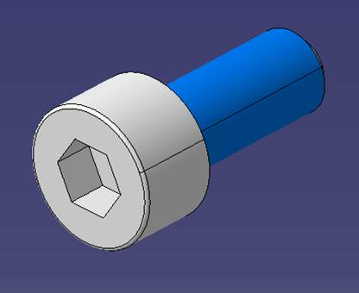
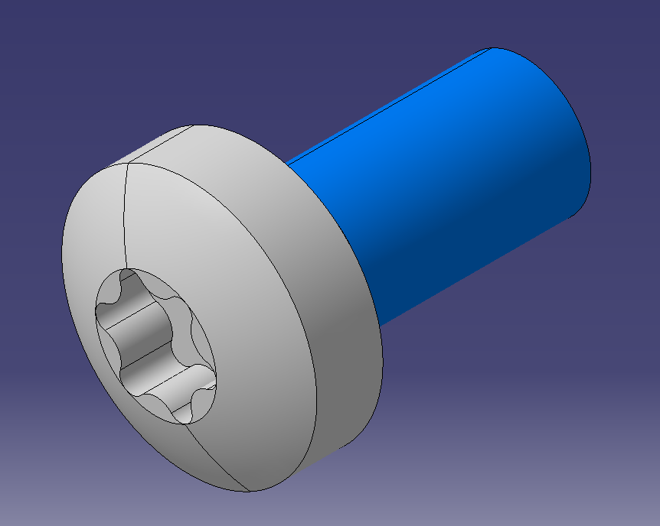
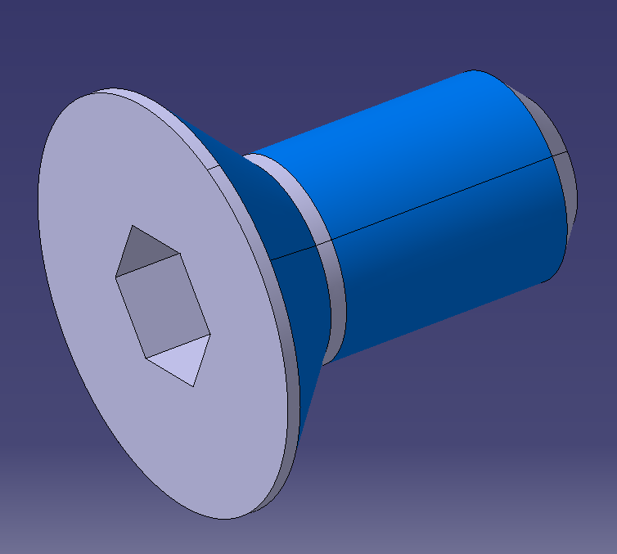
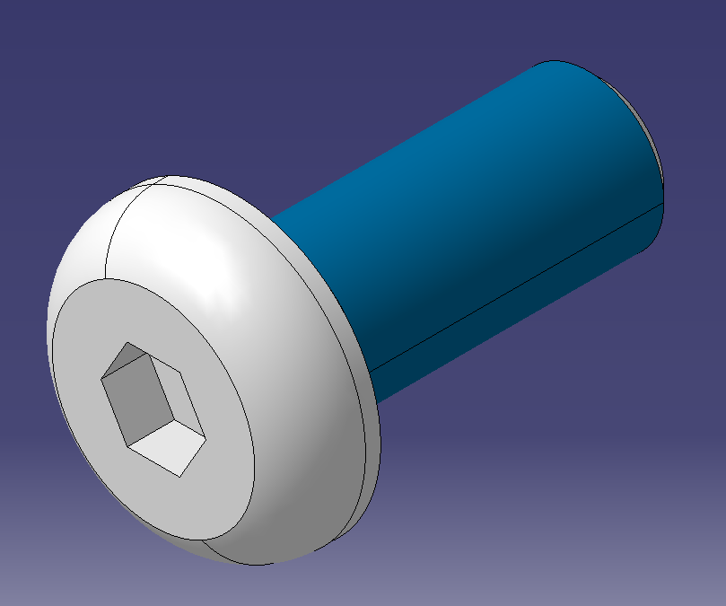
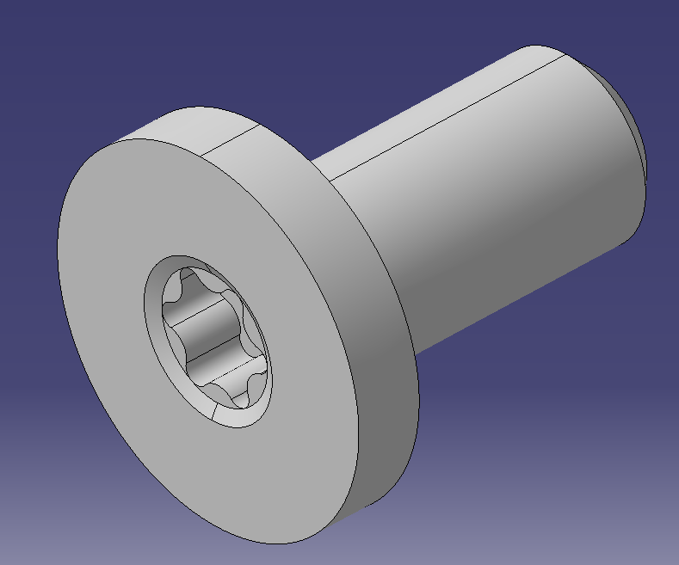
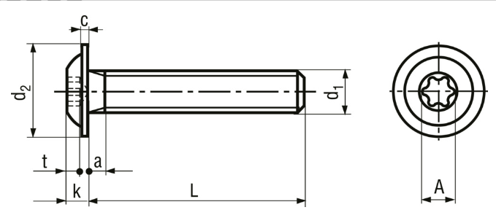
Parts and assembly Support arm
3D Model | Functionality | Material
ST1572023 (L) ST1602416 (R) | Positioning of the ceramic insulators, the faraday cage, the bottom electrode, the front reinforcement, the RF fingers and the cooling plate. Is attached to the flange | St. Steel EN 1.4429 EDMS 790774 Sheet
Which type of screw to be used?
Feedback expected

Slide 8
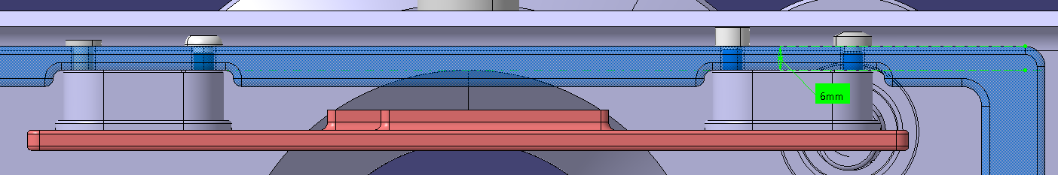
Parts and assembly Support arm
3D Model | Functionality | Material
ST1572023 (L) ST1602416 (R) | Positioning of the ceramic insulators, the faraday cage, the bottom electrode, the front reinforcement, the RF fingers and the cooling plate. Is attached to the flange | St. Steel EN 1.4429 EDMS 790774 Sheet
Space is limited between the arms and the tank
Thickness of the arm is 6mm now – countersunk holes / counterbored holes?

Slide 9
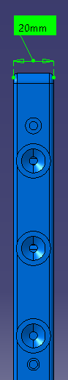
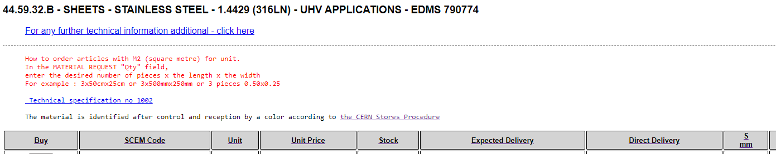
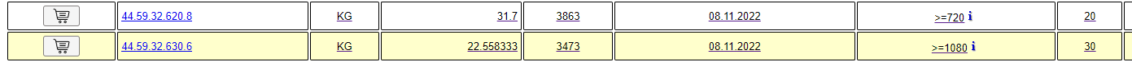
Parts and assembly Support arm
3D Model | Functionality | Material
ST1572023 (L) ST1602416 (R) | Positioning of the ceramic insulators, the faraday cage, the bottom electrode, the front reinforcement, the RF fingers and the cooling plate. Is attached to the flange | St. Steel EN 1.4429 EDMS 790774 Sheet
Thickness 20mm not ideal
Options:
Keep 20mm raw (not precise)
Reduce to 18/19mm (not ideal)
Enlarge width
Use 30mm bulk (lot of machining)
Use 50mm bulk (cut longitudinally)

Slide 10
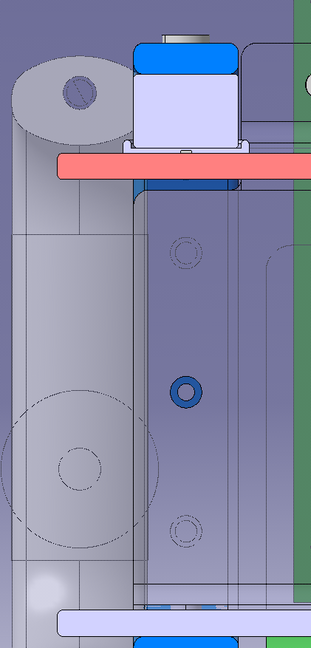
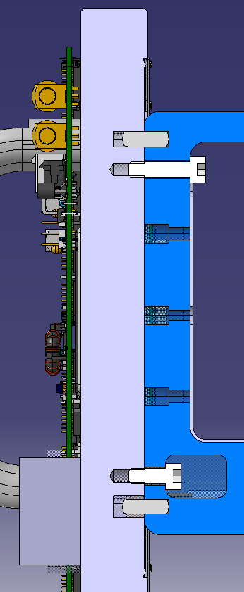
Parts and assembly Support arm
3D Model | Functionality | Material
ST1572023 (L) ST1602416 (R) | Positioning of the ceramic insulators, the faraday cage, the bottom electrode, the front reinforcement, the RF fingers and the cooling plate. Is attached to the flange | St. Steel EN 1.4429 EDMS 790774 Sheet
Threaded holes for arm dismantling
Threaded hole for Faraday cage attachment
Pins custom made or commercialized?
Which screws?

Slide 11
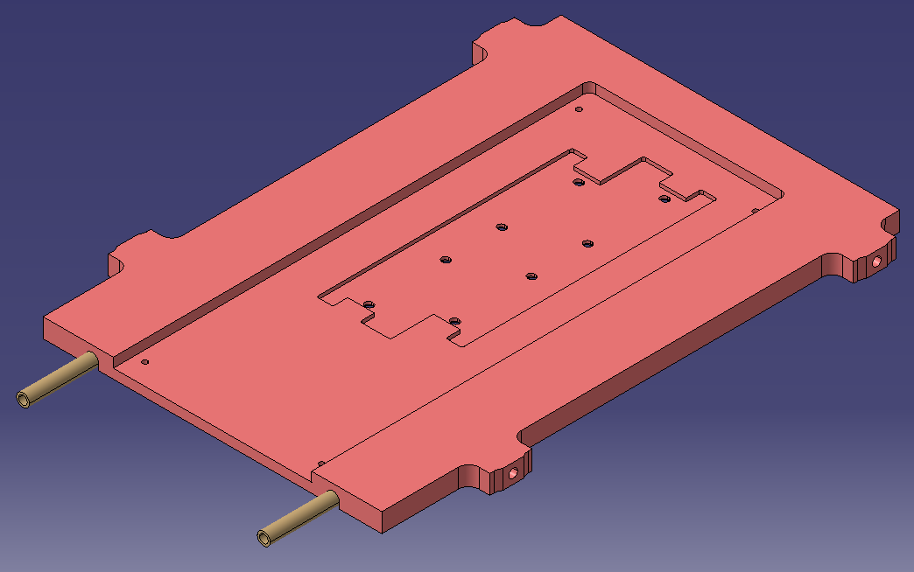
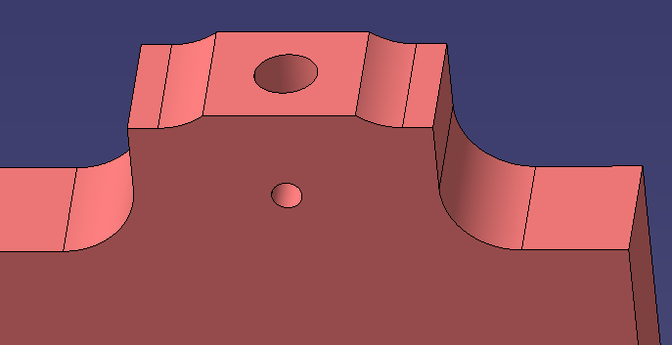
Parts and assembly Cooling base plate
3D Model | Functionality | Material
ST1571284 | Positioning of the cooling pipe, the detector modules and the ceramic guide | Cu OFE C10100 (HO2)
Radiuses added
Plate was made thicker by Teresa
Added:
Contact surface with the arm
Venting hole from the bottom

Slide 12
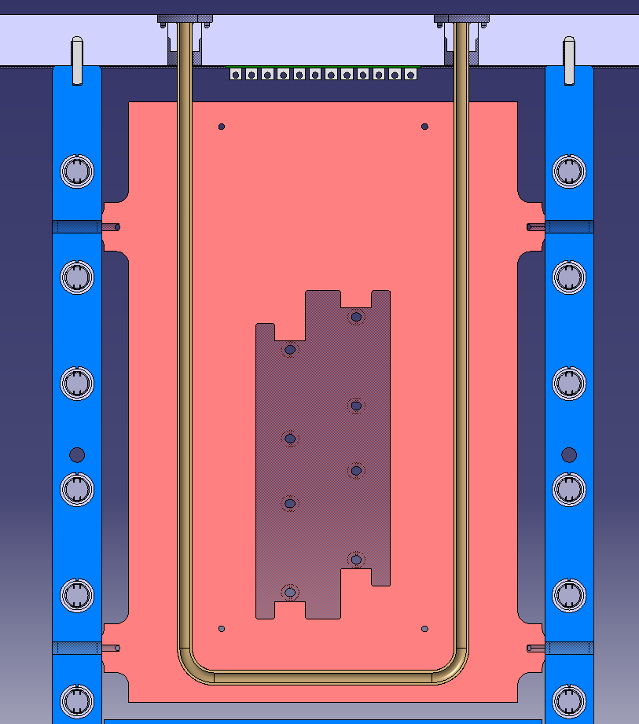
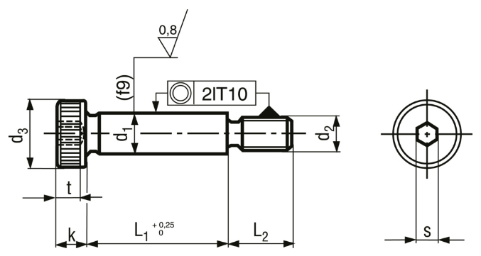
Parts and assembly Cooling base plate
3D Model | Functionality | Material
ST1571284 | Positioning of the cooling pipe, the detector modules and the ceramic guide | Cu OFE C10100 (HO2)
REMARKS:
The distance between the ceramic PCB (side facing the power cabling) and the power cabling NEEDS TO be 2.075 mm
The cooling base plate NEEDS TO ensure an accurate positioning of the TPX3 (pins + screws)
The detector assembly NEEDS TO be parallel to the beamline and centered
The slot for the cooling pipe NEEDS TO be precisely manufactured since it embraces the cooling pipe
Where are these Pins supposed to be?
No feature foreseen for it yet – idea shoulder screw
Careful with the assembly steps (centering and pipe welding)

Slide 13
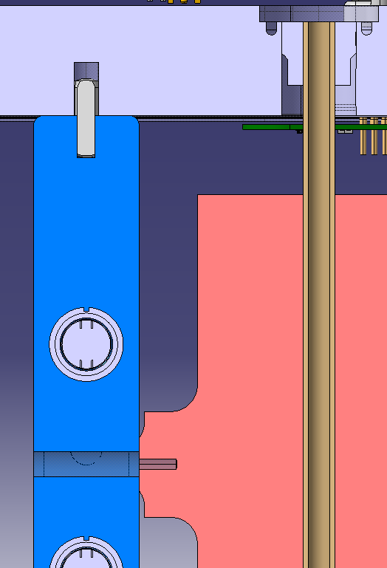
Parts and assembly Cooling base plate
3D Model | Functionality | Material
ST1571284 | Positioning of the cooling pipe, the detector modules and the ceramic guide | Cu OFE C10100 (HO2)
Think about positioning (pins/shoulder screws) and pipe welding
Slotted holes in cooling plate?

Slide 14
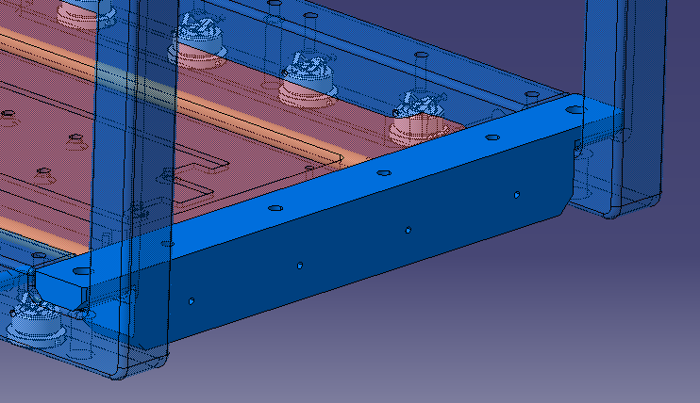
Parts and assembly Front reinforcement
3D Model | Functionality | Material
ST1571802 | Gives rigidity to the structure | St. Steel EN 1.4429 EDMS 790774 Sheet
Side made thicker
Feedback about radiuses expected
Feedback about RF fingers expected

Slide 15
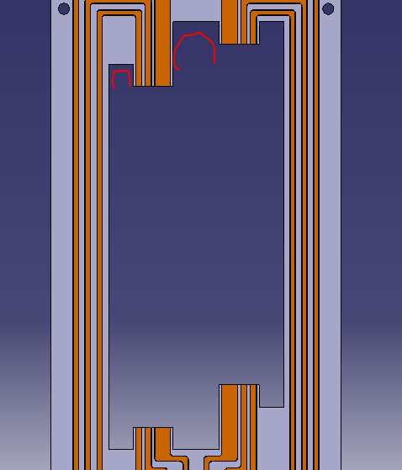
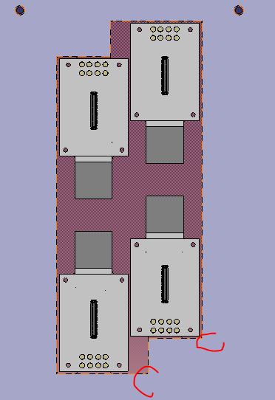
Parts and assembly Ceramic cover and Ceramic guide
3D Model | Functionality | Material
ST1584545 | Power cabling electrical insulation | Ceramic Al2O3 96%
Inner radiuses will be added
First discussion with workshop started

Slide 16
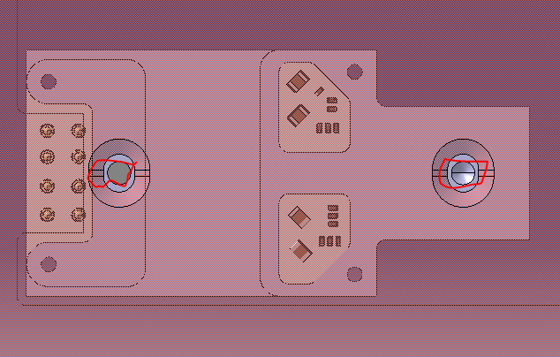
Parts and assembly Assembly detector
3D Model | Functionality | Material
ST1570691 | Integrates the TPX3, and power and data electronics | Module base: Alu EN AW-6082 (T6)
REMARKS:
The distance between the ceramic PCB (side facing the power cabling) and the power cabling NEEDS TO be 2.075 mm
The module base NEEDS TO ensure an accurate positioning of the TPX3
The detector assembly NEEDS TO be parallel to the beamline and centered
Is the screw connection accurate enough?
Add venting holes for the blind holes?

Slide 17
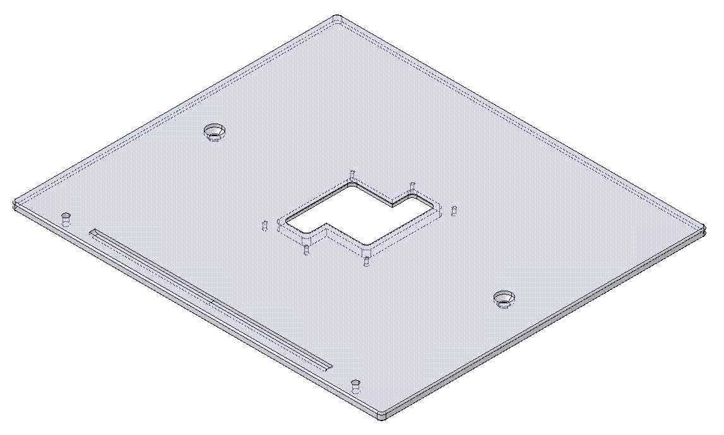
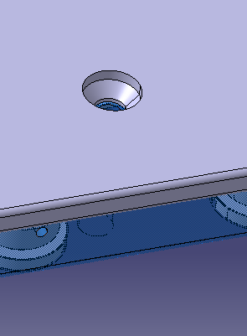
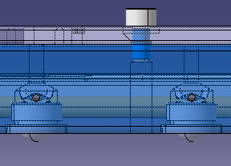
Parts and assembly Bottom electrode
3D Model | Functionality | Material
ST1571600 | Connected to GND, is in charge of creating the electric field. Its opening also allows electrons detection | St. Steel EN 1.4429 EDMS 790774 Sheet
Which type of screws?
Countersunk?
To not influence the electrical field?

Slide 18
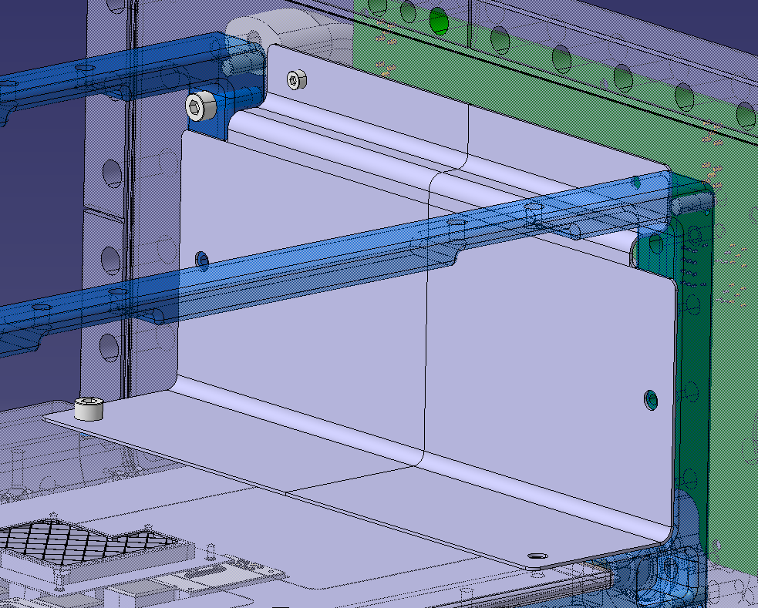
Parts and assembly Faraday cage
3D Model | Functionality | Material
ST1596265 | Protects the electronic components from radiation and insulates them from the magnetic field | Cu OFE C10100 (HO2) St. Steel EN 1.4429 EDMS 790774 Sheet
Design changed to 90deg bent
Two additional screws in top part

Slide 19
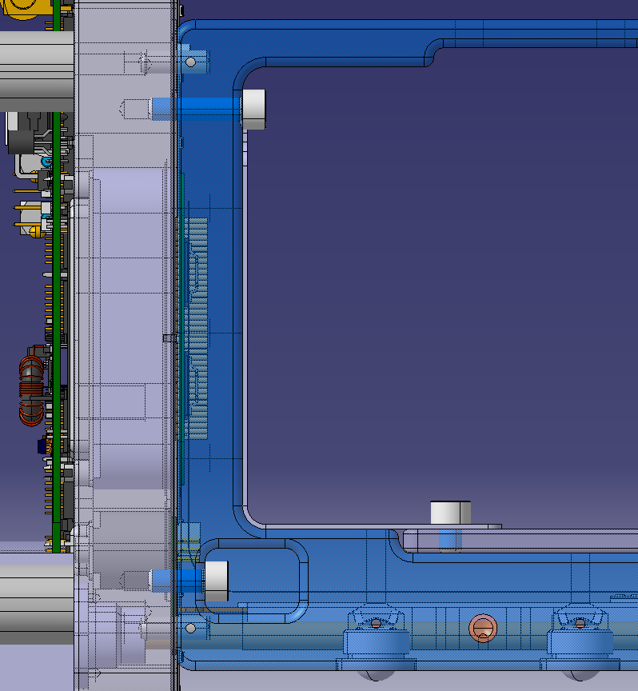
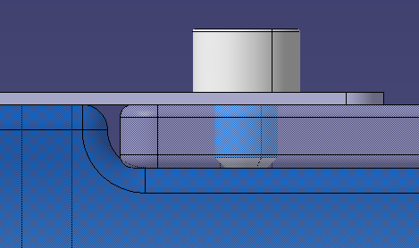
Parts and assembly Faraday cage
3D Model | Functionality | Material
ST1596265 | Protects the electronic components from radiation and insulates them from the magnetic field | Cu OFE C10100 (HO2) St. Steel EN 1.4429 EDMS 790774 Sheet
Outgassing? (pocket in bottom electrode/arm/grower)
Cut through the electrode and use longer screw with threaded hole in arm?

Slide 20
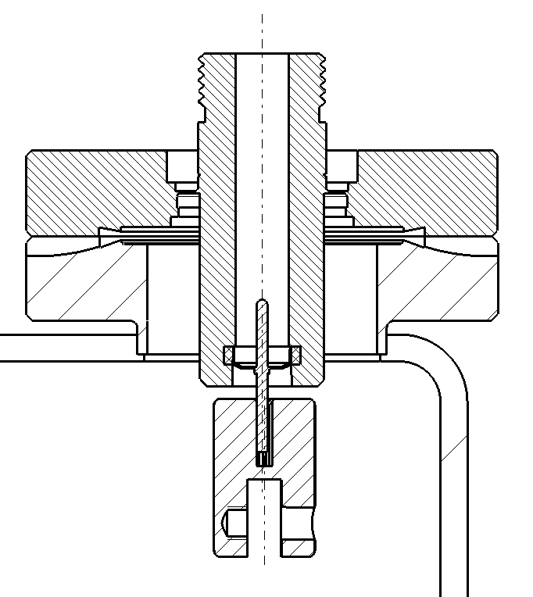
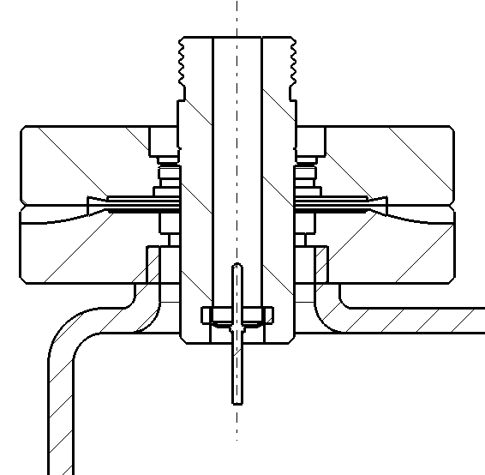
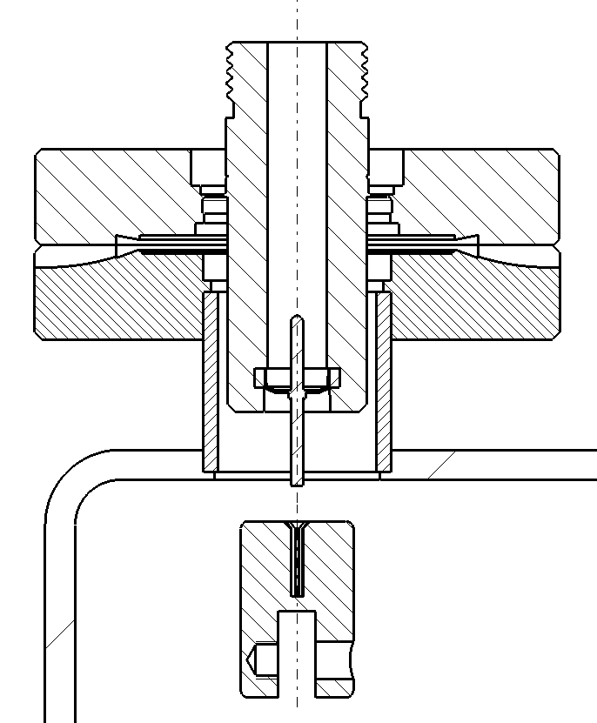
Parts and assembly Electrical feedthrough
3D Model | Functionality | Material
ST1589217 | Conducts a maximum of 40 kV
Three solutions for the feedthrough
New ideas?
Feedback from Wilfried expected

Slide 21
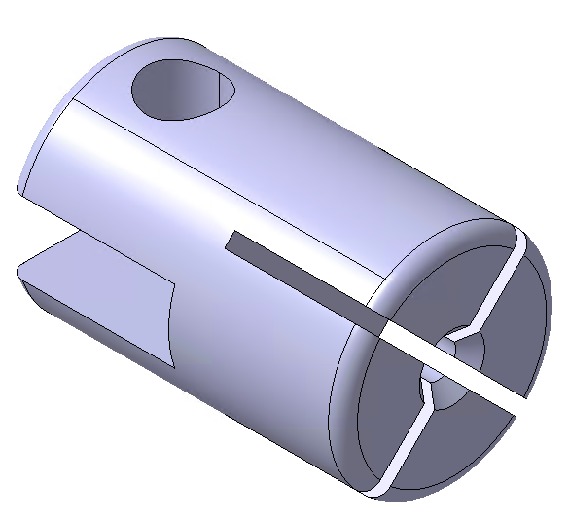
Parts and assembly Collet
3D Model | Functionality | Material
ST1589079 | Guarantees electrical contact between the feedthrough and the top electrode | St. Steel EN 1.4404 EDMS 1380627 Tube
New ideas?
Feedback from Wilfried expected

Slide 22
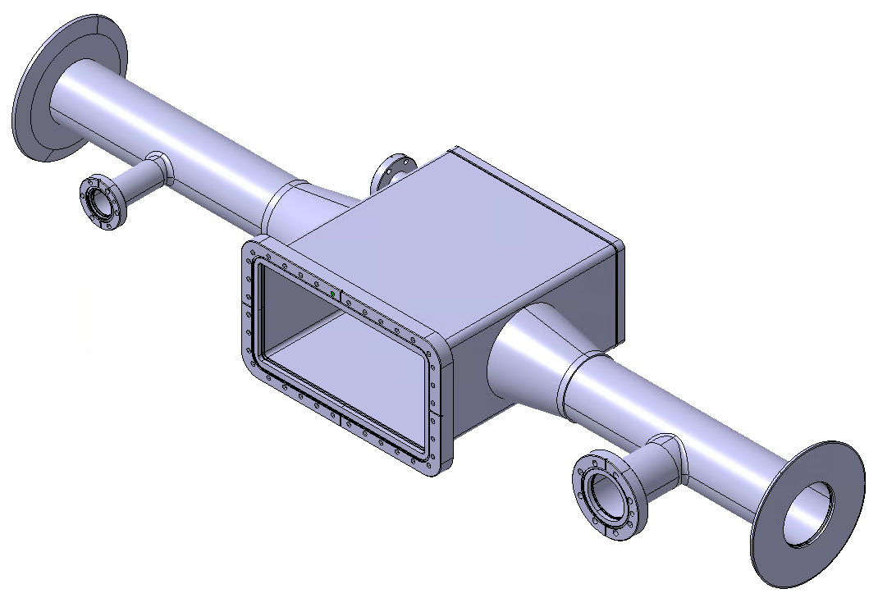
Parts and assembly Assembly chamber
3D Model | Functionality | Material
ST1588183 | Chamber where the instrument will be installed in a vacuum environment | St. Steel EN 1.4429 and 1.4306
Feedthrough tube
REMARKS:
The tank NEEDS TO fit between the magnet ribs
The open rectangular flange NEEDS TO fit between the magnet coils
The injection and pumping tubes NEEDS TO allow the magnet to slide
The feedthrough tube NEEDS TO be as long as necessary to allow the feedthrough insertion without modifying the pin
The cone chamber NEEDS TO accomplish RF standards
Injection chamber
Tank
Back tank
Conical flange
Injection tube
Pumping chamber
Open rectangular flange
Cone chamber
Pumping tube

Slide 23
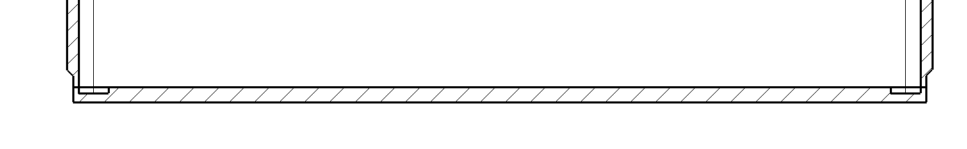
Parts and assembly Assembly chamber
3D Model | Functionality | Material
ST1588183 | Chamber where the instrument will be installed in a vacuum environment | St. Steel EN 1.4429 and 1.4306
New connection of the back tank
All welded connections will be discussed with workshop

