Slide 1
SPS-BGI Mechanical Design Discussion ML-MME 2
INDEX
BGI x ML Discussion

Slide 2
BGI x ML Discussion
1) | Is it needed a special roughness for the support arms due to the HV? | No, the standard surface finishing is enough
2) | Are RF fingers needed to create good electrical contact? Could another solution be implemented? | Another solution could be foreseen: a rods system to insert the instrument into the chamber, so the weight is resting in the vacuum chamber. For the electrical contact, we can replace the springs by RF fingers-stock gaskets.
3) | Is a RF contact needed between the bottom electrode and the front reinforcement? Figure 1 | Since we want to ensure good electrical contact between the bottom electrode and the support arms / front reinforcement, a U shape could be machined underneath the bottom electrode to install an RF finger-stock gasket. The bottom electrode can be larger, because it’s at GND
4) | Are oval holes needed to fix the detectors to the cooling base plate? Conical ones could be used instead? Figure 2 | Oval holes were needed in the PS instrument, because the detectors were placed in a row and their position needed to be adjusted. For the SPS-BGI, the holes can be conical (countersink). In addition, a mask can be used to precisely position the chip in the detector assembly.
5) | Can the screw’s heads that fix the faraday cage to the bottom electrode stand out? Figure 3 | Yes they can, but it’s better if they have rounded head. A discussion with the workshop is needed to check if we can do counterbored holes in the support arms

Slide 3
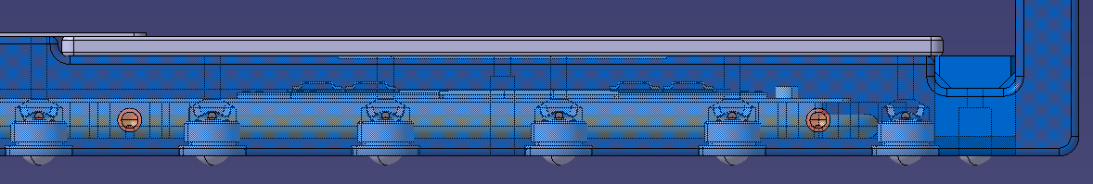
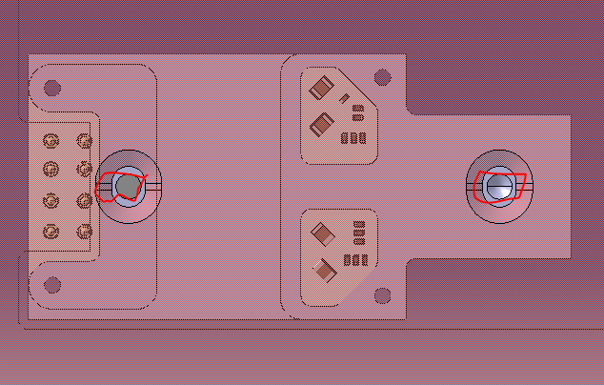
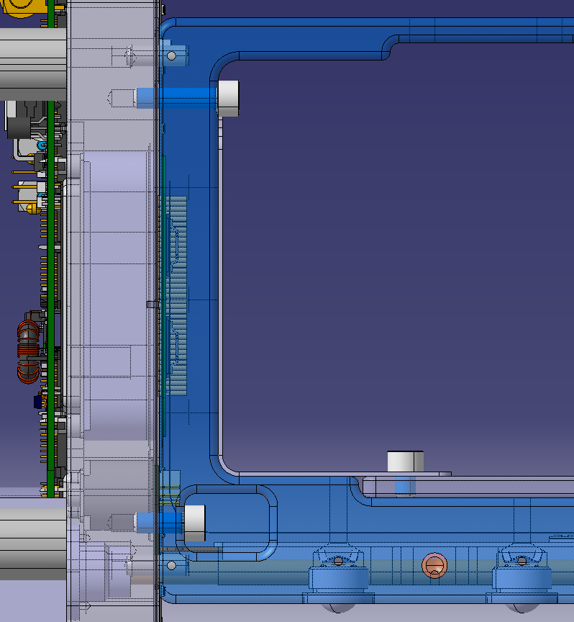
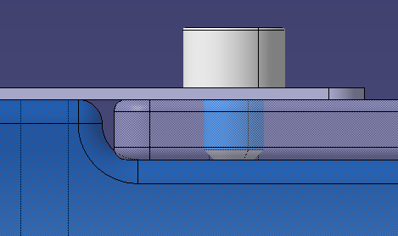
Figure 1
Figure 2
Figure 3

