Slide 1
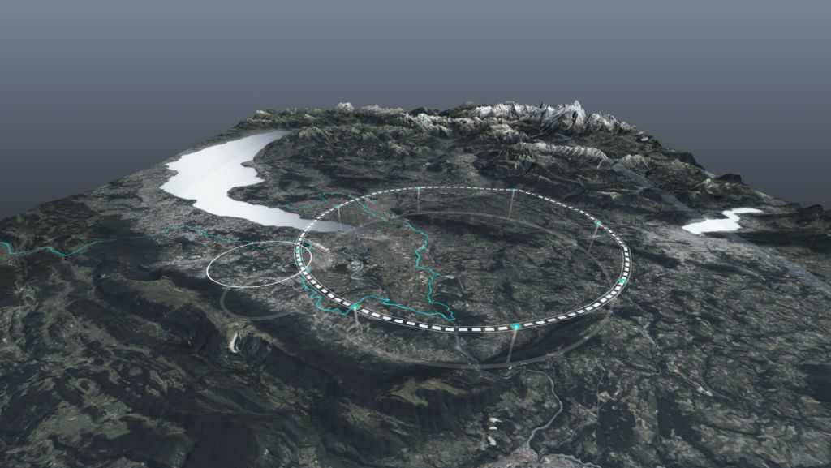










FCC Feasibility Study Status
Plenary ECFA, 17 November 2023
Michael Benedikt, Frank Zimmermann, CERN
on behalf of FCC collaboration & FCCIS DS team
http://cern.ch/fcc
Work supported by the European Commission under the HORIZON 2020 projects EuroCirCol, grant agreement 654305; EASITrain, grant agreement no. 764879; iFAST, grant agreement 101004730, FCCIS, grant agreement 951754; E-JADE, contract no. 645479; EAJADE, contract number 101086276; and by the Swiss CHART program
photo: J. Wenninger

Slide 2

Contents
Status and progress on
  Implementation activites
  Site investigations and environmental studies
  Civil engineering
  Cooling water supply concepts
  Excavation material management
Mid-term review update

Slide 3
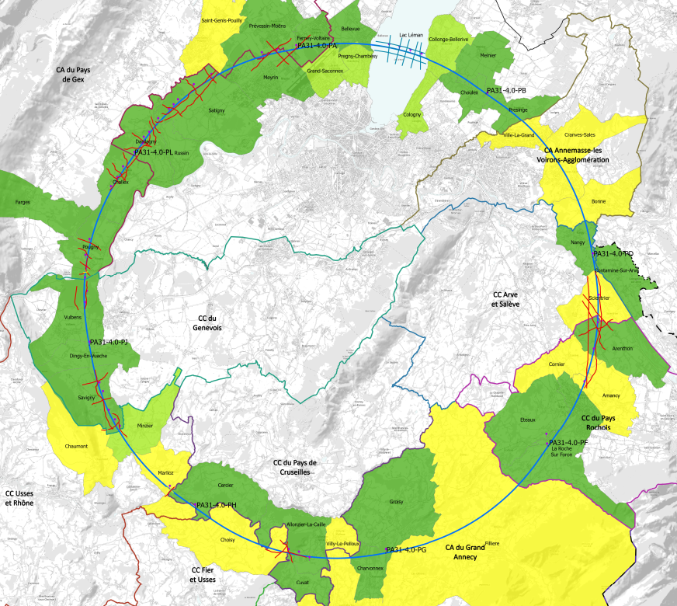
progress with implementation baseline PA31 90.7 km
Meetings with municipalities concerned
in France (31) and Switzerland (10)
PA – Ferney Voltaire (FR) – site experimental
PB – Présinge/Choulex (CH) – site technique
PD – Nangy (FR) – site experimental
PF – Roche sur Foron/Etaux (FR) – site technique
PG – Charvonnex/Groisy (FR) – site experimental
PH – Cercier (FR) – site technique
PJ – Vulbens/Dingy en Vuache (FR) site experimental
PL – Challex (FR) – site technique
status as of 10 November 2023
Individual meeting
Individual meeting planned
Collective meeting
The support of the host states is greatly appreciated and essential for the study progress!

Slide 4
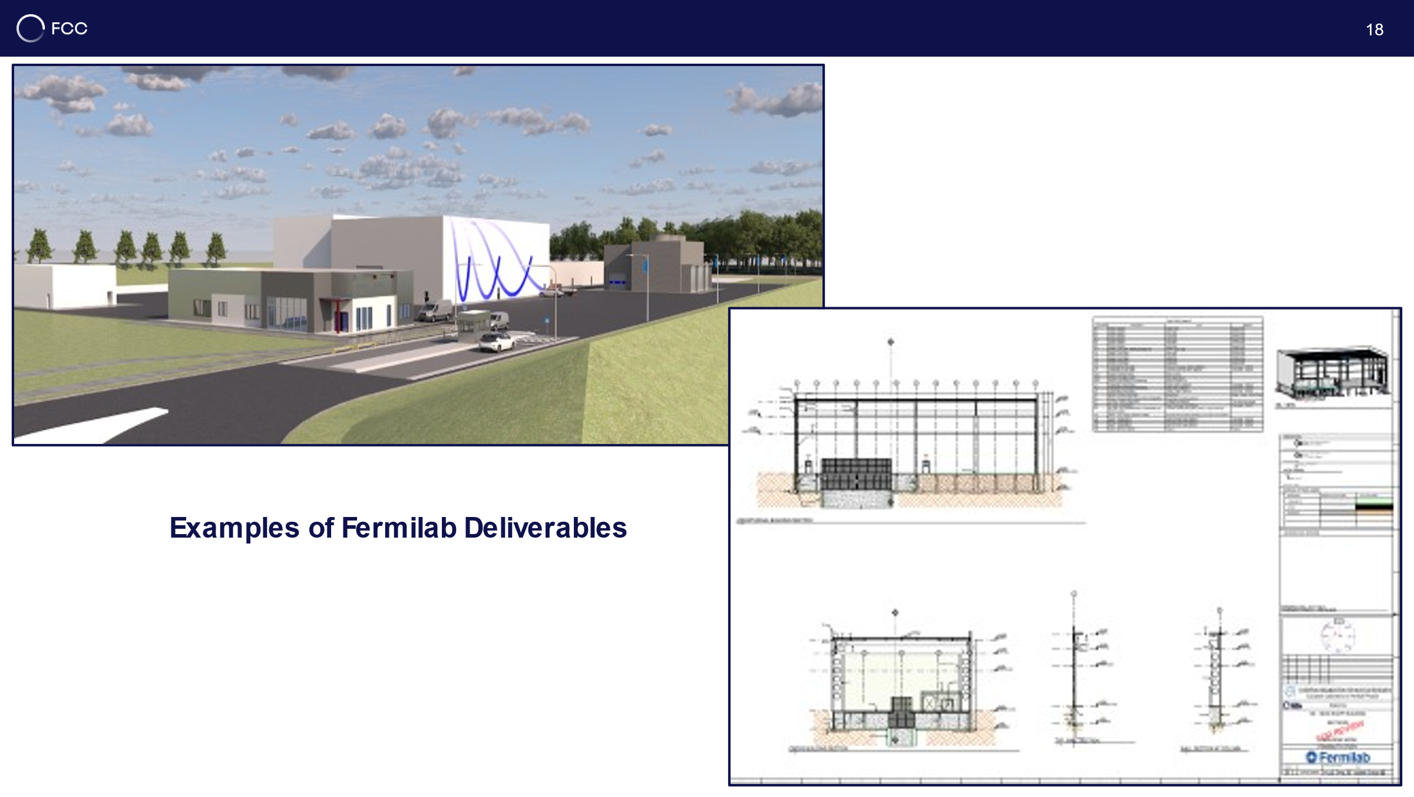
CE surface progress
Generic study of experiment site and technical site by FNAL
bills of quantities extracted from FNAL designs
basis for cost estimate by consultant with experience on industrial constructions in CH-FR area.
next steps: individual integration studies and design optimization with municipalities concerned

Slide 5
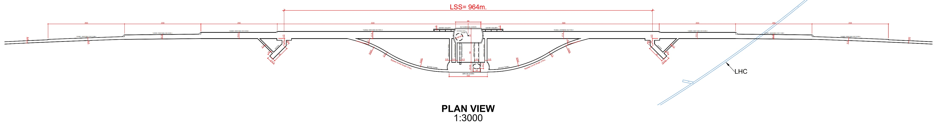
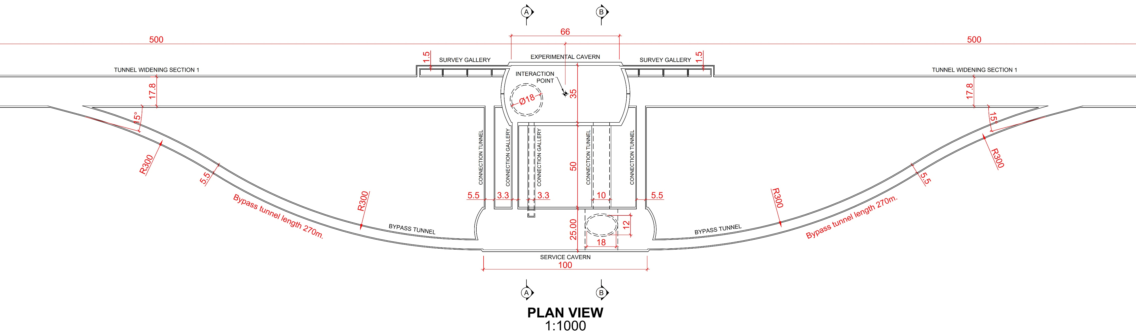
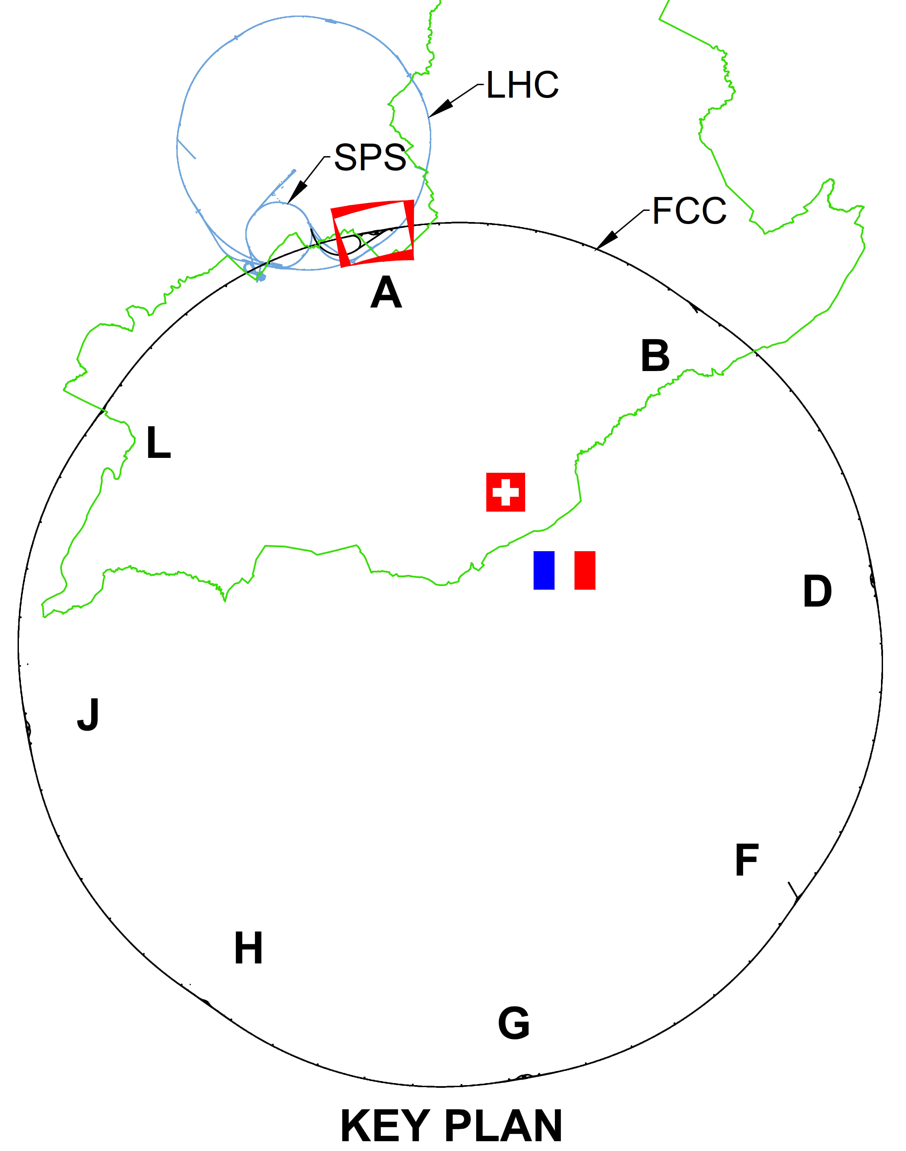
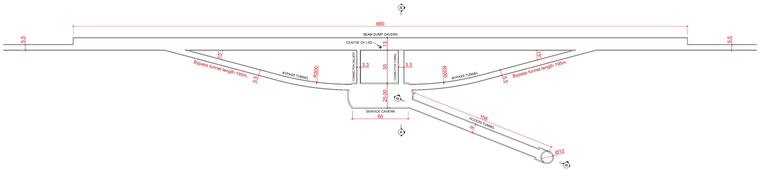
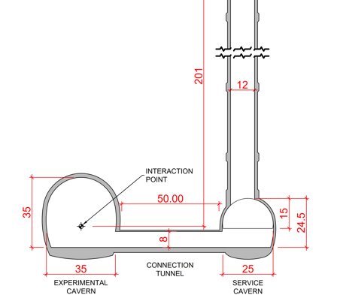
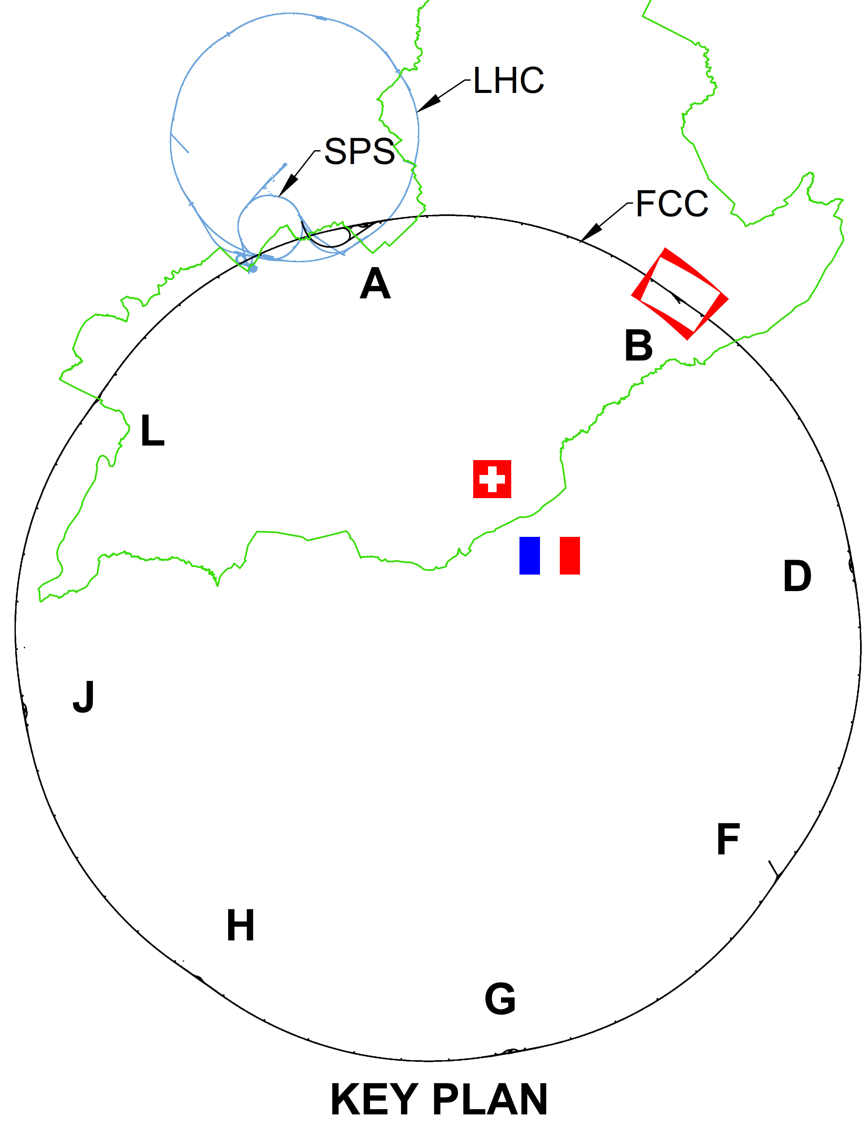
CE underground progress
Full 3D model of underground structures as basis for costing exercise
Experiment Site (PA)
Update of scheduling and costing with external consultant
Technical Site (PB)
next steps: adaptation of vertical alignment and tilt of tunnel and revision of construction methodology based on results from site investigations.

Slide 6
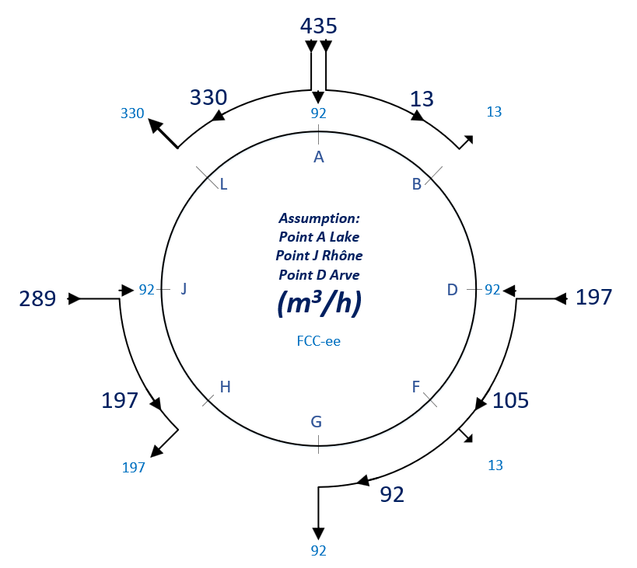
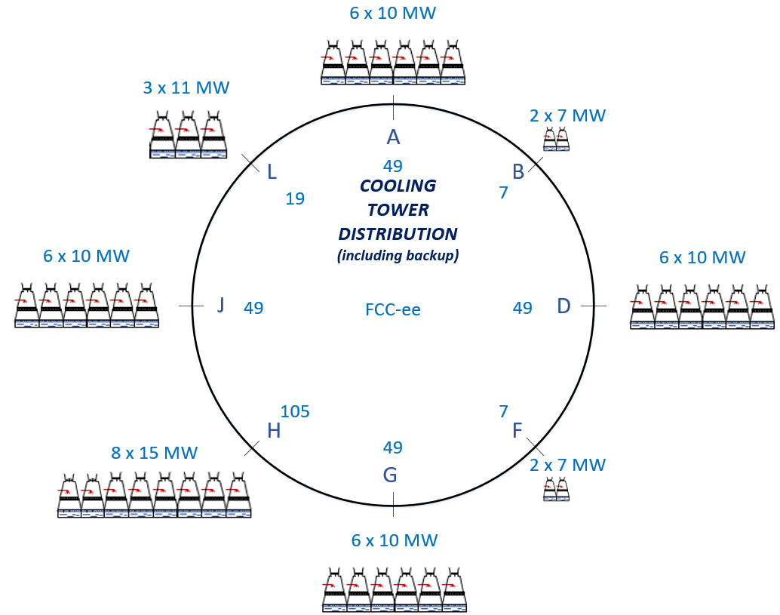
Cooling water supply concept
Potential sources of cooling water Geneva lake (PA), Rhone (PJ) and Arve (PD).
Existing line with lake water provided by SIG to CERN LHC P8 (LHCb) sufficient for FCC-ee.
Pipework in the tunnel will connect the remaining points to points PA, PD and PJ.
Main cooling towers placed at experiment points (PA, PD, PG, PJ), and RF sites (PL, PH).

Slide 7
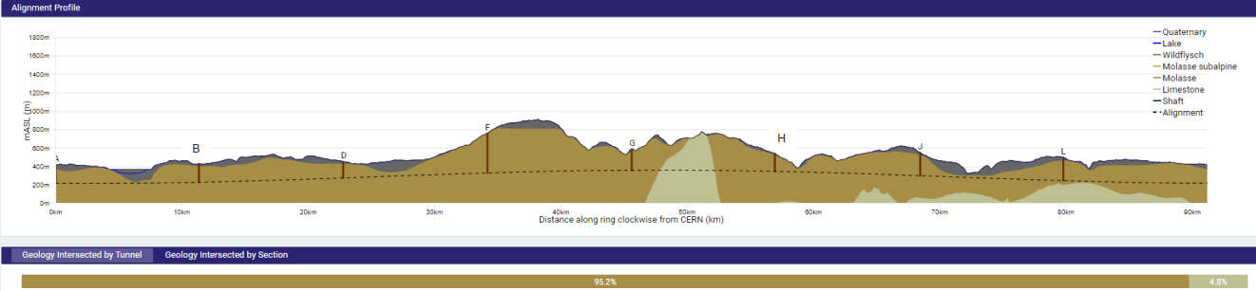
FCC tunnel implementation
Tunnel implementation summary
91 km circumference
95% in molasse geology for minimising tunnel construction risks
8 surface sites with ~5 ha area each.

Slide 8
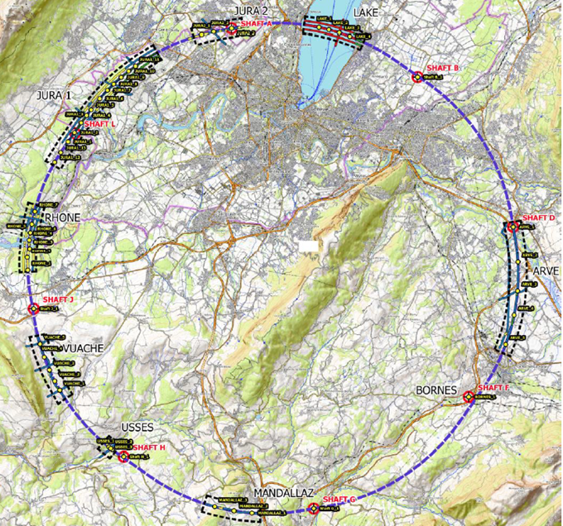
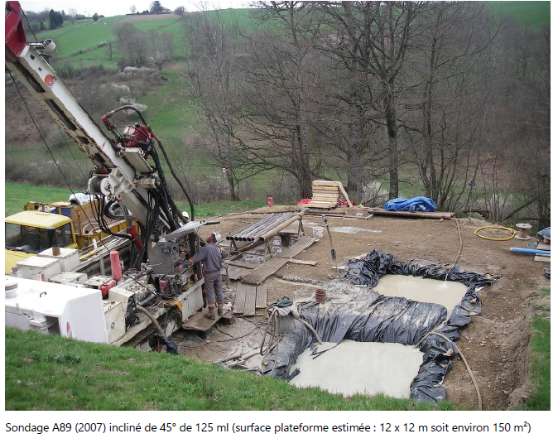
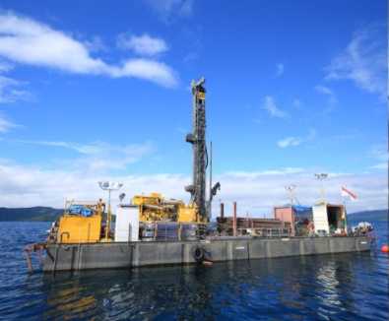
Status of subsurface investigations
Site investigations in areas with uncertain geological conditions:
  Optimisation of localisation of drilling locations ongoing with site visits since end 2022.
  Work with FR and CH ongoing to obtain autorisations for start of seismic investigations and drillings in Q2 2024.
Contracts Status:
  Contract for engineering services and role of Engineer during works, active since July 2022
  Tendering for execution contracts is ongoing towards contract placement in December 2023 and mobilization from January 2024.
Drilling works on the lake

Slide 9
Studies of environmental aspects ongoing
Studies of relevant environmental aspects over 18 months (> 4 seasons to see full cycle) with a consortium of specialized companies
Necessary inventory for the “Avoid-reduce-compensate” approach and costing (compensation measures)
Input for surface site designs, installation and operation aspects
Pre-requisite for the required initial state report, before an environmental impact assessment
Exhaustive list of topics covered:
  Topography, geology, hydrogeology, surface water, natural risks, urbanistic planning, fauna & flora survey, habitats and wetland analysis, soil quality and pollution, noise, light, radiation, technological risks, demography, economic activities, landscape and visibility, patrimony
Central management of all data in an “Environmental Information System” to be able to document the evolutions of the territory, the civil construction designs and the technical infrastructure development integrated with classical “Geographical Information System”

Slide 10
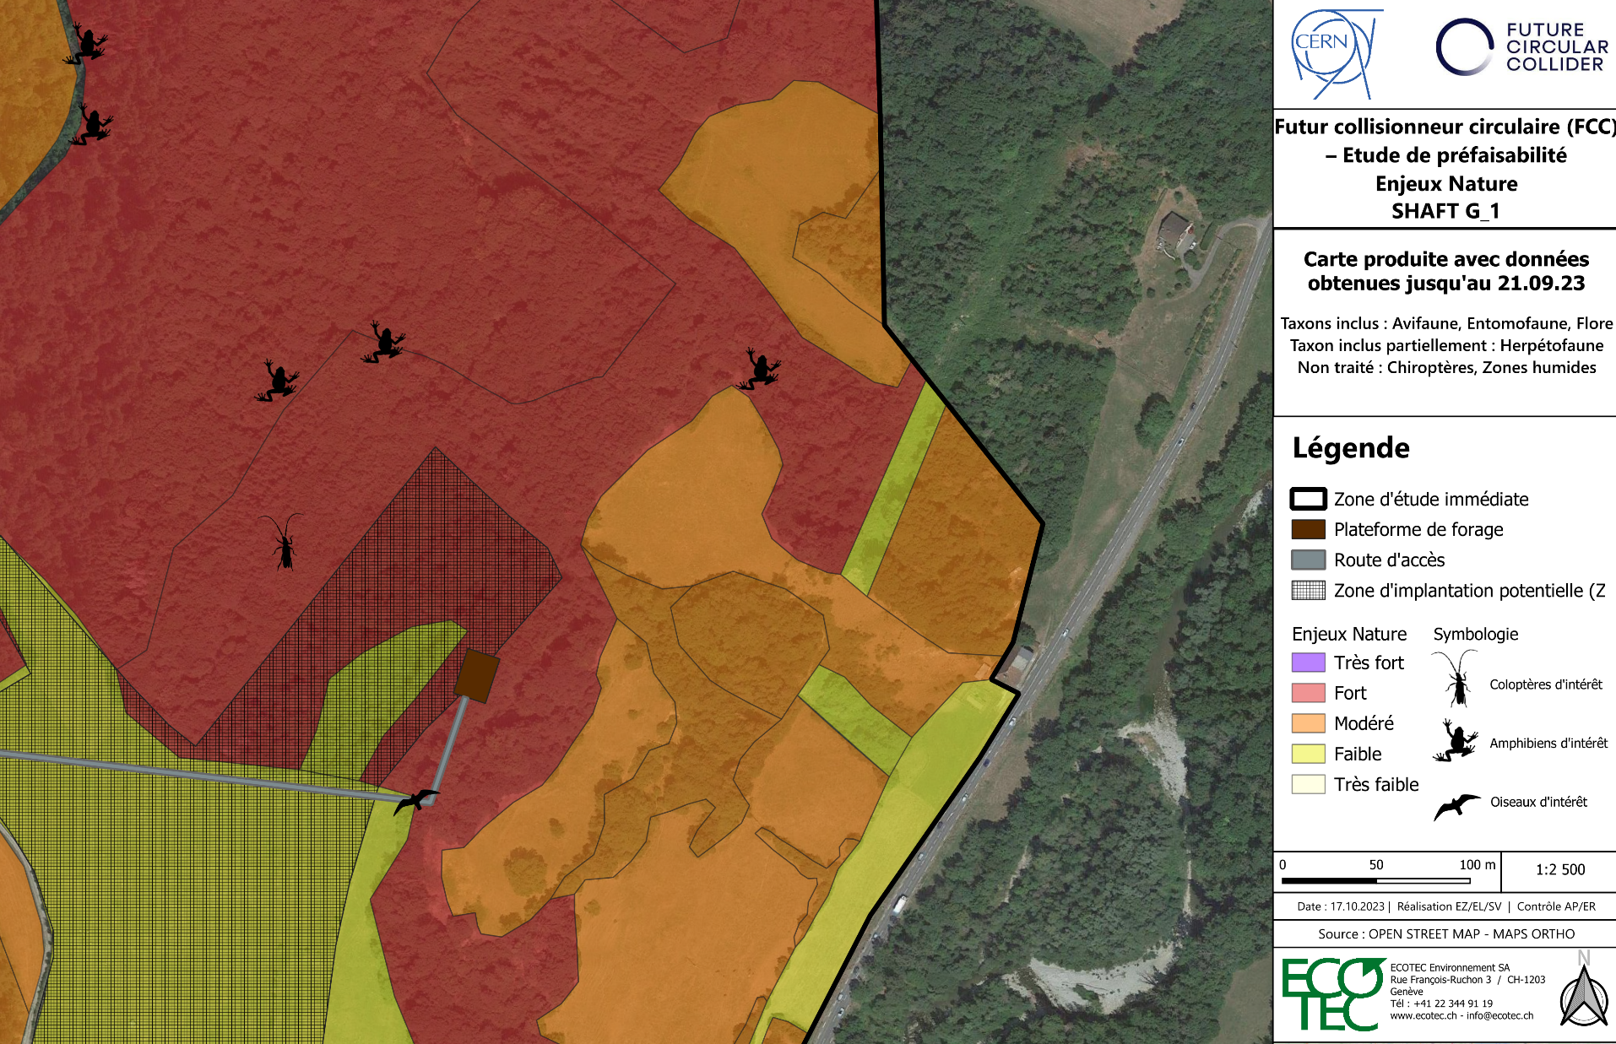
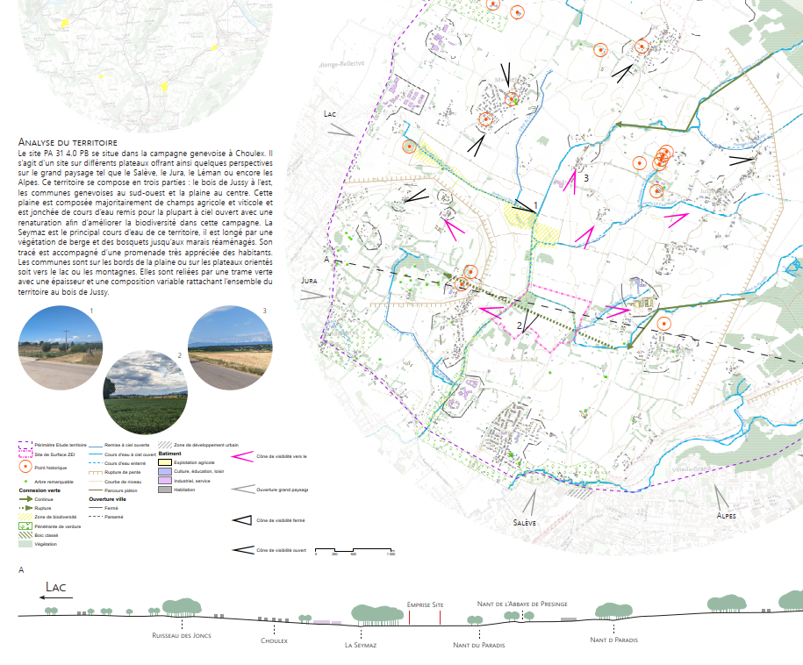
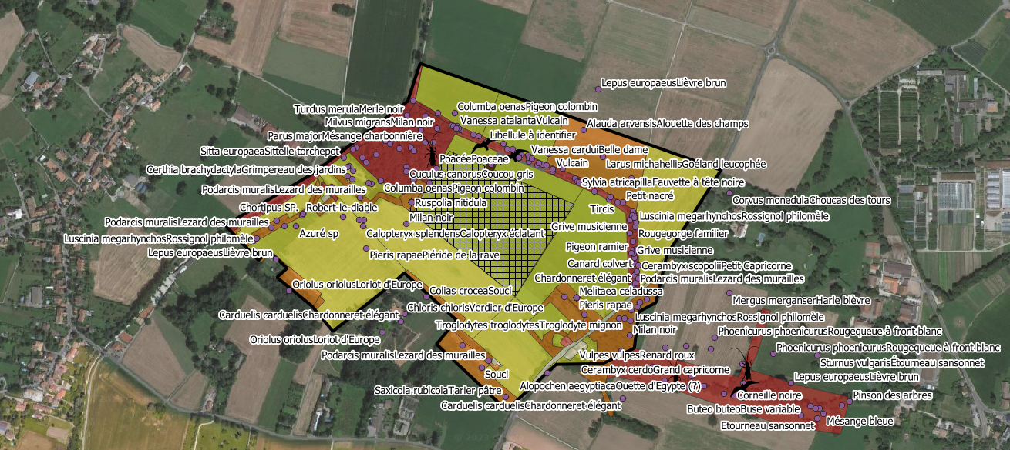

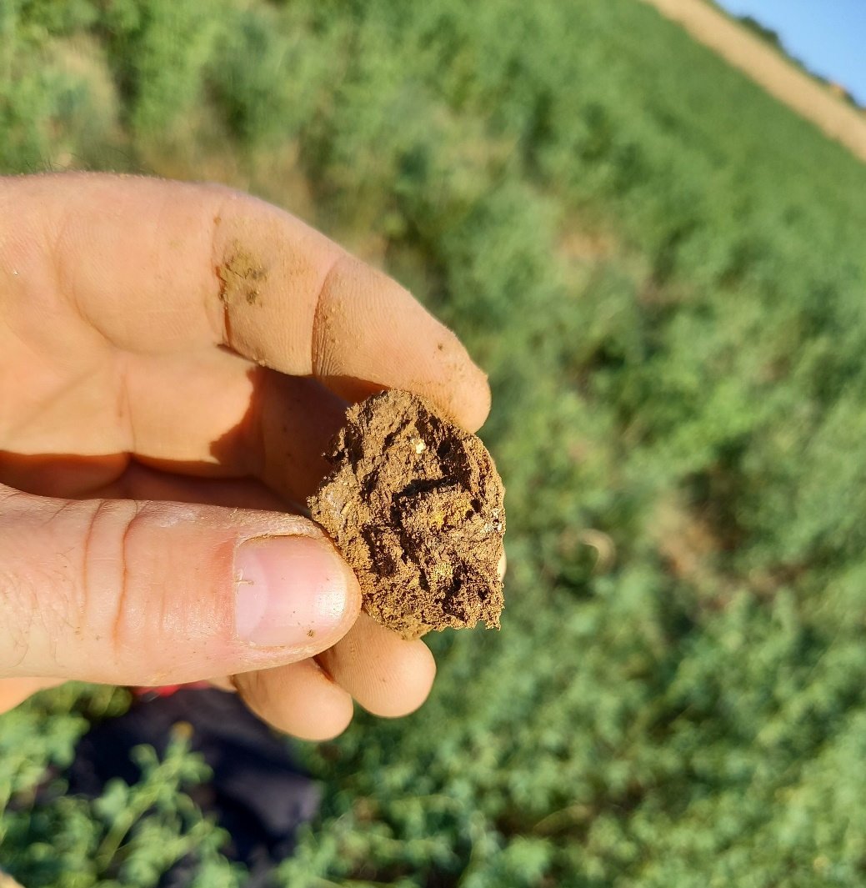
Examples for field investigations and environmental studies
Identification of protected species
Description of surrounding,
views to be preserved,
architectural aspects to be
Considered.
Inventory of fauna & flora on surface sites
Determination of quality of the top soil and potential pollution, determination of the economic land value

Slide 11
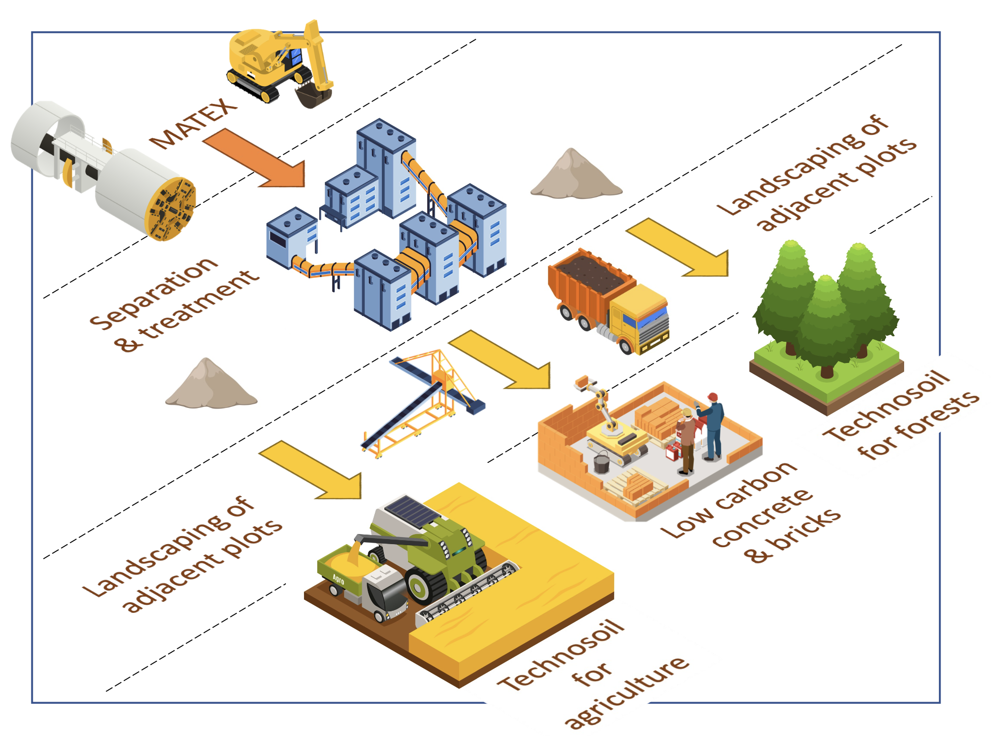
Excavation material management
An innovative local approach for excavated materials:
Excavated material from FCC subsurface infrastructures: 6.5 Mm³ in situ, 8.4 Mm³ excavated (bulk factor 1.3)
2021-2022: International competition “ Mining the Future”, launched with the support of the EU Horizon 2020 grant agreement 951754, to find innovative and realistic ideas for the reuse of Molasse (95% of excavated materials)
2023: Definition of the “OpenSky Laboratory” project:
Objective: Develop and test an innovative process to transform sterile “molasse” into fertile soil for agricultural use and afforestation.
Duration: 4 years (2024-2027)
Courtesy: J. Gutleber

Slide 12
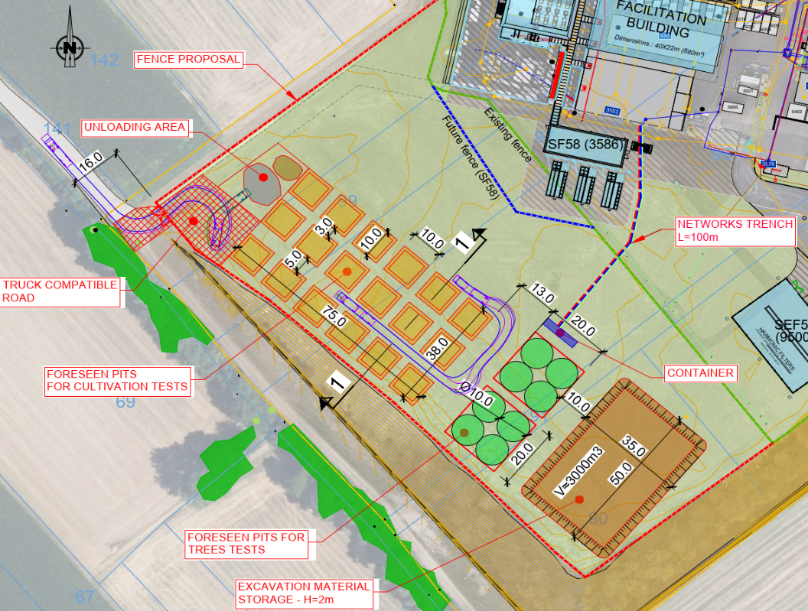
OpenSky Laboratory : HOW?
3’000 m² at LHC P5 in Cessy, France.
Trial with 5 000 t of excavated local molasse
18 cells for agriculture trials (10*10 m)
2 cells for forestry trials (20*20 m)
Different types of plants selected as function of regional specificities
1) Initial laboratory analysis to identify the most suitable mixing of molasse and amendments,
2) Mixing/spreading of the molasse with amendments on the trial cells,
3) Planting and treatment with monitoring of the field conditions in a controlled environment.

Slide 13
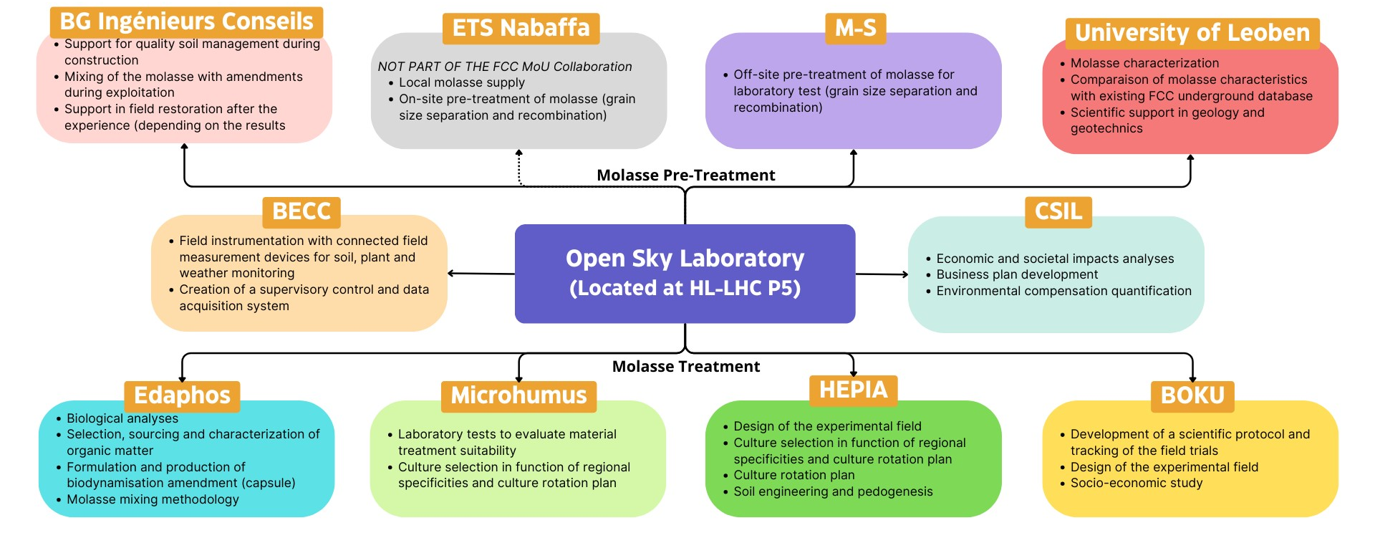
OpenSky Laboratory : WHO?
A collaborative effort of industry and academic/educational institutes

Slide 14
Preparatory phase planning - authorisations and CE
To start the excavation of the first shafts in 2033, a significant amount of preparatory work is required. An initial consideration of these preparatory works including scheduling and resource aspects has been made:
2025-2026 | Permits and authorization for complementary site investigations
 | Tendering for environmental impact and authorisation processes contract, tendering for subsurface investigations
2027-28 | Complementary subsurface investigations
 | Tendering for CE consultants, environmental impact studies, public concertation
2028 | Project approval
 | Award of CE consultant contracts
2029-30 | Tender design
 | Preparing calls for tenders for CE construction,
 | Project authorisations in France and Switzerland obtained
2031 mid 2032 | Construction design, Tendering for construction
mid 2032 | Award of CE construction contracts
 | Preparation of site (road access, electricity, water…)
2033 | Ground breaking

Slide 15
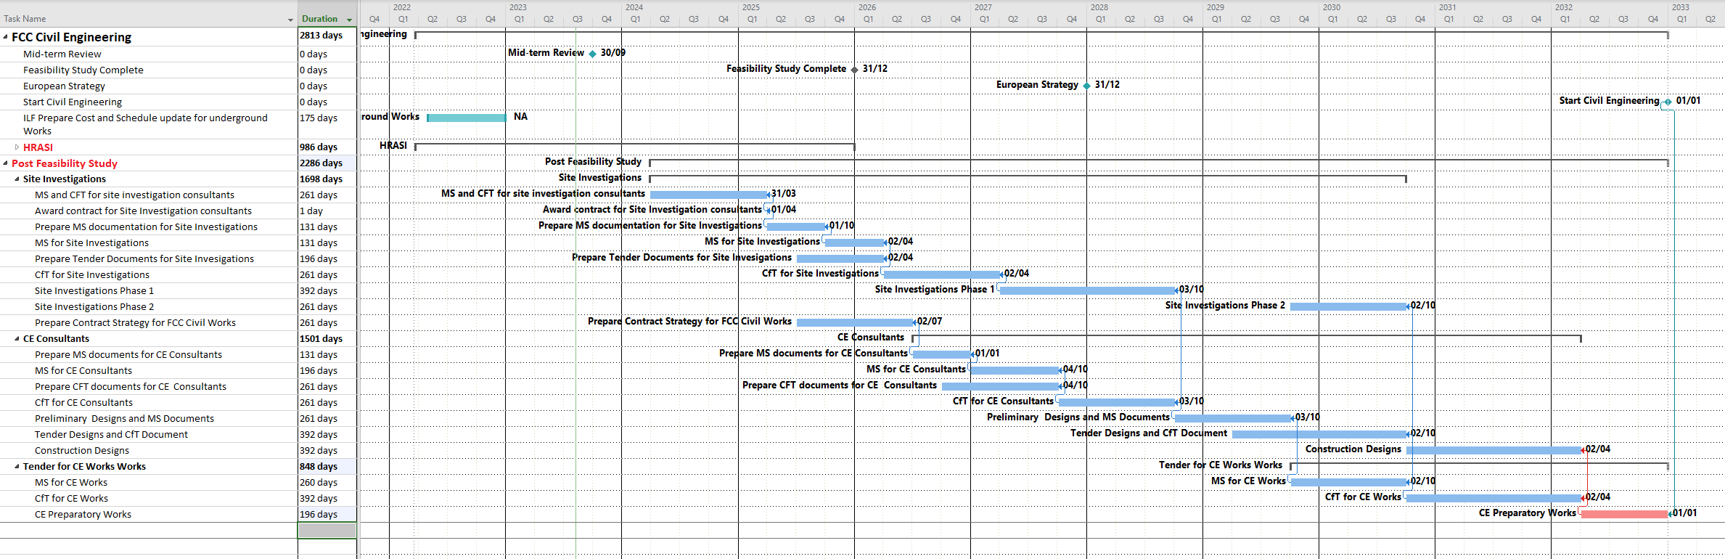
Preparatory phase planning civil engineering

Slide 16
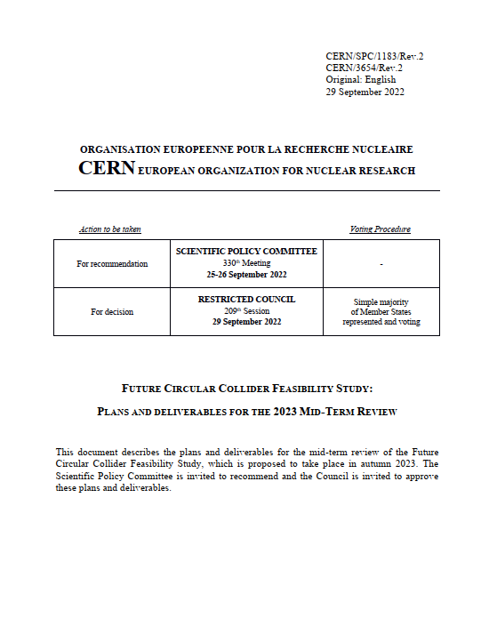
FCC FS mid-term review
Mid-term review setup and deliverables are defined in CERN/SPC/1183/Rev.2:
the scientific and technical results be reviewed by the FCC FS Scientific Advisory Committee, augmented by additional experts as needed;
the cost and financial feasibility, which will focus on the first-stage project (tunnel, technical infrastructure, FCC-ee machine and injectors), be reviewed by a committee including external experts, as proposed in CERN/3588;
FCC Scientific Advisory Committee
Riccardo Bartolini (DESY), Alain Chabert (Société Française du Tunnel Routier Fréjus),
Heinz Ehrbar (HEP), Brigitte Fargevieille (Électricité de France), Belen Gavela Legazpi (UAM), Gudrun Hiller (Dortmund), Srinivas Krishnagopal (BARC), Peter Krizan (Ljubljana), Philippe Lebrun (CERN, retired), Peter McIntosh (STFC), Michiko Minty (BNL),
Andrew Parker (Chair, Cambridge), Kyo Shibata (KEK), Roberto Tenchini (Pisa)
FCC Cost Review Panel
Carlos Alejaldre (Fusion for Energy), Austin Ball (CERN, retired), Umberto Dosselli (INFN), Heinz Ehrbar (HEP)
Vincent Gorgues (CEA), Norbert Holtkamp (Chair, Stanford), Christa Laurila (National Audit Office, Finland), Ursula Weyrich (German Cancer Research Centre), Jim Yeck (BNL), Thomas Zurbuchen (ETH Zürich)

Slide 17
Review committees
Scientific Advisory Committee:
review technical deliverables
D1: Definition of the baseline scenario
D2: Civil engineering
D3: Processes and implementation studies with the Host States
D 4: Technical infrastructure
D5: FCC-ee accelerator
D6: FCC-hh accelerator
(D7: Project cost and financial feasibility)
D8: Physics, experiments and detectors
Cost Review Panel Mandate:
(review of D7)
Review the methodology and assumptions used in producing the cost estimates
Identify inaccurate or missing cost information
Check the consistency of the cost estimates with respect to applicable reference work, e.g., recent large-scale infrastructure and accelerator projects
Review the uncertainty estimates
Identify potential areas of savings and cost mitigation for future work
Advise the FCC study team on matters of cost estimation in view of preparation of the final Feasibility Study Report for end 2025

Slide 18
FCC FS mid-term review status and further process
Status
Both SAC and CRP have formed expert groups for individual domains to interact with FCC team
More than 30 topical review meetings during August and September 2023
Final overall review meeting of SAC and CRP with FCC team 16-18 October 2023
Complete set of documentation material submitted for CERN Council Committees begin November 2023
  Future Circular Collider Mid-term Report
  Executive Summary of the Future Circular Collider Mid-term Report
  Updated Cost Assessment for the FCC Civil Engineering, Infrastructure and the FCC-ee Collider
  Future Circular Collider Funding Model: A First Analysis
  Cost Review Panel Mid-Term Review Report
  Scientific Advisory Committee Mid-Term Review Report
Further process
Special meetings of CERN Scientific Policy Committee and Finance Committee: 20-22 November
  SPC and FC Reports to Council by 31 December
Special Council meeting on mid-term review: 2 February 2024

Slide 19
FCC Feasibility Study – status summary
The first half of the FCC Feasibility Study will soon be completed with the mid-term review
End October 2023: Review committee reports available to Scientific Policy Committee and Finance Committee
20 – 22 November 2023: SPC and FC review meetings on mid-term review
2 February 2024: CERN Council meeting on mid-term review
Focus 2021 - 2023:
identifying best placement & layout and adapting entire project to new placement
this provided the input for the mid-term review
Fruitful collaboration between scientific & technical actors, in close cooperation with the host state services concerned, at departmental/cantonal and local level. Direct exchange in place with communes concerned by surface sites. Environmental studies ongoing.
Focus 2024 - 2025:
Subsurface investigations, further optimization of implementation, surface sites, synergies, etc.
Full design iteration in view of technical and cost optimisation of entire project

