Slide 2
High Intensity Upgrade of North Area's ECN3
M. Brugger (BE-EA) & M. Fraser (SY-ABT-BTP) on behalf of the PBC ECN3 Beam Delivery Task Force
Proposed Future Activities in the ECN3 beamline – 113th Plenary ECFA Meeting
CERN, Geneva, Switzerland
17th November 2023

Slide 3
Talk outline
PBC Beam Delivery Task Force: mandate and conclusions
Brief summary of relevant technical details
Where are we today?
Implementation schedule
Summary & next steps
M. Fraser High Intensity Upgrade of North Area's ECN3 113th Plenary EFCA Meeting 17 November 2023

Slide 4
PBC ECN3 Beam Delivery Task Force
Mandated to:
  Determine realistic beam line / infrastructure options for an intensity increase towards ECN3 for physics exploitation in Run4
Beam delivery investigations independent of PBC experiment LOI
Deliverables:
  NA-CONS project Cost, Scope & Schedule Review: aligned with ECN3 upgrade proposal
  PBC ECN3 Beam Delivery Task Force final report: CERN-PBC-REPORT-2023-001
  IEFC (LHC Injectors and Experimental Facilities Committee): preliminary cost envelope for upgrade endorsed by all CERN groups EDMS #2825627
  MTP exercise in 2023: strong physics motivation from SPSC, clear message of feasibility with cost estimates and a timeline endorsed by the Accelerator & Technology Sector
  Input to PBC Study Group report Post-LS3 Experimental Options in ECN3 document recently delivered to SPSC CERN-PBC-REPORT-2023-003
M. Fraser High Intensity Upgrade of North Area's ECN3 113th Plenary EFCA Meeting 17 November 2023

Slide 5
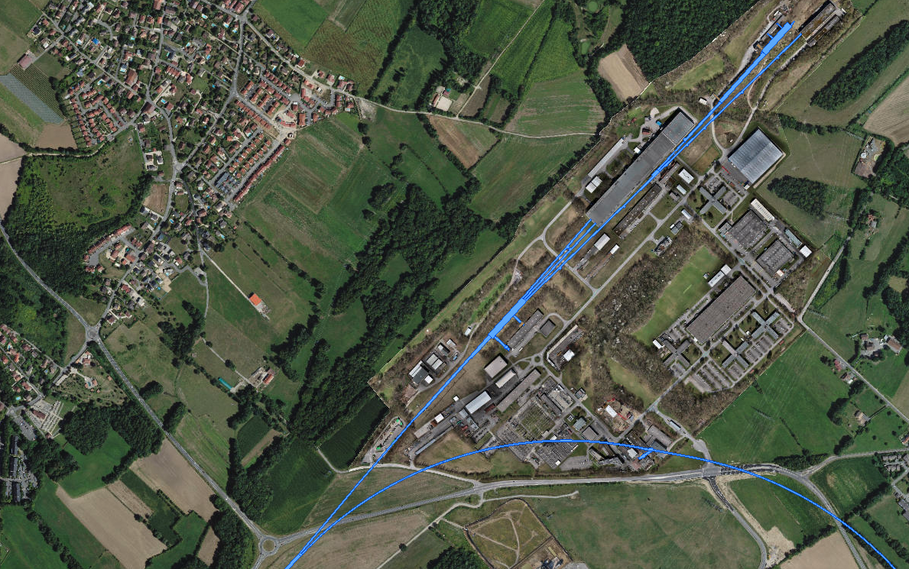
ECN3 and the North Area
ECN3
EHN2
RP sensitive area:
ECN3 Bridge
EHN1
TT85 (P42)
TCC8: T10 / TAX
→ K12
TT83 (P4)
TCC2:
T2 / T4 / T6 / TAX
TDC83
RP sensitive area:
EHN1 Ramp
~ 1.7 km !
TDC2: TT20 splitters
Transfer Tunnel (TT) 20
SPS LSS2
CCC
M. Fraser High Intensity Upgrade of North Area's ECN3 113th Plenary EFCA Meeting 17 November 2023

Slide 6
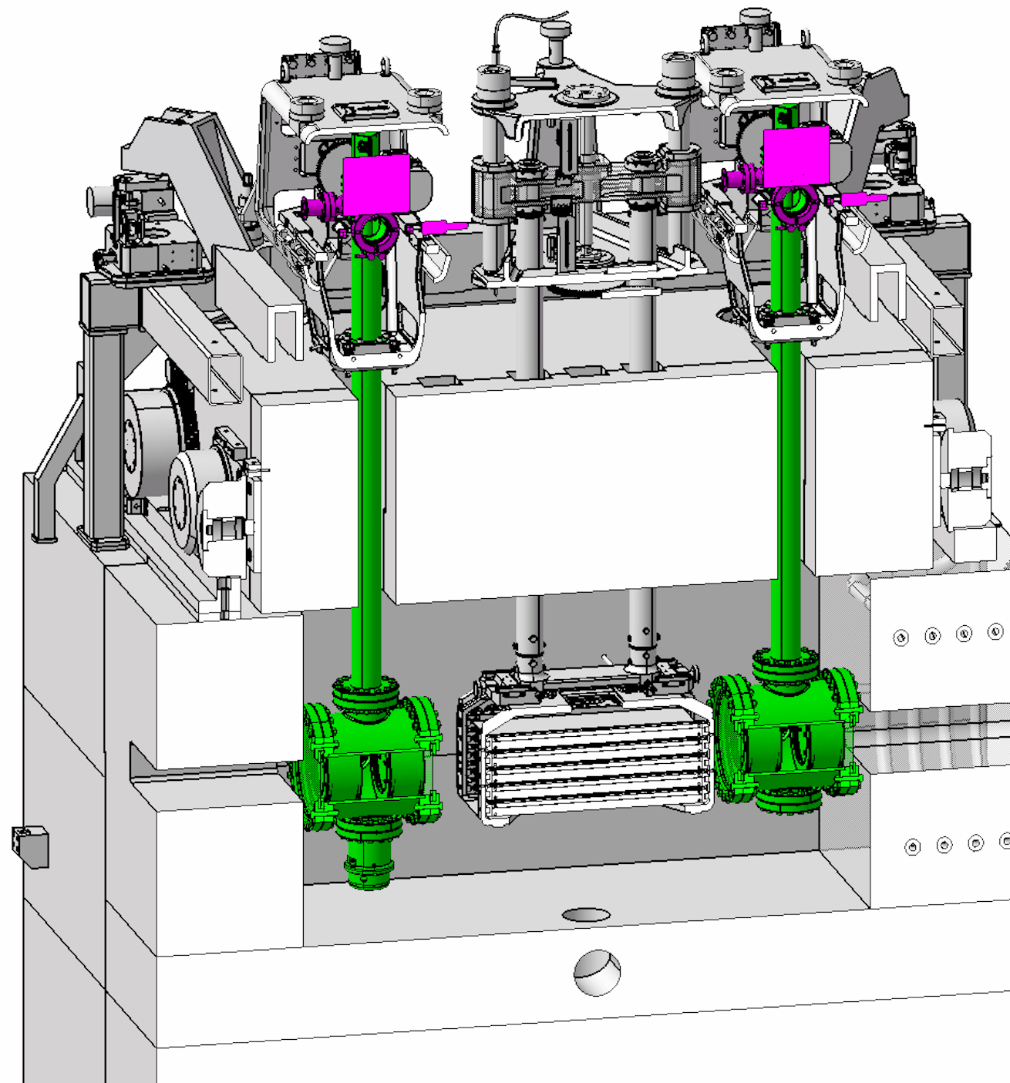
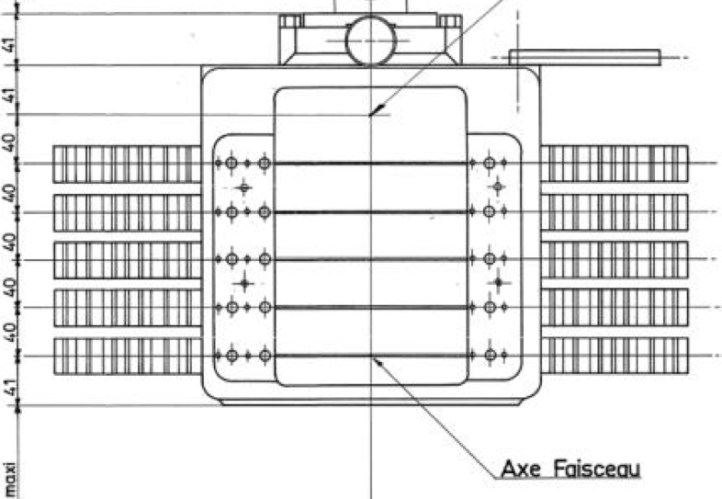
ECN3 Dedicated Beam Delivery Scenario
LSS2
TT21
TT22
TT23
T2
H2
No splitting
in TDC2
H4
SPS
EHN1
H6
Dedicated delivery to ECN3
Shared delivery
TT24
T4
H8
Field-free region
P4
P4:6
P41, P61
No interaction with TCC2 targets
ECN3
TCC8
P42, P62
PBC experiment
Horizontally deflected by the B-field
No losses
Continues straight: no B-field
TT25
T6
M2
EHN2
Optics changed in TT20 to shrink beam size, bump beam down into dipole aperture
Losses (~5%)
M. Fraser High Intensity Upgrade of North Area's ECN3 113th Plenary EFCA Meeting 17 November 2023

Slide 7
Beam Delivery TF Conclusions
Findings of the PBC ECN3 Beam Delivery Task Force, CERN-PBC-REPORT-2023-001
ECN3 TF Report: Appendix - Resource Evaluation, EDMS #2839731
A new high intensity facility in ECN3 is feasible for operation in Run4
  Over an order of magnitude increase in spill and yearly integrated intensity in ECN3
ECN3 upgrade is compatible with the NA-CONSolidation project:
  Critical NA-CONS items identified for action in Long Shutdown 3 (NA-CONS Phase 1)
  NA-CONS project scope and implementation schedule optimised
  Upgrade work in TCC8/ECN3 can be completed in Run4 without impact on NA operation
A dedicated ECN3 cycle is the preferred beam delivery scenario with a vertical magnetic bump to bypass TCC2 target systems:
  Satisfies requirements of all PBC LOIs submitted to SPSC without increasing dose rates
  Reduces scope of work in TDC2 and TCC2 during LS3: NA ready for start-up post-LS3
Cost & resource estimate (inc. M4P) ~ 64 MCHF from today to 2031:
  14 MCHF for high intensity beam delivery to ECN3
  50 MCHF for TCC8/ECN3 facility with peak spending expected 2028 - 2031
M. Fraser High Intensity Upgrade of North Area's ECN3 113th Plenary EFCA Meeting 17 November 2023

Slide 8
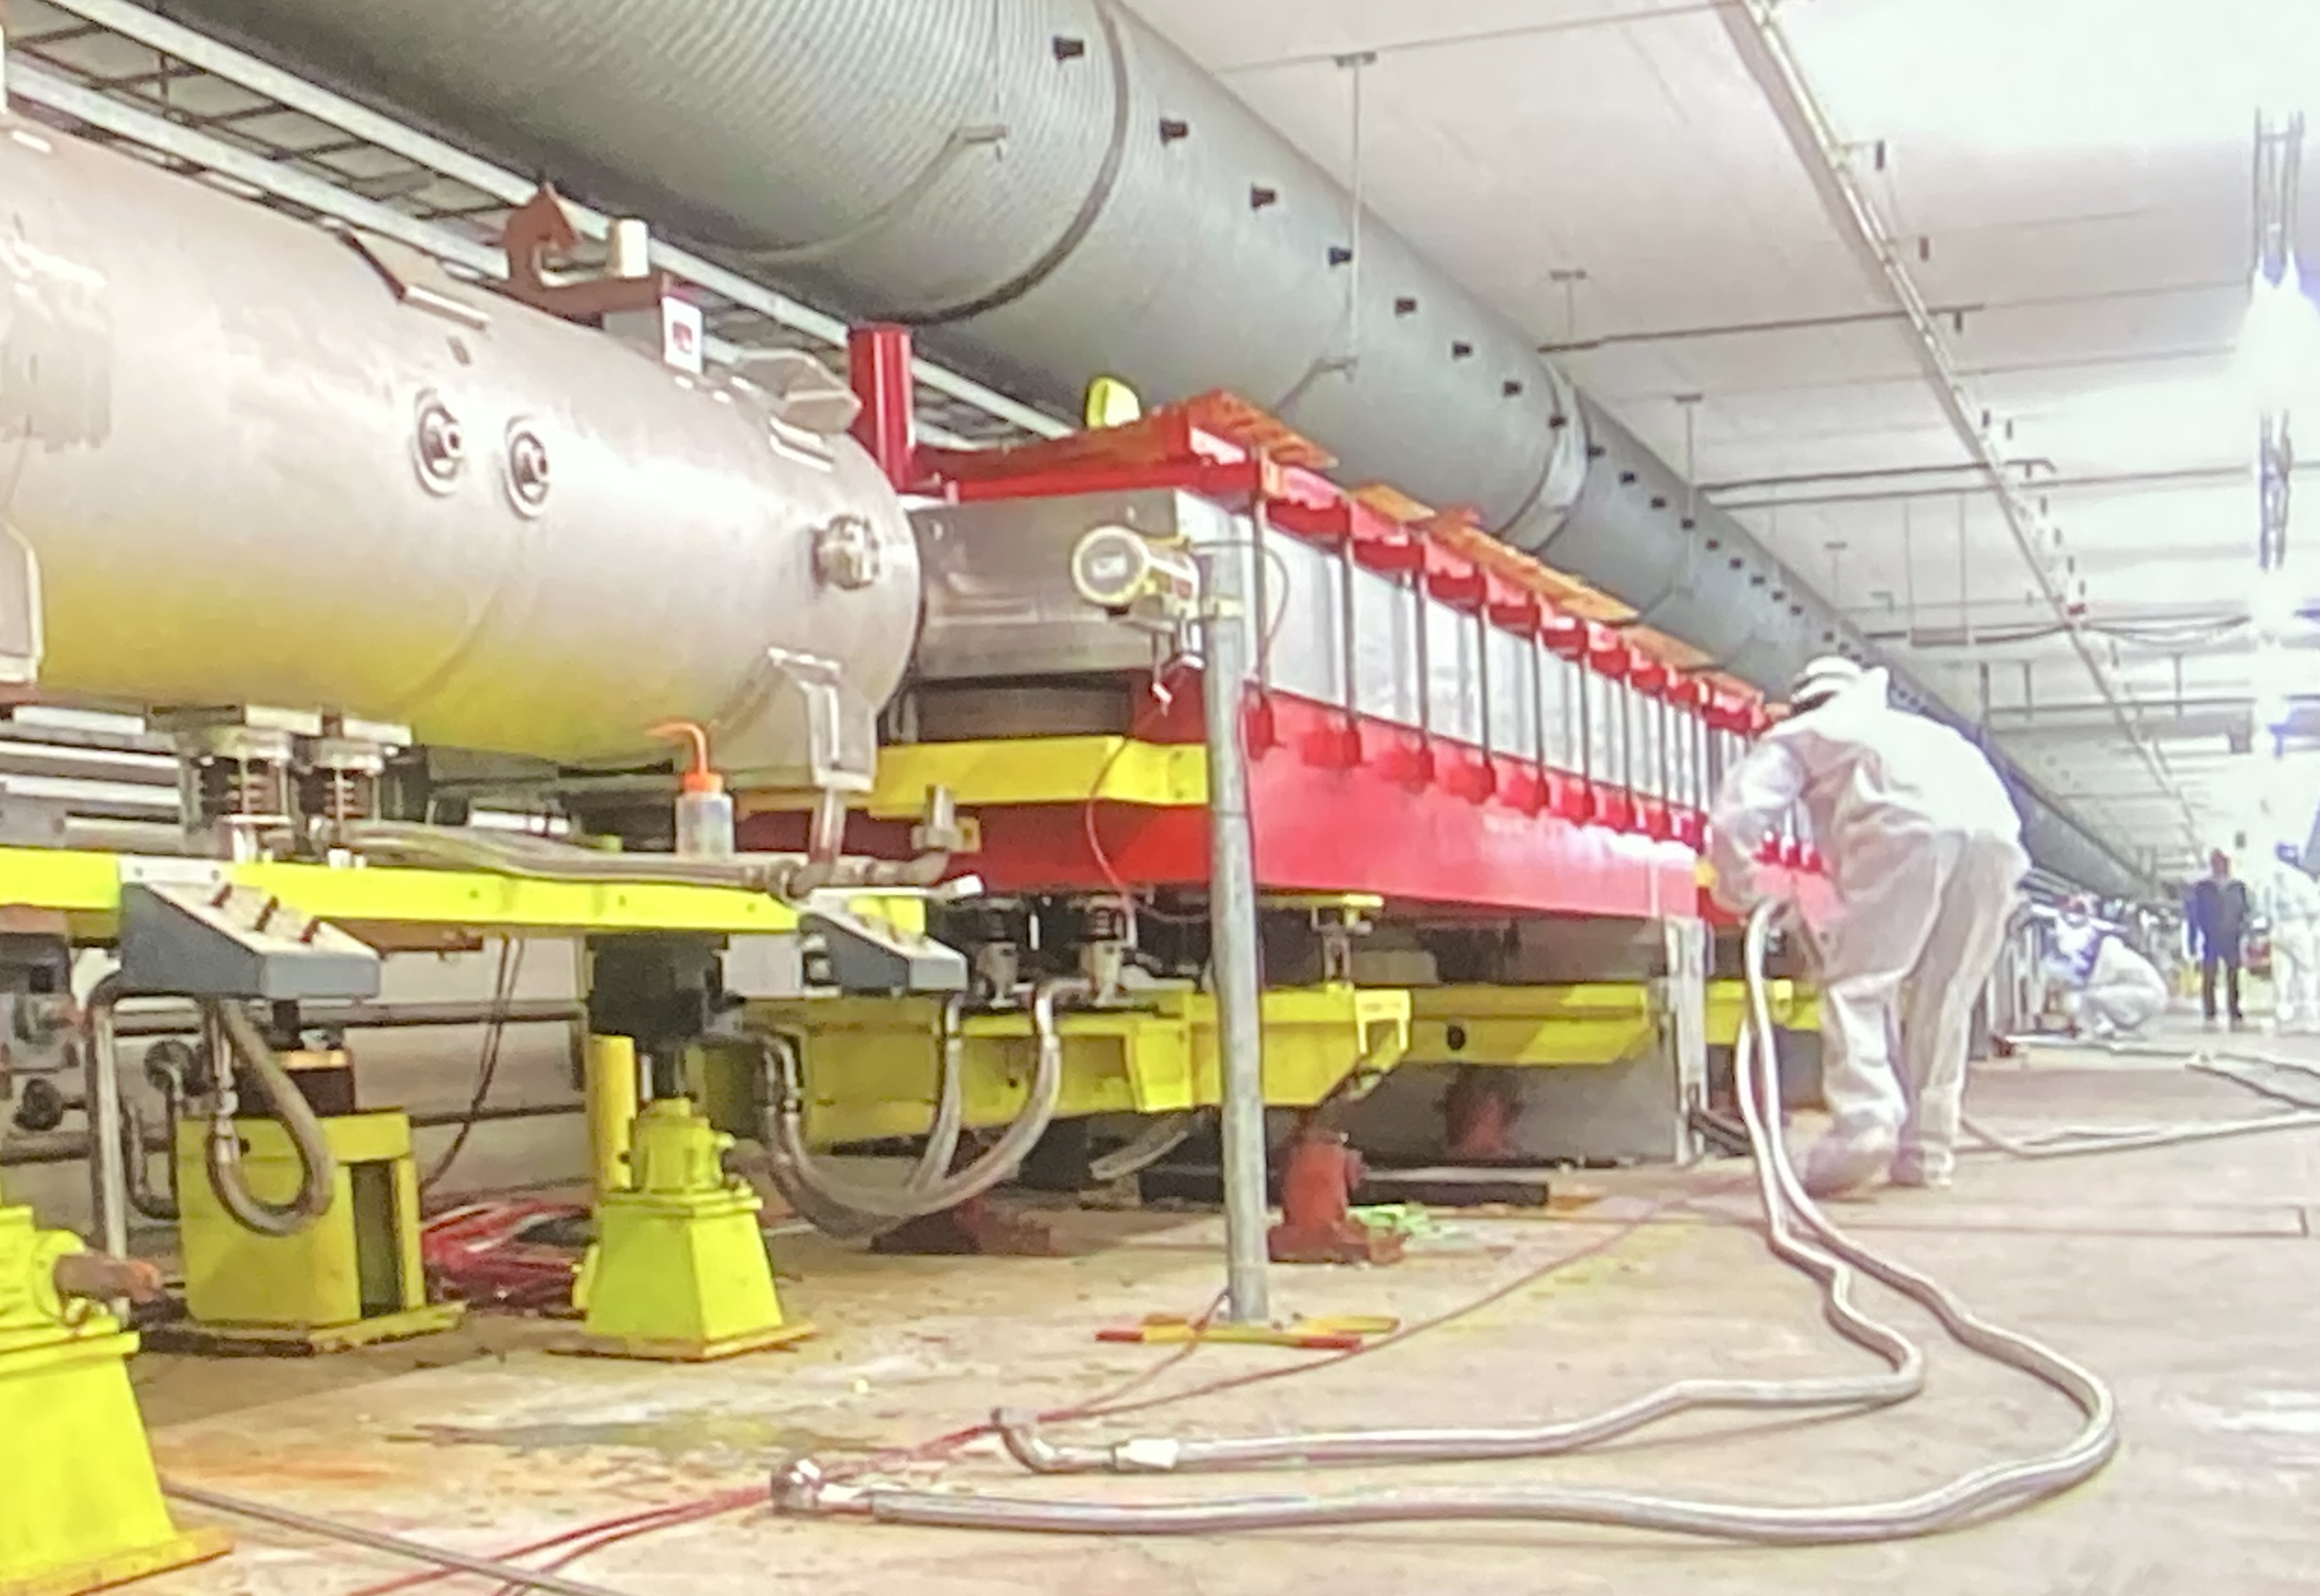
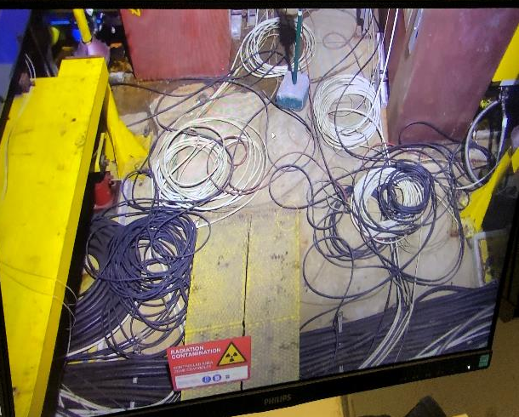
Critical NA-CONS project items in LS3
The North Area and future upgrade plans depend on the reliability and availability of the aged equipment and infrastructure in TDC2 and TCC2:
  A prioritized list of critical items based on recent operational experience have been strongly recommended for consolidation in LS3 to secure the reliability of a new facility in ECN3
LS2
LS3
Leaks: water, vacuum,
cabling/piping rerouting
ALARA improvements,
critical spares
M. Fraser High Intensity Upgrade of North Area's ECN3 113th Plenary EFCA Meeting 17 November 2023

Slide 9
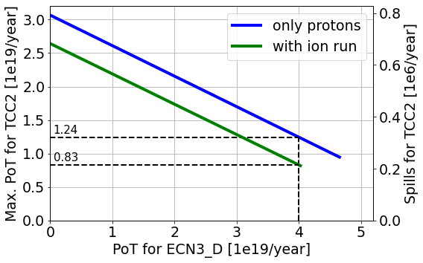
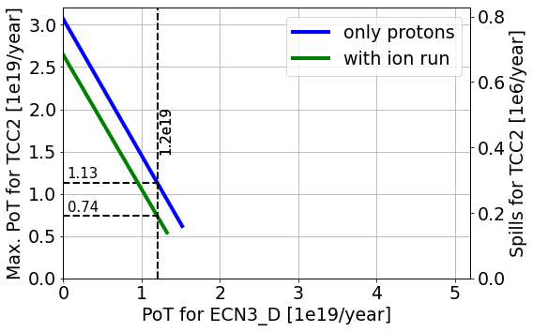
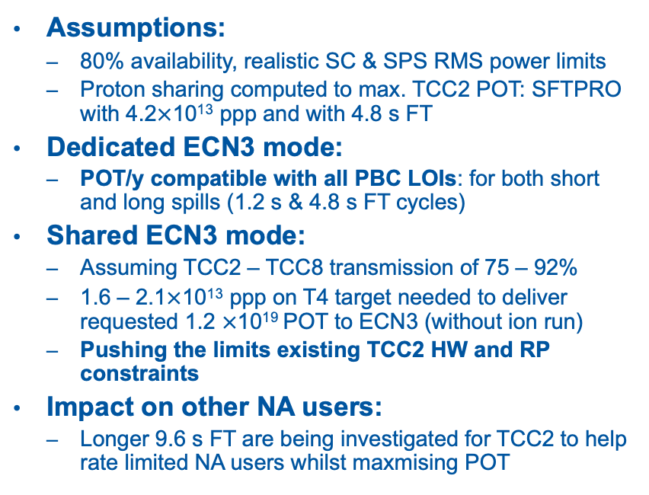


Proton sharing to ECN3
T. Prebibaj et al, SPS Operation and Future Proton Sharing Scenarios for the ECN3 facility, CERN-PBC-Notes-2023-001
1.2 s FT dedicated ECN3 cycles:
Assumptions:
  80% availability, realistic SC & SPS RMS power limits
  Proton sharing computed to max. TCC2 POT: SFTPRO with 4.2$×$10¹³ ppp and with 4.8 s FT
Dedicated ECN3 mode:
  POT/y compatible with all PBC LOIs: for both short and long spills (1.2 s & 4.8 s FT cycles)
Shared ECN3 mode:
  Assuming TCC2 – TCC8 transmission of 75 – 92%
  1.6 – 2.1$×$10¹³ ppp on T4 target needed to deliver requested 1.2 $×$10¹⁹ POT to ECN3 (without ion run)
  Pushing the limits existing TCC2 HW and RP constraints
Impact on other NA users:
  Longer 9.6 s FT are being investigated for TCC2 to help rate limited NA users whilst maxmising POT
ECN3 POT/yr = 4.0$×$10¹⁹
4.8 s FT dedicated ECN3 cycles:
ECN3 POT/yr = 1.2$×$10¹⁹
M. Fraser High Intensity Upgrade of North Area's ECN3 113th Plenary EFCA Meeting 17 November 2023

Slide 10
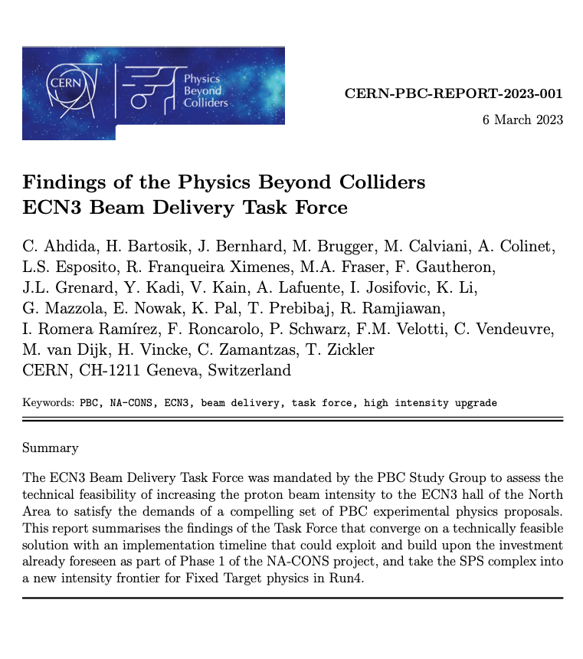
Technical challenges
Solutions to the technical challenges discussed in CERN-PBC-REPORT-2023-001:
Beam Delivery
Extraction beam loss, TT20 and P42 transfer line optics
TCC2 T4 target vertical by-pass: installed & tested in 2023
TCC2 → P42 transmission
RP limitations in P42 from TCC2 to TCC8
Magnet and power converters
Beam intercepting devices: TDC2 (collimator TCSC), TCC2 (T4 / TAX)
TCC8/ECN3:
Requirements for new target system and experimental infrastructure, and alignment with NACONS project scope and schedule
M. Fraser High Intensity Upgrade of North Area's ECN3 113th Plenary EFCA Meeting 17 November 2023

Slide 11
Key technical findings
Solutions to the technical challenges discussed in CERN-PBC-REPORT-2023-001
Upgrades of NA primary transfer lines required:
  Additional beam instrumentation, T4 target bypass (vertical bump), aperture bottlenecks removed, P42 realignment, P42 transfer line dump
  Beam transfer of high intensity will be compatible with RP requirements: areas with insufficient shielding identified and compatible solutions proposed
  Proton flux calibration of beam instrumentation for direct transmission measurements
  Magnetic measurements of spare quadrupoles to improve transfer line optics model
New target complex in TCC8 is a requirement for all PBC LOIs:
  High-power target system (> 100 kW average beam power) respecting today’s RP legislation & best practices
Decoupling of TCC8/ECN3 from the rest of the North Area is possible:
  Allows implementation work to carry on in parallel to NA operation of EHN1/EHN2 after LS3, e.g. for test beams etc.
Limited civil engineering required in TCC8 and ECN3
M. Fraser High Intensity Upgrade of North Area's ECN3 113th Plenary EFCA Meeting 17 November 2023

Slide 12
Target Complex in TCC8
Both BDF/SHiP & HIKE/SHADOWS require high power target systems to be installed in the TCC8 area impacting technical infrastructure
Remote handling is an intrinsic part of design and construction process
Maintenance scenarios and unforeseen operations anticipated as much as possible: limited team for the maintenance of all CERN targets and beam dump areas (CERN objective: max individual dose 3 mSv/y)
Ventilation and dehumidification systems are mandatory to prevent corrosion (which could end to contamination and operational problems)
Activation of soil and groundwater contamination must be well controlled and should minimise environmental impact: geohydrological survey underway
A new Target Complex is the dominant cost of the HI-ECN3 upgrade
M. Fraser High Intensity Upgrade of North Area's ECN3 113th Plenary EFCA Meeting 17 November 2023

Slide 13
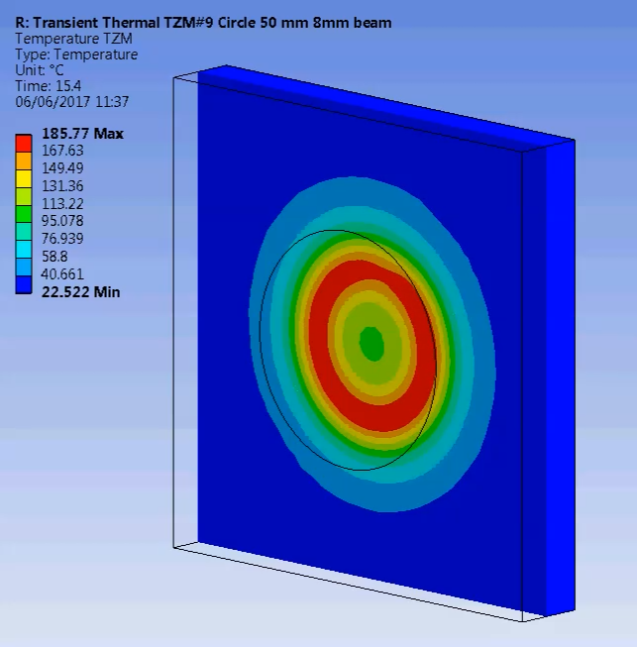
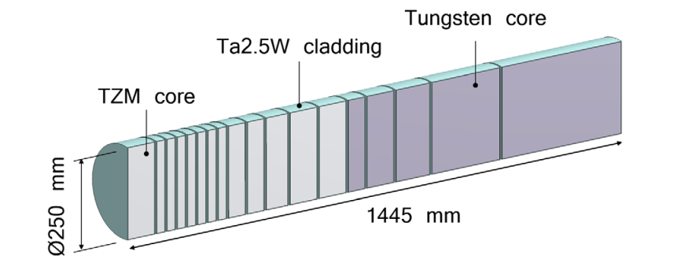
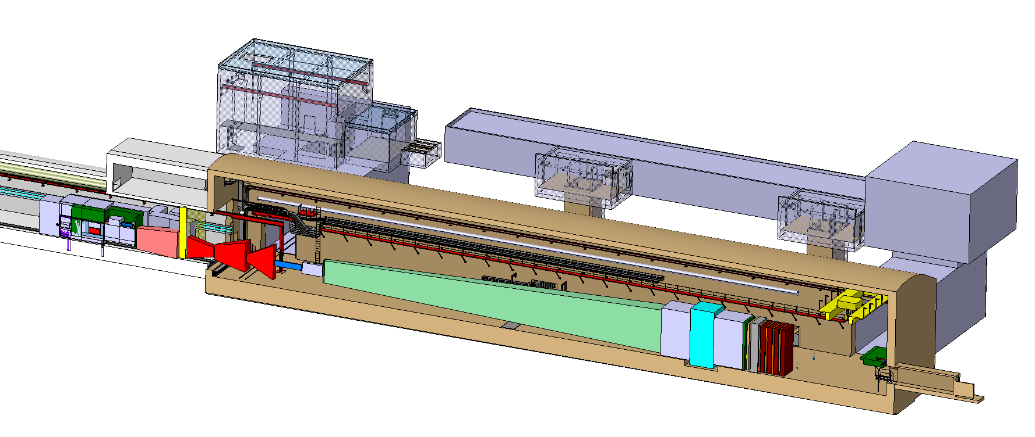
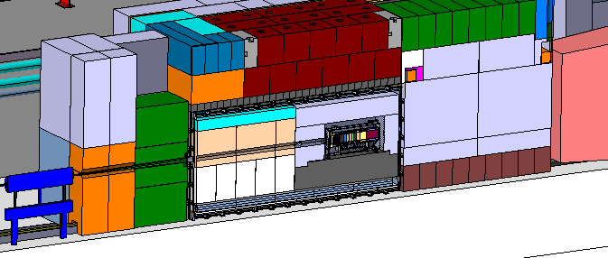
Target Complex: BDF/SHiP
Post-LS3 Experimental Options in ECN3, CERN-PBC-REPORT-2023-003
BDF Target
13x cladded TZM Blocks
5x cladded W Blocks
Beam “diluted” by magnets on the target
New surface building
New access shaft
Spectrometer magnet
TCC8
Muon shield
ECN3
Concept of the
Target Complex and Experimental Area
Vacuum vessel with longitudinal target handling with trolley
M. Fraser High Intensity Upgrade of North Area's ECN3 113th Plenary EFCA Meeting 17 November 2023
13

Slide 14
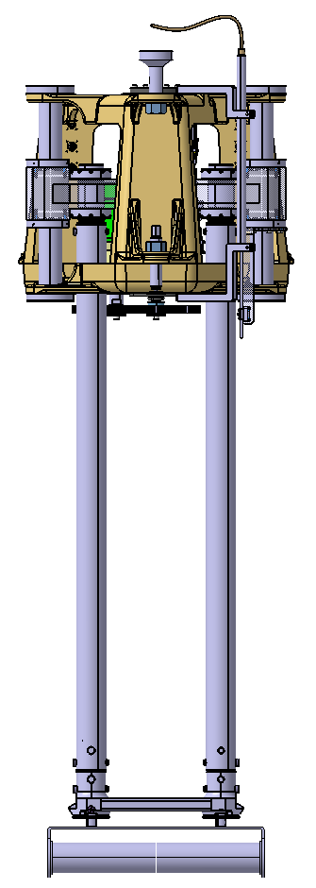
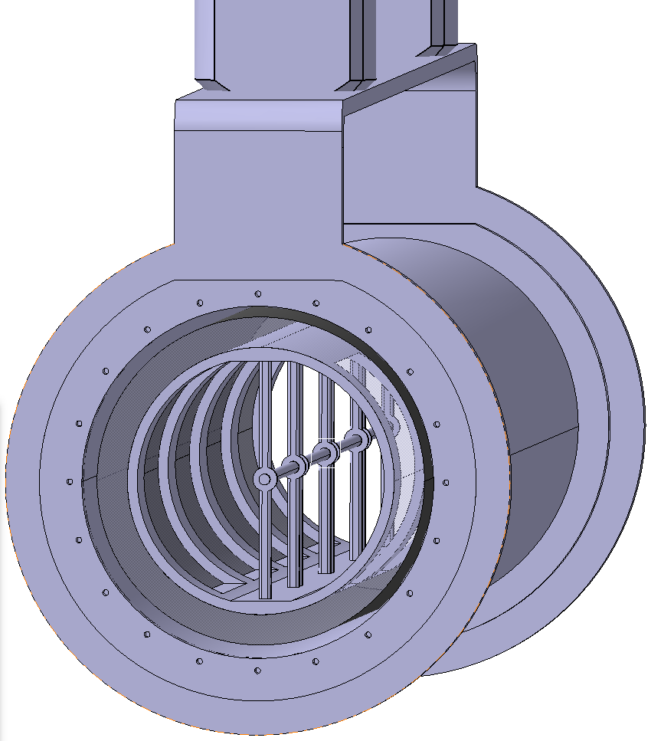
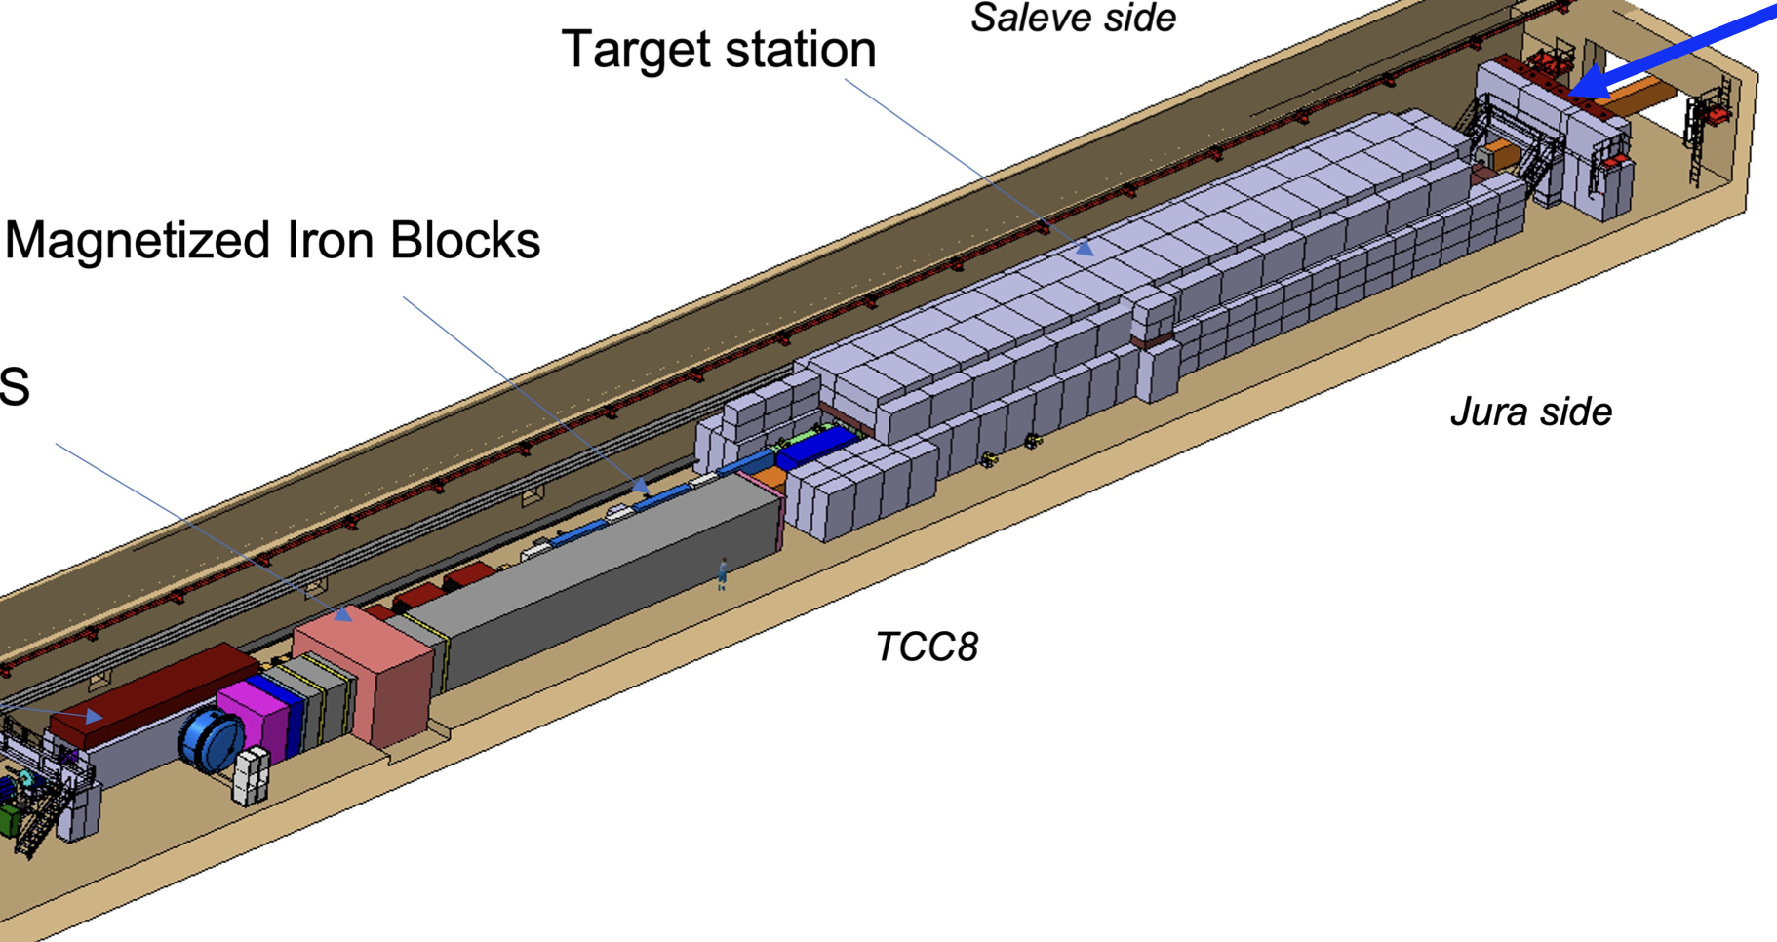
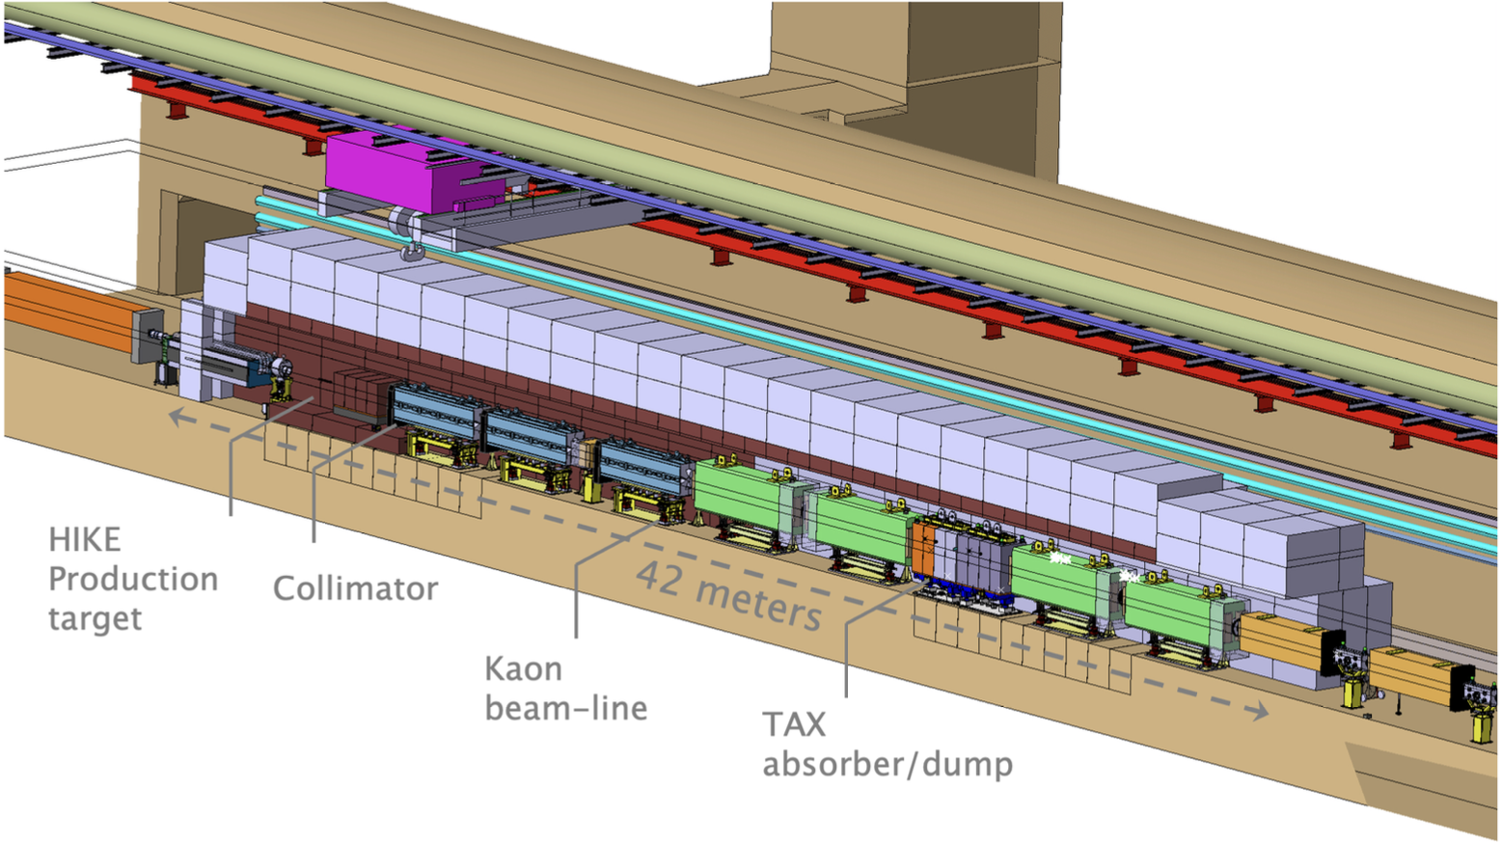
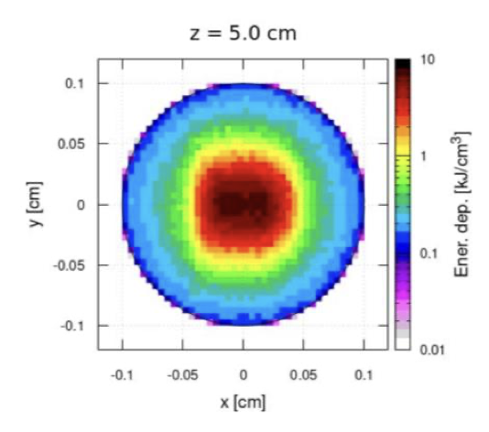
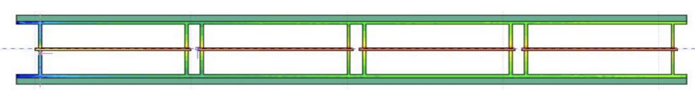
Target Complex: HIKE/SHADOWS
Post-LS3 Experimental Options in ECN3, CERN-PBC-REPORT-2023-003
TCC8
SHADOWS
spectrometer magnet
HIKE Target
Graphite rods supported by C-C
Air cooled
ECN3
Concept of the
Target Complex
M. Fraser High Intensity Upgrade of North Area's ECN3 113th Plenary EFCA Meeting 17 November 2023

Slide 15

Civil Engineering Study
  Study carried out by an external consultant:
  Objective of the study:
    Evaluate the feasibility of the proposed design and to assess the impact on the existing infrastructure
    Identify and evaluate design and construction options
    Create a preliminary cost estimate
  Synaxis AG, “CERN Prevessin Beam Dump Facility ECN3 & TCC8 - Report of
  Preliminary Study,” Lausanne, Switzerland, Tech. Rep. EDMS #2815529, 2023.
  [Online]. Available: https://edms.cern.ch/document/2815529
15
M. Fraser High Intensity Upgrade of North Area's ECN3 113th Plenary EFCA Meeting 17 November 2023
15

Slide 16
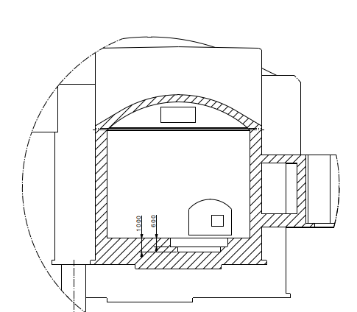
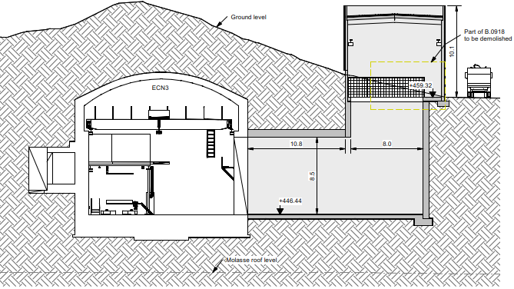
Civil Engineering Study: BDF/SHiP
Civil Engineering works in TCC8 (excavation and creation of the confined area) = 1.2 MCHF
New shaft and access building = 4.5 MCHF
Service Building for Target Complex (500 m²) = 3.1 MCHF
16
M. Fraser High Intensity Upgrade of North Area's ECN3 113th Plenary EFCA Meeting 17 November 2023
16

Slide 17
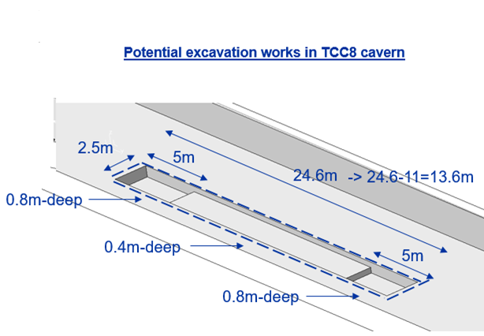
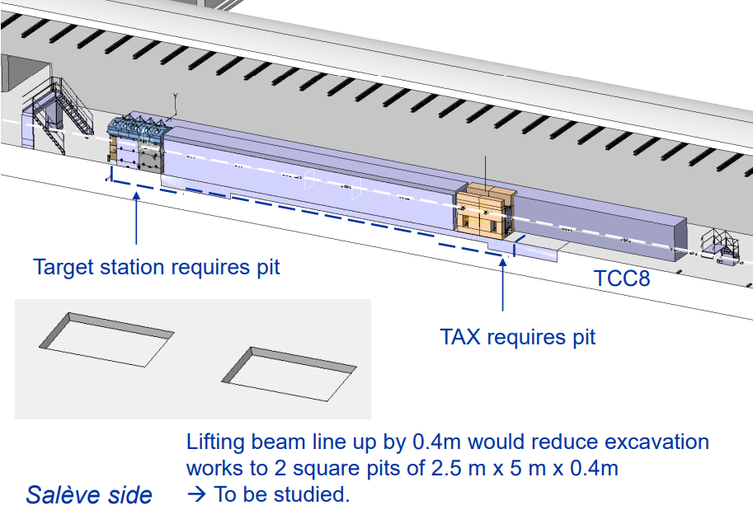
Civil Engineering Study: HIKE/SHADOWS
Civil Engineering works in TCC8 (excavation and creation of the confined area) = 1.2 MCHF
Dimension of the pit 2.8m x 12m x 1m deep, under SHADOWS detector = 0.6 MCHF
Service Building for Target Complex (500 m²) = 3.1 MCHF
17
M. Fraser High Intensity Upgrade of North Area's ECN3 113th Plenary EFCA Meeting 17 November 2023
17

Slide 18
Where are we today? (i)
Research Board (March 2023)
M. Fraser High Intensity Upgrade of North Area's ECN3 113th Plenary EFCA Meeting 17 November 2023

Slide 19
Where are we today? (ii)
Research Board (December 2023)
M. Fraser High Intensity Upgrade of North Area's ECN3 113th Plenary EFCA Meeting 17 November 2023

Slide 20
Where are we today? (iii)
Nomination as PL of ECN3 High Intensity Study inc. Mandate, EDMS #2921486
We came out of the MTP 2023 exercise in a position to move the study forward into a TDR phase:
  Decision of the DG [11/04/2023]: ‘Allocate 2.5 MCHF for 2023 and 2024 for the preliminary works, waiting for the project to be officially approved.’
  TDR budget approved by the CERN Council at the June 2023 meeting
Transitioning to a project ECN3 High Intensity Study (TDR phase):
  Nominated as PL (EDMS #2921486) in August and have been requested to setup the project structure should the project be approved:
NA-CONS Project
Planning &
Coordination
HI-ECN3 Project
WP1 - Project management
WP2 - Beam Delivery to ECN3
WP3 - Target Complex
WP4 - Target & BIDs
WP5 - Experimental Area & Experiment Interface
WP6 - Safety & RP
WP7 - Civil Engineering
ECN3 Experiment Project (EP)
Integration Coordination
Technical Coordination
M. Fraser High Intensity Upgrade of North Area's ECN3 113th Plenary EFCA Meeting 17 November 2023

Slide 21
Implementation schedule (i)
Length of LS3 being discussed:
Critical to have test beam time for experiment detector R&D
Research Board Experiment to be Approved (December 2023)
2023 - 2025: HI beam delivery engineering phase approved
2023 - 2028: NA-CONS LS3 related preparation and implementation phase
2024 - 2031: TCC8/ECN3 facility-specific TDR & implementation phase
M. Fraser High Intensity Upgrade of North Area's ECN3 113th Plenary EFCA Meeting 17 November 2023

Slide 22
Summary and next steps
HI-ECN3 Study Project to be launched imminently with a demanding schedule, but profiting with synergy to NA-CONS project
An experiment-specific decision is needed from the CERN Research Board before the end of 2023 to start experiment-specific TDR in 2024
TDR phase for TCC8/ECN3 facility to work in close synergy with the experiment, aiming for completion by end 2025
ATS counts on a strong collaboration with EP to guarantee we move through the TDR phase of TCC8/ECN3 facility efficiently (& vice versa!)
Attaining SPS North Area test-beam time in 2028 is important
M. Fraser High Intensity Upgrade of North Area's ECN3 113th Plenary EFCA Meeting 17 November 2023

Slide 23
Acknowledgements
Thanks to everyone who supported the PBC Beam Delivery Task Force team effort, including the equipment and service groups
Scientific Secretary: Rebecca Ramjiawan (PBC Fellow, SY/ABT-BTP)
Core-team representatives:
  NA-CONS: Y. Kadi (PL), R. Folch (Engineering), T. Zickler (Technical Systems), F. Gautheron
  TT20/P42 beam studies: Y. Dutheil, R. Ramjiawan, F. Velotti (SY/ABT)
  TCC2/P42 and impact on secondary beam studies: J. Bernhard, M. van Dijk (BE/EA)
  BIDs: M. Calviani, F. Sanchez-Galan, L. Esposito, J-L. Grenard, (SY/STI, BE/EA)
  Radiation Protection: C. Ahdida, E. Nowak, H. Vincke (HSE/RP)
Experts:
  G. Arduini (PBC), V. Kain, K. Li (BE/OP), P. Schwarz (TE/MSC), F. Roncarolo, C. Zamantzas (EABIWG, SY/BI), H. Bartosik, T. Prebibaj (PBC ACWG, BE/ABP), I. Josifovic (SY/EPC), C. Pasquino (TE/VSC), L. Krzempek, (BE/EA), P. Bestmann & C. Vendeuvre (BE/GM), D. Lafarge (EN/HE), F. Galleazzi + M. Lazzaroni (EN/ACE), A. Colinet, I. Romera Ramirez (TE/MPE), Y. Body, S. Deleval (EN/CV), E. Cano Gonzalez (EN/EL), K. Pal (SCE/DOD-FS), R. Franquiera Ximenes, G. Mazzola, A. Romero, C. Sharp, N. Solieri (SY/STI)
M. Fraser High Intensity Upgrade of North Area's ECN3 113th Plenary EFCA Meeting 17 November 2023

Slide 24
Thank you for your attention
Questions…?

Slide 25
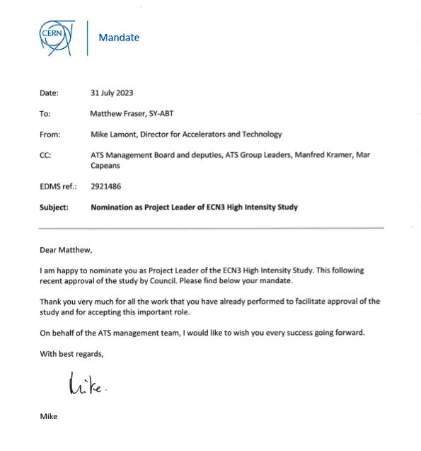

Mandate as PL…
Nomination as Project Leader of ECN3 High Intensity Study inc. Mandate, EDMS #2921486
M. Fraser High Intensity Upgrade of North Area's ECN3 113th Plenary EFCA Meeting 17 November 2023

Slide 26
Mandate as PL…
Nomination as Project Leader of ECN3 High Intensity Study inc. Mandate, EDMS #2921486
Form a Project Team for HI-ECN3:
  Project structure and team to be created with synergy to NA-CONS at its heart
  Discussions started with CERN groups
  Management have reacted positively and supportively, with resources starting to materialise
  EN-ACE will support Coordination for NA-CONS & HI-ECN3
ECN3 Beam Delivery Task Force:
  Continues in earnest until project structure is established
Deliver a TDR by end 2025:
  Timeline with resource and budget needs
  We are already on the critical path to launch civil engineering in 2027 (~ 2 years of civil works)
Asked to report back to ATSMB on 13th October 2023
  Aim to kick-off the project shortly afterwards
M. Fraser High Intensity Upgrade of North Area's ECN3 113th Plenary EFCA Meeting 17 November 2023

