Slide 1
Final Focus Design of CLIC BDS
Enrico Manosperti
11/11/2022

Slide 2
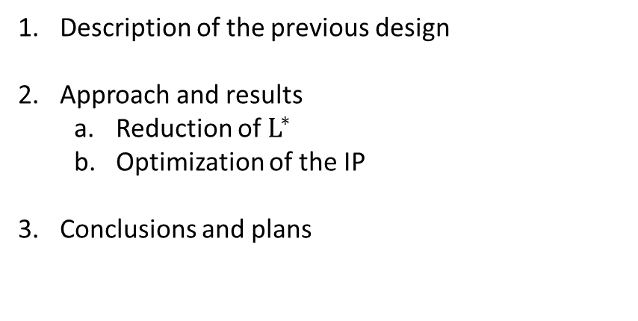
Table of contents
Description of the previous design
Approach and results
  Reduction of $L^{∗}$
  Optimization of the IP
Conclusions and plans
Enrico Manosperti 11/11/2022 2

Slide 3
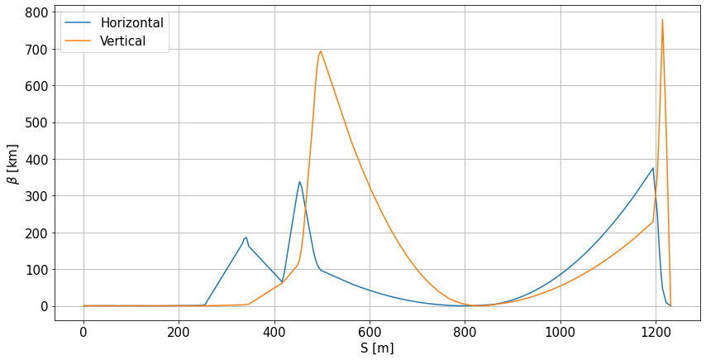
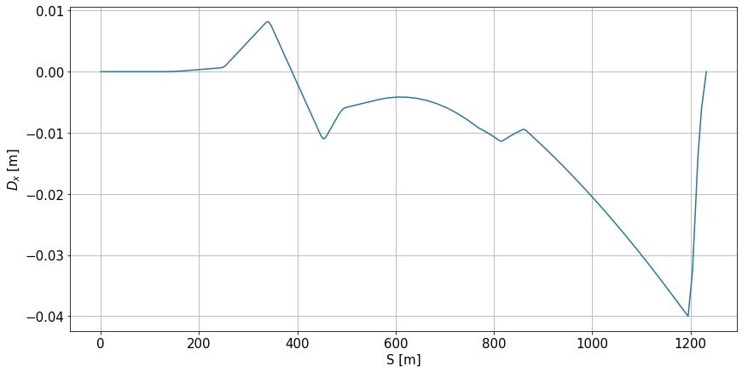

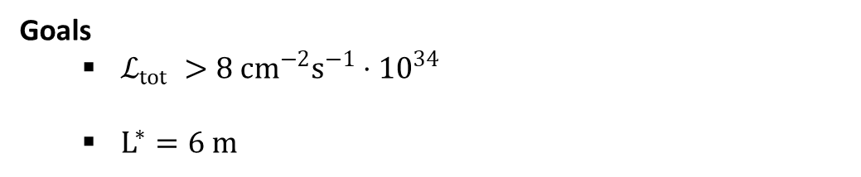
Previous design - FFS
$L_{FFS}=1232 m$
$β_{x}^{∗} /β_{y}^{∗} \left[mm\right]=11 / 0.19$
$σ_{x}^{∗} /σ_{y}^{∗} \left[nm\right]=32.9 / 0.75$
$δ_{p,rms} =0.3\%$
$δ_{p,FW}=1\%$
$ℒ_{tot} /ℒ_{peak} \left[cm^{−2}s^{−1}⋅{10}^{34}\right]=7.68 / 2.67$
$L^{∗}=9.5 m$
Goals
  $ℒ_{tot} >8 cm^{−2}s^{−1}⋅{10}^{34}$
  $L^{∗}=6 m$
Enrico Manosperti 11/11/2022 3

Slide 4
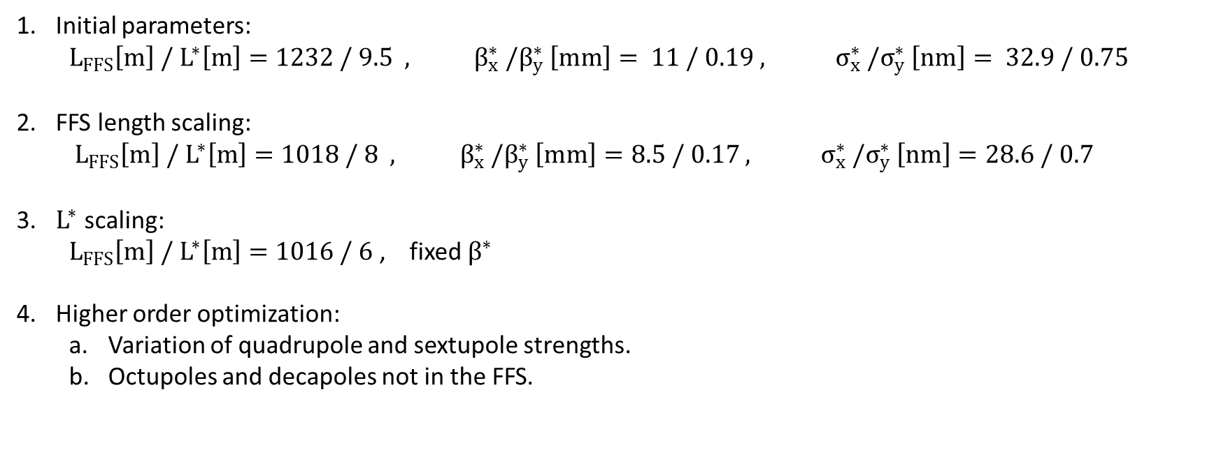
Approach
Initial parameters:
  $$L_{FFS}\left[m\right] / L^{∗}\left[m\right]=1232 / 9.5 , β_{x}^{∗} /β_{y}^{∗} \left[mm\right]= 11 / 0.19 , σ_{x}^{∗} /σ_{y}^{∗} \left[nm\right]= 32.9 / 0.75$$
FFS length scaling:
  $$L_{FFS}\left[m\right] / L^{∗}\left[m\right]=1018 / 8 , β_{x}^{∗} /β_{y}^{∗} \left[mm\right]=8.5 / 0.17 , σ_{x}^{∗} /σ_{y}^{∗} \left[nm\right]=28.6 / 0.7$$
$L^{∗}$ scaling:
  $L_{FFS}\left[m\right] / L^{∗}\left[m\right]=1016 / 6$ , fixed $β^{∗}$
Higher order optimization:
  Variation of quadrupole and sextupole strengths.
  Octupoles and decapoles not in the FFS.
Enrico Manosperti 11/11/2022 4

Slide 5
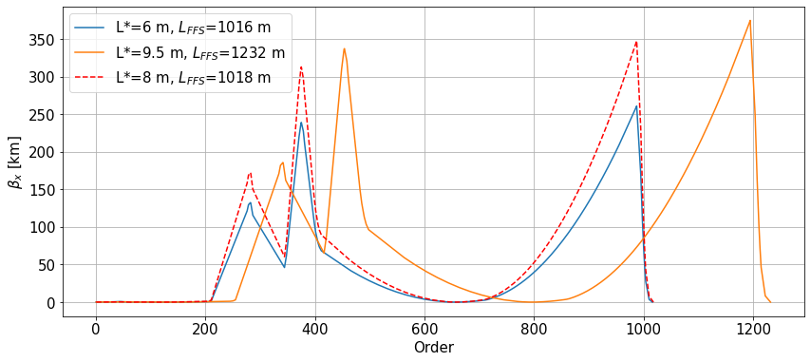
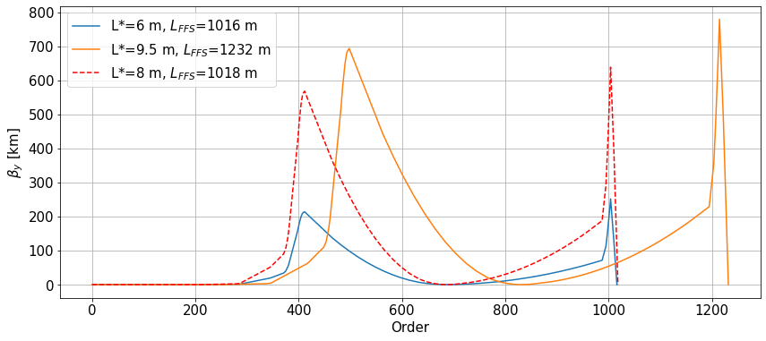
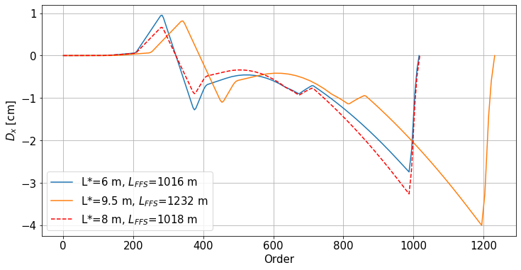
Final Focus - Twiss
Enrico Manosperti 11/11/2022 5

Slide 6
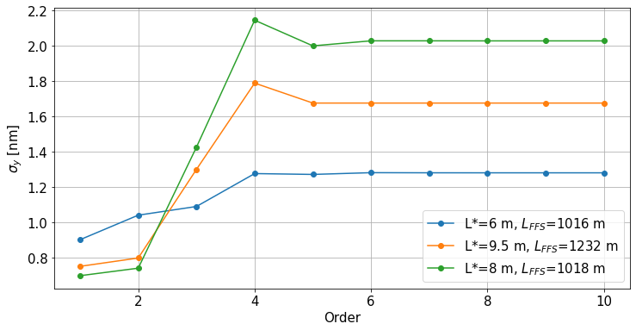
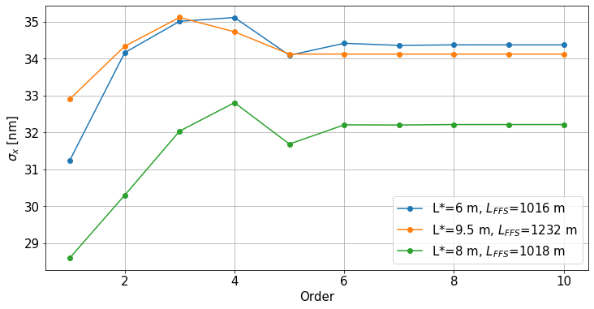
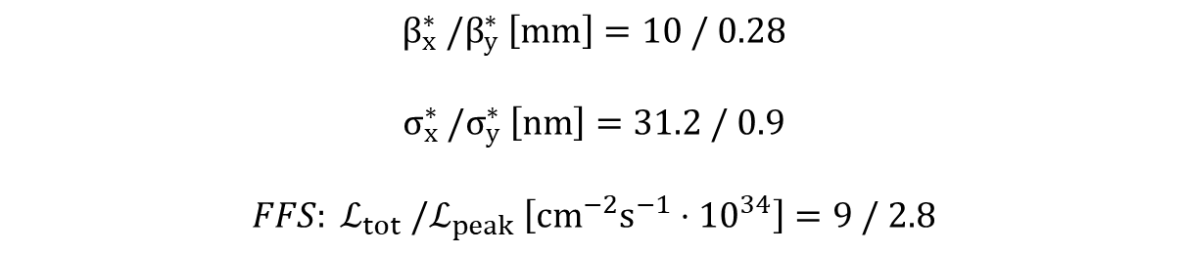
Final Focus - IP
$$β_{x}^{∗} /β_{y}^{∗} \left[mm\right]=10 / 0.28$$
$$σ_{x}^{∗} /σ_{y}^{∗} \left[nm\right]=31.2 / 0.9$$
$$FFS: ℒ_{tot} /ℒ_{peak} \left[cm^{−2}s^{−1}⋅{10}^{34}\right]=9 / 2.8$$
Enrico Manosperti 11/11/2022 6

Slide 7
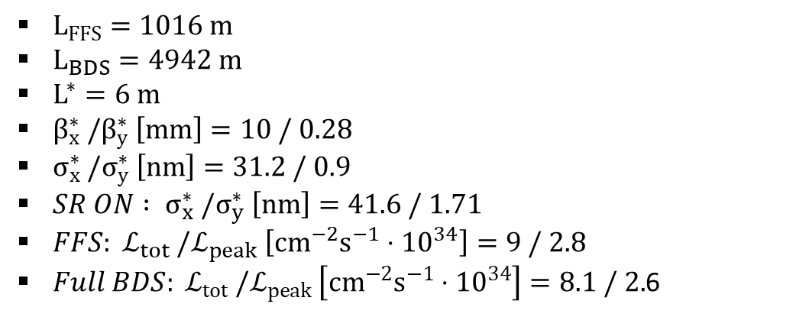
BDS parameters
$L_{FFS}=1016 m$
$L_{BDS}=4942 m$
$L^{∗}=6 m$
$β_{x}^{∗} /β_{y}^{∗} \left[mm\right]=10 / 0.28$
$σ_{x}^{∗} /σ_{y}^{∗} \left[nm\right]=31.2 / 0.9$
$SR ON : σ_{x}^{∗} /σ_{y}^{∗} \left[nm\right]=41.6 / 1.71$
$FFS: ℒ_{tot} /ℒ_{peak} \left[cm^{−2}s^{−1}⋅{10}^{34}\right]=9 / 2.8$
$Full BDS: ℒ_{tot} /ℒ_{peak} \left[cm^{−2}s^{−1}⋅{10}^{34}\right]=8.1 / 2.$6
Enrico Manosperti 11/11/2022 7

Slide 8
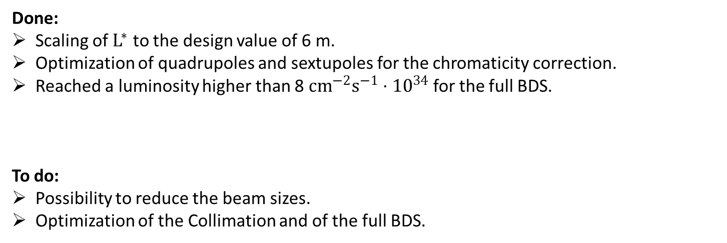
Conclusion and plans
Done:
Scaling of $L^{∗}$ to the design value of 6 m.
Optimization of quadrupoles and sextupoles for the chromaticity correction.
Reached a luminosity higher than 8 $cm^{−2}s^{−1}⋅{10}^{34}$ for the full BDS.
To do:
Possibility to reduce the beam sizes.
Optimization of the Collimation and of the full BDS.
Enrico Manosperti 11/11/2022 8

Slide 9
Extra
Enrico Manosperti 11/11/2022 9

Slide 10
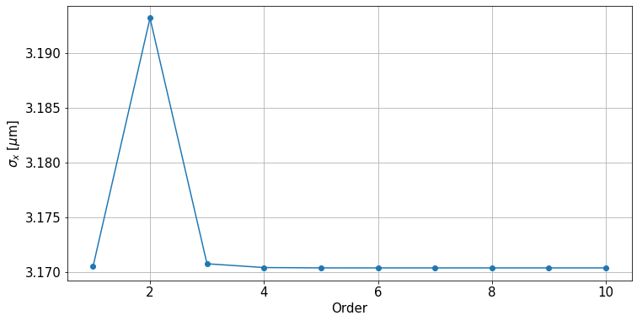
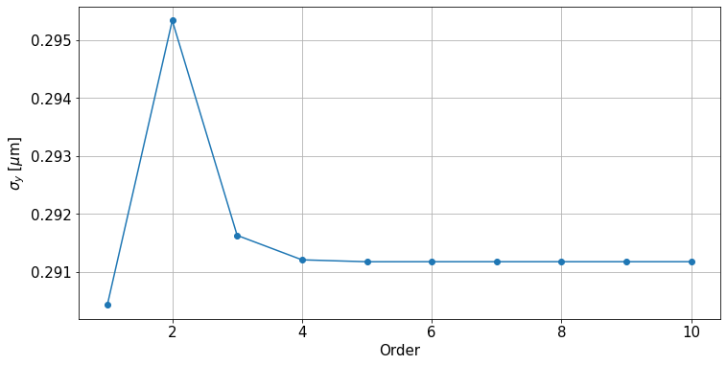
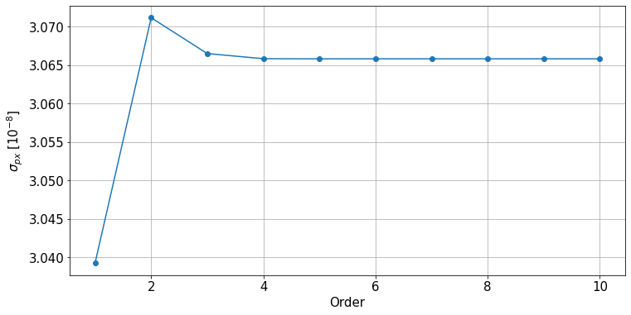
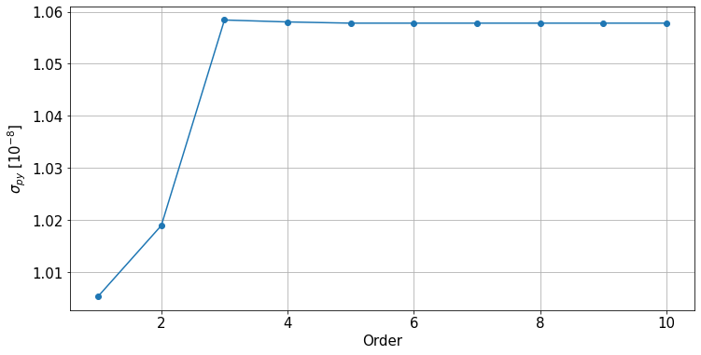
Previous design - End of Collimation
Enrico Manosperti 11/11/2022 10

Slide 11
Phase advance
3 TeV
NAME | MUX | MUY
SF6 | 4.227849 | 7.243695
SD5 | 4.727758 | 7.244884
SF5 | 4.727791 | 7.244950
SD4 | 4.727821 | 7.244963
SF1 | 5.227793 | 7.744952
SD0 | 5.227812 | 7.744961
7 TeV
NAME | MUX | MUY
SF6 | 4.100514 | 7.326528
SD5 | 4.600409 | 7.329722
SF5 | 4.600448 | 7.329899
SD4 | 4.600482 | 7.329934
SF1 | 5.100451 | 7.829908
SD0 | 5.100475 | 7.829931
SD0 - SD4 (X)
3 TeV 9.05200000023143e-06
7 TeV 7.648000000415323e-06
SF1 - SF5 (X)
3 TeV -1.972000000627361e-06
7 TeV -3.4030000000129235e-06
SF5 - SF6 (X)
3 TeV 5.728799999982215e-05
7 TeV 6.65739999998749e-05
SD0 - SD4 (Y)
3 TeV 1.9039999994419077e-06
7 TeV 3.0989999997288464e-06
SF1 - SF5 (Y)
3 TeV -2.3409999991841346e-06
7 TeV -8.818000000410109e-06
SF5 - SF6 (Y)
3 TeV 0.0012541830000003529
7 TeV 0.003371183999999694
Enrico Manosperti 11/11/2022 11

