Slide 2
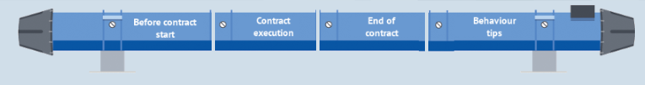
How to follow-up a service contract
(RACI Matrix)

Slide 3
Introduction
Internal audit: Procurement Service to create guidelines (RACI matrix) on the role and responsibilities of technical officer for management of service contracts
Working group created included HSE and representative service contract managers
Document based on best practices

Slide 4

Definition of technical officer
For the present RACI, the technical officer comprises
The technical responsible identified in the contract
Any person helping him/her to supervise the performance of the services
+

Slide 5
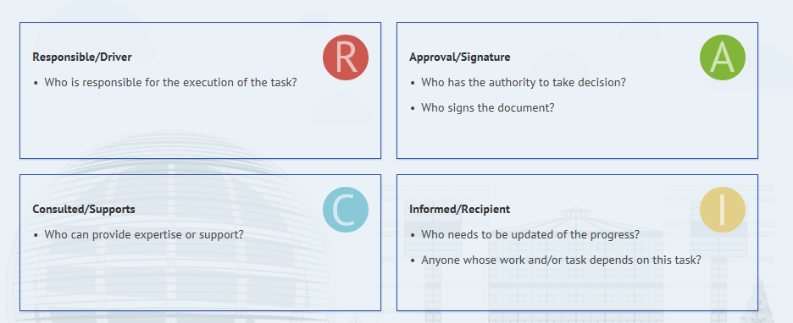
Legend

Slide 6
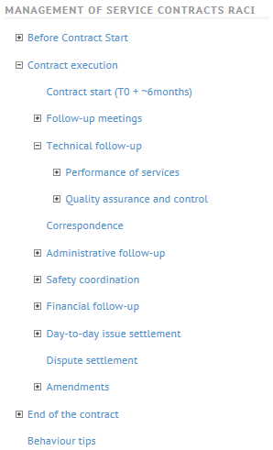
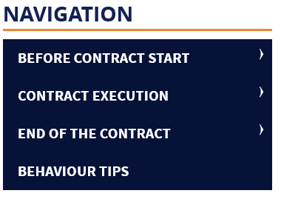
Summary

Slide 7


BEFORE CONTRACT START
The technical and procurement officers shall monitor the implementation of the contract before its start.

Slide 8

Kick-off meeting
1
2
3
4
Nominate CERN’s and contractor’s contacts
Review main aspects of the contract
5
6
7
8
Check coherence between the implementation plan and the evaluation questionnaire (ex.: human and material resources)
Administrative aspects (registration, subcontractors, etc.)
Present CERN property (keys, SIM cards, ODH detectors etc)
Safety and financial aspects
Define actions and set deadlines
Draft minutes

Slide 9
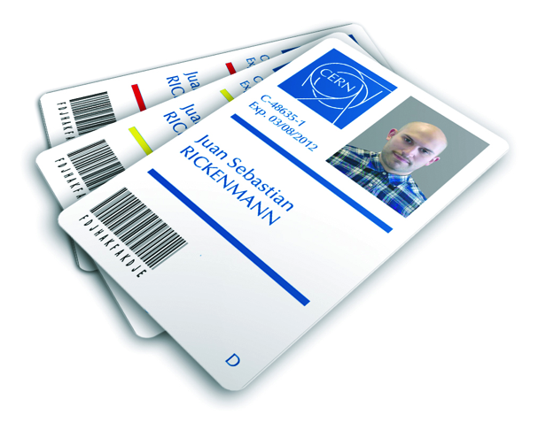
Implementation phase (1)
Organise regular progress meetings (weekly or bi-monthly) to follow the actions decided during the kick-off meeting
Registration and access to the contractor’s personnel (PRT2)
Access to CERN’s buildings (EDH-Adams)
Distribution of CERN property (with inventory, if applicable)

Slide 10
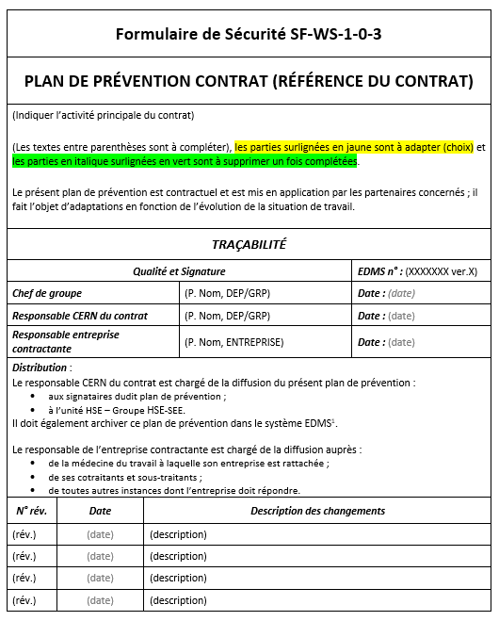
Implementation phase (2)
Prevention Plan (PP)
Joint inspection visit (VIC)

Slide 11
Implementation phase (3)
Explain VAT applicable rules:
  Services performed in FR: invoice including French VAT in EUR;
  Services performed in CH: invoice without Swiss VAT (subject to A/OI exemption form, issued by the procurement service)
This requires that:
  the contractor tracks services performed in FR vs CH;
  Issues two separate invoices.

Slide 12
CONTRACT EXECUTION

Slide 13


Contract start (T0+6 months)
All deliverables (QAP, report templates, etc.) are provided and reviewed according to contract provisions
Check that
All actions agreed are implemented (number and qualification of resources, organization chart, etc.)

Slide 14
Follow-up meetings
2 types (different participants)
Operational meetings
Contractual meetings
(with procurement officer)
Safety
Ongoing activities
Schedule
Quality of service
etc.
Volume of work
Organization chart
Safety issues
Non-conformities, PAL, KPI
Contractual issues
etc.
 The technical officer, not the contractor, shall draft the minutes of meeting

Slide 15
Performance of services
QA
KPI/ SLA follow-up
Management of non-conformities and application of penalties
Information provided for
Small work contracts
Maintenance contracts
Contracts remunerated on a lump sum basis or time spent

Slide 16
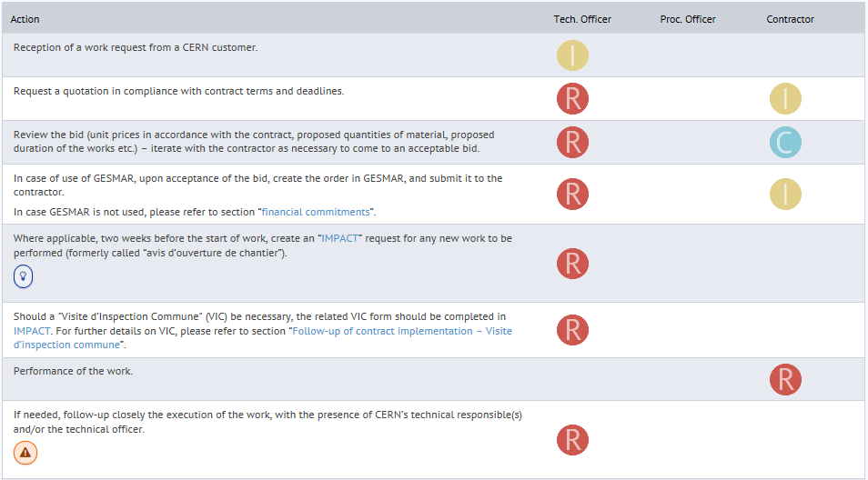
Small works contracts
Notes:
:
QA:

Slide 17
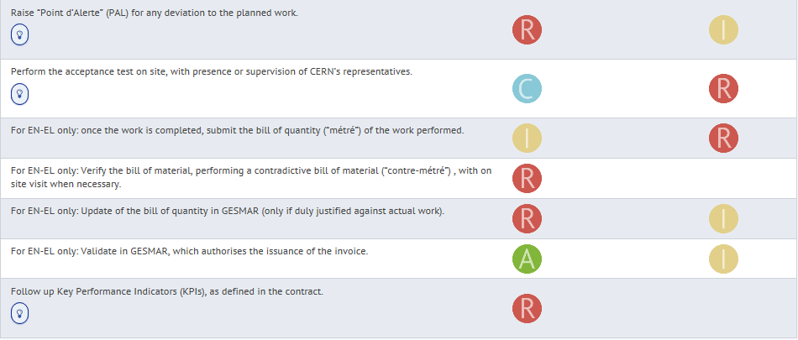
Small works contracts
Notes:
:
QA:

Slide 18
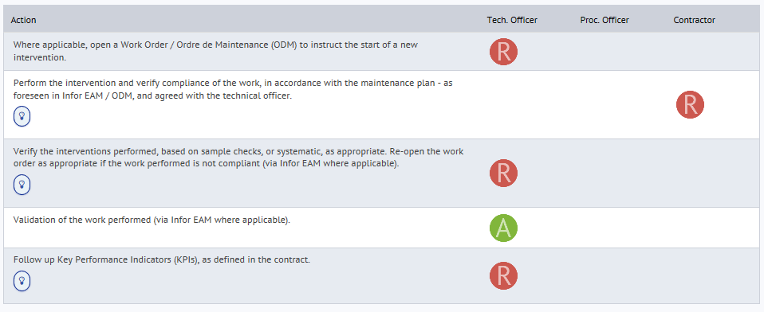
Maintenance contracts (preventive)
Notes:
:
QA:

Slide 19
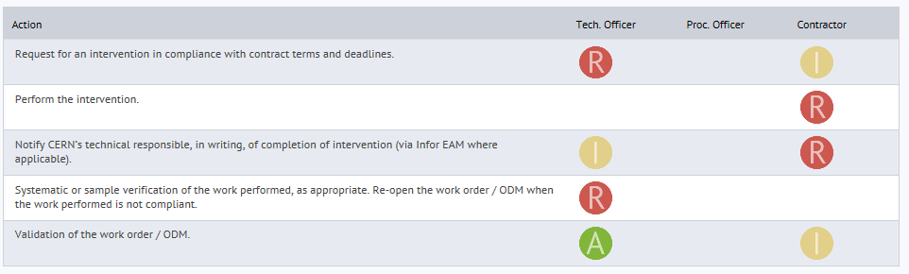
Maintenance contracts (corrective)
Notes:
:
QA:

Slide 20
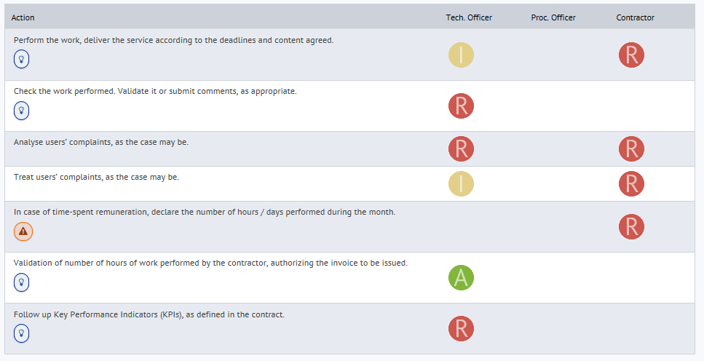
Lump-sum or Time-spent based contracts
Notes:
:
QA:

Slide 21

Correspondence
Keep all records in writing. Documents non-conformities via a NC registry.
The ‘Ordre de Service’ (OS) should include a provision such as:
“You are kindly requested to return to CERN a signed copy of the present Service Order within five working days of its reception. Without any response from you within this deadline, the Service Order will be considered accepted.”

Slide 22



Administrative follow-up
Registration and access authorizations
Approval of a subcontractor
Work outside normal working hours

Slide 23

Safety coordination
 It is the responsibility of the technical officer to inform the contractor of the risks or hazards related to the performance of the services under the contract.
PP and its update
Declaration of incidents
VIC(s)
Notes:
VIC

Slide 24

Day-to-day issue settlement
Up to the technical officer;
The procurement officer shall be informed as soon as the performance of the contract is threatened.
  Ex: Services not compliant with contractual requirements

Slide 25

Dispute settlement
Inform the procurement officer asap:
  document all non-conformities
And together, assess the situation:
  Collect documentation;
  Identify options;
  Prepare negotiations;
  Review termination.
Meetings with the contractor;
Penalties;
Letter of notice;
Decide whether to continue or terminate the contract (withdrawal of bank guarantee?).

Slide 26

Amendments
Will be needed for the:
  Renewal of a contract
  Any contractual change (name of contractor, prices, scope, etc). Please inform the procurement service before committing to the contractor.

Slide 27
END OF CONTRACT

Slide 28

End of contract
Termination
Termination may be due to:
Breach
Gross negligence
Willful misconduct
Convenience, etc.
  Inventories of CERN’s assets (spare parts, access cards, keys, vehicles, etc.)
Expiry
  Date initially foreseen
Notes:
Expiry of the contract at the date initially foreseen. Actions remaining:
Inventories of CERN’s assets (spare parts, access cards, keys, vehicles, etc.)

Slide 29
BEHAVIOURAL TIPS

Slide 30

Behavioural tips (1)
1
2
3
4
5
6
Comply with CERN’s Integrity Policy,
including CERN’s Code of Conduct
Defend CERN’ interests
Read, understand and acquire full
knowledge of your contract
Keep track of all records, do not
make oral commitments
Use templates wherever they exist
Clearly define the roles and responsibilities of CERN personnel in charge of the follow-up of the contract

Slide 31
Behavioural tips (2)
7
Set the relationship with the contractor up for success
Show the example: be prompt, stick to the time frames, be meticulous with paperwork
Be fair and impartial
Be constructive and pragmatic
Distinguish facts and opinions
Trust and verify

Slide 32
Behavioural tips (3)
8
9
10
11
Be respected, but not feared, by the contractor
Be aware of matters and risks related to “délit de marchandage”
12
13
14
15
Do not negotiate on your own, inform procurement service as soon as any dispute arises
Expect and manage change
Learn and share
Protect ‘commercial-in-confidence’ information
Be aware of the evolution of applicable law, rules and regulations
Contact the procurement officer for any question related to contractual and commercial matters

Slide 33
Integrity and ethics codes at CERN
Reference document | Applicable to | Referred to in
CERN Code of Conduct | CERN contributors: ”members of the personnel, consultants, contractors working on the site, or people engaged in any other capacity at or on behalf of CERN” | HR’s website WOCS Procurement's website (Key reference documents) Purchase orders
CERN Code of Professional Ethics | “Anyone involved in procurement for CERN” | Procurement's website (CERN personnel) WOCS
CERN Conflict of Interest Policy and Anti-fraud Policy | CERN contributors | CERN Code of professional ethics Procurement's website (Key reference documents)
Guidelines for the implementation of the Conflict of Interest policy | CERN contributors | CERN Conflict of Interest Policy and Anti-fraud Policy
CERN Supplier Code of Conduct | CERN Suppliers (whether on site or not) | Procurement's website (Key reference documents) Tender Forms (done) Purchase Orders (done) WOCS (being updated) General Conditions of CERN Contracts (will be updated asap)
New

Slide 34

CERN Code of Conduct

Slide 35
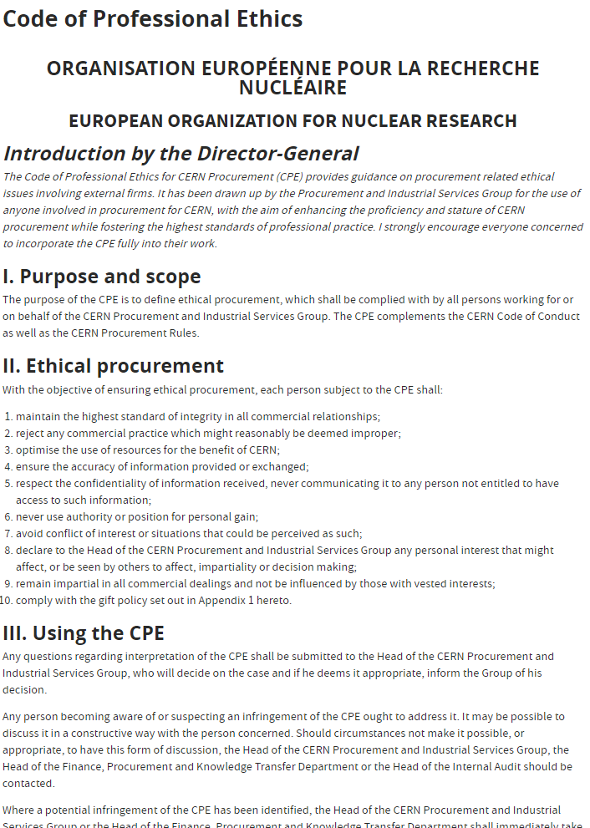





Code of Professional Ethics - Key Principles
Never engage in improper conduct
Avoid any behaviour that could be perceived as unethical or illegal. Never use authority or position for personal gain.
Reject inducements or gifts
Do not accept gifts, favours, or other inducements that may influence or appear to influence your decision making.
Avoid conflicts of interests
Disclose any potential conflict of interest with suppliers or contractors.
Follow procurement rules
Adhere to all procurement policies and procedures
Maintain confidentiality
Keep sensitive information private. Do not share details about contracts or procurement processes.

Slide 36
Gift policy
“ You should neither offer nor accept gifts, favours or hospitality. This applies equally to your family and friends, as well as any individual or organisation with which you are directly or indirectly connected. Examples include:
1
2
3
4
5
6
7
cash gifts of any amount;
a special entitlement given for private use;
travel and/or accommodation paid directly or indirectly;
recurrent invitations for meals or even a single invitation for a meal that could be perceived as excessive or unreasonable;
invitations to sporting, cultural or social events;
recruitment of a family member as a personal favour;
any items, including advertising and promotional items, the market value of which typically exceeds 30 CHF.”

Slide 37
Ethics – conflict of interests
1
2
3
“Conflict of interest arises when the impartiality and objectivity of CERN contributors in the performance of their functions for CERN or in the fulfilment of their contractual obligations towards the Organization could be influenced or compromised by their private interests or any other professional obligations or relationships. […] In particular, CERN contributors are required:
not to accept gifts, favours or hospitality that could create or appear to create a situation of conflict of interest;
to provide immediate notification to CERN if, in the performance of their functions, they are called upon to advise on, to decide on or to control matters in which they have a private interest or competing professional obligation or relationship which could impair or appear to impair their impartiality and objectivity;
to discuss the matter with their relevant hierarchy at CERN if they are unsure as to whether a conflict of interest might exist.”

Slide 38

CERN Supplier Code of Conduct
Available in Documents: Key Reference Documents | Procurement and Industrial Services Group (cern.ch)
New

Slide 39
RACI MATRIX WEB PAGE

