Slide 1
G. De Robertis, F. Licciulli, F. Loddo
Micro-RWELL Frontend Electronic

Slide 2

FATIC2 architecture
Features:
Technology: TSMC 130 nm
32 channels
  Programmable polarity, gain and peaking time
  Charge and time measurement
  Time measurement using 100 ps TDC
Calibration, Bias and Monitoring
  Charge injection calibration
  Programmable biases (currents and voltages)
  Monitoring ADC (12 bit SAR)
320 Mbps serial link, LpGBT compatible
Power supply 1.2 V
Radiation hardness: up to 100 Mrad
In_Chtest
Test Channel
Digital
Control Unit
I/O
In_Ch0
Analog Channel 0
In_Ch1
Analog Channel 1
In_Ch31
Analog Channel 31
TDC
Global Bias

Slide 3
Channel block diagram
Charge branch
Shaper
Peak
Detector
Ack.
Comparator
Digital
Logic
Preamplifier
Fast
Comparator
TDC
Timing branch
Preamplifier features:
CSA operation mode
Input signal polarity: positive & negative
Recovery time: adjustable
Timing branch:
  Measures the arrival time of the input signal
  Time jitter: 400 ps @ 1 fC & 15 pF (Fast Timing MPGD)
Charge branch:
  Acknowledgment of the input signal
  Charge measurement: dynamic range > 50 fC, programmable charge resolution
CSA mode:
Programmable Gain: 10 mV/fC ÷ 50 mV/fC
Peaking time: 25 ns, 50 ns, 75 ns, 100 ns

Slide 4
CSA output dynamic measurement
CSA output dynamic
Measured gains:
  HG: 37 mV/fC
  LG: 9.66 mV/fC

Slide 5
CSA noise vs input cap
Measurement conditions: fast-branch, LG, positive polarity

Slide 6
Fast-branch: timing measurements
TOA
Jitter
Measurement conditions: fast-branch, LG, positive polarity, 100 pF input capacitance, threshold 4.5 fC
Threshold can be reduced

Slide 7
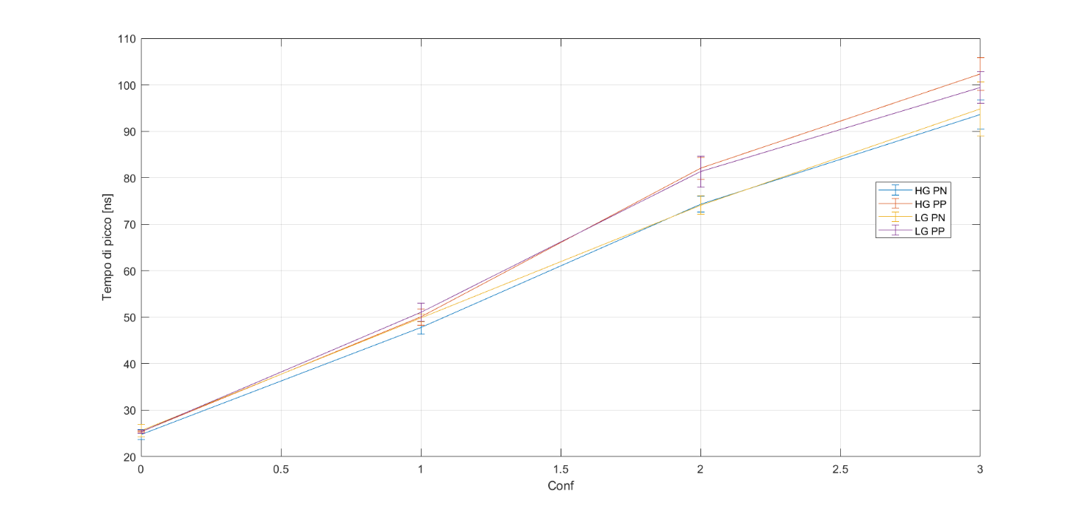
Charge branch: peaking time measurement

Slide 8
Charge branch: charge measurement

Slide 9
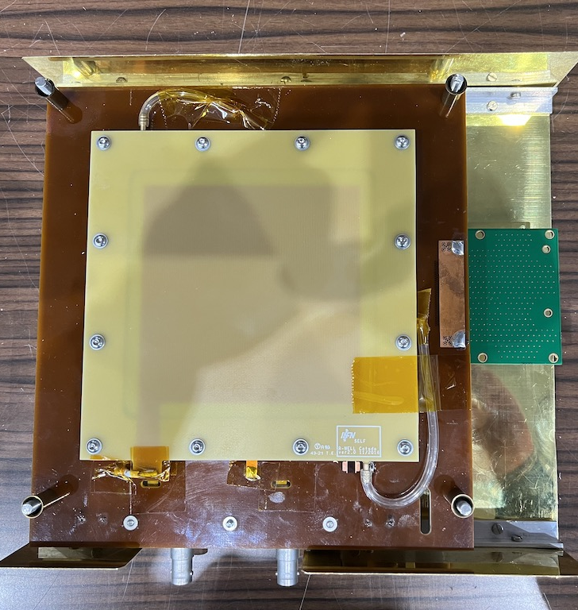
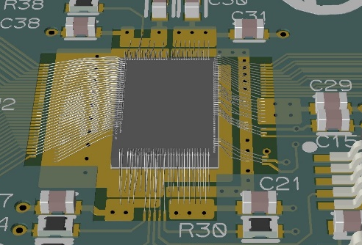
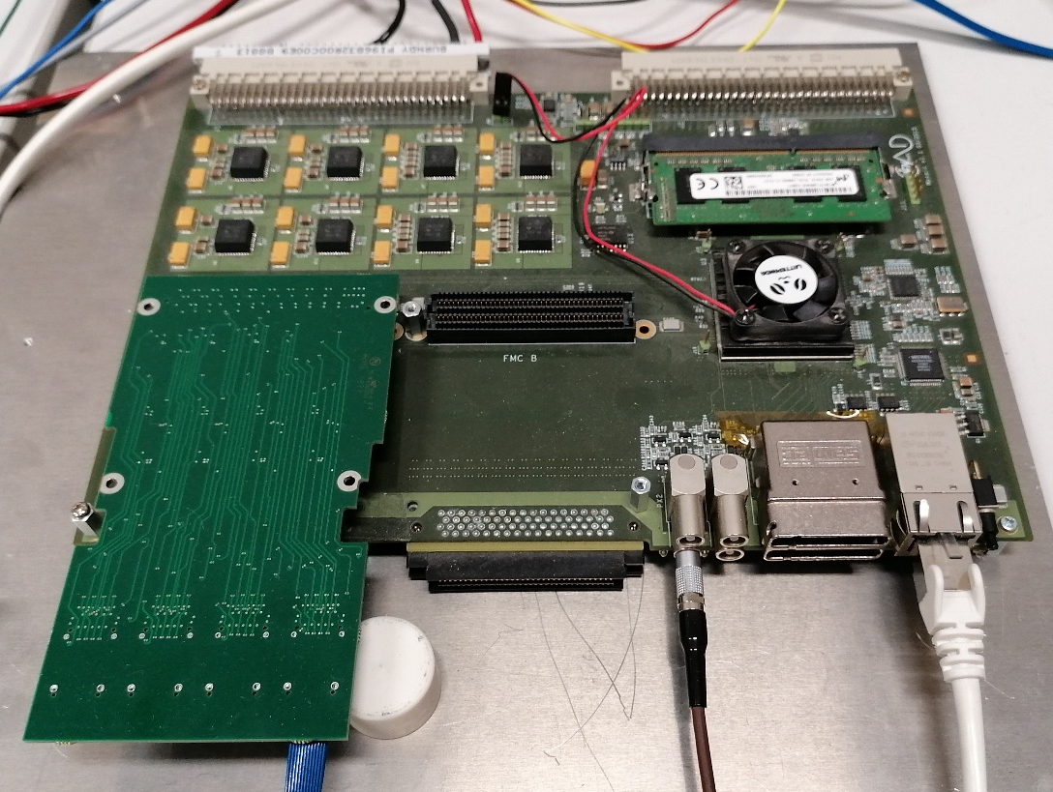
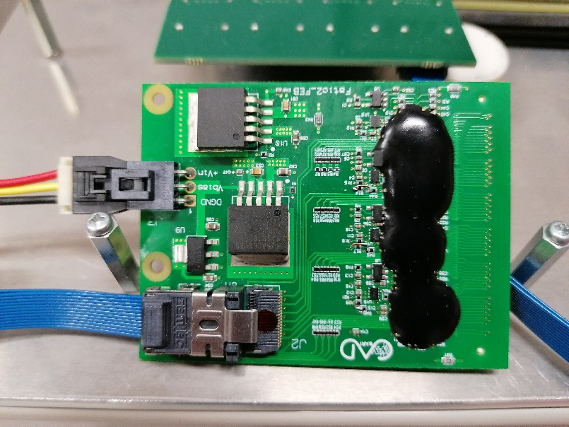
Test setup
Test system ready to perform noise measurement and data acquisition from up to 4 Front-End boards (4 x 128 channels)
Trigger system will be implemented in firmware

Slide 10
To do
Test @ INFN-Bari:
  10 x 10 cm2 u-rwell is arriving @ INFN BARI,
  FATIC2_FEB to read-out the chamber,
  Test target:
    Noise measurements: understand the pad capacitance effect on the current front-end
Test @ INFN-Frascati:
  10 x 10 cm2 u-rwell + FATIC2_FEB, FATIC2 test board
  Measurement with cosmic muons
  Test target:
    Timing measurements (with FATIC2_FEB)
    Charge measurements (with FATIC2_FEB): statistic on the u-rwell charge
    u-rwell output waveform acquisition (with FATIC2 test board): understand the signal shape, time duration
Purpose of tests:
  Collect data about the u-rwell: capacitance, signal shape (charge and time duration)
From preliminary discussions, the FATIC2 front-end is not suitable for LHCb application: architecture not suitable for the expected rate.
Combining the test results and the LHCb specifications we should study:
  Feasibility of the design
  Choose the most appropriate front-end architecture

