Slide 1

Crab Cavity impedance at the fundamental
Update on the RF comb filter
P. Baudrenghien, CERN, SY-RF
HL-LHC WP2/WP4 meeting, Nov 22nd 2022

Slide 2
Crab Cavity impedance at the fundamental
The transverse impedance caused by a single crab cavity is
with
This results in 902 kΩ/m per cavity
We count on the active RF feedback to reduce it
Beam dynamics calculations show that reduction by a factor of 1000 (linear) is required.
Symbol | Value | Unit
ω_{R} | 2 π 400.8 10⁶ | s⁻¹
Q_{L} | 5 10⁵
R/Q | 215 | Ω
R_{s} | 7.575 10⁹ | Ω/m²
R_{x} | 9.024 10⁸ | Ω/m
τ | 1.2 10⁻⁶ | s

Slide 3
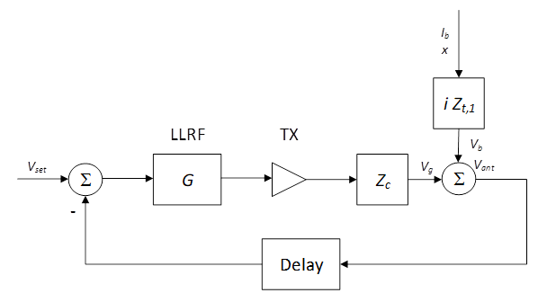
RF feedback (1/2)
The LLRF will include a proportional RF feedback
The idea is to measure the cavity voltage (V_{ant}), compare it to the demanded (constant) crabbing voltage (V_{set}) and generate a drive (TX current) that corrects for the error
Z_{c} is the ratio between cavity voltage and generator current

Slide 4
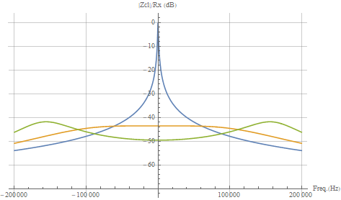
RF feedback (2/2)
The gain in a proportional RF feedback is limited by the loop delay
In the HL-LHC layout this delay is estimated at τ =1.2 μs
The maximum feedback gain is then calculated at 150 (linear)
With the RF feedback, the effective cavity transverse impedance becomes
Reduction of the modulus of the transverse impedance with:
No feedback (blue)
Feedback gain=150 (orange)
Feedback gain=300 (green).

Slide 5
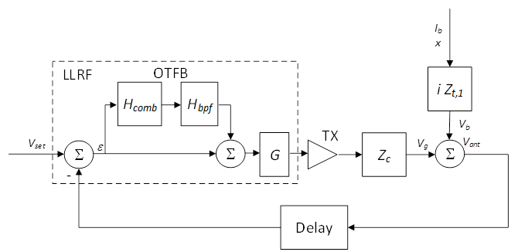
Comb filter (1/3)
To prevent coupled-bunch instabilities (mode 1) the impedance must be reduced on the synchrotron sidebands (k ± Q_{s}) f_{rev} for longitudinal motion, and on the betatron sidebands (k ± Q_{β}) f_{rev} for transverse motion
Comb filters providing additional gain on the synchrotron sidebands, with an exact One-Turn delay, are widely used in LLRF for accelerating cavities (PS, SPS, LHC, PEPII,…)
We propose to adapt the design to cover the betatron bands.

Slide 6
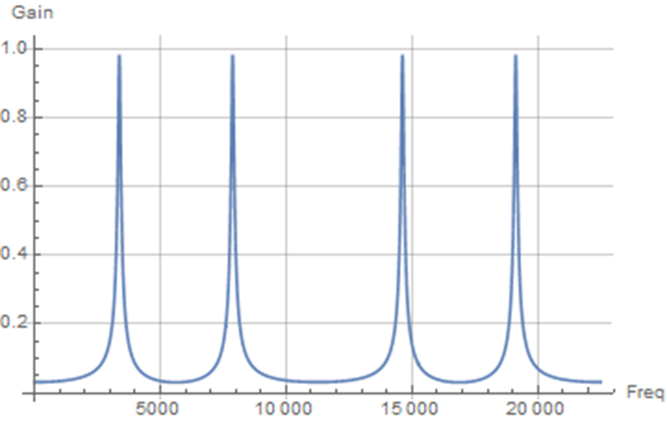
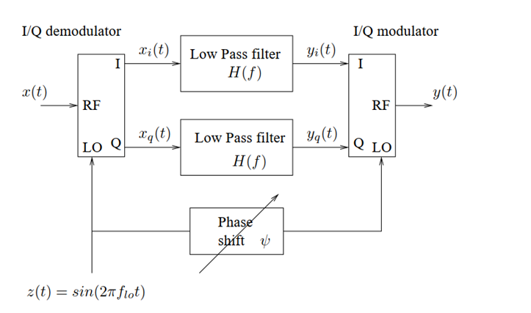
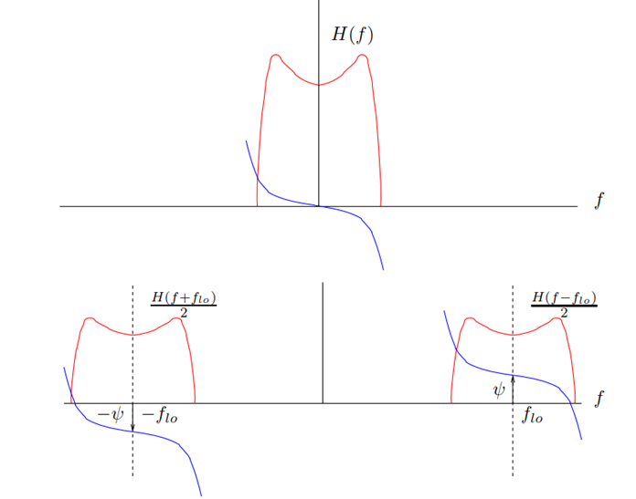
Comb filter (2/3)
We start with a baseband filter having resonances at (k ± Q_{β}) f_{rev}
Then we insert it into a pair of I/Q demodulators/Modulators whose LO is equal to the f_{RF}
The result is a BPF centered at f_{RF} with resonances on the betatron sidebands.

Slide 7
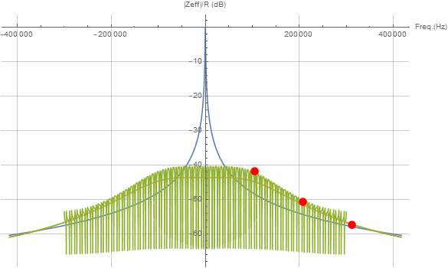
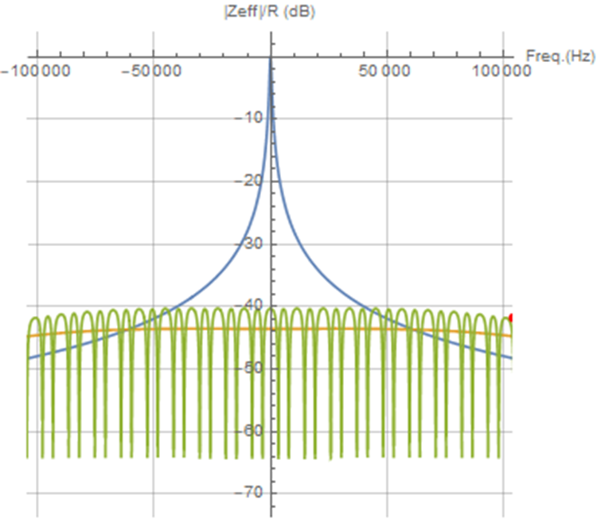
Comb filter (3/3)
The effective cavity impedance now becomes (with τ’ =2.8 μs)
The impedance is further reduced on the betatron bands by 10 (linear)
The comb response must be limited to the ± 300 kHz band.
Reduction of the modulus of the transverse impedance with:
No feedback (blue), RF Feedback (orange), RF and comb Feedback (green).

Slide 8
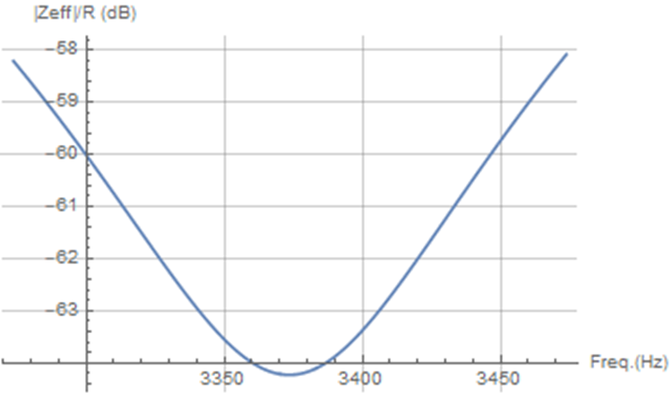
Conclusion
With the combination of RF feedback and Betatron Comb we can reduce the impedance by 1500 (linear) on the betatron bands
What are the limits?
  With the proposed comb response, increasing the gain calls for a reduction of the notch BW. We have 50 Hz SSBW, to be compared to a rms tune spread of 33 Hz (σ_{β}=0.003)
  The betatron tune must be known with high accuracy (0.005?) so that the notches remain aligned with the tune distribution. We would change the comb filter coefficients via a function. If 0.005 is not reachable we could use a more complex comb providing wider notch BW.
Enlargement of the modulus of the transverse impedance within one betatron notch.

Slide 9
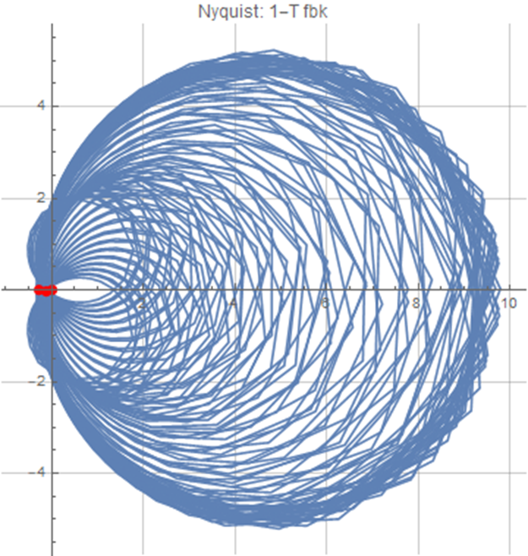
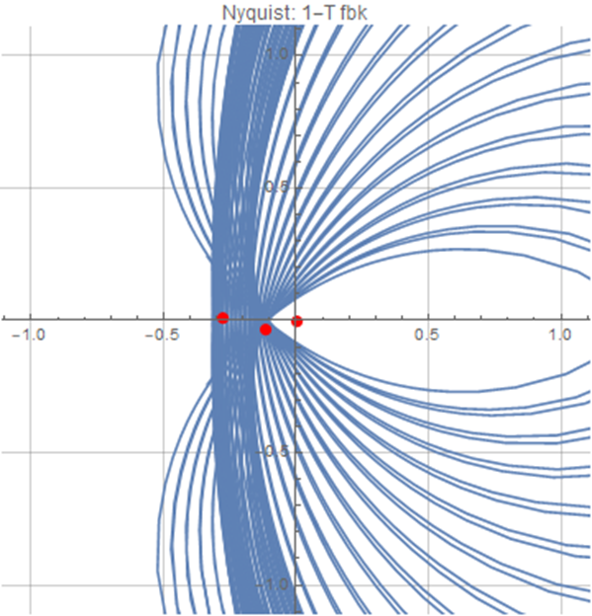
Back-up

