Slide 1
Crab cavity phase scan in the SPS
S. Kostoglou, H. Bartosik, , P. Baudrenghien, R. Calaga, T.Levens, R. Tomas Garcia, N.Triantafyllou
All scripts are from L. Carver
Notes:
=

Slide 2
Introduction
First step in Crab Cavity MD on RF multipoles (28/09) was to perform a phase scan to reconstruct cavity voltage and phase.
Data from HeadTail monitor (resolves intra-bunch motion) and BPMs (from orbit→ kick → voltage)
HeadTail measurements were used in the past SPS CC MDs for the phase scan. However, parameters were different in this MD:
  Bunch intensity: 1e11 ppb (vs ~3e10)
  Bunch length: 3 ns
  Energy: 26 GeV (vs 270 GeV)
  Q20 optics (vs Q26)

Slide 3
Introduction
Phase of only CC1 was modified, estimated voltage at 1 MV.
13 Phase scan steps and then a sinusoidal fit is applied to compute cavity voltage and phase :
Phase (deg) | Time (CET)
0 | 2022-09-28 09:47:00
30 | 2022-09-28 09:50:38
60 | 2022-09-28 09:53:45
90 | 2022-09-28 09:54:48
120 | 2022-09-28 09:56:21
150 | 2022-09-28 09:57:55
179 | 2022-09-28 09:59:29
-30 | 2022-09-28 10:01:02
-60 | 2022-09-28 10:02:36
-90 | 2022-09-28 10:05:12
-120 | 2022-09-28 10:06:14
-150 | 2022-09-28 10:07:48
-180 | 2022-09-28 10:11:26

Slide 4
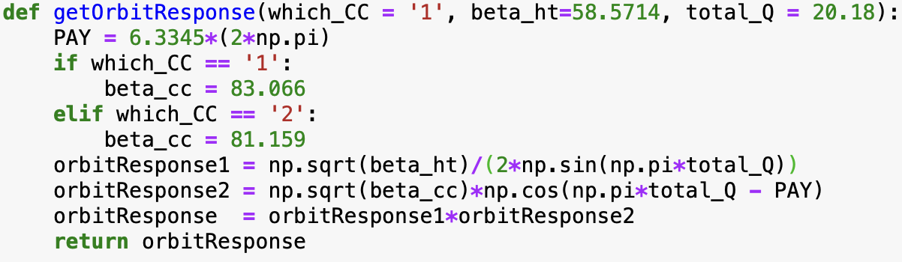
Voltage & phase from headtail monitor
Updated beta-functions, phase advances, energy.
Updated calibration factor (from arbitrary units to mm):
  C=0.1037 for ~3e10 ppb
  C=0.1037·10^{10/20}= 0.3279 for ~1e11 ppb from T. Levens

Slide 5
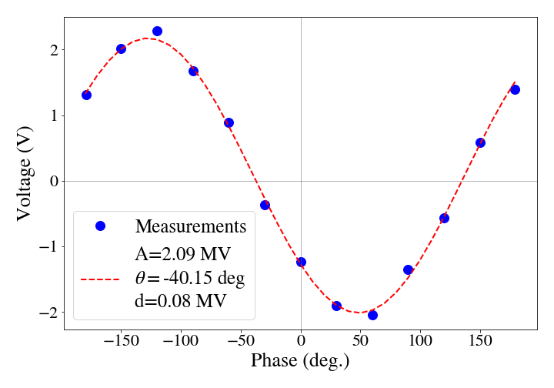
Voltage & phase from headtail monitor
Voltage fit yields 2 MV instead of 1 MV with an angle of 40 degrees.

Slide 6
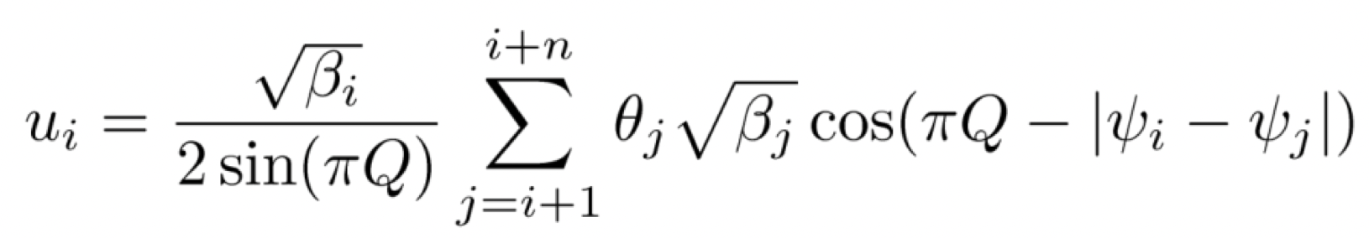
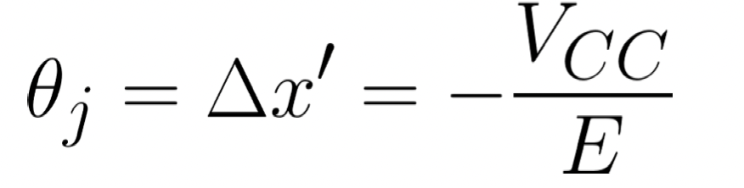
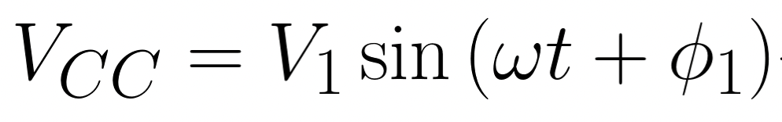
Voltage & phase from BPMs
From orbit → equivalent kick → voltage for each phase scan time point.

Slide 7
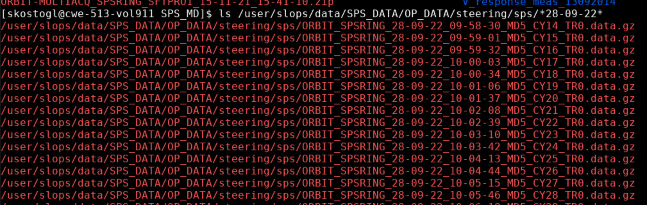
Voltage & phase from BPMs
From orbit → equivalent kick → voltage for each phase scan time point.
Data available only from 09:58 onwards (no data for 0, 30, 60, 90, 120, 150 deg. scan)

Slide 8
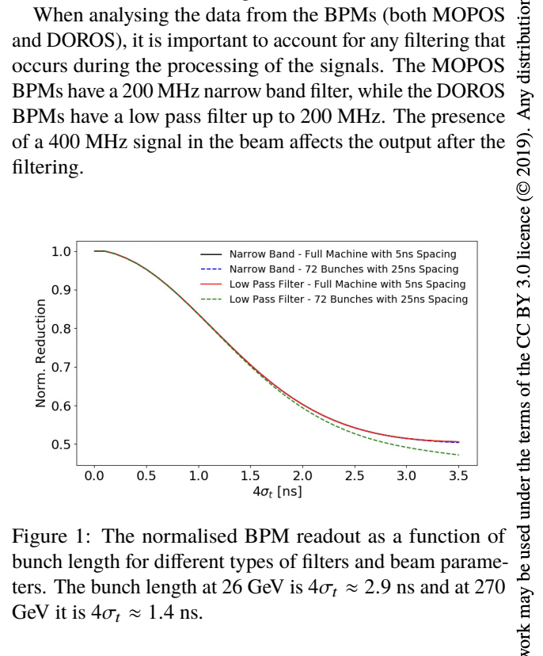
Voltage & phase from BPMs
From orbit → equivalent kick → voltage for each phase scan time point.
Data available only from 09:58 onwards (no data for 0, 30, 60, 90, 120, 150 deg. scan)
In the past, signal from MOPOS BPMs was attenuated depending on the bunch length due to BPM filtering.
Paper from L. Carver

Slide 9
Voltage & phase from BPMs
From orbit → equivalent kick → voltage for each phase scan time point.
Data available only from 09:58 onwards (no data for 0, 30, 60, 90, 120, 150 deg. scan)
In the past, signal from MOPOS BPMs was attenuated depending on the bunch length due to BPM filtering.
If this is still the case with ALPS, expecting signal attenuation by a factor of 2.
Paper from L. Carver

Slide 10
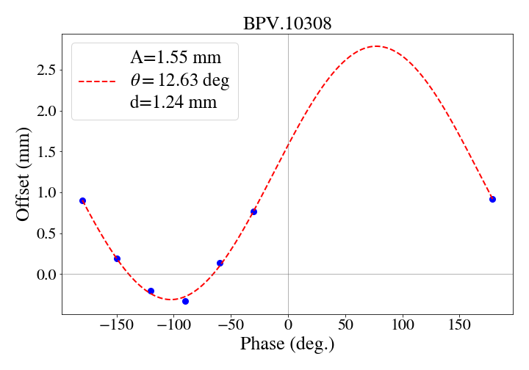
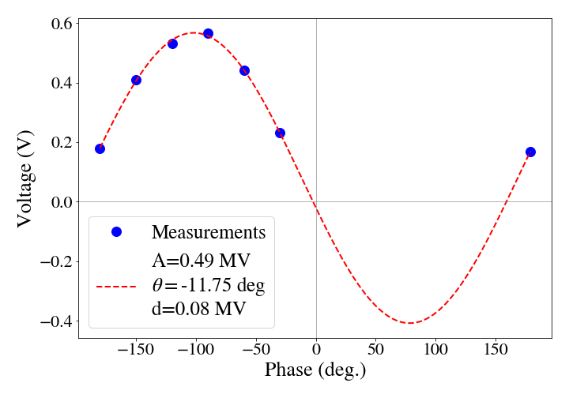
Voltage & phase from BPMs
Example of offset at one BPM location
Voltage fit from BPMs’ signal
Needs to be multipled by a factor of 2, which yields ~1 MV cavity voltage

Slide 11
Conclusions
HeadTail measurements do not agree with 1MV expectation:
  A factor of 2 discrepancy in the fitted cavity voltage from the headtail monitor that is currently not understood.
  Not an issue in the past MDs.
  Updated all the relevant parameters in the scripts (Q20 optics, energy and headtail calibration factor).
BPM measurements agree with 1MV expectation (to be confirmed):
  Used orbit measurements to reconstruct cavity voltage.
  Missing data from the first 10 minutes of the phase scan.
  Voltage fit yields a cavity voltage of 0.5 MV x 2 =1 MV (to be confirmed with BI If this reduction factor is still valid).

