Slide 1
Follow-up of outstanding EN-IM support issues for BE-CEM
Ioan Kozsar, Eve Fortescue, Cedric Charrondiere
12th December 2022

Slide 2
RQF1825090
In EAM light: Display a structure of Functional Positions and allow assets to be attached by clicking and scanning the barcode or typing ID into a text box (not by searching and not each position individually)
  Feedback from meeting in Nov ’22
    New tree implemented everywhere and available in production
    Can use in install equipment to select the parent and child and link them
    Can also be used to detach children from parents
    Tested by CEM-IN, comments added to issue
    Issue completed and closed 15/11/2022
Notes:
Reply from meeting 01/09/22:
Was a problem with the tree implementation
Proposed to have a solution without the tree- but this makes no sense
Will have news at next meeting – Lukasz handling this issue.
Reply from meeting on 23/09:
Revampled eam light application
Equipment tree will be redone during October
Everywhere, not just in “install equipment”
Reply from meeting in 14.11
Everything in prod
Equipment tree everywhere – inc work orders, still remains
Install equipment – select as parent, select as child
Can select a parent and type a child asset
Can you scan a barcode? Probably
Test and let know
Bug with + sign – to be fixed this week

Slide 3
RQF1879029
Move a set of assets e.g. a crate and its modules from one parent position to another. i.e. in the case of expired functional positions or during dismantling.
First step: “Dismantle Equipment” button to detach all assets from a Functional Position structure and place in a “buffer location”
As a second step the same process could be applied when triggered by an action in Layout i.e. Expire of positions in Layout -> detach all assets and set positions “Hors Service” in InforEAM
  Feedback from meeting (Nov’ 22):
    No real solution for this at the moment
Notes:
Reply from meeting 01/09/22
David to look into this – further internal discussions required
Goran asked if we want functionality to detach only part of a tree – this is more complicated
Reply from meeting 23/09
Leverage equipment tree to allow manipulation
No real solution for this at the moment

Slide 4
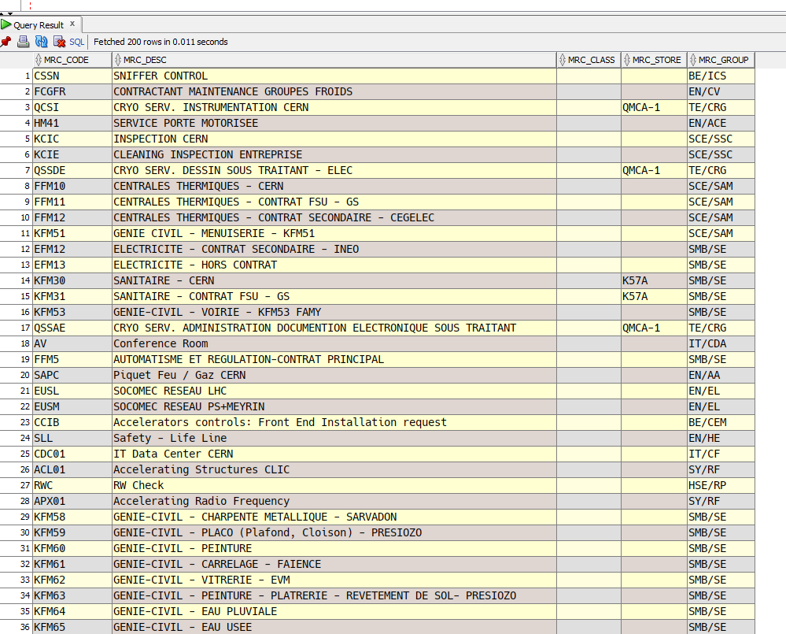
RQF1879056
Allow an e-group to be specified as the responsible of an Asset/Functional Position in InforEAM
Feedback from last meeting (Nov’ 22):
  Constraint on egroups is now disabled in test prod – in original field
  Egroup autocomplete only In EAM light
  Egroup can also be added in EAM
  Layout has been informed, as they need to remove the check on their side.
    In progress, but it is unclear what data Infor is expecting (egroup id? What if it is not unique with person ID?)
    Suggested Service Unit in layout can be compiled using list of people in egroup, as it is loosely coupled to group
Notes:
For locations: Current version supports publishing to room. Data should be migrated.
Reply after meeting: 01/09/22
A new responsible field is available that supports egroups
CMMS will migrate the data for everyone to this new field
Constraints will be relaxed on existing field to allow publication of egroups without change to Layout
During this period the two fields will be synchronised
Finally the old field will be removed and Layout requested to point to the new field
CMMS have an internal task to transfer the FPs from the buildings to the rooms. Have to check that the data is still valid in the temp field.
Reply after meeting 23/09
Constraint on egroups is now disabled in test and with be on prod by Monday – in original field
Egroup autocomplete only In EAM light – not EAM
Layout has been informed, as they need to remove the check on their side
What happens to suggested department code in layout – is there a mapping between egroups and dept code
Can we still attach assets to positions which aren’t CCIB?
Constraint disabled on original field
Autocomplete works on original field in infor
Service unit not linked to person in infor
Shouldn’t be a problem to attach assets to non-ccib position
Lukasz to follow up on location migration
Egroup can be added to eam, but no autocomplete
Responsible not linked to service unit
Test publishing from layout with an egroup – still doesn’t work in current version – there is an internal check on the layout side before pushing to infor. Will be implemented in new version of layout

Slide 5
Aside (no ticket)
Update locations of functional positions to be at the room level instead of the building level, using the data in the temporary field that was completed during publication from Layout.
Feedback from last meeting (Nov’ 22):
  Need to discuss with Sonia
Notes:
For locations: Current version supports publishing to room. Data should be migrated.
Reply after meeting: 01/09/22
A new responsible field is available that supports egroups
CMMS will migrate the data for everyone to this new field
Constraints will be relaxed on existing field to allow publication of egroups without change to Layout
During this period the two fields will be synchronised
Finally the old field will be removed and Layout requested to point to the new field
CMMS have an internal task to transfer the FPs from the buildings to the rooms. Have to check that the data is still valid in the temp field.
Reply after meeting 23/09
Constraint on egroups is now disabled in test and with be on prod by Monday – in original field
Egroup autocomplete only In EAM light – not EAM
Layout has been informed, as they need to remove the check on their side
What happens to suggested department code in layout – is there a mapping between egroups and dept code
Can we still attach assets to positions which aren’t CCIB?
Constraint disabled on original field
Autocomplete works on original field in infor
Service unit not linked to person in infor
Shouldn’t be a problem to attach assets to non-ccib position
Lukasz to follow up on location migration
Egroup can be added to eam, but no autocomplete
Responsible not linked to service unit
Test publishing from layout with an egroup – still doesn’t work in current version – there is an internal check on the layout side before pushing to infor. Will be implemented in new version of layout

Slide 6
RQF1879050
Expire Functional Positions in InforEAM from Layout
Prerequisite: Must detach any assets first and put in buffer, as per request #2
  Feedback from last meeting (Nov’ 22):
    Several ideas/discussions on how to implement this
    Intermediate solution is to have an expiry date field
    No decision reached
Notes:
When layout functional position are cloned/evolved… would be interesting to be able to transfer assets structure from one parent position to another in InforEAM.
=> Complicated due to different use cases (structure of functional positions superposed with structure of assets with some variations..)
Not a problem on the layout side. Infor should find out how to detach all assets from their side. Expiry is trivial.
Reply form meeting:
First stage for CMMS is to have a field containing the expiry, and then potentially a report sent to users that positions should be out of service
Reply from meeting 23/09
Several ideas how to implement this
To be discussed with Layout on 6.10
Haven’t reached an decision with Layout
Still up in the air
Having a field is an intermediate solution

Slide 7
RQF1879067
Rename Functional Positions in InforEAM from Layout
  Feedback from last meeting (Nov’ 22):
    Webservice exposed to Layout
    Access to the function should be limited to layout admins
    Sonia to discuss with Pascal when it will be available
Notes:
Users requesting to be able to rename functional position from layout UI. Possible ? Can this be pushed forward with EN-EL ? (LAYOUT-3766)
=> First need to discuss this in parallel with Eric Van Uytvinck from EN-EL
But InforEAM API is supporting rename
Reply from meeting
Rename does exist
Worried about who should use it – would need to be restricted to admins in layout
Need to provide API to Layout - september
Reply from meeting 23/09
Webservice exposed to Layout
Can it be done from eAM light
Access to the function should be limited to layout admins
Nov 22
Rename coming only from layout.
Shouldn’t rename in light
Sonia to discuss with Pascal but didn’t manage yet – to be followed this week

Slide 8
RQF1879063
Generate part in InforEAM from Naming Interface
Feedback from last meeting (Nov’ 22):
  Intermediate solution proposed: launch create part page with data pre-filled from naming
    Internal discussion required
    Development not scheduled
  To be rediscussed with David
Notes:
Reply from meeting
Equipment generator might help reduce inconsistencies at least between parts and assets
May not help with part
Functionality exists to create part from edms item – may not be helpful to us
Should see some progress on this
Reply from meeting 23/09
Equipment generator not good for our needs – we don’t have items
Need to go back to original proposal – link from naming
More internal discussions required – mixed opinions
PLM section very busy
Naming tool not top priority
To be checked with David - dates

Slide 9
RQF1879073
Add "Deprecated" status to Parts: CCI Parts have 3 mutually exclusive states: Active, Deprecated or Out of Service
  “Tracking Method” drop-down list reconfigured for this usage
  Not an ideal solution:
    “Out of Service” status is a checkbox and “Deprecated” is part of a drop-down list
    The two fields could potentially contradict each other (even though HS overrides deprecated)
  We would have preferred one mutually exclusive status field
  To be rediscussed with David
Notes:
Results of meeting:
David understood problem and will try to come up with a better solution.
Argument is that if a part is out of service, then this overrides everything and it disappears, so it doesn’t matter that the tracking method is deprecated
Not mentioned at meeting 23/09 – to be revisited
To be discussed with David again

Slide 10
RQF1879074
Set up stock-level notifications
For assets: Raise an alert when the number of assets "in stock" is less than 10% of the number of installed assets
For parts not tracked by asset: set a threshold of 10 units
  Not easily achievable in EAM, as part thresholds are set per store
  Requested views on stock levels and assets to hitdb account.
  Produced our own automated weekly email report using the BE-CO commons library
  Customised the thresholds for each part (by percentage or unit)
  To be rediscussed – as a generic/reusable solution may be preferable
Notes:
Result from meeting:
David understood request but couldn’t understand why it wasn’t done
They will look at it again
Result from 23/09
Apologies from Lukasz
Could rediscuss in October – we would be happy if they could do this as it is perhaps something reusable.
Internal discussion tomorrow

Slide 11
RQF2139577 (1)
EAM Inventory QR/barcode issues with Kiosk interface
  When clicking "Issue" > "Employee" > Scan "Part or equipment". Loading screen stays in a loop with the three dots animation in the centre of the screen. No error message displayed
    Solved by deleting cache on phone
    Will this happen again?
Notes:
Will be in the next sprint

Slide 12
RQF2139577 (2)
EAM Inventory QR/barcode issues with Kiosk interface
  When clicking for example "BIN2BIN" and trying to scan "part or asset". It detects QR and barcodes, but it doesn't copy the result into the text box. The QR/barcode detection seems to be working because the camera reader popup is closed if and only right after a QR/barcode is placed in front of the camera. So, it seems to be a matter of relaying the decoded value into the text box.
    Confirmed bug, JIRA ticket created for developer team – solved
Notes:
Will be in the next sprint

Slide 13
RQF2139577 (3)
EAM Inventory QR/barcode issues with Kiosk interface
  Sometimes there's not a QR/barcode scanner button next to the "bin" field, so it cannot be acquired by the scanner, and only by typing the code. It works when clicking on "BIN2BIN" but not on "ISSUE".
    There is no scan button on Issue (and Return).
    Another JIRA ticket will be created for this request. - solved

Slide 14
RQF2139577 (4)
EAM Inventory QR/barcode issues with Kiosk interface
  When issuing or returning any equipment, we always need to scan the QR code of that asset two consecutive times
    User error – select “employee” option when checking assets out of the store

Slide 15
RQF2139577 (5)
EAM Inventory QR/barcode issues with Kiosk interface
  “Return” button hidden by keyboard
    Pending

Slide 16
INC3317803
Kiosk finds parts from another store in CCI-864-1-B
  Long-standing bug
    Fixed and deployed in version 2.28.2 of kiosk

Slide 17
INC3317803
Kiosk finds parts from another store in CCI-864-1-B
  Long-standing bug
    Fixed and deployed in version 2.28.2 of kiosk

Slide 18
INC3317639
KIOSK ISSUE/RETURN from search engine
Search for a part or asset, without scanning a QR code
Tick the box “Choose”
Click ISSUE or RETURN ,Employee, NEXT
The Part Description is displayed but the “Part” is empty
If I click “ISSUE” / “RETURN” then I have an error message “PartID is a required field”
Also if clicking anywhere on the line containing the description, the entire page becomes blank
KIOSK does not copy the Part ID at the same time as the description.
Bug-fix scheduled for January sprint

Slide 19
RQF2183001
Add link to store in GIS in header bar of kiosk
  Pending

