Slide 1
High Energy Muon and Hadron Collider Projects - within the overall future accelerator panorama
Outline
Introduction
Scope 1: e+e- Higgs factories
Scope 2: Beyond Higgs factories
Some accelerator concepts
Proton and muon colliders
General challenges and main points
Steinar Stapnes, CERN
Sao Paulo 31.08.2023

Slide 2
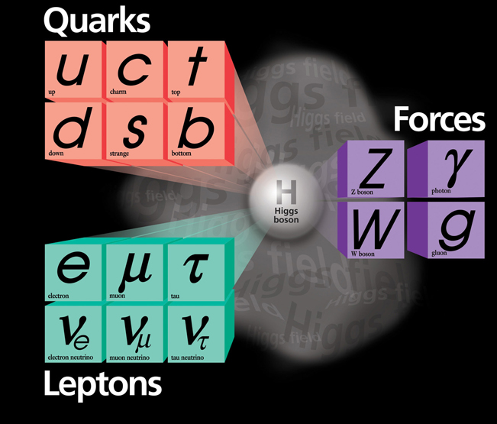

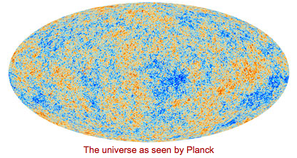
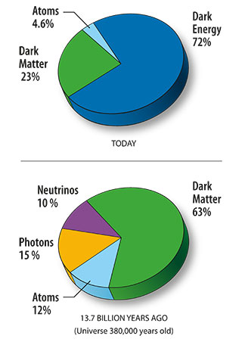
Higgs and Beyond the Standard Model
Many unknowns:
Flavour structure
Matter-antimatter
Why is the Higgs so light ?
etc
General Relativity versus Quantum Field Theories
Dark Matter and Energy
The Higgs is new, it is special, we believe studying it in detail can be a portal to new physics

Slide 3
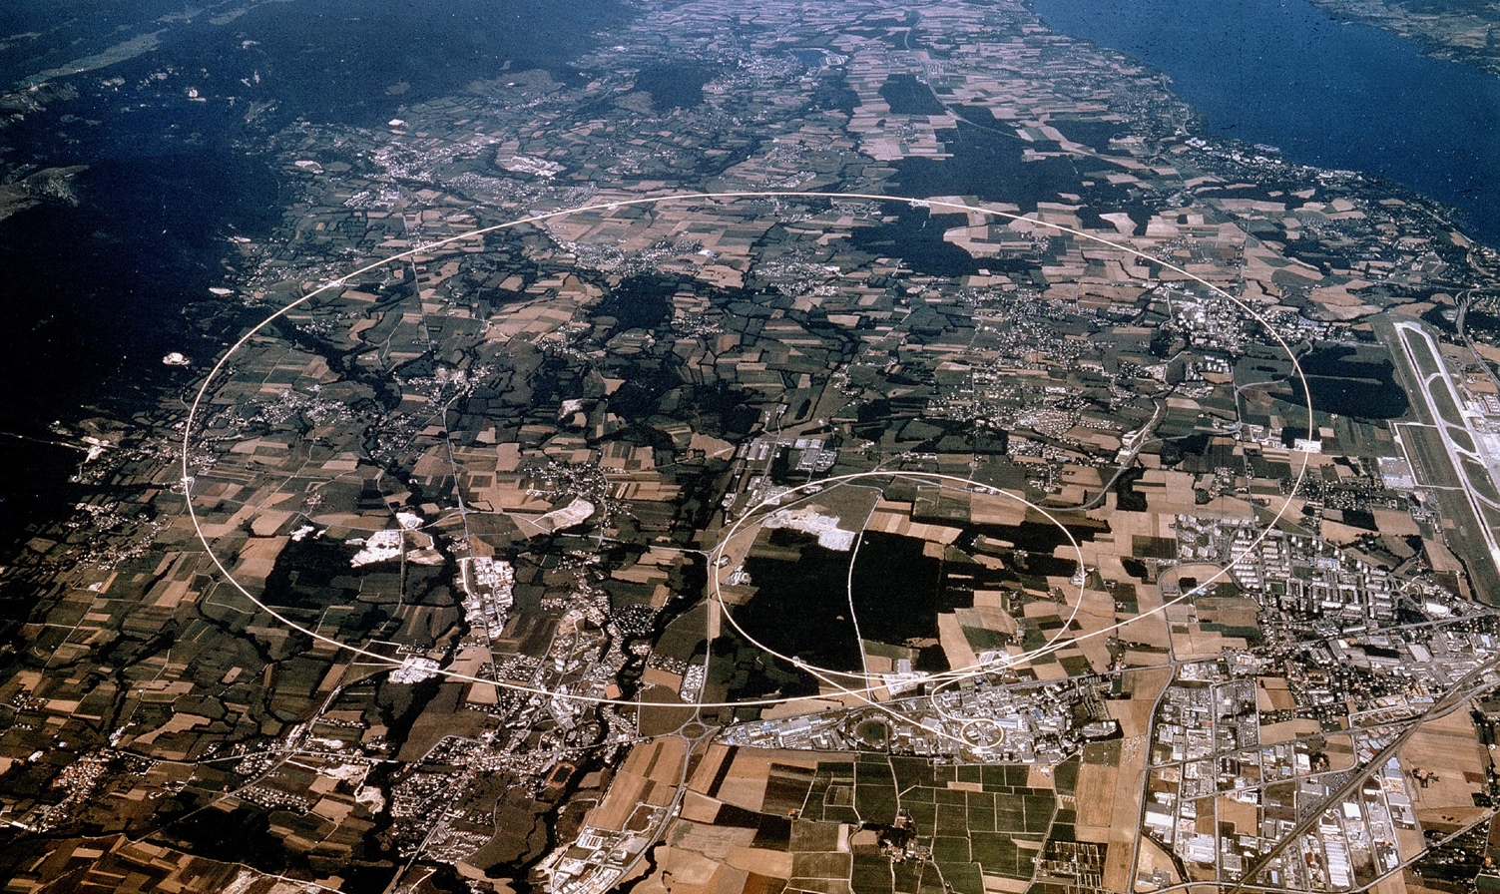
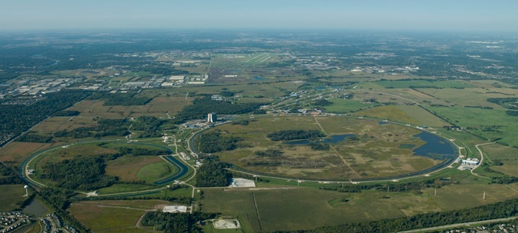
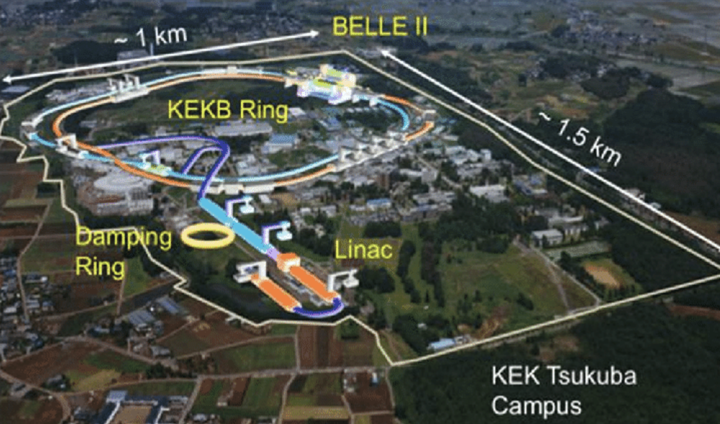
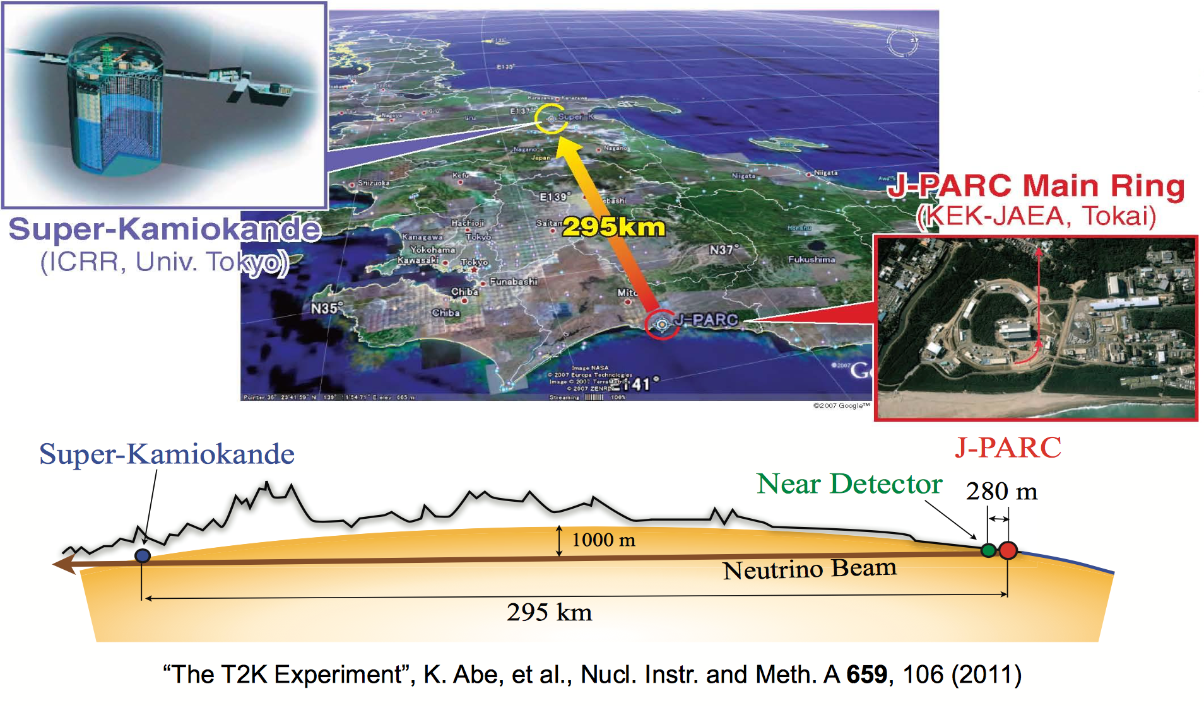
Some of our existing tools
Colliders and proton drivers
Notes:
Add SuperKEKb

Slide 4
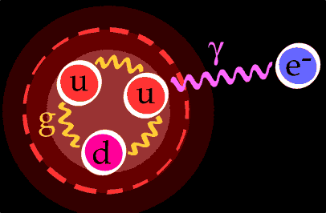
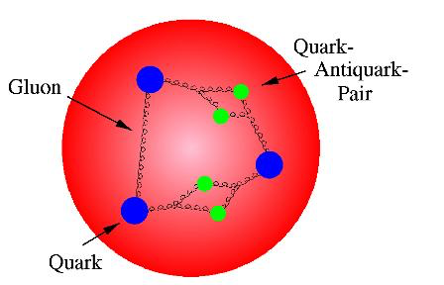
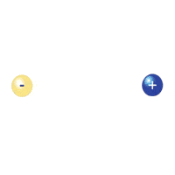
Particle types to accelerate
Not so many choices:
  Need stable charges particles: protons, electrons, (muons), ions – most used: electrons (and positrons) and protons
  Secondary beams: photons, pions, kaons, neutrons, neutrinos, …..
Proton collisions: compound particles
  Mix of quarks, anti-quarks and gluons: variety of processes
  Parton energy spread
  QCD processes large background sources
Electron/positron collisions: elementary particles
  Collision process known
  Well defined energy
  Background from other physics limited
  Muons: elementary particle, but lifetime only 2.2 𝜇s
proton mass
electron mass
≈ 2000

Slide 5
Outline
Introduction
Scope 1: e+e- Higgs factories
Scope 2: Beyond Higgs factories
Some accelerator concepts
Proton and muon colliders
General challenges and main points

Slide 6
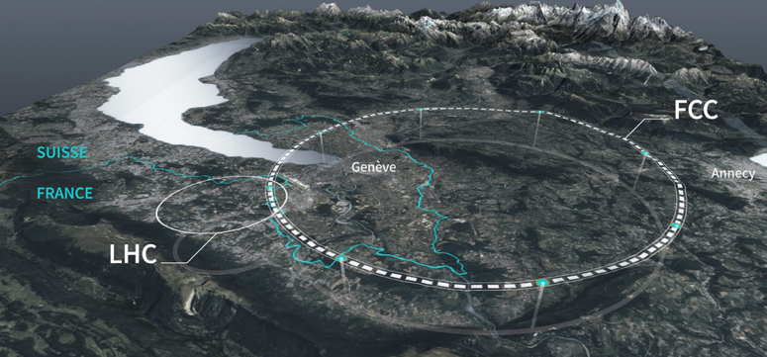
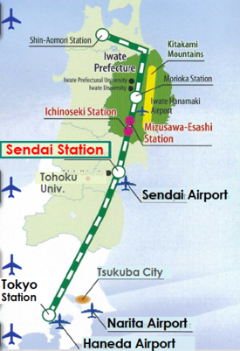
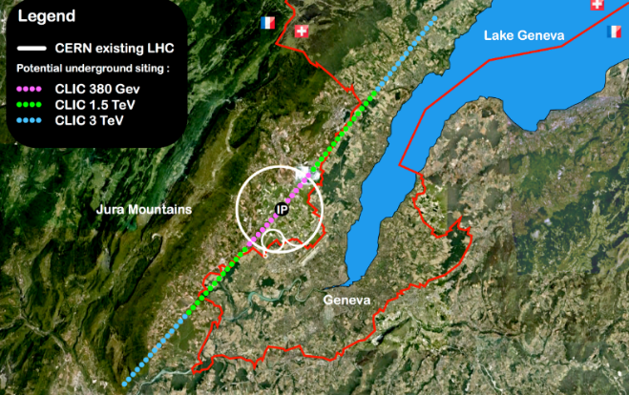
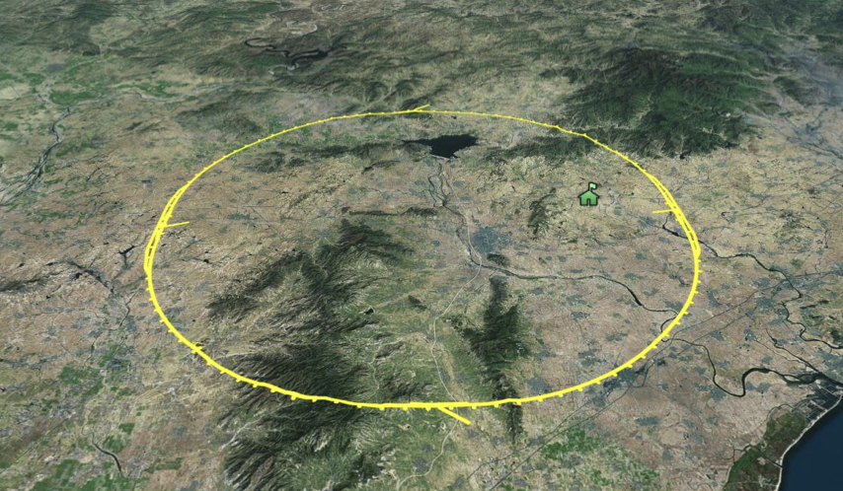
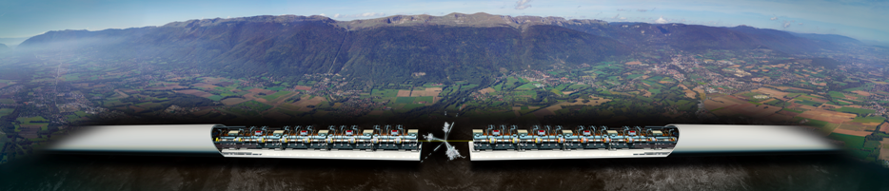
Scope 1: A Higgs factory
Need e+e- collisions at least at 250 GeV,
four alternatives:
ILC in Japan (linear) FCC at CERN (ring)
CLIC at CERN (linear) CEPC in China (ring)
Linear colliders: 13 (Higgs) -> 50 (max) km for higher energies later
Rings ~100km, can be used for protons
after
Notes:
Change FCC picture

Slide 7
New ideas being developed

Slide 8
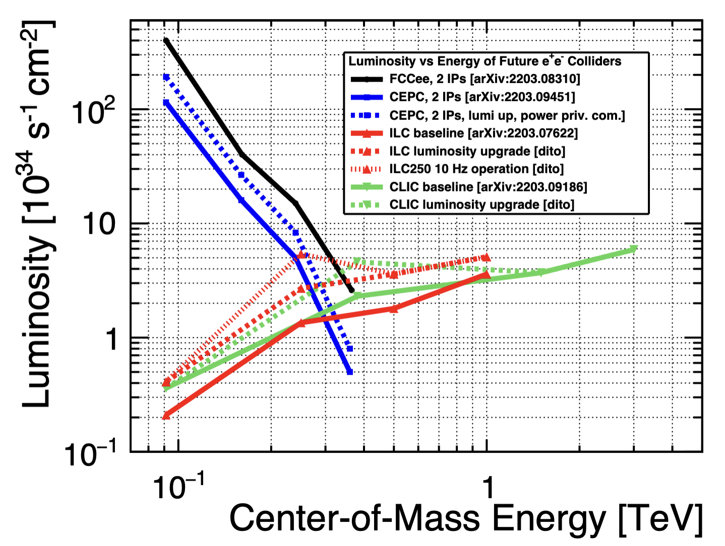


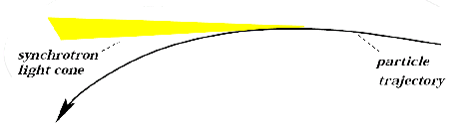
Circular versus linear
High energy limited by how strong electric fields you can have inside metallic structures:
Make accelerators circular, then we become limited by magnetic fields for bending – as in LHC, accelerating protons
It also allows us to re-collide “bunches” for hours (moderns machines are ”topped” up)
For electrons we are limited by synchrotron radiation when bending a particle, at some point cannot provide enough energy in a circle to compensate for these losses, go back to linear accelerators (CLIC/ILC designed for 3/1 TeV at ~50km)
CLIC is ~11km (380 GeV), ILC ~20km (250 GeV), FCC/CEPC ~100km (~350 GeV)

Slide 9
Several large electron linac and ring projects outside particle physics
Electron accelerators providing a lot of technical expertise, industry support – but not colliders

Slide 10
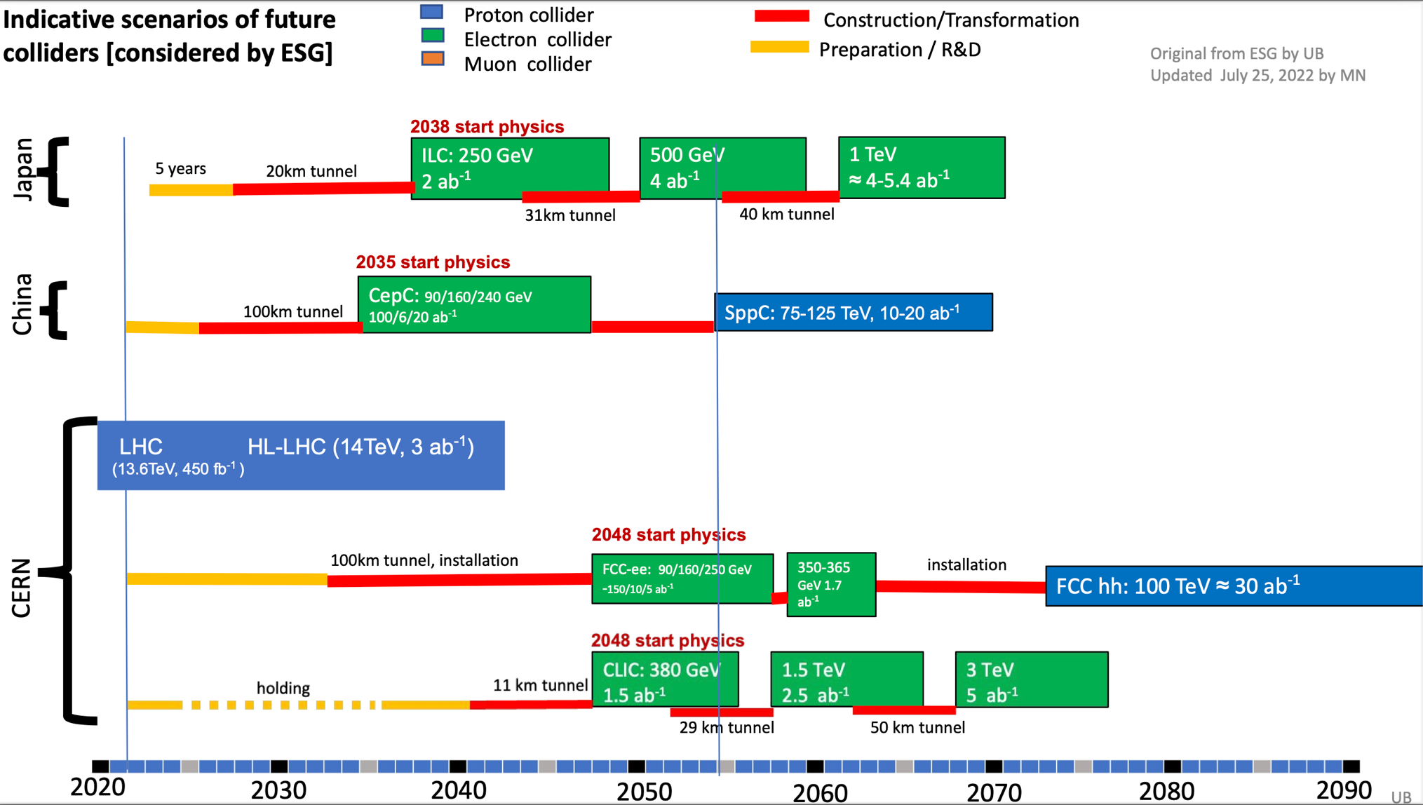
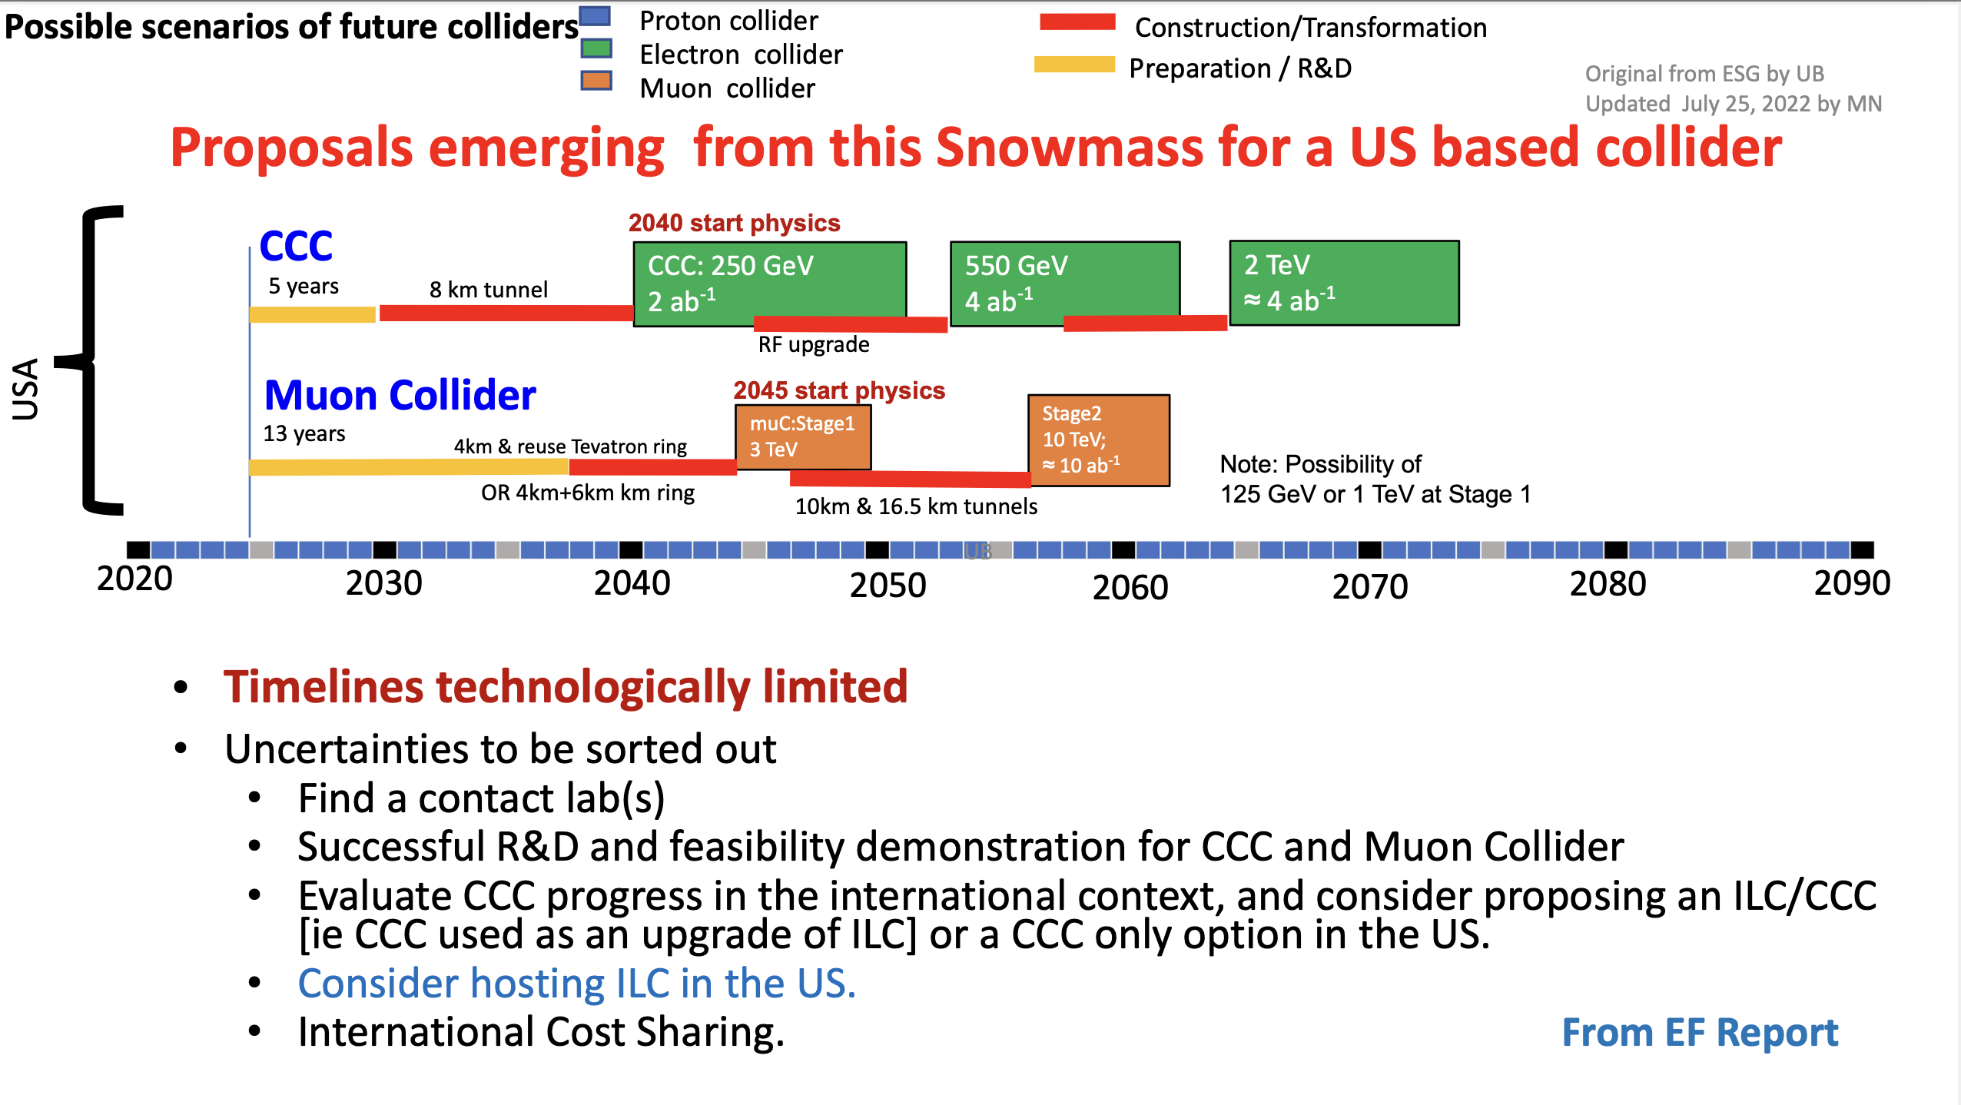
Timelines in Snowmass Energy Frontier summary
Comments:
Timelines are technologically limited – except for the CERN projects that are linked to completion of the HL-LHC
CEPC and ILC schedules are mature, but the projects need to pass approval processes in the near future to maintain these schedules
CCC and MC are less well defined but R&D and project development on the shown timescales is reasonable, CCC can also upgrade ILC
From Meenakshi Narain “EF summary” Snowmass

Slide 11
Outline
Introduction
Scope 1: e+e- Higgs factories
Scope 2: Beyond Higgs factories
Some accelerator concepts
Proton and muon colliders
General challenges and main points

Slide 12
Scope 2: Beyond Higgs Factories (BHF)
- ref presentation Tuesday by Carlos Wagner about physics -
Beyond Higgs-factories we want a proton collider at least at 100 TeV (the more the better), and lepton colliders towards 10 TeV (also here more is better)
In all cases luminosities at least around ~10³⁵ cm⁻² s⁻¹ are needed
Note: the experimental conditions are different, the clean nature of e+e- collisions would give advantages but reaching ~10 TeV difficult, the muon collider background looks manageable and hadron collisions are notoriously difficult with large pileup, but with a lot of LHC and HL LHC experience giving confidence
How close – or rather how far away – are we from these goals ?

Slide 13
Circular machines, e+e- and later hadrons
In both cases the initial civil engineering, and to the extend possible tunnels and caverns are prepared for replacing the initial Higgs factories (e+e-) with proton-proton colliders
FCC-hh and SppC
(see presentation in a moment about CEPC - > SppC by Prof. Tang)

Slide 14
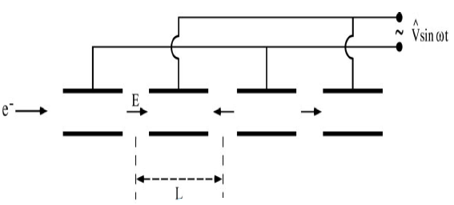
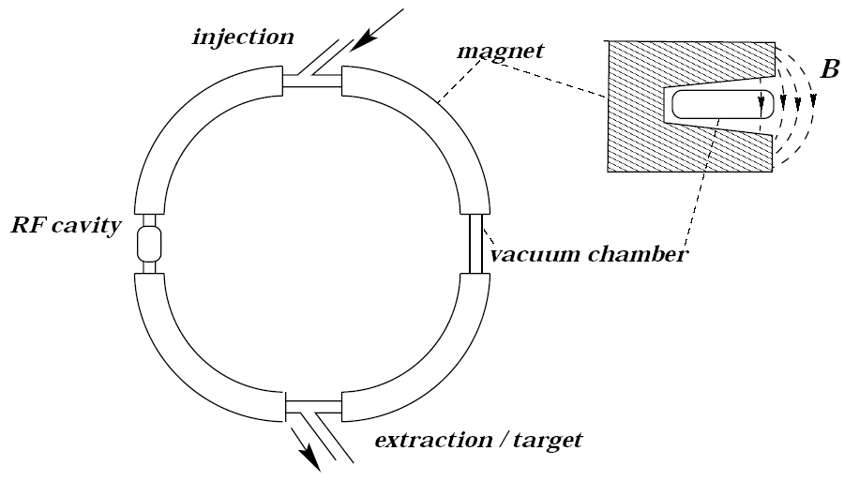
Energy reach of circular accelerators
The technological limit on the electrical field in an RF cavity (breakdown)
Gives a limited ΔE per distance
⇒ Circular accelerators, in order to re-use the same RF cavity
This requires a bending field F_{B} in order to follow a circular trajectory
In circular arc sections the magnetic field must provide the desired radius,
and the energy achievable is limited by radius (i.e. cost) and bending field
(other effects as radiation losses in super conducting magnets and overall beam power represent additional challenges for future circular hadron machines)
These considerations are applicable for other particles as electrons and muons as well. For electrons the synchrotron radiation is much more limiting such that the magnet strength achievable are not an issues
(the FCC-ee and CEPC machines are limited to ~350 GeV as e+e- colliders, while aiming for ~100 TeV with protons)
Hence the importance of high field magnet development as presented yesterday by P.Vedrine

Slide 15
Linear Colliders, for Higgs, top and later 1-3 TeV
Both CLIC and ILC can be extended in energy, by lengthening, higher gradients (in fact CLIC is primarily designed for 3 TeV with a very extendable drivebeam).
C3 also foresees extending in energy to above 500 GeV and can in principle go further
HALVH is somewhat extendable
There is no real design beyond 3 TeV for e+e- colliders
Plasma acceleration promising for electrons, positrons less so currently
Issues like RF efficiency increasingly important – for any acceleration technology
CLIC at 3 TeV is around 500 MW (~2.5 TWh annually).
.. but there are also other limitations (see next slide)
-> Efficient RF systems, luminosities optimisation (luminosity for a given beam power)
For the hadron machines:
Embedded carbon in many heavy elements
High Field magnets very demanding, beyond performance and cost concerns also the power consumption is very high (including cryo-system)
-> HFM research, e.g. HTS to operate at higher temperatures

Slide 16
Muon collider
The luminosity per beam power is about constant in linear colliders
It can increase in muon colliders
Strategy CLIC:
Keep all parameters at IP constant
(charge, norm. emittances, betafunctions, bunch length)
Linear increase of luminosity with energy (beam size reduction)
Strategy muon collider:
Keep all parameters at IP constant
With exception of bunch length and betafunction
Quadratic increase of luminosity with energy (beam size reduction)
Notes:
CLIC – some degradation in beam quality so not fully constant
Muon – same improvement with energy (linear), plus optimization of bunch length and betafunction possible with energy providing another E dependence (divided by power)

Slide 17
This bring us to proton and muon colliders (in the title of the talk) as primary candidates for very high energy colliders
“High Energy Muon and Hadron Collider Projects - within the overall future accelerator panorama”
Not excluding linear colliders can make transformative improvements, plasma acceleration is radically more compact than “conventional” RF while most other technology changes in our field are gradual
Some reminders and concepts are useful first

Slide 18
Outline
Introduction
Scope 1: e+e- Higgs factories
Scope 2: Beyond Higgs factories
Some accelerator concepts
Proton and muon colliders
General challenges and main points

Slide 19
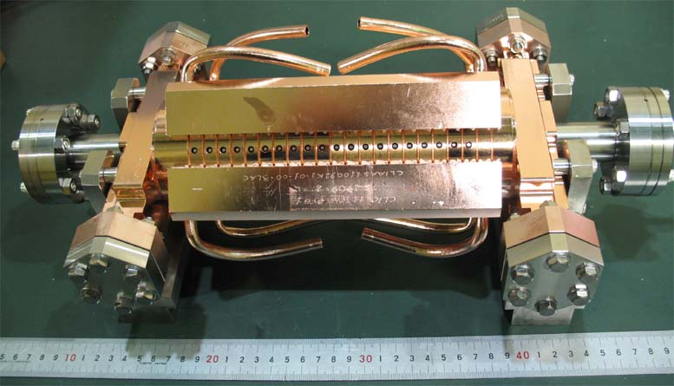
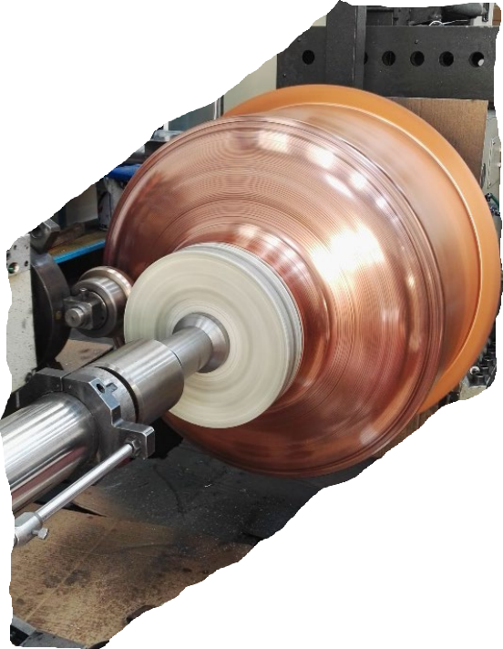
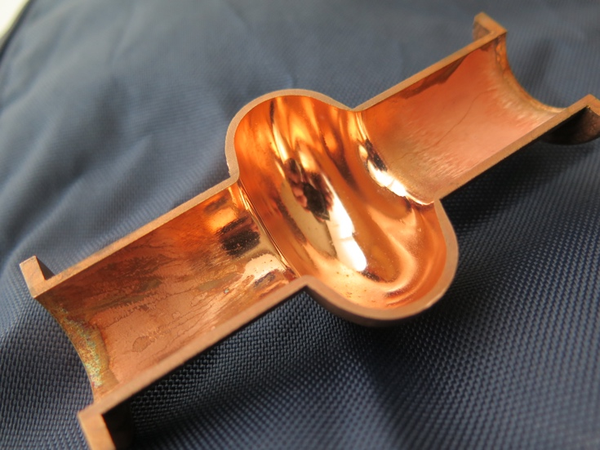
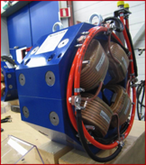
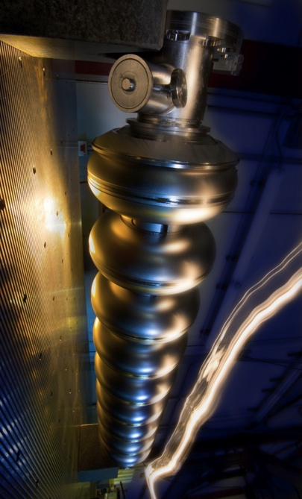
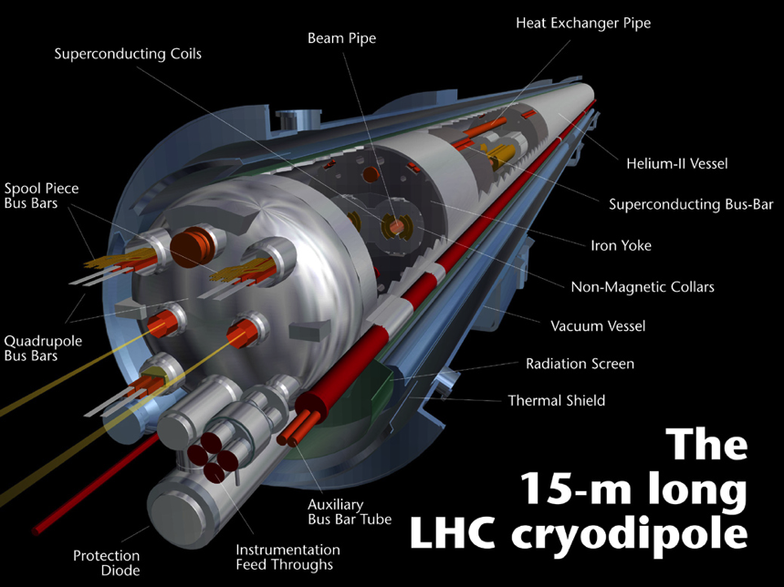
Lorentz equation
The two main tasks of an accelerator
  Increase the particle energy
  Change the particle direction (follow a given trajectory, focusing “bunches” of particles)
Lorentz equation:
F_{B} ⊥ v ⇒ F_{B} does no work on the particle
  Only F_{E} can increase the particle energy
F_{E} or F_{B} for deflection? v ≈ c ⇒ Magnetic field of 1 T (feasible) same bending power as en electric field of 3⋅10⁸ V/m (NOT feasible)
  F_{B} is by far the most effective in order to change the particle direction (steering, focusing)

Slide 20
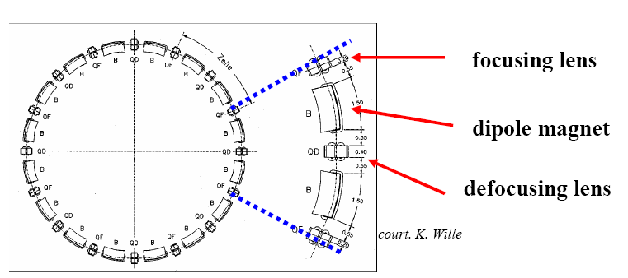
The Lattice of an accelerator
An accelerator is composed of bending magnets, focusing magnets and usually also sextupole magnets, bending (dipole magnets) the performance driver for energy reach
The ensemble of magnets in the accelerator constitutes the “accelerator lattice”

Slide 21
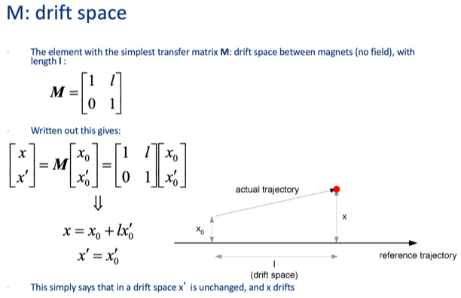
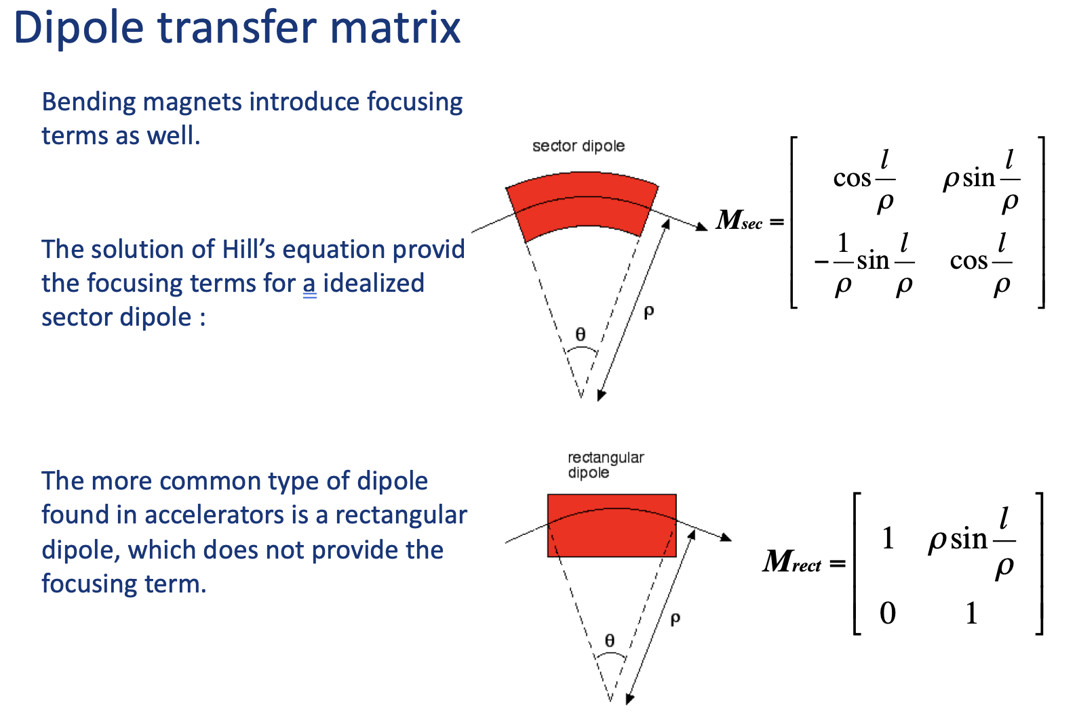
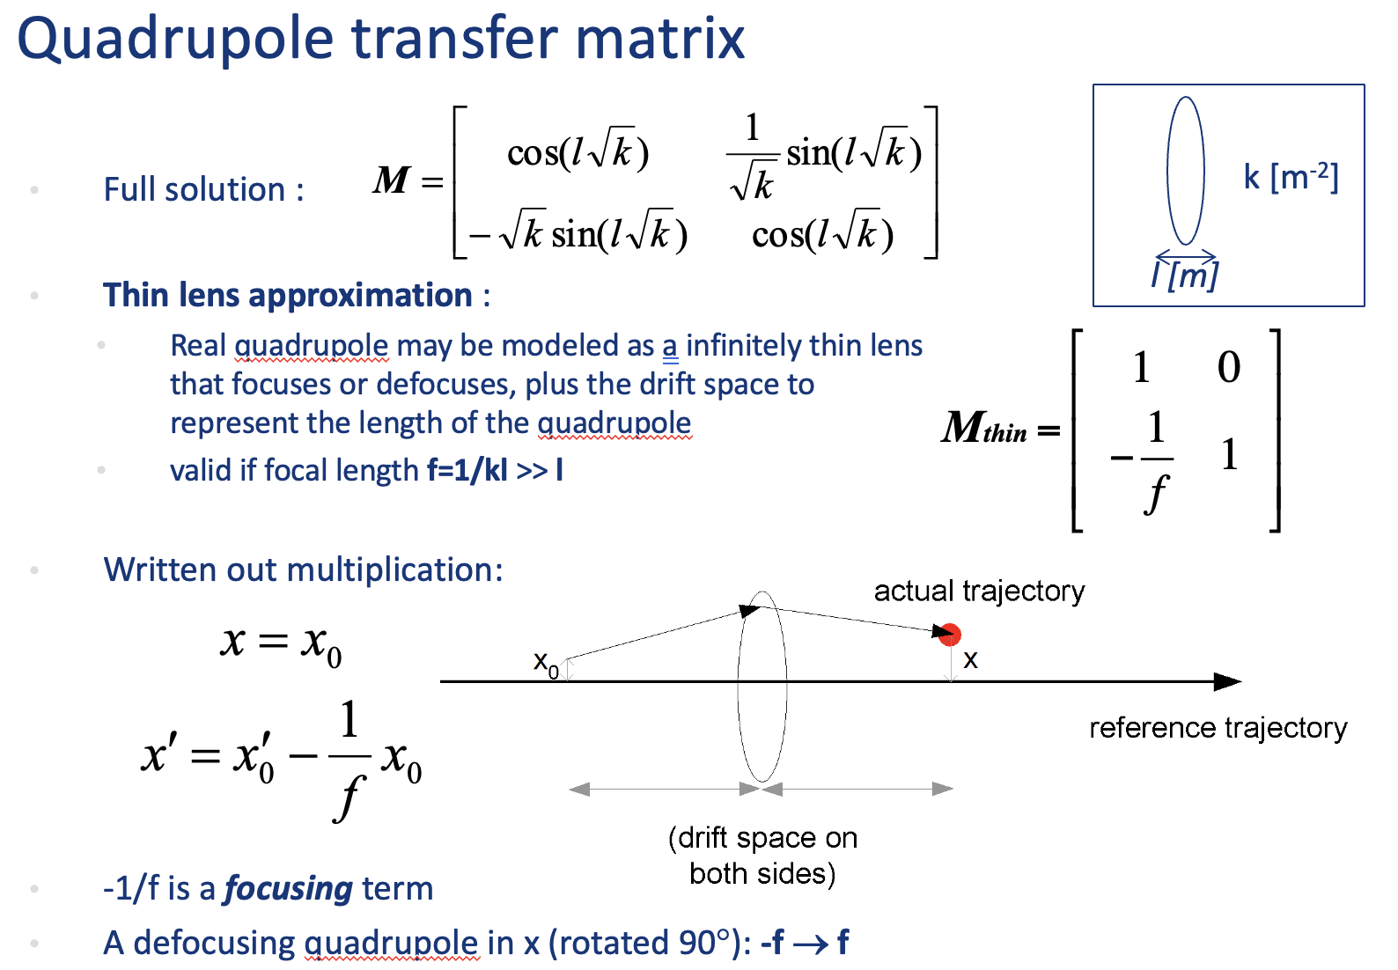
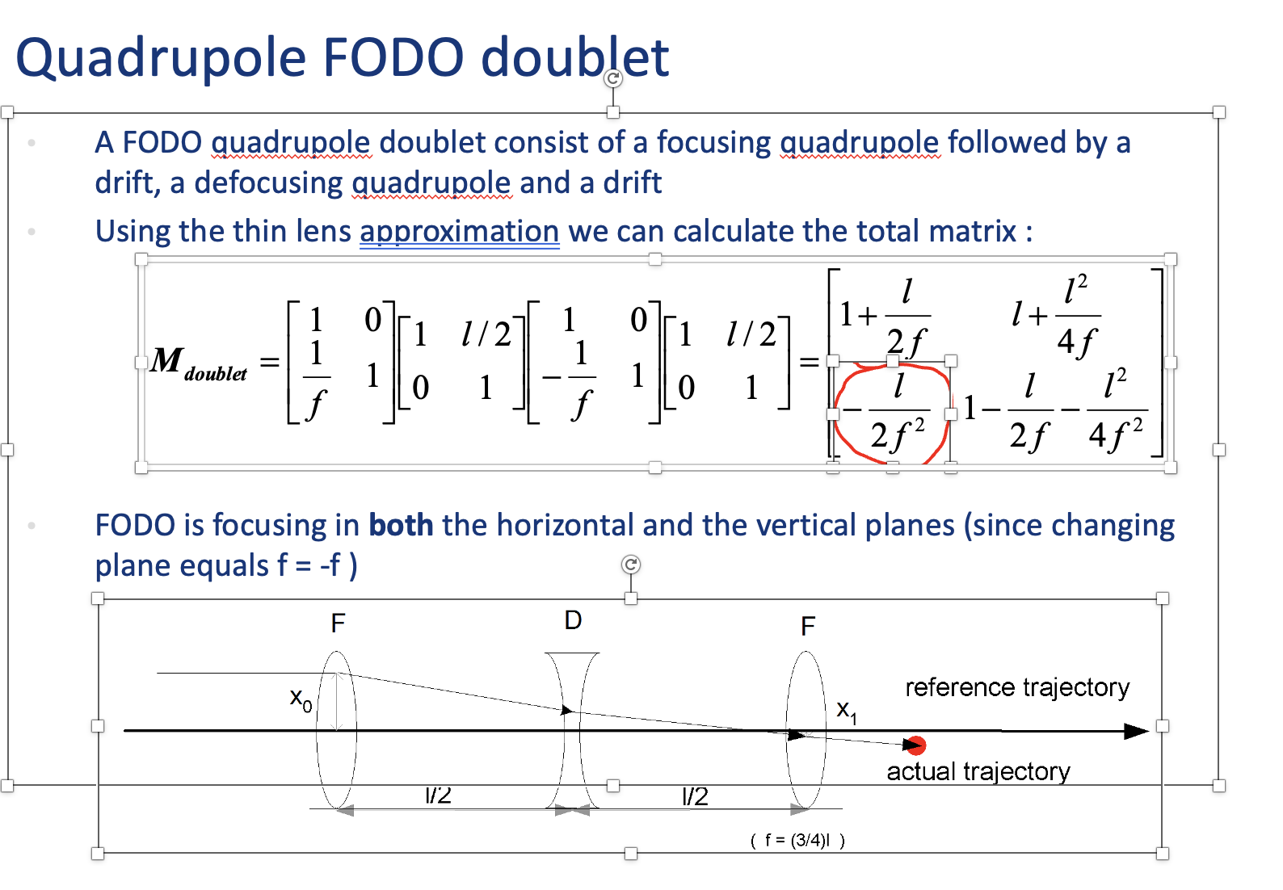
The elements

Slide 22
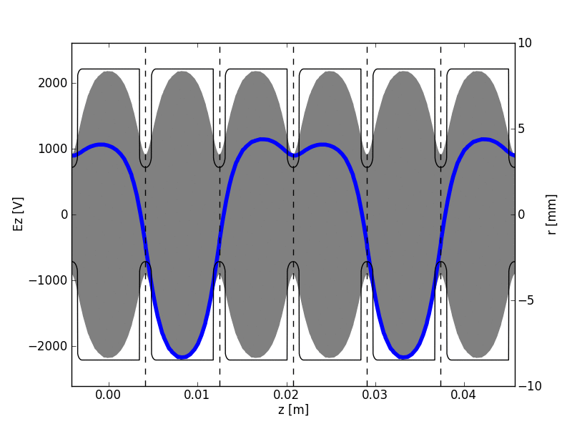
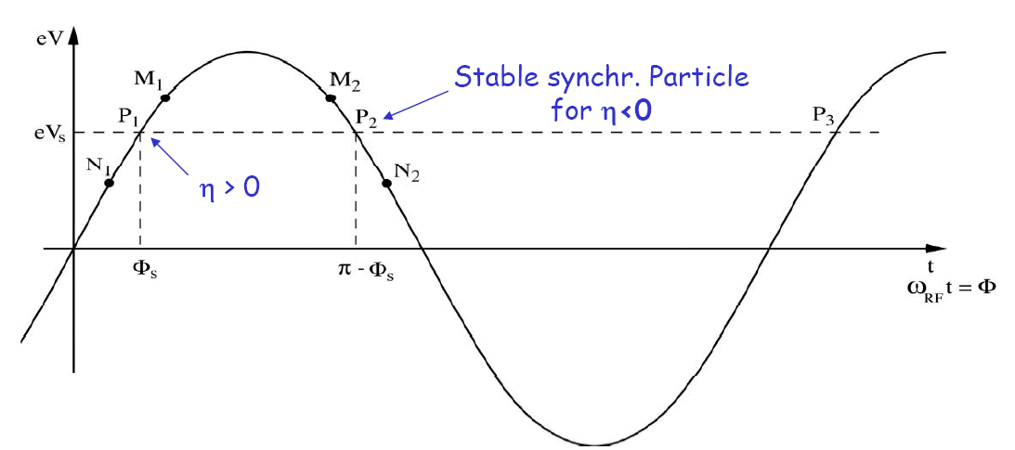
Phase stability in a synchrotron
h>0: velocity increase dominates, f_{r} increases
Synchronous particle stable for 0º<f_{s}<90º
  A particle N₁ arriving early with f= f_{s}-Df will get a lower energy kick, and arrive relatively later next pass
  A particle M₁ arriving late with f= f_{s}+Df will get a higher energy kick, and arrive relatively earlier next pass
h<0: stability for 90º<f_{s}<180º
h=0 at the transition energy. When the synchrotron reaches this energy, the RF phase needs to be switched rapidly from f_{s} to 180-f_{s}
Animation from Kyrre Sjøbæk, showing optimal phasing of a beam (red) in a periodic loaded structure.

Slide 23
Bunches in collision

Slide 24
Outline
Introduction
Scope 1: e+e- Higgs factories
Scope 2: Beyond Higgs factories
Some accelerator concepts
Proton and muon colliders
General challenges and main points

Slide 25
Hadron colliders – LHC: the ultimate proof of concept
14 TeV proton-proton collider built in the LEP tunnel
Lead-Lead (Lead-proton) collisions
1983 : First studies for the LHC project
: First magnet model (feasibility)
1989-1994 : Approval process
1996-1999 : Series production industrialisation
1998 : Declaration of Public Utility & Start of
civil engineering
1998-2000 :Placement of the main production contracts
2004 : Start of the LHC installation
2005-2007 : Magnets Installation in the tunnel
2006-2008 : Hardware commissioning
2008-2009 : Beam commissioning and repair
2009-2040 :Physics exploitation and HL upgrade

Slide 26
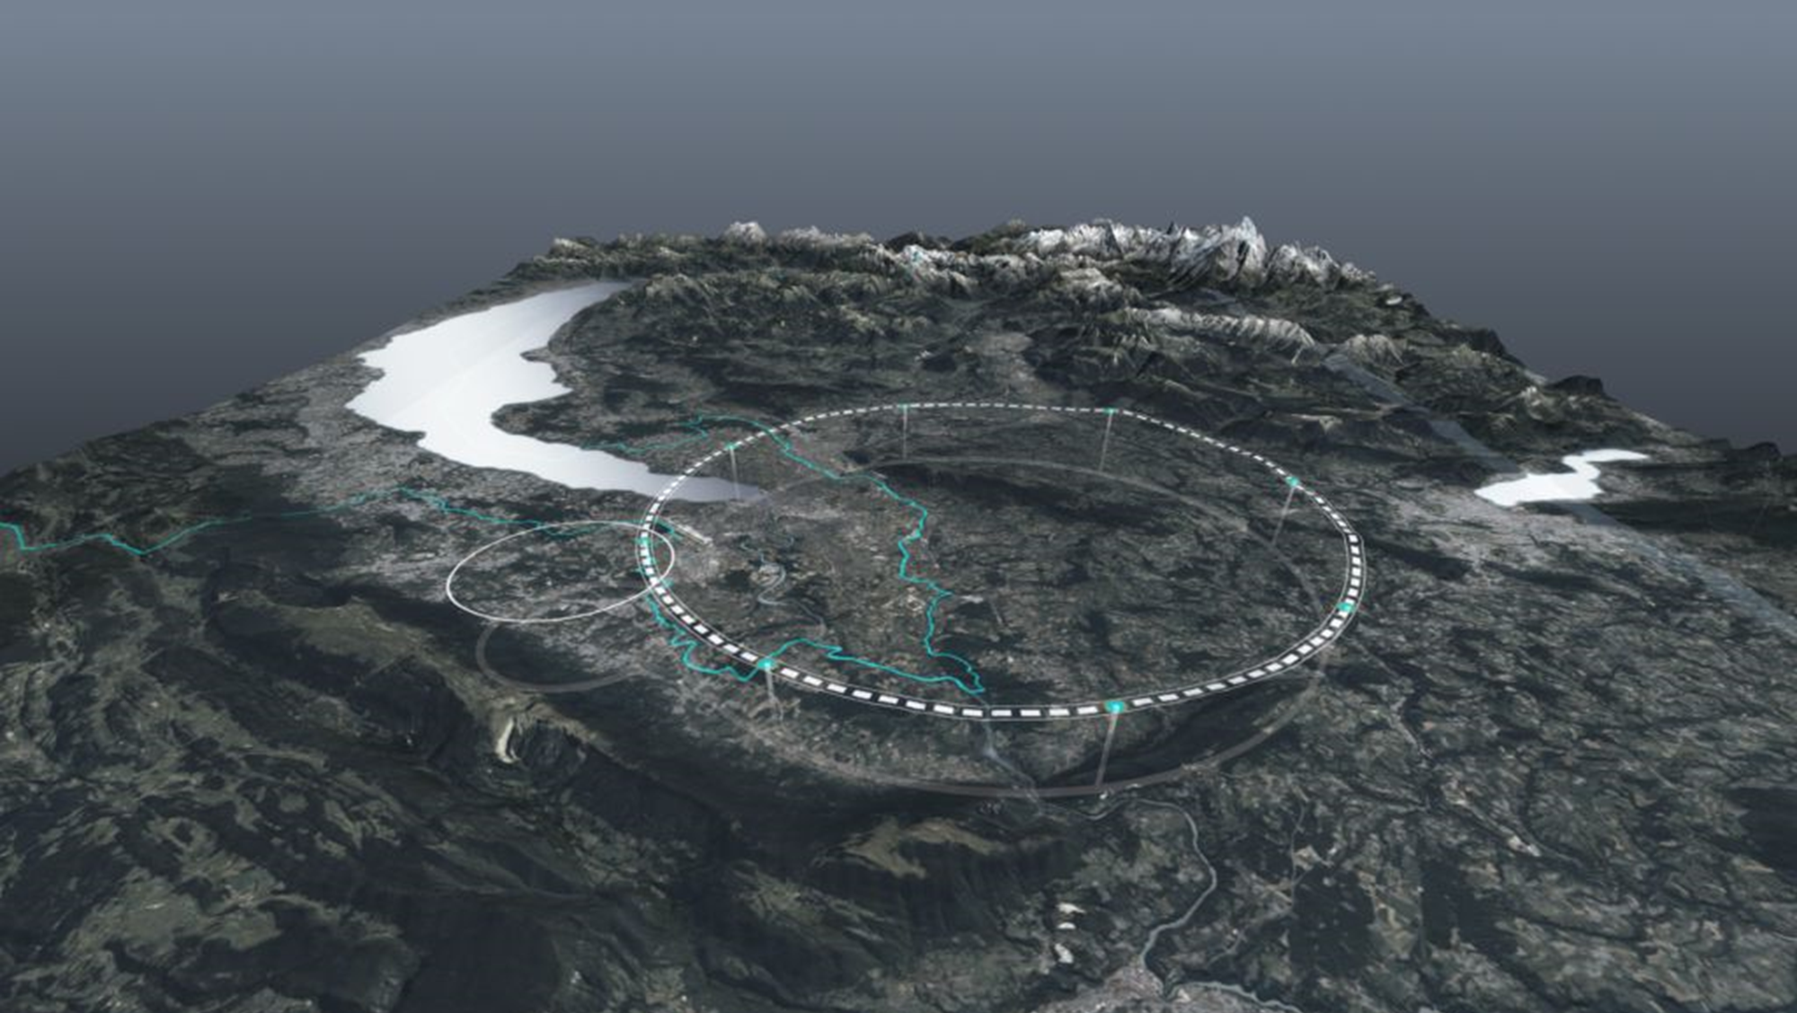
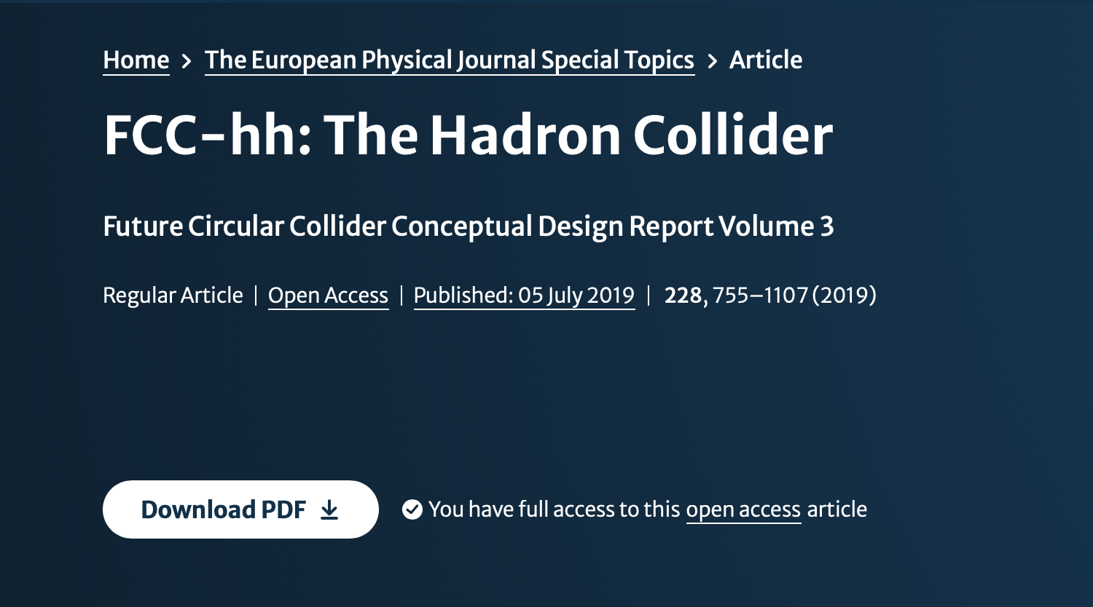
FCC-hh – conceptual design reports in 2018
The basic design was pursued strongly towards towards the European Strategy process update in 2018-19, and the main design and technical issues identified
Will show some slides on the CDR studies – magnets recognised as critical
The High Field Magnet studies (was covered yesterday by P.Vedrine)
During the last 3-4 years a much more detailed design of the FCC-ee has been made, and the FCC-hh design is being updated to match/adapt to these changes
Change of circumference and hence lattice
More work of the injector and technical studies
Will show some examples
Link to the CDR

Slide 27
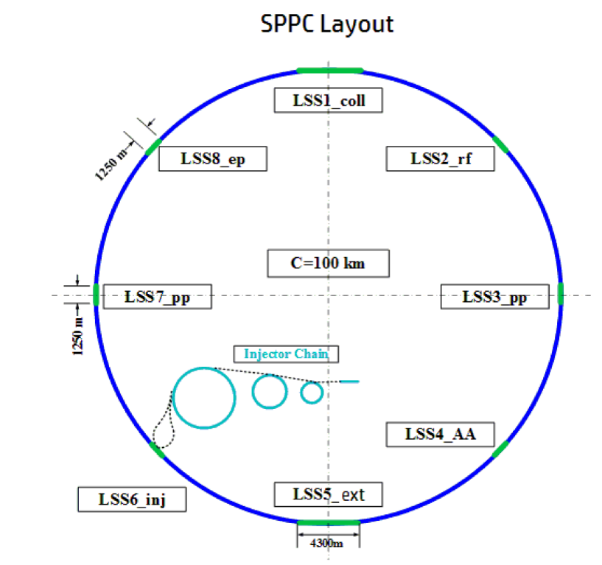
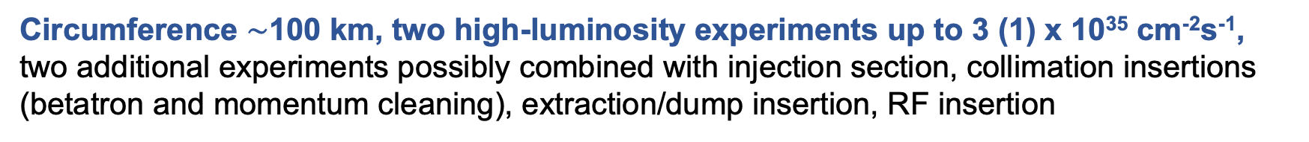
2018: Circular hadron colliders - FCC-hh and SppC
Circumference $\sim$100 km, two high-luminosity experiments up to 3 (1) x 10³⁵ cm⁻²s⁻¹, two additional experiments possibly combined with injection section, collimation insertions (betatron and momentum cleaning), extraction/dump insertion, RF insertion
values in brackets refer to CEPC
FCC-hh
SppC
new injector chain,
simultaneous operation with e+e- collider
based on existing CERN injector chain,
Luminosity goal ~20 ab-1 per main IP within 25 years
For more recent studies of the SppC see next talk by J.Tang
Slide from M.Benedikt: Link

Slide 28
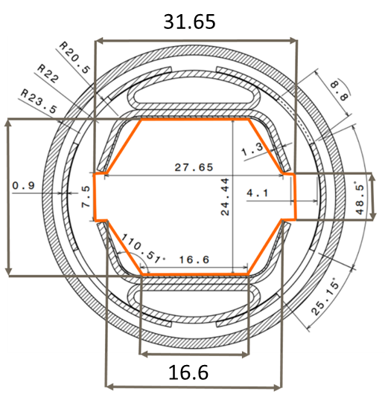
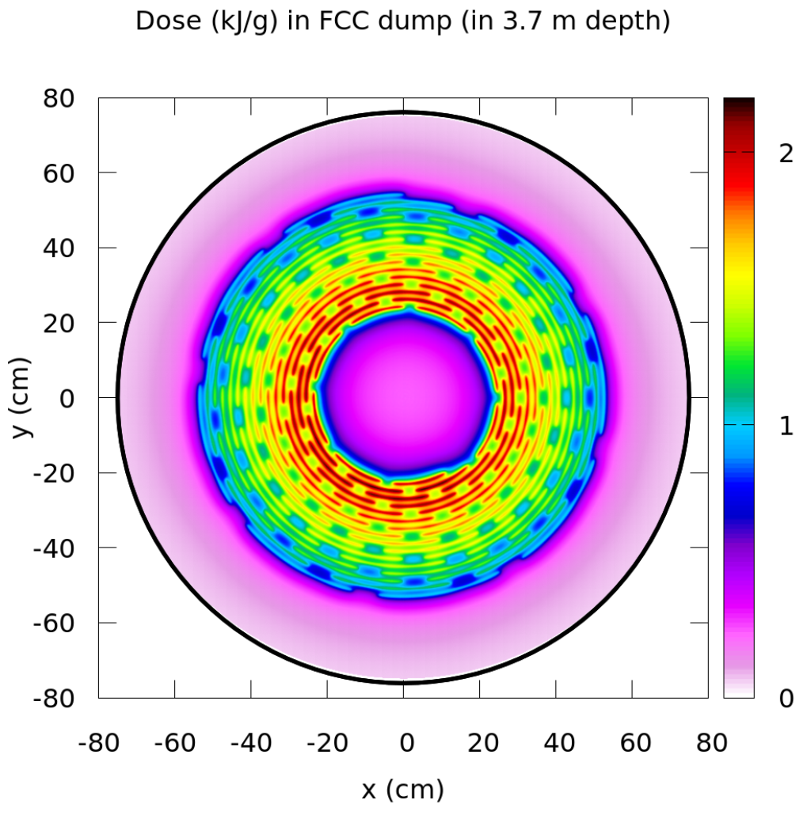
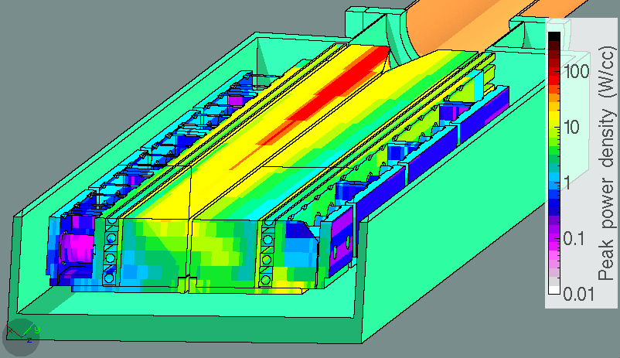
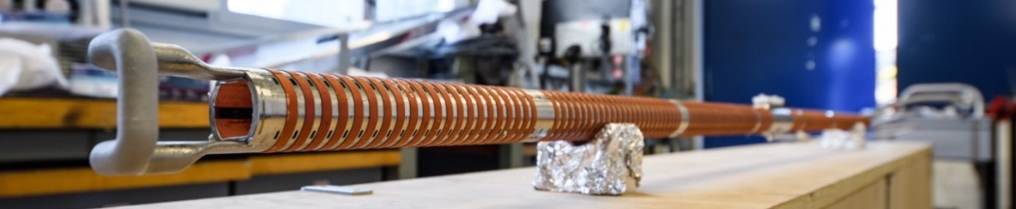
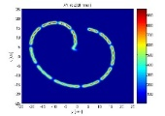
2018: Challenges for hadron colliders
High stored energy in the beam ~8-9 GJ
  Beam handling and dumping
  Collimation cleaning system optimization
  Kinetic energy of Airbus A380 (empty) at 880 km/h
High synchrotron radiation inside magnets several MW
  Beam screen design and cryogenic efficiency
FCC Secondary Collimator
FCC dump pattern
max power density
115 Wcm⁻³
Beam screen prototype
LHC pattern
R&D on new materials, kickers & generators, vacuum systems, cryogenic system, electron lenses, ….
Slide from M.Benedikt: Link

Slide 29
High Field Magnets
High field magnets, crucially important for the hadron colliders energy reach, costs and power consumption
See talk of P.Vedrine yesterday (LINK)

Slide 30
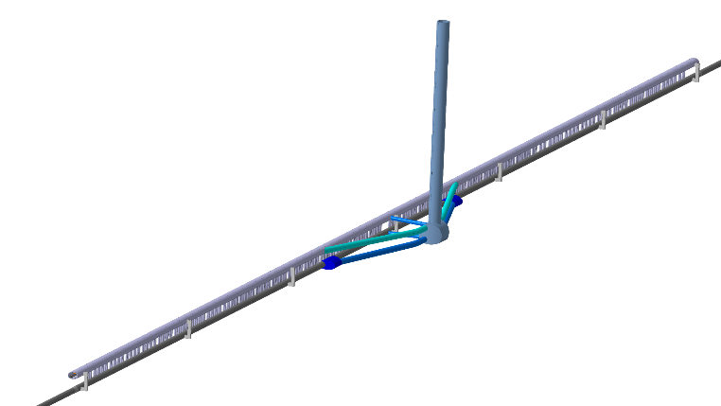
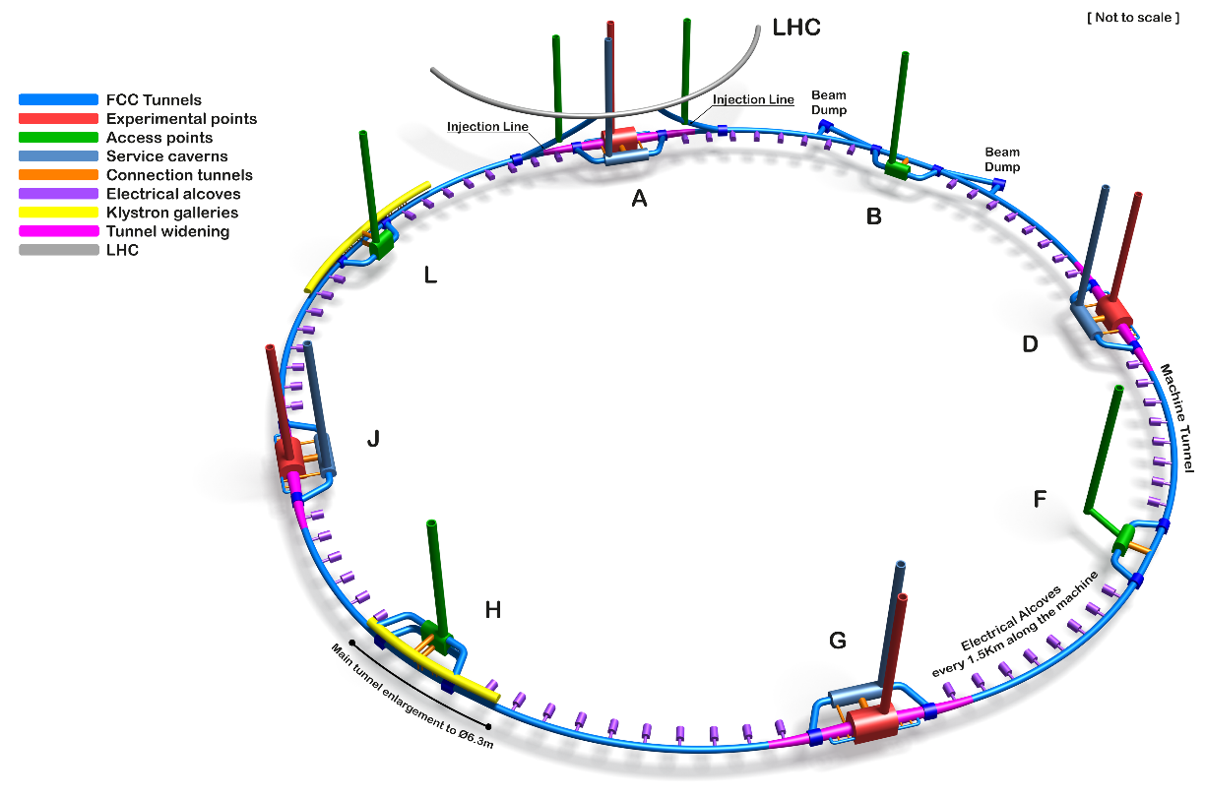
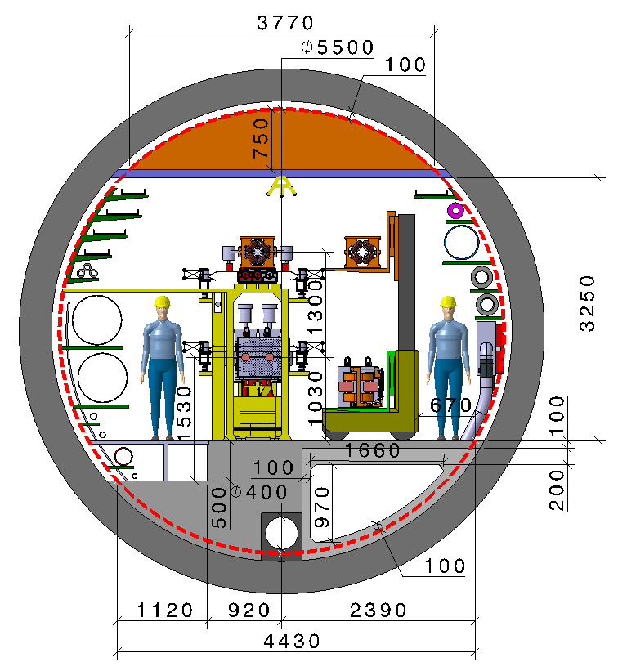
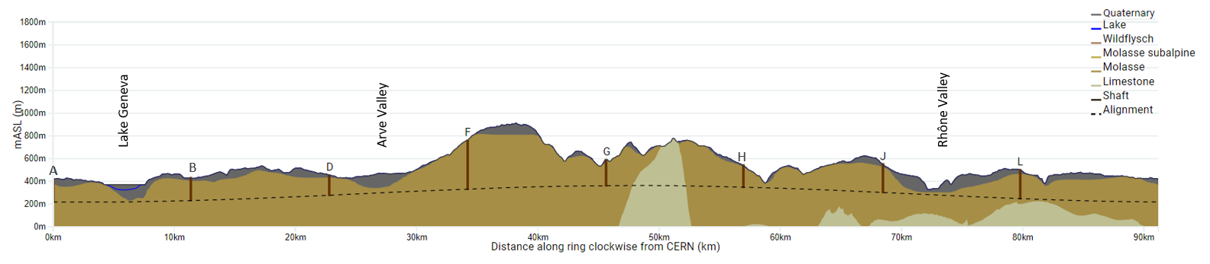
FCC feasibility study
Main activities:
Developing & confirming concrete implementation scenario, in collaboration with host state authorities, including environmental impact analysis
Global collaboration, supported by the EC H2020 Design Study FCCIS and Swiss CHART.
Goals:
  Demonstrate feasibility by 2025/2
  Next milestone is the mid-term review this year
  CE Cost & construction schedule underway
Progress on underground design
90.6km alignment, PA31-3.0
Integration studies (klystrons, alcoves, caverns, beam dump)
8 point baseline design frozen
Excavated materials study
This leads to changes for FCC-hh

Slide 31
FCC-hh updates

Slide 32
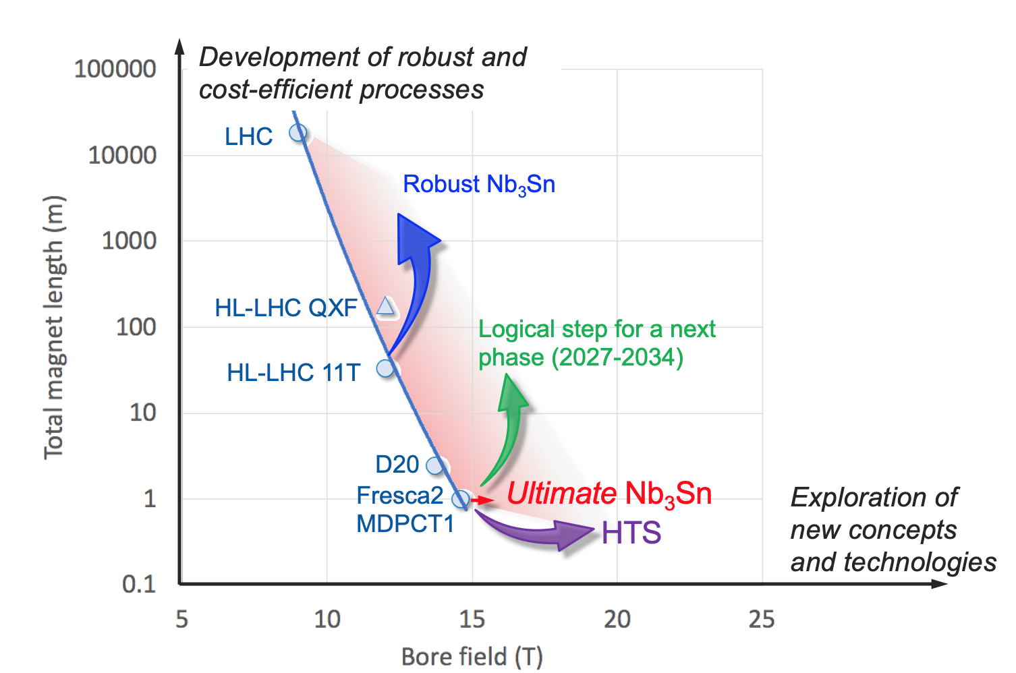
FCC-hh technical update examples
HFM remain the main performance, costs and power consumption drivers

Slide 33
Outline
Introduction
Scope 1: e+e- Higgs factories
Scope 2: Beyond Higgs factories
Some accelerator concepts
Proton and muon colliders
General challenges and main points

Slide 34
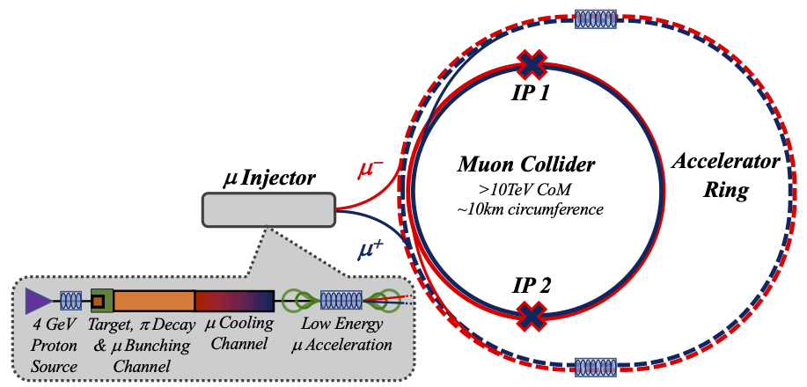
A muon collider addressing size, luminosity, power
Comparing to FCC ~100km and CLIC 3 TeV ~50km
Parameter | Unit | 3 TeV | 10 TeV | 14 TeV
L | 10³⁴ cm⁻²s⁻¹ | 1.8 | 20 | 40
N | 10¹² | 2.2 | 1.8 | 1.8
f_{r} | Hz | 5 | 5 | 5
P_{beam} | MW | 5.3 | 14.4 | 20
C | km | 4.5 | 10 | 14
<B> | T | 7 | 10.5 | 10.5
σ_{δ} | % | 0.1 | 0.1 | 0.1
σ_{z} | mm | 5 | 1.5 | 1.07
β | mm | 5 | 1.5 | 1.07
ε_{L} | MeV m | 7.5 | 7.5 | 7.5
ε | μm | 25 | 25 | 25
σ_{x,y} | μm | 3.0 | 0.9 | 0.63
34

Slide 35
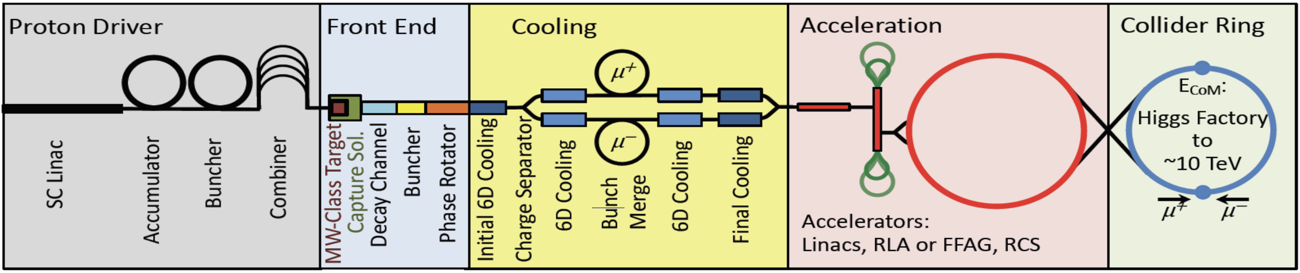
Overview of the muon collider systems
High power proton beam (short intense bunches) and low repetition rate on target.
Stages of muon ionisation cooling in matter.
Merging of μ bunches into one bunch.
Low energy acceleration with recirculating linacs.
Acceleration to collision energy in a sequence of pulsed synchrotrons.
Target and capture channel, protons produce pions which decay into muons.
Large energy spread μ beam split to sequence of bunches.
Collider packed with high field magnets to minimise circumference and maximise luminosity.
Short muon life-time —> Ionization cooling, fast acceleration, high RF gradients and high field magnets!

Slide 36




Muon Production and Capture
Proton complex:
Baseline lattice for accumulator-compressor based on neutrino factory lattice.
Work ongoing on limitations to accommodate the 2MW beam at 5Hz.
Studying 2 MW target:
Stress in target, shielding, vessel and window being studied.
Studies of HTS solenoids ongoing.

Slide 37




Muon Cooling
Short muon lifetime —> Ionisation cooling only option
B. Stechauner
6D cooling
MuCool demonstrated >50 MV/m in 5 T
H2-filled copper
Be end caps
Absorber: reduction of longitudinal and transverse momentum
High Field solenoids: 30-40 or above T
Scattering: beam blow-up —> need for strong solenoids and low Z absorbers.
Cavities: acceleration, RF in magnetic field, i.e., increase of only longitudinal momentum.
Net effect: reduction of transverse momentum and thus beam cooling.

Slide 38





Acceleration
Fast acceleration to avoid significant muon losses due to decay
Initial acceleration to 0.06TeV
Re-Circulating Linacs
Rapid Cycling Sychrotron
Use of high (average) RF gradients to accelerate single μ⁺/μ⁻ bunch.
Start with re-circulating linacs (RCL).
Followed by rapid cycling synchrotrons (RCS)
  acceleration within few tens of turns, studies based on Tesla cavities
  hybrid RCSs have fast ramping normal conducting and constant superconducting dipoles
  the fast-ramping magnet system and energy management are expected to be important cost and power drivers
  FFAs a possible alternative.

Slide 39





Muon Collider Ring - radiation due to muon decay
A. Lechner et al.
Beam-parameters and lattice design challenging
Radiation due to photons and e⁻/e⁺:
Residual power “leaking” into cold mass.
Cryo load, radiation damage etc. “under control” with 30-40mm absorber.
W absorber to intercept most of shower (~500 W/m for 10km).
Due to neutrinos:
Showers generated by neutrinos close the earth surface
  extensive use of dipoles and combined function magnets for evenly distribute the neutrino radiation
  wobbling of machine in vertical direction (modulation within ±1 mrad reduce peak dose by factor ~100)
  positioning such that neutrinos from IR reach earth surface in uncritical areas.
Strong increase of maximum dose with muon energy.
C. Carli et al.

Slide 40


Muon Collider Magnets
Page 40

Slide 41
Cooling Test Facility
Downstream diagnostics area, 5 m
Collimation and upstream diagnostics area, 10 m
Target
+ horn (1st phase) /
+ superconducting solenoid (2nd phase)
Cooling area, 50 m
Momentum selection chicane, 10 m
Look for an existing proton beam with significant power.
Different sites are being considered
CERN, FNAL, ESS are being discussed
J-PARC also interesting as option
C. Rogers

Slide 42
Outline
Introduction
Scope 1: e+e- Higgs factories
Scope 2: Beyond Higgs factories
Some accelerator concepts
Proton and muon colliders
General challenges and main points

Slide 43


Power and energy
100 MW corresponds to ~0.6 TWh with the running scenario on the left
1 TWh very roughly 100 MCHF
Power/energy is generally associated with carbon footprint but we can probably access and adapt to use of green energy by ~2050 (nuclear, sun, wind, hydro, thermal …)

Slide 44


Sustainable facilities
Optimize with respect to:
Energy reach, luminosities, experimental conditions
Facility size and schedule
Costs and Power
Environmental Impact and Sustainability (we are learning what this means)
Keep in mind: This is not only more constraints but also a new opportunity for R&D, new ideas, collaboration
“Not enough to look at operation power and guess the CO2 from this power in ~2050 in your favourite country”

Slide 45


Personnel estimate and cost – for Higgs factories
One FTEy estimated to 200kUS$

Slide 46

Higher energy projects – and costs

Slide 47
Impact on/from – and collaboration with – other fields
Landscape of accelerators
The large markets are medical and industrial small accelerators (dominated by electron linacs and ion implantation)
Material and life-sciences: Synchrotron-sources (new or upgrades) and FELs, ESS (0.5 - 2B projects)
Research in particle and nuclear physics, LHC and HL, EiC, Neutrino “Factories”, Future colliders …
Whenever possible we benefit strongly from aligning to overall accelerator landscape – connected industry, connected laboratories
In some cases we can link to use of “our” key technologies in other fields, e.g. energy sector with HF magnets a very good example (fusion, power generators, etc)

Slide 48

Summary
Higgs-factories are well in reach technically – much needed
Beyond this a hadron collider and/or muon collider are ambitious and very interesting opportunities:
for the hadron collider the magnets are crucial, drives energy reach, cost and power
for the muon collider a wider range of challenges, cooling, RF and and also magnets
LC e+e- can be pushed to ~3 TeV.
Unclear (to me at least) if realistic 10 TeV e+e- collider concepts can be established, even though plasma acceleration can provide very high gradients
Resources needed are large, and sustainability issues will need to be a part of the design throughout
Many opportunities for students and young scientists, these project studies are open collaborations
Proton road
Electron road
Muon road
We are not in a position to ignore any of them

Slide 49
Most of the slides/information from:
The Snowmass Implementation Task Force (chair T.Roser)
M.Benedikt, T.Raubenheimer, M.Giovannozzi
D.Schulte, K.Skoufaris
B.List and ARUP team
E.Adli
M.Narain
Earlier talks in the school, in particular Carlos Wagner (physics) and Pierre Vedrine (high field magnets)
….
THANKS

