Slide 1
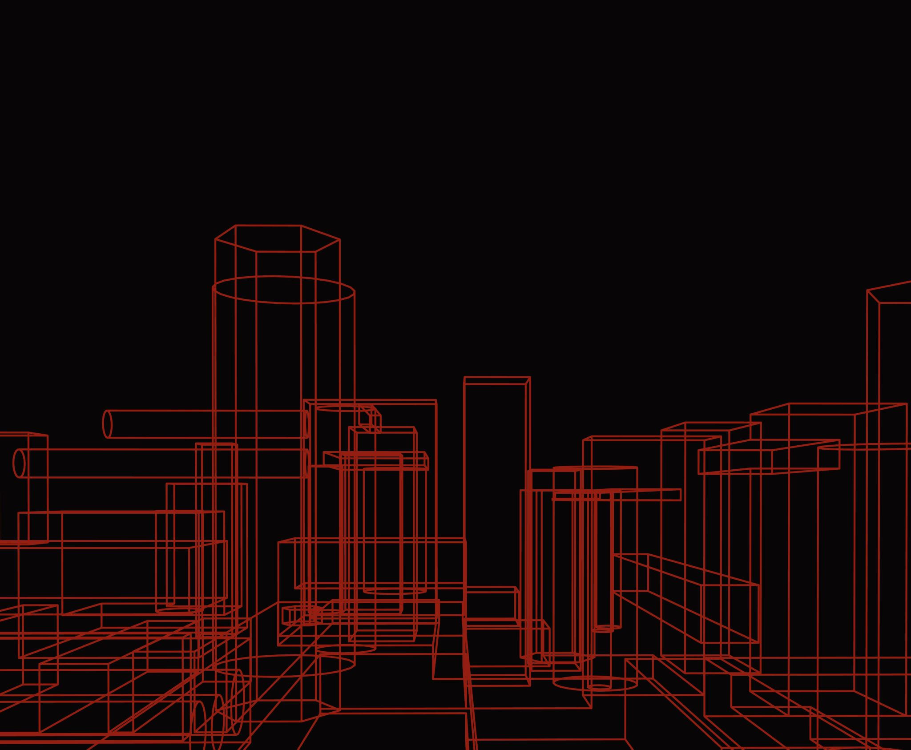
Artificial Intelligence: Challenges and Opportunities
Marcelo Finger
Full Prefessor, Computer Science, IME-USP
Principal Investigator, USP-IBM-Fapesp C4AI -- Center for Artificial Intelligence
September 2023

Slide 2
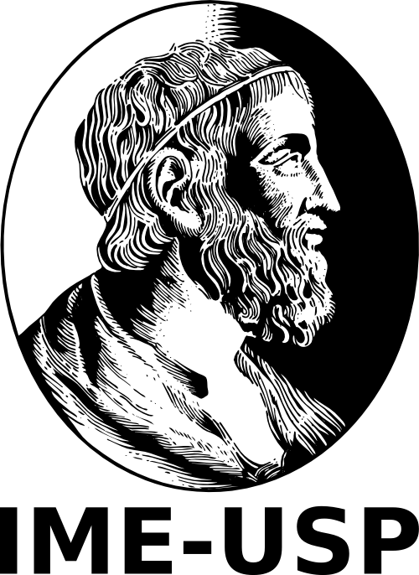
Context

Slide 3

Artificial Intelligence is having a strong impact on society
Impacted Areas
Science and Business
The Culprits
ChatGPT – OpenAI / Facebook
Bard – Google
LLaMA – Meta/Facebook
Transformers

Slide 4

GPT 3.5
Chat GPT
GPT4

Slide 5
The latest hype is impressive
GPT-4 has 170 trillion parameters
Cost of hardware for trainig is U$ 350 millions
Microsoft has already investedi U$ 3 billions, promised U$10 bi
Performance seems impressive!
However ...

Slide 6

Several questions are being raised
Unknown/unpredictable behavior
Need for “Prompt Engineering”
Ethical issues, regulatory inexperience
Generation of Deepfakes and Fakenews
Where have all those problems come from?

Slide 7
Very Brief History of Neural Nets

Slide 8
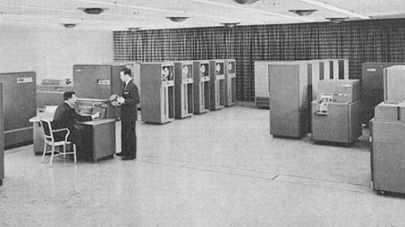
The birth of AI
Dartmouth Workshop 1956 (AI has a birthdate!)
Excitement and wonder with the first computer programs

Slide 9
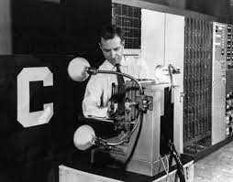

The Initial Hype
1957: Perceptron by Frank Rosenblatt
Coverage in the New York Times and The New Yorker

Slide 10
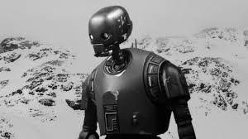
The First Winter
AI is plagued by a cycle Hype-Winter-Hype
Hype = Interest + $$$
Winter = little $$$
Symbolic AI, Probabilistic AI, Classificatory AI, Generative AI

Slide 11
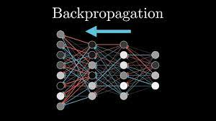
The rebirth of Neural Nets...
In 1986, Hinton popularizes the backpropagation algorithm: training multilayer neural networks

Slide 12
Backpropagation requires much more memory and processing power than what was available in the 80s and 90s
… that then die again

Slide 13
New Winter
Japanese 5th Generation project fails: official termination of the project in 1995, after spending more than ¥50 billion
Again, expectations about Artificial Intelligence lead to disappointment

Slide 14



And times goes by
Microcomputers spread
As well as computeR games
And the demand for video cards (GPUs)

Slide 15

Modernidade

Slide 16



The Birth of Deep Learning
Hardware technology evolution
GPUs begin to provide the computational capacity for training neural networks
The Internet now makes data available for training: the birth of Big Data

Slide 17
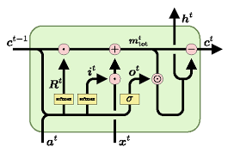
New Neural Architectures
Recurrent neural networks
LSTM (Word Processing)
Convolutional networks (images and video)

Slide 18
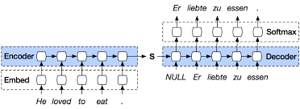
Advances in Translation
Seq2seq Model (2014)

Slide 19
Other advances
Seq2seq with neural atention (input/output correlation)
Free Software for Neural Nets: TensorFlow/Google (2015), PyTorch/Facebook (2016)
Explosion in neural models

Slide 20
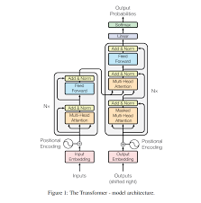
Transformers
2017 (pre-history: < 2017)
Attention, Encoder, Decoder without recurrence
Machine learning ABOVE expectations

Slide 21
Several questions are being raised
Unknown/unpredictable behavior
Need for “Prompt Engineering”
Ethical issues, regulatory inexperience
Generation of Deepfakes and Fakenews
Only the BigTechs (OpenAI, Microsoft, Google, Meta, Amazon, Anthropic, Inflection) are capable of AI development?

Slide 22
Local Development of
Artificial intelligence

Slide 23




How to tackle problems with AI?
What it does
How it does it
What I wish it would do
Is it risk or oportunity?
- Make sense of data
- Predict events
- Classify situations
- Dynamic adjustment
- Detect exceptional states
- Automate processes
Etc..
- Is ethics being considered?
- Is there an applicable regulation?

Slide 24

What is AI for
Data Classification
Ex. Diagnostic assistant, outlier
detection
Estimation
Ex. Demand prediction (Uber)
Event forecasting
Ex: film recommendation, asthma attack

Slide 25
Generative AI
(GPT and its competitors)
Improper uses
Chatbots não são oráculos!
ChatGPT, Bard are not oracles!
They generate false information and hallucinate
Their performance should be rigorously verified
Interactions that start in the wrong way are hard to correct
So unreliable for decision making
Proper Uses
text, email, letter, memo, etc, generation.
Infomation extraction
Sumarization
Regulation, etc.

Slide 26



Pre-Requisites For AI Development
Ethical professionals
Data
Algorithms

Slide 27
AI and Future Jobs
Data Colection and Generation for AI training
Analysis, pre-processing of data [>70%]
Design and implementation of inteligent modules
Inserting AI in large systems. Using AI
Legislation and “Cibernetic Vigilance”
Education for AI
What we do will be the future

Slide 28

Sitting on a treasure
Not only the BigTechs may develop AI
AI is not exclusive for english speakers!

Slide 29
Data is an Investment
- Data require colection, cleanig, storage
- Processing and Training
- Culture creation in which “data is part of the routine”
- All this requires $$$
Only those who see value in its use will enter the world of AI

Slide 30
Methodology for Artificial Intelligence in Practice

Slide 31

How to develop AI with
one’s own data???
Notes:
Especificação das fontes:
Título: Montserrat, negrito ativado, tamanho 72.
Nome: Montserrat, tamanho 44
Cargo: Montserrat, italic, tamanho 28.
Como baixar e instalar a fonte:
A fonte Montserrat está disponível para baixar em: https://fonts.google.com/specimen/Montserrat
Para instalar as fontes é só seguir o simples e rápido passo-a-passo em: https://www.tecmundo.com.br/word/2351-instalando-novos-tipos-de-letras-fontes-.htm

Slide 32
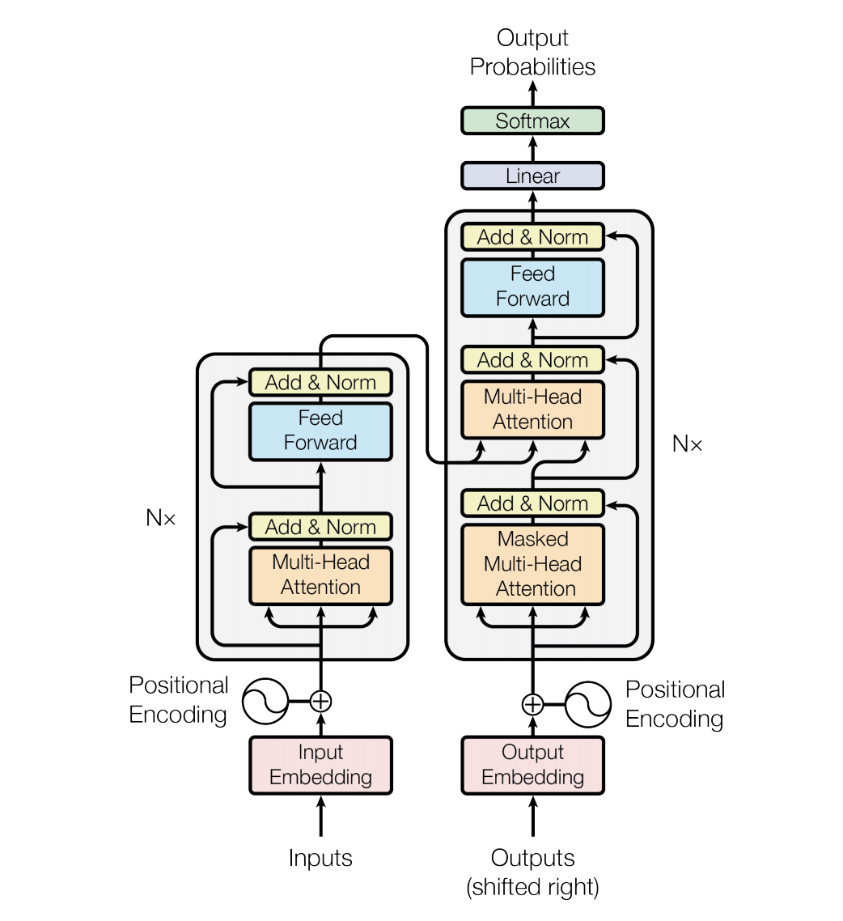
Algorithms for Serious AI
Transformers [2017], GPT – only the second part
The power lies on the data
How to take advantadge of all that power?

Slide 33



AI Employment Methodology
What for do I need data?
How top colect?
There are no “generic data”
Each domain has its own perks
How to get return on investment?

Slide 34

AI Employment Methodology
What for do I need data?
How top colect?
There are no “generic data”
Each domain has its own perks
How to get return on investment?
Where do HUMANS fit in?

Slide 35
A Few Ongoing Projects

Slide 36
AI based projects in progress
Spira – AI for respiratory insuifficiency detection bia audio analysis
Cement – AI for Property Predictions; AI for demand forecasting
Carolina – language resources for Portuguese. AI for natural language processing and Large Language Models
Brazilian Indigenous languages – AI for studying, translating and preserving indigenous languages
Literacy – AI for fluency analysis in children's reading

Slide 37
Conclusions
LLMs – are just another possibility for the applications of Artificial Intelligence
We cannot fail to mention the discussions around ETHICS and the effects on society
The path to/with AI is just beginning

Slide 38
obrigado
Contact:
mfinger@ime. usp.br

