Slide 1
INFIERI 2023
Global quantum networks
Daniel Felinto
Departamento de Física, UFPE
São Paulo, September 08 2023
daniel.felinto@ufpe.br

Slide 2
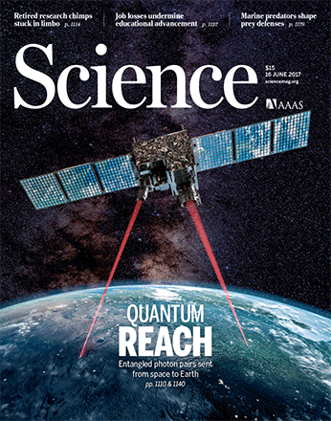
Global Quantum Networks
1st meaning
2nd meaning
isolated quantum system
quantum system
quantum world

Slide 3
overview
Global Quantum Communication (1st meaning)
Global Quantum Systems (2nd meaning)
  Rayleigh scattering
  Raman scattering
From quantum networks to the quantum internet
Connecting global and local quantum networks
Conclusions and perspectives

Slide 4
1. Global Quantum Communication
2nd Quantum Revolution
1st Revolution ⟹ solid state physics (microelectronics, computers, lasers)
quantum devices performing classical tasks
2nd Revolution ⟹ quantum computing, communication, sensing
quantum devices performing quantum tasks
Quantum strategies for solving problems
Quantum programming
Quantum engineering
Engineers and computer scientists with knowledge of quantum mechanics

Slide 5
1. Global Quantum Communication
1st application: Quantum Key Distribution (BB84)
Figure by Iqbal et. al 2016
No Cloning: quantum states cannot be duplicated
Completely secure public distribution of cryptographic Keys, since eavesdropper would disturb the state and could be detected
Bennett & Brassard, in Int. Conf. Computers, Systems & Signal Processing, Bangalore 175-179 (1984)

Slide 6
1. Global Quantum Communication
First experiment in quantum cryptography
Bennett et al., J. of Cryptology 5, 3 (1992)

Slide 7
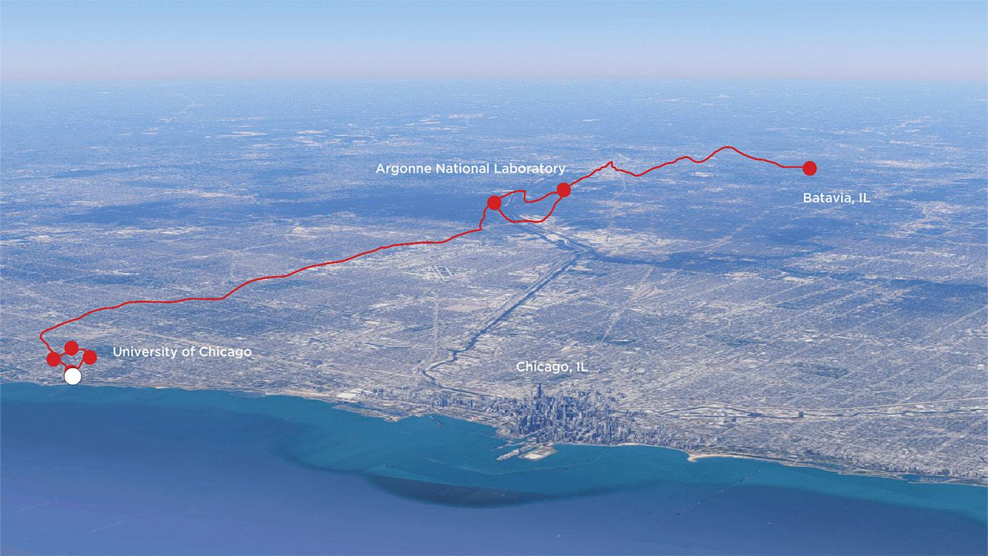
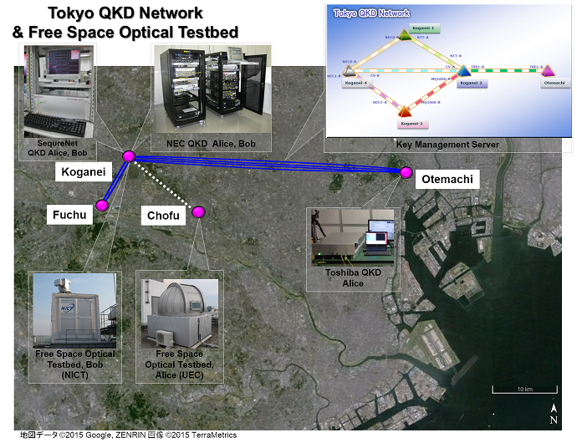
1. Global Quantum Communication
No Cloning ⟹ no amplification
initial limitation to city-wide networks
local networks
First large scale application of quantum cryptography
(City of Geneva + id Quantique)
2007
securing data transfer for city elections
Chicago 2020
Vienna
2008
Tokyo
2010
Cambridge 2019
Beijing 2007

Slide 8
1. Global Quantum Communication
Micius
China’s first quantum satellite
transmission through thin atmosphere allows to reach long distances

Slide 9
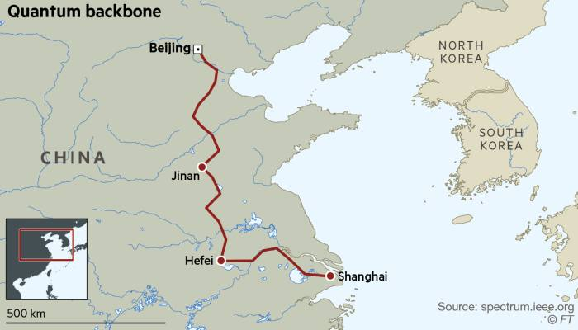
1. Global Quantum Communication
cascading links for Quantum Key Distribution
Beijing – Shangai
2017
Problem: Cascanding QKD requires trusted relys (ground or satellite) that have knowledge of all keys.
Sustained an encrypted videoconference between China and Austria for 75 min
Solution: to use quantum entanglement

Slide 10
1. Global Quantum Communication
So far, huge development on a specific communication task (QKD).
How to move forward?
Development of Quantum Key Distribution Protocols
1984: BB84 protocol with single photons
1991: Ekert protocol with
quantum entangled photon pairs
1990s – 2000s: widespread use of
attenuated laser pulses
(unsafe alternative to single photons)
2000: Experimental implementation of
Ekert protocol [PRL 84, 4729 (2000); 4733 (2000);
4737 (2000)]
2005: decoy-state BB84 protocol makes
attenuated lasers safe for QKD
Use of attenuated laser pulses is nowadays the standard for QKD between 2 sites

Slide 11
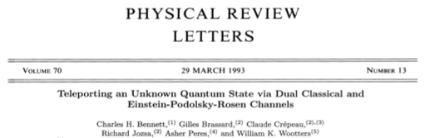
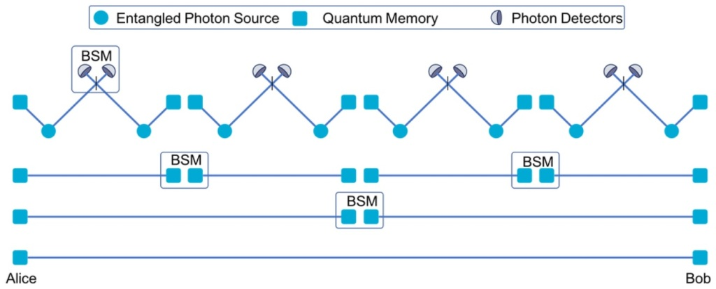
1. Global Quantum Communication
Entanglement-based quantum communication
Quantum teleportation (1993)
Quantum state cannot be copied (No Cloning), but can be transported from site A to site B if these sites share quantum entanglement
Quantum entanglement as a new type of communication channel
Quantum repeaters [PRL 81, 5932 (1998)]
Quantum communication with entangled states is scalable
(not limited by No Cloning theorem)

Slide 12
1. Global Quantum Communication
China’s Micius satellite
June 2017: distribution of quantum entanglement between systems separated by 1200 km.
Network of satellites up 2030

Slide 13
1. Global Quantum Communication
source of entangled photon pairs:
Spontaneous Parametric Down-Conversion
Setup for QKD with quantum entanglement [PRL 84, 4733 (2000)]
relatively mundane physical system
correlated spontaneous emission
tip of the iceberg
of quantum resources

Slide 14
2. Global Quantum Systems
More realistic approach
Even more realistic…
open quantum system
Usual quantum mechanical treatment
quantum system
isolated quantum system
quantum world
world
statistical mixture
master equation
intrinsically multi-partite (quantum information)
addressing an individual system in contact to another
addressing all interacting systems

Slide 15
2.(a) Global Quantum Systems: Rayleigh scattering
laser
interest → simplest quantum system to model light-matter interaction
→ widely applied classical models
challenges → lack of structure prevents most filtering techniques
→ mix of different contributions may hide purely quantum effects

Slide 16
2.(a) Global Quantum Systems: Rayleigh scattering
Moreira et al., Opt. Commun. 459, 127075 (2021)
Hanbury-Brown-Twiss (HBT) interferometer
thermal light source
g⁽²⁾(0) = 2
g⁽²⁾(𝜏 →∞) = 1

Slide 17
2.(a) Global Quantum Systems: Rayleigh scattering
Criteria for quantum correlations: Cauchy-Schwarz inequality
cross-correlation
auto-correlations
R ≤ 1: classical correlations
g₁₁(0) ≈ g₂₂(0) ≈ 2
g₁₂(𝜏) > 2
thermal states
quantum region

Slide 18
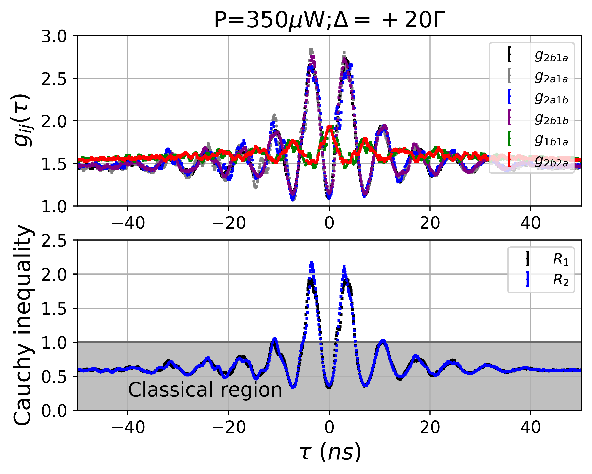
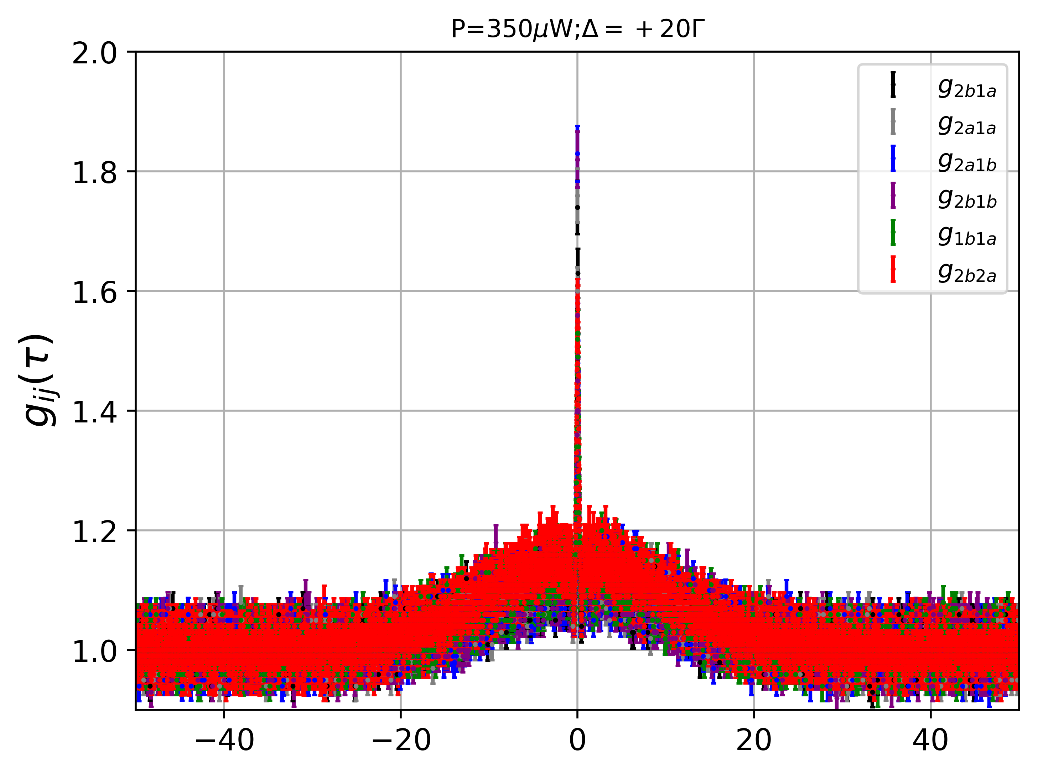
2.(a) Global Quantum Systems: Rayleigh scattering
cross-correlations
auto-correlations
τ (μs)
non-classical correlations!
Quantum correlations prevail over the Rayleigh scattering background
Classical models may predict some experimental results but not all
Decay of quantum correlations faster than predicted ⟹ superradiance

Slide 19
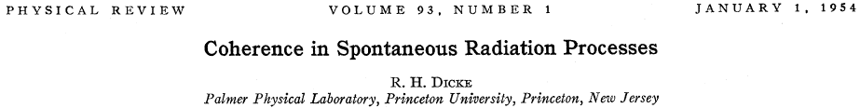
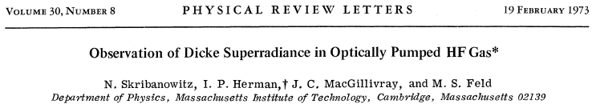
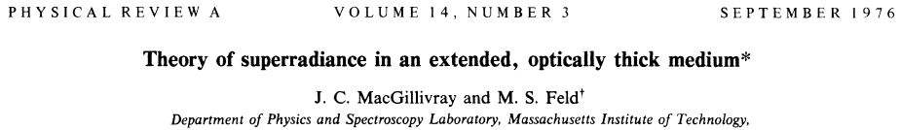
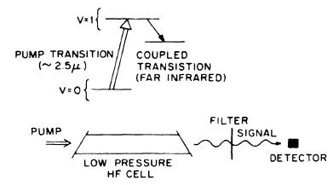
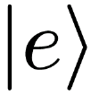
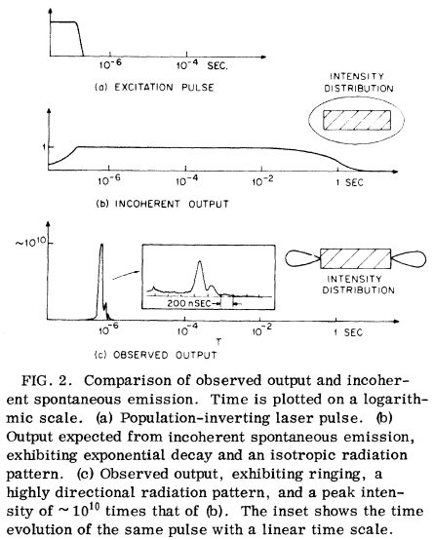
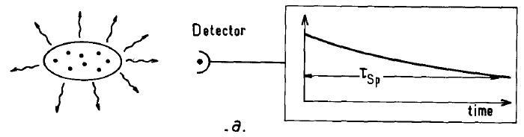
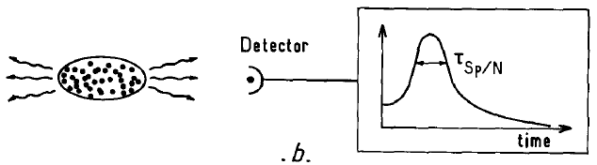
2.(a) Global Quantum Systems: Rayleigh scattering
Superradiance
1st experiment
same vacuum mode shared by a large number of atoms
coherent coupling of atoms through the vacuum
low density or # atoms (N)
high density or # atoms (N)

Slide 20
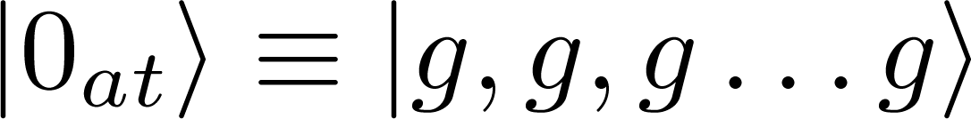



2.(b) Global Quantum Systems: Raman scattering
: excitation probability
write
field 1
...
write
field 1
√ click!
Conditional preparation of entangled collective state with 1 excitation
measurement on the quantum reservoir
Theoretical proposal (DLCZ protocol): Duan et. al, Nature 414, 413 (2001)
First implementation: Kuzmich et. al, Nature 423, 731 (2003)

Slide 21

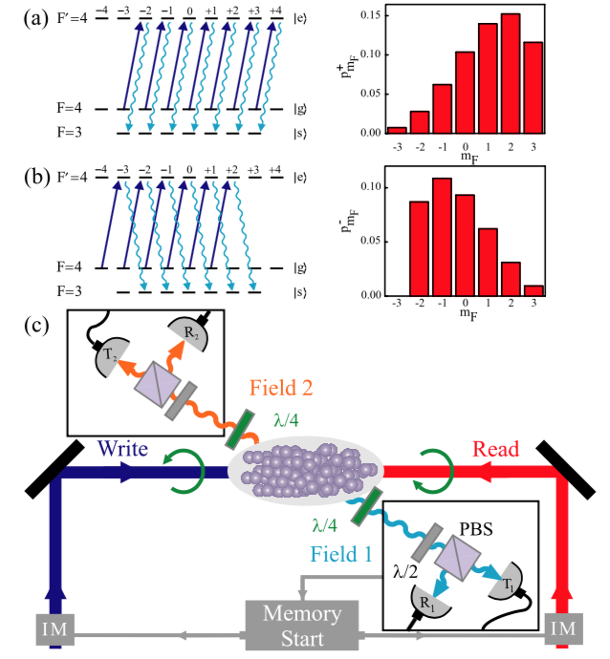
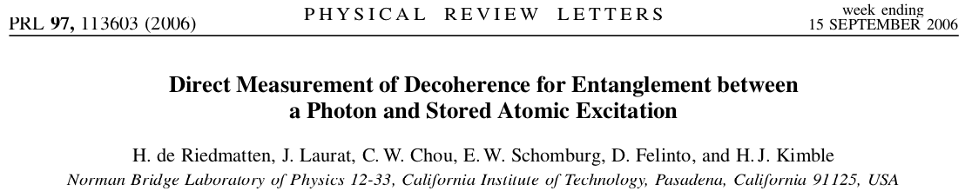
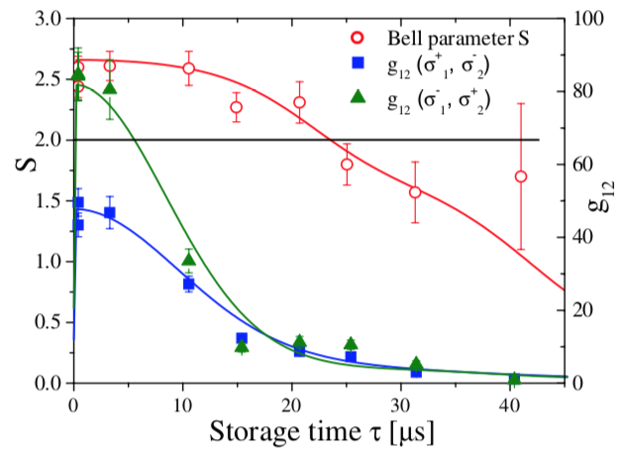
2.(b) Global Quantum Systems: Raman scattering
field 2
superradiant
emission
read
Fock state (no classical analogue)
Large suppression of all other |n₂> components
read
field 2

Slide 22
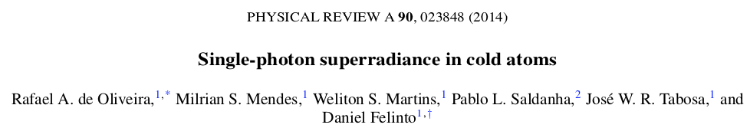
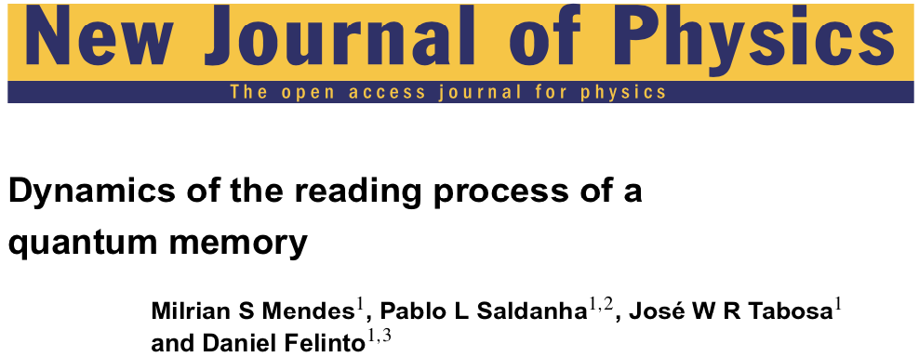
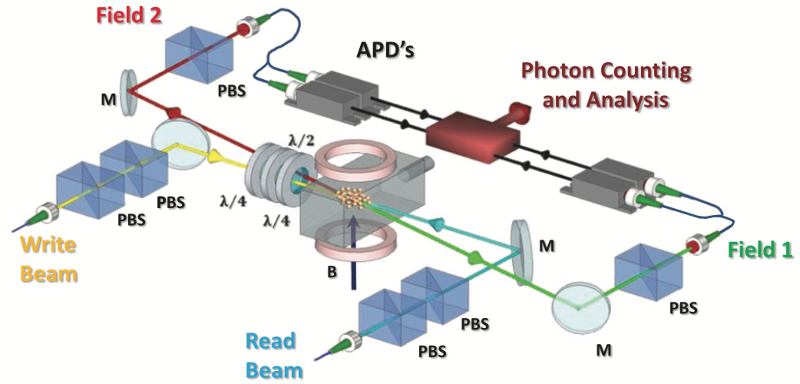
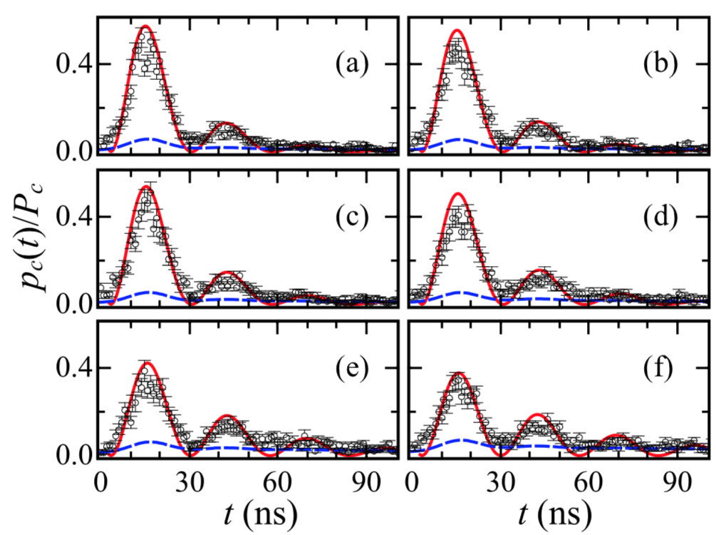

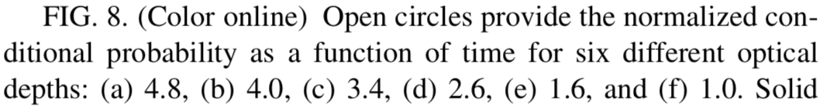
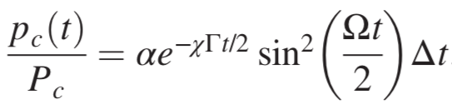
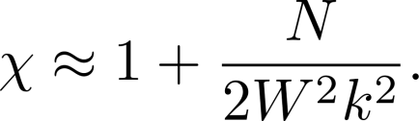
2.(b) Global Quantum Systems: Raman scattering
suppression of 2-photon component (field 2)
<< 1 (coherent state)
accelerated decay
1 atom: (Γ/2)⁻¹ = 60 ns
observed: (χΓ/2)⁻¹ = 16 ns
Single photon emitted collectively

Slide 23
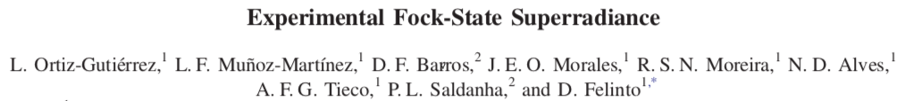
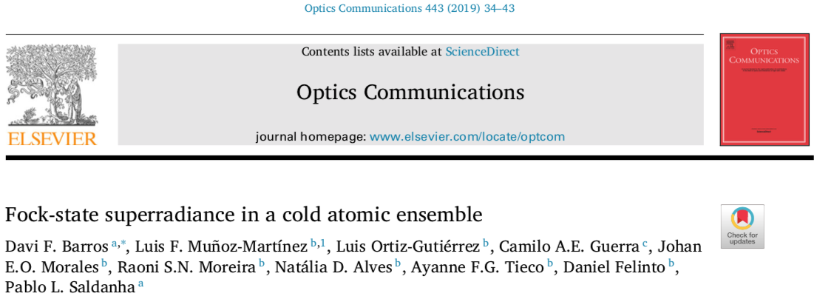

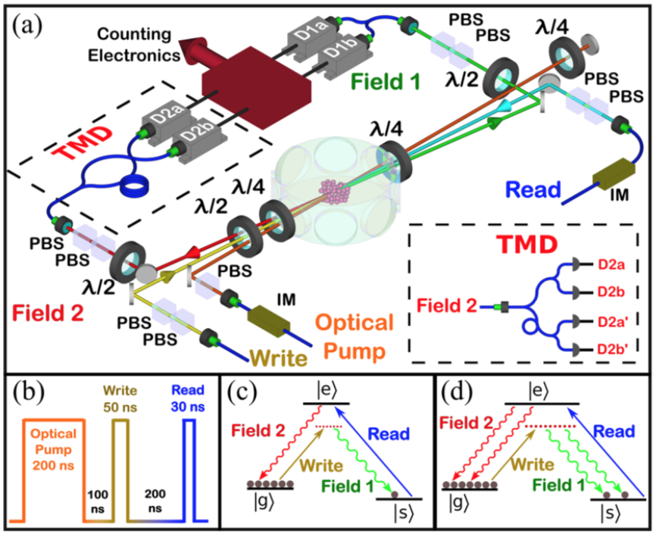
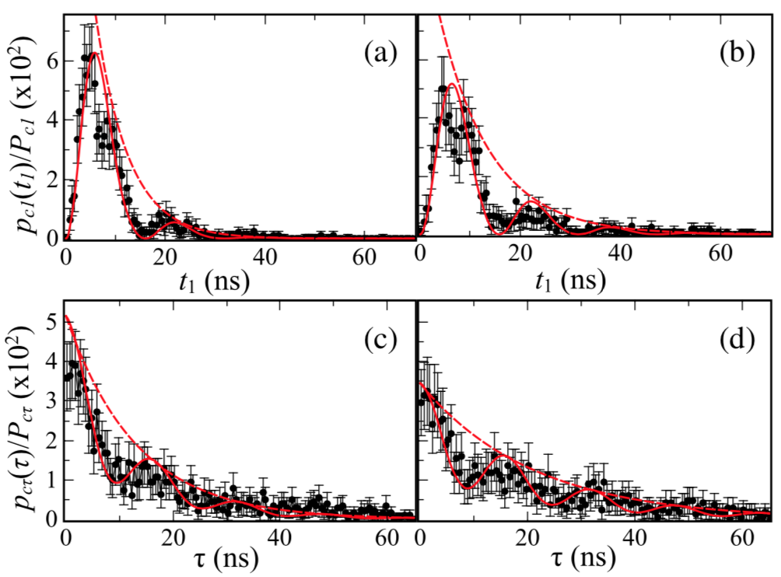
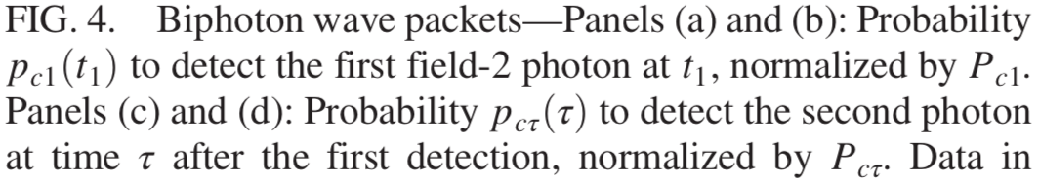
2.(b) Global Quantum Systems: Raman scattering
Beyond discussion
single photon X attenuated laser
two-photon superradiance

Slide 24
2.(b) Global Quantum Systems: Raman scattering

Slide 25
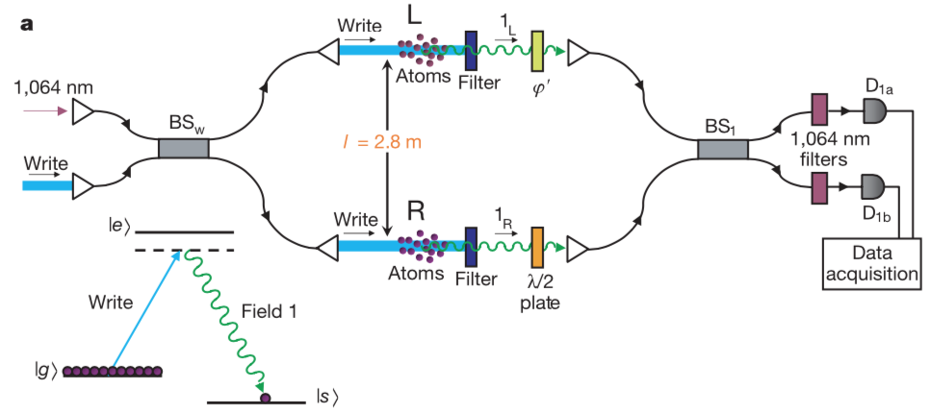

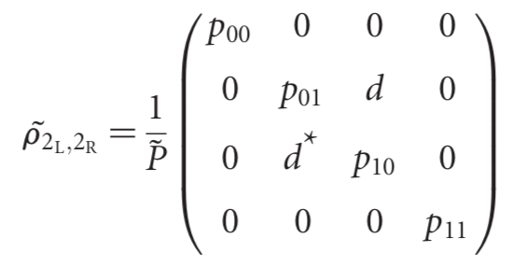
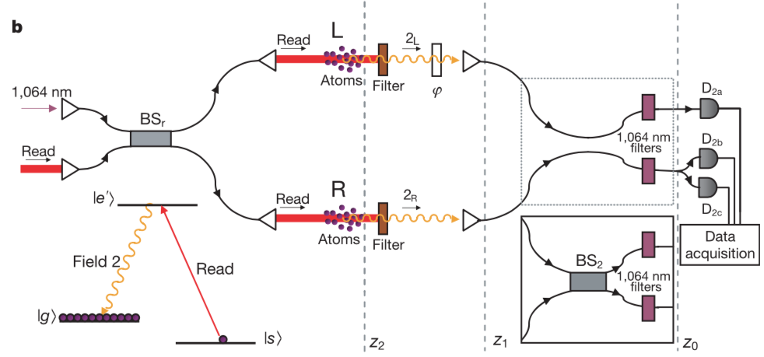
3. From quantum networks to the quantum internet
entangled state between remote sites
Concurrence: entanglement quantification (Wooters, 1998)
quantum entangled

Slide 26
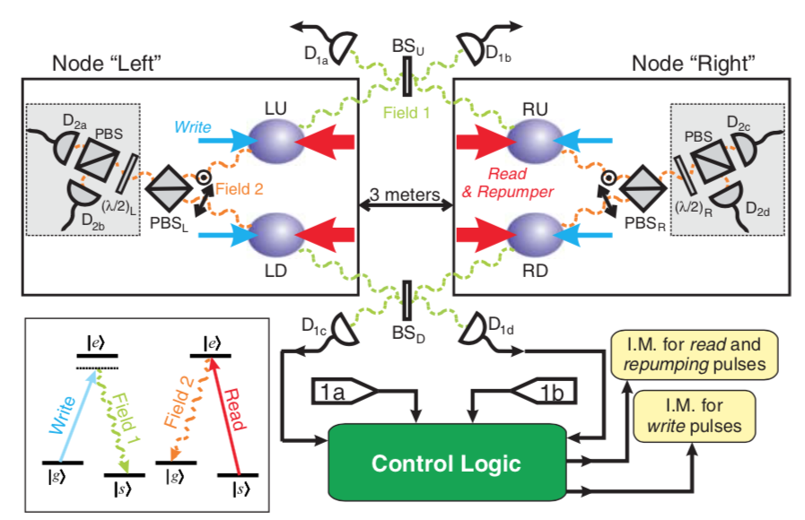
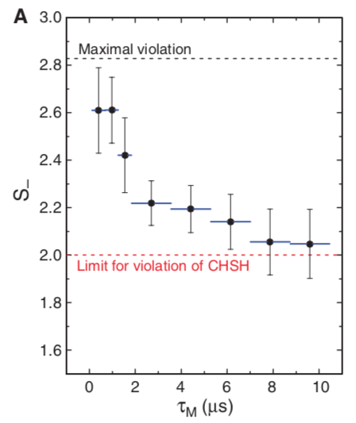
3. From quantum networks to the quantum internet
polarization entanglement
quantum cryptography (Ekert, 1992)

Slide 27
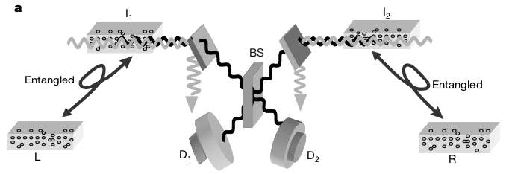
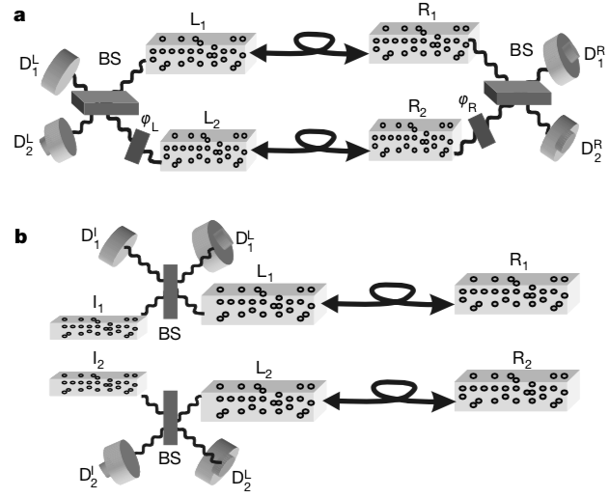
3. From quantum networks to the quantum internet
DLCZ protocol
entanglement swapping
capabilities
teleportation
cryptography

Slide 28

3. From quantum networks to the quantum internet
quantum networks (1997)

Slide 29
4. Connecting global and local quantum networks
Yin et al., Science 356, 1140 (2017)
polarization entangled photon pairs at 800 nm
based on Sagnac interferometer
Similar source implemented at UFPE
Mendes et al., J. Opt. Soc. Am. B 32, 1670 (2015)
Moreira et al., Opt. Commun. 428, 212 (2018)

Slide 30
4. Connecting global and local quantum networks
Proposal for mapping of ultrabroad band single photons into an atomic memory
Mendes et al., J. Opt. Soc. Am. B 32, 1670 (2015)
Moreira et al., Opt. Commun. 428, 212 (2018)
interaction of ultrabroad band single photons with atomic ensembles
Pathway to connect ultrabroad band flying photons into a narrow band memory compatible to local quantum networks

Slide 31
5. Conclusions and perspectives
The evolution of our understanding of quantum mechanics led to the field of quantum information, which engendered the ongoing 2nd quantum technological revolution.
A central aspect of this revolution is quantum entanglement.
We are just starting to understand the role of quantum entanglement in nature and its potential applications.
We presented some of our recent work on this problem, pointing out its connection to the development of a quantum internet.

Slide 32








Profs: Daniel Felinto (Quantum Networks Laboratory – 2023)
José Tabosa
Lúcio Acioli
Sandra Vianna
Márcio Miranda
Fernando Parísio
Katiúscia Cassemiro
José Ferraz (UFRPE)
Pablo Saldanha (UFMG)
Marco Bellini (LENS)
Post-docs: Alejandro Fonseca
Alexandre Almeida
Juan C. C. Capella
Lucas S. Marinho
Michelle O. Araújo
Weliton S. Martins
Doctorate: Wellington Martins Filho
Gabriel Carvalho Borges
Milrian S. Mendes
Rafael A. de Oliveira
Luis Ortiz-Gutiérrez
Raoni S. N. Moreira
Luis F. Muñoz-Martínez
Alyson José Alves Carvalho
Davi S. Barros (UFMG)
Master: Rodrigo L. C. Santos Filho
Gabriel P. S. da Silva
Johan E. O. Morales
Lenin Fernández
Natália D. Alves
Ayanne A.F. Tieco
Paulo J. C. de Vasconcelos Filho
experiments in Recife

Slide 33
Thanks!
open positions for postdocs and grad students!

