Slide 1
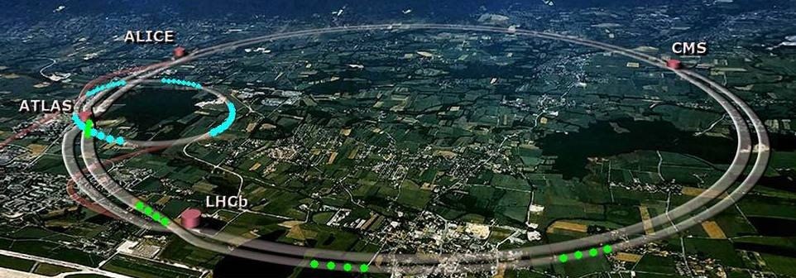
Brainstorming on Possible MDs
in CERN acc. complex
S. Gilardoni –SY/STI
Nov. 2022

Slide 2
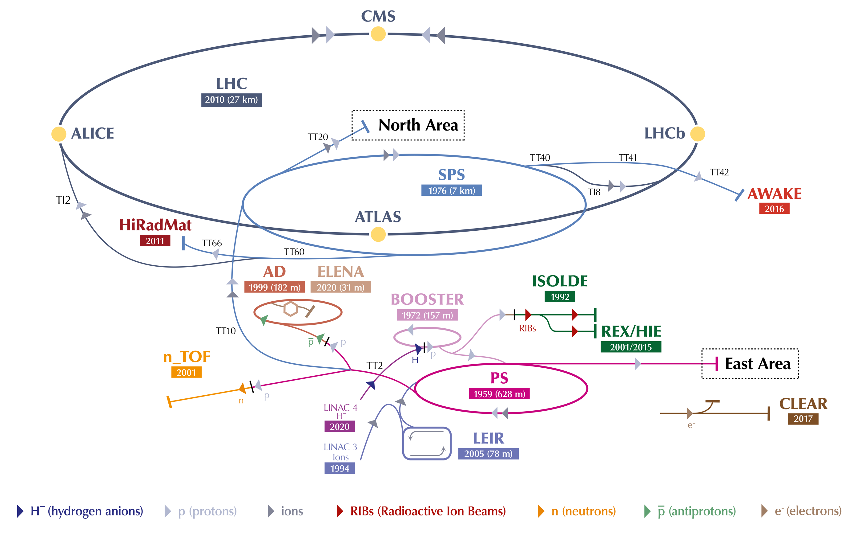
CERN accelerator complex as now

Slide 3
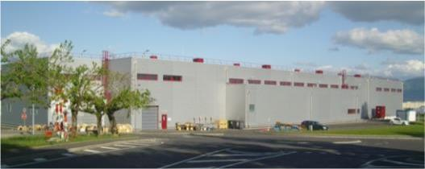
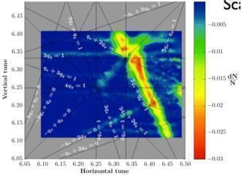
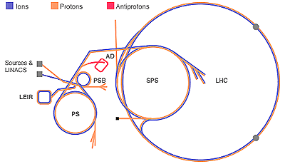
LS2 : (2019-2020), LHC Injector Upgrades (LIU)
LINAC4 – PS Booster:
  H⁻ injection and increase of PSB injection energy from 50 MeV to 160 MeV, to increase PSB space charge threshold
  New RF cavity system, new main power converters
  Increase of extraction energy from 1.4 GeV →2 GeV
PS:
  Increase of injection energy from 1.4 GeV → 2 GeV to increase PS space charge threshold
  Transverse resonance compensation
  New RF Longitudinal feedback system
SPS
  Electron Cloud mitigation – strong feedback system, or coating of the vacuum system
  Impedance reduction, improved feedbacks
  Large-scale modification to the main RF system
These are only the main modifications and this list is far from exhaustive

Slide 4
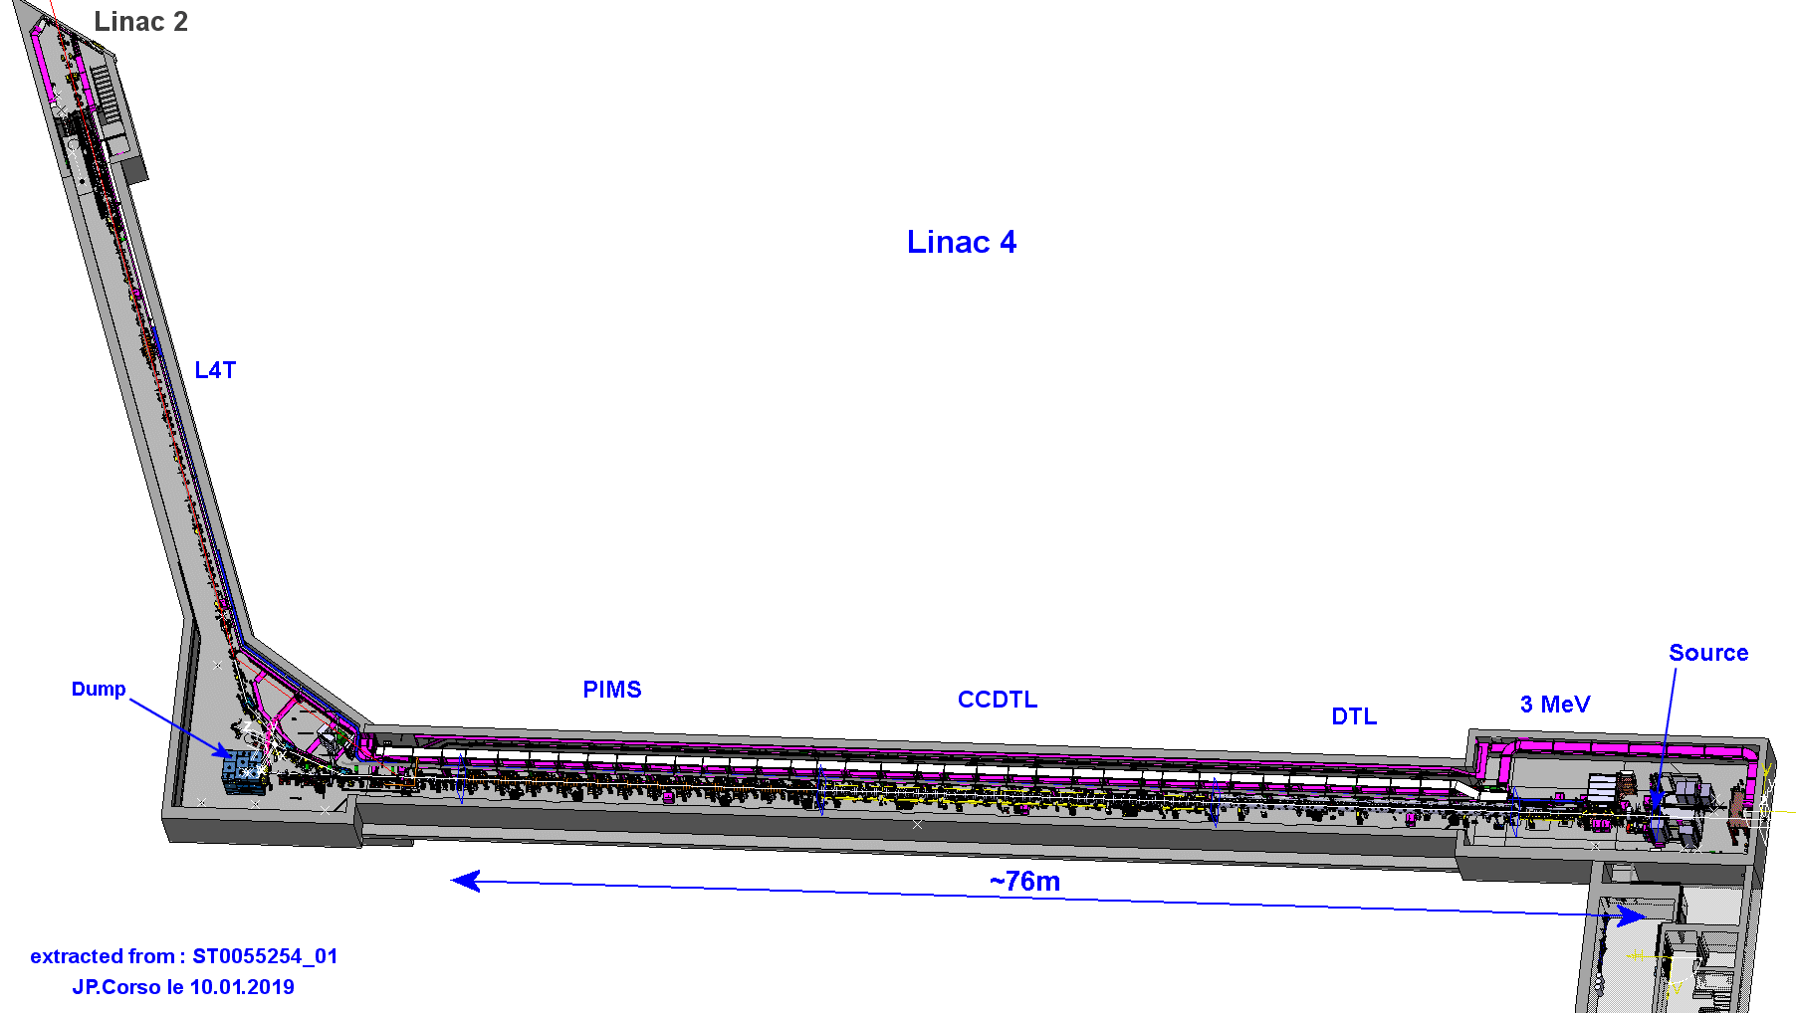
LINAC4 - layout
See A. Lombardi
presentation
Vertical step to connect to LT, LTB and BI lines
in Linac2/PS tunnel
Cell-Coupled Drift Tube Linac
100 MeV
7 Modules
6 Klystrons
7 EMQ
7 steerers
14 PMQ
25 m
Pre-injector
3 MeV
Source(s) @ 45 kV
2 solenoids
RFQ (1 Klystron)
11 EMQ
3 Buncher Cavities
2 Chopper units
+ dump
Π-mode Structure
160 MeV
12 Modules
6 Klystrons
12 EMQ
12 steerers
23 m
Drift Tube Linac
50 MeV
3 Tanks
3 Klystrons
1 EMQ
2 steerers
114 PMQ
19 m

Slide 5
Linac 4

Slide 6
Linac4 Parameters
 | CDR Design Parameters | Goal Post-LS2 Parameters
Ion Species | H⁻ | H⁻
Output Energy | 160 MeV | 160 MeV
Bunch Frequency | 352.2 MHz (LEP!)
Max. Repetition Rate | 2 Hz
Max. Beam Pulse Length | 400 μs @ 0.833 Hz | 600 μs @ 0.833 Hz
Max. Beam Duty Cycle | 0.08% | 0.12%
Chopper Beam-on Factor | ~65% | Max. ~65%
Source Peak Current | 80 mA | ~60 mA
Linac Peak Current | 65 mA | 40 mA
Linac Chopped Current | 40 mA | 26 mA
Transv. Emittance (Source) | 0.25 π mm mrad
Transv. Emittance (Exit) | 0.4 π mm mrad | 0.4 π mm mrad
Require only 0.833 Hz
(1.2 s basic cycle)
Chopping at 3 MeV for
~loss-free injection into
the PSB RF bucket
(~630 ns beam ON)
RF structures dimensioned for 50 Hz,
power supplies, electronics, electricity, cooling for 2 Hz
Notes:
~2.8 ns bunches * 222 → 630 ns beam in PSB bucket

Slide 7
CERN accelerator complex

Slide 8
PSB main features
Injection
  160 MeV H⁻
  Multiturn charge exchange injection with transverse and longitudinal painting up to ~120 turns
4 superimposed ring magnetically coupled
Lattice: Triplet, FDF
  Operating below transition
Acceleration cycle
  ~ 700 ms
  1.2 cycling period
RF: Finemet
  Operation with h=1 and h=2
Extraction:
  Max : 2 GeV
  Single turn fast extraction with vertical recombination
Particles types:
  Protons, (Ions - O, S, In, Xe)
Max total intensity: ~ 4-5e13 ppp
External Exp. Area: ISOLDE

Slide 9
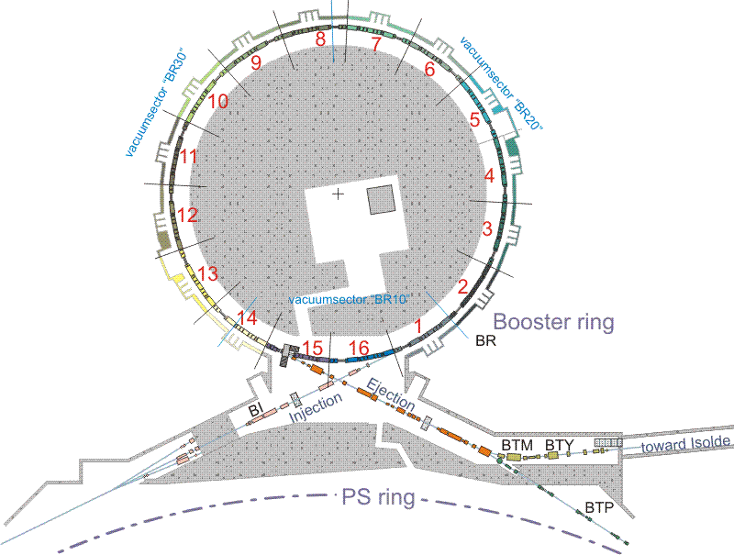
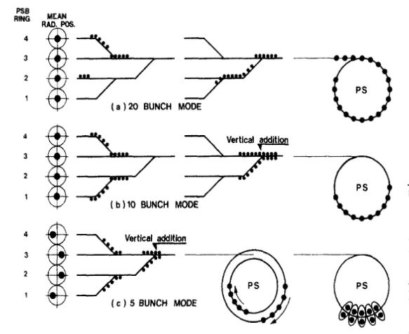
PSB MD brainstorming
Vertical recombination tests
160 MeV
2 GeV
IEEE Transactionson Nuclear Science, Vol.NS-26,No,3,June197
MD@PSB:
H⁻ injection (to be explored with experts)
Vertical recombination of bunches from separated rings (up 1e13 per bunch per ring)
  Final bunch lenght
  Transverse emittance growth
  Beam can go on external beam dump or to the PS

Slide 10
CERN accelerator complex

Slide 11
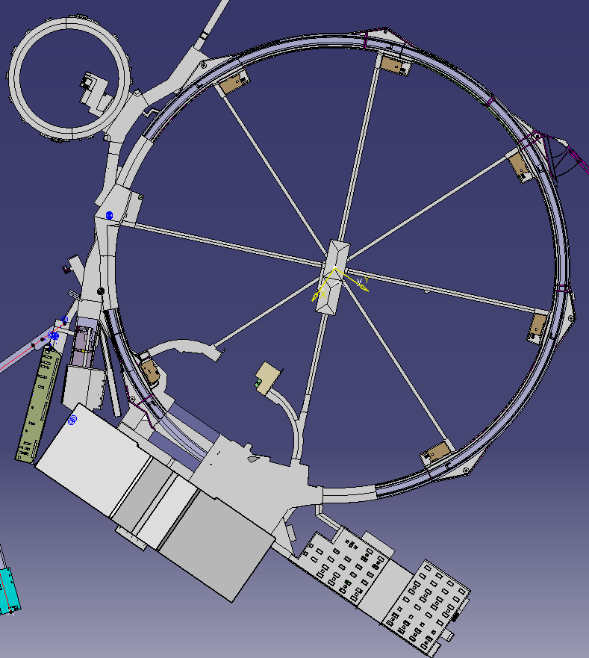
PS main features
Injection
  Max: 2 GeV protons
  70 MeV/n lead ions
  Single turn injections
Lattice: FODO with combined-function magnets
  Transition crossing with gamma-jump at 6.1 GeV
Acceleration cycle
  Up to 3.6 s depending on final user
  1.2 cycling period
RF:
  10 MHz ferrite loaded main RF system
  20, 40, 80 MHz for LHC beams production
  200 MHz for beam recapture after de-bunching
  h=7, 8,16, 21, 42, 84,168
  Finemet as longitudinal feedback system
Extraction:
  Fast extraction at 20 GeV and 26 GeV
  Multiturn (5 turns) extraction at 14 GeV
  Slow extraction 24 GeV
Particles types:
  Protons, Ions (Pb, O, S, In, Xe)
  In the past: anti-protons, e+, e-
Max total intensity: ~ 4e13
External Exp. Area: East hall, AD

Slide 12
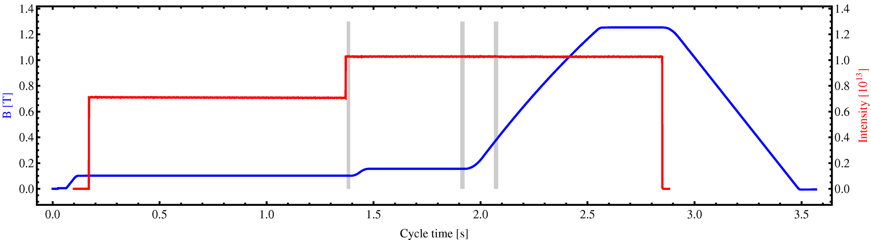
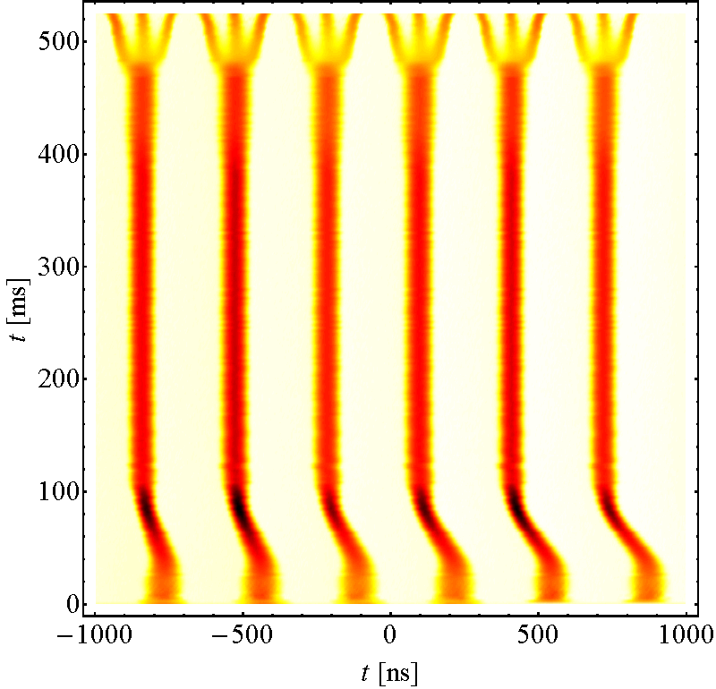
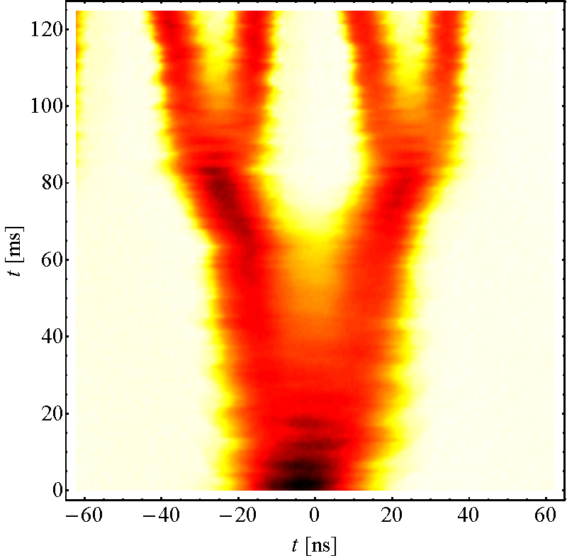
LHC25ns Production Scheme as today
25 ns is bunch spacing required by the LHC Production scheme:
a) Double batch injection from PSB (3 x 2 bunches, 6 bunches for PS at h=7)
b) 4 batches of 72 bunches each transferred to the SPS
Transverse emittance produced in the PSB, longitudinal in the PS
Multiturn proton injection in PSB
RF gymnastics in PS:
  Acceleration
  Triple splitting
  Acceleration
  2 x Double splittings
  Bunch rotation
3 (1) RF systems in PSB
5 RF systems in PS
2 RF systems in SPS
Inject 4+2 bunches
Controlled blow-ups
Eject 36 or
Eject 36 or
72 bunches
h = 7
h = 21
γ_{tr}
72 bunches
h = 84
Triple splitting at E_{kin} = 2.5 GeV
Split in four at flat top energy
25 ns
E_{kin} = 2.5 GeV
50 ns
2nd injection
26 GeV/c
25 ns: Each PSB bunch divided by: 12 → 6 x 3 x 2 x 2 = 72
50 ns: Each PSB bunch divided by: 6 → 6 x 3 x 2 = 36

Slide 13
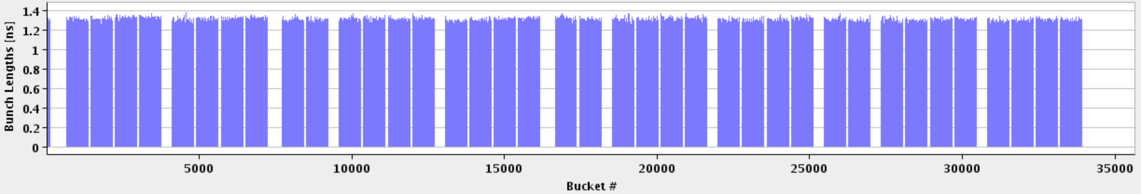
LHC and Injectors – 25 ns
1 SPS batch
(288 bunches)
1 PS batch
(72 bunches)
Abort gap
To LHC
LHC - 26.7 km - ~2500 bunches – 25 ns
= Field in main magnets
450 GeV
= Proton beam intensity (current)
= Beam transfer
SPS
26 GeV
PS
Time structure
1.4 GeV
PSB
Brillance
1.2 seconds
Time

Slide 14
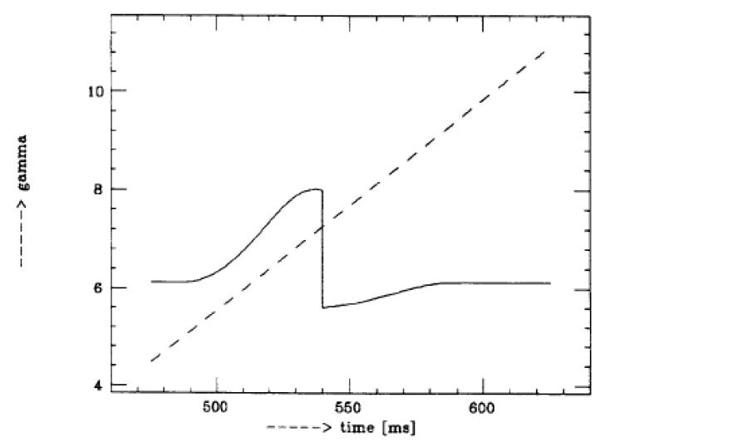
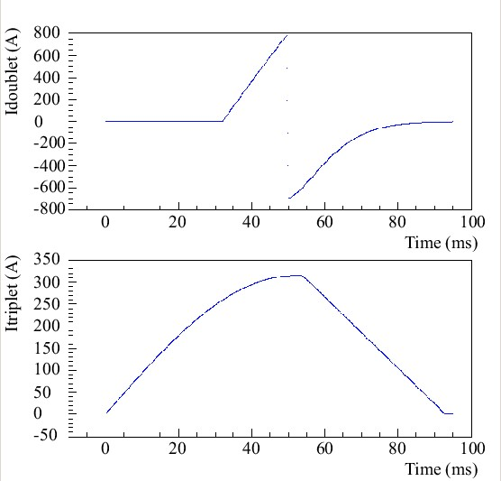
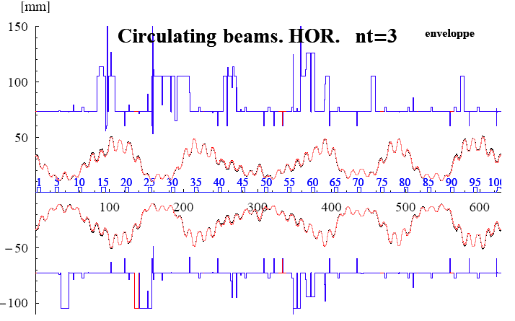
Gamma jump – transition crossing
Δγtr
See S. Aumon thesis: CERN-THESIS-2012-261

Slide 15
MD brainstorming
Space charge and instability measuremenst at different energies to check space charge limit for example
  See R. Wasef thesis CERN-THESIS-2017-455
  “8th Order Super-Structure Resonance driven by Space Charge”
  See A. Huschauer thesis CERN-THESIS-2016-061
  “Beam Dynamics Studies for High-Intensity Beams in the CERN Proton Synchrotron”
  Space charge tune shift can be modulated also by bunch compression at injection
Study of isochronous lattice
  PS can be put on coast for 500 ms or so close to/on top of transition crossing
  See S. Aumon thesis: CERN-THESIS-2012-261
Study of bunch rotation
  Bunch rotation of high intensity beams with space charge at low energy, could even decelerate the beam to 1 GeV
  Bunch rotation on gamma-jump modified lattice close to transition crossing.

Slide 16
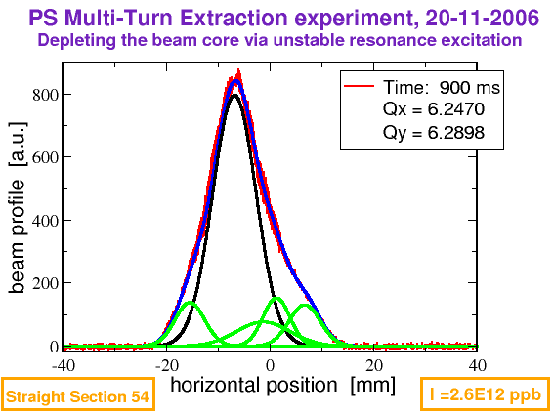
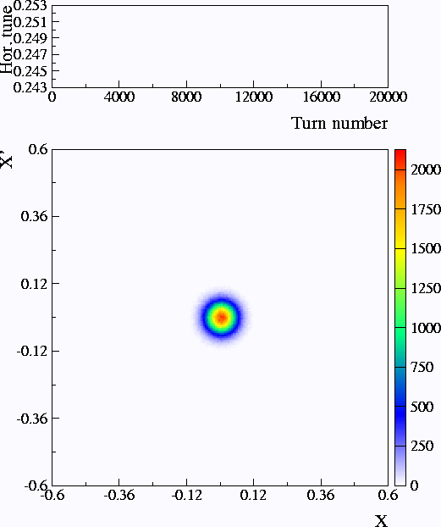
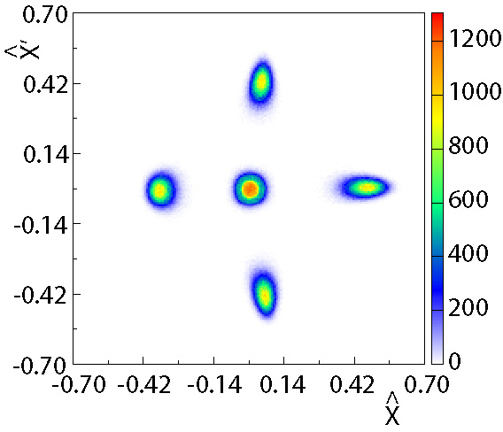
Multi-turn extraction – 5 turn extraction
At the septum location
B_{field} = 0
B_{field} ≠ 0

Slide 17
CERN accelerator complex

Slide 18
SPS main parameters
Injection
  14 GeV or 26 GeV protons
  26 GeV proton equivalent Pb ions
  Multi-batch injection from PS
Lattice: FODO with dispersion free SS
  Transition crossing for injection
  below 20 GeV. No gamma-jump
Acceleration cycle
  Up to 21.6 s (depending on user)
  1.2 cycling period
RF:
  Main system: 200 MHz travelling wave
  800 MHz to control longitudinal emit.
Extraction:
  Slow extraction at 400 GeV
  Fast extraction at 450 GeV
Operation in p-pbar collider mode
  Machine on indefinite coast @ 270 GeV
Particles types:
  Protons, Pb, pbar, e+,e-, O, In, S, Xe
Max total intensity: ~5.3e10¹³
External Exp. Area: North Area, HIRADMAT, AWAKE, Neutrino Platform

Slide 19
HIRADMAT at SPS
See Nikos’ presentation
HiRadMat (High-Radiation to Materials) : users facility designed to provide
high-intensity pulsed beams to irradiate material samples and accelerator component.

Slide 20
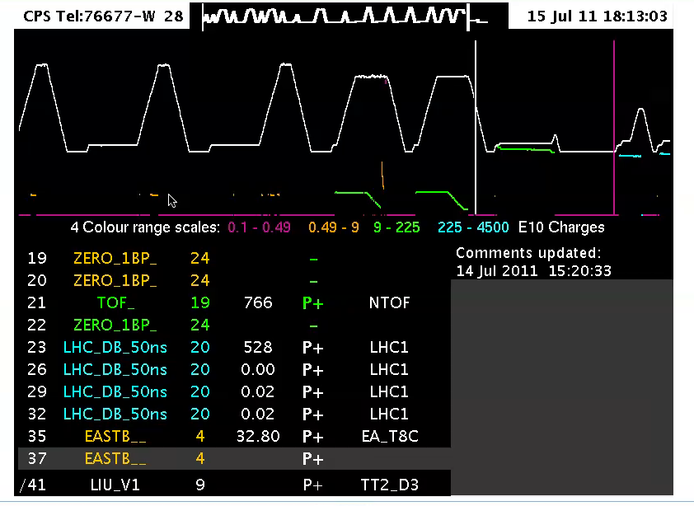
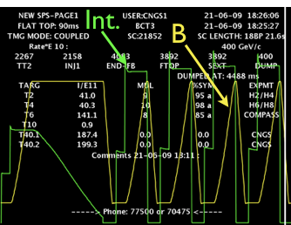
Multi-user operation: Pulse-to-pulse modulation
time
B(t)
Injector complex (up to SPS) can have several
different consecutive operation mode,
including different particle type, extraction energy,
extraction types every 1.2 s.
Up to 24 consecutive different beam users
can be executed

Slide 21
Thanks for your attention

