Slide 1
Report of the Coordinator
Summary of the Project meeting
Sandro Rossi
Coordinator
General Assembly – Wien, December 13th, 2022

Slide 2
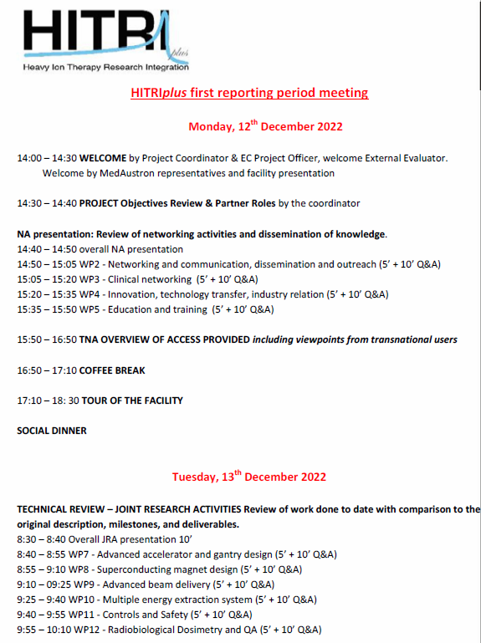
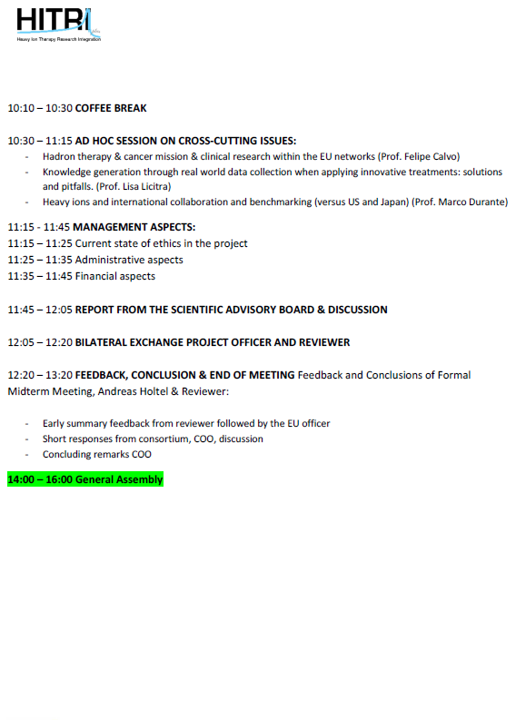
First Review Meeting (18 mo)
12-13 December 2022
MedAustron – Wiener Neustadt

Slide 3
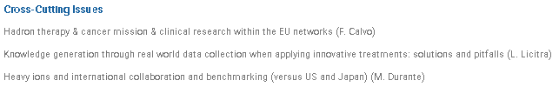

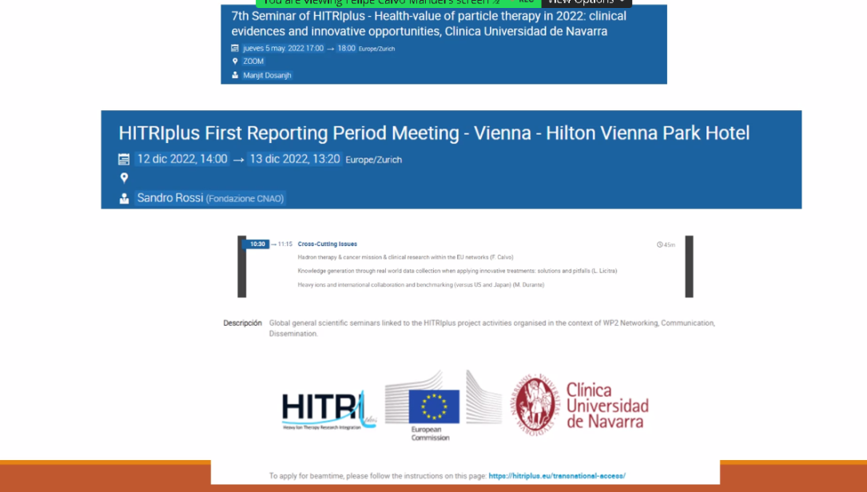
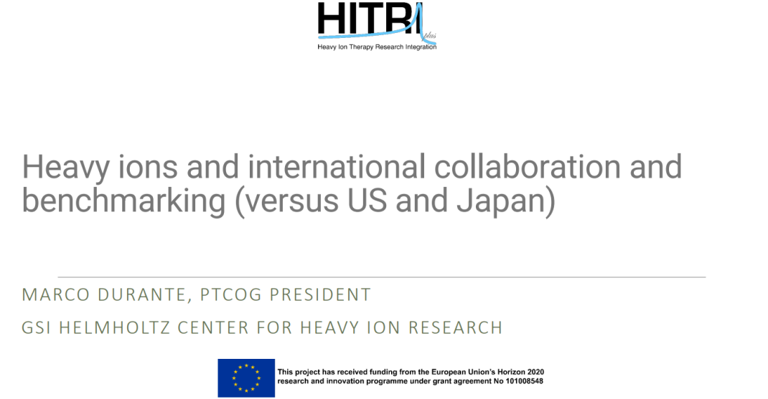

Slide 4

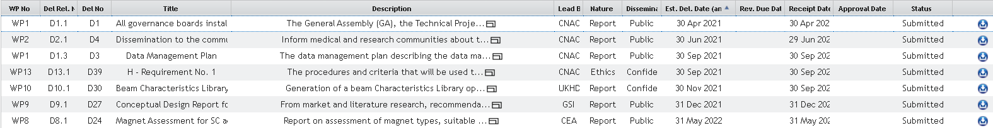
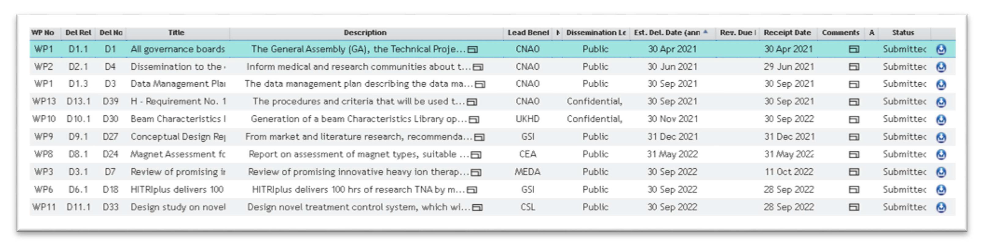
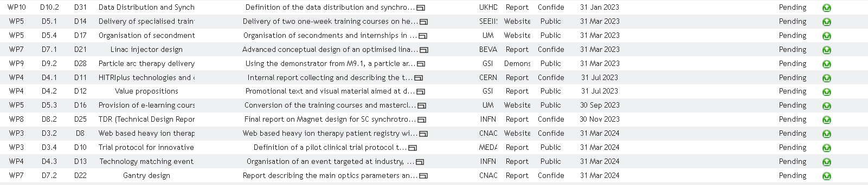
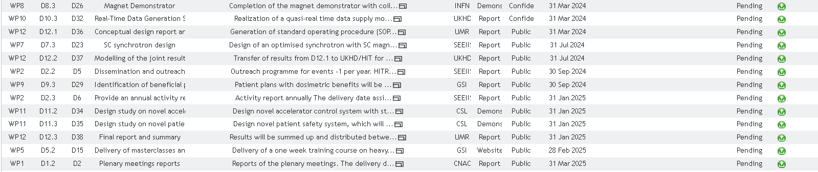
Deliverables
10/10 Deliverables completed

Slide 5
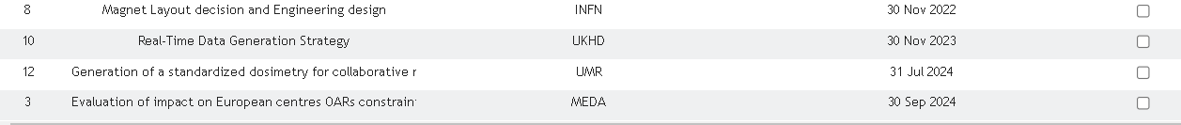
Milestones
10/10 Milestones completed

Slide 6
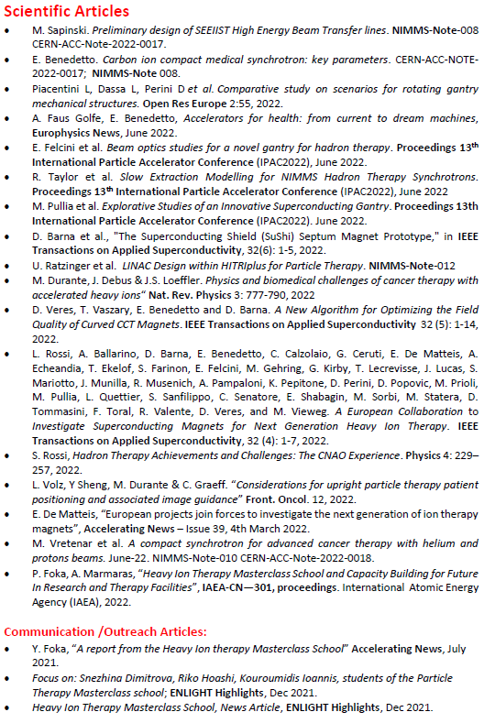
Scientific publications
(20 articles)

Slide 7
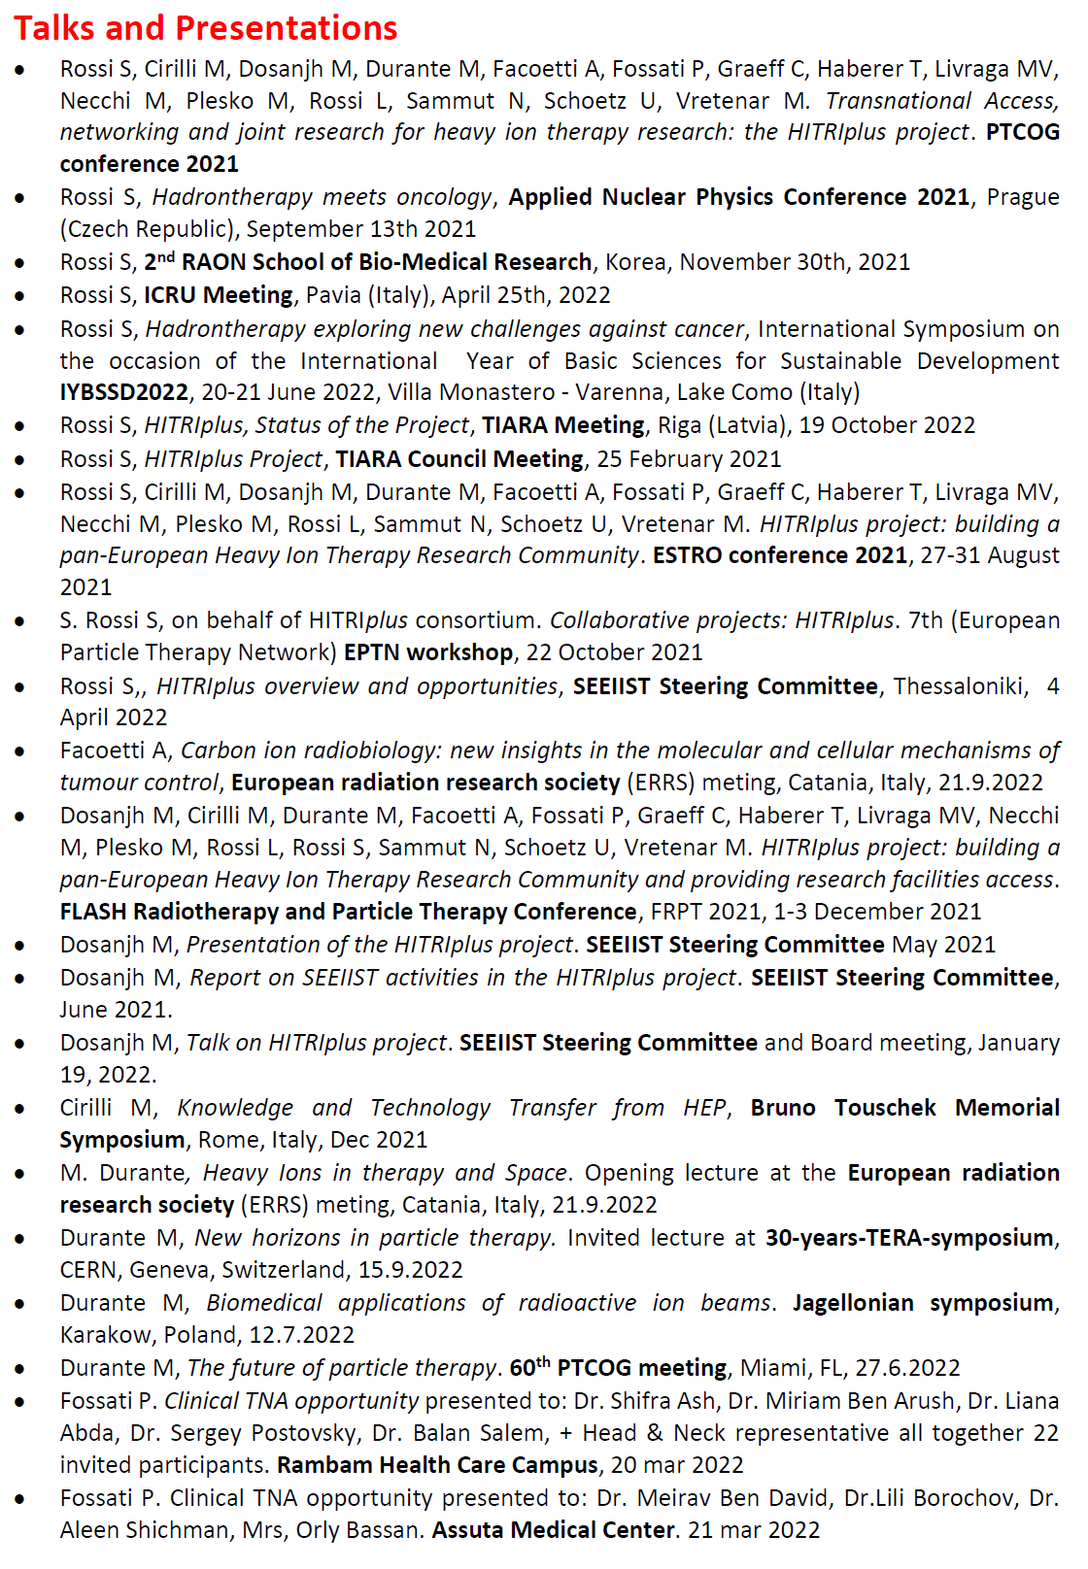
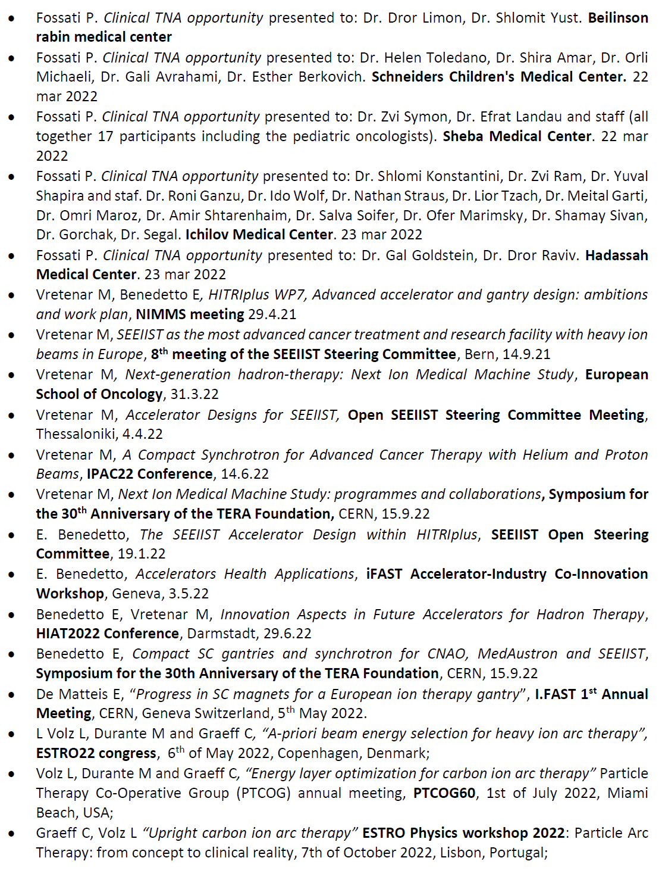
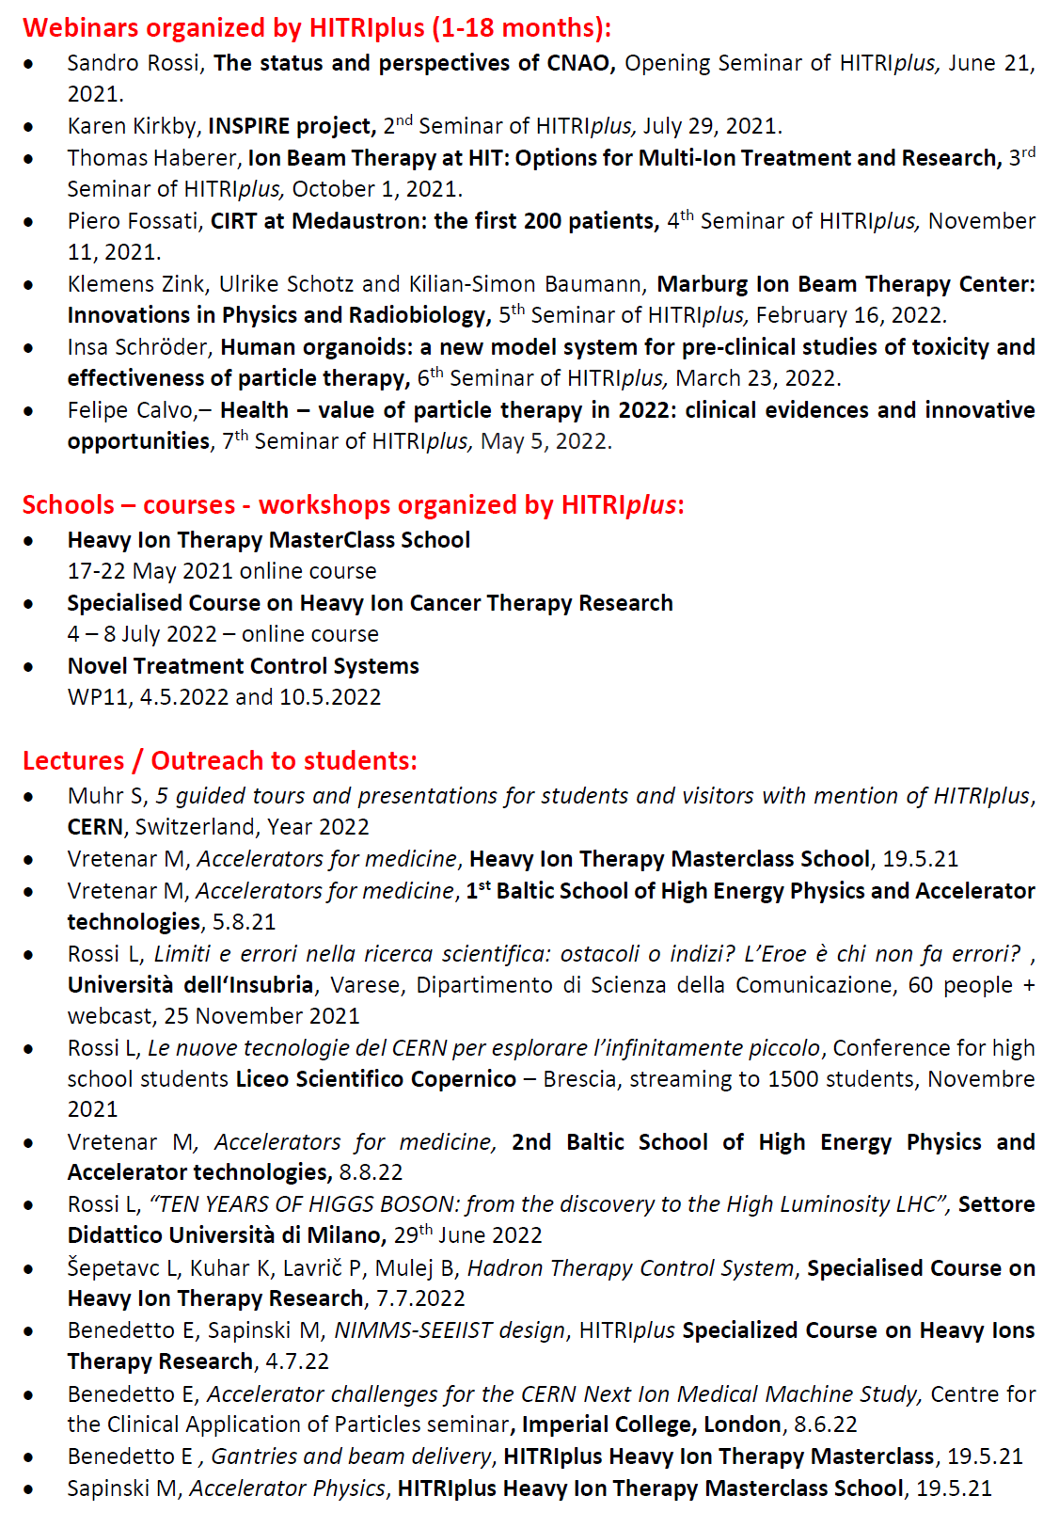
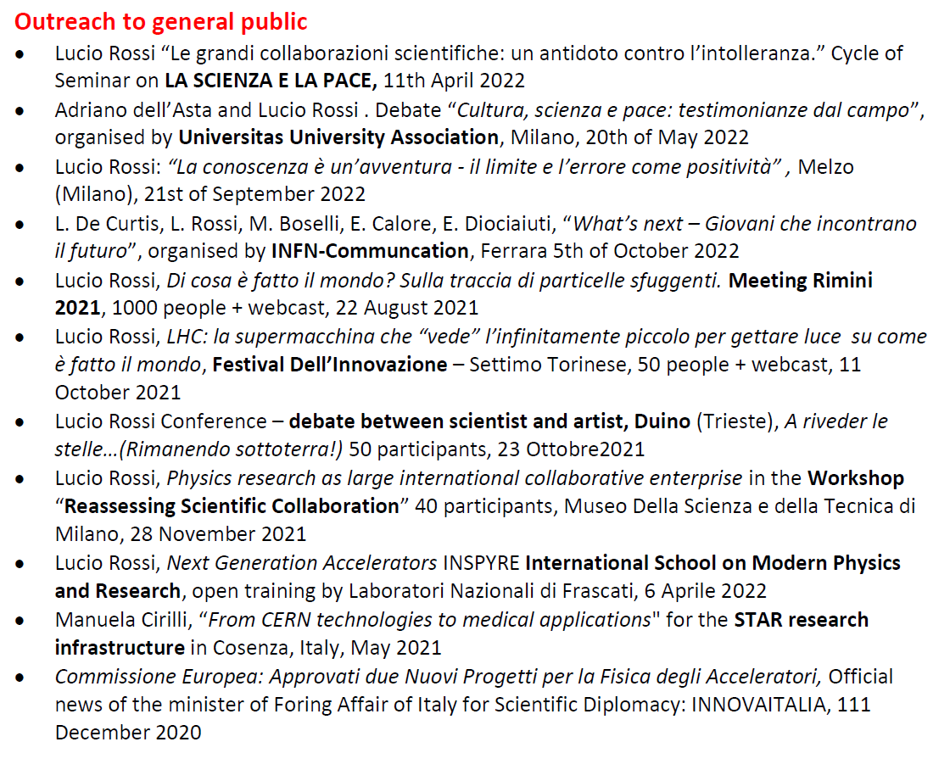
Talks
(41 speeches)
Webinars
(7 events)
Schools
(3 courses)
Lectures
(23 events)

Slide 8

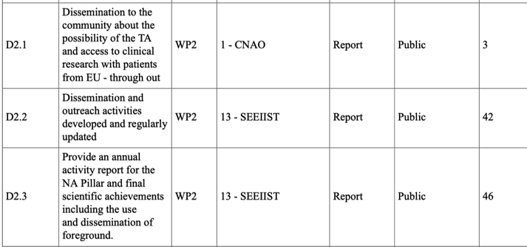



WP2: Network and Communication Dissemination and Outreach
Deliverables and Milestones
done
done and in progress
done and in progress
done

Slide 9

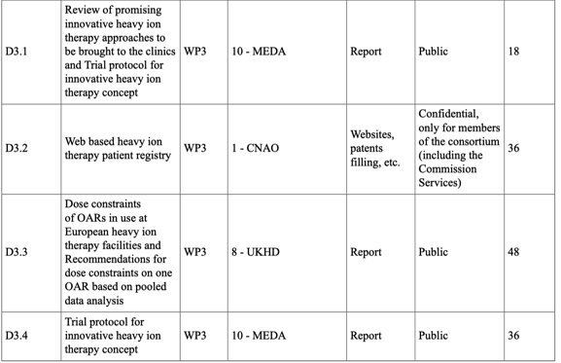
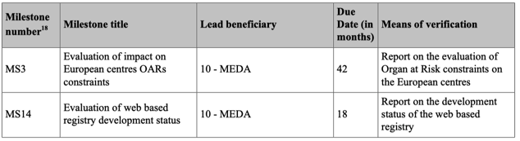

WP3: Deliverables and Milestones
WP3 Clinical Networking: Deliverables and Milestones

Slide 10
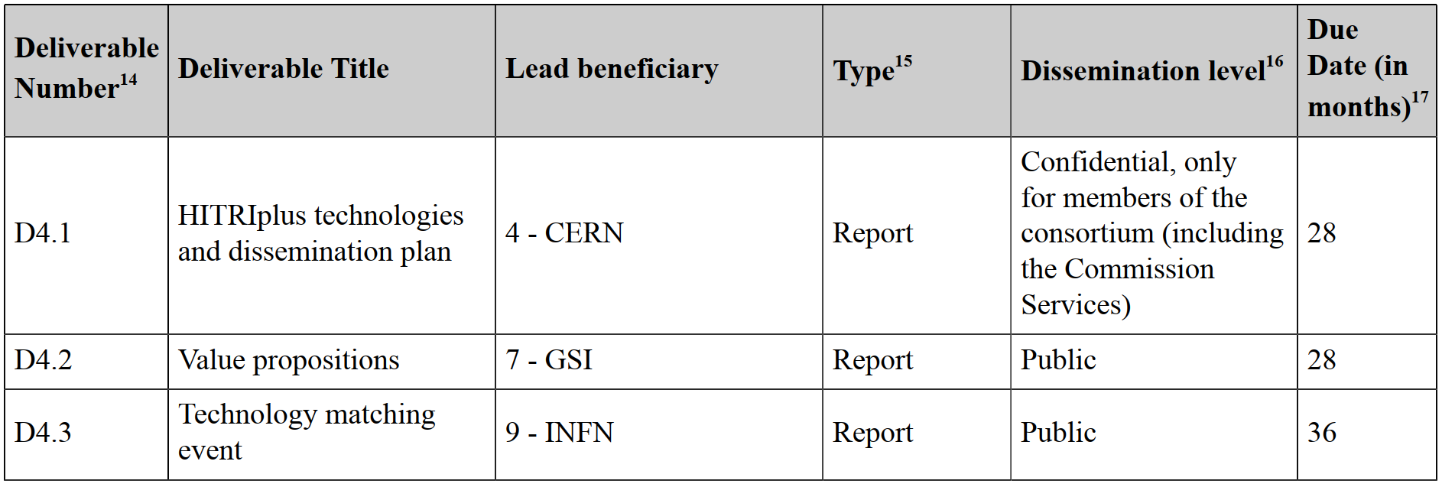
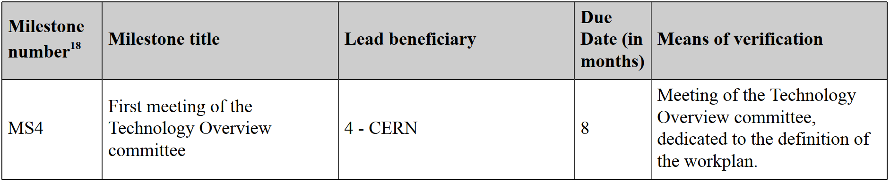
WP4: Innovation, technology transfer, industry relation
Deliverables and Milestones
July 2023
In Progress
March 2024
In Progress
November 2021
Done

Slide 11
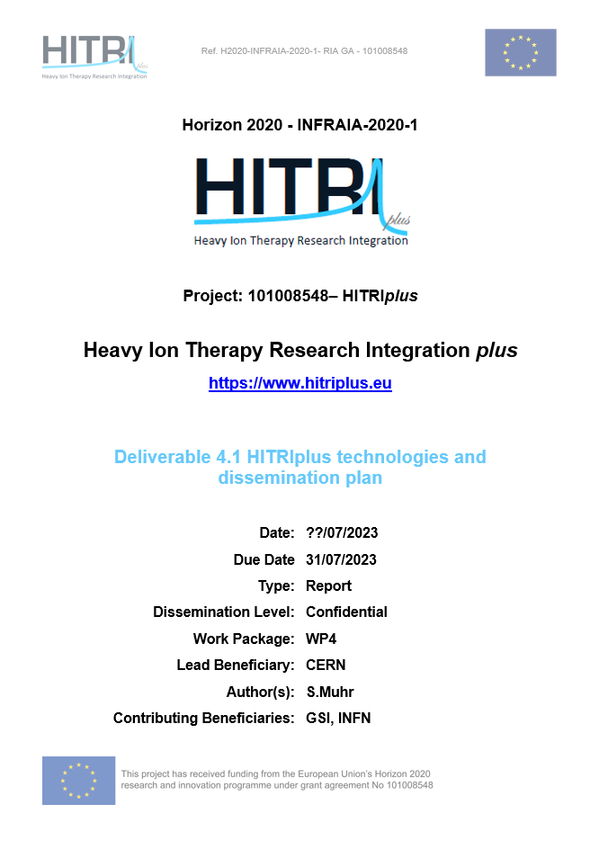
WP4: Innovation, technology transfer, industry relation
D4.1: HITRIplus Technologies and dissemination plan
In progress (deadline: July 2023)
Confidential, for the consortium and the Commission Services

Slide 12
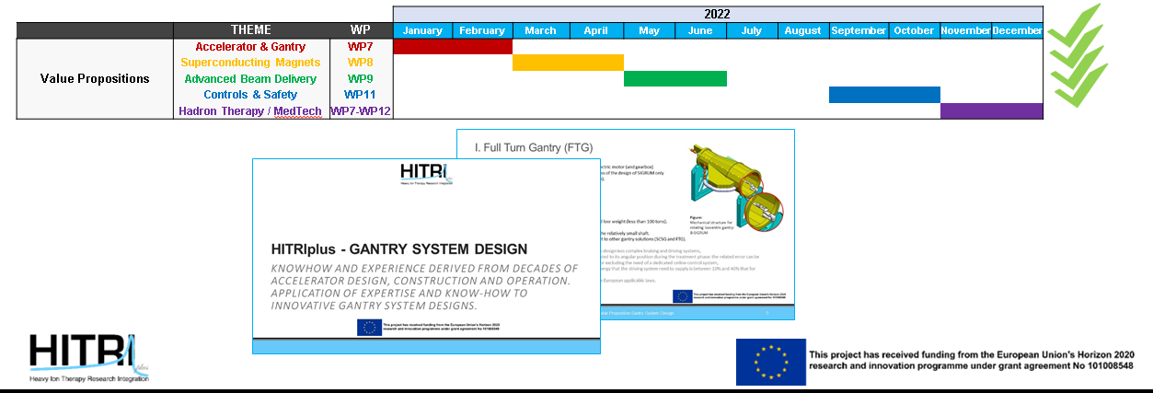
WP4: Innovation, technology transfer, industry relation
D4.2: Value Propositions
In progress (deadline: July 2023)
Planned: Dissemination on the channels of the consortium

Slide 13
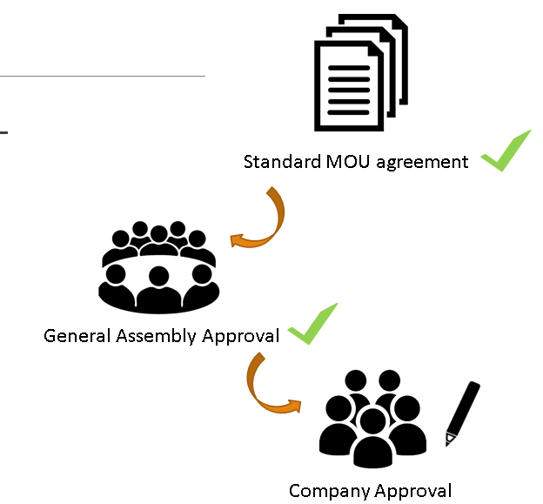
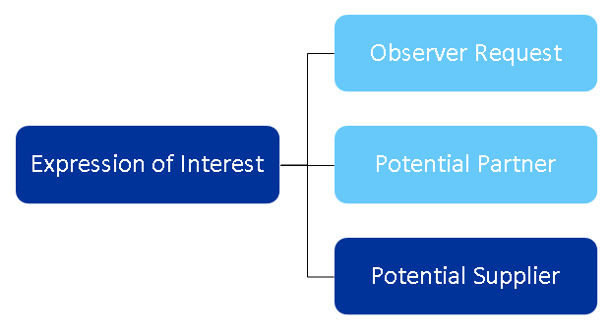
WP4: Innovation, technology transfer, industry relation
D4.3: Technology Matching Event
Will expand industrial interest (deadline: March 2024)
Work has started to define format and location.

Slide 14
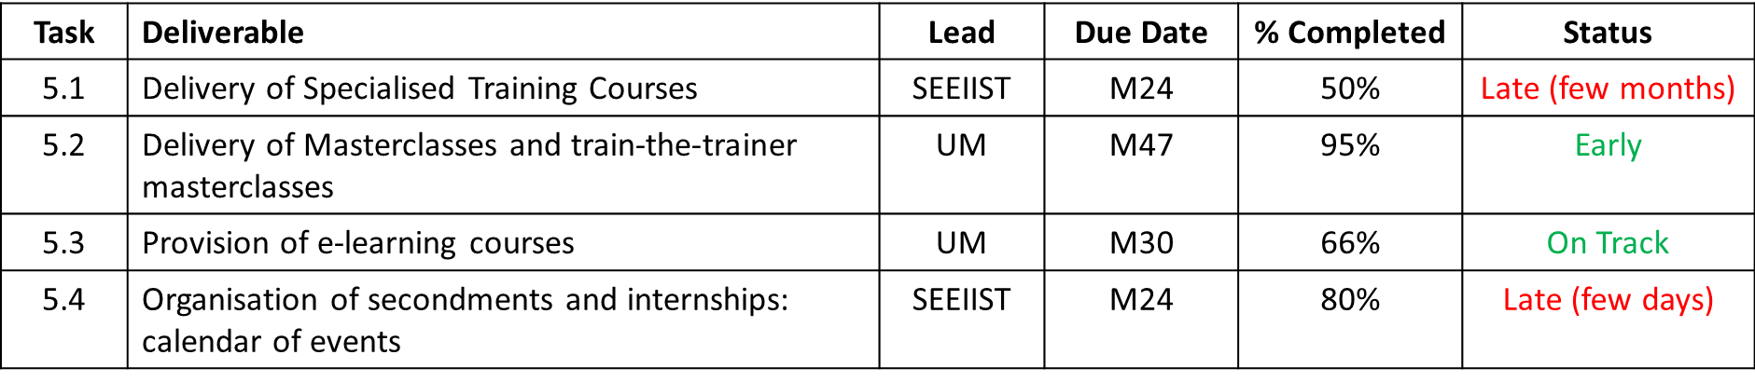
WP5: Education and Training
Deliverables and Milestones

Slide 15
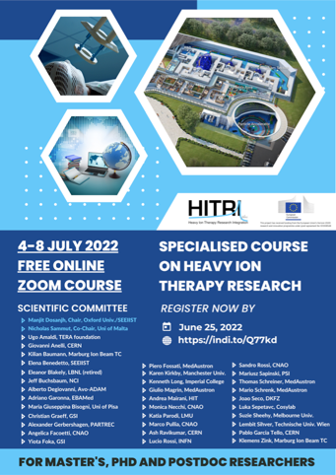
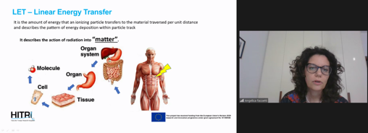
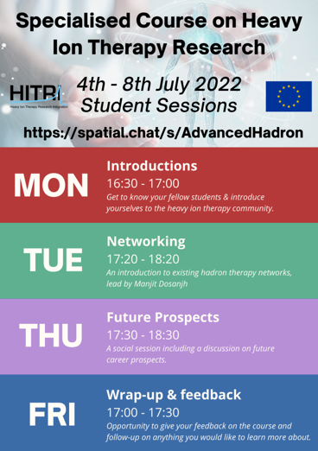
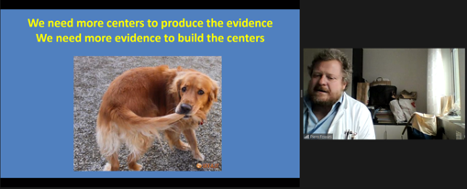
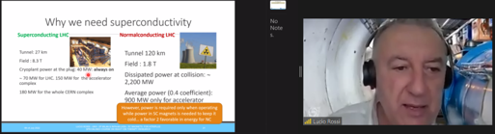
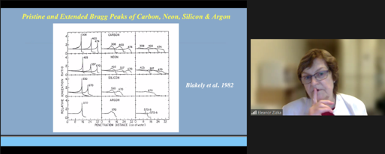
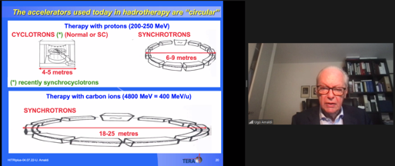
WP5: Education and Training
Task 5.1 – Specialised Courses
- Led by SEEIIST
- Two schools of 1 week long - medical physics held on 4th to 8th July 2022
- clinical aspects planned for Q2 2023

Slide 16
WP5: Education and Training
Task 5.2 – Masterclass School
- led by GSI – Yiota Foka
- Online 17th - 22nd May 2021
- Report & tracer study underway
- 36 lecturers (15 female)
- undergrads, masters, PhDs postdocs, researchers from close fields
- 1050 registrants
- 992 attended at some point – average of 600 per day (50% from EU, 12% from Balkan region)
- 158 attendance certificates awarded
- 33 hours of engagement time

Slide 17
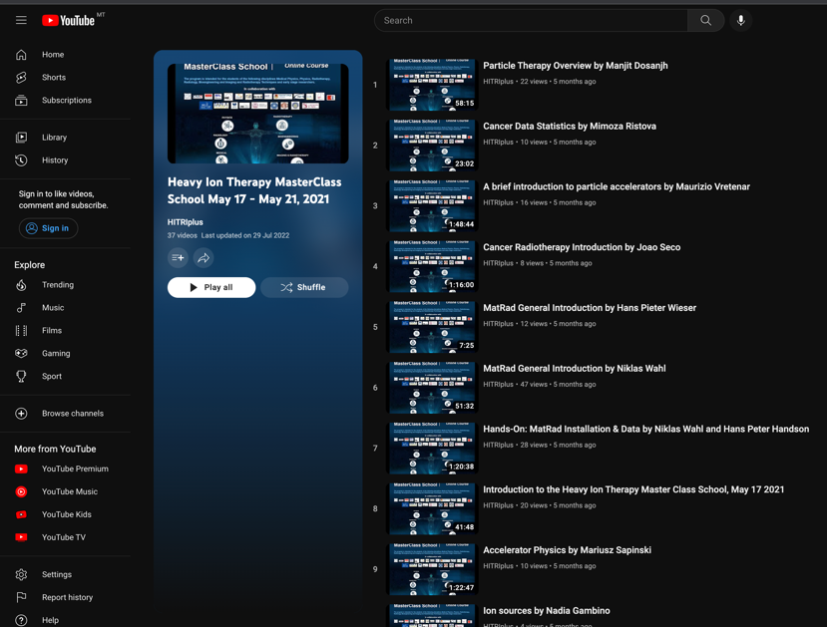
WP5: Education and Training
Task 5.3 – e-learning Material
- led by UM
- conversion of task 5.1 and 5.2 into e-learning courses
- Task 5.1 1st specialised school recorded and made available online (1605 views to date)
- Task 5.2 masterclass school recorded and made available online (425 views to date)
- Still to do – editing of all recordings, recording and publishing 2nd specialised school

Slide 18
WP5: Education and Training
Task 5.4 – Secondments & Internships
- UM in collaboration with CNAO
- 8 opportunities available
- €2000/month for internships; €3000/month for secondments
- 56 applications (40 form EU or Balkan states)
- 25 eligible applications
- 2 internships offered ; Microdosimetry, Accelerator Physics
- 3 secondments offered; Radiation Oncology, Medical Physics, Radiotherapy
- 59 weeks in total
- countries represented: Italy/Palestine, Turkey, Albania, Romania
- 1 final secondment left to take place in Q1 2023

Slide 19





 | Res. [h] | Clin. [accesses] | Total
CNAO | 80 | 12 | 92
GSI | 296 | - | 296
UKHD/HIT | 72 | 10 | 82
MEDA | - | 12 | 12
MIT | - | 16 | 16
 | 448 | 50 | 498
WP6: Transnational Access
Research
Clinic

Slide 20
Deliverable 6.1: HITRIplus delivers 100 hrs of research TNA by month 18
WP6: Transnational Access
Applications to all three participating research centres have been received.
Applicants came from:
  Spain
  Italy
  France
  Germany
  Netherlands
  UK
Access has been granted to five groups for 107 hours.
Several further applications have been granted but not yet implemented.
Notes:
To demonstrate the broad geographical impact of WP6 in many European countries.

Slide 21
Research TNA applications
Applicant | Affiliation | Proposal title | h requested | h used | Host facility | Period
Carlos Guerrero | Centro Nacional de Aceleradores (CNA), 41092 Sevilla, Spain | Feasibility of real-time PET range verification in proton, He and C therapy using short-lived nuclides | 38 | 62 | HIT | Oct. 12/13, 25/26, Nov. 18-20, Dec. 15-17, 2021
Piergiorgio Cerello | INFN Turin, Italy | FragmentatiOn Of Target @ HIT (FOOT@HIT) | 24 | 24 | HIT | July 17-24, 2022
Katia Parodi | LMU München | SIRMIO (Small Animal Proton Irradiator for Research in Molecular Image-guided Radiation-Oncology) | 20 | 20 | CNAO | May 29 – June 1, 2022
Yolanda Prezado | Research Center-Orsay, Institut Curie, France | Spatially fractionated RT with Hadrons | 20 | 20 | GSI | May 28/29, 2022
Veronica de Micco | University of Naples Federico II, Department of Agricultural Sciences | Assessing radiosensitivity of higher plants and mechanisms for radioresistance at different phenological stages (RADIOPLANT) | 16 | 9 | GSI | April 2 & May 28, 2022
Marie Vanstalle | Institut Pluridisciplinaire Hubert Curien (IPHC), Strasbourg | Measurements of damages to biomolecules in solution induced by carbon ions and their secondary fragments | 24 | - | CNAO | Upcoming
Christophe Badie | UK Health Security Agency | Assessing space like radiation dose exposure and long-term risks in humans by using real-time differential gene expression sequencing analysis | 6 | - | GSI | Upcoming
Ilaria Rinaldi | MAASTRO Maastricht | Stopping power ratio measurements of electron density phantom | 5 | - | HIT | Upcoming
Ester Orlandi | CNAO | Commutative property in mixed X-ray plus C-ions clinical trials (COMIX) |  |  | GSI | Upcoming
Veronica de Micco | University of Naples Federico II, Department of Agricultural Sciences | Exploring the radioresistance and radiosensitivity mechanisms of edible plants (RadioPlant2) |  |  | GSI | Upcoming
Fernando Dominguez | Universidad de Santiago de Compostela, Spain | Silver atomic Quantum Clusters of five atoms (Ag5-AQCs), radiosensitizer for heavy-ion particle therapy. | 12 |  | GSI | Upcoming
Notes:
The animated bars highlight the two projects that are presented in more detail on the next slide. I chose FOOT, because it is your project, and Prezado, because she came to GSI.

Slide 22
WP6: Transnational Access: voice to the users
Application by Piergiorgio Cerello:
  part of the large FOOT experiment
  measuring fragmentation cross sections of interest for particle therapy and radioprotection in space
  Measurements carried out at HIT focussed on charge changing fragmentation cross sections of 4He projectiles on C targets at beam energies of 200 MeV/u.
  The experiments were performed at HIT between July, 17th and July, 24th (54h).
Application by Veronica De Micco:
  Plants are more radioresistant than animals, due to their different structure and metabolism
  The severity of damage in higher plants depends on radiation type, exposure time (acute or chronic), dose, phenological stage and species
  Knowledge gaps: structure/function related mechanisms for radioresistance to validate the idea of exploiting ionizing radiation as a sort of stimulant factor for the production of high-nutritious plant-derived food
  Experiments at GSI/SIS18 on April 2 and May 28, 2022 (9 hrs)

Slide 23
WP6: Transnational Access:
Deviation from deliverable & countermeasures
Deliverable: 10 patients; Treated: 3 patients
Potential reasons:
Travel restrictions due to pandemic.
Insufficient knowledge of method and opportunity.
Obstacles to communication: lack of counterparts for medical discussion.
Countermeasures taken:
Strategic meetings of the TPB and USP on April 28th & October 25th
Invitations to EPTN and EURACAN have been sent. Flyers have been distributed on IBC, ENLIGHT & MEDINET mailing lists, and on ESTRO, EFOMP & IEEE congresses.
Clinical TNA has been opened to physicians wishing to discuss the eligibility of a specific patient.
The designation of TNA contact persons by each clinical centre has been suggested and is currently under implementation.
Notes:
This can lead over to the next slide.

Slide 24
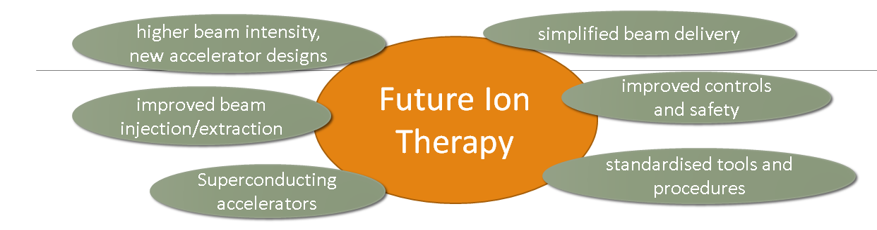
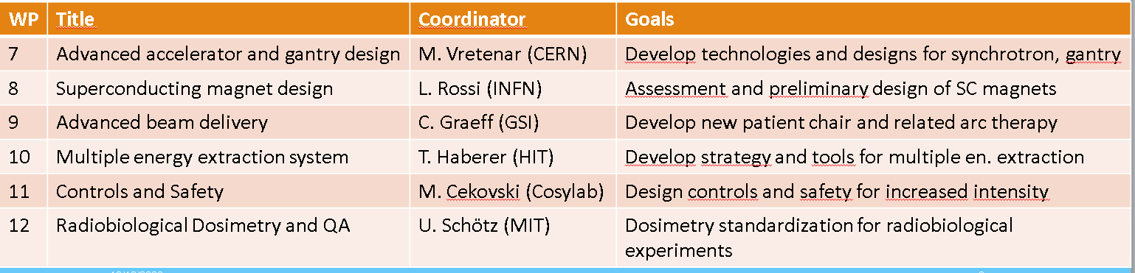
The 6 JRA’s: a set of strategic directions to advance Heavy Ion Therapy

Slide 25
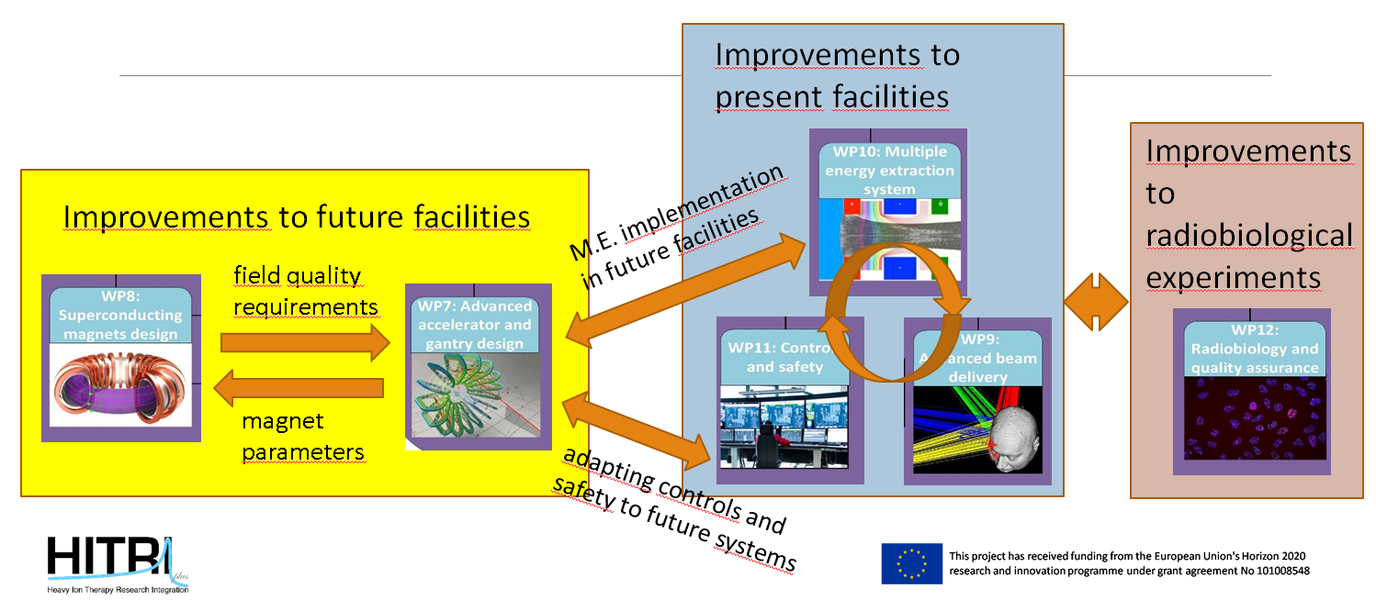
Interactions between the HITRIplus JRA’s

Slide 26
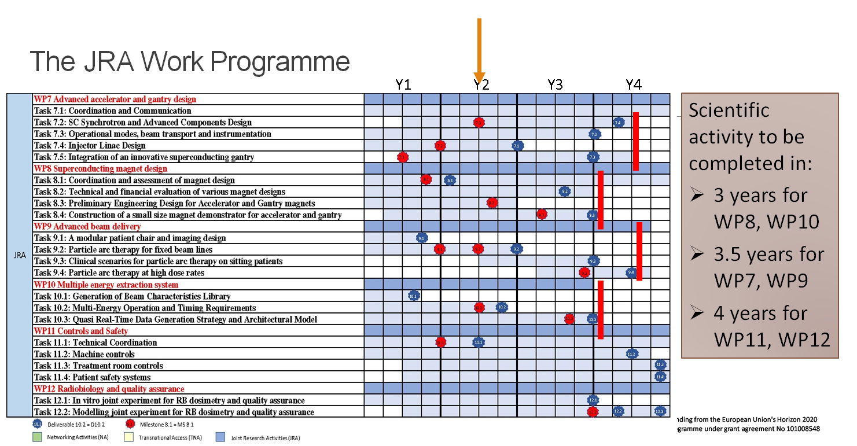
Common issue to most of the JRA’s during P1 were delays due to problems in finding PhD students or expert personnel.

Slide 27
Quick Overview Period 1 for HITRIplus JRAs
WP7: Milestone 7 (Linac and Gantry conceptual design, and SC synchrotron main parameters), baseline design ready for P2.
WP8: D8.1 (Magnet Assessment for SC accelerator and gantry).
WP9: D9.1 (Conceptual Design Report for a patient chair capable of rotating the patient around a vertical axis as well as a vertical in-room imaging system) and MS9 (Simulation environment for particle arc therapy).
WP10: D10.1 (Beam Characteristics Library).
WP11: Milestone 11 (Intermediate report on the state-of-the-art treatment room, accelerator control systems, and patient safety systems). D11.1 (Design study on novel treatment room control systems).
WP12: no contractual obligations.

Slide 28
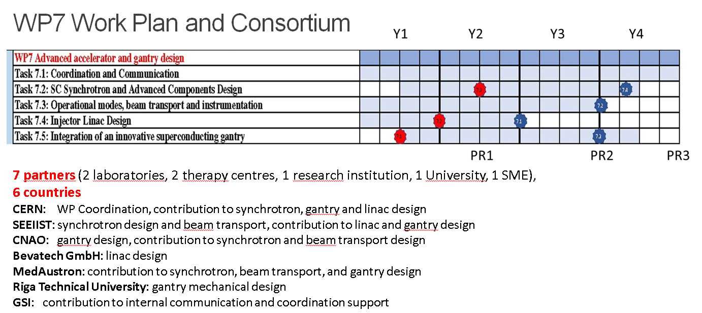
WP7: Advanced accelerator and gantry design
Work plan and Consortiium

Slide 29
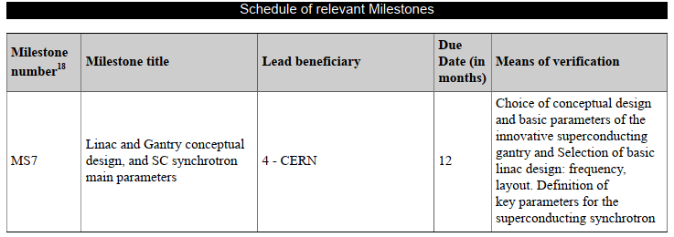
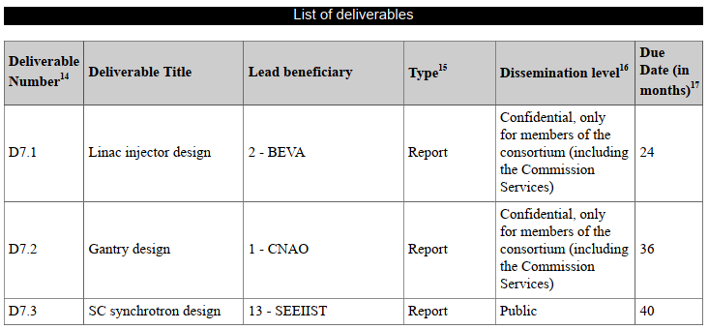
WP7: Advanced accelerator and gantry design
Period 1: contractual obligations and status
In P1 only 1 Milestone (MS7): achieved on schedule.
Summarises the basic design choices in preparation for the 3 final deliverables foreseen between M24 (April 2023, linac) and M40 (August 2024, synchrotron).
Main issues during P1 are related to personnel:
Delay in finding a PhD student at CERN has delayed study one of the two linac options,
Loss of 1.5 senior experts at SEEIIST (replaced by 2 junior post-docs and a short-time senior expert) leads to some delay in the synchrotron design, still compatible with the final deliverable date.

Slide 30
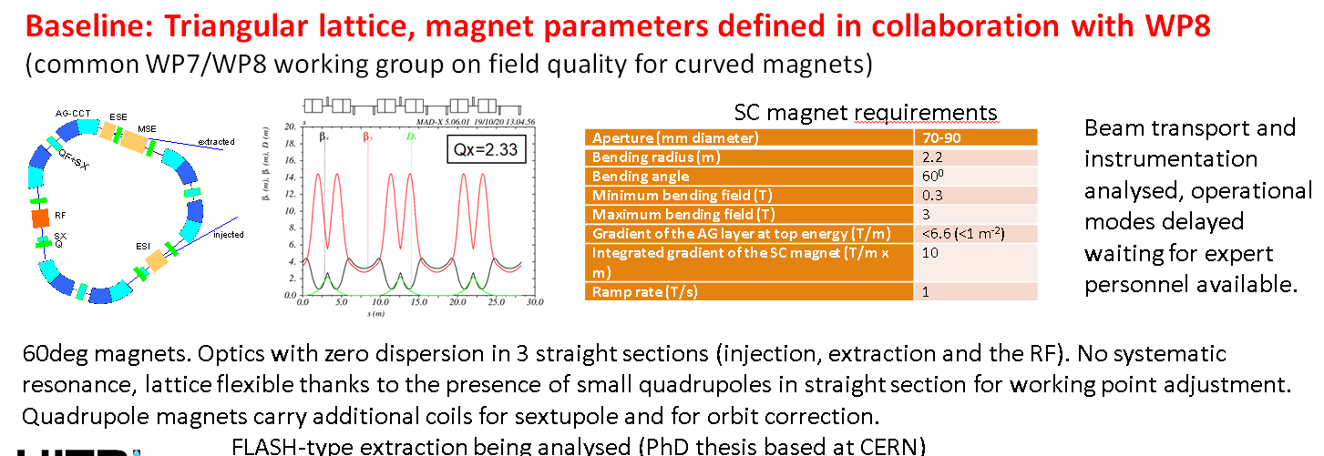
Task 7.2, 7.3 - SC Synchrotron and Components Design, Operational Modes, Beam Transport (SEEIIST, CERN, CNAO, MEDA)

Slide 31
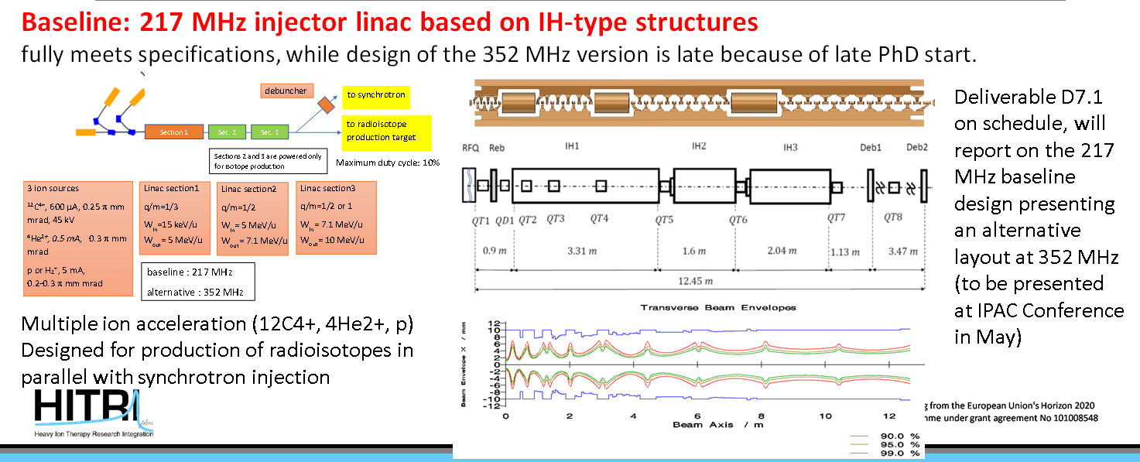
Task 7.4 - Injector Linac Design (BEVA, CERN, SEEIIST)

Slide 32
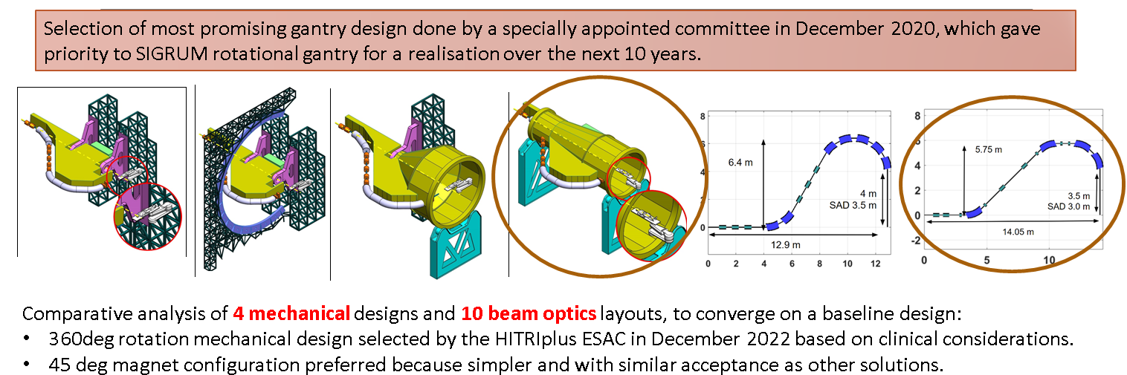
Task 7.5 - Integration of an innovative superconducting gantry: optics, mechanics, beam delivery (CNAO, CERN, SEEIIST, MEDA, RTU)

Slide 33
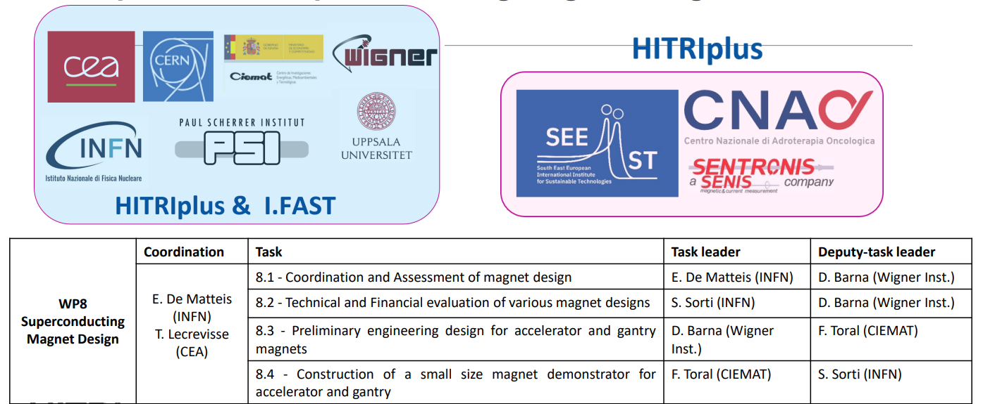
WP8: Superconducting magnet design

Slide 34
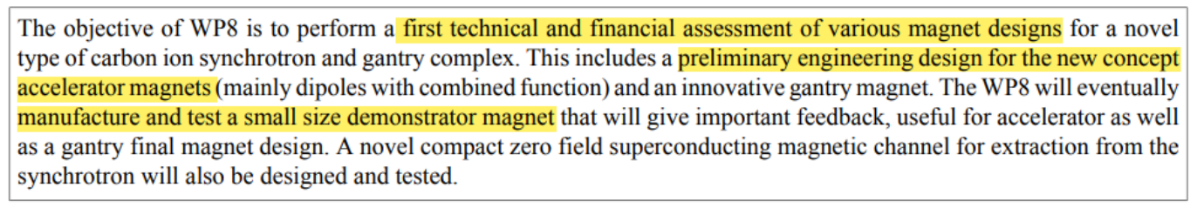
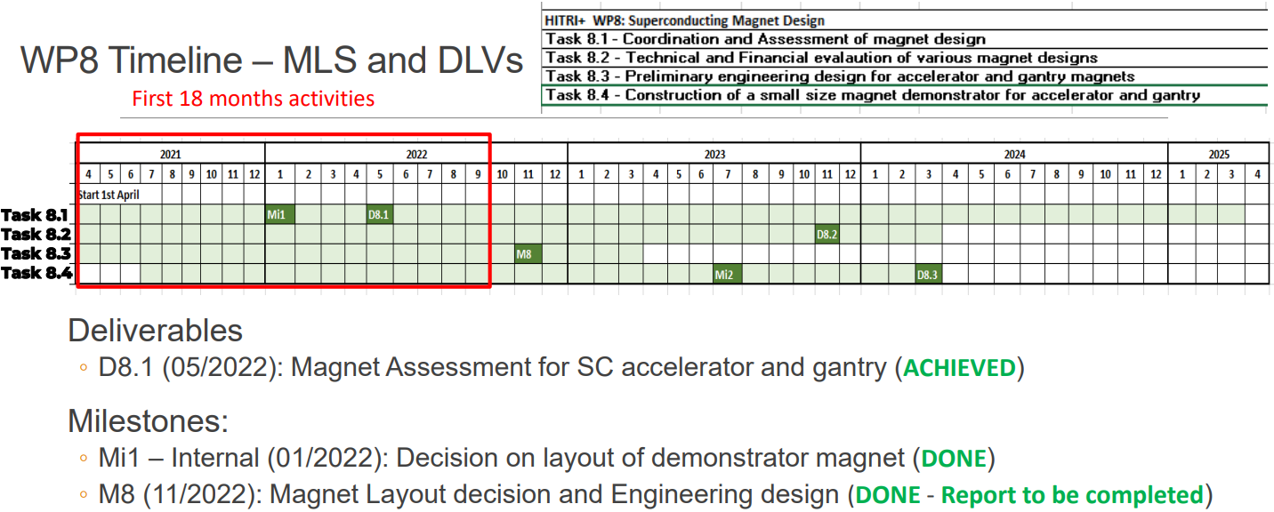
WP8: Superconducting magnet design

Slide 35
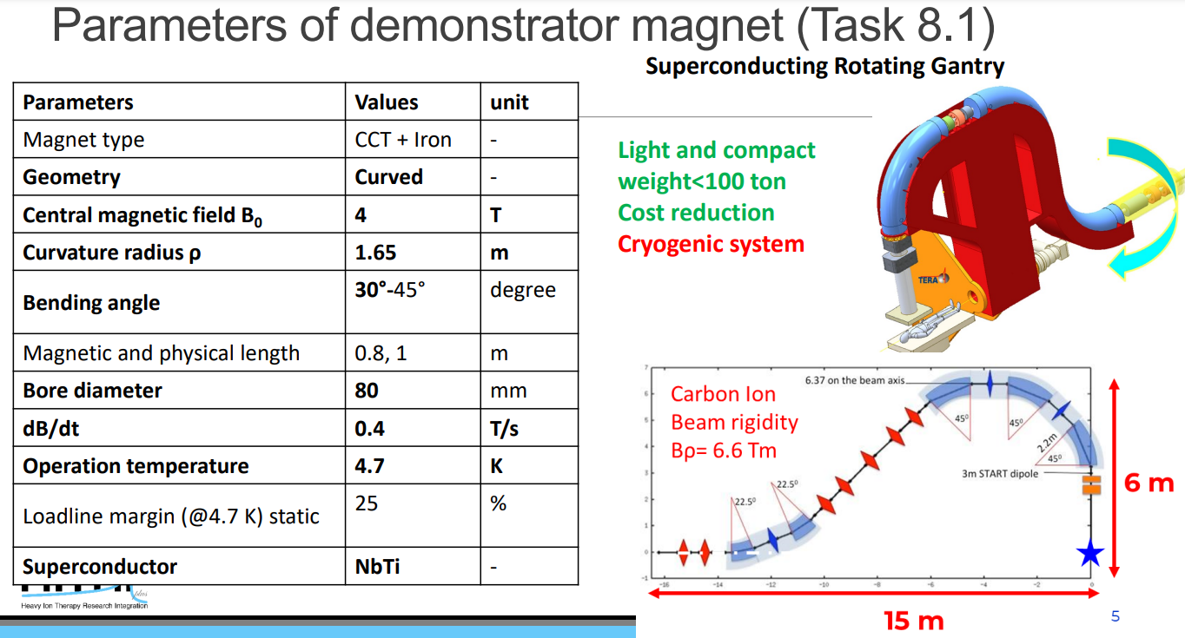
WP8: Superconducting magnet design

Slide 36
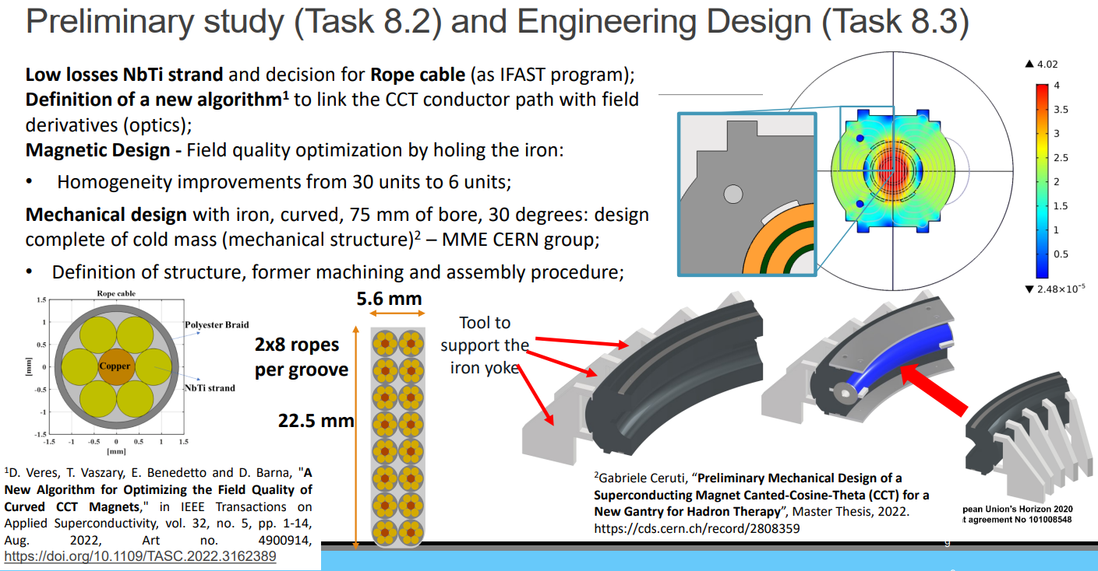
WP8: Superconducting magnet design
Preliminary study (Task 8.2) and Engineering Design (Task 8.3)

Slide 37
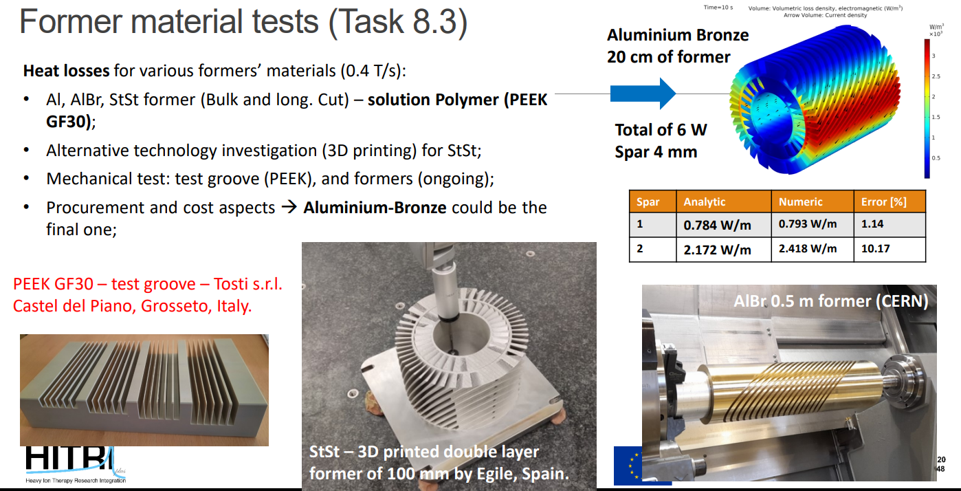
WP8: Superconducting magnet design

Slide 38
WP9: Advanced beam delivery
Deliverables and milestones so far have been delivered on time
Well on track for next deliverable due in March 2024
Established international collaborations (SPHIC, UPenn, Beaumont Hospitals, Leo Cancer Care Ltd.)
Several dissemination activities:
  Open access review article Volz et al. (2022) Frontiers in Oncology
  Poster at ESTRO2022 (Task 9.2)
  Talk at PTCOG60 2022 (Task 9.2)
  Talk at ESTRO physics workshop 2022 (Task 9.2)
  2 manuscripts on Task 9.2 currently in preparation

Slide 39
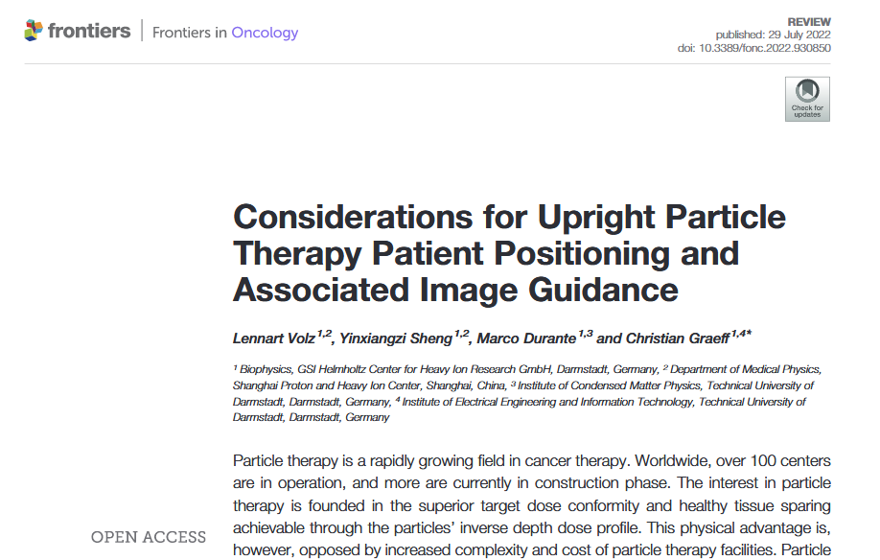
WP9: Advanced beam delivery
Task 9.1: A modular patient chair and imaging design
Deliverable 9.1: finished on time
  Discussed chair design, patient positioning and image guidance options
  Recommendations for early adopters
Conceptual design report published as open access review article in frontiers

Slide 40

WP9: Advanced beam delivery
Task 9.2: Particle arc therapy for fixed beam line

Slide 41

WP9: Advanced beam delivery
Task 9.3: Clinical scenarios for particle arc therapy on sitting patients
Acquired cohort of 23 H&N patients from Shanghai Proton and Heavy Ion Therapy Center
Study on the way investigating clinical benefit of upright rotational arc therapy
Current collaboration with UPenn (Dr. Taoran Li) and Beaumont Hospitals Proton Center (Dr. Xianfeng Ding) on carbon arc therapy for patients with multiple brain metastases
Collaboration with Leo Cancer Care Ltd. for comparing upright and supine carbon therapy

Slide 42

WP9: Advanced beam delivery
Task 9.4: Particle arc therapy at high dose rates
Investigate arc therapy at high dose rates (FLASH effect?)
Port GEM beam position monitor to DDS
  Fast TERA ADC chips connected to MWPC (different project)
  Sets the basic infrastructure for GEM detectors

Slide 43


WP10: Multiple energy extraction system

Slide 44


WP10: Multiple energy extraction system
Task 10.1: Generation of Beam Characteristics Library

Slide 45

WP10: Multiple energy extraction system
Task 10.2: Timing requirements

Slide 46

WP10: Multiple energy extraction system
Task 10.3: Real-Time Data Generation

Slide 47

WP11: Controls and safety
Tasks and deliverables

Slide 48



WP11: Controls and safety
Achievements in the first reporting period

Slide 49


WP12: Radiobiology and quality assurance
– Objectives and Tasks

Slide 50

WP12: Radiobiology and quality assurance
– timeline

Slide 51


WP12: Radiobiology and quality assurance
– situation

Slide 52

THANK YOU!
https://www.hitriplus.eu/

