Slide 1
First Technical Reporting
Angelica Facoetti (CNAO)
HITRIplus
Fourth General Assembly meeting
Wien (Austria)
December 13th, 2022

Slide 2


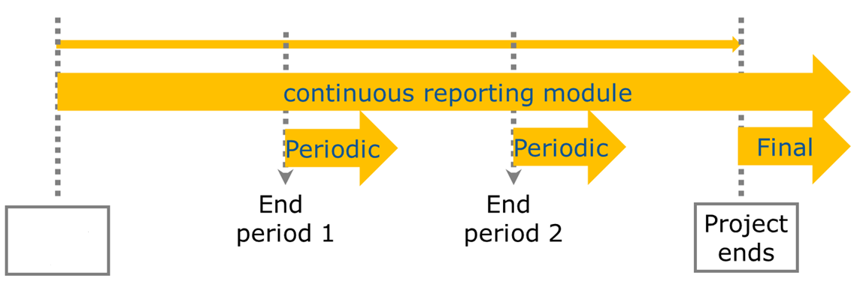
Project reporting obligations
Continuous Reporting (Deliverables, Milestones)
Periodic Reporting (60 days after end of reporting period)
Periodic technical report
Periodic financial report
Final Reporting
Final technical report
Final financial report
Article 19
of the GA
Article 20
of the GA
Month 48
1 April 2021
Month 18
Month 36
31 March 2025
Project starts
Project ends
30 September 2022
31 March 2024
All reporting done electronically through the Participant Portal.

Slide 3
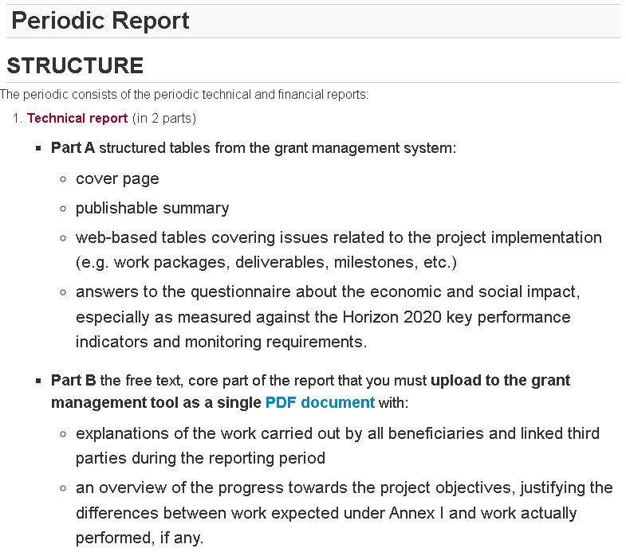
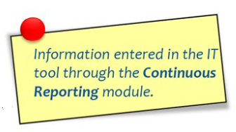

https://ec.europa.eu/research/participants/data/ref/h2020/gm/reporting/h2020-tmpl-periodic-rep_en.pdf#page=18

Slide 4
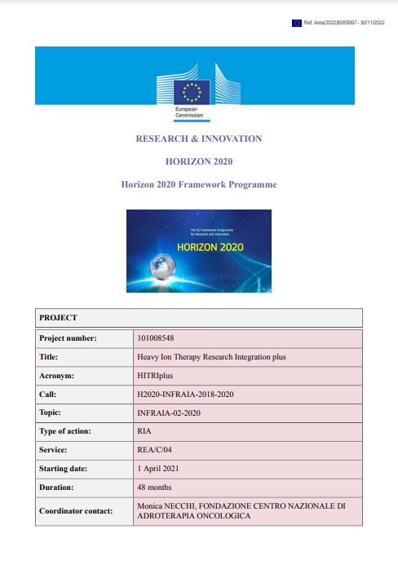
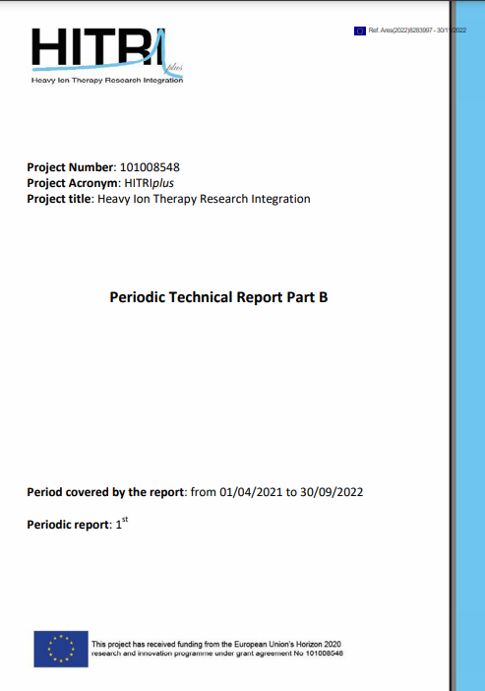

Slide 5
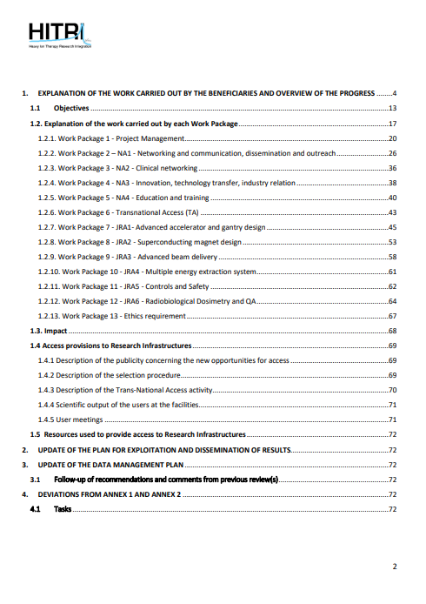


Slide 6

Periodic reporting module – 1st period
Activated after the end of each reporting period
All beneficiaries complete their own Financial Statement and their contribution to the Technical Part of the Periodic Report.
Beneficiaries e-sign and submit their Financial Statements to the Coordinator.
The Coordinator approves the elements of the Periodic Report & submits to the EU Services.
EU services review the submitted Periodic Report and accept or reject it.
The PO/ FO may request additional documents/ justifications/ explanations
Approval and Payment

Slide 7

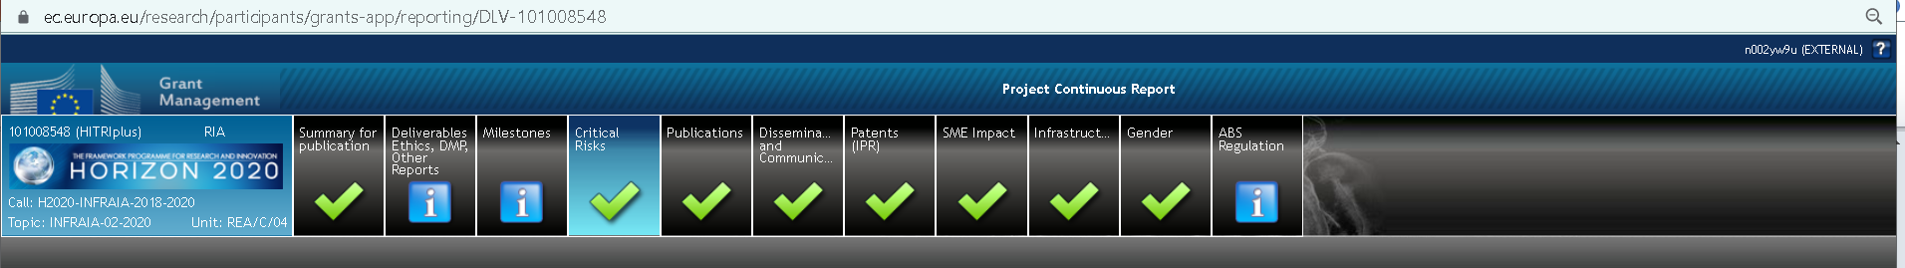
Continuous Reporting
The continuous reporting functionality is available as soon as the project starts to submit information about the progress of the project.
This includes:
deliverables
progress in achieving milestones
updates to the publishable summary
response to critical risks, publications, communications activities, IPRs.
All this information is automatically compiled to create part A of every technical periodic report.

Slide 8
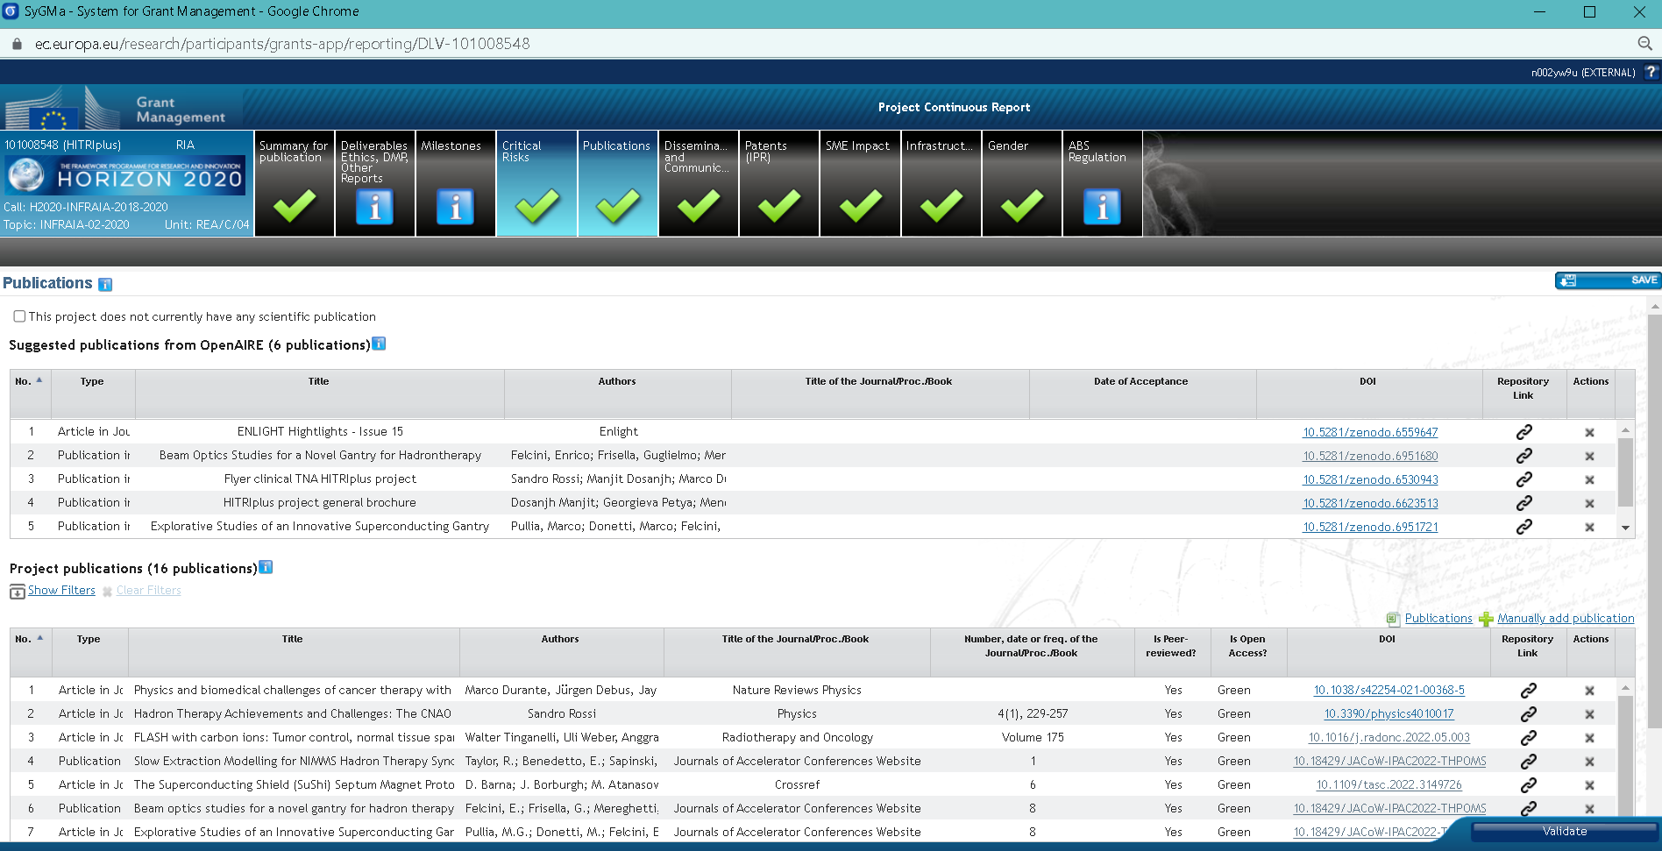

Slide 9
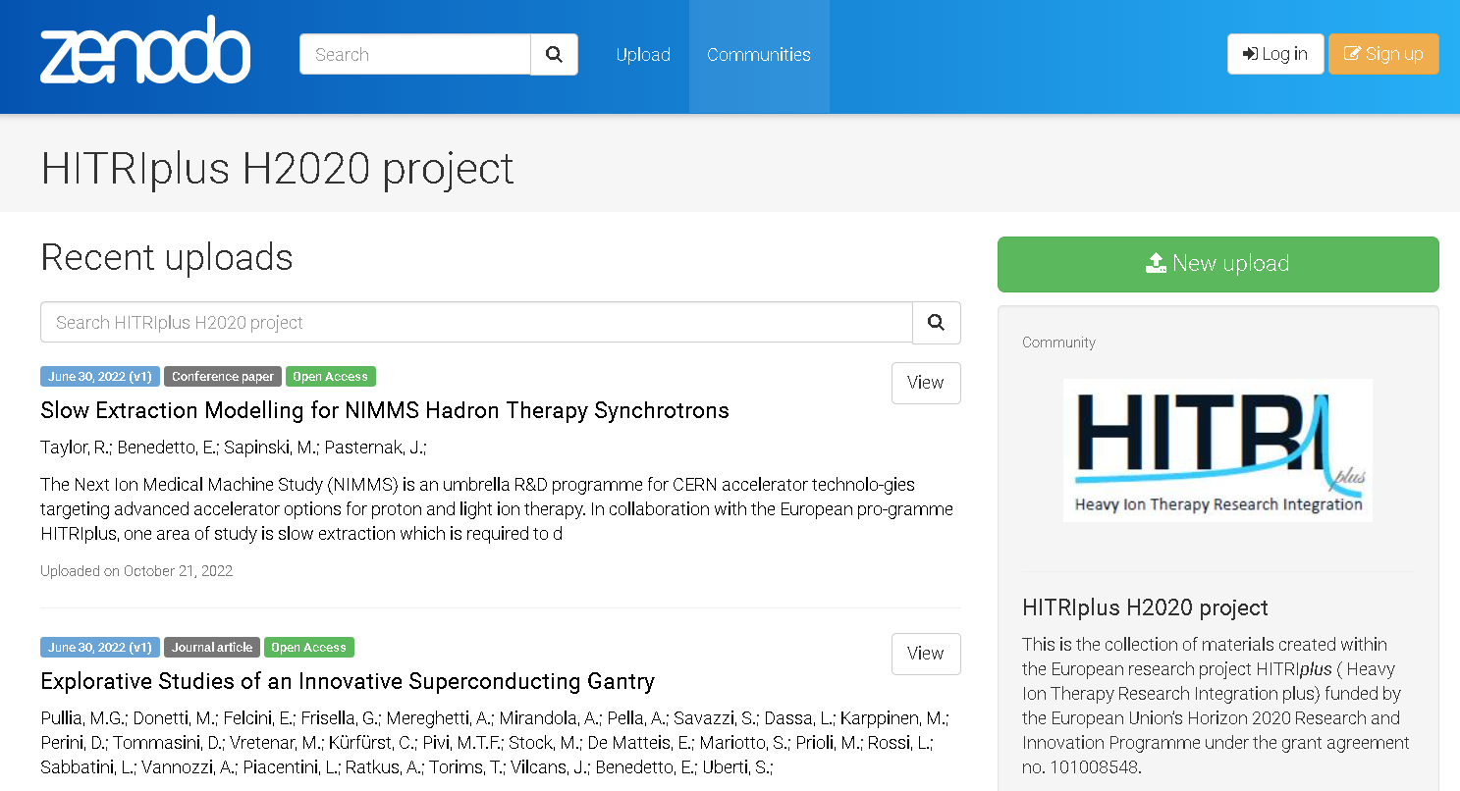
Zenodo is an open repository that makes scientific outputs of all kinds citable, shareable and discoverable for the long term. All uploads get a Digital Object Identifier (DOI) to make them easily and uniquely citeable. Any file format.
→ Zenodo is integrated into reporting lines for research funded by the European Commission via OpenAIRE.
https://zenodo.org/communities/hitriplus/?page=1&size=20

Slide 10
Project reporting obligations
Continuous Reporting (Deliverables, Milestones)
Periodic Reporting (60 days after end of reporting period)
Periodic technical report
Periodic financial report
Final Reporting
Final technical report
Final financial report
Article 19
of the GA
Article 20
of the GA
Month 48
1 April 2021
Month 18
Month 36
31 March 2025
Project starts
Project ends
30 September 2022
31 March 2024
All reporting done electronically through the Participant Portal.

Slide 11
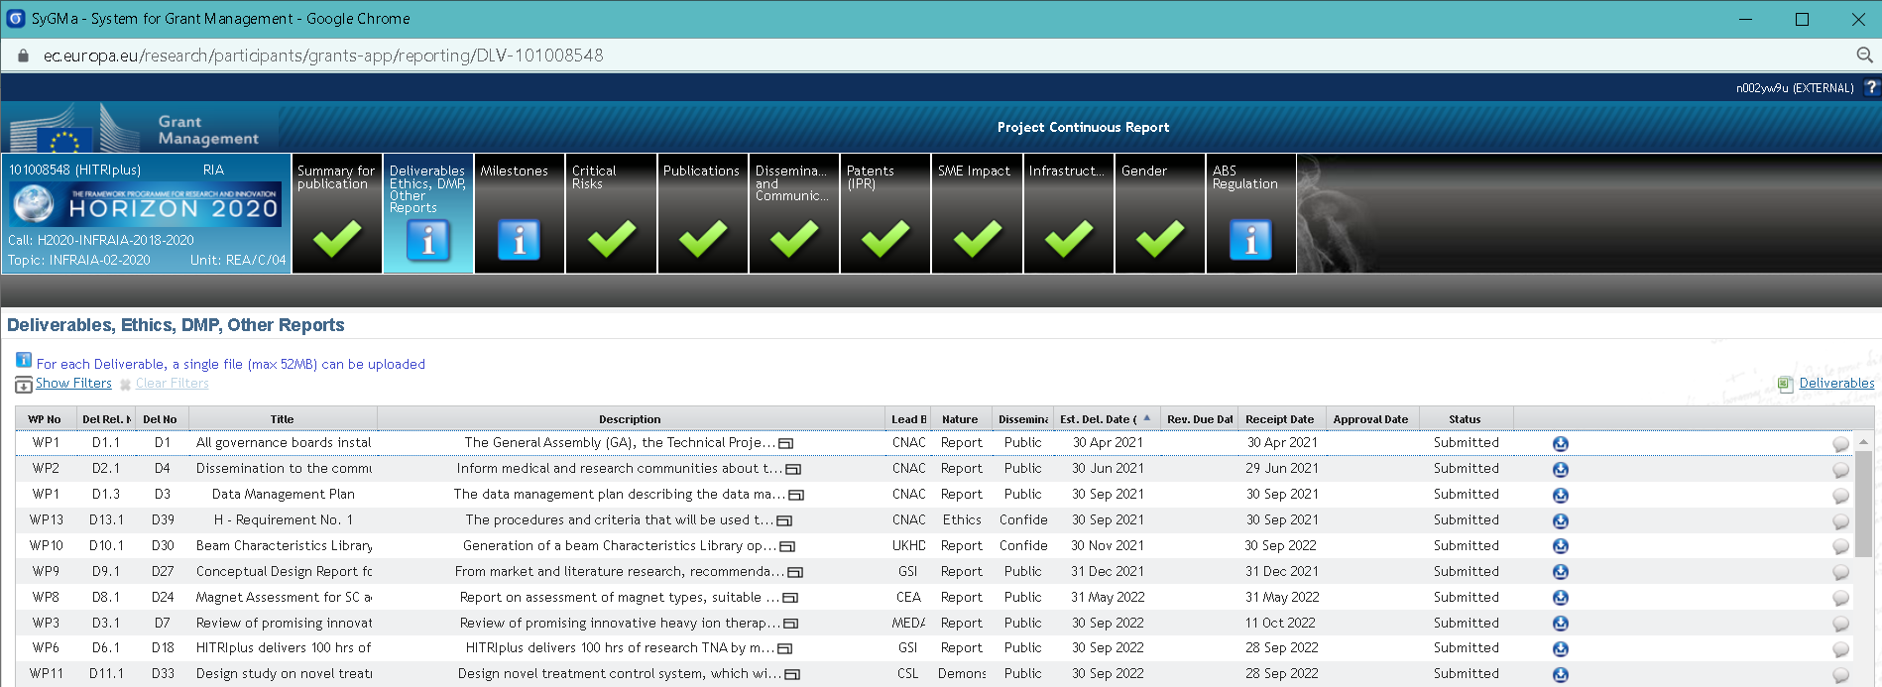
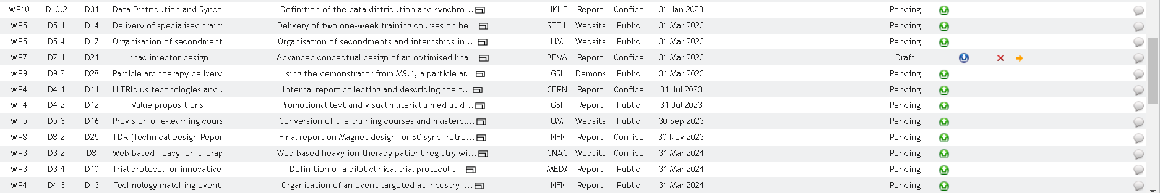
1° reporting period
2° reporting period

Slide 12
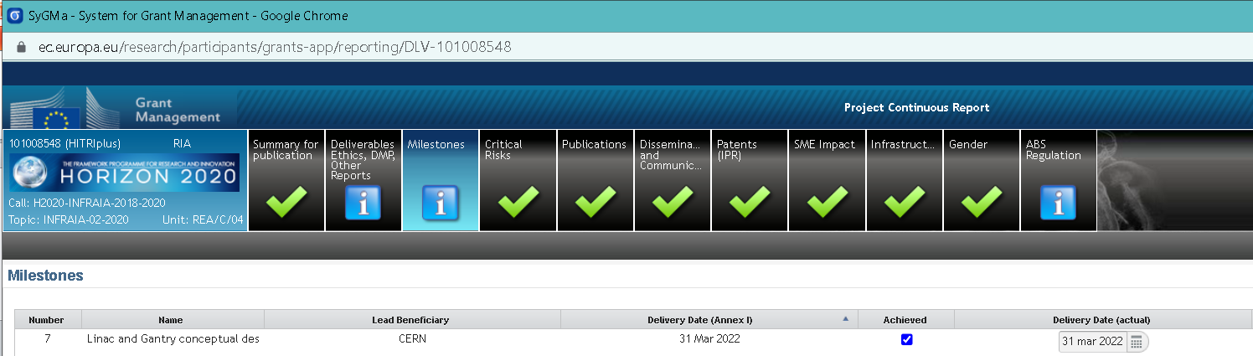
1° reporting period
2° reporting period

Slide 13
THANK YOU!!!

