Slide 1




Muon Collider
D. Schulte and S. Stapnes
for the International Muon Collider Collaboration
LDG
November 2022

Slide 2
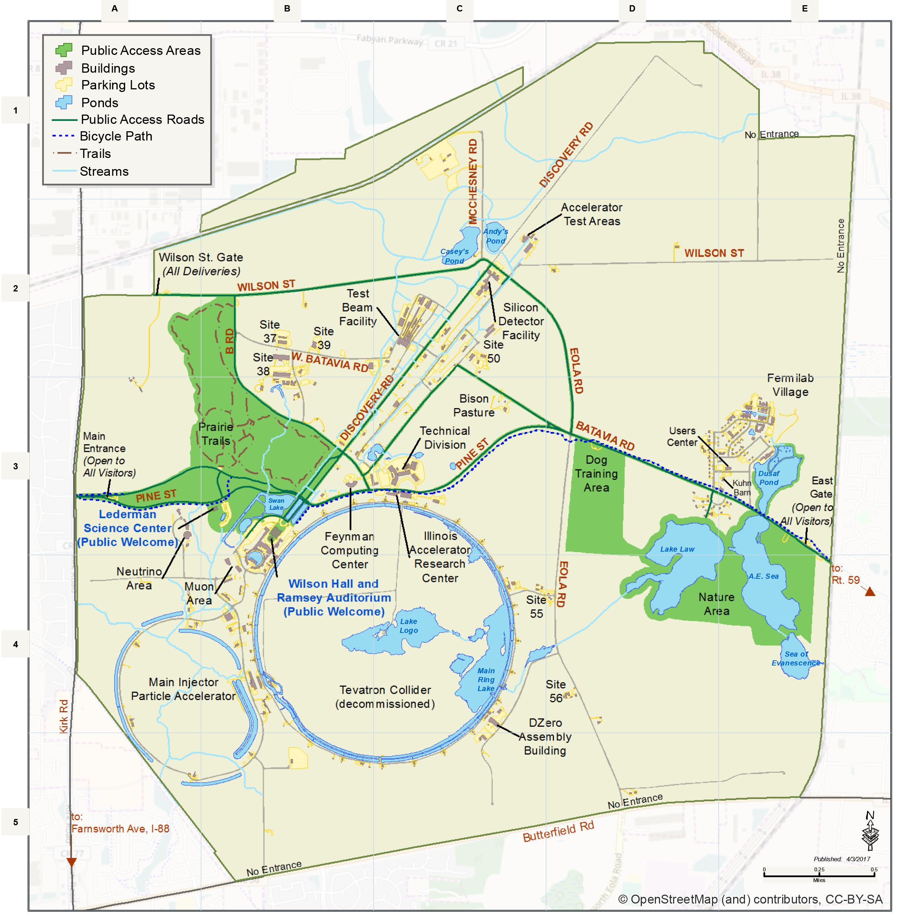
Muon Collider Community
Formed collaboration to implement and R&D Roadmap for CERN Council
EU Design Study approved this summer, 32 partners, O(3+4 MEUR)
(EU+Switzerland+UK and partners)
50+ partner institutions
30+ already signed formal agreement
US Snowmass has strong support
to contribute to R&D
as a collider in the US
Now waiting for P5
Plan to apply in 2024 for HORIZON-INFRA-2024-TECH Goal: prepare experimental programme, e.g. demonstrator, prototypes, …

Slide 3
MoC and Design Study Partners
IEIO | CERN
FR | CEA-IRFU
 | CNRS-LNCMI
DE | DESY
 | Technical University of Darmstadt
 | University of Rostock
 | KIT
IT | INFN
 | INFN, Univ., Polit. Torino
 | INFN, Univ. Milano
 | INFN, Univ. Padova
 | INFN, Univ. Pavia
 | INFN, Univ. Bologna
 | INFN Trieste
 | INFN, Univ. Bari
 | INFN, Univ. Roma 1
 | ENEA
UK | RAL
 | UK Research and Innovation
 | University of Lancaster
 | University of Southampton
 | University of Strathclyde
 | University of Sussex
 | Imperial College
 | Royal Holloway
 | University of Huddersfield
 | University of Oxford
 | University of Warwick
 | University of Durham
SE | ESS
 | University of Uppsala
PT | LIP
NL | University of Twente
FI | Tampere University
US | Iowa State University
 | Wisconsin-Madison
 | Pittsburg University
 | BNL
China | Sun Yat-sen University
 | IHEP
 | Peking University
EST | Tartu University
LAT | Riga Technical Univers.
AU | HEPHY
 | TU Wien
ES | I3M
CH | PSI
 | University of Geneva
 | EPFL
BE | Louvain
IT | INFN Frascati
 | INFN, Univ. Ferrara
 | INFN, Univ. Roma 3
 | INFN Legnaro
 | INFN, Univ. Milano Bicocca
 | INFN Genova
 | INFN Laboratori del Sud
 | INFN Napoli
US | FNAL
 | LBL
 | JLAB
 | Chicago
Japan | Akira Yamamoto
 | Akira Sato
 | Toru Ogitsu
3

Slide 4
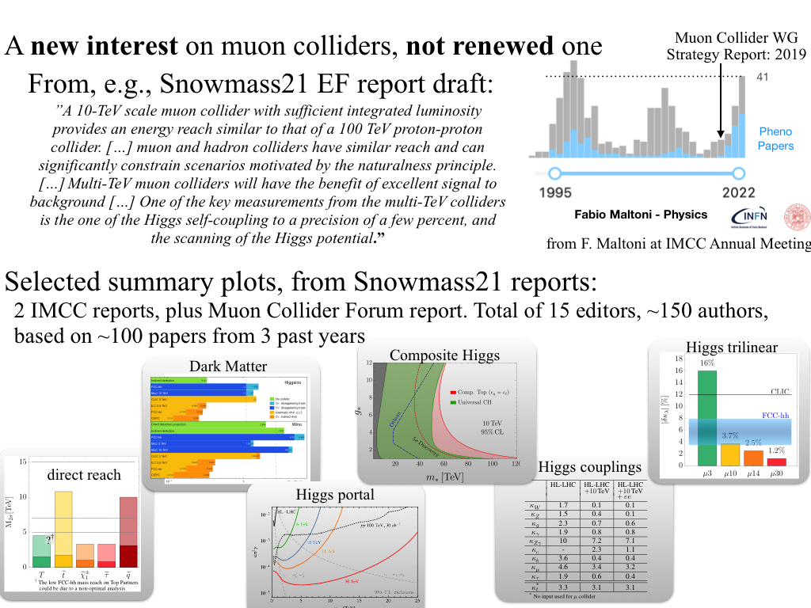
Large US interest in Muon Colliders
A. Wulzer, F. Maltoni, P. Meade et al.
O(150) authors, 15 editors, 100 papers

Slide 5
Collaboration documents
Memorandum of Collaboration(MoC): Being signed by collaboration members (list shown earlier)
Governance document: “Collaboration own” document, with updated description of the organisation, also taking into account being part of the European Accelerator R&D roadmap:

Slide 6
Organisation
International Collaboration Board represents the partners
International Advisory Committee
Coordination Committee
executes the study
(only Study Leader in MoC)
Steering Board oversees study and links to regional supervision (addition to MoC)

Slide 7
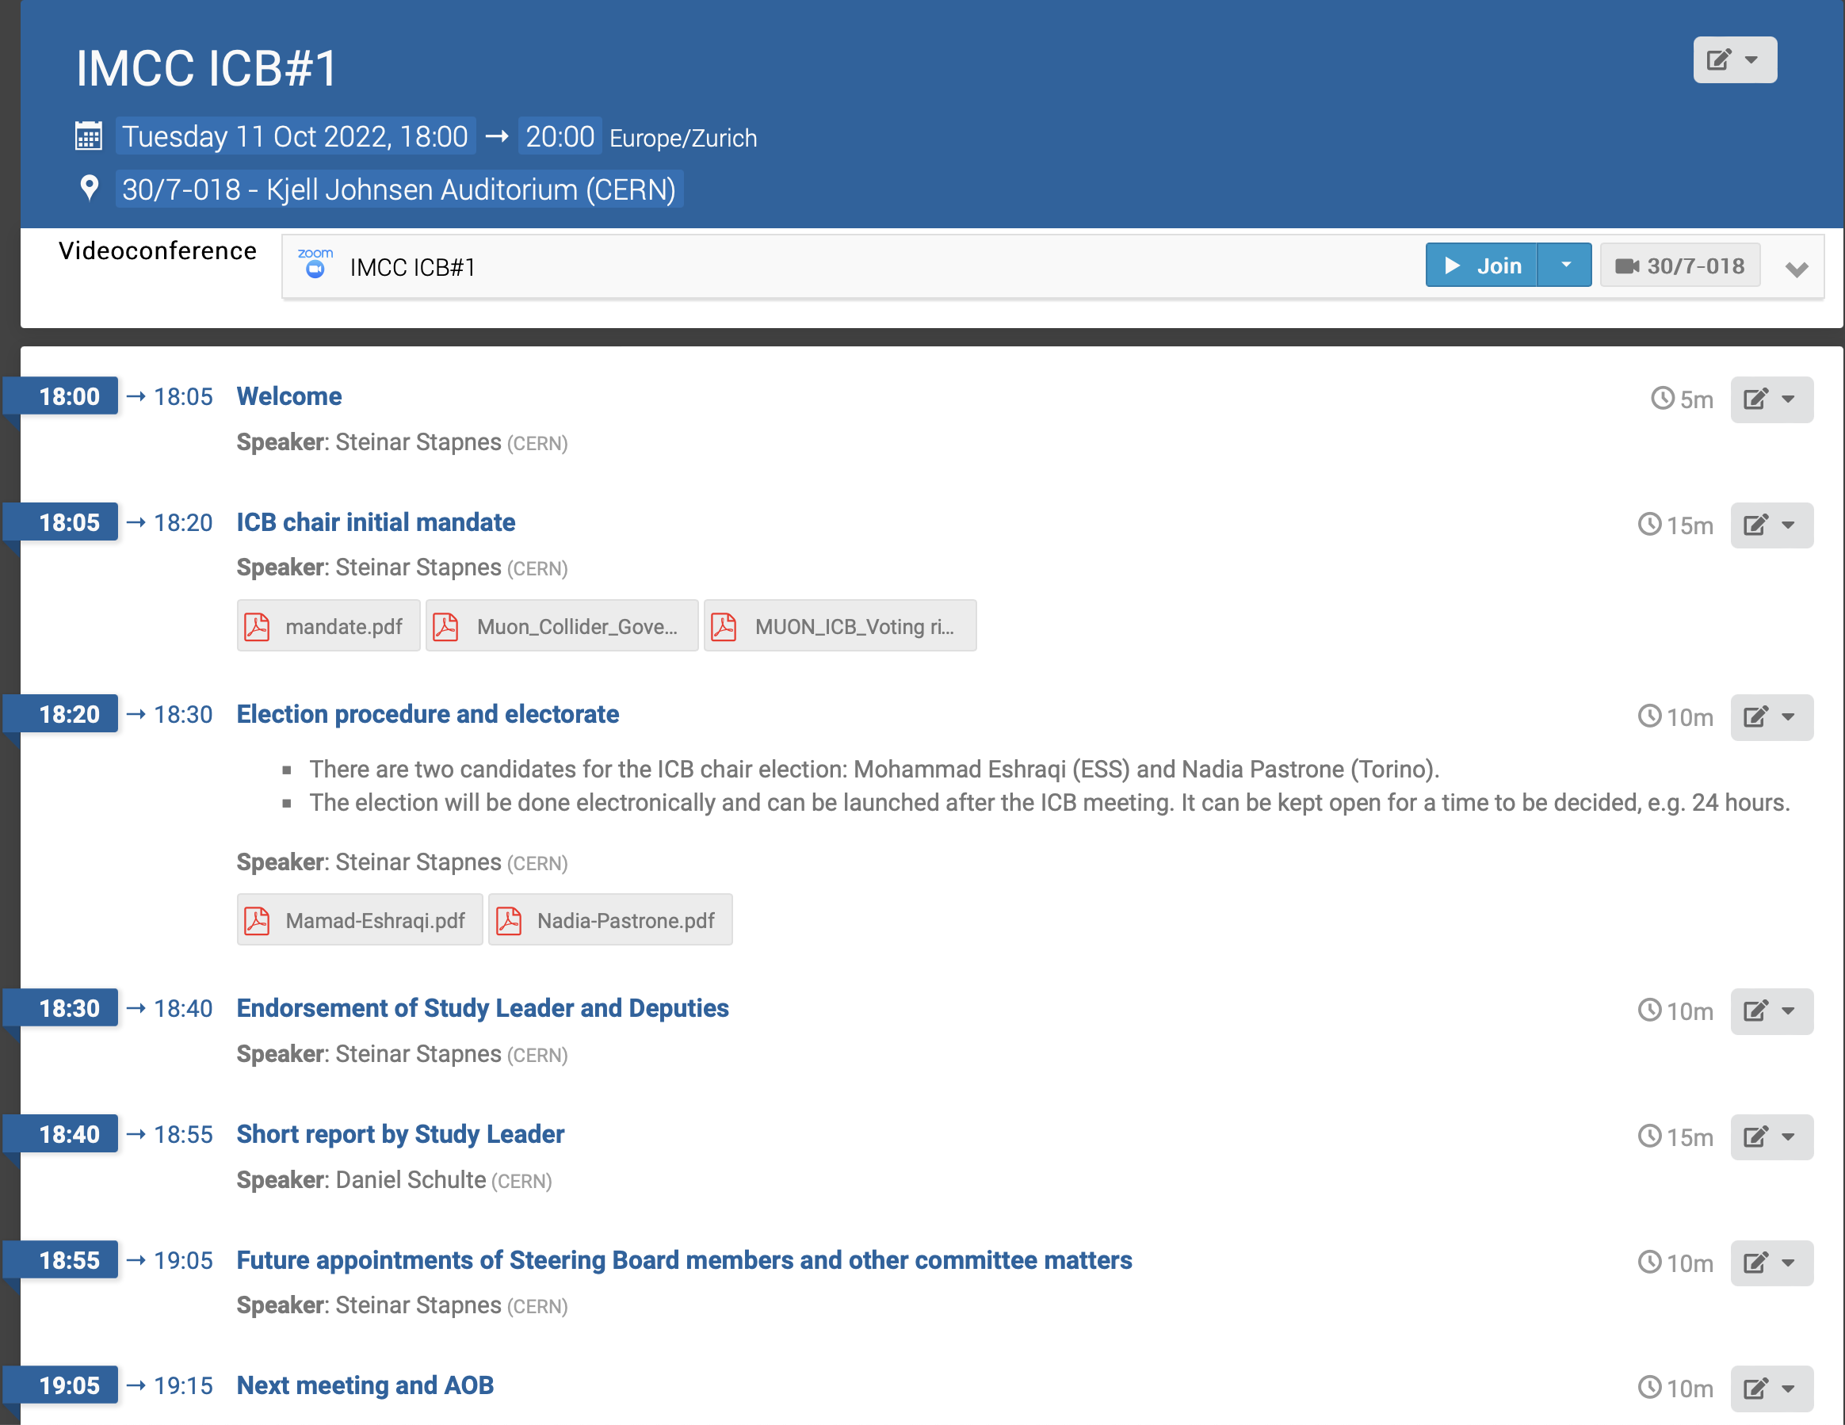

Slide 8
Organisation
Collaboration Board (ICB)
  Elected chair: Nadia Pastrone
Steering Board (ISB)
  Chair Steinar Stapnes, CERN members: Mike Lamont, Gianluigi Arduini, +ICB representatives, SL and deputies
  Started initial meetings between Steinar, Nadia, Daniel, ISB to be completed by next ICB
Coordination committee (CC)
  ICB endorsed
    Study Leader Daniel Schulte
    Deputies: Andrea Wulzer, Donatella Lucchesi, Chris Rogers
  Members have been already working
  Consider enlarging physics and detectors

Slide 9
Coordination Committee Members
Physics | Andrea Wulzer
Detector and MDI | Donatella Lucchesi
US (detector) | Sergo Jindariani
US (accelerator) | Mark Palmer
Asia (China) | Jingyu Tang
Asia (Japan) | tbd
Protons | Natalia Milas
Muon production and cooling | Chris Rogers
Muon acceleration | Antoine Chance
Collider | Christian Carli
Magnets | Luca Bottura
RF | Alexej Grudiev, Claude Marchand
Beam-matter int. target systems | Anton Lechner
Collective effects | Elias Metral
Cooling cell design | Lucio Rossi
Demonstrator | Roberto Losito

Slide 10
Points brought up in the ICB
Next CB meeting linked to MuCol kick off (Spring 2023)
Some important points to address/prepare for next ICB meeting:
  Continue to include institutes according to rules to be defined (e.g. MoC, foreseen contributions, resources)
  Work out/Clarify overlaps and co-existence between the collaboration structure overall and the MuCol project, from technical work to collaboration board/governing board and advisory group(s)
  Complete the Steering Group (with representatives from collaboration and CERN)

Slide 11
Key points
Good progress in building the organisational structures.
Keep a focus on integration of groups not yet fully members of the collaboration, among them the US labs where this required more legal legwork and creativity
Specifically for the muon collider: the Panel tasks are already largely covered by the collaboration bodies, but the SB – which include the collaboration management - can add value in particular in two areas:
  In communication with the LDG including other panels. and other regions main FAs
  And considering how a quite large demonstrator programme can be envisaged in next stage, again with key FAs
Coordination Panel Terms of Reference
Oversee the development of a detailed execution plan for each R&D Theme, and coordinate the necessary work
Have representation from all stakeholders, including (as appropriate) participating laboratories, institutes, and national communities
Include representation from international partners, ensuring that a uniform picture for both European and international oversight bodies
Act as a decision-making and prioritisation body within the approved scope of each R&D Theme, based on a consensus of stakeholders
Where changes of objectives or scope, or prioritisation between objectives, are needed, submit recommendations and requests for comment to the LDG
Ensure that decisions are made on a sound technical basis, drawing on the expertise of the collaborating projects and institutions, and setting up any subsidiary technical working groups that may be needed

Slide 12
Accelerator R&D Roadmap
Full funding scenario deliverables by next ESPPU/other processes
Project Evaluation Report
  key performance, risk, cost and power drivers
  site considerations (CERN and elsewhere)
R&D Plan
  describes a path towards the collider;
  key element is demonstrator concept
Interim Report (2023)
Allows to make informed decisions
Current funding level allows only to address the most critical items
making priorities based on risk and collaborator interest
http://arxiv.org/abs/2201.07895
12

Slide 13
Project Evaluation Report
The Project Evaluation Report for the next ESPPU will contain an assessment of whether the 10 TeV muon collider is a promising option and identify the required compromises to realise a 3 TeV option by around 2045. In particular the questions below would be addressed.
What is a realistic luminosity target?
What are the background conditions in the detector?
Can one consider implementing such a collider at CERN or other sites, and can it have one or two detectors?
What are the key performance specifications of the components and what is the maturity of the technologies?
What are the cost drivers and what is the cost scale of such a collider?
What are the power drivers and what is the power consumption scale of the collider?
What are the key risks of the project?
13

Slide 14
Aspirational Timeline
2023
Interim Report to gauge progress
Initial baseline defined
2025
Assessment Report
2025-2027
R&D plan will be refined
14

Slide 15
MuCol

Slide 16
Reminder: Coordination Committee Members
Physics | Andrea Wulzer
Detector and MDI | Donatella Lucchesi
US (detector) | Sergo Jindariani
US (accelerator) | Mark Palmer
Asia (China) | Jingyu Tang
Asia (Japan) | tbd
Protons | Natalia Milas
Muon production and cooling | Chris Rogers
Muon acceleration | Antoine Chance
Collider | Christian Carli
Magnets | Luca Bottura
RF | Alexej Grudiev, Claude Marchand
Beam-matter int. target systems | Anton Lechner
Collective effects | Elias Metral
The MuCol WP coordinators are CC members
essentially all activities are integrated in MuCol
Cooling cell design | Lucio Rossi
Demonstrator | Roberto Losito

Slide 17
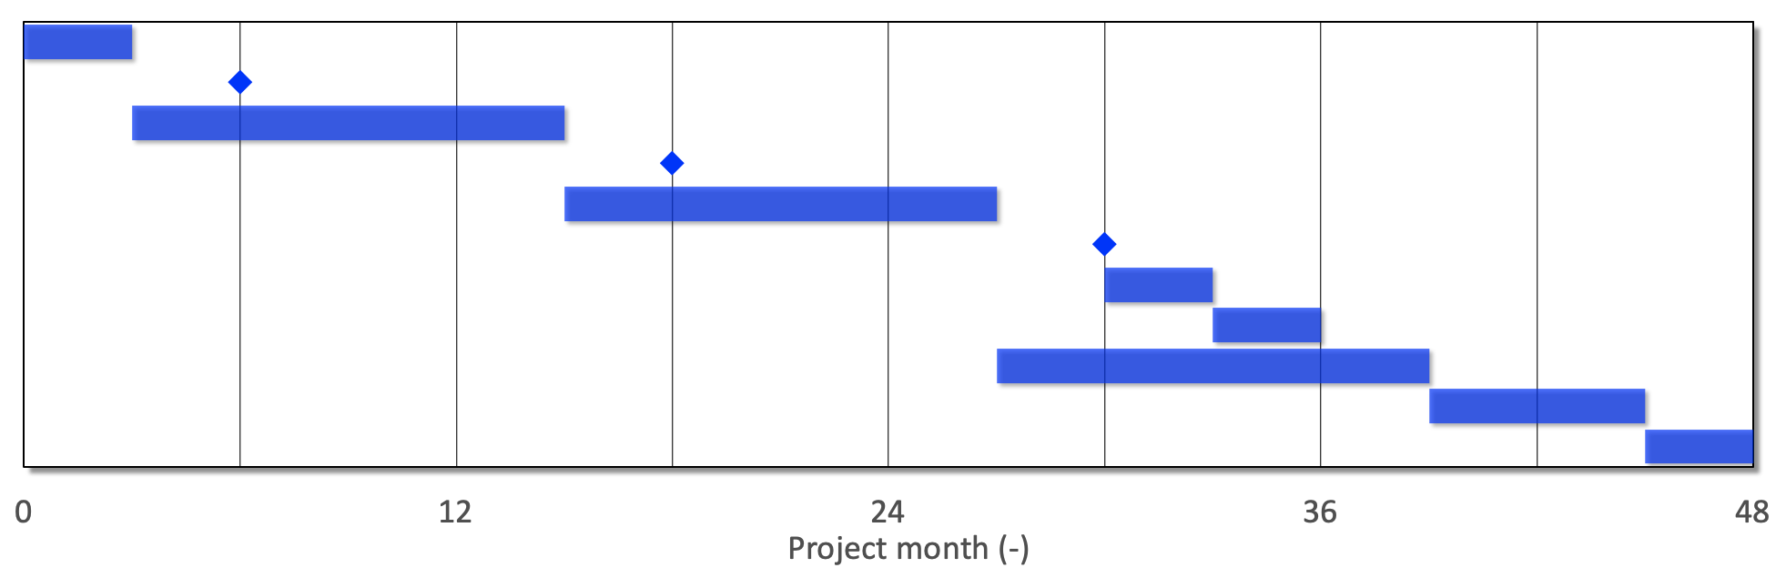
EU Design Study Timeline
Tentative concept
Preliminary concept
Consolidated concept
Finalization
Initial parametric study
Establish tentative parameters
Develop tentative concept
Establish preliminary parameters
Develop preliminary concept
Establish consolidated parameters
Documentation of preliminary concept
Preliminary assessment report
Study consolidated concept
Final adjustment and review
Consolidated assessment report
2023 2024 2025 2026
Next ESPPU ?
Representative of overall workplan

Slide 18
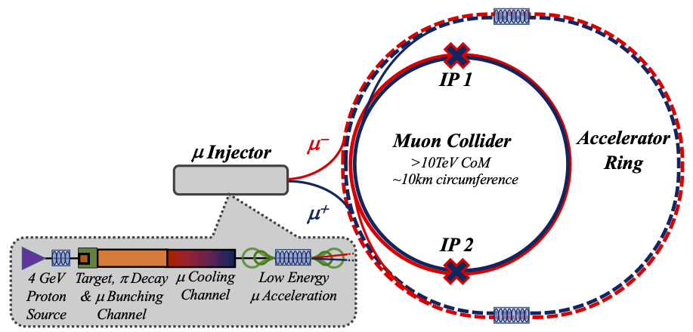
Key Challenges
0) Physics case
4) Drives the beam quality
MAP put much effort in design
optimise as much as possible
2) Beam-induced background
1) Dense neutrino flux
mitigated by mover system and site selection
3) Cost and power consumption limit energy reach
e.g. 35 km accelerator for 10 TeV, 10 km collider ring
Also impacts beam quality
18

Slide 19
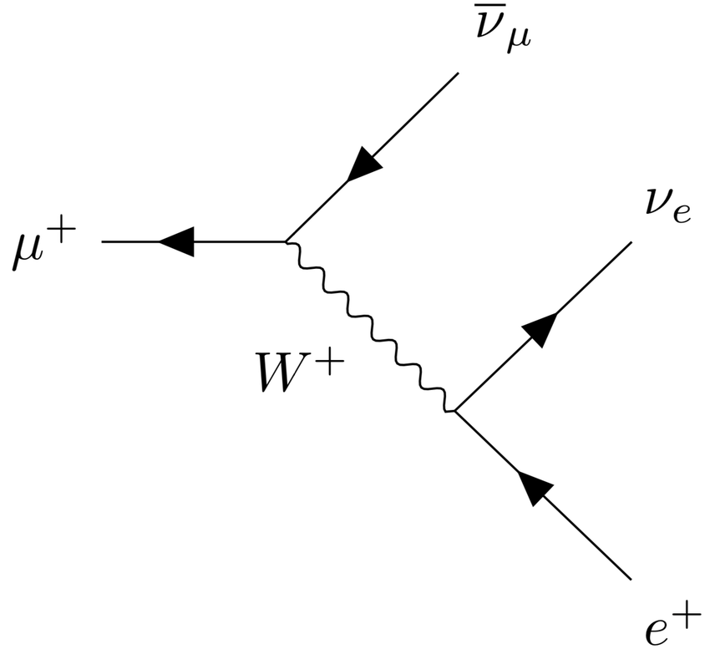
Muon Decay and Detector Background
Muons decay produces electrons and positrons
Loss per unit length almost independent of energy
Tools mostly ready to generate background
tentative beamline and mask, FLUKA
tentative beam-beam for muons (GUINEA-PIG)
Studies at 1.5 <and 3 TeV with concept based on CLIC detector
Radiation level in detector similar to HL-LHC
Studies with beam-induced background in progress
some channels are not affected by background
some improvement required for other channels
Concept for 10 TeV in progress
Detector team
O(69) authors, O(150 signatories)
UNIPD, with the participation of INFN, CEA, DESY, UOS, LIP, CERN, ISU, SYSU, UNIPV
WP 2: Detector concept for 3 and 10+ TeV
WP 2: Reconstruction algorithm development
WP 2: Detector performance evaluation
19

Slide 20
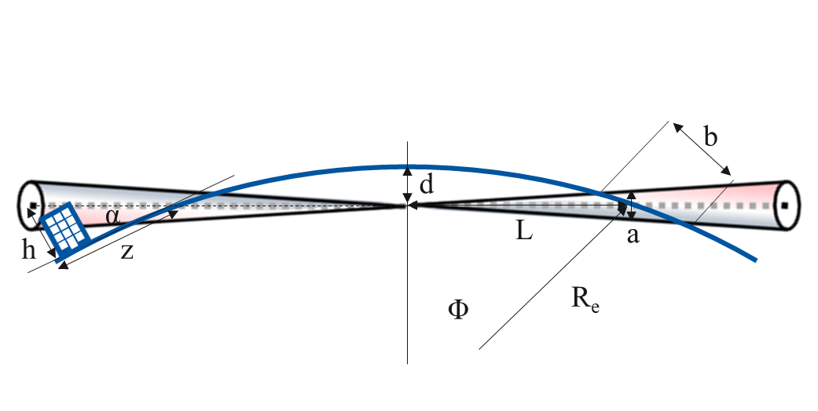
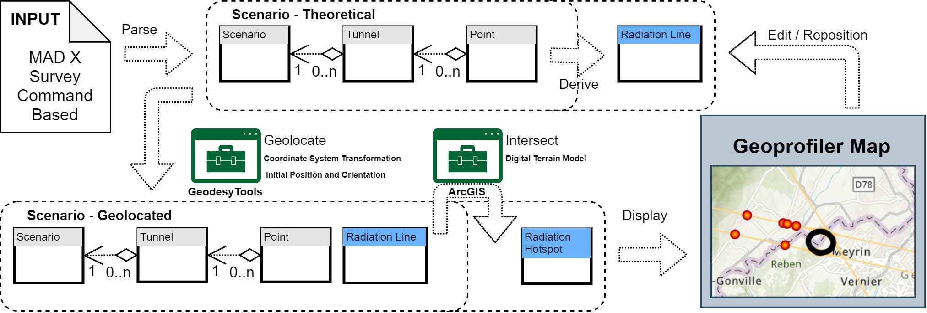
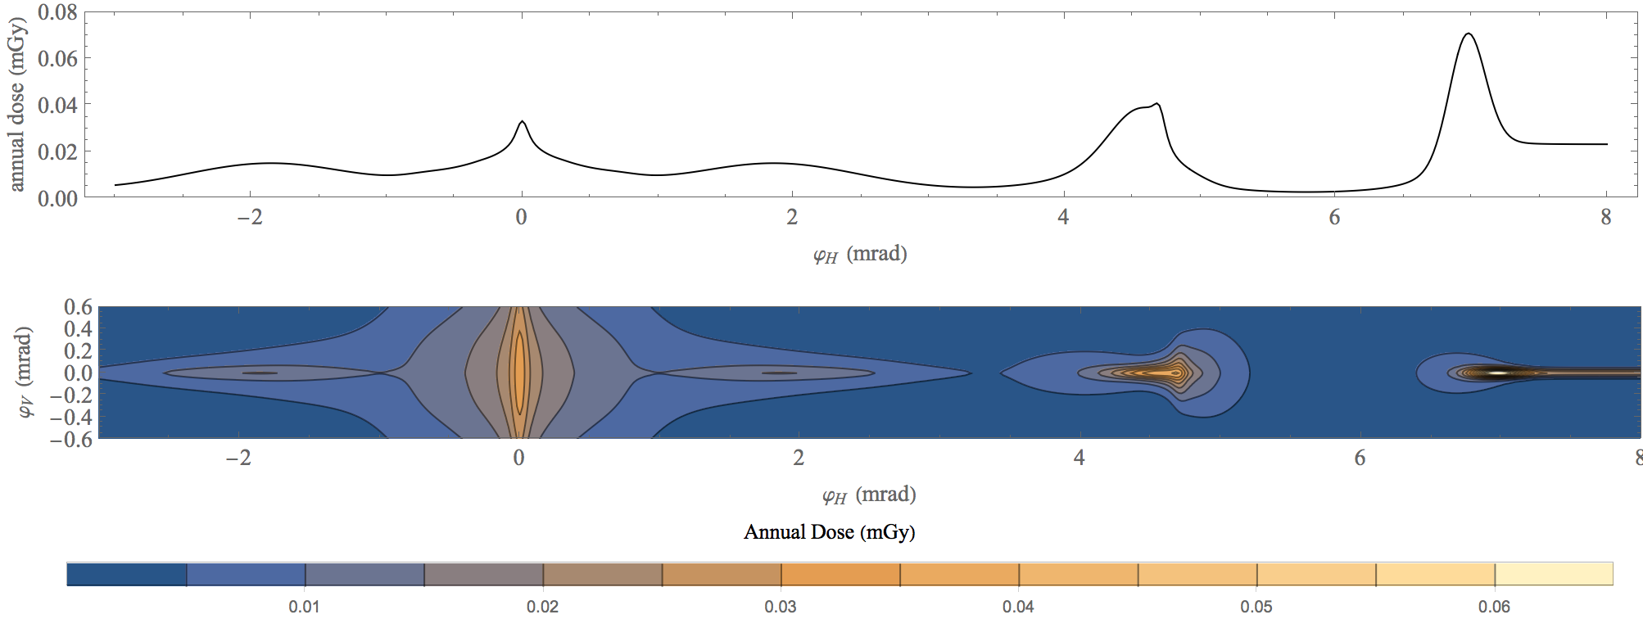
Neutrino Flux
Goal: similar to LHC: limit neutrino flux to have negligible impact, “fully optimised” (10% of MAP goal)
Verify performance of concept to be good for 14 TeV
CERN, FNAL
WP 5: contains parts
Mover and support system
FLUKA dose studies
Conformity Verification Scheme
F. Bertinelli et al. (CERN, Riga)
G. Lerner, D. Calzolari, A. Lechner, C. Ahdida
G. Lacerda, Y. Robert, N. Guilhaudin (CERN)
C. Ahdida, P. Vojtyla, M. Widorski, H. Vincke
Flux direction map / lattice design / mover impact on beam
Mitigation:
Site choice tool
C. Carli, K. Skoufaris (CERN)
20

Slide 21
Proton Complex
Need about 2 MW proton beam
400 kJ per pulse at 5 Hz
Complex system
Due to resources focus on bunching of beams
ESS, CERN, Uppsala
WP3: Compressor ring design (ESS)
design
WP 3: Linac parameters (CERN)
basic parameters
N. Milas et al. (ESS, Uppsala)

Slide 22
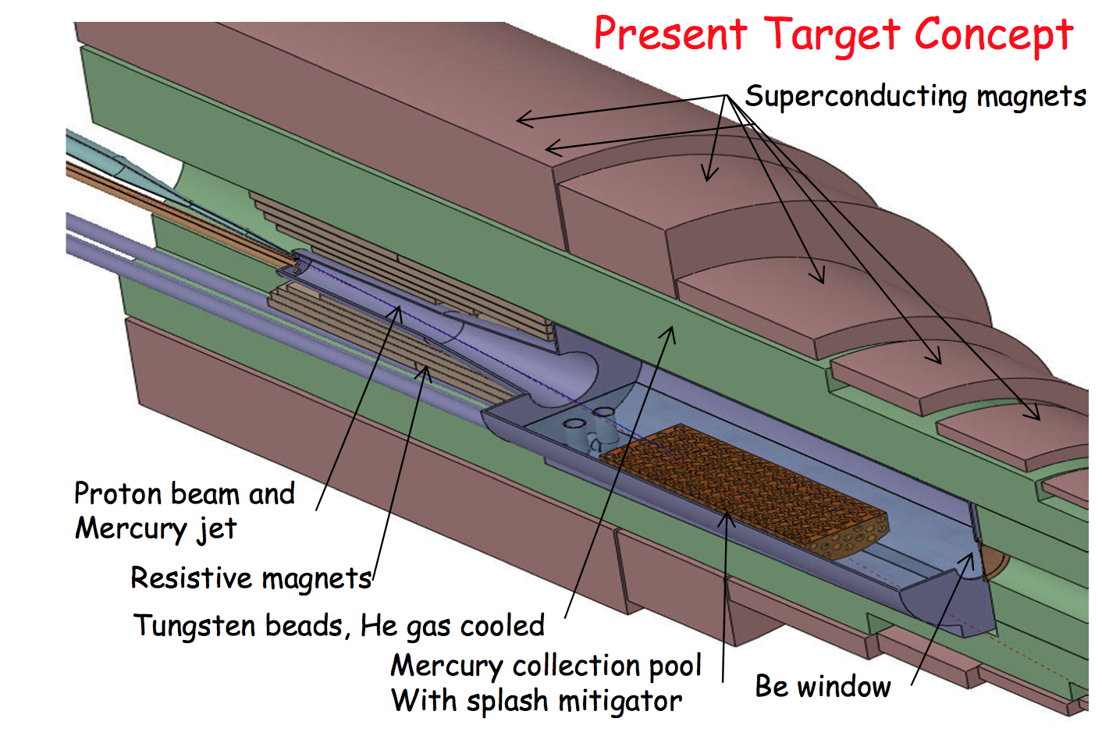
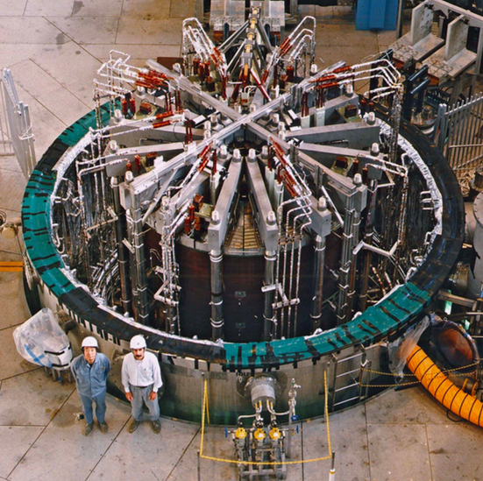
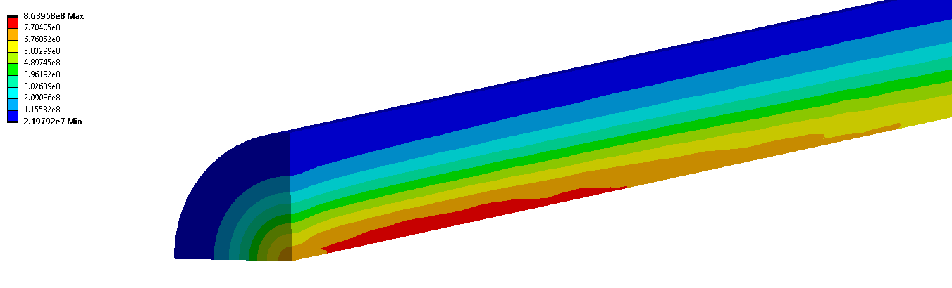
Target
Two approaches:
15 T LTS + 5 T resistive or 20 T HTS
Large aperture for shielding
WP 7: Solenoid target parameters
WP 4: Shielding needs and radiation
Synergy with ITER
MAP target design, K. McDonald, et al.
12…15 T
20 T
A. Lechner et al.
L. Bottura et al.
Rui Franqueira Ximenes et al.
UKRI, Imperial, UWAR, CERN, INFN, UMIL, ENEA
WP4: Target design (CERN)
WP4: Shielding needs
WP7: Solenoid target parameters
ITER Central Solenoid Model Coil
13 T in 1.7 m (LTS)
WP 4: Shock in target: Simulations of graphite target indicate 2 MW could be acceptable
STFC will also study alternatives
Proton beam
Operation at 2000 °C to maximise stress resistance
22

Slide 23
Muon Cooling
MAP designs almost achieve 10 TeV goal
miss factor two for final cooling
C. Rogers, B. Stechauner, E. Fol et al. (RAL, CERN)
UKRI, Imperial, UWAR, CERN, INFN, UMIL, ENEA, EPFL
WP4: Lattice design (UKRI)
WP4: Code development (Imperial)
CHART: Collective effects (EPFL)
C. Rogers et al. (RAL, CERN)
T. Pieloni et al. (EPFL, CERN)

Slide 24
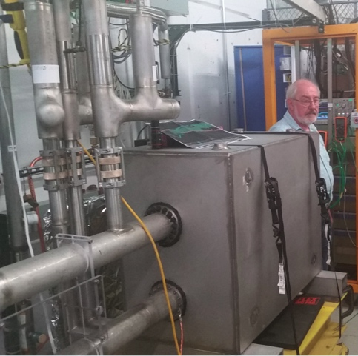
Acceleration Complex
Core of baseline is sequence of pulsed synchrotron (0.4-11 ms)
Key cost and power driver, novel system
CEA, INFN, CERN, HUD, RHLU, BNL, LNCMI, Bologna, Darmstadt, Twente, Rostock, Milano, RAL
Integrated design of RCS
  WP 5: lattice with realistic hardware specifications
  WP 5: collective effects
Concept of key components
  WP 7: Fast-ramping normal magnets
  HTS alternative
  WP 7: Efficient power converters
  WP 6: RF with transient beam loading
WP 5: Alternative FFA
A. Chance et al. (CEA)
E. Metral et al. (CERN)
L. Bottura et al. (LNCMI, Darmstadt, Bologna, Twente)
F. Boattini et al.
EMMA proof of FFA principle
Nature Physics 8, 243–247 (2012)
H. Damerell, F. Batsch, U. van Rienen, A. Grudiev et al. (Rostock, Milano, CERN)
FNAL 300 T/s HTS magnet
S. Machida et al. (RAL)

Slide 25
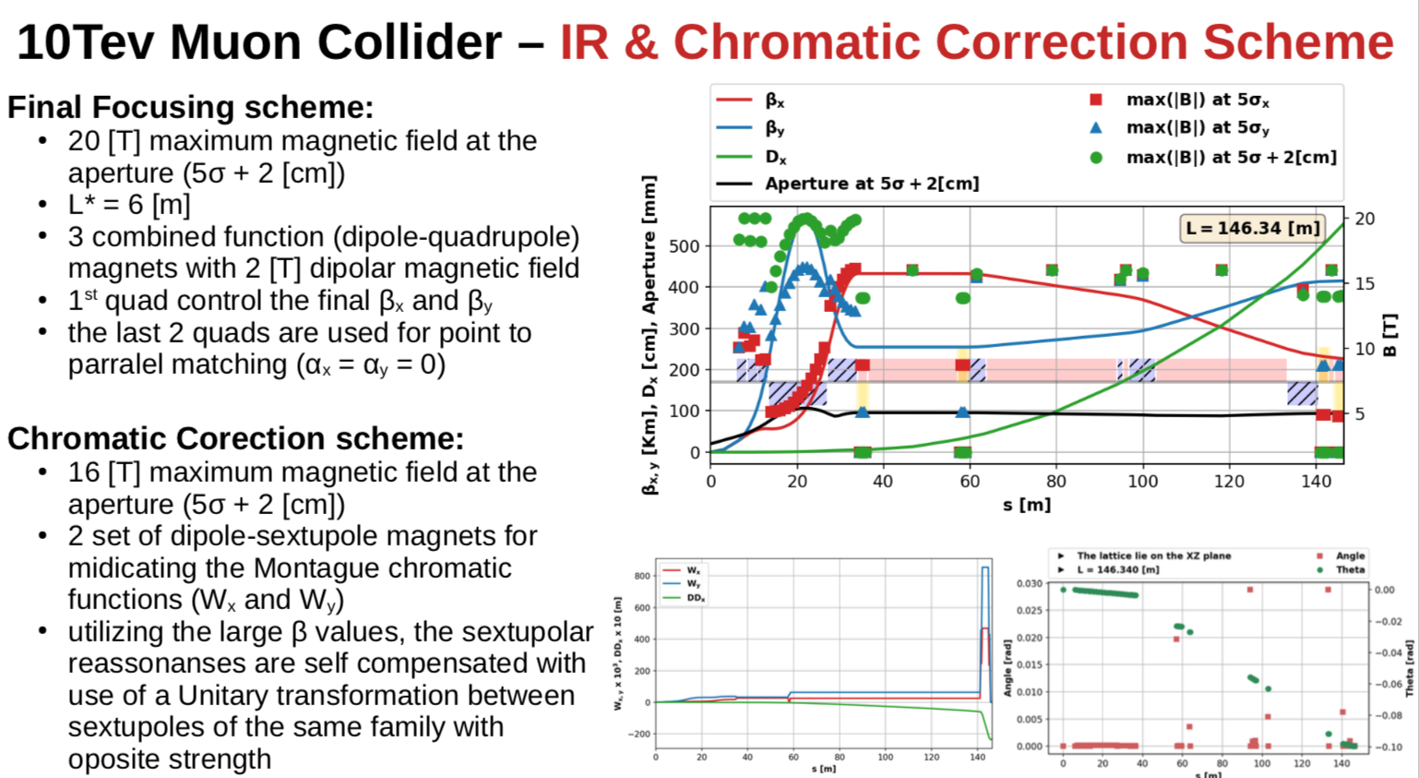
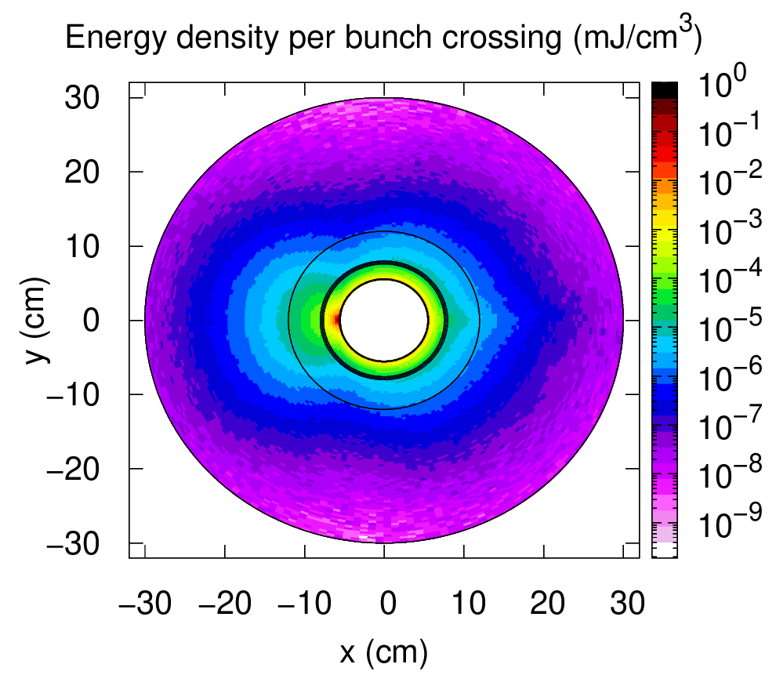
Collider Ring
MAP developed 4.5 km ring for 3 TeV with Nb₃Sn
magnet specifications in the HL-LHC range
Work progressing on 10 km ring for 10 TeV collider ring
around 16 T Nb₃Sn or HTS dipoles
final focus based on HTS
Need stress managed magnet designs
Shielding
C. Carli, K. Skoufaris (CERN)
CERN, INFN, Milano, Kyoto, profit from US
WP 5: lattice design
WP 5: collective effects
WP 5: shielding
WP 7: collider magnets
A. Lechner
D. Calzolari (CERN)
Field choice will be reviewed for cost
Example alternatives:
a 6 km 3 TeV ring with NbTi at 8 T in arcs
a 15 km 10 TeV ring with HL-LHC performances
Coil
25

Slide 26
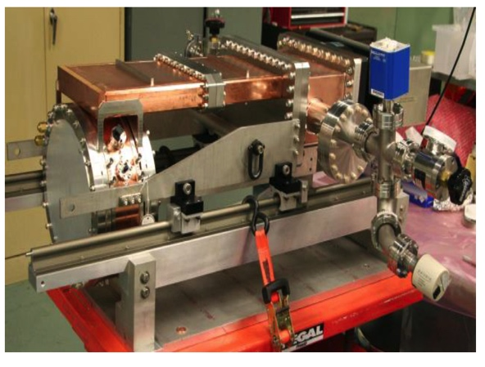
RF Technology
RF cavities in magnetic field
MAP demonstrated higher than goal gradient
Improve design based on theoretical understanding
Preparation of new test stand, but needs funding
Test stand at CEA (700 MHz, need funding)
Test at other frequencies in the UK considered
Use of CLIC breakdown experiment considered
High-energy RF system
beamloading impact on beam
efficiency
robustness
C. Marchand, Alexej Grudiev et al. (CEA, Milano, CERN, Rostock, Tartu)
MuCool demonstrated >50 MV/m in 5 T
H2-filled copper
Be end caps
CEA, INFN, UROS, ULA, Strathclyde, CERN
WP 6: Muon cooling RF design (CEA, INFN)
WP 6: Breakdown mitigation (CEA)
based on theoretical understanding
WP 6: High-energy complex RF (Rostock)
WP 6: Efficient power sources (ULA)
Preparation of new test stand, but needs funding
Test stand at CEA (700 MHz, ned funding)
Test at other frequencies in the UK considered
Use of CLIC breakdown experiment considered
26

Slide 27
Magnet Technology
Target solenoid
Large aperture high field, potential synergy with ITER
6D cooling solenoids
Large aperture high field, potential synergy with power generators
Highest field solenoids
MAP demonstrated 30 T
now magnets aim for 40+ T
even more can be possible
synergy with high-field research
Collider ring magnets
Large aperture dipoles, quadrupoles etc.
L. Bottura et al.
INFN (Task Leader), CEA, CERN, LNCMI, PSI, SOTON, UNIGE and TWENTE, in collaboration with KEK and US-MDP
INFN, CERN, CEA, CNRS, KIT, PSI, SOTON, UNIBO, UNIGE, PSI, TUDa, TWENTE, in collaboration with KEK and US-MDP
WP 7: Target capture and cooling magnets (INFN)
WP 7: Fast-ramping magnets (CERN)
WP 7: Collider ring magnets (INFN)
For all: Develop realistic performance targets
Almost no budget for experiments
27

Slide 28
Cooling Cell Integration
Cooling cell poses engineering challenges
Timely design and prototyping is essential for test facility
Use specific designs of components that are available in the very near future
UMIL, INFN, UKRI, CERN, Imperial
WP 8: Absorbers and windows (CERN)
WP 8: RF system (INFN)
WP 8: Solenoids (Milano)
WP 8: Performance (UKRI)
WP 8: Cooling cell integration (Milano)
Will develop example cooling cell
understand tight constraints
additional technologies (absorbers, instrumentation,…)
early preparation of demonstrator facility
28

Slide 29
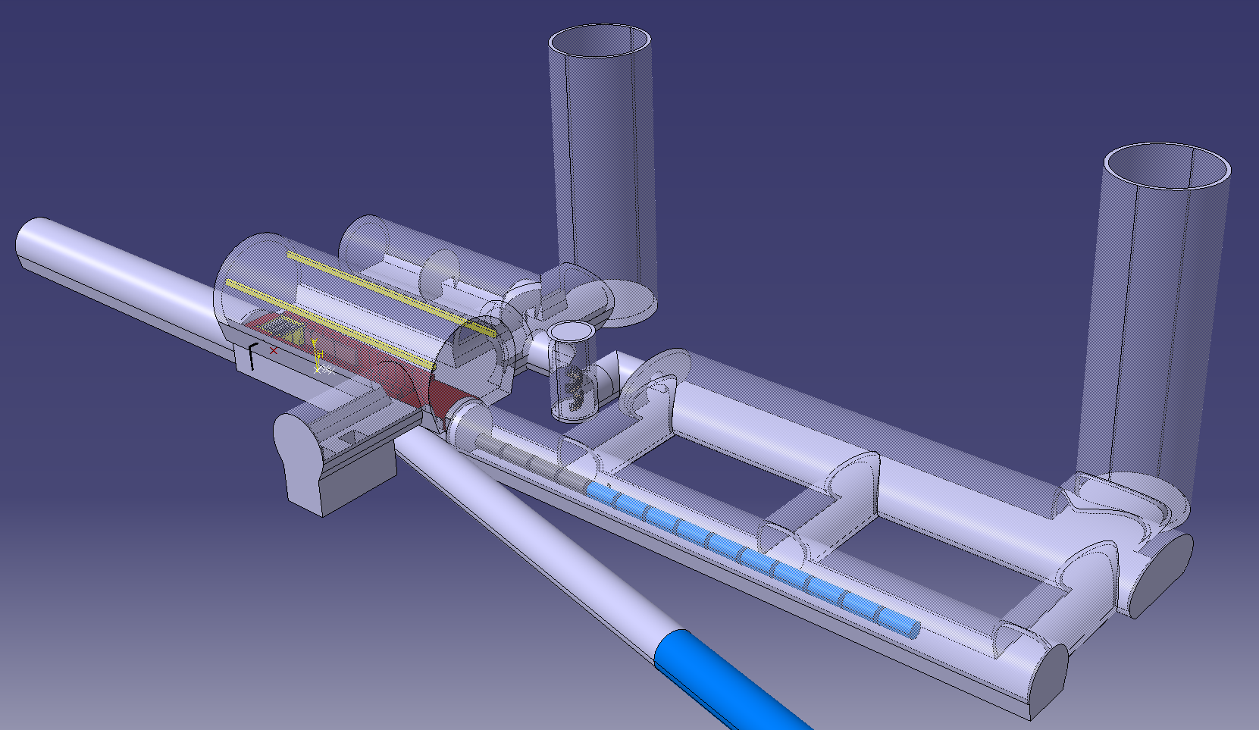
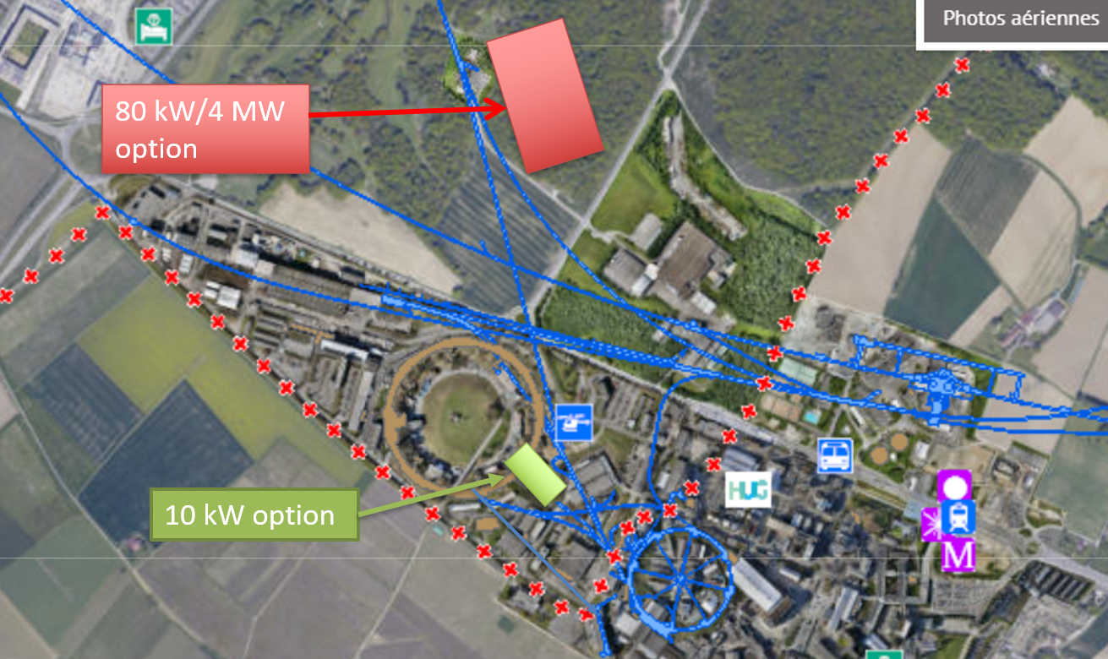
Demonstrator(s)
R&D efforts can be distributed over labs
cooling demonstrator
RF test stand
module test stand
…
Could also have synergies
booster for light sources (e.g. ESRF) or proton therapy?
M. Calviani
Use PS beam
or SPL if constructed
Could also feed neutrino facility
For cooling demonstrator look for an existing proton beam with significant power
Different sites are being considered
CERN, FNAL, ESS are being discussed
J-PARC also interesting as option
Small effort to understand options
not enough resources for more at this moment

Slide 30
Technically Limited Timeline
To be reviewed considering progress, funding and decisions
Muon collider important in the long term
Prudently explore if MuC can be option as next project
e.g. in Europe if higgs factory built elsewhere
sufficient funding required now
very strong ramp-up required after 2026
might require compromises on initial scope and performance
  3 TeV
Evaluation+decision
Evaluation+decision
30

Slide 31
US Snowmass
Strong interest in the US community in muon collider
seen as an energy frontier machine
decoupled from LC
US community wants funding for R&D
Community interested in the US to host a muon collider
Implementation task force:
MC 10 cost range 12-18G$
MC 10 power O(300 MW)
Meenakshi Narain: Energy Frontier / Large Experiments, Snowmass Community Summer Study July 17-26, 2022
31

Slide 32
What is missing?
Relevant gaps exist in the accelerator design
Proton system: only compressor ring, simple parameters for linac, other systems missing
Target area design: Beam transport, capture, bunching
Muon cooling system: Quite limited for complex system, bunch combination design, alternatives
Initial linac design: Not covered
Accelerator and collider rings: Somewhat thin (e.g. operational considerations, tolerances)
Demonstrator design: Focus is on cooling test module

Slide 33
What is missing?
Planned technology activities are mainly theoretical at this moment
More experimental effort is required, in particular
RF test stand to validate cavities in magnetic field
Magnet models in particular for HTS
Power converter technology
Absorbers and windows
Target

Slide 34
Conclusion
Collaboration exists
  expect to still increase
  US P5 will play an important role
Addressing key challenges
  Very motivated team
  Synergy with applications for society, e.g. HTS solenoids
  More funding required for full results by next ESPPU
Working on increasing resources
  to provide project evaluation report
  to provide R&D plan and demonstrator design
Did not cover physics and (most of the) detector
http://muoncollider.web.cern.ch Contact muon.collider.secretariat@cern.ch
34

Slide 35
Reserve

Slide 36
Collider Concept
Fully driven by muon lifetime, otherwise would be easy
Short, intense proton bunch
Ionisation cooling of muon in matter
Acceleration to collision energy
Collision
Protons produce pions which decay into muons
muons are captured
Thanks to MAPS
36

Slide 37
Motivation and Goal
Previous studies in US (now very strong interest again), experimental programme in UK and alternatives studies by INFN
New strong interest in high energy, high luminosity lepton collider
Combines precision physics and discovery reach
Muon collider promises sustainable approach to the energy frontier
limited power consumption, cost and land use
Technology and design advances in past years
review did not find any showstoppers
Goal is
10+ TeV collider
potential initial energy stage (e.g. 3 TeV)
higher energies to be explored later
37

Slide 38
Sustainability
CLIC is highest energy proposal with CDR
No obvious way to further improve linear colliders (decades of R&D)
Cost 18 GCHF, power approx. 500 MW
Rough rule of thumb:
cost proportional to energy
power proportional to luminosity
Muon Collider goals (10 TeV), challenging but reasonable:
Much more luminosity than CLIC at 3 TeV (L=20x10³⁴, CLIC: L=2x10³⁴/6x10³⁴)
Lower power consumption than CLIC at 3 TeV (P_{beam,MC}=0.5P_{beam,CLIC})
Lower cost
Staging is possible
Synergies exist (neutrino/higgs)
Unique opportunity for a high-energy, high-luminosity lepton collider
38

Slide 39
Alternatives: The LEMMA Scheme
LEMMA scheme (INFN) P. Raimondi et al.
Note: New proposal by C. Curatolo and L. Serafini needs to be looked at
Uses Bethe-Heitler production with electrons
45 GeV positrons to produce muon pairs
Accumulate muons from several passages
Excellent idea, but nature is cruel
Detailed estimates of fundamental limits show that we require a very large positron bunch charge to reach the same luminosity as the proton-based scheme
Need same game changing invention

Slide 40
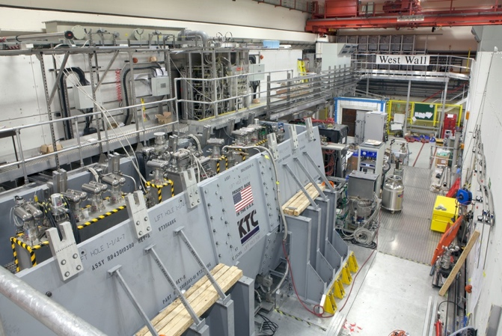
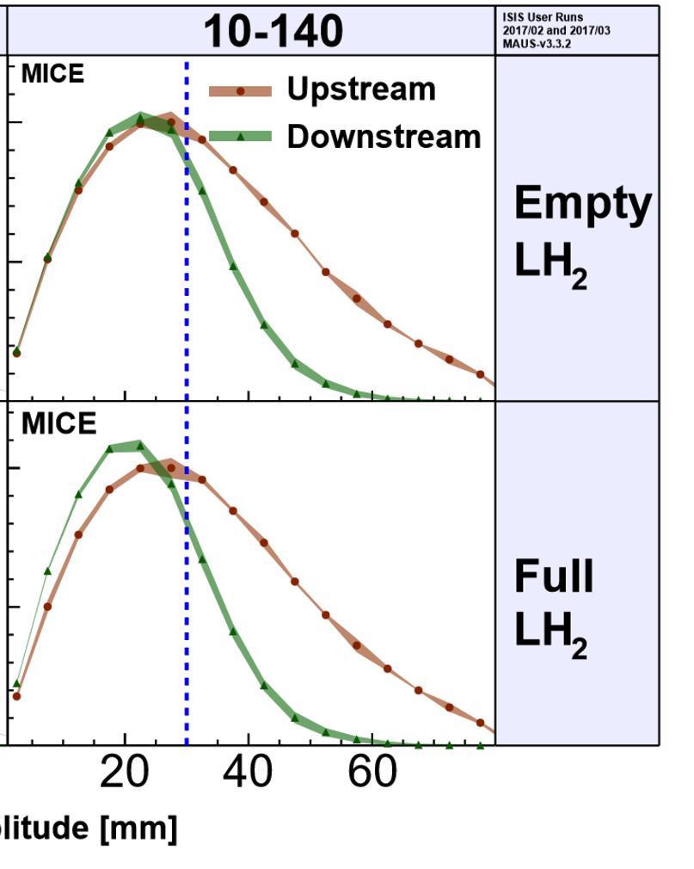
MICE: Cooling Demonstration
More particles at smaller amplitude after absorber is put in place
Nature vol. 578, p. 53-59 (2020)
More complete experiment with higher statistics, more than one stage required
Integration of magnets, RF, absorbers, vacuum is engineering challenge
Principle of ionisation cooling has been demonstrated
Use of data for benchmarking is still ongoing
WEPOPT053
40

Slide 41
Neutrino Flux
Dense neutrino flux cone can impact environment Challenge scales with E x L
Goal is to reduce to negligible level, similar to LHC
3 TeV, 200 m deep tunnel is about OK
Expand idea of Mokhov, Ginneken to move beam in aperture: move collider ring components, e.g. vertical bending with 1% of main field
14 TeV, in 200 m deep tunnel comparable to LHC case with +/- 1 mradian
scales with luminosity toward higher E
~2 x 600 m
Need to study mover system, magnet, connections and impact on beam
Working on different approaches for experimental insertion
Other optimisations are possible (magnetic field, emittance etc.)
41

Slide 42
Organisation
International Collaboration Board represents the partners
International Advisory Committee
Coordination Committee
executes the study
(only Study Leader in MoC)
Steering Board oversees study and links to regional supervision (addition to MoC)

Slide 43
Thanks
Muon Beam Panel: Daniel Schulte (CERN, chair), Mark Palmer (BNL, co-chair), Tabea Arndt (KIT), Antoine Chance (CEA/IRFU) Jean-Pierre Delahaye (retired), Angeles Faus-Golfe (IN2P3/IJClab), Simone Gilardoni (CERN), Philippe Lebrun (European Scientific Institute), Ken Long (Imperial College London), Elias Metral (CERN), Nadia Pastrone (INFN-Torino), Lionel Quettier (CEA/IRFU), Magnet Panel link, Tor Raubenheimer (SLAC), Chris Rogers (STFC-RAL), Mike Seidel (EPFL and PSI), Diktys Stratakis (FNAL), Akira Yamamoto (KEK and CERN) Contributors: Alexej Grudiev (CERN), Roberto Losito (CERN), Donatella Lucchesi (INFN)
Community conveners: Radio-Frequency (RF): Alexej Grudiev (CERN), Jean-Pierre Delahaye (CERN retiree), Derun Li (LBNL), Akira Yamamoto (KEK). Magnets: Lionel Quettier (CEA), Toru Ogitsu (KEK)‎, Soren Prestemon (LBNL), Sasha Zlobin (FNAL), Emanuela Barzi (FNAL). High-Energy Complex (HEC): Antoine Chance (CEA), J. Scott Berg (BNL), Alex Bogacz (JLAB), Christian Carli (CERN), Angeles Faus-Golfe (IJCLab), Eliana Gianfelice-Wendt (FNAL), Shinji Machida (RAL). Muon Production and Cooling (MPC): Chris Rogers (RAL), Marco Calviani (CERN), Chris Densham (RAL), Diktys Stratakis (FNAL), Akira Sato (Osaka University), Katsuya Yonehara (FNAL). Proton Complex (PC): Simone Gilardoni (CERN), Hannes Bartosik (CERN), Frank Gerigk (CERN), Natalia Milas (ESS). Beam Dynamics (BD): Elias Metral (CERN), Tor Raubenheimer (SLAC and Stanford University), Rob Ryne (LBNL). Radiation Protection (RP): Claudia Ahdida (CERN). Parameters, Power and Cost (PPC): Daniel Schulte (CERN), Mark Palmer (BNL), Jean-Pierre Delahaye (CERN retiree), Philippe Lebrun (CERN retiree and ESI), Mike Seidel (PSI), Vladimir Shiltsev (FNAL), Jingyu Tang (IHEP), Akira Yamamoto (KEK). Machine Detector Interface (MDI): Donatella Lucchesi (University of Padova), Christian Carli (CERN), Anton Lechner (CERN), Nicolai Mokhov (FNAL), Nadia Pastrone (INFN), Sergo R Jindariani (FNAL). Synergy: Kenneth Long (Imperial College), Roger Ruber (Uppsala University), Koichiro Shimomura (KEK). Test Facility (TF): Roberto Losito (CERN), Alan Bross (FNAL), Tord Ekelof (ESS,Uppsala University).
43
And the participants to the community meetings and the study

Slide 44
Other Key Studies
Review proton complex
average power of 2 MW is no problem
but merging into 5 pulses of 400 kJ per second needs to be verified
Collective effects across the whole complex to identify bottlenecks
review apertures, feedback and other specifications
  first results for aperture requirements
potential instability of interaction of muon beam with matter
Power and cost optimisation
Vacuum and absorber, instrumentation, cryogenics, …
Reuse of existing infrastructure, e.g. LHC tunnel to house accelerator
N. Milas et al. (ESS, Uppsala)
E. Metral et al. (CERN, EPFL/CHART)
J. Ferreira Somoza, M. Wendt, et al.
44

Slide 45
Initial Target Parameters
Target integrated luminosities
Note: currently focus on 10 TeV, also explore 3 TeV
Tentative parameters based on MAP study, might add margins
Achieve goal in 5 years
FCC-hh to operate for 25 years
Aim to have two detectors
Parameter | Unit | 3 TeV | 10 TeV | 14 TeV
L | 10³⁴ cm⁻²s⁻¹ | 1.8 | 20 | 40
N | 10¹² | 2.2 | 1.8 | 1.8
f_{r} | Hz | 5 | 5 | 5
P_{beam} | MW | 5.3 | 14.4 | 20
C | km | 4.5 | 10 | 14
<B> | T | 7 | 10.5 | 10.5
ε_{L} | MeV m | 7.5 | 7.5 | 7.5
σ_{E} / E | % | 0.1 | 0.1 | 0.1
σ_{z} | mm | 5 | 1.5 | 1.07
β | mm | 5 | 1.5 | 1.07
ε | μm | 25 | 25 | 25
σ_{x,y} | μm | 3.0 | 0.9 | 0.63
CLIC at 3 TeV
2 (6)
28
45

Slide 46
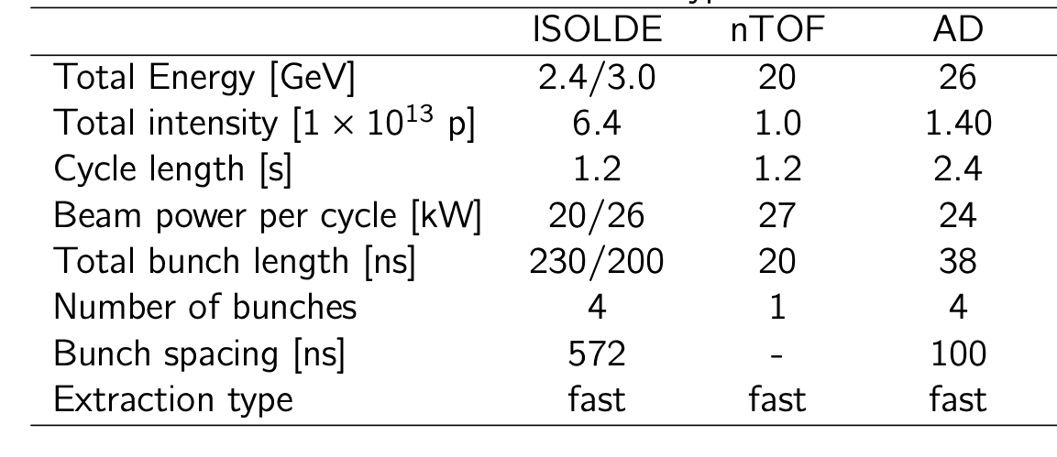
Available Power
Consider nTOF-like beam for cooling experiment
Higher power for target (and maybe cooling) tests if possible, up to O(100 kW)
If SPL were, installed could use its beam, e.g. 5 GeV, 4 MW

Slide 47
R&D Plan
The R&D plan will describe the R&D path toward the collider, in particular during the CDR phase, and will comprise the elements below.
An integrated concept of a muon cooling cell that will allow construction and testing of this key novel component.
A concept of the facility to provide the muon beam to test the cells.
An evaluation of whether this facility can be installed at CERN or another site.
A description of other R&D efforts required during the CDR phase including other demonstrators.
This R&D plan will allow the community to understand the technically limited timeline for the muoncollider development after the next ESPPU.

Slide 48
Roadmap
In aspirational scenario can make informed decisions:
Three main deliverables are foreseen:
a Project Evaluation Report for the next ESPPU will contain an assessment of whether the 10 TeV muon collider is a promising option and identify the required compromises to realise a 3 TeV option by 2045. In particular the questions below would be addressed.
  What is a realistic luminosity target?
  What are the background conditions in the detector?
  Can one consider implementing such a collider at CERN or other sites, and can it have one or two detectors?
  What are the key performance specifications of the components and what is the maturity of the technologies?
  What are the cost drivers and what is the cost scale of such a collider?
  What are the power drivers and what is the power consumption scale of the collider?
  What are the key risks of the project?
an R&D Plan that describes an R&D path towards the collider;
an Interim Report by the end of 2023 that documents progress and allows the wider community to update their view of the concept and to give feedback to the collaboration.
48

Slide 49
Minimal Scenario
Will allow partially informed decisions
No conceptual design of neutrino flux and alignment system
No alternative superconducting fast-ramping magnet system
Several collider systems would (almost) not be covered, in particular
  the linacs
  the target complex
  the proton complex
  engineering considerations of the muon cooling cells
  alternative designs for the final cooling system, acceleration, collider ring
No RF test stand would be constructed for the muon cooling accelerating cavities
No conceptual design of a muon cooling cell for the test programme
No conceptual design of a muon cooling demonstrator facility
No concept of RF power sources
No tests/models to develop solenoid technology.

Slide 50
Schedule
2023
Interim Report to gauge progress
Initial baseline defined
2025
Assessment Report
2025-2027
R&D plan will be refined
50

Slide 51
Motivation and Goal
Previous studies in US (now very strong interest again), experimental programme in UK and alternatives studies by INFN
New strong interest:
Focus on high energy with high luminosity
  10+ TeV
  potential initial energy stage (e.g. 3 TeV)
Technology and design advances
Combines precision physics and discovery reach
Discovery reach
14 TeV lepton collisions are comparable to 100-200 TeV proton collisions for production of heavy particle pairs
Luminosity goal
(Similar to L(E_{CM} > 0.99 E_{CM,0}) CLIC at 3 TeV)
4x10³⁵ cm⁻²s⁻¹ at 14 TeV
51

Slide 52
Other Key Studies
Review proton complex
average power of 2 MW is no problem
but merging into 5 pulses of 400 kJ per second needs to be verified
Collective effects across the whole complex to identify bottlenecks
review apertures, feedback and other specifications
  first results for aperture requirements
potential instability of interaction of muon beam with matter
Power and cost optimisation
Vacuum and absorber, instrumentation, cryogenics, …
Reuse of existing infrastructure, e.g. LHC tunnel to house accelerator
N. Milas et al. (ESS, Uppsala)
E. Metral et al. (CERN, EPFL/CHART)
J. Ferreira Somoza, M. Wendt, et al.
52

Slide 53
Muon Decay and Detector Background
At 10 TeV O(40 000 muons/m bunch crossing decay)
About 1/3 of energy in electrons and positrons:
Masks protect detectors from background
optimising 10 TeV design
Other mitigation
Timing (background mostly out of time
Track direction (most background from mask)
Detector design
…
Other background from incoherent pairs is also studied (addition in GUINEA-PIG)
Detailed simulation studies at 1.5/3 TeV indicate DELPHES card is realistic
studies indicate background does not increase significantly at 10 TeV (fewer decays/m)
D. Lucchesi, A. Lechner, C Carli et al.
53

Slide 54
Test Facility Dimensions
Downstream diagnostics area, 5 m
Collimation and upstream diagnostics area, 10 m
Target
+ horn (1st phase) /
+ superconducting solenoid (2nd phase)
Cooling area, 50 m
Momentum selection chicane, 10 m
Look for an existing proton beam with significant power
Different sites are being considered
CERN, FNAL, ESS are being discussed
J-PARC also interesting as option
C. Rogers

Slide 55
Possible CERN Locations
Consider nTOF-like beam from PS for cooling experiment:
1 pulse of 10¹³ p at 20 GeV per 1.2 s, i.e. 27 kW
maybe O(100kW) possible
If SPL were, installed could use its beam, e.g. 5 GeV, 4 MW
M. Calviani

Slide 56
Workpackages
Proton complex (ESS, CERN, Uppsala)
High-power linac (CERN)
Compressor ring design (ESS)
Muon production and cooling complex (UKRI, Imperial, UWAR, CERN, INFN, UMIL, ENEA)
Cooling system development (UKRI)
Target system development (CERN)
Code development (Imperial)

