Slide 1

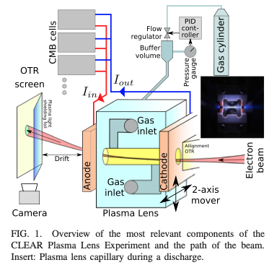
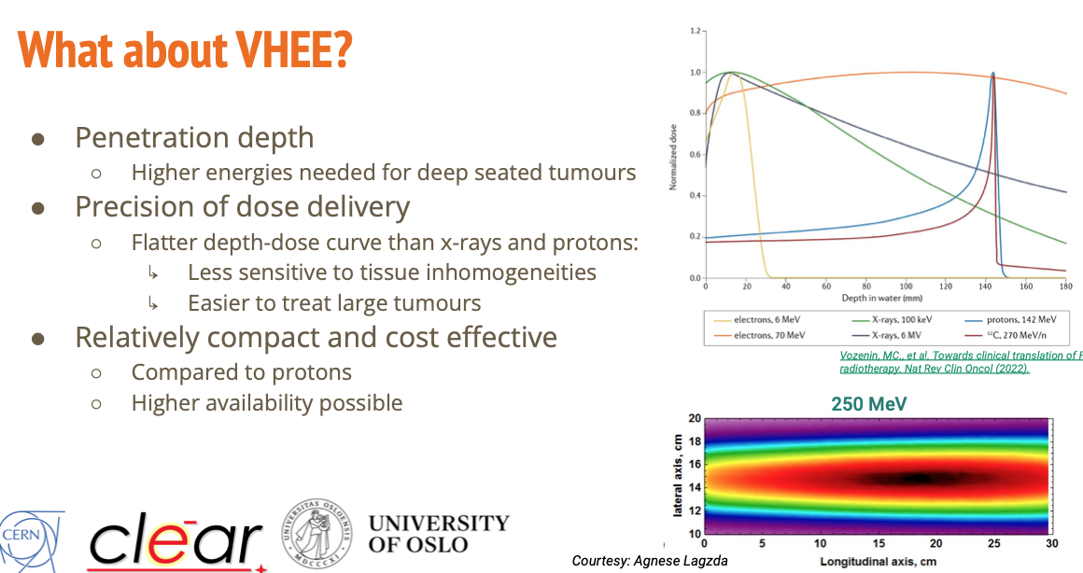
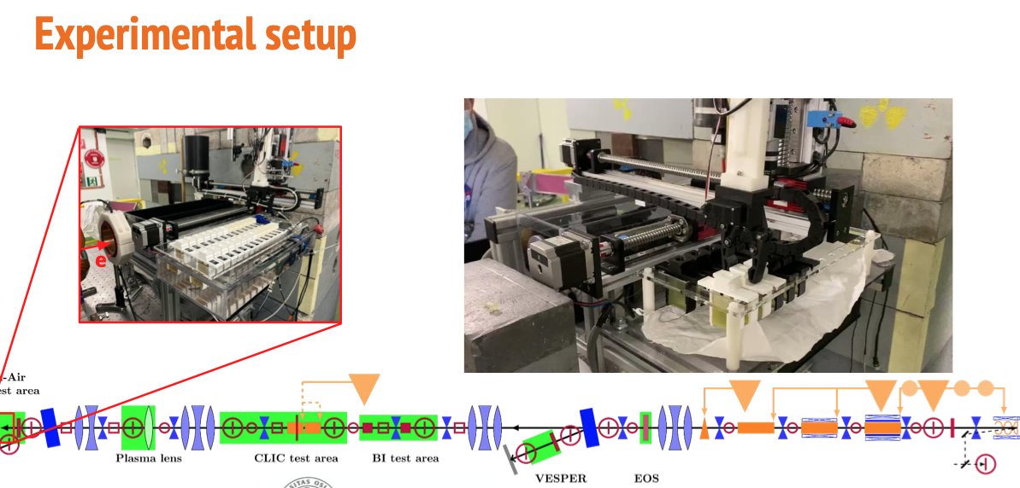
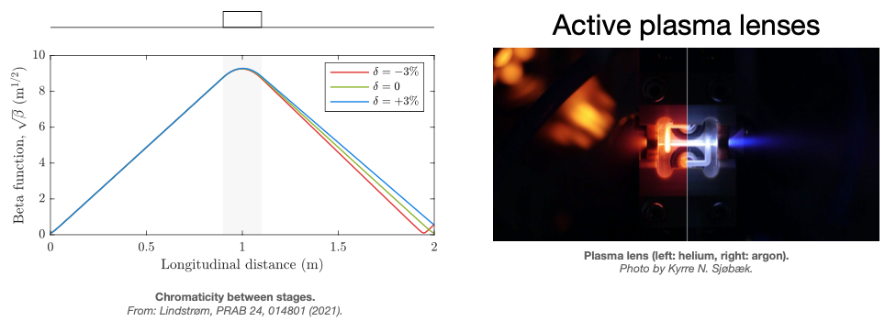
CLIC CB, Updates, University of Oslo
Prof. Erik Adli, Dec 7, 2022
Advanced accelerator
technology potentially applicable to LC
LC technology towards
medical applications
Rieker et al.,
IPAC 22, VHEE...in CLEAR
Korysko, Sjobak et al.,
IPAC 22, Updates....at CLEAR
Sjobak, Lindstrom, Adli et al.,
Phys. Rev. Accel. Beams 24, 121306 (December 2021)

