Slide 1
MP3 Quench Database
Per Hagen, CERN
Discussion topic
Improve structure & contents
Use existing data in FPA Notebooks
The apple doesn't fall far from the tree

Slide 2
MP3 data usage (as of today)
MP3 event analysis (HWC, operation)
  Is circuit and protecting subsystems (magnets, leads, QPS, PC, QHs, EE) OK for repowering?
  If Not OK, provide supporting information for subsystem experts
  Event simulation for non-trivial cases (independent activity)
  Update quench data with new event
Scientific studies
  Quench behavior and statistics (“holy grail” of SC magnets!)
  Prediction of future quenches in training campaigns
  Risk analysis (probability of having to warm-up sector for repair of equipment, or damaging “delicate” equipment hard to replace)
Other “MP3” data not related to quench (not topic of this presentation)
  ELQA circuit health qualifications, transfer functions, “shorts”
  Evolution of splice R in magnets and busbars (special HWC tests)
Difficult to know what event parameters can be of importance for future studies!

Slide 3
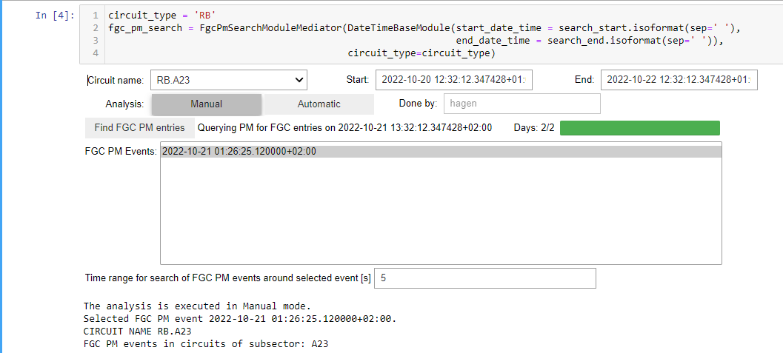

How we do FPA today
Run SWAN FPA Notebook for a single event (trip, quench)
html report
generated
copy & paste
from .csv
no plot zoom
MP3 excel quench file
lock file when updating

Slide 4
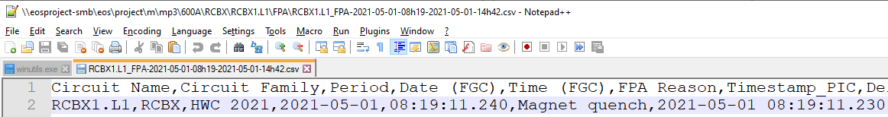
Excel specific problems!
Discussion topic. I am not the Oracle of Delphi so I do not have all the answers!
We experienced one or more file corruptions during HWC
  For this reason, and secondly, I am not sure about the IT doing backup on a regular basis, I make snapshot backups once in a while when there is MP3 activity going on: \\eosproject-smb\eos\project\m\mp3\QuenchFilesBackup
File sometimes remains locked after update
  Fortunately Excel tells who the person locking the file is. I have learnt to live with this problem. It “mainly” delays the propagation from Notebook .csv to Excel. This can be a real problem if next person to analyse needs the data!
Excel date/time formats
  We use ISO 8601 recommendations in the .csv made by the FPA Notebooks to avoid ambiguity. So far so good. Still we need to use the Excel special copy&paste values to have the same formatting as in the previous row. I remember documenting this year(s) ago. Last, but not least, the data is still there in any case so I reformat stuff when I see something strange.

Slide 5
Excel and OneDrive strategy
Discussion topic. I am not the Oracle of Delphi and here I am without answers!
Long term future of our Microsoft OneDrive website as a collaborative tool???
Simply migrate files to EOS where we have all the Notebook reports in any case (consistent approach) ???
Remember Monty Python 1971: And Now for Something Completely Different
Relational database???
Something already exists off the shelf (inside CERN)???
We need:
  Update of a single event from Notebook FPA or manually for exceptions
  Browse and edit web user interface
  Download selection of data to [Excel, PowerPoint, analytic tools]
This problem can also be seen in the context of signal monitoring and storing of is derived data (like busbar R evolution). Store into NXCALS and extract via TIMBER into analytic tools???

Slide 6
External applications RB use case
During operation: interlock history gives “big picture”
Energy Extraction must be checked with PM Powering Playback

Slide 7
External applications 600 A use case
Many cases with red “flags” because U_DUMP_RES based upon theoretical calculated curves (does not consider current, quenchback, timing tolerances?)
Serious problems with EE are very rare or perhaps non-existent so we often alert EE experts for no good reason!

Slide 8
FPA parameters collected (today)
Take RB as “use case”. All others are essentially subsets / variants.
Circuit name, type, date+time, period: HWC, Operation
PIC time and PM timing wrt PIC: ∆t(FGC), ∆t(EE_{ODD,EVEN})
Circuit parameters for start of FPA:
  I, ∆I/dt or t_{plateau,} Û_{EEODD,EVEN}
  Analyser: FPA reason, Quench # in circuit if HWC, Comments
Circuit parameters during FPA:
  MIITS: 10⁶ ∫I²dt
  Î_{earth}
  Analyser: EE OK? VF OK?
For each quenched magnet:
  Cell, QPS crate, t_{pic}, ∆t(iQPS), ∆t(nQPS), # in event, QH OK?
  I_{magnet,} aperture (EXT/INT)
  ∆U_QS0/dt, Û_{symm,} ∆Û_{symm}/dt (last 2 not implemented!)
  Analyser: QDS trigger, quench # in circuit if HWC
  R_{max_diode_leads @} I_{diode_leads}
Notebook + API versions
Magnet data (MB #, SC cable types, SM18 I_{1st_q}) using cell lookup

Slide 9

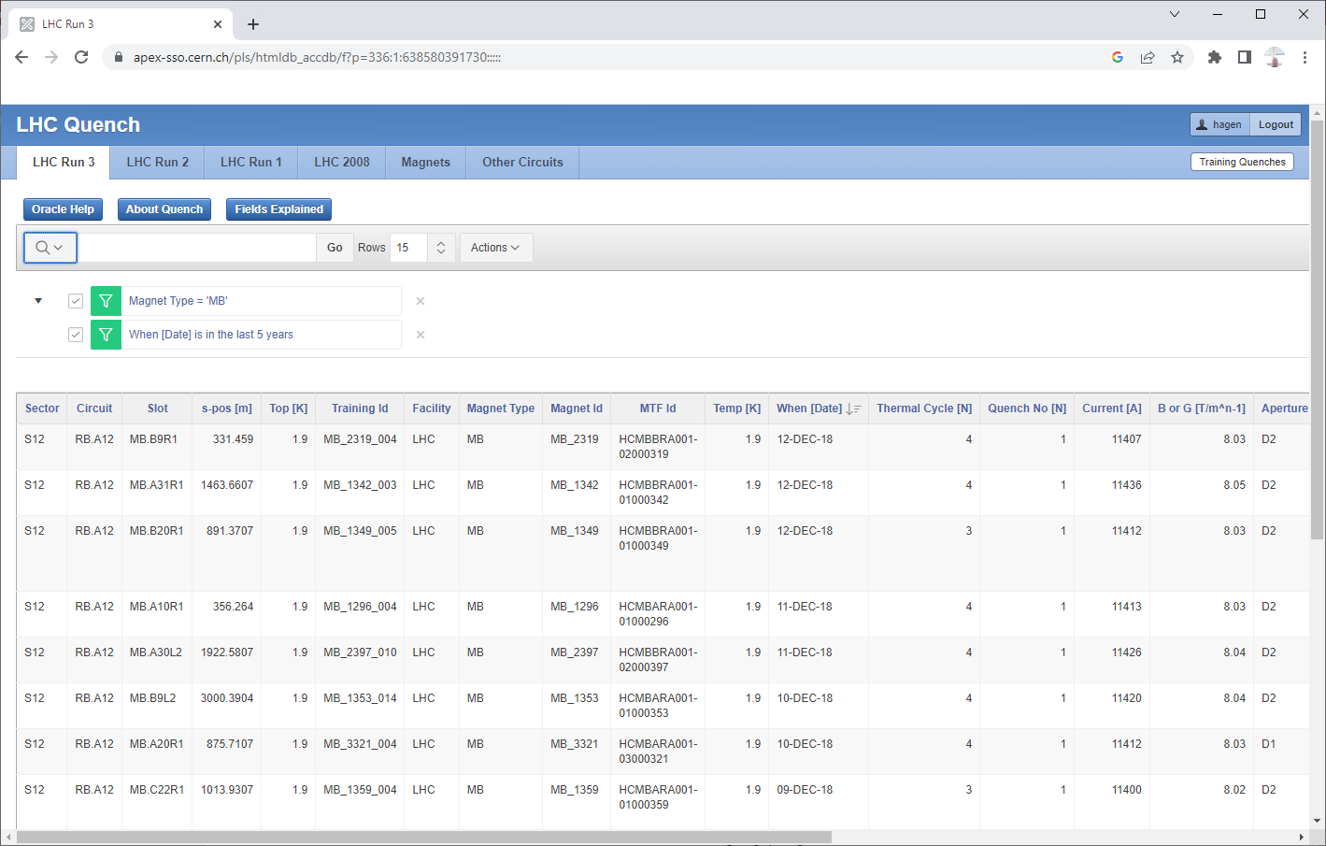
FPA parameters (continued)
Take RB as “use case”. All others are essentially subsets / variants.
Look in layout sheet if we want to know the magnet in cell as function of time
Filter in RB sheet if we want to know the (quench) history as function of time. SM18 quenches in another Excel dump from Oracle.
( next slide )

Slide 10
http://cern.ch/lhc-quench
Showing a small subset of data so more columns available.
Updated until 2020 with help of Excel Visual Basic code

Slide 11
FPA data improvements since end of HWC
Missing old data in Notebook FPA format (general problem):
  FPA Notebooks developed for the LS2 HWC (> 2020)
  I have collected RB FPA data for Run 2 after a few simple code modifications (nQPS buffers often created long time after event and sometimes missing)
  In progress: Code modifications for RB FPA Run 1 and hopefully all the way back to 2007
  But collecting RB FPA data is so far manual work *
In progress: Correction of ∆U_{res}/dt for IPQ quench file thanks to new algorithm and automation work by Zinur, Lena, Ola …
* Quote from Forrest Gump movie 1994:
”My mama always said, life is like a box of chocolates. You never know what you're gonna get.”

Slide 12


Now it is your turn!
In a democratic world we must learn to live with our different view of things
Improve structure & contents of FPA Notebooks
Use existing data in FPA Notebooks

