Slide 1
Welcome to the
MP3 day 2022
1 Dec 2022, CCC
Indico: https://indico.cern.ch/event/1222548/
About 25 participants from MP3, OP, EPC, EE, ELQA, QPS, PIC, CB
7 presentations and 3 breaks, with lots of time for discussion
Wrap-up HWC 2011: https://indico.cern.ch/event/129805/
MP3 review 2015: https://indico.cern.ch/event/384361/

Slide 2
Aim:
Learn from last HWC campaign
Ideas for further automation of analysis
Improve / smoothen future HWC campaigns and operation
Define our software needs for the coming years
Magnet training: Lessons from the past & idea for the future
Output:
List the action points and suggestions for the coming 1-2 years, for ourselves but also for other groups/teams (EE, ELQA, EPC, QDS, OP, etc)

Slide 3
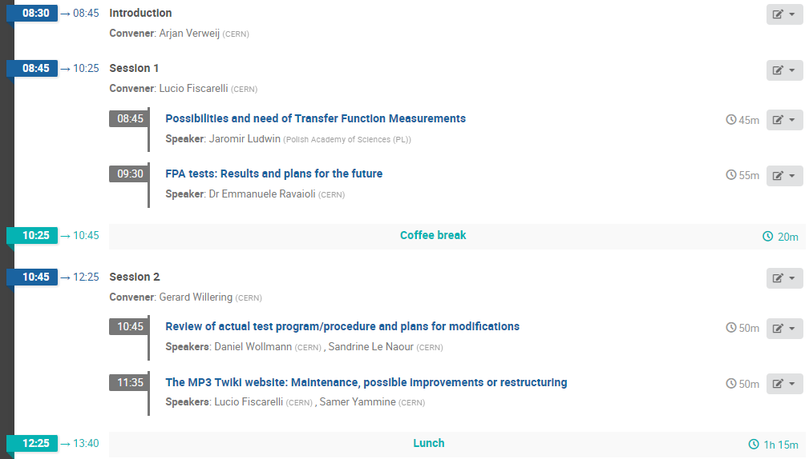
Agenda

Slide 4
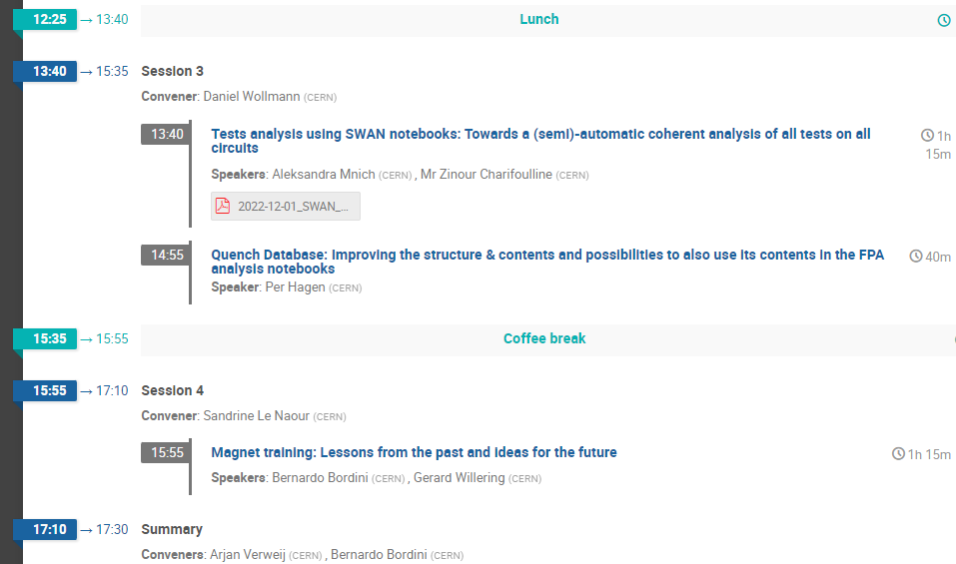
Agenda

Slide 5
Have a nice day
Ask lots of questions
All ideas are welcome

