Slide 1
Cultivating a Growth Mindset
October 31st 2022
Catarina Batista & Romain Muller

Slide 2
It’s time to reconfigure your environment

Slide 3
Getting Hammered!
Notes:
What can you use a hammer for?
3 rounds of 15-30 seconds each.
Sharing different rounds at the end.

Slide 4
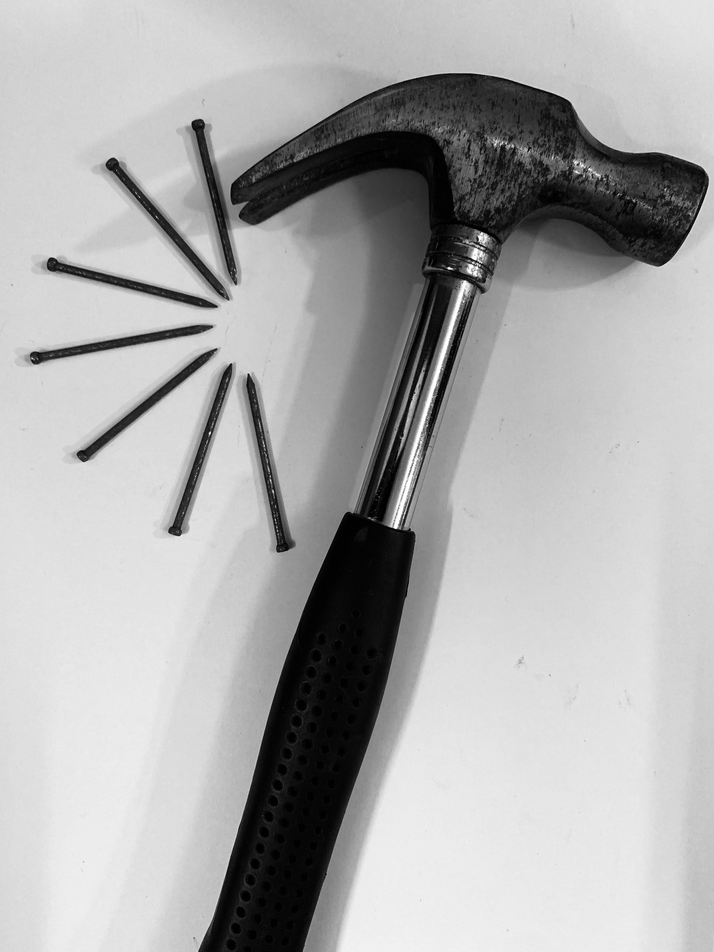
Functional Fixedness
Tendency to see the functions of different objects in the way you usually use them.
Blocks our ability to see its utility for other purposes.
Many problems might require the problem-solver to use an object in the solution in an unusual way.
Photo by DevVrat Jadon on Unsplash
Notes:
Representation can have a strong in􀃗uence on how easy or hard it is for you to solve problems. One of the
reasons you have dif􀃖culty with certain problems is functional 􀃖xedness. Functional 􀃖xedness refers to the
tendency to see the functions of different objects, tools and so on in the way you usually use them. For
example, you normally use hammers to drive nails into wood, but they can just as well serve as
paperweights, or as doorstops. Having a well-learned use for an object does not only make it easy to decide
to use that object as a tool for its normal use, it also blocks your ability to see its utility for other purposes;
you become 􀃖xed on its normal function. Many problems take advantage of this by requiring the problemsolver
to use an object in the solution in an unusual way.

Slide 5
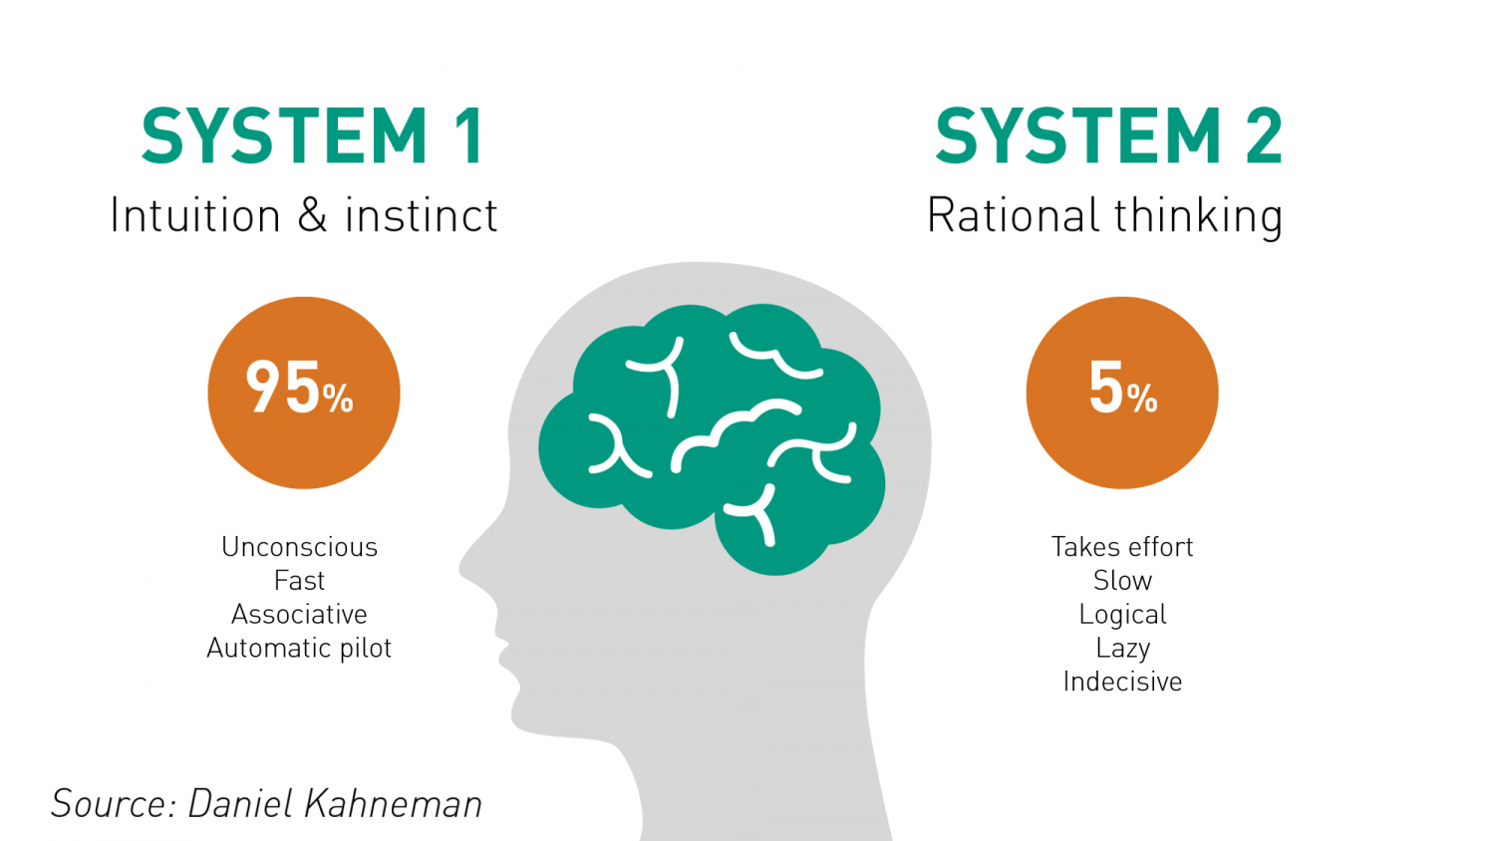
2 systems
https://www.rogerleishman.com/2017/12/thing1.html

Slide 6
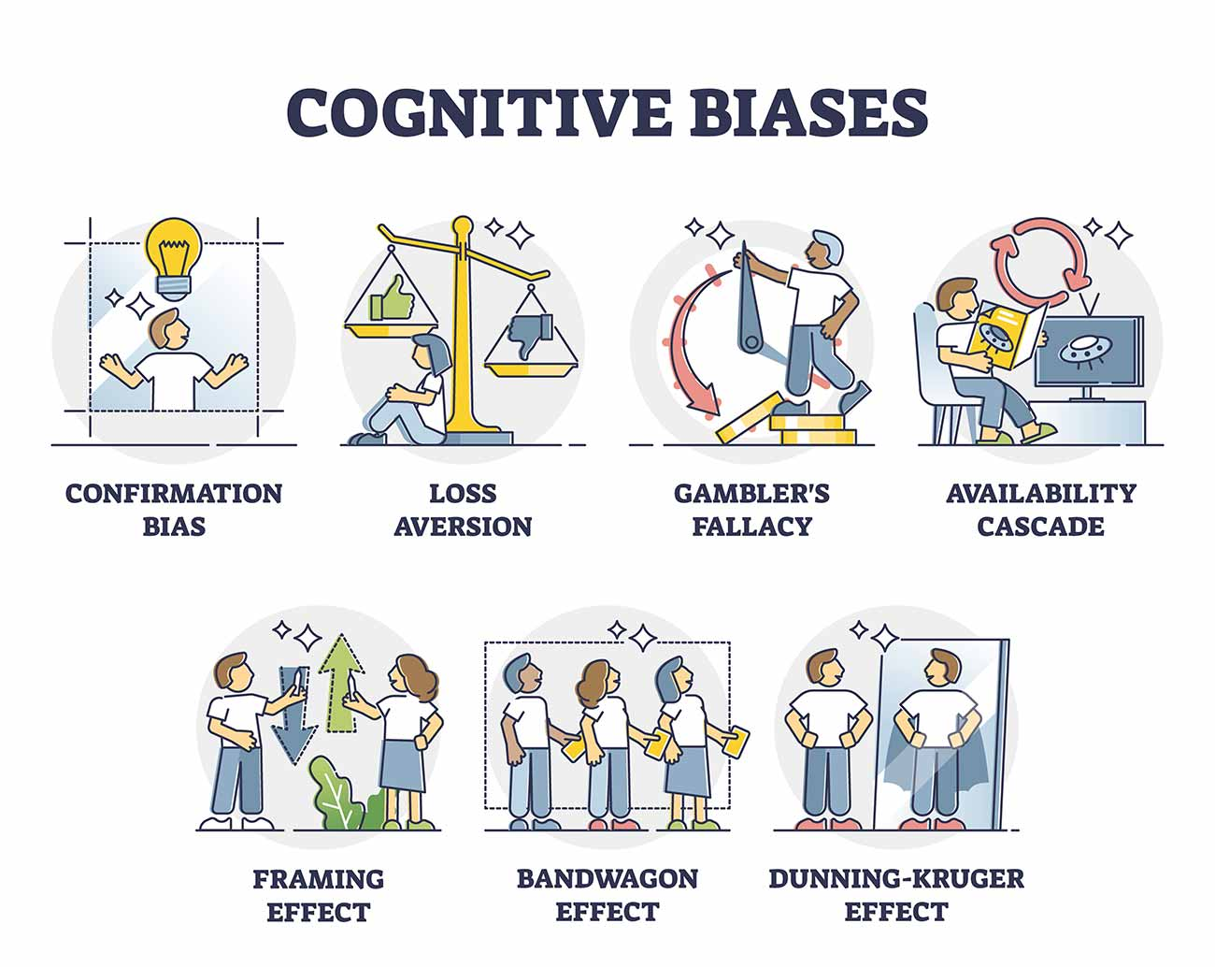
Biases
Graphic from: https://www.simplypsychology.org/cognitive-bias.html

Slide 7
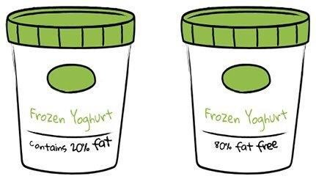

Slide 8

Bounded rationality
We are constantly making decisions with insuffiencient data, information, abilities and memory.
We need to select which information we should collect and prioritize it.
Our decision process is bounded by practical, often cognitive, factors (Simon,1957).
Photo by Katya Korovkina on Unsplash
Notes:
Herbert Simon 1957
Known and unknown (benefit of being okay with the unknown)

Slide 9
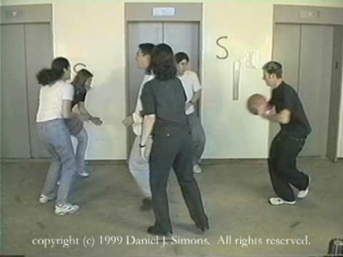
Selective attention
Notes:
How do we make decisions?
Selective attention

Slide 10

How can we get better at solving problems and driving disruptive solutions?
Not doing “business as usual” requires more than conventional thinking…
Photo by Adam Nieścioruk on Unsplash

Slide 11
How can we get better at solving problems and driving disruptive solutions?
Engaging in practices that kick up our System 2 and make us look at problems in a different light.
Taking a step back to look at the bigger picture.
Cultivating a growth mindset.
Photo by Adam Nieścioruk on Unsplash

Slide 12
Growth mindset
What does growth mindset mean and why is it important?

Slide 13
“Mindset change is not about picking up a few pointers here and there. It's about seeing things in a new way.“
Dr. Carol Dweck, Mindset: The New Psychology of Success

Slide 14

What does “mindset” mean?
“…a mindset is a set of assumptions, methods, or notions held by one or more people or groups of people. ” (Cambridge English Dictionary)
“in cognitive psychology, a mindset represents the cognitive processes activated in response to a given task” (French, 2016)
Photo by Bekir Dönmez on Unsplash
Notes:
“A mindset may be so firmly established that it creates a powerful incentive within these people or groups to continue to adopt or accept prior behaviors, choices, or tools. The latter phenomenon is also sometimes described as mental inertia, "groupthink", and it is often difficult to counteract its effects upon analysis and decision making processes.”
https://en.wikipedia.org/wiki/Mindset#cite_note-2

Slide 15

Growth Mindset
“Why waste time proving over and over how great you are, when you could be getting better?”
Photo by Jeremy Bishop on Unsplash
Notes:
“In a growth mindset, people believe that their most basic abilities can be developed through dedication and hard work—brains and talent are just the starting point. This view creates a love of learning and a resilience that is essential for great accomplishment” (Dweck, 2015).

Slide 16
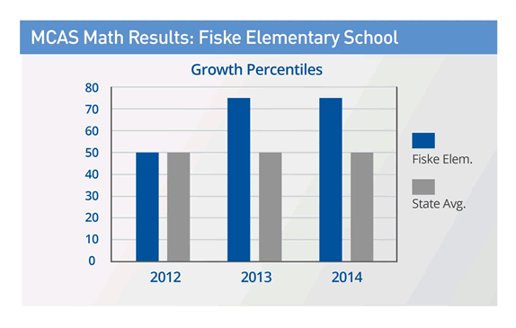
Case Study: Fiske Elementary School
https://www.mindsetworks.com/science/Case-Studies
Notes:
Fiske Elementary School
Lexington, Massachusetts
Download the Fiske Case Study
Fiske Case Study.pdf
(PDF 320 KB)
School Profile
Fiske Elementary School is a school with 350 students in grades K-5, located in the Metro West suburbs of Boston. Despite its location in an affluent community of Wellesley, Fiske is a diverse school due to its status as a magnet school for the district’s English language learners and its proximity to the town’s low-income housing complex. Hence, Fiske is diverse with respect to socio-economics, language learning, and special education status.
Case Study of MindsetMaker™
THE CHALLENGE
How to best provide student feedback and praise to a diverse student population as a way to encourage greater student effort, resulting in gains in academic achievement.
Overarching Goals
The Fiske School staff wanted to leverage teacher praise to close the achievement gap with high needs students (ELL, SPED, minority populations, and low income).
Action Plan
The plan started with a small staff-led team who had previously developed and implemented an anti-bullying initiative throughout the school in 2011-12. An incoming principal who had done some preliminary work on growth mindset in another school district embraced this group’s work. Together, the group saw the connections between growth mindset and anti-bullying initiatives, and they decided to share their work with the school.
In the first year, in addition to a whole school book study on Mindset, teachers engaged in professional development sessions using components of the LeaderKit™. That first year, the focus was on changing teacher praise from performance-based to effort-based. Teachers practiced changing their language, and were supported by observations and feedback sessions from the principal. Data was collected, and teachers were encouraged by initial results, so they sought out more resources and tools to keep learning and improving.
In the second year, the MindsetMaker™ Online Professional Development course was used to deepen the work. At grade level meetings, in the teachers' lounge, and throughout the hallways, staff discussed and questioned common teaching practices. The schools' new common vocabulary was forged from language presented in the videos, articles, and activities Fiske teachers engaged in with MindsetMaker™.
RESULTS
Both teacher-reported student growth and standardized test gains were powerful. Student growth percentile in math MCAS scores rose dramatically in 2013 and were maintained in 2014. Typical average growth in the state is 50 points, but in Fiske, student growth percentile was an average of 75.5 and the growth was maintained in 2014 across all fourth and fifth grade students. Just recently in 2016, Fiske learned that they are one of 39 schools that are being commended by the state for "high achievement, high progress or narrowing the proficiency gap." This means that Fiske made significant progress in moving students to proficiency as indicated by MCAS scores.
CONCLUSION
At Fiske, growth mindset discussions and continued professional development have become part of the school culture. In developing annual teacher goals, teachers often reference a growth mindset as part of their approach. The growth mindset culture has paid off in collegiality, student learning and achievement gains, and in closing the achievement gap.
https://www.mindsetworks.com/science/Case-Studies

Slide 17

Case Study: Chicago High School

Slide 18
The power of ”not yet”
“If you get a failing grade, you think, „I’m nothing, I’m going nowhere.“ But if you get the grade ‘not yet’, you understand that you’re on a learning curve. It gives you a path into the future.”
Dweck, 2014
Notes:
https://fs.blog/2015/03/carol-dweck-mindset/
https://onedublin.org/2012/06/19/stanford-universitys-carol-dweck-on-the-growth-mindset-and-education/
https://www.youtube.com/watch?v=-71zdXCMU6A

Slide 19
2 truths and
1 “not yet”

Slide 20






Fixed mindset
Avoid challenges
See effort as fruitless or worse
Feel threatened by the success of others
Ignore useful negative feedback
Give up easily
Intelligence is static/ desire to look smart
Notes:
Icons made by <a href="https://www.flaticon.com/authors/smashicons" title="Smashicons">Smashicons</a> from <a href="https://www.flaticon.com/" title="Flaticon"> www.flaticon.com</a>

Slide 21
Fixed mindset
Avoid challenges
See effort as fruitless or worse
Feel threatened by the success of others
Ignore useful negative feedback
Give up easily
Intelligence is static/ desire to look smart
Growth mindset
Persist in the face of setbacks
Learn from criticism
Intelligence can be developed/ desire to learn
Embrace challenges
Find lessons and inspiration in the success of others
See effort as the path to mastery
Adapted from Two Mindsets graphic by Nigel Holmes
Notes:
Making the reflection about where each individual stands on the mindset spectrum; where your team stands in the spectrum.
Connection to the fact that we will never simply be on the fixed or growth side, it is not linear and we will always be challenged in our personal and professional lives (triggers, team conflitcts, etc).
Icons made by <a href="https://www.flaticon.com/authors/smashicons" title="Smashicons">Smashicons</a> from <a href="https://www.flaticon.com/" title="Flaticon"> www.flaticon.com</a>

Slide 22
Notes:
It’s not about the environment or what is happening arounds us, is about we perceive it and frame it.
How can we best support ourselves and each other in our growth journey? (as a prompt for movement exercise).

Slide 23
Fixed mindset
Avoid challenges
See effort as fruitless or worse
Feel threatened by the success of others
Ignore useful negative feedback
Give up easily
Intelligence is static/ desire to look smart
Growth mindset
Persist in the face of setbacks
Learn from criticism
Intelligence can be developed/ desire to learn
Embrace challenges
Find lessons and inspiration in the success of others
See effort as the path to mastery
Adapted from Two Mindsets graphic by Nigel Holmes
Notes:
Making the reflection about where each individual stands on the mindset spectrum; where your team stands in the spectrum.
Connection to the fact that we will never simply be on the fixed or growth side, it is not linear and we will always be challenged in our personal and professional lives (triggers, team conflitcts, etc).
Icons made by <a href="https://www.flaticon.com/authors/smashicons" title="Smashicons">Smashicons</a> from <a href="https://www.flaticon.com/" title="Flaticon"> www.flaticon.com</a>

Slide 24

Lateral Thinking
Reframing
set of processes & tools to think creatively
taking a new perspective into a complex problem

Slide 25
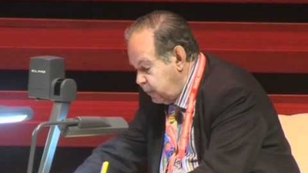

Slide 26
Lateral thinking
set of processes & tools to think creatively
Notes:
What can you use a hammer for?
3 rounds of 15-30 seconds each.
Sharing different rounds at the end.

Slide 27


Lateral thinking
Notes:
Velcro was invented by George de Mestral in 1941 and was inspired by the burrs he found on himself and on his dog. Being an engineer and entrepreneur, Mr. de Mestral examined the burr under a microscope and realized the small hooks of the burr and loops of the fur/fabric allowed the burr to adhere exceedingly well. This sparked his idea to mimic the structure as a potential fastener. The words velours (French for loop) and crochet (French for hook) were combined to start the Velcro company in 1959. Since then, Velcro has become integrated into daily life and has revolutionized the fastener industry.¹
https://www.microphotonics.com/biomimicry-burr-invention-velcro/

Slide 28

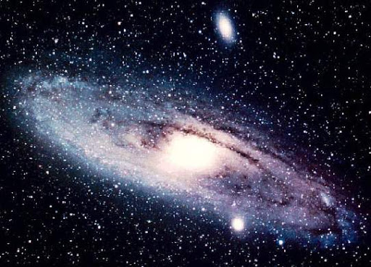
Lateral Thinking
Notes:
Johannes Kepler – invented astrophisycs
Gentner. D et al 1997, ‘Analogy and Creativity in the Works of Johannes Kepler‘

Slide 29
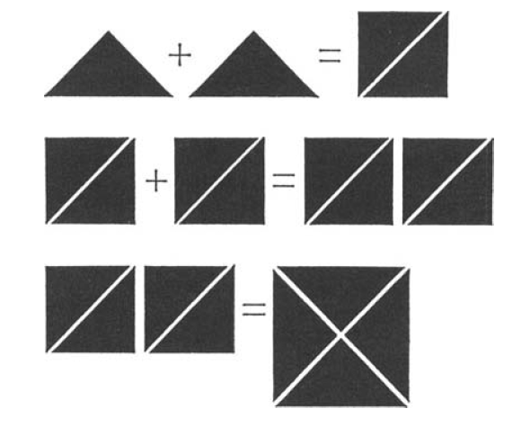
Lateral Thinking
Vertical thinking is analytical, lateral thinking is provocative.
Approaching problems from an unusual direction.
Often envolves drawing connections from different fields.
Set of processes & tools to think unconventionally.
De Bono, 2016

Slide 30
Some Methods of Lateral Thinking
Random Entry Idea Generating Tool
Provocation Idea Generating Tool
Movement Techniques
Challenge
Concept Formation
Disproving
Fractionation
De Bono, Edward (1992)¹⁰
Notes:
Random Entry Idea Generating Tool[edit]
The thinker chooses an object at random, or a noun from a dictionary and associates it with the area they are thinking about. De Bono exemplifies this through the randomly-chosen word, "nose", being applied to an office photocopier, leading to the idea that the copier could produce a lavender smell when it was low on paper.^{[7]}
Provocation Idea Generating Tool[edit]
Further information: Po (lateral thinking)
A provocation is a statement that we know is wrong or impossible but used to create new ideas. De Bono gives an example of considering river pollution and setting up the provocation, "the factory is downstream of itself", causing a factory to be forced to take its water input from a point downstream of its output, an idea which later became law in some countries.^{[8]} Provocations can be set up by the use of any of the provocation techniques—wishful thinking, exaggeration, reversal, escape, distortion, or arising. The thinker creates a list of provocations and then uses the most outlandish ones to move their thinking forward to new ideas.
Movement Techniques[edit]
The purpose of movement techniques is to produce as many alternatives as possible in order to encourage new ways of thinking about both problems and solutions. The production of alternatives tends to produce many possible solutions to problems that seemed to only have one possible solution.^{[9]} One can move from a provocation to a new idea through the following methods: extract a principle, focus on the difference, moment to moment, positive aspects or special circumstances.
Challenge[edit]
A tool which is designed to ask the question, "Why?", in a non-threatening way: why something exists or why it is done the way it is. The result is a very clear understanding of "Why?", which naturally leads to new ideas. The goal is to be able to challenge anything at all, not those that are problematic. For example, one could challenge the handles on coffee cups: The reason for the handle seems to be that the cup is often too hot to hold directly; perhaps coffee cups could be made with insulated finger grips, or there could be separate coffee-cup holders similar to beer holders, or coffee shouldn't be so hot in the first place.^{[9]}
Concept Formation[edit]
Ideas carry out concepts. This tool systematically expands the range and number of concepts in order to end up with a very broad range of ideas to consider.^{[9]}
Disproving[edit]
Based on the idea that the majority is always wrong (as suggested by Henrik Ibsen^{[10]} and by John Kenneth Galbraith^{[11]}), take anything that is obvious and generally accepted as "goes without saying", question it, take an opposite view, and try to convincingly disprove it. This technique is similar to de Bono's "Black Hat" of Six Thinking Hats, which looks at identifying reasons to be cautious and conservative.
Fractionation

Slide 31
Some Methods of Lateral Thinking
Random Entry Idea Generating Tool
involves picking a random word (usually a noun) or an image and following its associations until you find new ideas that can be applied to your problem.
https://randomwordgenerator.com/
Provocation Idea Generating Tool
A statement that we know is wrong or impossible but is used to create new ideas. Provocations can be set up using any of the provocation techniques—wishful thinking, exaggeration, reversal, escape, distortion, or arising.
De Bono, Edward (1992)¹⁰
Notes:
Random Entry Idea Generating Tool[edit]
The thinker chooses an object at random, or a noun from a dictionary and associates it with the area they are thinking about. De Bono exemplifies this through the randomly-chosen word, "nose", being applied to an office photocopier, leading to the idea that the copier could produce a lavender smell when it was low on paper.^{[7]}
Provocation Idea Generating Tool[edit]
Further information: Po (lateral thinking)
A provocation is a statement that we know is wrong or impossible but used to create new ideas. De Bono gives an example of considering river pollution and setting up the provocation, "the factory is downstream of itself", causing a factory to be forced to take its water input from a point downstream of its output, an idea which later became law in some countries.^{[8]} Provocations can be set up by the use of any of the provocation techniques—wishful thinking, exaggeration, reversal, escape, distortion, or arising. The thinker creates a list of provocations and then uses the most outlandish ones to move their thinking forward to new ideas.

Slide 32
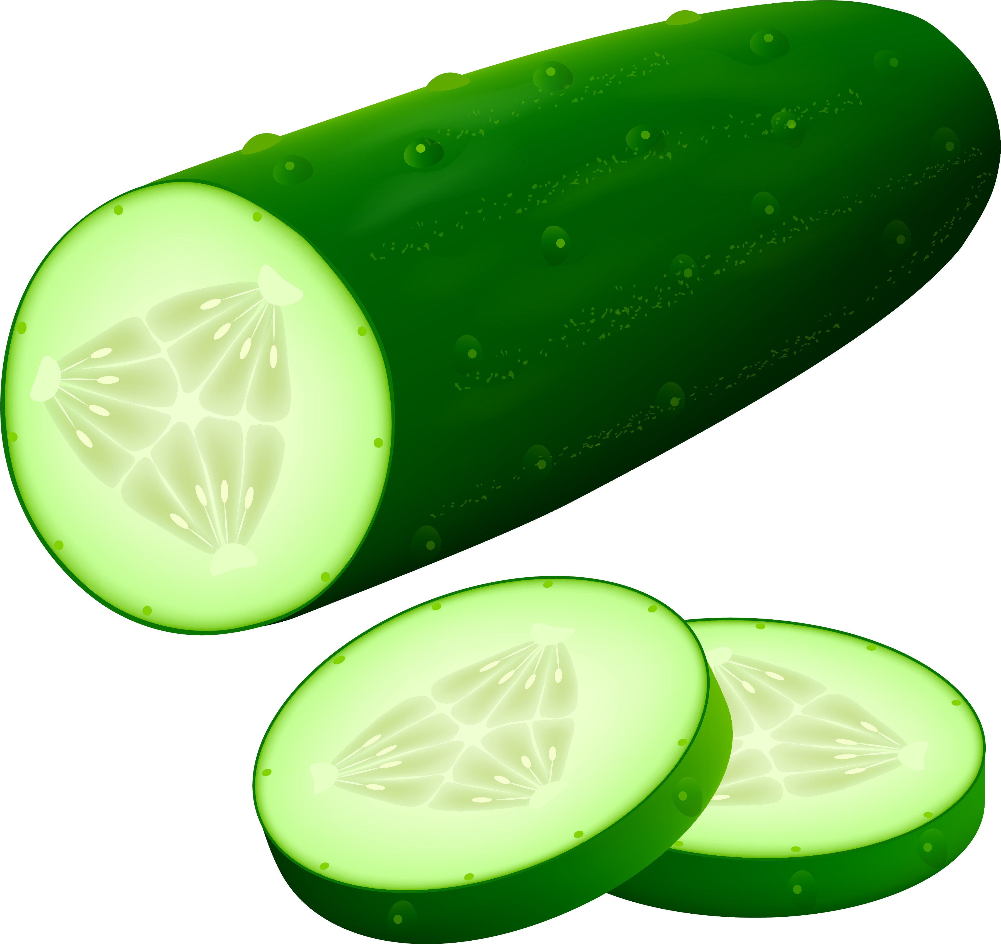
Some Methods of Lateral Thinking
Random Entry Idea Generating Tool
involves picking a random word (usually a noun) or an image and following its associations until you find new ideas that can be applied to your problem.
https://randomwordgenerator.com/
Provocation Idea Generating Tool
A statement that we know is wrong or impossible but is used to create new ideas. Provocations can be set up using any of the provocation techniques—wishful thinking, exaggeration, reversal, escape, distortion, or arising.
De Bono, Edward (1992)¹⁰
Notes:
Random Entry Idea Generating Tool[edit]
The thinker chooses an object at random, or a noun from a dictionary and associates it with the area they are thinking about. De Bono exemplifies this through the randomly-chosen word, "nose", being applied to an office photocopier, leading to the idea that the copier could produce a lavender smell when it was low on paper.^{[7]}
Provocation Idea Generating Tool[edit]
Further information: Po (lateral thinking)
A provocation is a statement that we know is wrong or impossible but used to create new ideas. De Bono gives an example of considering river pollution and setting up the provocation, "the factory is downstream of itself", causing a factory to be forced to take its water input from a point downstream of its output, an idea which later became law in some countries.^{[8]} Provocations can be set up by the use of any of the provocation techniques—wishful thinking, exaggeration, reversal, escape, distortion, or arising. The thinker creates a list of provocations and then uses the most outlandish ones to move their thinking forward to new ideas.

Slide 33
Some Methods of Lateral Thinking
Random Entry Idea Generating Tool
involves picking a random word (usually a noun) or an image and following its associations until you find new ideas that can be applied to your problem.
https://randomwordgenerator.com/
Provocation Idea Generating Tool
A statement that we know is wrong or impossible but is used to create new ideas. Provocations can be set up using any of the provocation techniques—wishful thinking, exaggeration, reversal, escape, distortion, or arising.
De Bono, Edward (1992)¹⁰
Notes:
Random Entry Idea Generating Tool[edit]
The thinker chooses an object at random, or a noun from a dictionary and associates it with the area they are thinking about. De Bono exemplifies this through the randomly-chosen word, "nose", being applied to an office photocopier, leading to the idea that the copier could produce a lavender smell when it was low on paper.^{[7]}
Provocation Idea Generating Tool[edit]
Further information: Po (lateral thinking)
A provocation is a statement that we know is wrong or impossible but used to create new ideas. De Bono gives an example of considering river pollution and setting up the provocation, "the factory is downstream of itself", causing a factory to be forced to take its water input from a point downstream of its output, an idea which later became law in some countries.^{[8]} Provocations can be set up by the use of any of the provocation techniques—wishful thinking, exaggeration, reversal, escape, distortion, or arising. The thinker creates a list of provocations and then uses the most outlandish ones to move their thinking forward to new ideas.

Slide 34
But… I’m not a kid or a teenager anymore… how can this still be true for me?
Probably what you’re thinking right now

Slide 35

Neuroplasticity!
ability of neural networks in the brain to change through growth and reorganization
  e.g. circuit and network changes from learning a new ability, environmental influences, practice, and psychological stress
many aspects of the brain can be altered (or are "plastic") even through adulthood.
Notes:
Is ability of neural networks in the brain to change through growth and reorganization. These changes range from individual neurons making new connections, to systematic adjustments like cortical remapping.
once thought by neuroscientists to manifest only during childhood, but
Learning languages, playing musical instruments!

Slide 36
Reframing
taking a new perspective into a complex problem
Notes:
What can you use a hammer for?
3 rounds of 15-30 seconds each.
Sharing different rounds at the end.

Slide 38
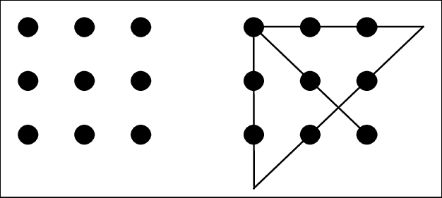
9 Dot Problem
Connect all 9 dots
Use only 4 lines
Don‘t lift the pen after you start drawing

Slide 39
9 Dot Problem
To solve it, we need to literally think outside the box…

Slide 40
5 + 5 = ?
Notes:
This is a problem that has one right answer

Slide 41
? + ? = 10
Notes:
Take the same mathconcept and ask it this way, you end up having infinite number of solutions // You went from one answer to an infinite number of answers

Slide 42

How to design a new bridge?

Slide 43
“If I had an hour to solve a problem, I'd spend 55 minutes thinking about the problem and 5 minutes thinking about solutions.”
Albert Einstein

Slide 44
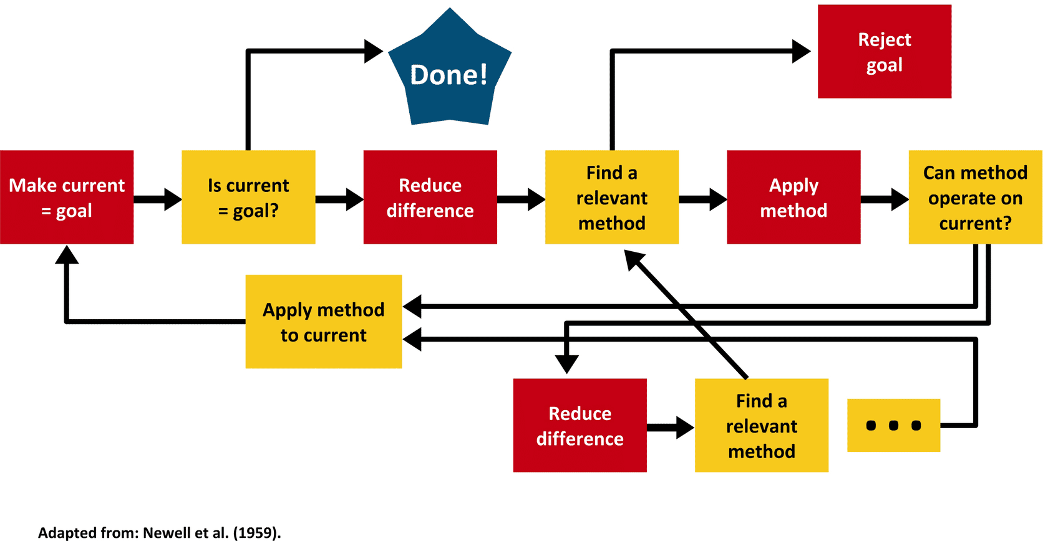

Slide 45
It is not about solving the problem right, but solving the right problem!
Work problem
Problem
Representation

Slide 46
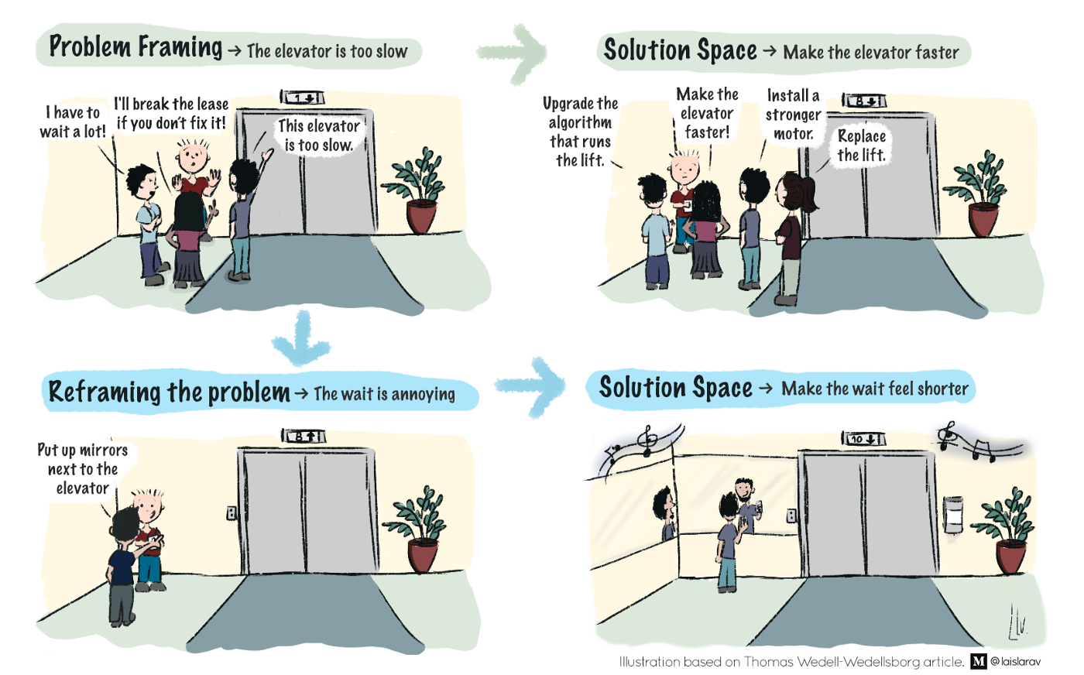

Slide 47
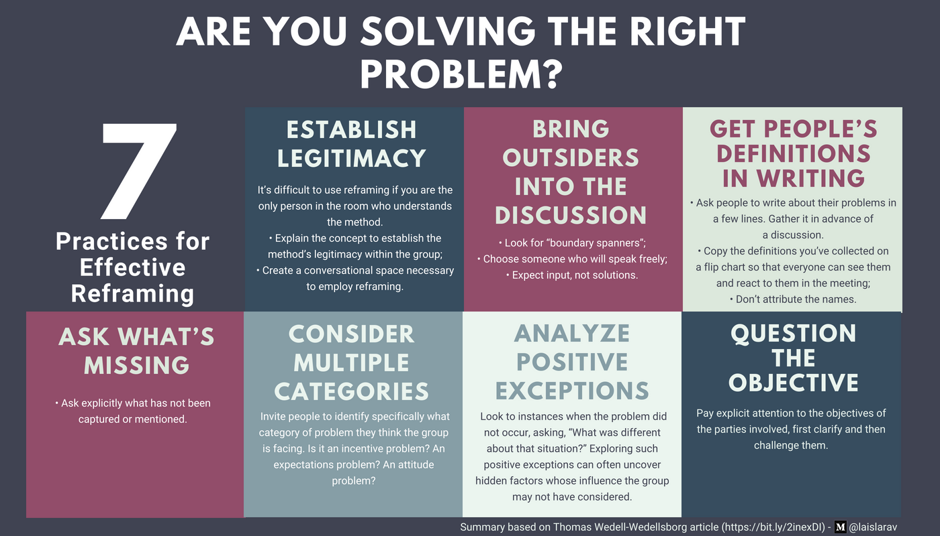
https://hbr.org/2017/01/are-you-solving-the-right-problems

Slide 48


Who reframed?
What if people could watch TV and movies anytime anywhere?
What if you could get an affordable, on-demand chauffeur and not need cash?

Slide 49

In summary…
Stop and look at the bigger picture.
Think - how you can shift your perspective?
Challenge your mind –listen to things you disagree with, talk to strangers, cultivate lateral thinking…
Photo by Raphaël LR on Unsplash

Slide 50
How can you look at your technology differently?
Notes:
What can you use a hammer for?
3 rounds of 15-30 seconds each.
Sharing different rounds at the end.

Slide 51
Sources (not complete)
"MINDSET - meaning in the Cambridge English Dictionary". Retrieved 2019-12-10.
French, R. P. II. (2016). The fuzziness of mindsets: Divergent conceptualizations and characterizations of mindset theory and praxis. International Journal of Organizational Analysis, 24(4), 673–691. https://doi.org/10.1108/IJOA-09-2014-0797
The power of believing you can improve, Dweck C. 2014 https://www.ted.com/talks/carol_dweck_the_power_of_believing_that_you_can_improve
Stanford University's Carol Dweck on the Growth Mindset and Education". OneDublin.org. 2012-06-19.
De Bono, 2016. https://www.edwddebono.com/lateral-thinking
De Bono, Edward (1992). Serious creativity: using the power of lateral thinking to create new ideas. HarperBusiness. p. 145.

