Slide 1
Thinking in Systems
December 15th 2022
Catarina Batista

Slide 2
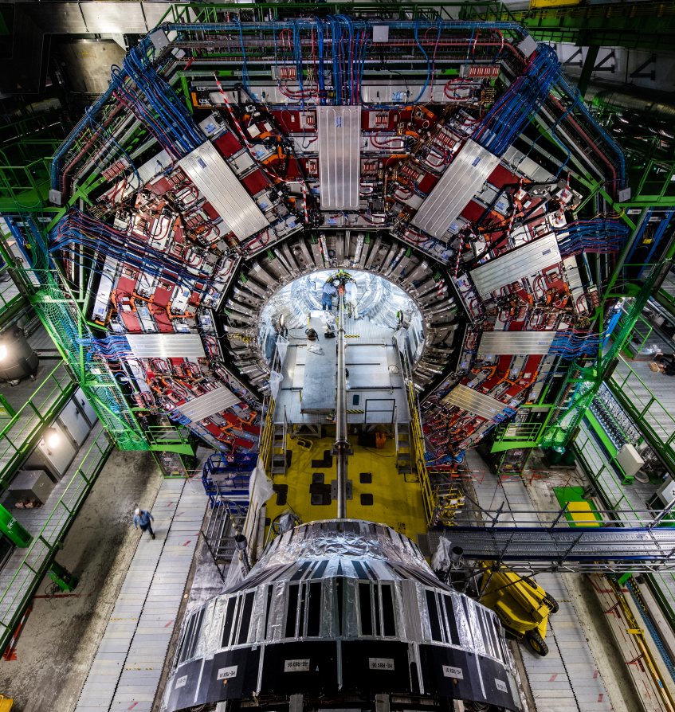
Business as usual is not in our DNA, but we also don’t want any “magic”…
Ideas should be disruptive, without:
Breaking the laws of physics;
Causing more harm than good.

Slide 3
Our specialties
Order of magnitude thinking (+ estimations!)
    - Ideas should be disruptive enough to generate excitement
    - While also having a substantial basis behind - “Do the math”
Systemic and Exponential thinking
    Going for exponential ideas
    Thinking in planetary levels
    Nothing is so great that there is nothing bad: what are the implications of your solution?

Slide 4
Solving complex problems in times of change

Slide 5
…why does the world seem to be getting more complex?

Slide 6
Because entropy is our natural state
Entropy is a scientific concept as well as a measurable physical property that is most commonly associated with a state of disorder, randomness, or uncertainty.
(that’s from Wikipedia)

Slide 7
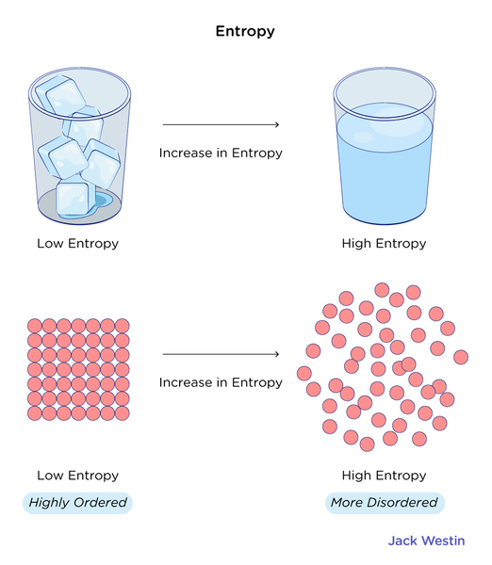
https://jackwestin.com/resources/mcat-content/energy-changes-in-chemical-reactions/second-law-concept-of-entropy

Slide 8
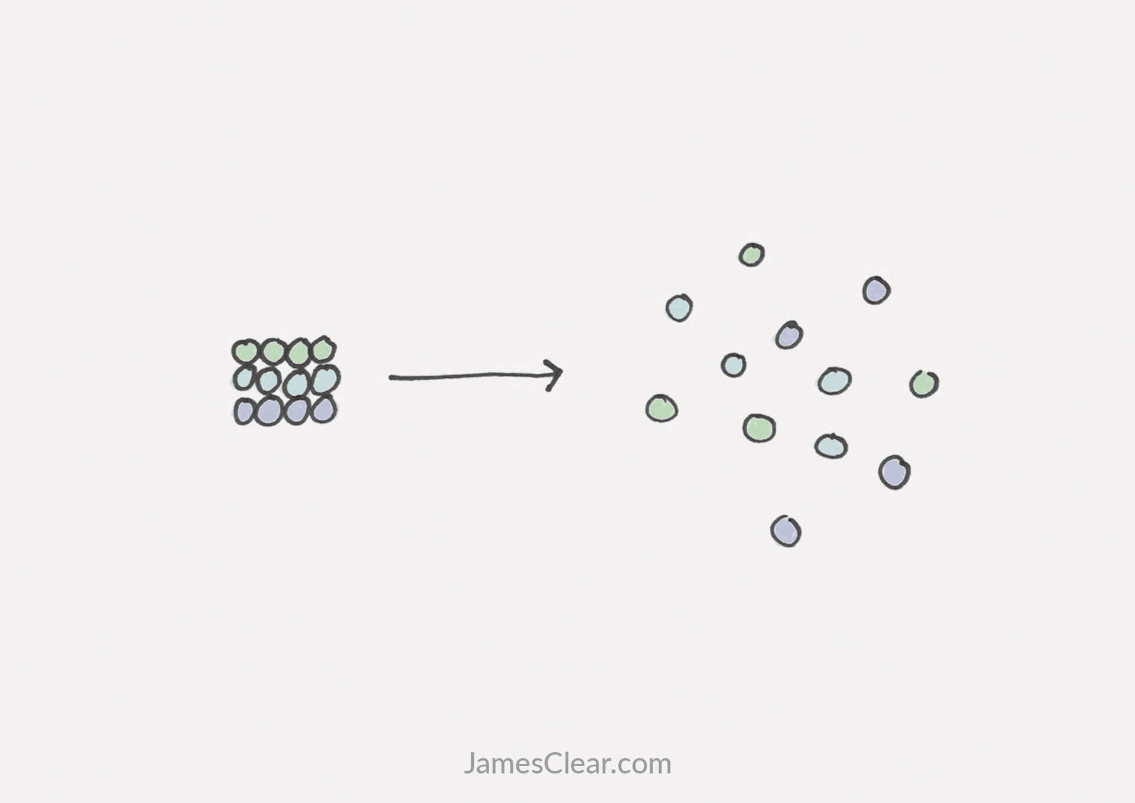
https://jamesclear.com/entropy

Slide 10

Some examples of complex problems
Climate change
Homelessness
Integrated healthcare
Smart cities
Poverty
Gender equality
…
Notes:
https://www.eur.nl/en/master/governance-and-management-public-sector/examples

Slide 11
To tackle them, we need to adapt our ways of thinking/working
Unprecedented complexity and fluidity of problems and systems.
This rapidly changing world demands skills that can connect new ideas and work across contexts. Epstein (2019, p. 53. 107)
Drawing conclusions from experience is no longer sufficient.
“Survival of the Most Fluid“ Mlodinow, L. (2018)
Relying on experience from a single field can be disastrous. Epstein (2019, p. 53. 107)
There are no fixed rules, it is up to us to derive them and they change without notice. Epstein (2019, p. 31)
Notes:
We are dealing with unprecedented complexity and fluidity of problems and systems.
Drawing conclusions from experience is no longer sufficient when we are constantly faced with novel and ambiguous issues.
There are no fixed rules, it is up to us to derive them and even then they change without notice. Epstein (2019, p. 31)²
„…what a rapidly changing, wicked world demands – conceptual reasoning skills that can connect new ideas and work across contexts.“Epstein (2019, p. 53. 107)³
Relying on experience from a single field can be disastrous. Epstein (2019, p. 53. 107)³
„Survival of the Most Fluid“ Mlodinow, L. (2018)⁴

Slide 12
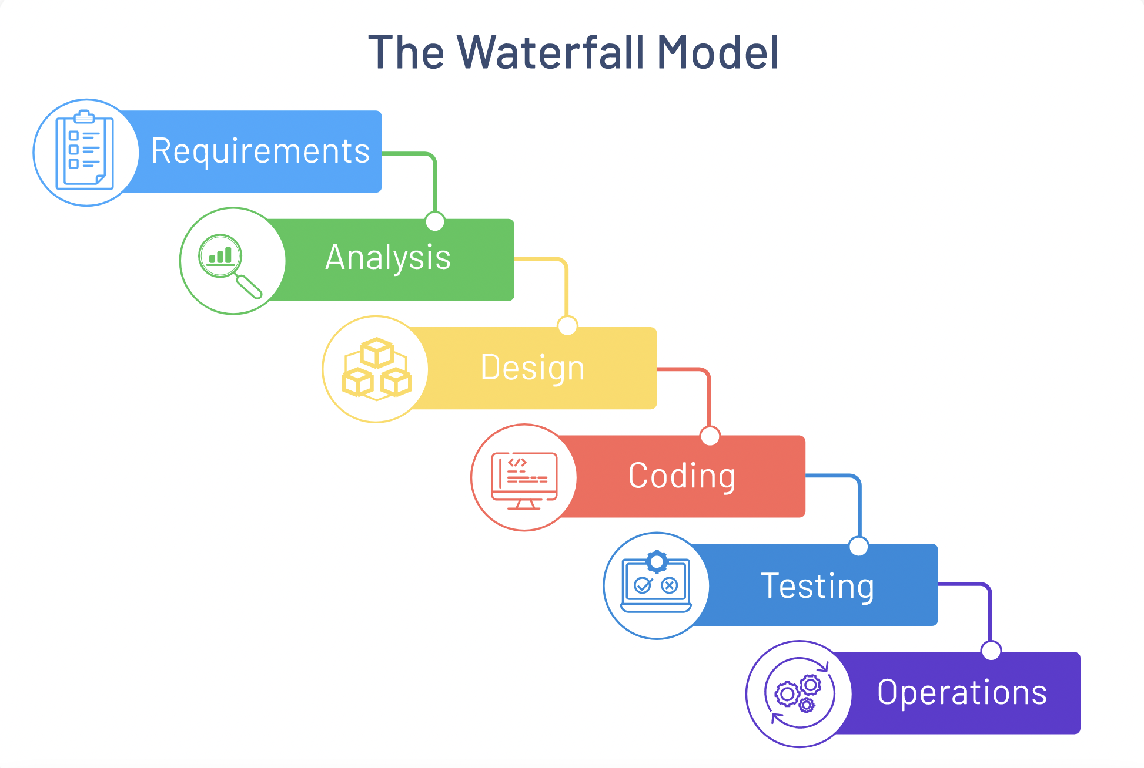

Slide 13
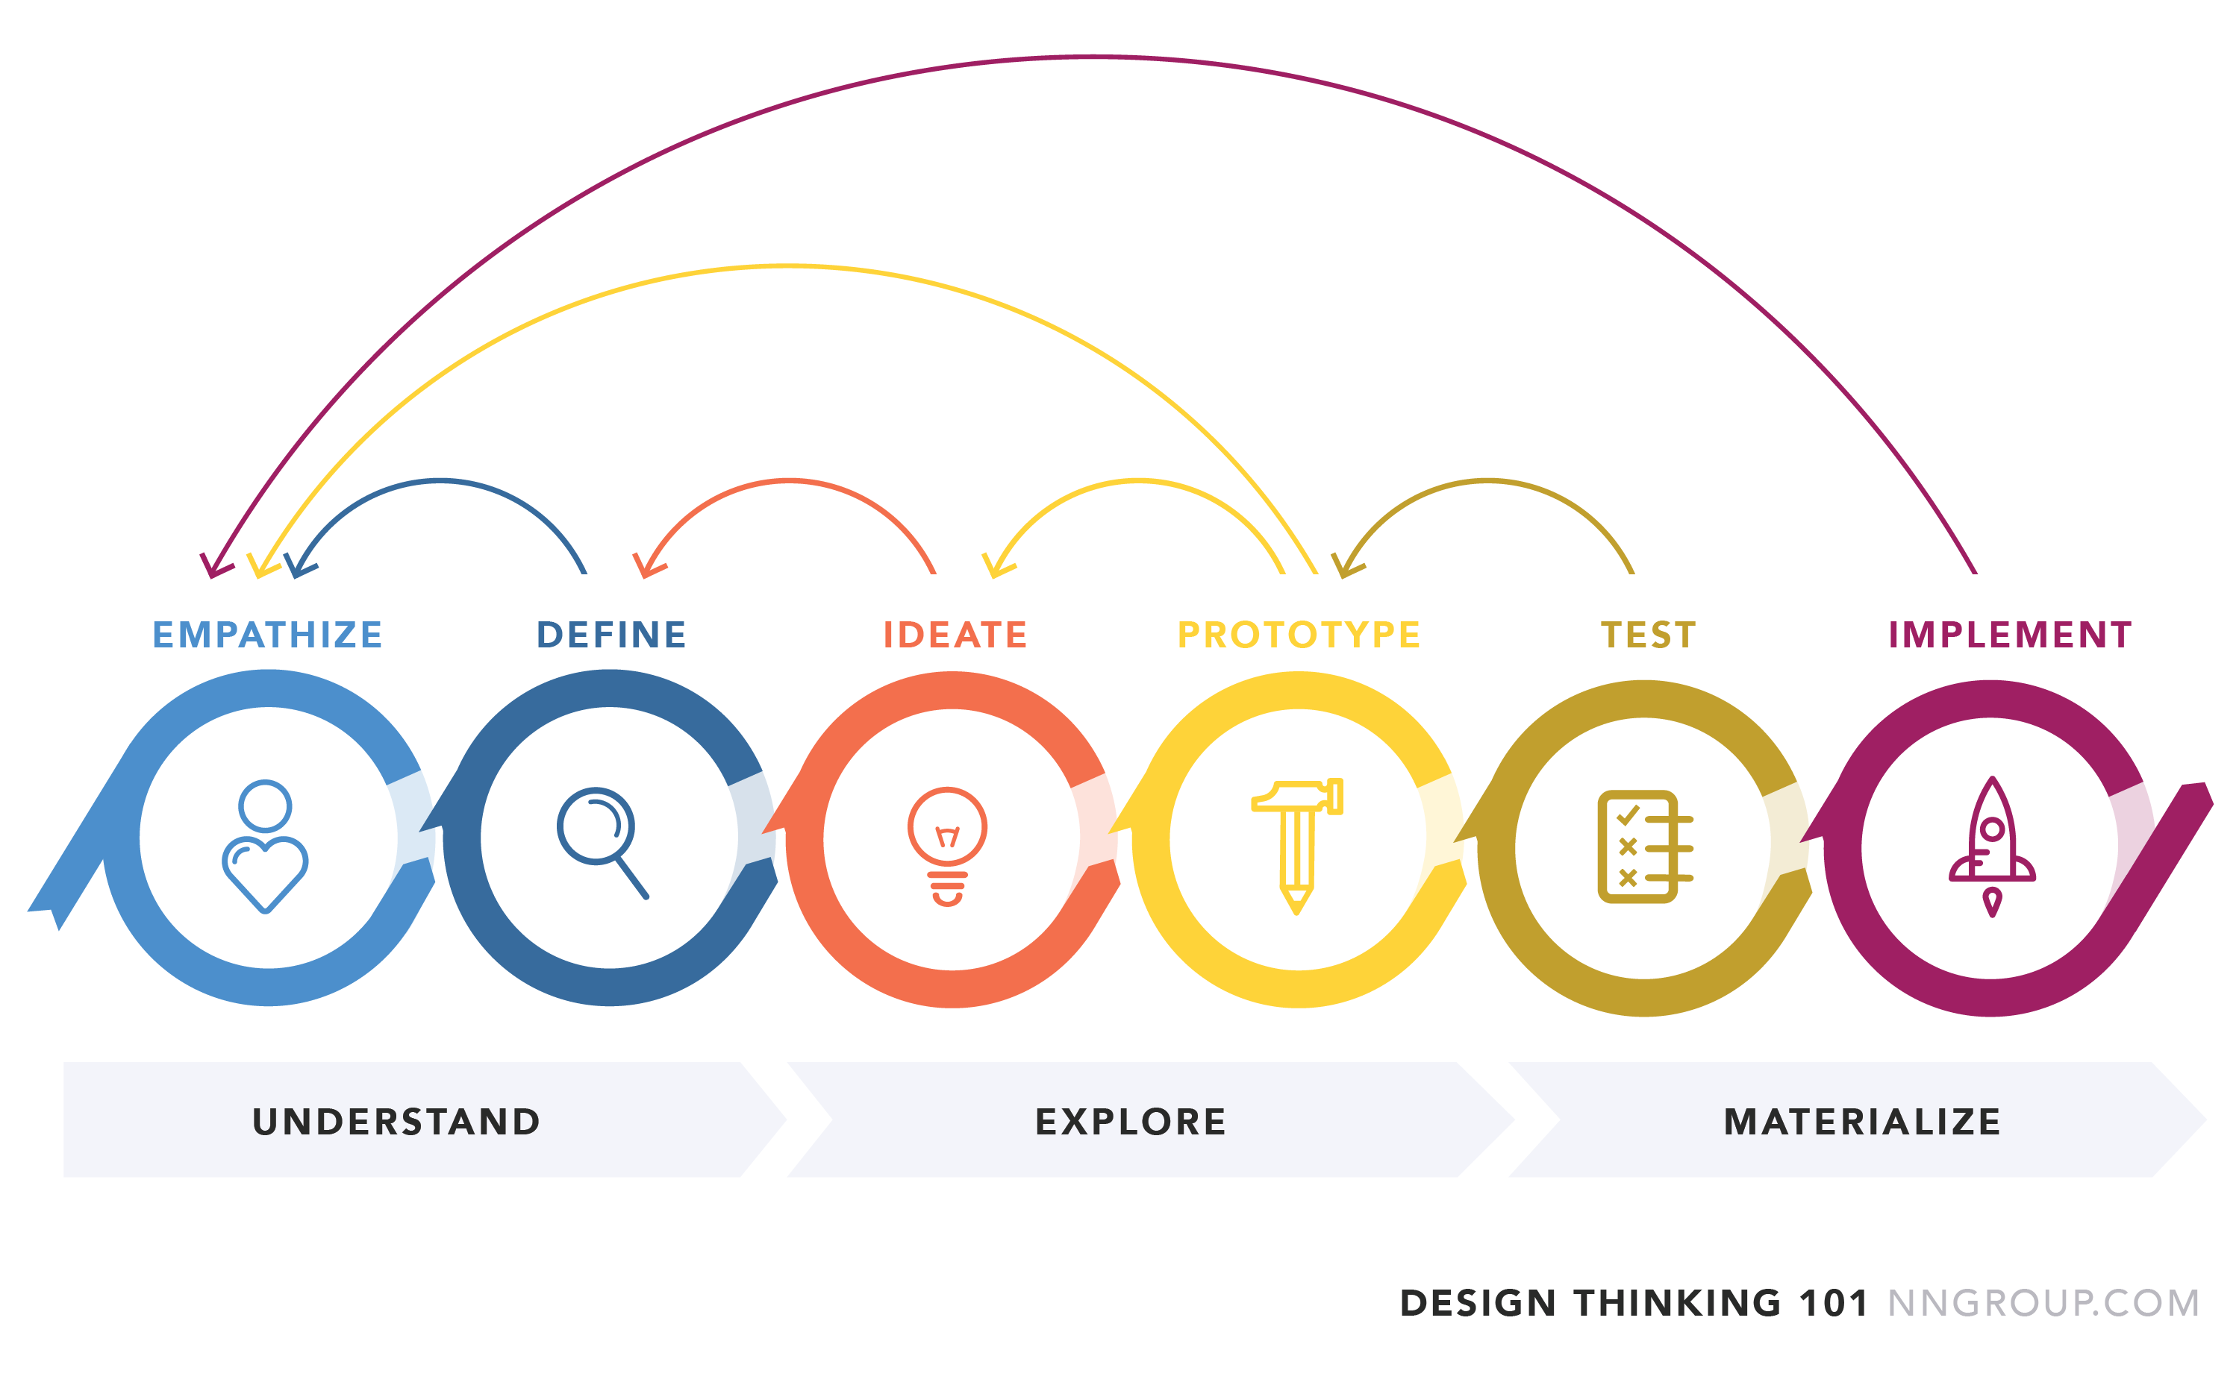

Slide 14
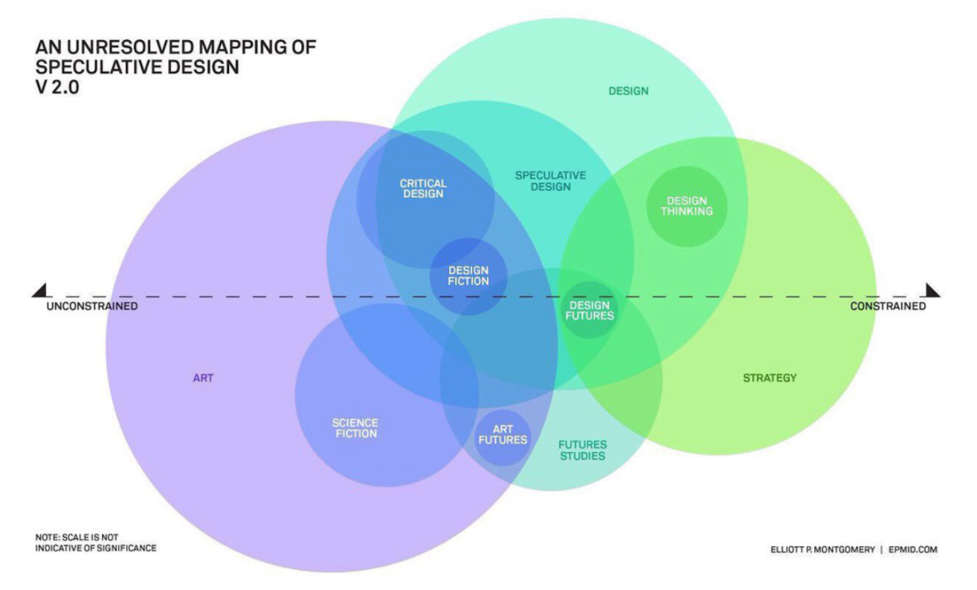




Image source: https://i.ytimg.com/vi/BMmmDJCcBDU/maxresdefault.jpg

Slide 15


Product-
Service
System

Slide 16
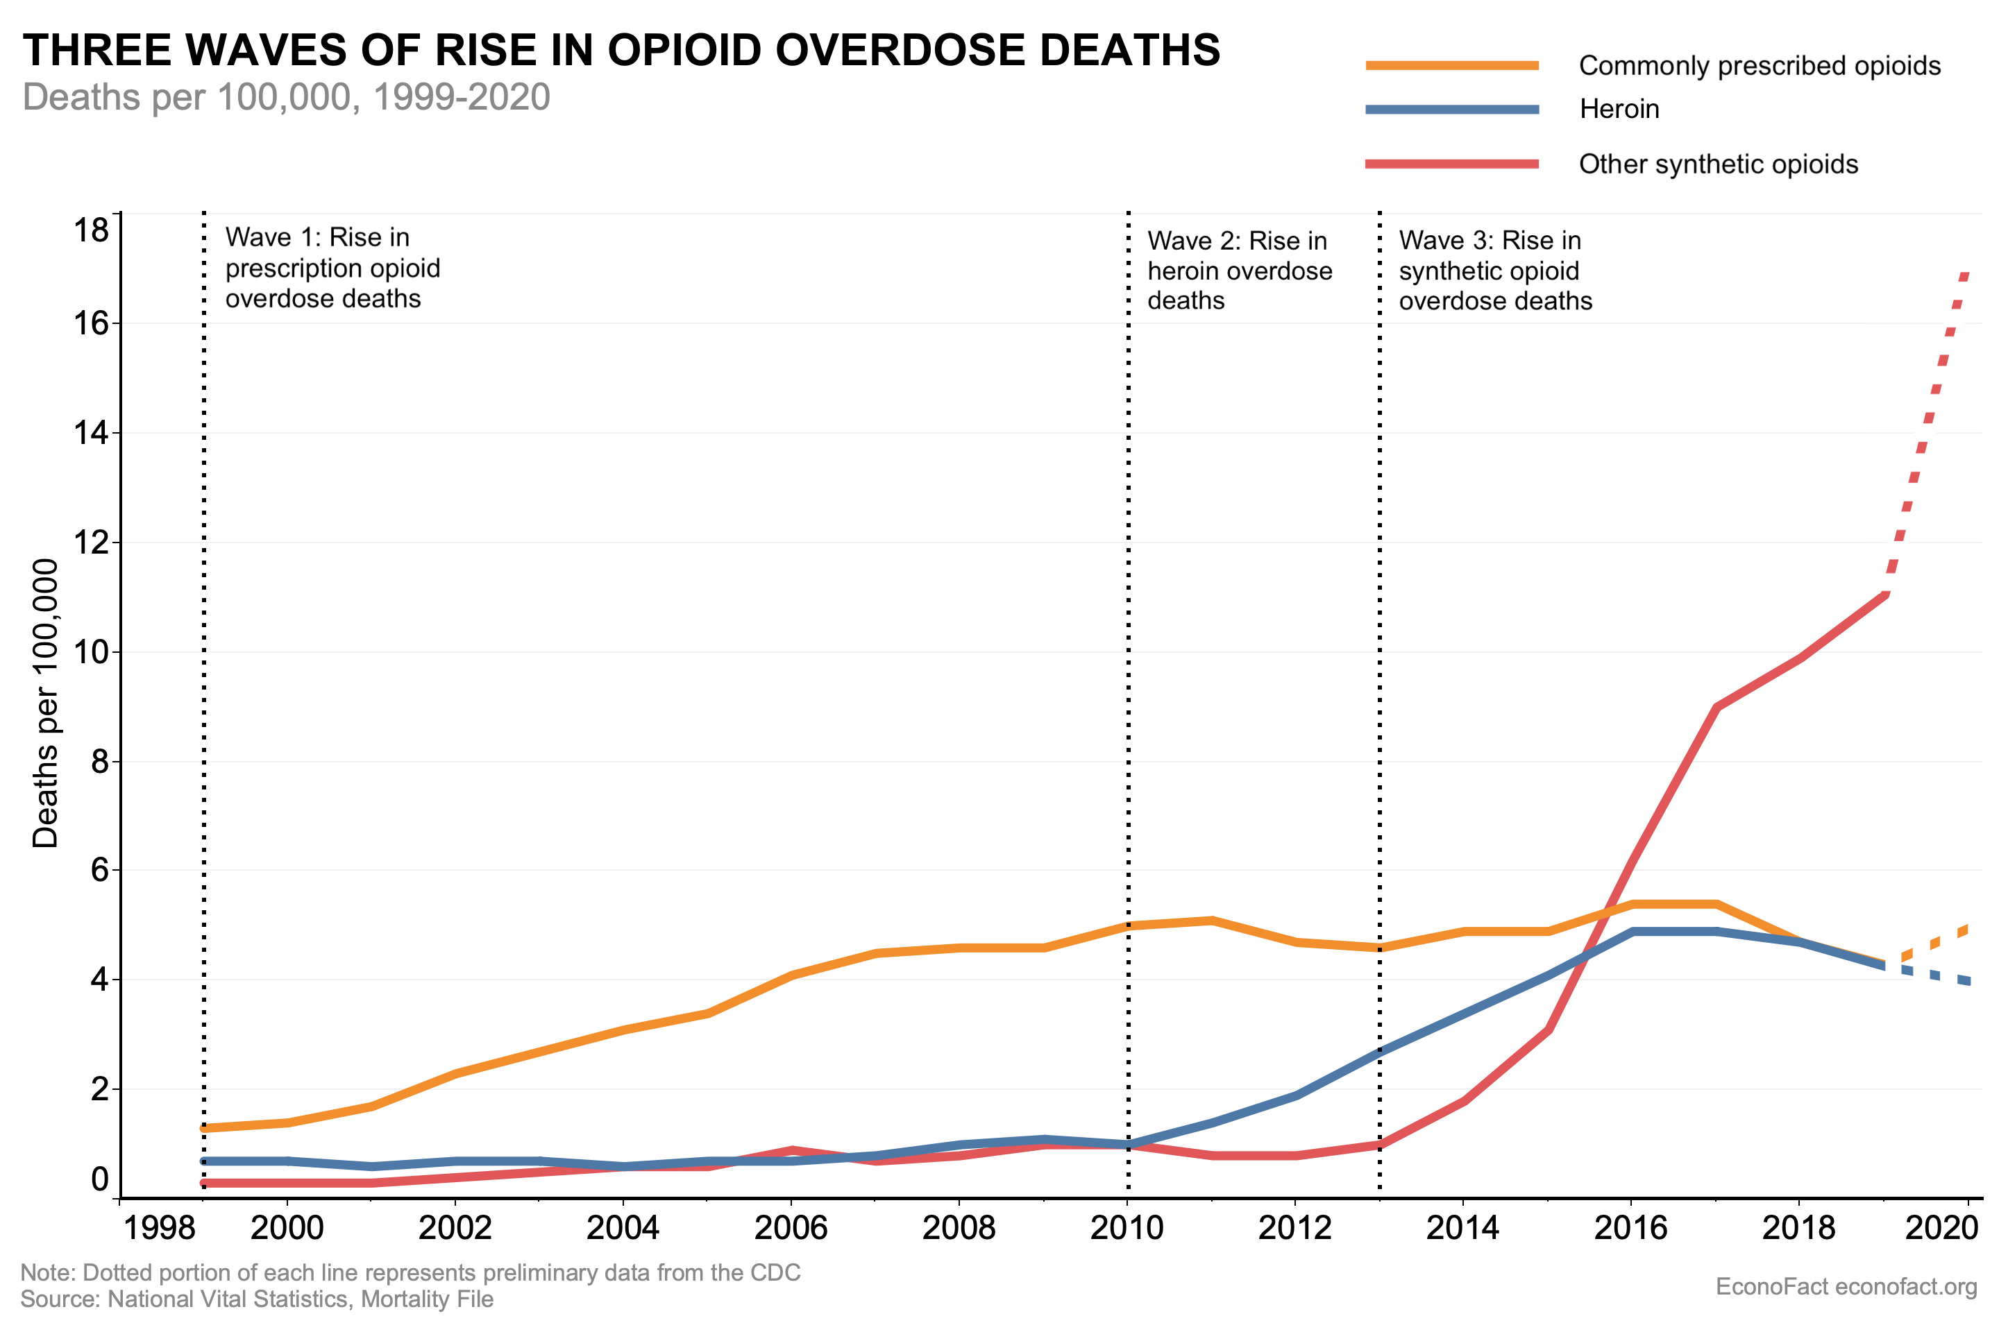

Slide 17
But first… draw how you make toast

Slide 18
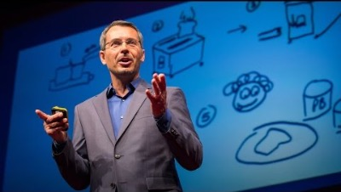

Slide 19
Definition of a system
“A system is an interconnected set of elements, that is coherently organised in a way that achieves something.”
Elements – many are visible / tangible
Interconnections – what holds the elements together, such as physical flows or information flows, influence and power
Function or purpose - watch and see how it behaves
In a system, one plus one equals something else than two.
Notes:
– easiest part (many of them are visible / tangible)

Slide 20
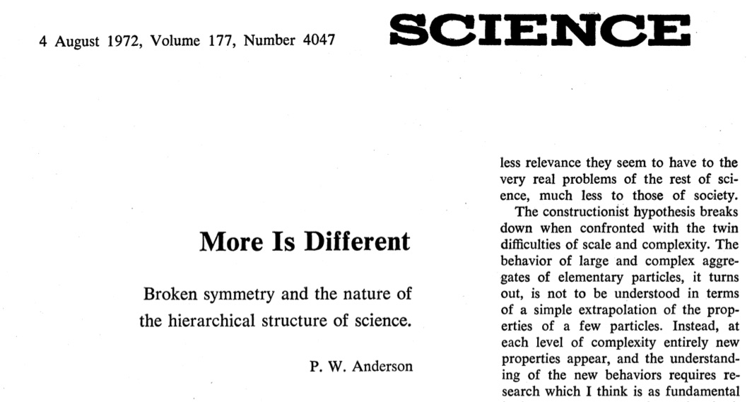
Notes:
– easiest part (many of them are visible / tangible)

Slide 21
Evolving systems
Systems are more than a sum of its parts. They can adapt and evolve.
→ Emergent properties
Any part of a system can be changed:
Changing elements (restaurant: change the waiters, still a restaurant)
Changing interconnections (customers get their own food)
Changing purpose / function (feed the people on the street)

Slide 22
What is thinking in systems?
Systems thinking is a way of making sense of the complexity of the world by looking at it in terms of wholes and relationships rather than by splitting it down into its parts. (Magnus Ramage and Karen Shipp. 2009. Systems Thinkers)

Slide 23

What does systems thinking give us?
Ability to see the range of choices we have before us, then manage and adapt them.
Way of thinking to identify root causes of problems.
Way to discover new opportunities.
Overview to understand possible unintended consequences and ripple effects.
Notes:
Another example: Did Trump change the US or did the US society create Trump?

Slide 24
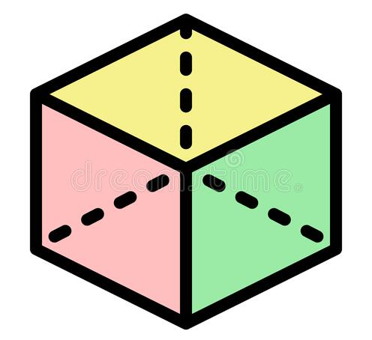
Including different perspectives

Slide 25
Including different perspectives
Systems Thinking is a lens to look at the world.

Slide 26


Thinking linear
Problem:
hunger
Solution:
increase food production.

Slide 27
Thinking linear
Problem:
hunger
Solution:
increase food production.
Solved?

Slide 28
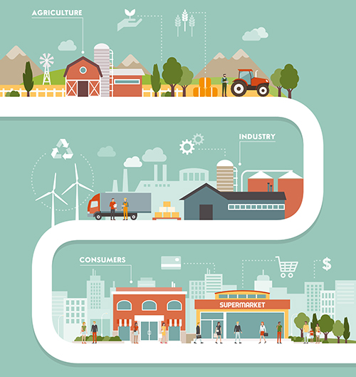
Tackling hunger
We could feed much more than the world’s population.
  Main cause: food waste.
  Reasons: cold storage, relative prices, and portion size
The direction we are headed, despite good intentions, is that 2 billion people more will be experiencing hunger in 2050
https://www.redwoodlogistics.com/five-challenges-in-food-and-beverage-supply-chains/

Slide 29
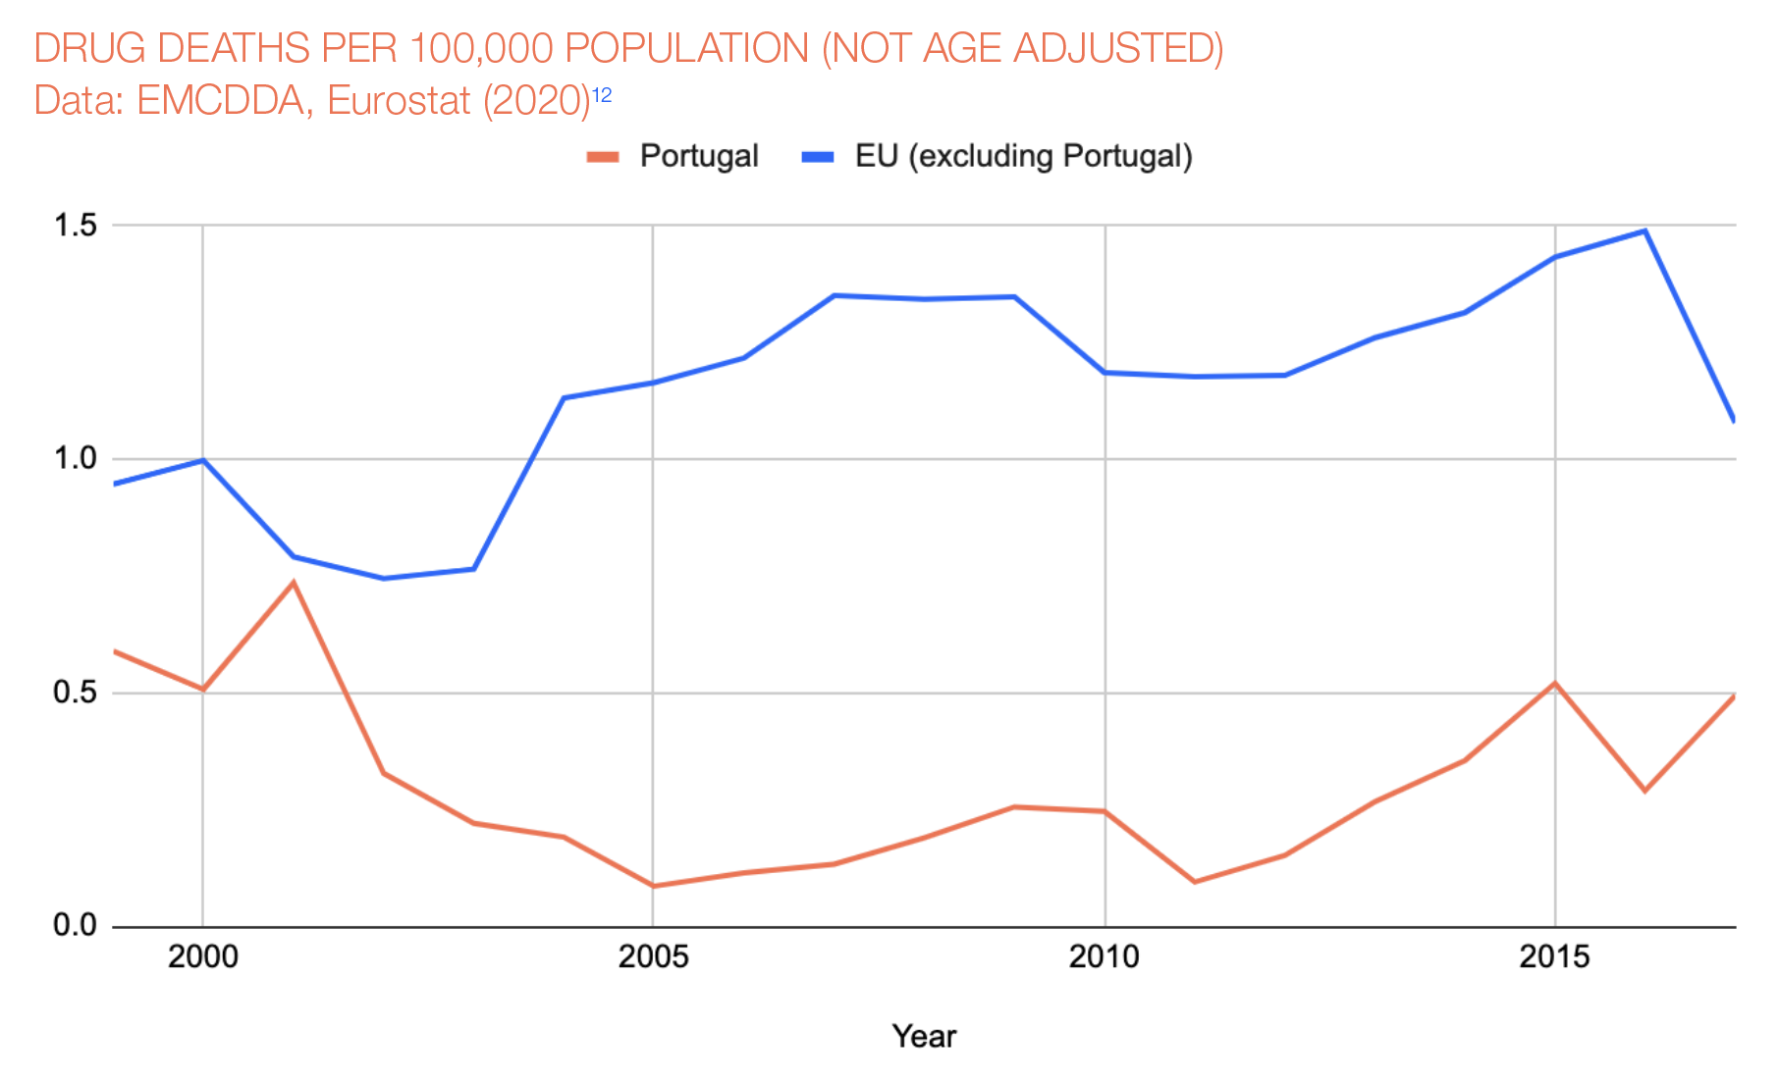
From addiction to connection
In 2001, Portugal decriminalised the personal possession of all drugs as part of a wider re-orientation of policy towards a health-led approach.

Slide 30
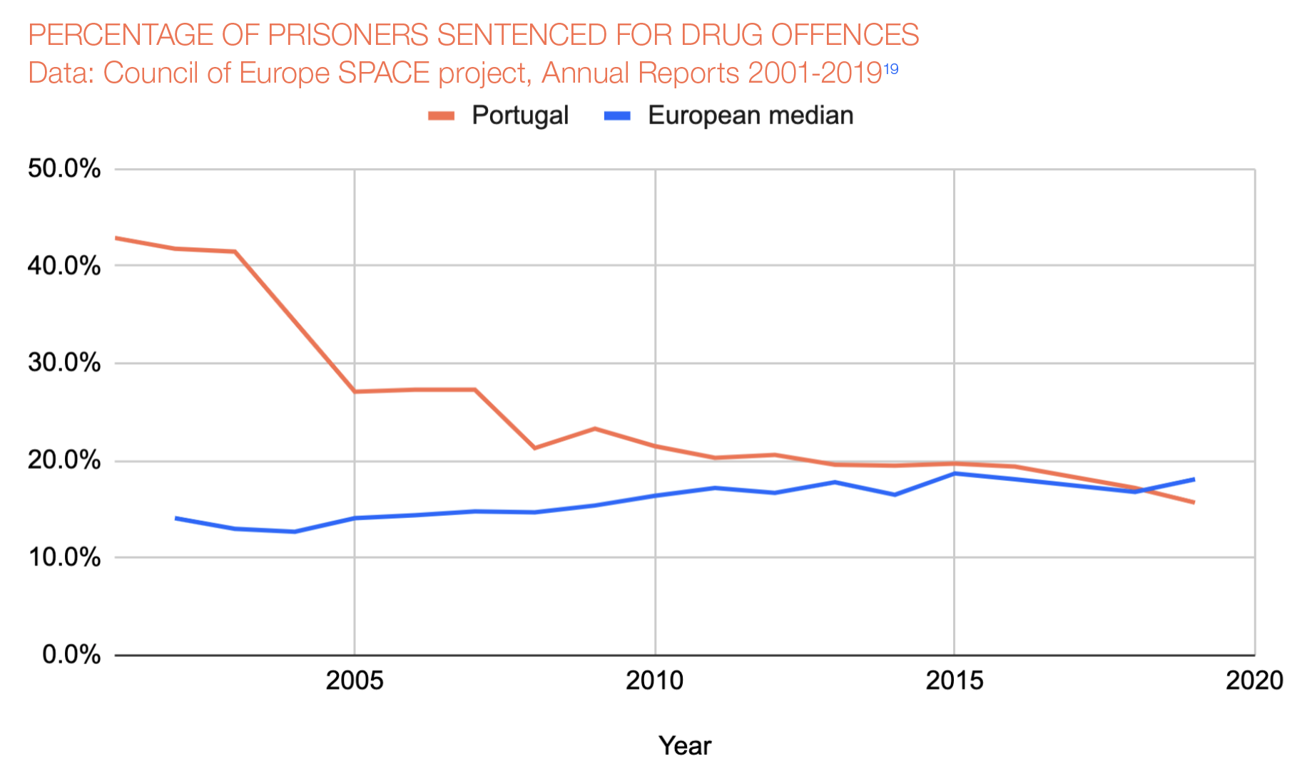
From addiction to connection
In 2001, Portugal decriminalised the personal possession of all drugs as part of a wider re-orientation of policy towards a health-led approach.

Slide 31

Changing relationships
Curitiba as a rapidly growing city.
Bank gave out loan to rebuild the “favelas”.
Standardized housing units – 10k/unit with registered builders
Council argued that people could build their own house with their own labour – 3k/unit
Variety of architectural styles – sense of community, stronger and richer.
More than 120.000 home owners

Slide 32
https://medium.com/disruptive-design/tools-for-systems-thinkers-the-6-fundamental-concepts-of-systems-thinking-379cdac3dc6a
Notes:
Singapore Gardens by the Bay – example of a complex man made eco-system

Slide 33
Notes:
Structure of how to communicate and visualise your system

Slide 34
How does proximity care look like in your context?
Consider your area of action for CBI and map out what constitutes its system.
What institutions, services and people/roles are involved?
How are they connected?
Use one colour
influences
informs

Slide 35
How does proximity care look like in your context?
Consider your area of action for CBI and map out what constitutes its system.
What resources are coming in and out? (e.g. energy, land/soil, plants, people, forest, animals, money, precious metals, water, raw materials)
What are some gaps or tension points?
Use a different colour
Try to keep this in mind when calculating the net impact of your interventions

Slide 36
How to solve wicked problems
Wicked problems are by nature systemic problems
almost nobody wants to create things like hunger, still they persist.
A step by step guide to solving wicked problems (as proposed by Meadows)
Understanding the issue (draw a map, find the links and purposes)
Reclaiming our intuition as opposed to rationalising
Stop casting blame, see the system as the source of its own problems
Find the courage and wisdom to restructure it
In short: Don’t try to fix the symptom, fix the cause

Slide 37
A system is an ever living organism…
So how to can we predict possible changes?

Slide 38
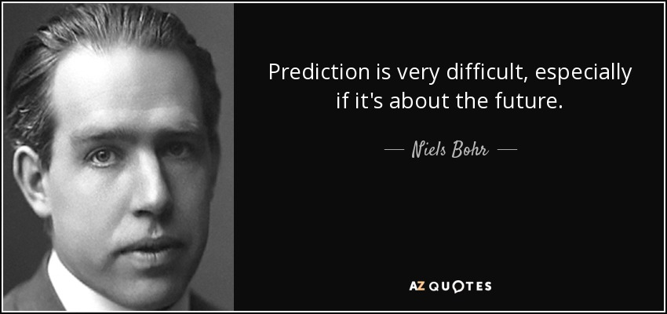

Slide 39
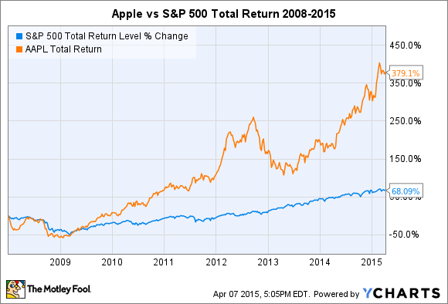

Slide 40
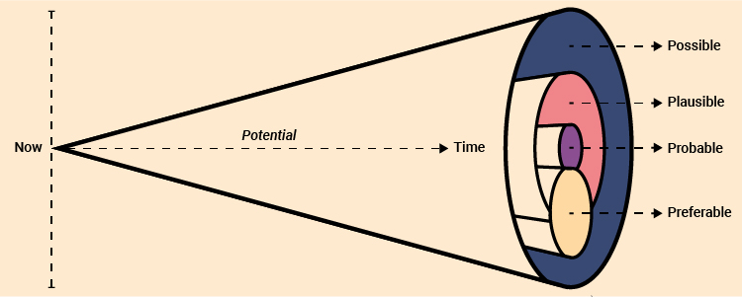
There are many possible futures…
https://www.jisc.ac.uk/guides/vision-and-strategy-toolkit/futures-cone

Slide 41
Let’s imagine…
What could the future of proximity care look like in 50 years?
What are some probable possibilities?
What would be preferable futures?
Think individually or in groups and write down a few ideas.
You can consider technological, social, economical, ethical, political and environmental aspects.
(5 min)

Slide 42
Let’s reflect…
How does your preferable future look like?
How does it impact your journey as a team and future-change makers?
What can you change today to make your preferable future more probable?
(10 min)

Slide 43

Illustration by Rebekka Dunlap for TIME

Slide 44
Are you letting your imagination flow?

Slide 45
catarina.batista@cern.ch

Slide 46
Further reading and sources
Epstein. D (2019). ‘The cult of the head start‘ in Epstein. D. Range: Why generalists thriumph in a specialized world. New York: Riverhead books, pp.30-34.
Epstein. D (2019). ‘Thinking outside experience‘ in Epstein. D. Range: Why generalists thriumph in a specialized world. New York: Riverhead books, pp.99-119.
Mlodinow, L. (2018). Your elastic mind. Psychology Today.
Meadows D. and Wright D. (2008), Thinking in Systems. Chelsea Green Publishing.
Got a wicked problem? First, tell me how you make toast, Tom Wujec.
Hirsh, J. B., Mar, R. A., & Peterson, J. B. (2012). Psychological entropy: a framework for understanding uncertainty-related anxiety. Psychological review, 119(2), 304–320. https://doi.org/10.1037/a0026767
Protopia Futures Framework, https://medium.com/protopia-futures/protopia-futures-framework-f3c2a5d09a1e
Juncker, J.-C., & European Commission. (2017). White paper on the future of europe : reflections and scenarios for the eu27 by 2025. European Commission. https://doi.org/10.2775/550306
The workforce of the future, pwc, https://www.pwc.com/gx/en/services/people-organisation/publications/workforce-of-the-future.html
Vision and Strategy Toolkit, Jisc, https://www.jisc.ac.uk/guides/vision-and-strategy-toolkit

