Slide 1
BCT TRIC Acquisition Update
Improved acquisition subject to low frequency/linear baseline distortions
M.Dolenc, R.Ruffieux, M. Gasior, A. Topaloudis, D. Alves

Slide 2
Summary
Acquisition setup
Measurement method and why it sometimes underperforms
Solution space for baseline fluctuations
New measurement method and results

Slide 3
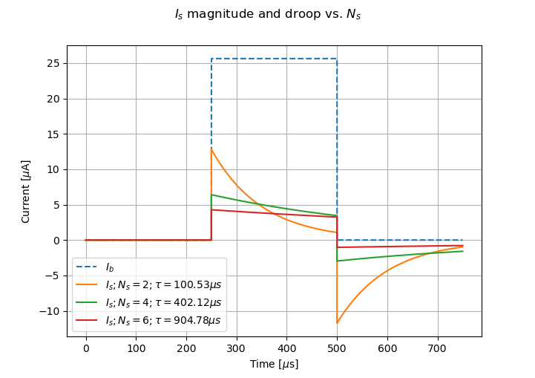
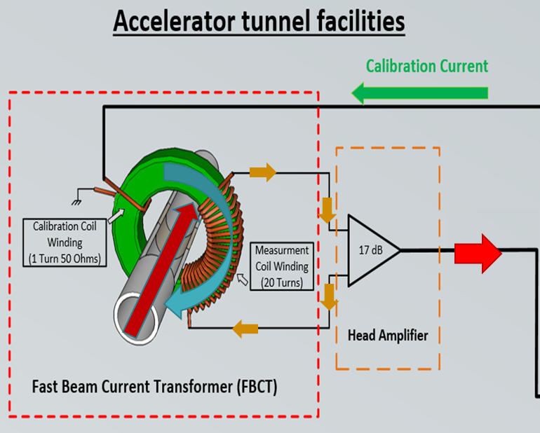
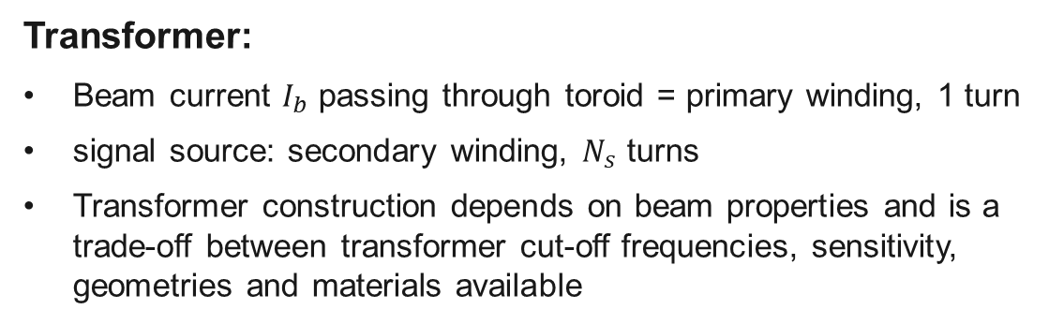
Transformer and head amplifier
Transformer:
  Beam current $I_{b}$ passing through toroid = primary winding, 1 turn
  signal source: secondary winding, $N_{s}$ turns
  Transformer construction depends on beam properties and is a trade-off between transformer cut-off frequencies, sensitivity, geometries and materials available
Calibration pulses sent into calibration winding induce currents on secondary winding, just like beam does
Head amplifier:
  Amplifies transformer signal into range TRIC card can handle
  Transformer transfer function compensation, used primarily for LINAC systems with long beam pulses
    To reduce droop, we amplify low frequencies by up to 2 orders of magnitude more than pass-band
    Low frequency interference amplified as well!

Slide 4
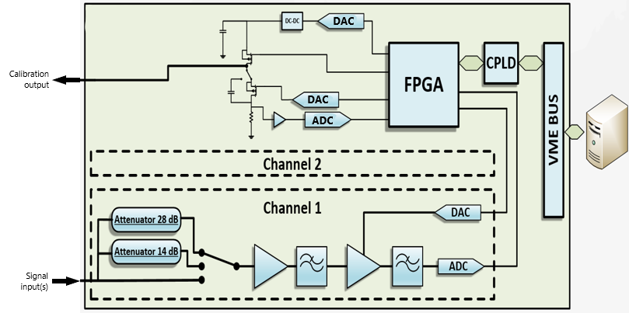
Acquisition setup
Consists of
  TRIC card:
    Basic signal conditioning (configurable attenuation)
    2 ADC channels and FPGA to capture “raw” and integrated data
    Calibration pulse generator with DC-DC converter, calibration voltage/current monitoring
  FESA class
    Central timing synchronized
    Configures the cards
    Reads data
    Performs various calculations before publishing

Slide 5
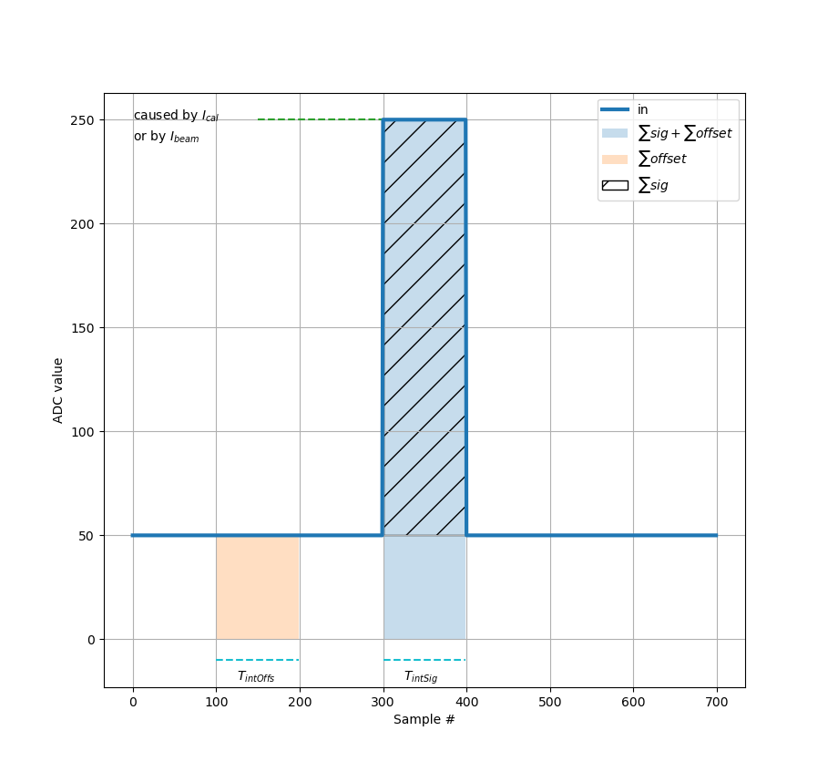
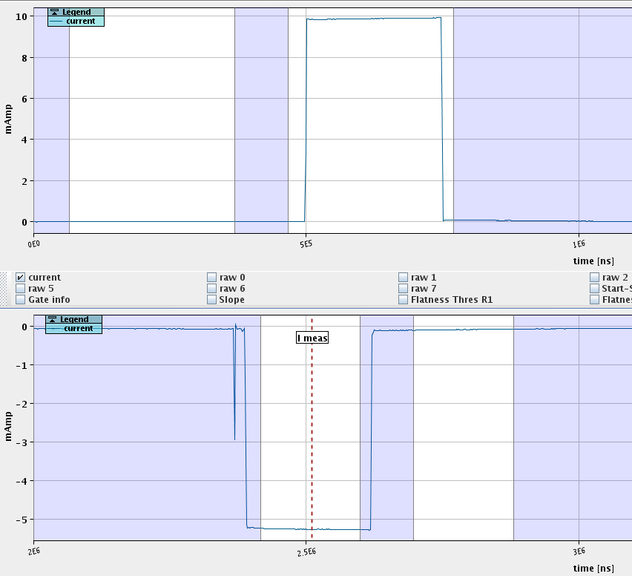
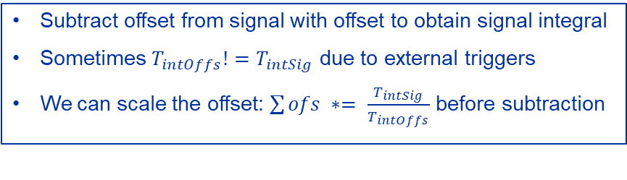
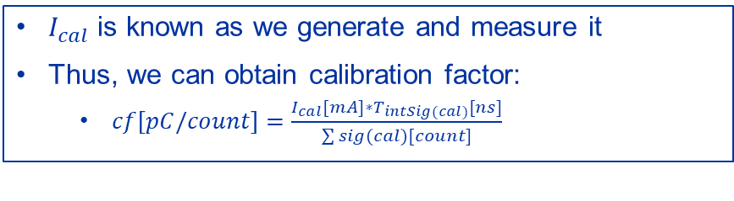
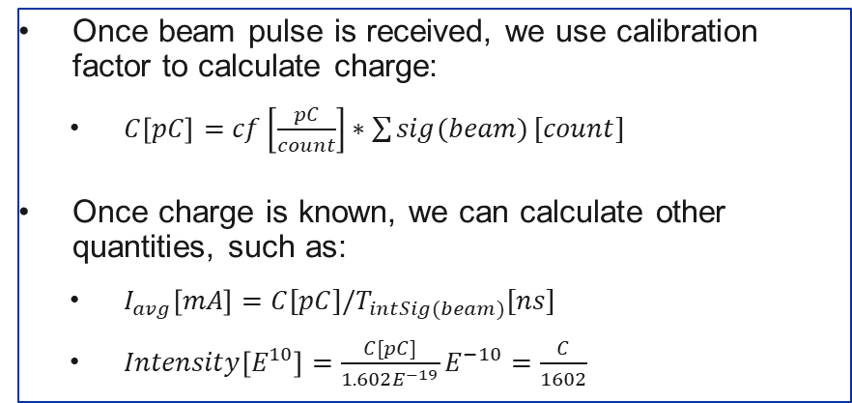
Existing measurement method
Beam current response related to calibration current response
Subtract offset from signal with offset to obtain signal integral
Sometimes $T_{intOffs}!=T_{intSig}$ due to external triggers
We can scale the offset: $\sum{ofs ∗= \frac{T_{intSig}}{T_{intOffs}}}$ before subtraction
Beam offset
Beam pulse +
Beam offset
$I_{cal}$ is known as we generate and measure it
Thus, we can obtain calibration factor:
  $cf\left[pC/count\right]=\frac{I_{cal}[mA]∗T_{intSig(cal)}[ns]}{\sum{sig(cal)}[count]}$
Once beam pulse is received, we use calibration factor to calculate charge:
  $C\left[pC\right]=cf\left[\frac{pC}{count}\right]∗\sum{sig(beam)}[count]$
Once charge is known, we can calculate other quantities, such as:
  $I_{avg}\left[mA\right]=C[pC]/T_{intSig(beam)}[ns]$
  $Intensity\left[E^{10}\right]=\frac{C[pC]}{1.602E^{−19}}E^{−10}=\frac{C}{1602}$
Cal pulse +
Cal offset
Cal offset

Slide 6
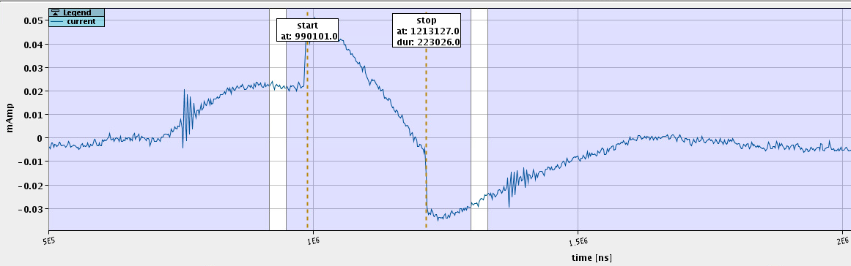
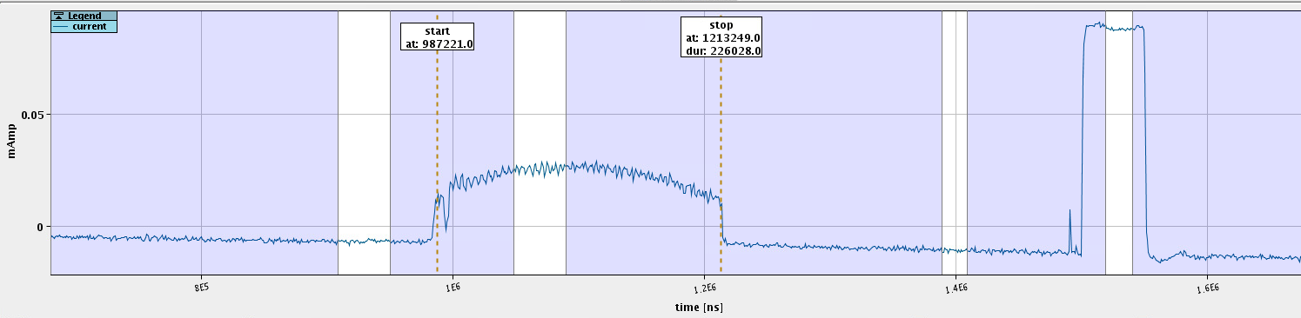
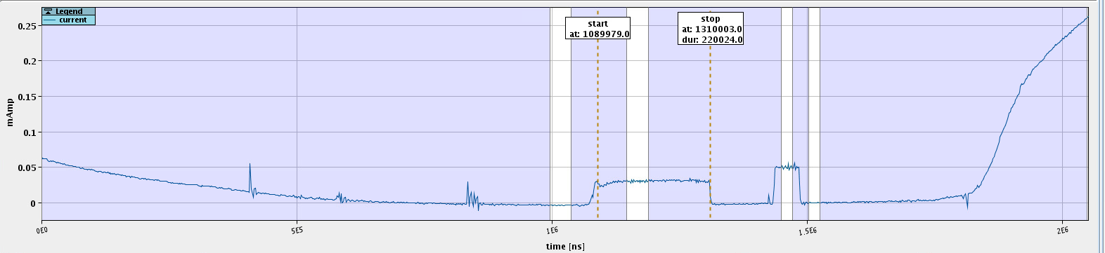
From LAB to reality
Interference sources
Stray electro-magnetic fields around BCT
Parasitic ground and chamber currents
Induction on cables from neighboring high-power installations
Transformer droop under- or over-compensation
LEI, EI.BCT10
Offset
Calibration offset
Calibration
Offset
Beam
Beam
LEI, ETL.BCT20
L3, ITF.BCT25
Calibration
Calibration offset
Offset
Beam

Slide 7
Interference mitigation
Replace old BCTs with better constructed ones (better shielding)
  Expensive and invasive, prone to handling damage, outcome not guaranteed, happens gradually throughout the complex
Check and improve cabling, grounding
  Inter-: section, department, group activity. Done continuously as new problems come up, usually new aggressor equipment started or changed, cabling changes. Challenging organization, access.
Improve head amplifier design
  In progress, will gradually happen throughout complex, sometimes challenging to access
  Challenging to compensate transformers transfer function completely. Ideally 1 BCT = 1 matched amplifier; maintenance nightmare, not guaranteed due to ageing, drifts
FW/SW signal processing
  Always looking at ways to improve, extent limited by acquisition system
    Insufficient RAM to store raw data for SW processing
    Small and old FPGA with limited resources (52x 9-bit multipliers, 1024 samples of RAM for 1ms+ pulses)

Slide 8
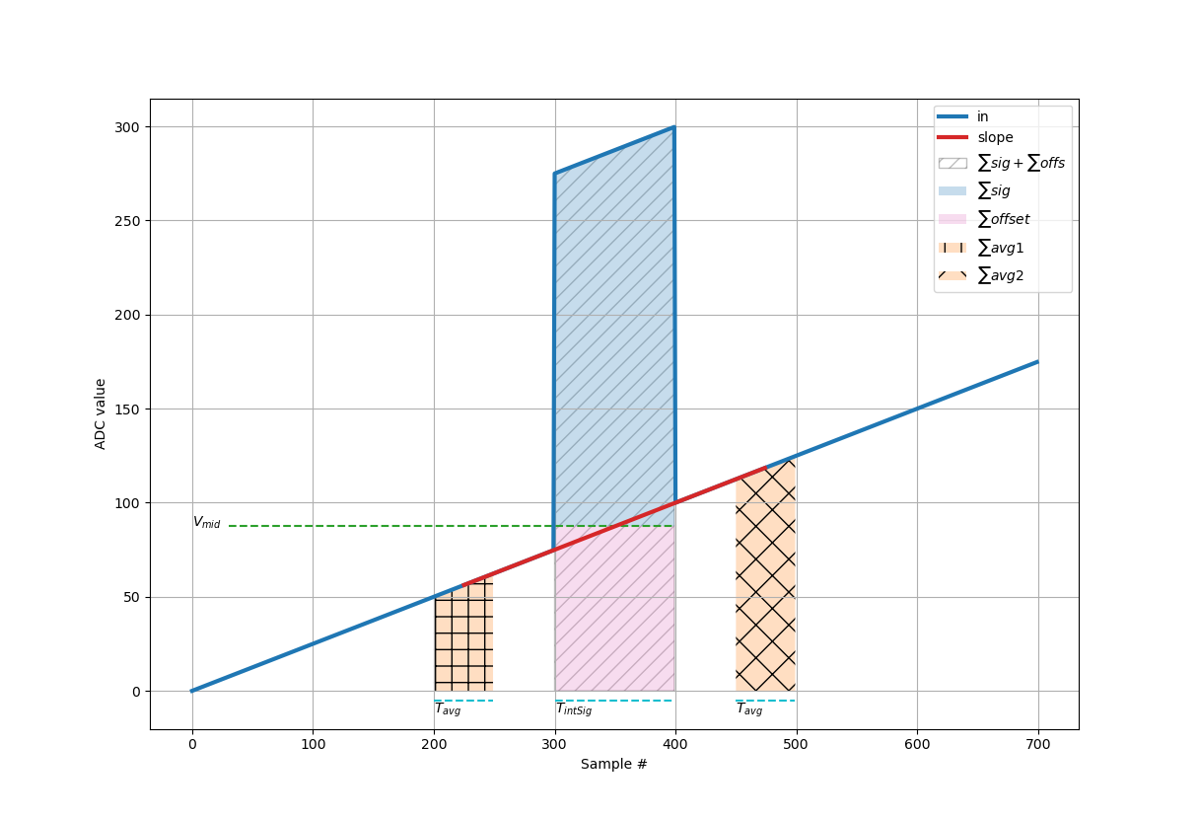
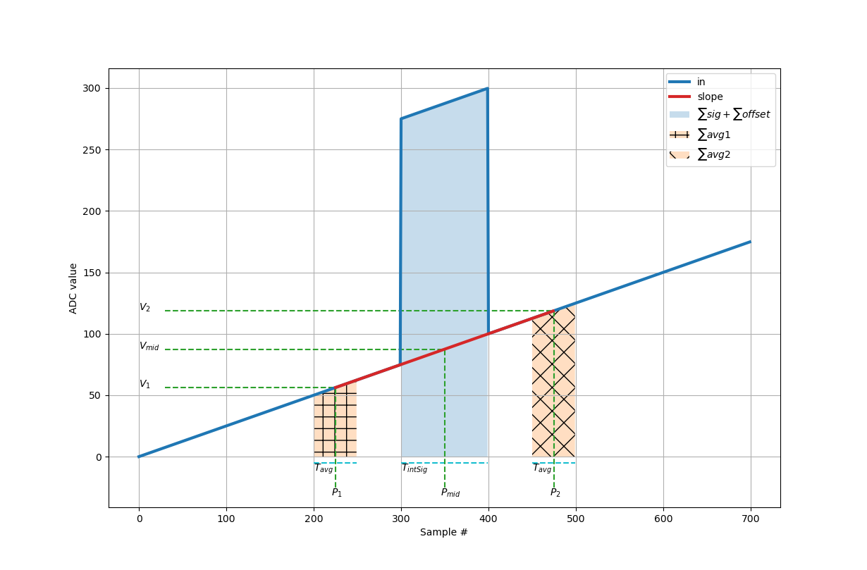
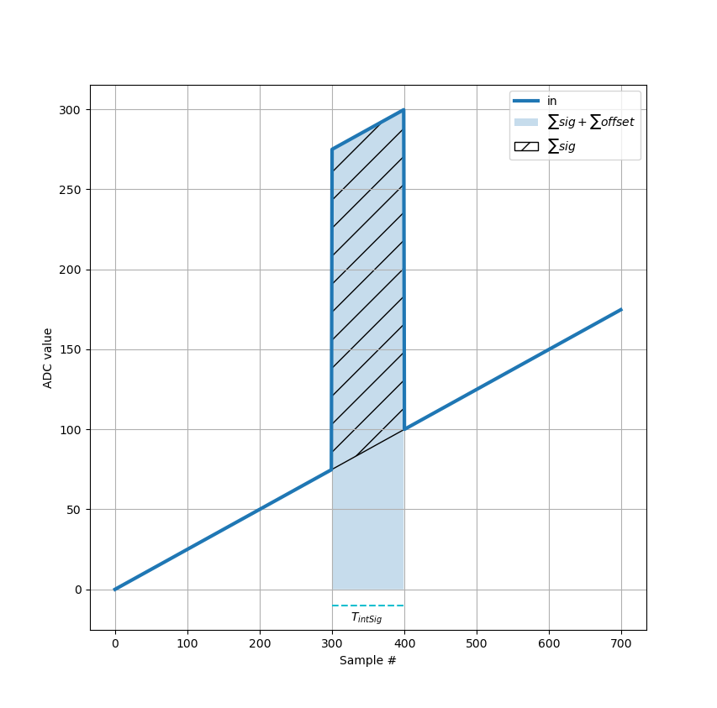
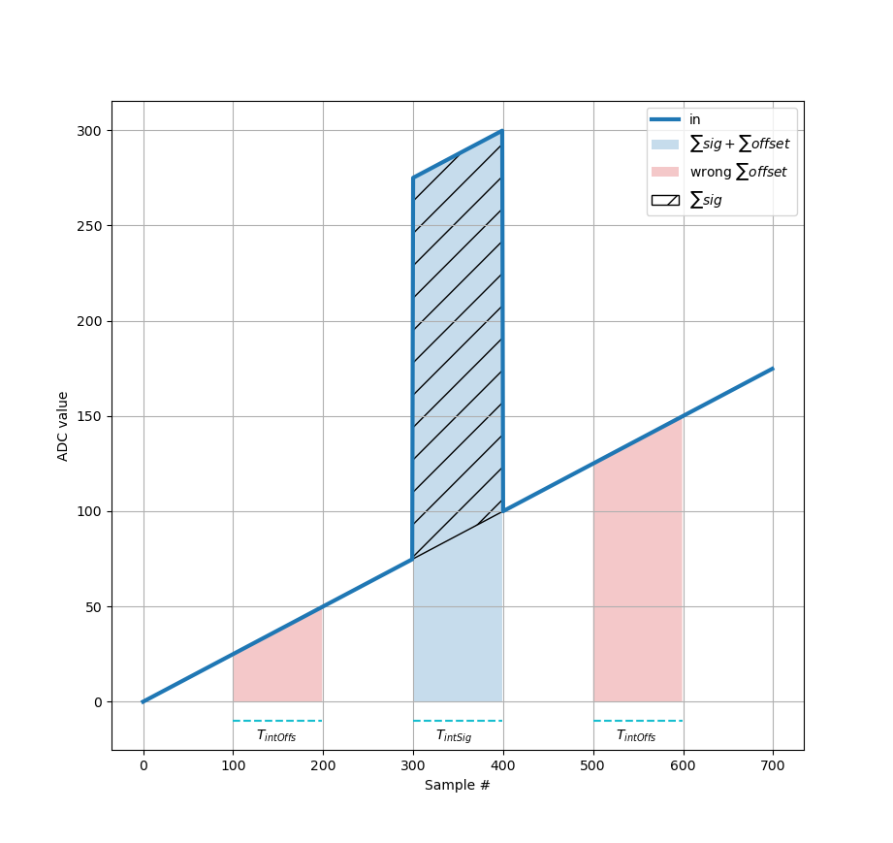

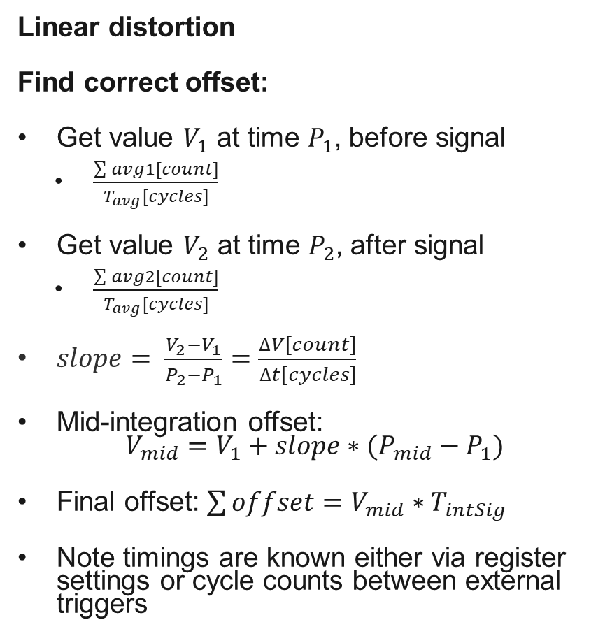
Updated measurement method
Linear distortion
Find correct offset:
Get value $V_{1}$ at time $P_{1}$, before signal
  $\frac{\sum{avg1[count]}}{T_{avg}[cycles]}$
Get value $V_{2}$ at time $P_{2}$, after signal
  $\frac{\sum{avg2[count]}}{T_{avg}[cycles]}$
$slope= \frac{V_{2}−V_{1}}{P_{2}−P_{1}}=\frac{∆V[count]}{∆t[cycles]}$
Mid-integration offset:
$V_{mid}=V_{1}+slope∗(P_{mid}−P_{1})$
Final offset: $\sum{offset}=V_{mid}∗T_{intSig}$
Note timings are known either via register settings or cycle counts between external triggers

Slide 9
Scope of the updates
FPGA Firmware
Driver
CPP driver lib
FESA Class
Expert GUI
Full SW stack and FPGA firmware needed updating
There are many stakeholders, hence need to follow through with Smooth Upgrades Working Group
Other feature requests to fulfil as well
Two FESA classes currently used are going to be merged into single class
Opportunity to migrate from ENCORE to EDGE driver framework

Slide 10
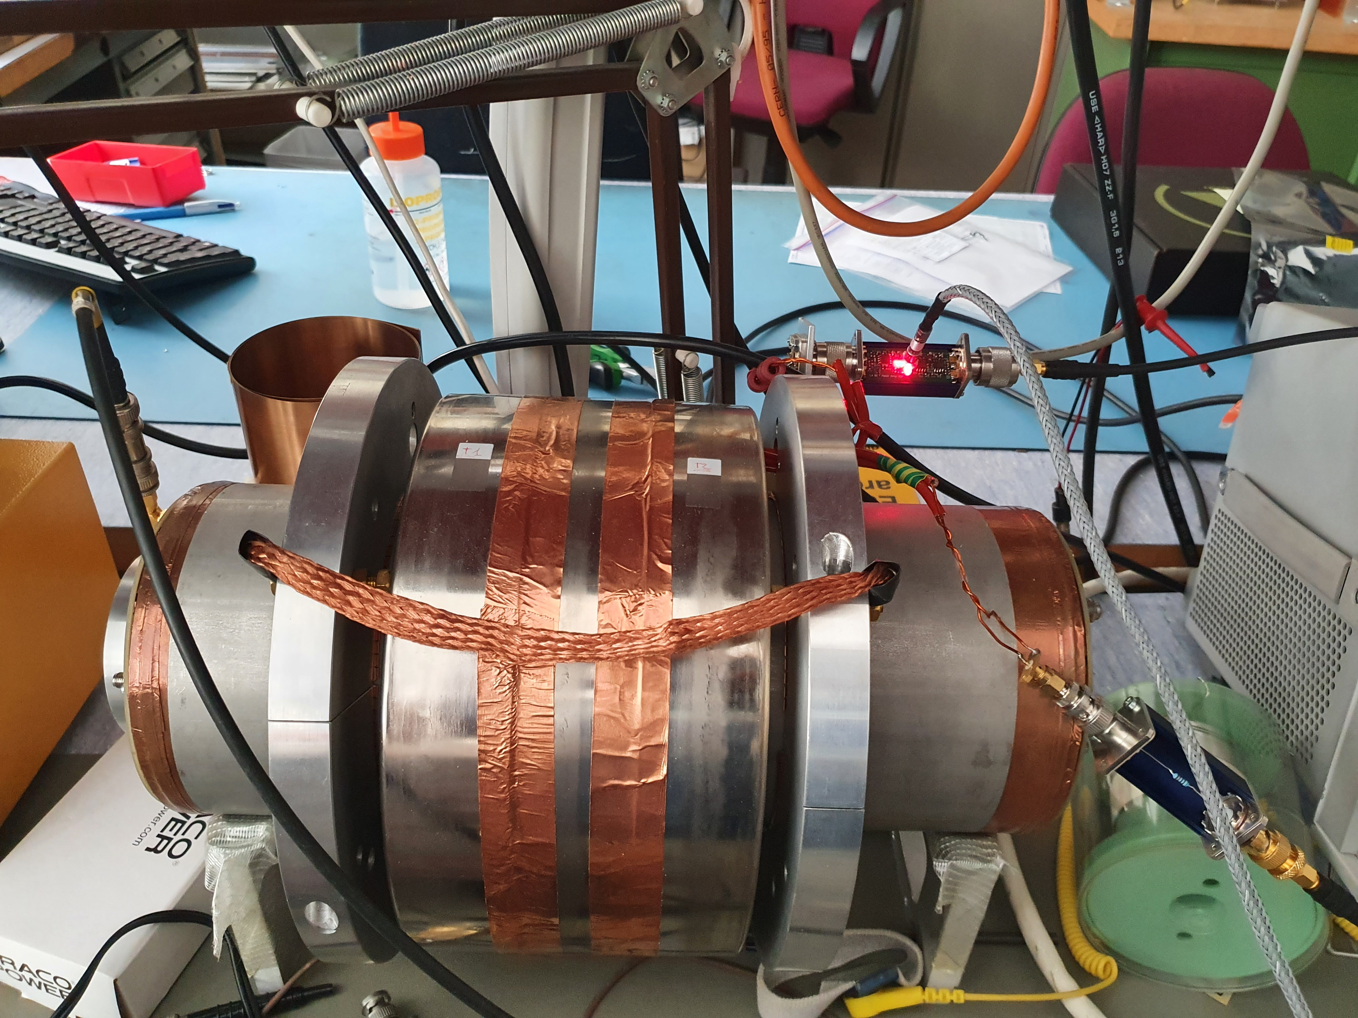
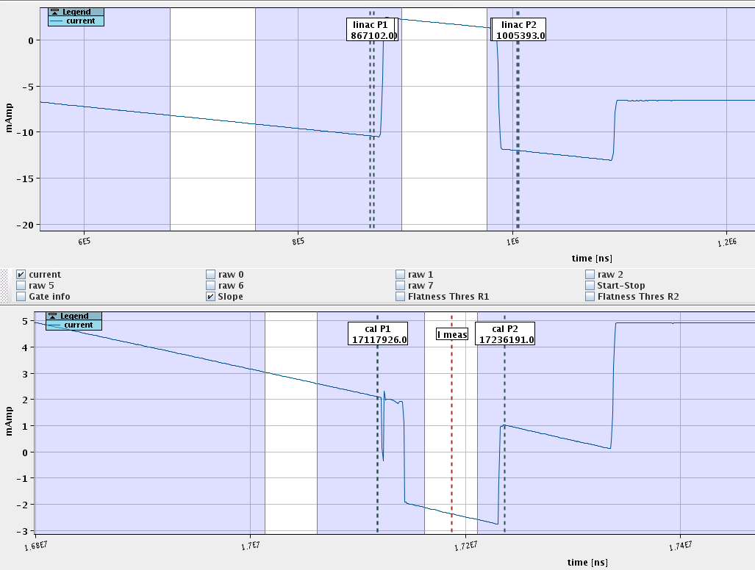
Results – LAB
Transformer connected to Keysight waveform generator
  Baseline distortion (zero, positive, negative offset and/or ramp)
  Measured pulses (“beam”) (zero, positive, negative)
TRIC card connected to pick-up and calibration winding, operating as normal
Comparing pulse measurements:
  Reference: default method for offset measurement (correction disabled), no baseline distortion (no offset, no slope)
  Distorted baseline (offset and/or ramp) with:
    correction disabled
    correction enabled
Corrected measurements across all tested baseline distortions and pulse polarities below 0.3% deviation from reference; non-corrected up to 30% off
Limitation: Very high SNR, hence not representative of weak or noisy beam measurements
Offset
“Beam”
Cal. offs.
Cal..

Slide 11
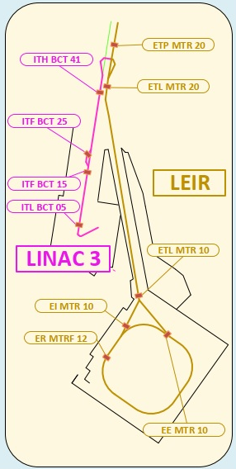
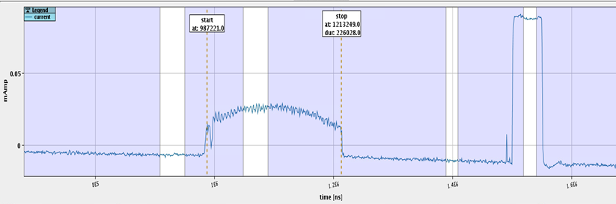
Results – LEIR
One crate, 2 BCTs, single user; correction on channel 1, same data without correction on channel 2 for comparison
Compare measured intensity between ETL.BCT20 and EI.BCT10, not corrected and corrected
ETL.BCT20
Offset
Beam
EI.BCT10
Offset
Calibration offset
Calibration
Beam

Slide 12
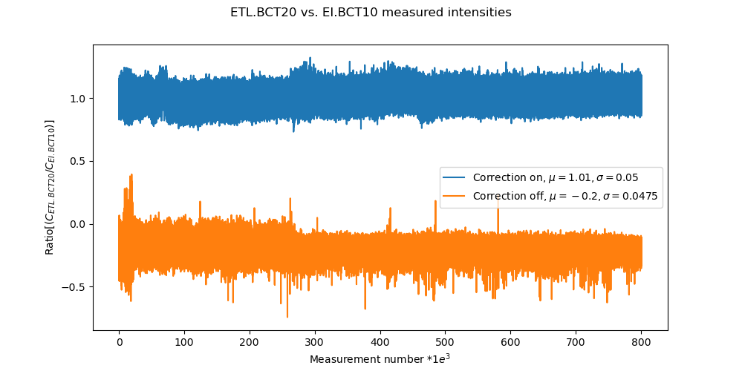
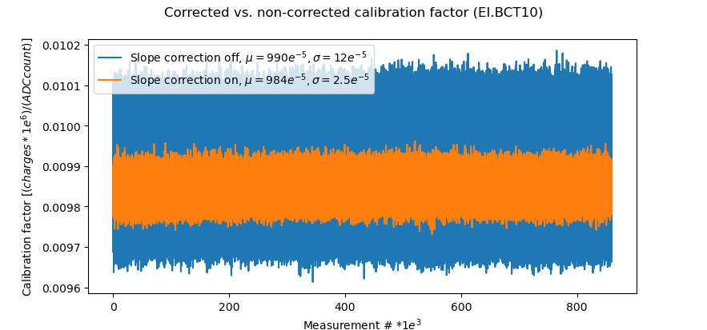
Results – LEIR
Expecting minor losses of a few % between upstream and downstream BCTs => ratio >1.0.
Un-corrected:
  Mean measurement ratio between ETL.BCT20 and EI.BCT10 is non-sensical – not surprising due to interference observed on ETL.BCT20.
Corrected:
  Much more sensible mean ratio of 1.01
  Excursions below 1.0 still observed, hence other means should be deployed as well; nonetheless, a very good start
Double-check: exclude most external variability and compare calibration factor with correction on and off:
  On EI.BCT10 with minor slope problem, the stability improves by ~80%

Slide 13
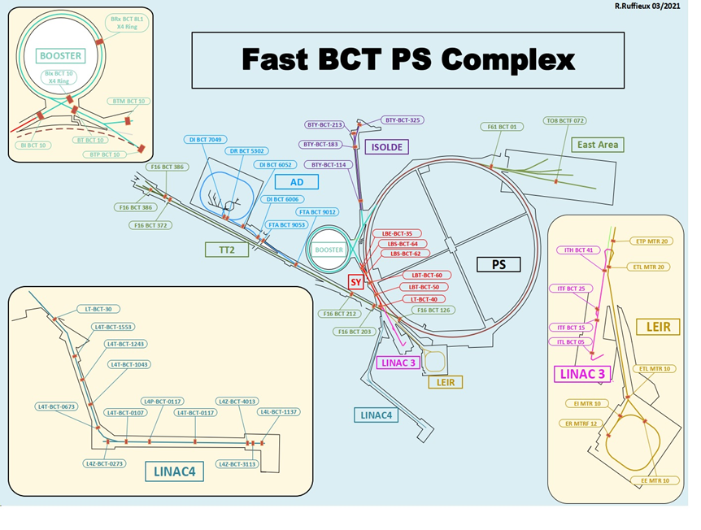
Conclusion
Promising test results, hence, for current system:
  Deploying upgrades this YETS
  Enable new feature in a few places with highest potential to benefit from it and further analyse results
    If still all good, we will consider to use it by default
  Improved flexibility and maintainability with one FESA class and EDGE driver framework
  Find/implement other ideas to improve
  Survive till LS3
Consolidation of acquisition system:
  Consolidation project request submitted – target LS3
  Should open paths to more powerful analysis as well as digital and software processing
With thanks to everyone in my section, SW section and ultimately, LEIR/L3 operators, always willing to help

