Slide 1
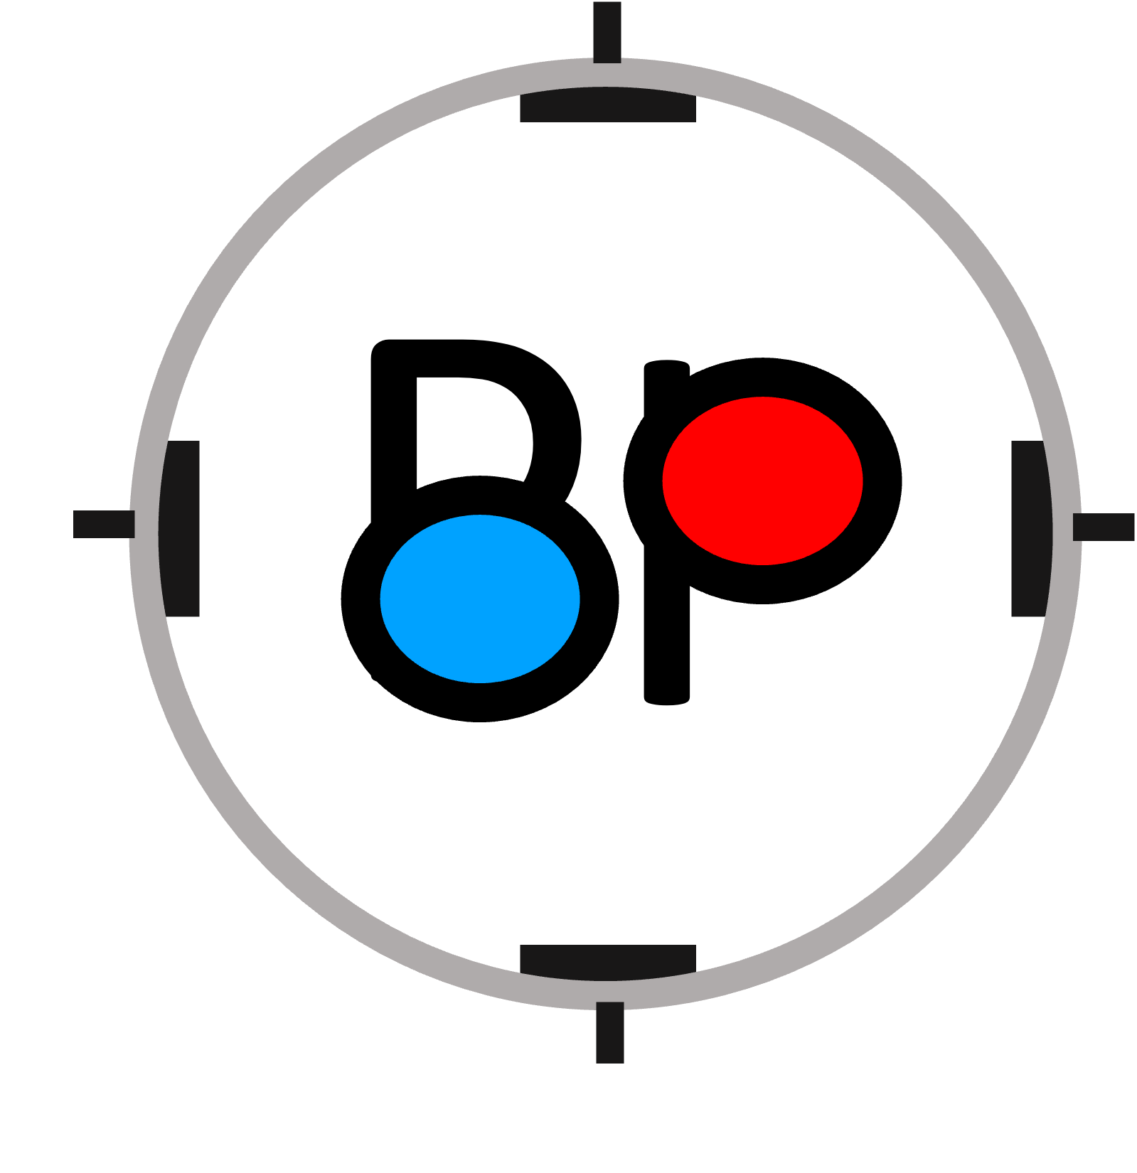
Beam Position Monitor
Test Bench
Guillot-vignot F
16 Dec 2022

Slide 2
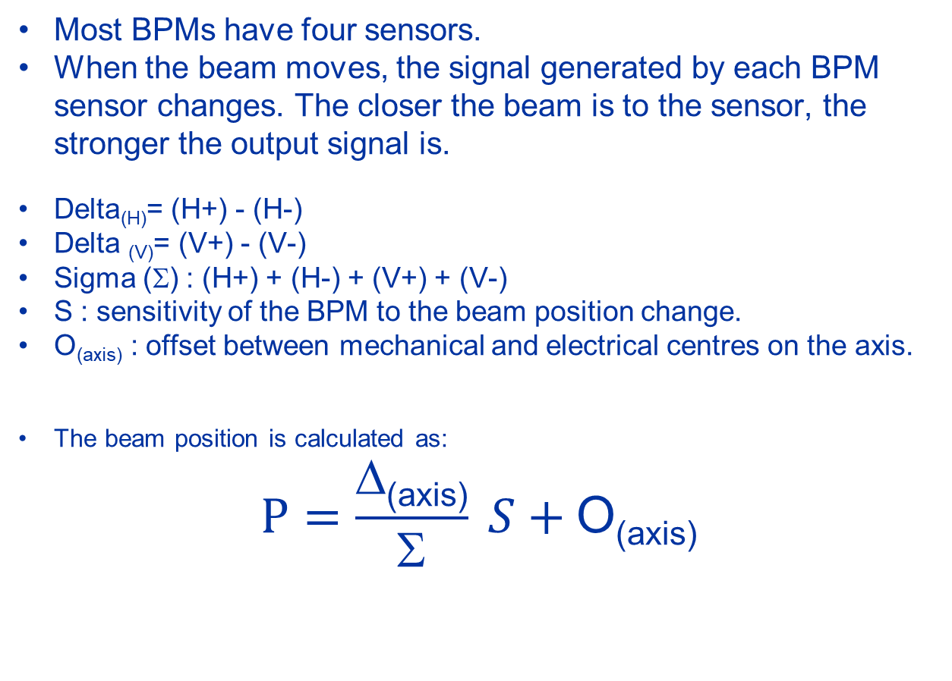
Beam Position Monitor (BPM) : Working principle
Most BPMs have four sensors.
When the beam moves, the signal generated by each BPM sensor changes. The closer the beam is to the sensor, the stronger the output signal is.
Delta_{(H)}= (H+) - (H-)
Delta _{(V)}= (V+) - (V-)
Sigma (Σ) : (H+) + (H-) + (V+) + (V-)
S : sensitivity of the BPM to the beam position change.
O_{(axis)} : offset between mechanical and electrical centres on the axis.
The beam position is calculated as:
$$P=\frac{\text{Δ}\text{(}\text{axis}\text{)}}{\text{Σ}} S+\text{O}\text{(}\text{axis}\text{)}$$
V+
H-
H+
V-
Arrow represent sensors output signal
longer arrow = stronger signal

Slide 3
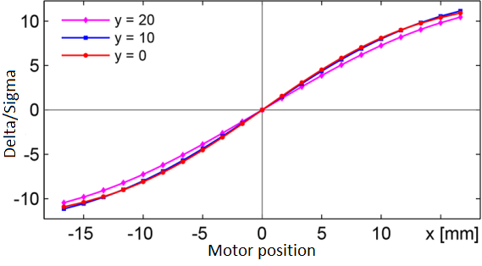
Goal of the test bench
Into the machine, users want to know the position of the beam.
To know the position, we need to know the Sensitivity and Offset_{(axis)} value of the sensors.
So the goal of the test bench is to characterise those two values.
H=?
H 0→7
V=?
V 0→5
In general, S is not a constant!

Slide 4
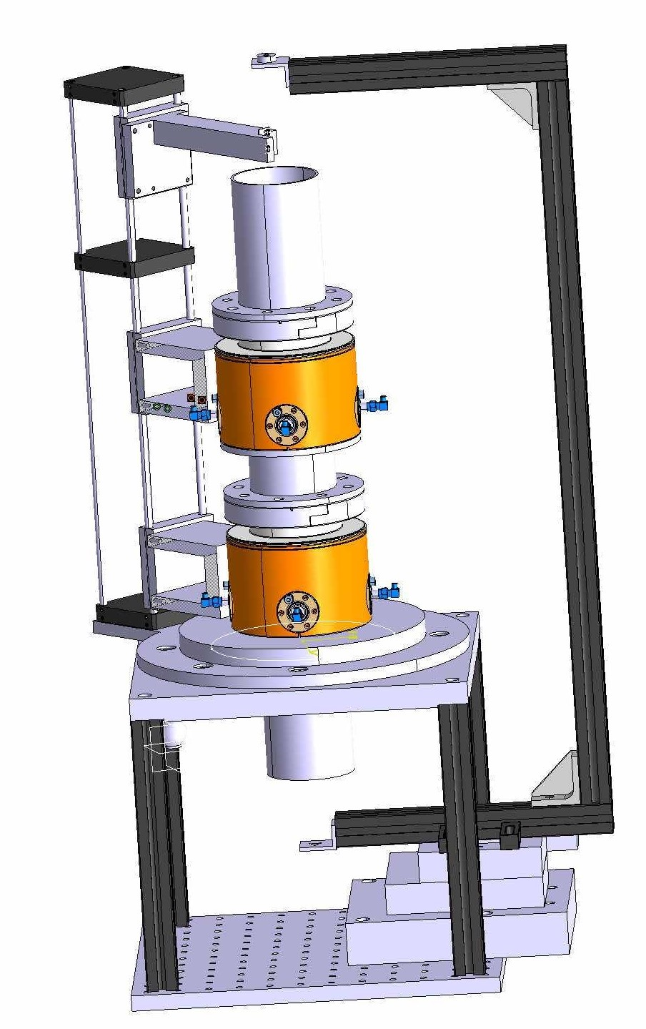
BPM Test bench principle
To obtain the BPM parameters :
The beam passing through the sensor is simulated by a wire connected to a vector network analyser (VNA).
The wire is stretched on a frame moved to a known positions by two motors.
BPM outputs are measured by a VNA, then computed to obtain sensitivity and offset of each axis.
Wire
Frame
Motors

Slide 5
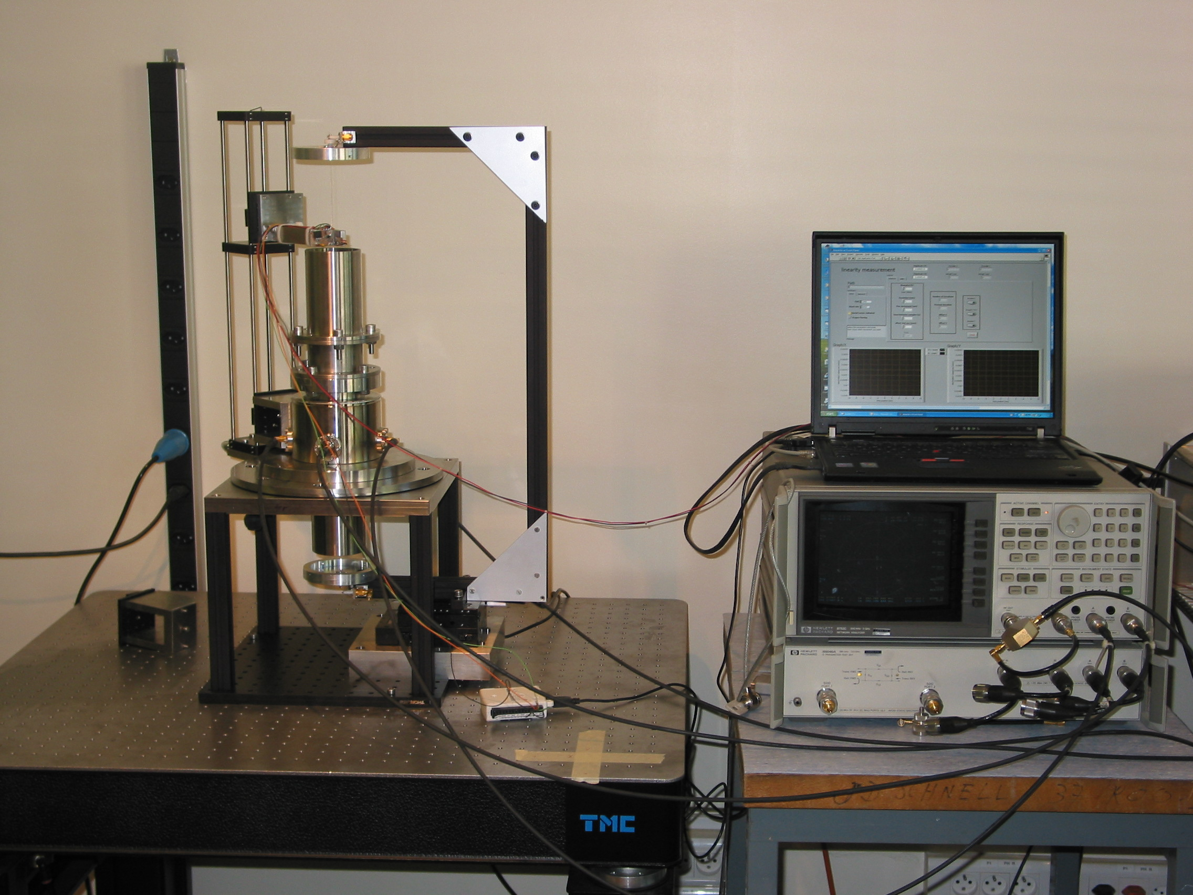
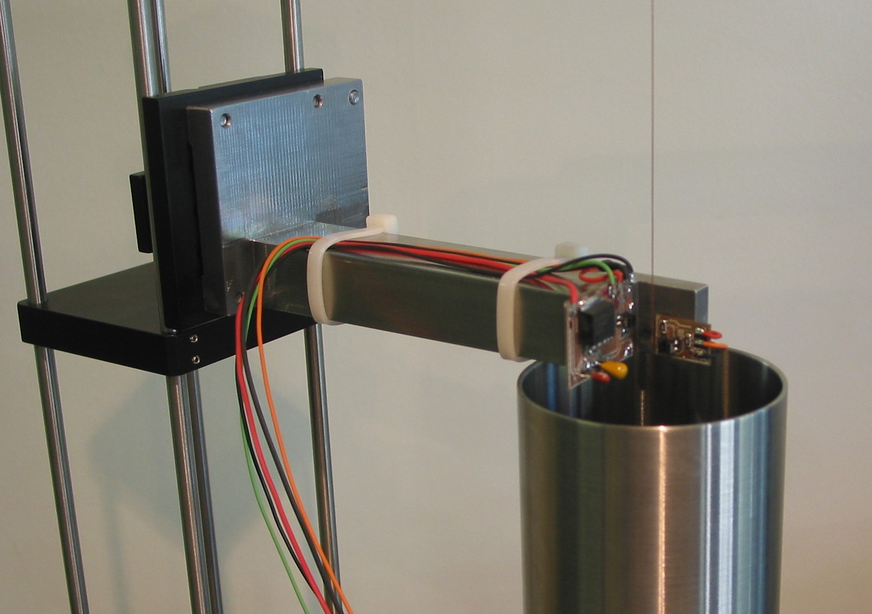
First prototype (3 MeV BPM)
25.4mm movement capacity
  Too small for other BPM
“C” shape frame
  Bending due to wire stretching
Thorlab rod column
  Not stiff enough to obtain a good reference
Optical fork tool calibration
  Good results
Two inputs VNA
  Requires two-step measurement

Slide 6
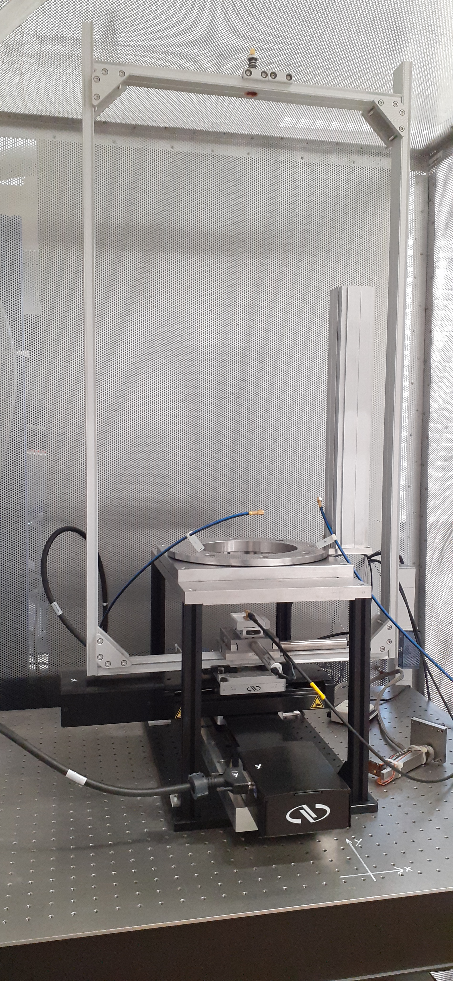
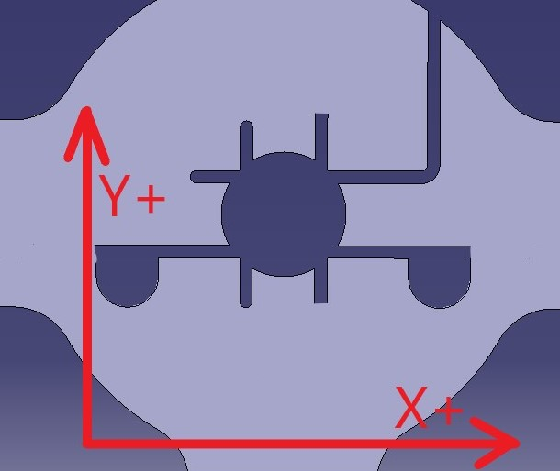
Actual structure
100x200mm frame movement capacity
25x25mm wire parallelism adjustment
Rectangular frame
Thorlab 66mm optical rail
  Not stiff enough for heavy BPM
Calibration via - Optical fork tool
- Capacitive tool
Two inputs VNA
  Requires two-step measurement
Capacitive tool
(Michele Bozzolan (BI-BP) design)

Slide 7
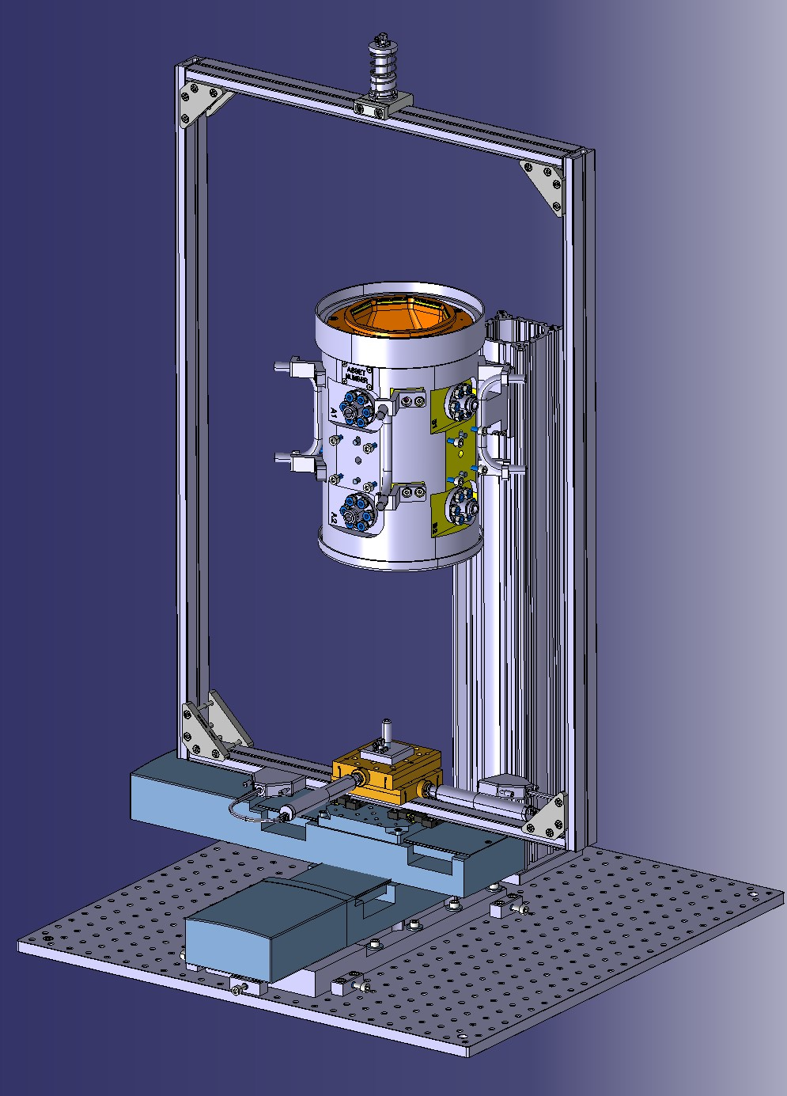
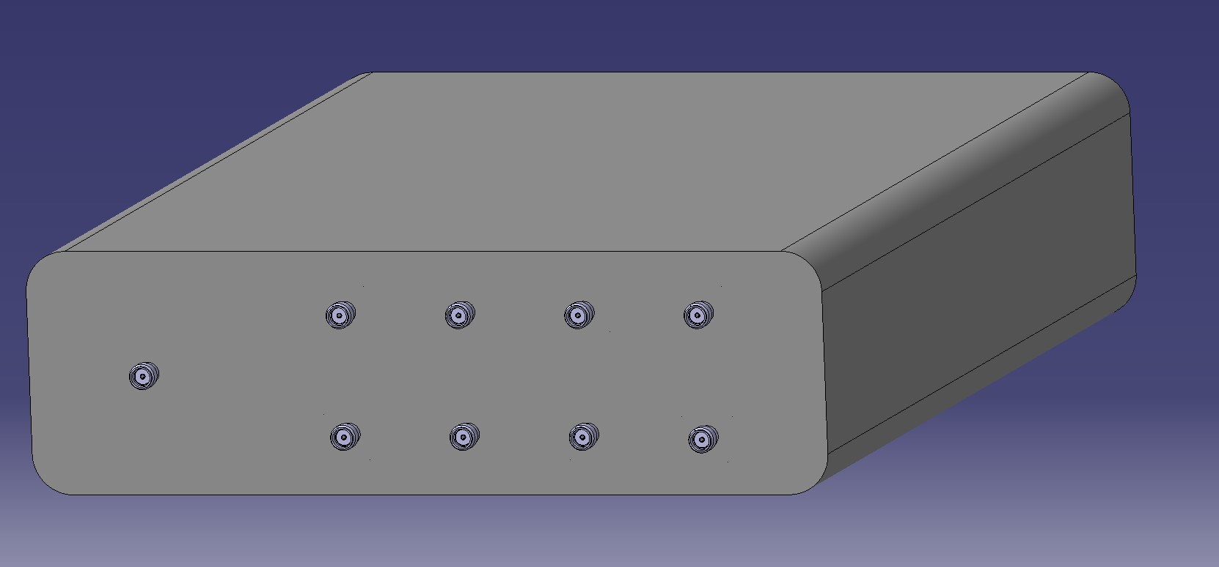
Next steps
Frame and motors : no changes
Thorlabs optical rail replaced by a column and fixation designed by Dmitry Gudkov (BI-ML)
Compatible with heavy BPM without bending
Capacitive tool as the main wire calibration system
Home-made instrument (designed by Henrik Doetsch (BI-BP), based on XILINX RFSoC ZCU111 ) : Simultaneous 8 Channel detection
Theoretical centre position tolerance +/- 60um (HL-LHC BPM). Calculation done by Heeral Bhatt (BI-ML)

Slide 8
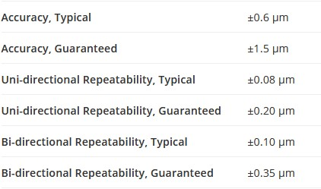
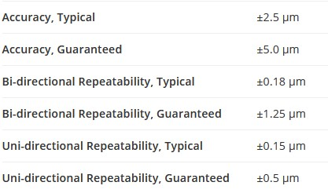
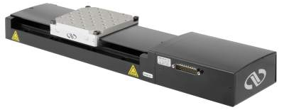
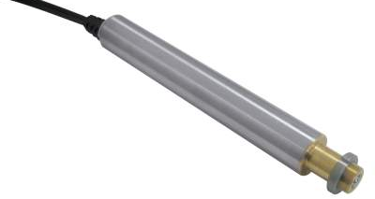
Motors
Frame motors
Newport ILS-100HA, ILS-200HA
Wire correction motors
Newport TRA-25-PPD

Slide 9
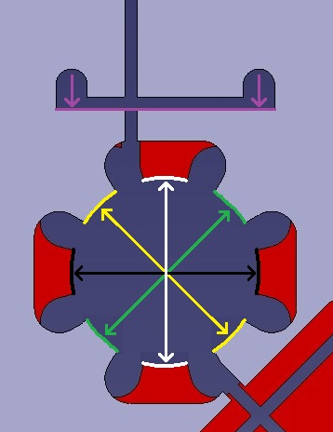
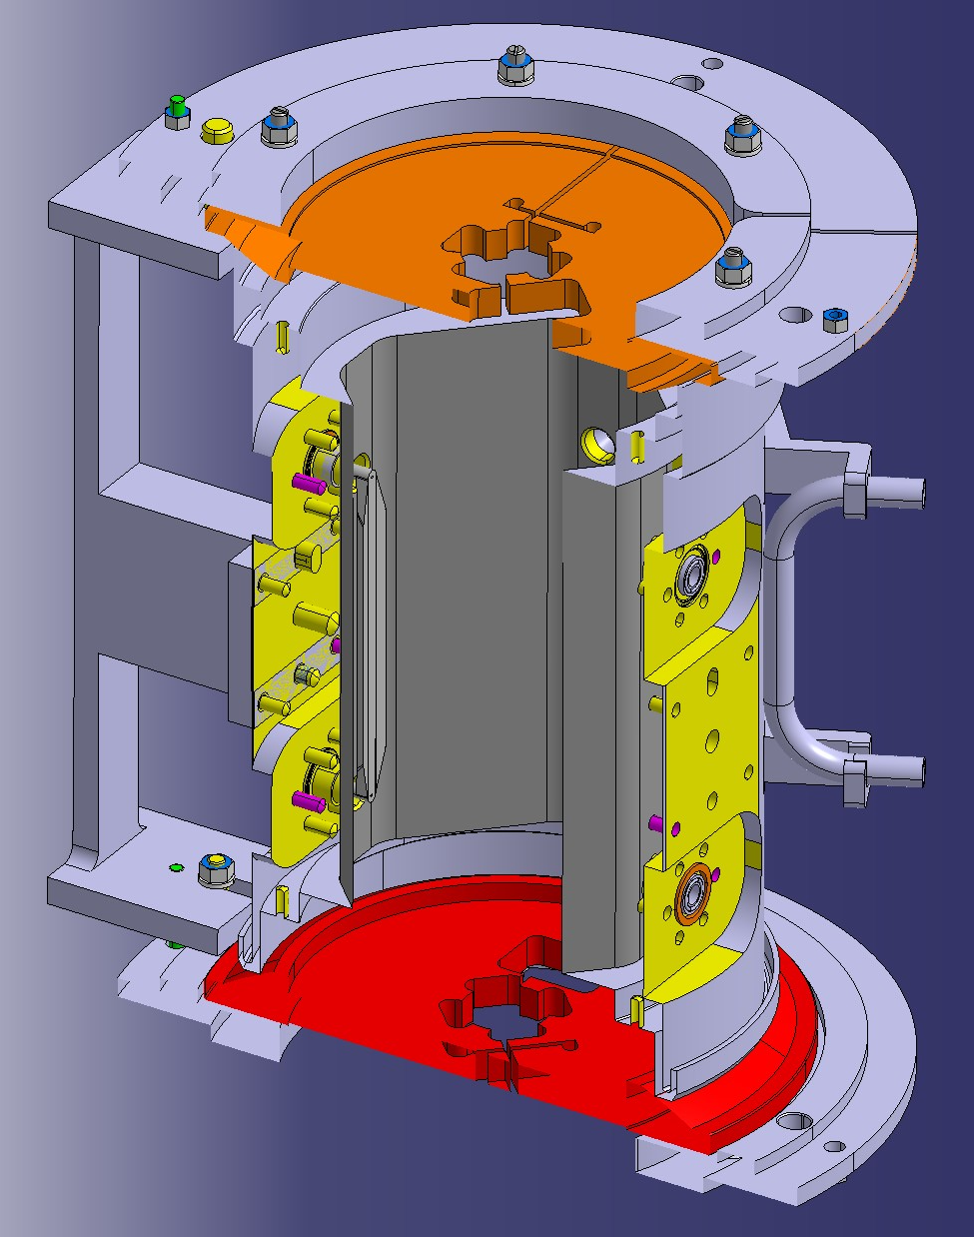
Capacitive Tool (CT) centering method
Wire frame is moved to find equal capacitance against each opposite surface
Each centre for each axis is calculated using the found coordinate
Top tool : Green + Yellow coordinates
Bottom tool : Black + white coordinates.
Wire / BPM beam axis parallelism is corrected using TRA25PPD motors
Rotation measure : calculated using the two measurement points (purple)

Slide 10
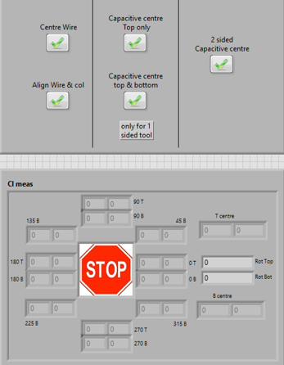
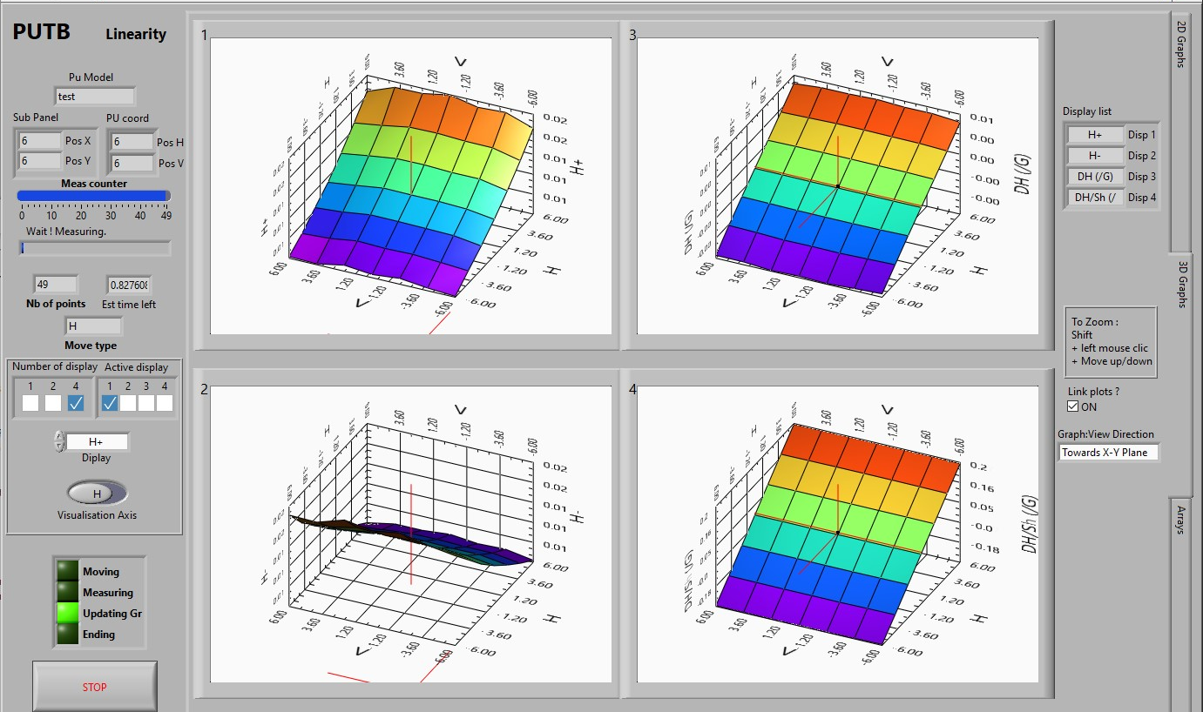
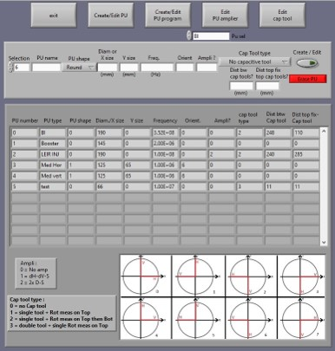
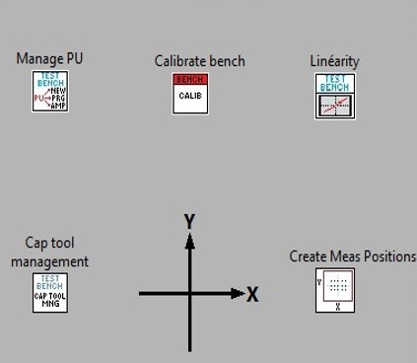
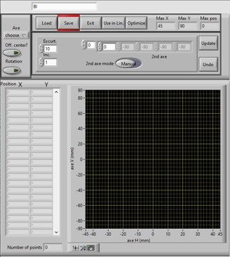
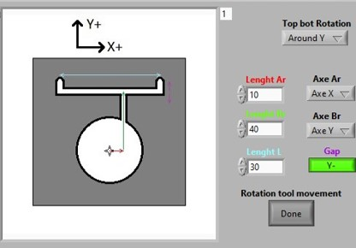
Control software
Calibration software
Linearity software
BPM management
CT creation
Main program
Measurement array creator

Slide 11

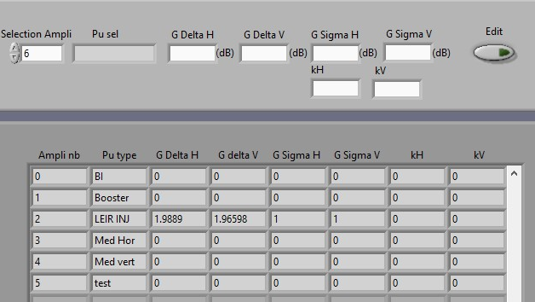
BPM Parameters
This Virtual Instrument (VI) allows the user to fill all needed measurement parameters :
Name,
Shape,
Size,
Measure frequency,
Amplifier gain….
BPM parameters page
amplifier parameters page

Slide 12
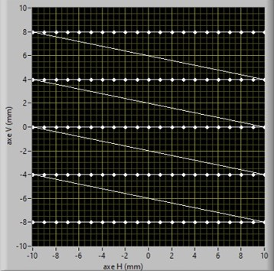
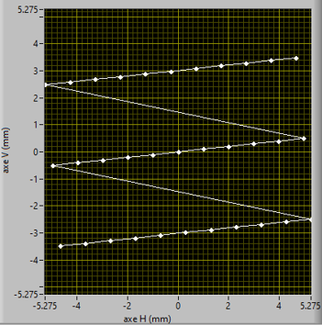
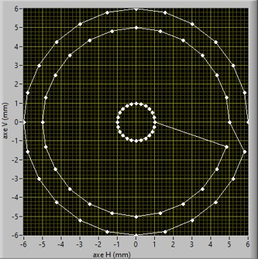
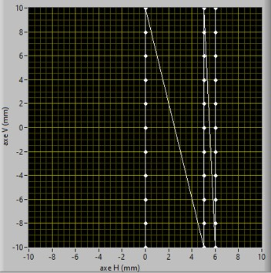
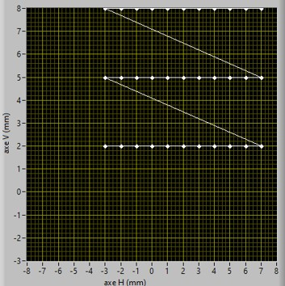
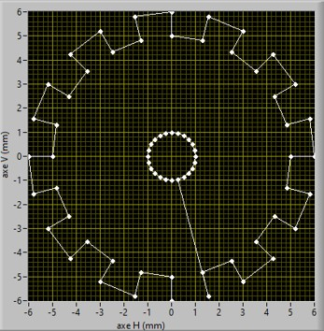
Measurement point array creator
H moves with regular offsets
Moves with rotation
Circular moves
Moves with distance optimization
V moves with manual offsets
Array with general offsets

Slide 13
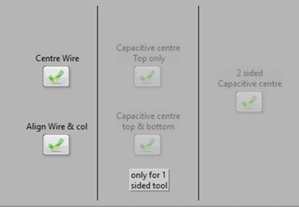
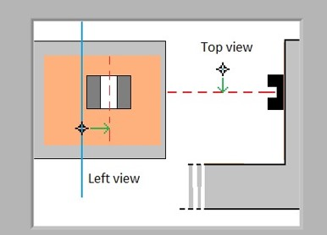
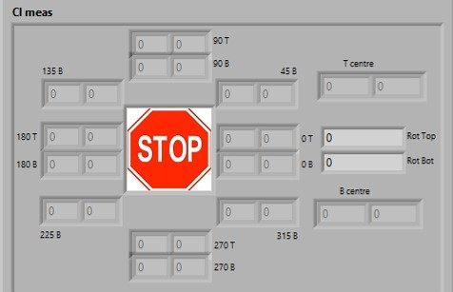
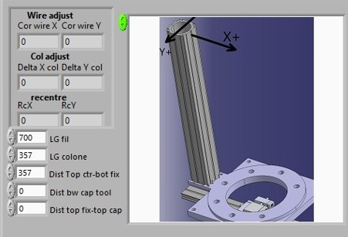
Bench calibration
The Calibration VI guides the users through the required manual step
Measure all points for the wire centre
Define calculated centre as the new motors centre
99% automated with CT calibration mode
Centring method selection.
Wire initial positioning for optical calibration.
Measurement point and centre values.
Manual correction for column system.

Slide 14
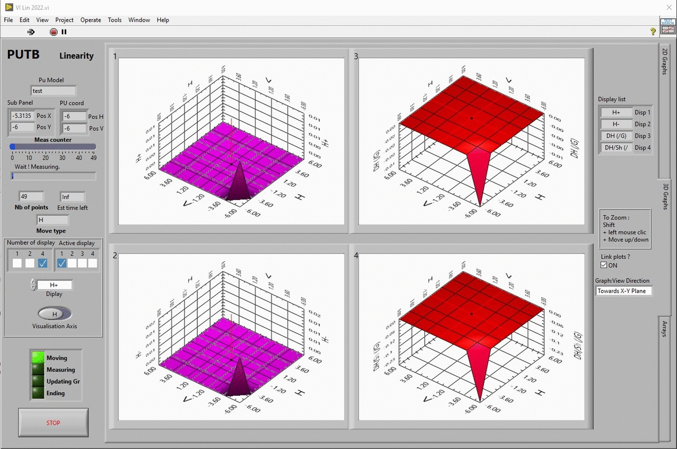
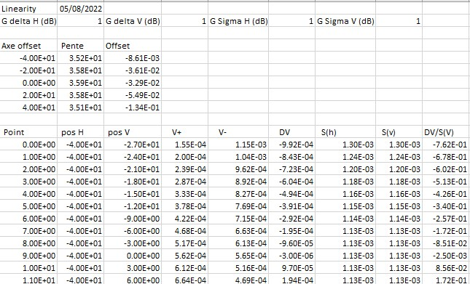
Sensitivity scan software
CSV output file

Slide 15
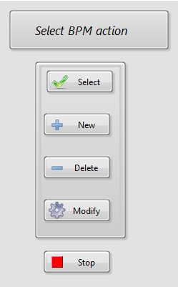
Results
A large number of sensors have been already successfully measured
The quality of the measurements improves with each evolution
Different possibilities of measurements are offered to the user
Soon a new software environment, more user friendly.

