Slide 1





SPS North Area SEM detectors and their absolute calibration
BI Day 2022
L. Parsons França , M.van Dijk, F. Ravotti, F. Roncarolo, C. P. Welsch, H. Zhang

Slide 2




Outline
Background
Calibration Steps
Preliminary Results
Next steps
North Area beamlines
Experimental setup 1
SEM operating principle
Activation measurement + calculations
POT and spill
Why calibrate?
Experimental setup 2
North Area Beamlines
SEM operating principle
Why Calibrate?
Calibration Steps
Experimental Setup m1
Activation measurement + calculations
Experimental Setup m2
Preliminary Results
Next steps
Background

Slide 3
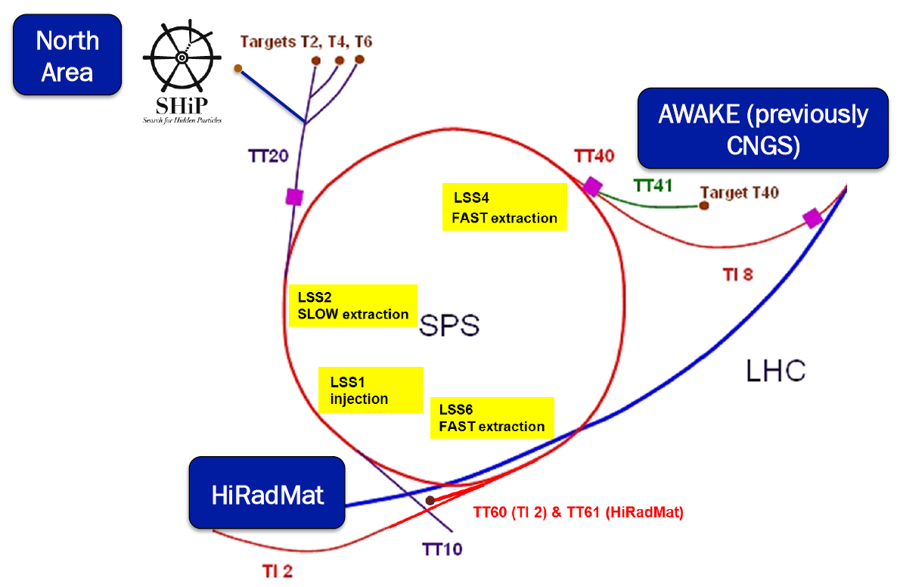


Location
Background
Calibration Steps
Preliminary Results
Next steps

Slide 4
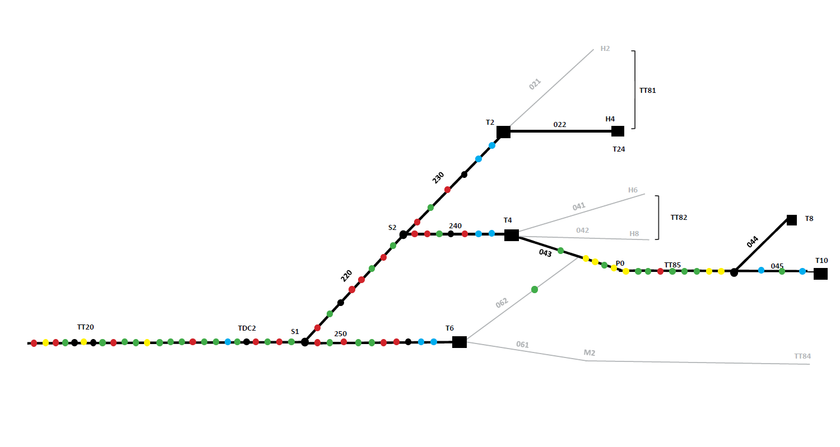
North Area Beamlines
Nearest Beam Current Transformer is in the SPS ring (before extraction)
Background
Calibration Steps
Preliminary Results
Next steps

Slide 5
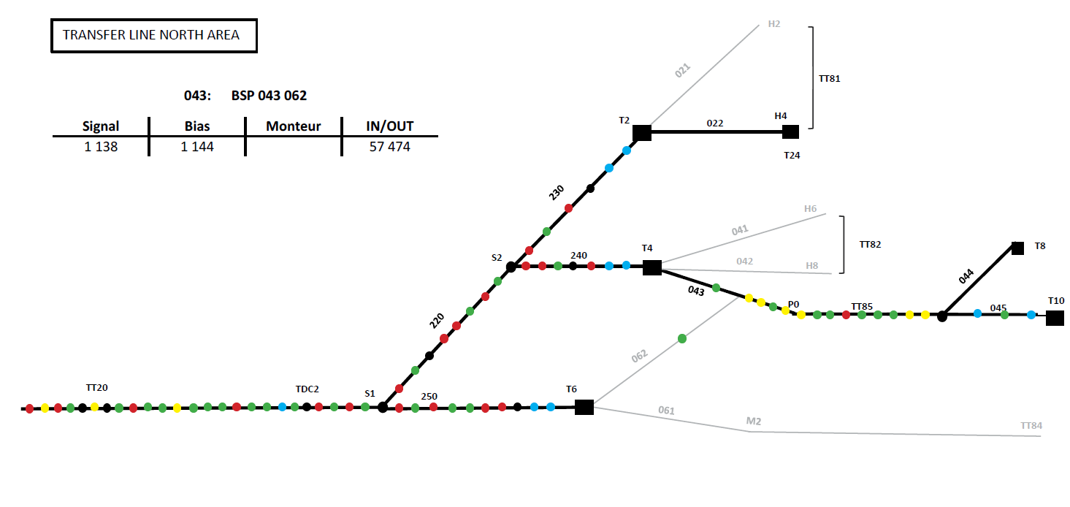
North Area Beamlines
Many types of Secondary Emission Monitors (SEMs) are used in TT20:
BSM(H,V) – beam position
BSP(H,V) – beam position
BSG(H,V) – beam profile/position
BBS(H,V) – beam profile/position
BSI – beam intensity
We will focus on BSI (beam intensity)
Calibration Location
210
Background
Calibration Steps
Preliminary Results
Next steps

Slide 6
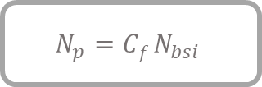
Operating
Principle
Protons hit metal foils/bands transferring energy to the material
Energy transfer liberates electrons, generating a current, that can be measured
The number of electrons emitted per incident proton is known as the Secondary Emission Yield (SEY)
The number of ADC counts in the device is related to the number of protons via a calibration factor:
BSI (Al or Ti Plate)
P+
Signal
BIAS
BIAS
e-
$$N_{p}={Cf N}_{bsi}$$
Beam Secondary emission Intensity (BSI)
Background
Calibration Steps
Preliminary Results
Next steps

Slide 7
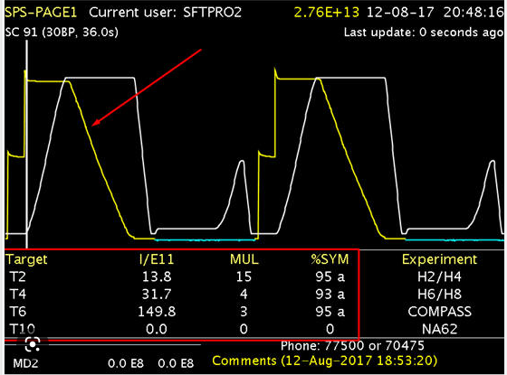
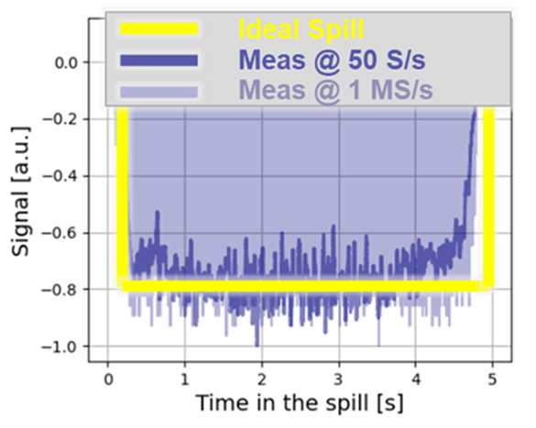
Protons on Target and Spill
Current measured BCT
Extraction
From SPS into NA
Protons extracted from SPS ring split between different targets
BSIs at each target measure protons on target (POT)
Spill corresponds to one extraction period (~ 4.8s in NA)
Ideal spill measured by BSI is flat, but in practice there are fluctuations in the signal
BSI
7
Background
Calibration Steps
Preliminary Results
Next steps

Slide 8
Why Calibrate?
Recent renewed interest in North Area
Fixed target experiments need accurate number of Protons On Target (POT) for reference
The calibration uncertainty is dominated by the SEY
Changes in the material over time could affect SEY (e.g. radiation and vacuum history)
Instrumentation in North Area has not been calibrated since the 90s
Background
Calibration Steps
Preliminary Results
Next steps

Slide 9
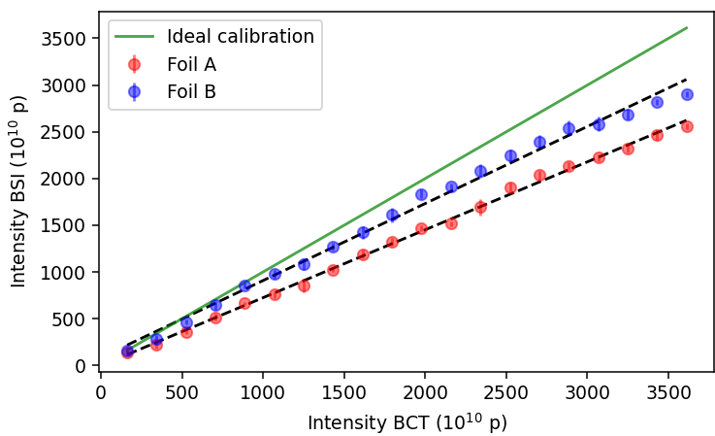
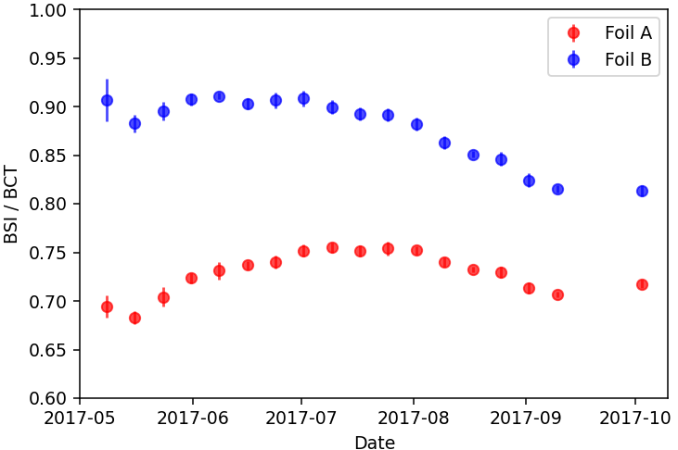
2017 Data Highlighting Calibration Uncertainties
Slope = 0.82
Slope = 0.73
Slope deviation possible causes:
• Systematic errors in the BSI calibration
• Absolute extraction losses
Non linearity possible causes:
• SEY drift in time
• Variation of losses with beam intensity.
Background
Calibration Steps
Preliminary Results
Next steps

Slide 10
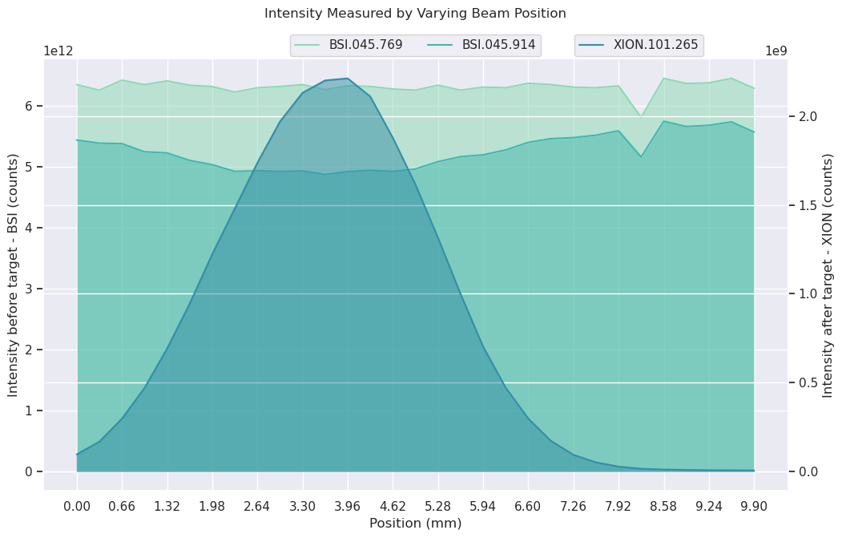
Damage to the BSI Foil
Upstream of Target box, minimal damage to foil
BSI Inside Target box has dip in intensity which coincides with centre of target
Background
Calibration Steps
Preliminary Results
Next steps

Slide 11
Challenges for Calibration
TT20 is a slow extracted beamline (beam not bunched)
Beam current transformers (BCTs ) not suitable
First order BSI calibration- compare to BCTs located in SPS ring (before de-bunching):
  Affected by knowledge of absolute losses between SPS and TT20
Use known calibration technique: “activation method”
  Performed in the past in North Area
  Used more recently in East Area
TT20
BSI
BCT
SPS
Background
Calibration Steps
Preliminary Results
Next steps

Slide 12

Calibration steps
Insert foil stack in beamline
Irradiate for short period
Remove foils
Cool down
Measure activity in foils
Use activation cross-section to find number of protons
Compare to current measured by BSI
Background
Calibration Steps
Preliminary Results
Next steps

Slide 13
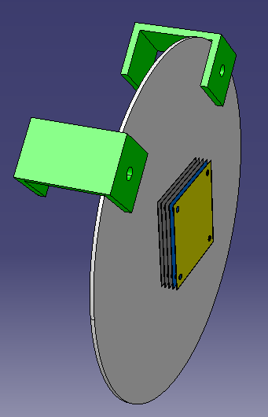
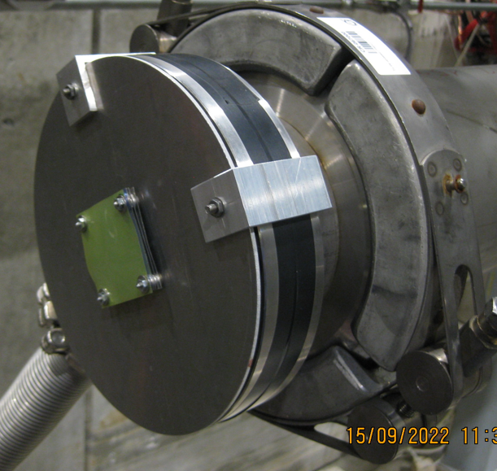
Experimental Setup m1
Insert foil stack in beamline
Irradiate for short period
Remove foils
Cool down
Measure activity in foils
Use activation cross-section to find number of protons
Compare to current measured by BSI
Aluminium foils (100 μm thick) x 3
Gafchromic Films x2
Foils irradiated for ~ 30 mins
f2
f3
f1
Beam
Gafchromic Films
Background
Calibration Steps
Preliminary Results
Next steps

Slide 14
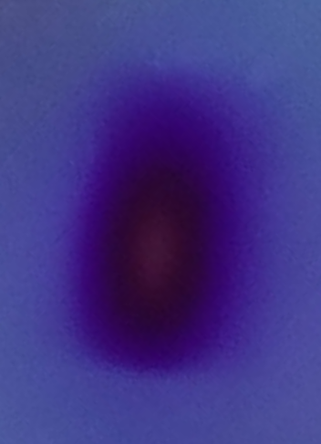
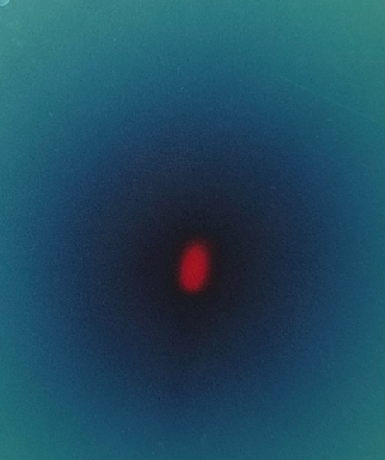
Activation Measurement 1
Remove foils
Cool down
Measure activity in foils
Na-24 peak
Thin film
(beamspot only)
Thick film
(full area)
Foil 1 (most downstream) has significantly lower activity
Central foil to be used
From M. van Dijk
Background
Calibration Steps
Preliminary Results
Next steps

Slide 15
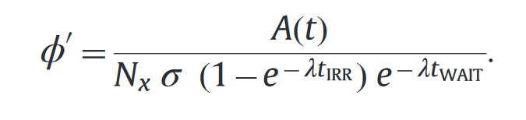
POT Calculations
Measure activity in foils
Use activation cross-section to find number of protons
Surface Atomic density
Activity
Irradation time
Time elapsed since irradiation
Cross-section
Decay constant
No. particles per second traversing foil
Background
Calibration Steps
Preliminary Results
Next steps

Slide 16
Considerations and Corrections
Assessment of material composition (99.5% Al): impurities negligible
Interactions in material generate neutrons and other charged particles
Generates additional activation
Scales with thickness of foil material
Two values available for 24-Na cross-section in aluminium at high energy
CERN @ 400 GeV 8.79 +/- 0.18 mb (corrected for extra activation)
Fermilab @ 300 GeV 8.15+/-0.59 mb (corrected to match energy)
From M. van Dijk
Background
Calibration Steps
Preliminary Results
Next steps

Slide 17
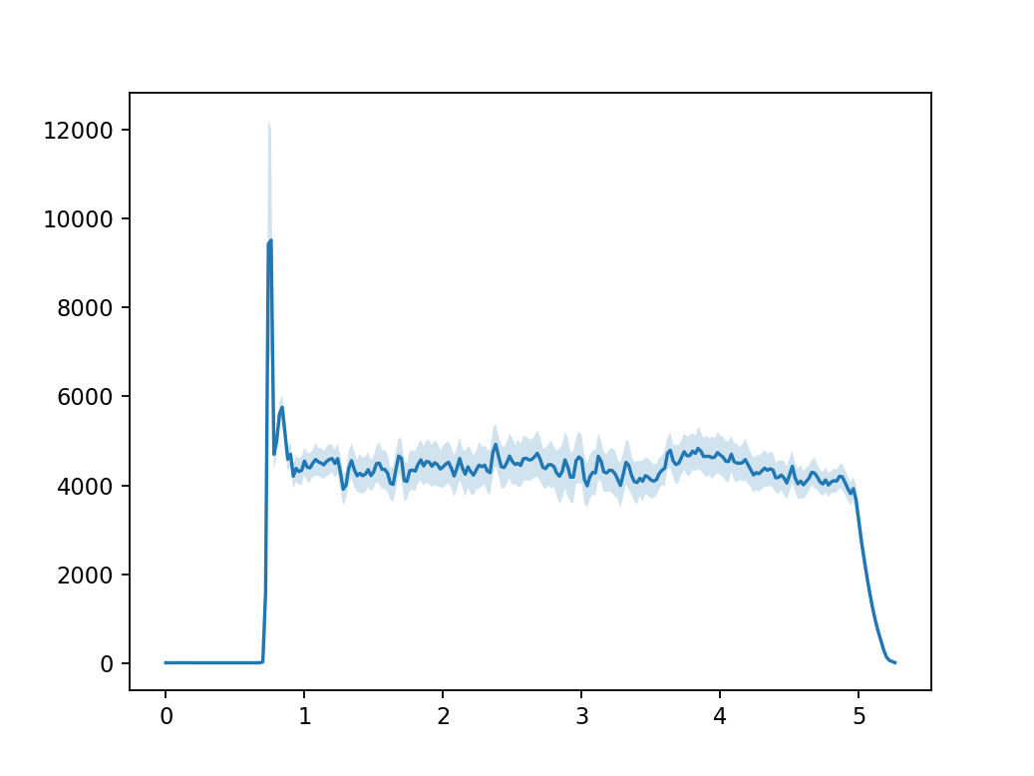

BSI Measurement
Use activation cross-section to find number of protons
Compare to current measured by BSI
Mean of 109 spills
Step 1: Add all adc counts for each spill
Step 2: Scale by the gain (400V)
Step 3: Total counts = 109 spill integrals added
ADC counts
Time (s)
Spill integral
Background
Calibration Steps
Preliminary Results
Next steps

Slide 18
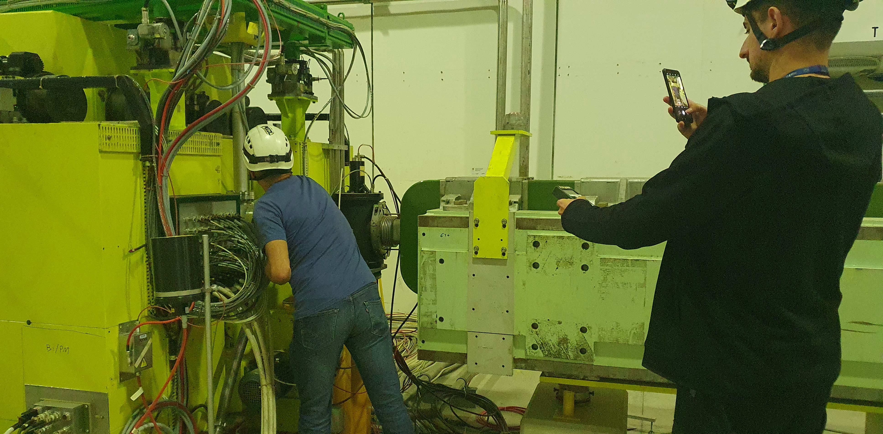
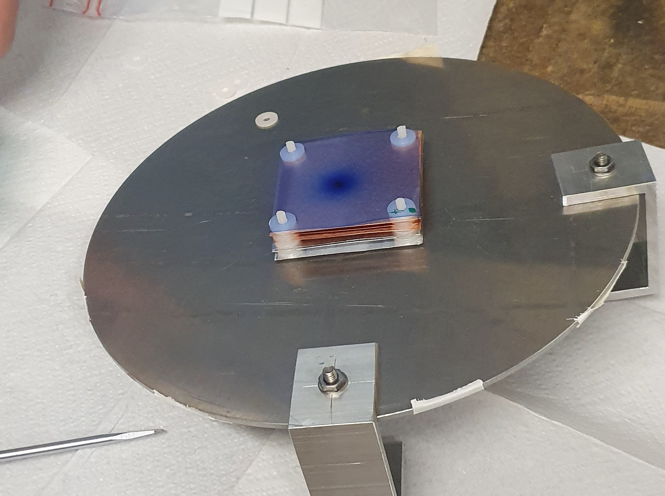
Experimental Setup 2
Aluminium foils - 99.999% purity (100 μm thick) x 3
Copper foils - 99.99% purity (100 μm thick) x 3
Gafchromic Films x2
Foils irradiated for ~ 30 mins
Gafchromic Films
Cu Foils
Al Foils
Plastic spacer

Slide 19
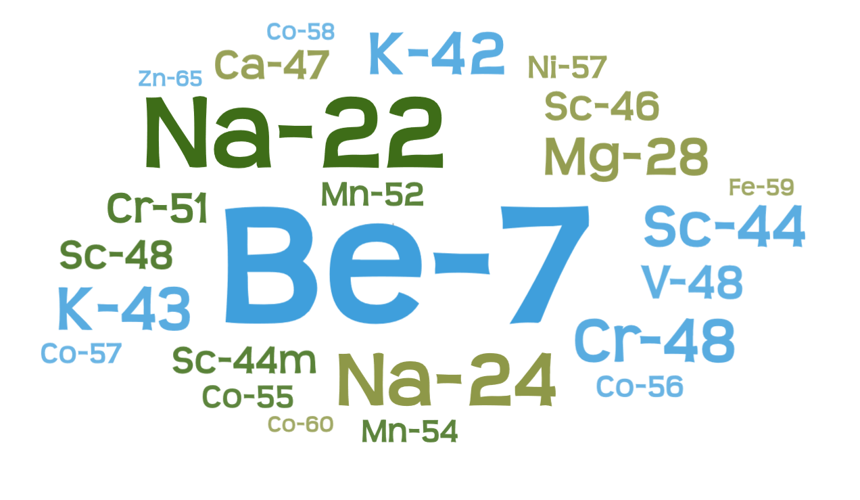
Measurement 2 Data Analysis
Cooldown period was much longer (~5 days)
Many more isotopes were found in gamma spectrometry analysis
Background
Calibration Steps
Preliminary Results
Next steps

Slide 20
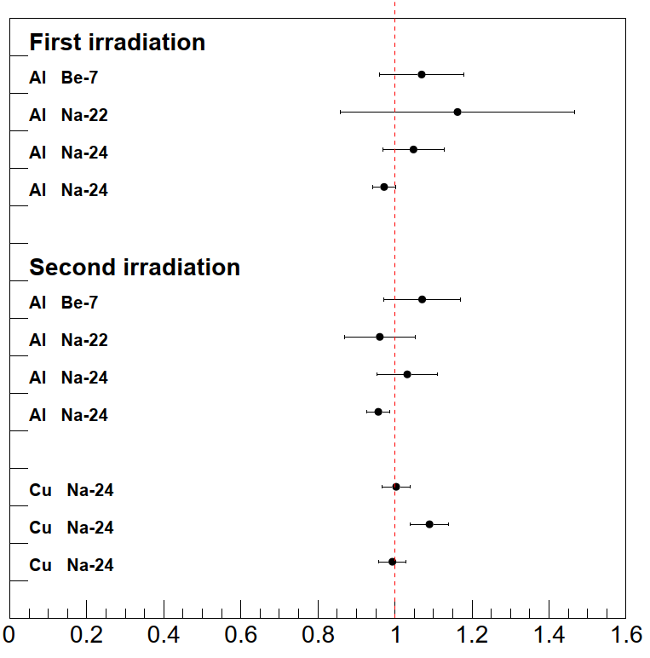

Preliminary Results
Current cf= 1.3e9
Calibraction Factor
Protons measured
With activation method
$$C_{f}\text{=}\frac{N_{activation}}{N_{bsi}}$$
Protons measured
with BSI
Plot from M. van Dijk
C_{f} = 99.1 +/- 1.8%
Background
Calibration Steps
Preliminary Results
Next steps

Slide 21
Conclusion and next steps
Data analysis is still ongoing
We will compare our results to each other to check for systematic errors
We aim to:
  Repeat the measurements in other target locations
  Propose new BSI monitor design optimised for this kind of calibration → ~easy (and ALARA ‘friendly’) installation and removal of activation foil close to BSI foil
We plan to standardise the procedure to make it repeatable for regular implementation in these beamlines
Background
Calibration Steps
Preliminary Results
Next steps

Slide 22

Questions

Slide 23
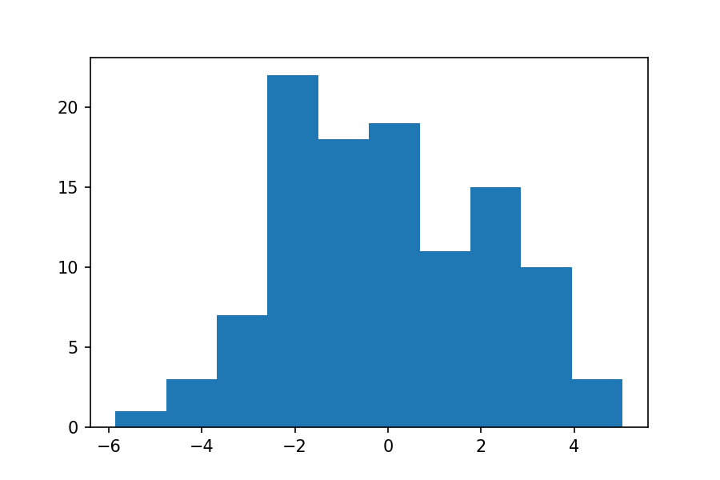
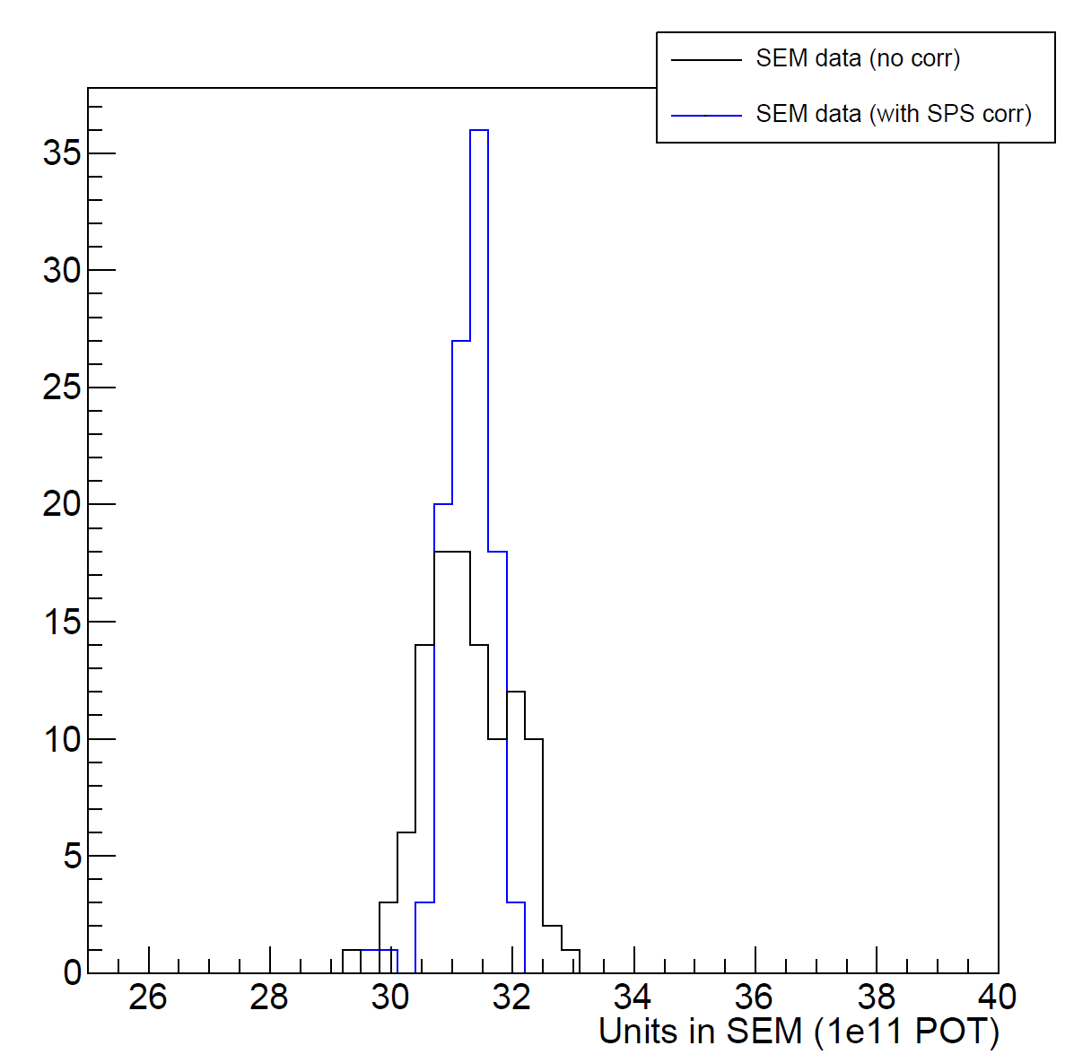
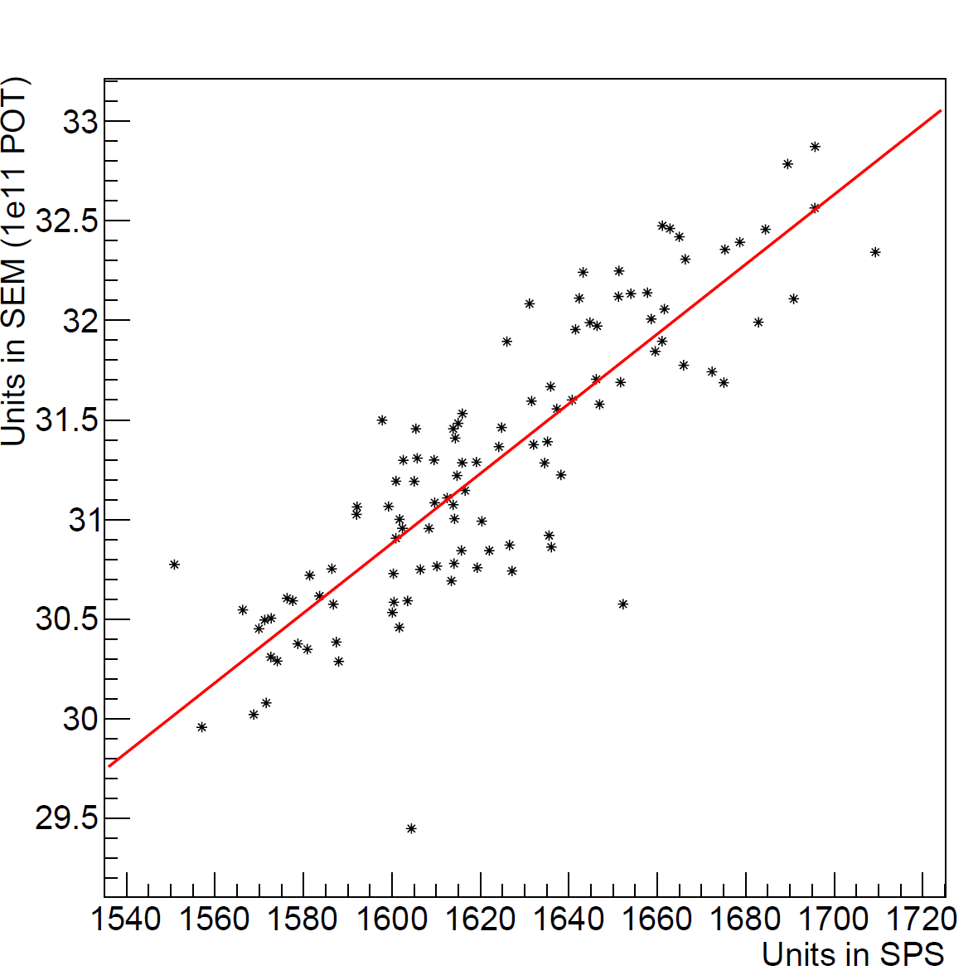
Estimation of statistical error on BSI
Deviation from mean for integrated adc counts
Check for correlation between BSI and BCT measurements
Apply correlation correction to bsi data
Error %
variation on individual measurement ~2%
But this includes variation of the beam intensity
2 Plots from M. van Dijk
new variation on BSI measurement: 1.2%
Error on total adc counts = error on the mean (0.11%)

