Slide 1

Rad-Tol COTSs Qualification for LHC BPM CONS
Selim Can Ozdogan on behalf of SY-BI-BP
16 Dec 2022

Slide 2
Rad-Tol COTSs Qualification for LHC BPM CONS
Agenda
  Introduction & Motivation
  LHC BPM Consolidation project
  Radiation qualification of Commercial Off The Shelf (COTS) components
  Summary

Slide 3
Rad-Tol COTSs Qualification for LHC BPM CONS
Agenda
  Introduction & Motivation
  LHC BPM Consolidation project
  Radiation qualification of Commercial Off The Shelf (COTS) components
  Summary

Slide 4
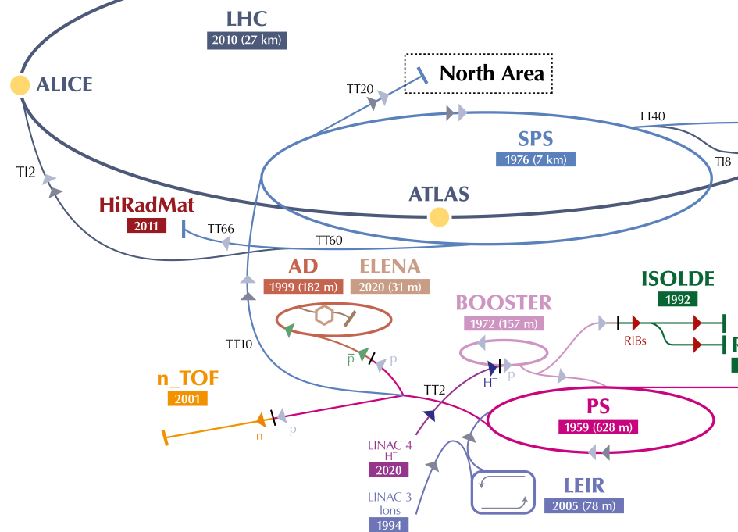
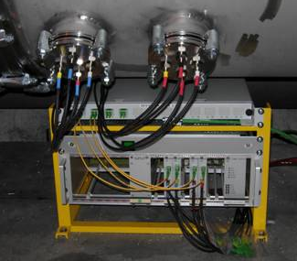
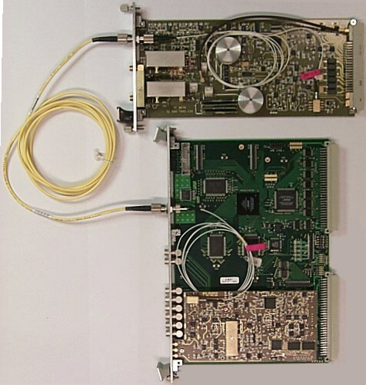
Introduction & Motivation
Current LHC BPM system overview
~1250 BPMs
  Located at LHC ring and TI2 & TI8
  Button & Stripline BPM pick-ups
  Dual plane (H & V)
Front-End (FE) readout based on analog electronics
Back-End (BE) based on Digital Acquisition Board (DAB) from BI
Why is a consolidation required?
System operating for ~20 years
  Aging of electronics -> performance and reliability issues
  Limited spares -> long run maintenance compromised
  Complicated calibration procedures
Surface
Tunnel
Tunnel installation
BE & FE readout electronics

Slide 5
Rad-Tol COTSs Qualification for LHC BPM CONS
Agenda
  Introduction & Motivation
  LHC BPM Consolidation project
  Radiation qualification of Commercial Off The Shelf (COTS) components
  Summary

Slide 6
LHC BPM Consolidation Project – Radiation Environment
Current annual (360 fb⁻¹) LHC radiation levels
 | TID (Gy) | HEH (cm⁻²) | Th. Neut. (cm⁻²) | 1MeVn-eq (cm⁻²)
Arcs | 0.05 | 5.0 · 10⁷ | 5.0 · 10⁸ | 5.0 · 10⁸
RRs | 4.8 (max.) | 4.8 · 10⁹ (max.) | 4.8· 10¹⁰(max.) | 4.8 · 10¹⁰ (max.)
Values extracted from “CERN-ACC-NOTE-2018-088 “ and calculated with EDMS 2302154
Increased luminosity in HL-LHC operation Higher radiation levels
Expected annual (360 fb⁻¹) HL-LHC radiation levels
 | TID (Gy) | HEH (cm⁻²) | Th. Neut. (cm⁻²) | 1MeVn-eq (cm⁻²)
Arcs | 1.4 | 2.4 · 10⁹ | 1.2 · 10¹⁰ | 1.6 · 10¹⁰
RRs | 25 (max.) | 1.4 · 10¹⁰ (max.) | 1.2 · 10¹¹(max.) | 7 · 10¹⁰ (max.)
Values extracted from the “Radiation level specification document for HL-LHC” (EDMS 2302154)

Slide 7
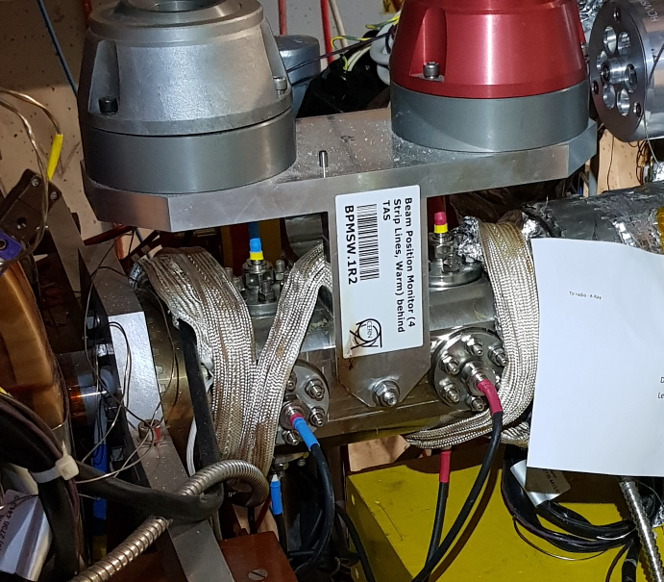
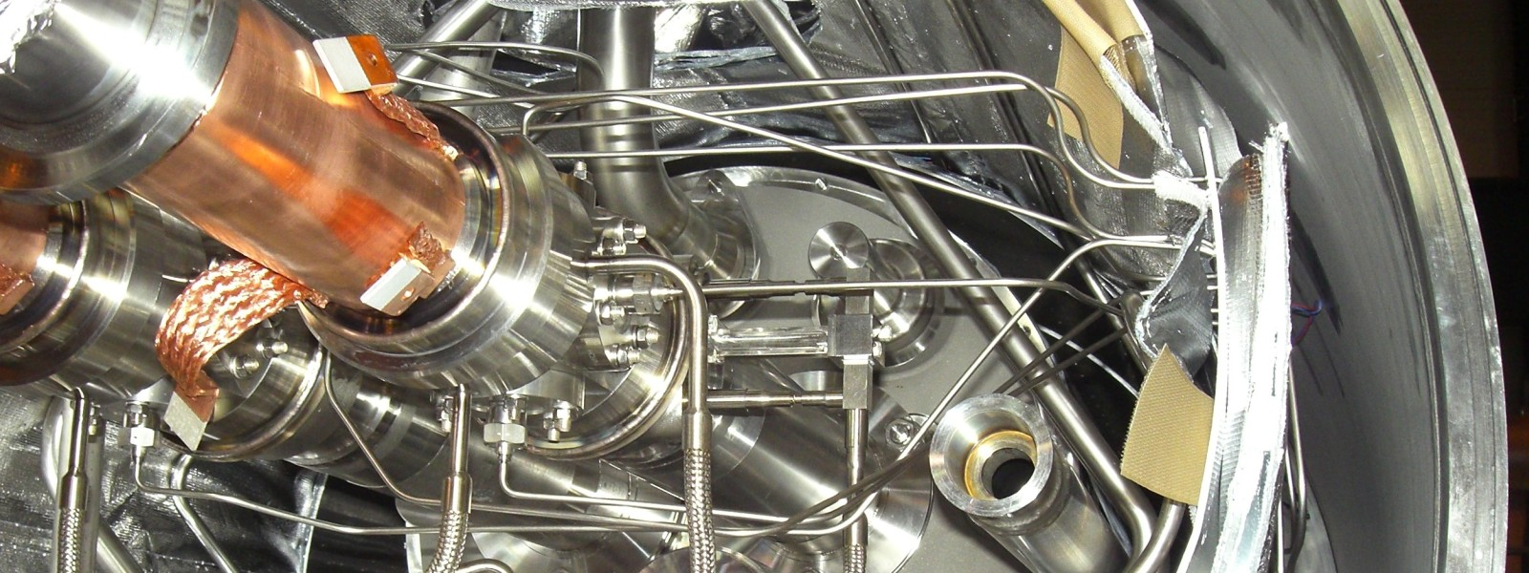
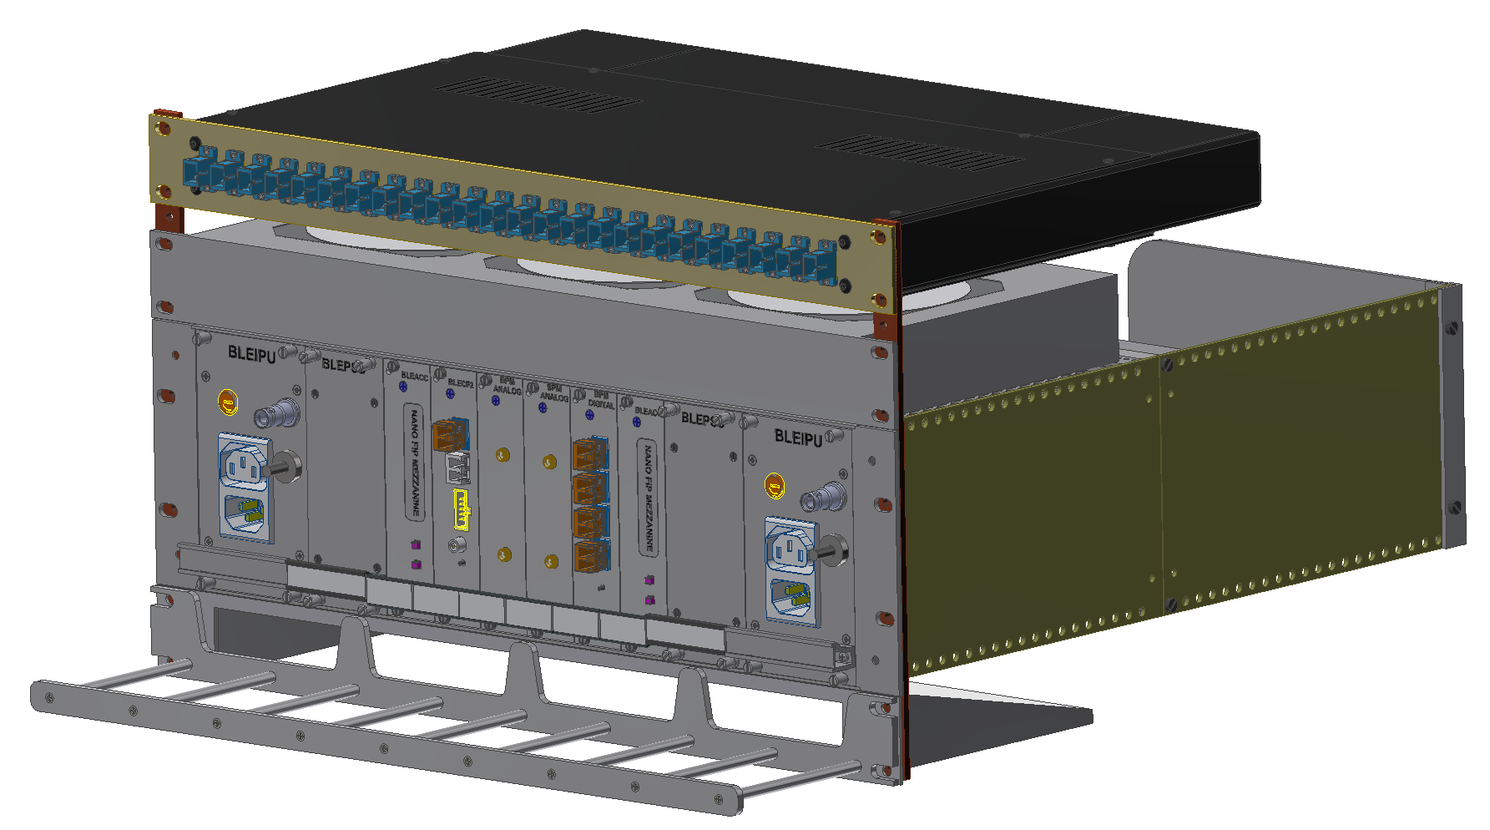
LHC BPM Consolidation Project – Architecture
BPM pick-ups
Reuse of current infrastructure
  BPMs pick-ups
  Cryo-cables, Coaxial cables & Optical fibres
  Slow control fieldbus (WorldFIP)
Front-End
  Exposed to radiation
  Slow control interface: NanoFIP FMC (developed by BE-CEM)
  Crate shared with BLM (developed by SY-BI-BL)
Optical link for data read-out (in collaboration with EP-ESE)
Back-End TBD
Cryo-cables
3D model courtesy of William Vigano (SY-BI-BL)
Surface
Tunnel
BE
FE
BLM side
BPM side
Tunnel installation
BE & FE readout electronics

Slide 8
LHC BPM Consolidation Project – Front-End readout block diagram
  BPM pick-ups as current system
  Analog Front-End TBD
  Digital Front-End:
    ADC (4 x 12-bit @ 1.28GSps)
    Clock Scheme: Crystal Oscillator & Clock Synthesizer
    Optical link: 4 x 10 Gbps per BPM
All active components must be radiation tolerant.
Tunnel
Surface
Digital Front-End
BPM1
LPF
ATT.
AMP.
ADC
Optical Transmitter
DELAY
Optical Transmitter
Optical
MUX
DELAY
Optical Transmitter
LPF
ATT.
AMP.
ADC
Optical Transmitter
Analog Front-End
Clock
Synth
Osc.
BPM2
DELAY
LPF
ATT.
AMP.
ADC
Optical Transmitter
Optical Transmitter
Optical
MUX
DELAY
LPF
ATT.
AMP.
ADC
Optical Transmitter
Optical Transmitter

Slide 9
LHC BPM Consolidation Project – Front-End main components
Front-End components selection | Front-End components selection
Component Type | Component Type | Number of candidates | Comments
ADC | ADC | 2 | One preferred candidate from Teledyne
Clocks scheme | Crystal osc. | 3 | Selection based on ADC requirements
 | Clock synth. | 3
Optical link | CERN custom (VTTx) | 1 | Primary option RadHard by design
 | COTS Transceivers | 8 | Secondary option
Other COTS | Other COTS | - | TBD

Slide 10
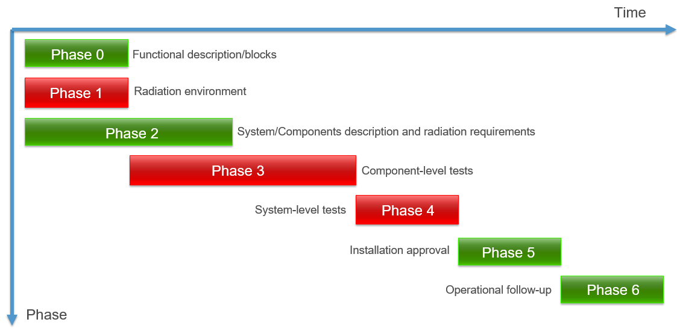


LHC BPM Consolidation Project – Radiation Hardness Assurance (RHA) timeline
2020
2022
2023
2024
2025
A: Clock scheme
B: Optical link
C: ADC
D: Other COTSs
E: Front-End
A
B
C
D
E

Slide 11
Rad-Tol COTSs Qualification for LHC BPM CONS
Agenda
  Introduction & Motivation
  LHC BPM Consolidation project
  Radiation qualification of Commercial Off The Shelf (COTS) components
  Summary

Slide 12
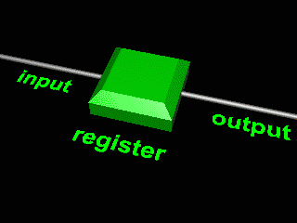
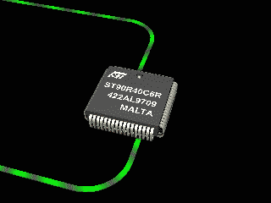
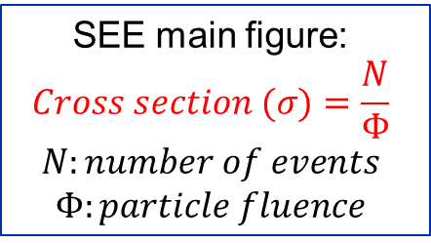
Radiation qualification of COTS components – Radiation effects to electronics
Cumulative Effects
Single Event Effects (SEE)
Total Ionizing Dose (TID)
Displacement Damage (DD)
Soft Effects
Hard Effects
Single Event Upset
(SEU)
Single Event Transient
(SET)
Single Event Functional Interrupt
(SEFI)
Single Event Latch-up
(SEL)
Single Event BurnOut
(SEBO)
Single Event Gate Rupture
(SEGR)
Lifecycle of all types of components
Bipolar
&
Opto elec.
TID unit:
Gray (Gy)
DD unit:
1MeVn-eq
SEE main figure:
$$Cross section (σ)=\frac{N}{\text{Φ}}$$
$$N:number of events$$
$$\text{Φ}:particle fluence$$
https://www.famars.unibas.ch/singanim.htm
https://www.famars.unibas.ch/lunpanim.htm

Slide 13
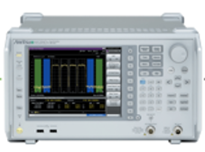
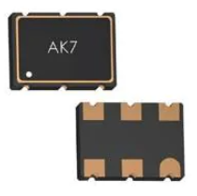
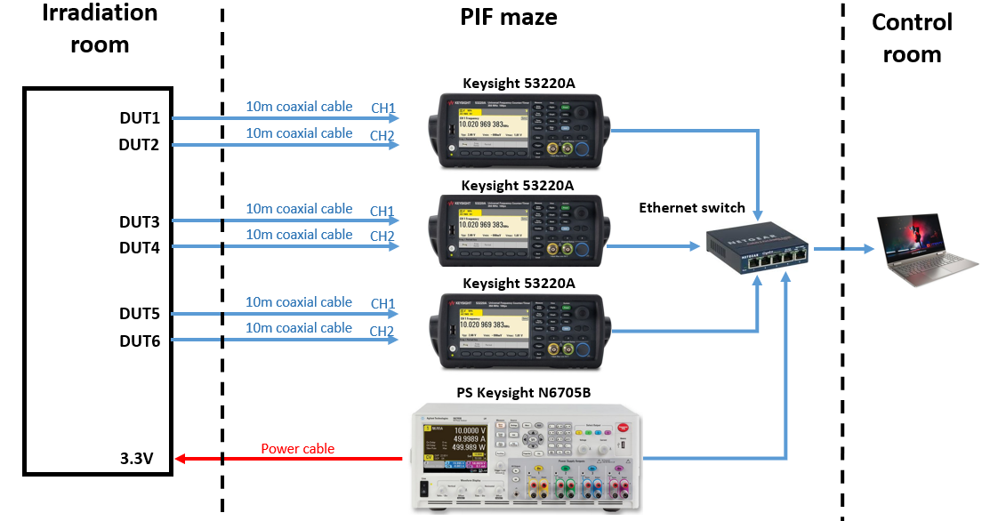
Radiation qualification of COTS components – Clocks Scheme
Crystal Oscillator
3 candidates selected
  Frequency:100MHz-200MHz
  Output Type: LVDS
  RMS Jitter: fs regime
1 candidate tested (6 samples)
  Radiation Test campaign carried out @PSI
    total ionizing dose (TID): 500 Gy
    proton fluence: 8.60x10¹¹ p/cm⁻²
Monitored Parameters:
  Output Clock Frequency
  Duty Cycle
  Rise/Fall Times
  Phase Noise
  Current Consumption
Spectrum Analyzer
DUT1
DUT2
Frequency Counter
DUT3
DUT4
Frequency Counter
DUT5
DUT6
Frequency Counter
Power Analyzer
No significant degradation of the monitored parameters during the test
Waiting for radiation test report

Slide 14
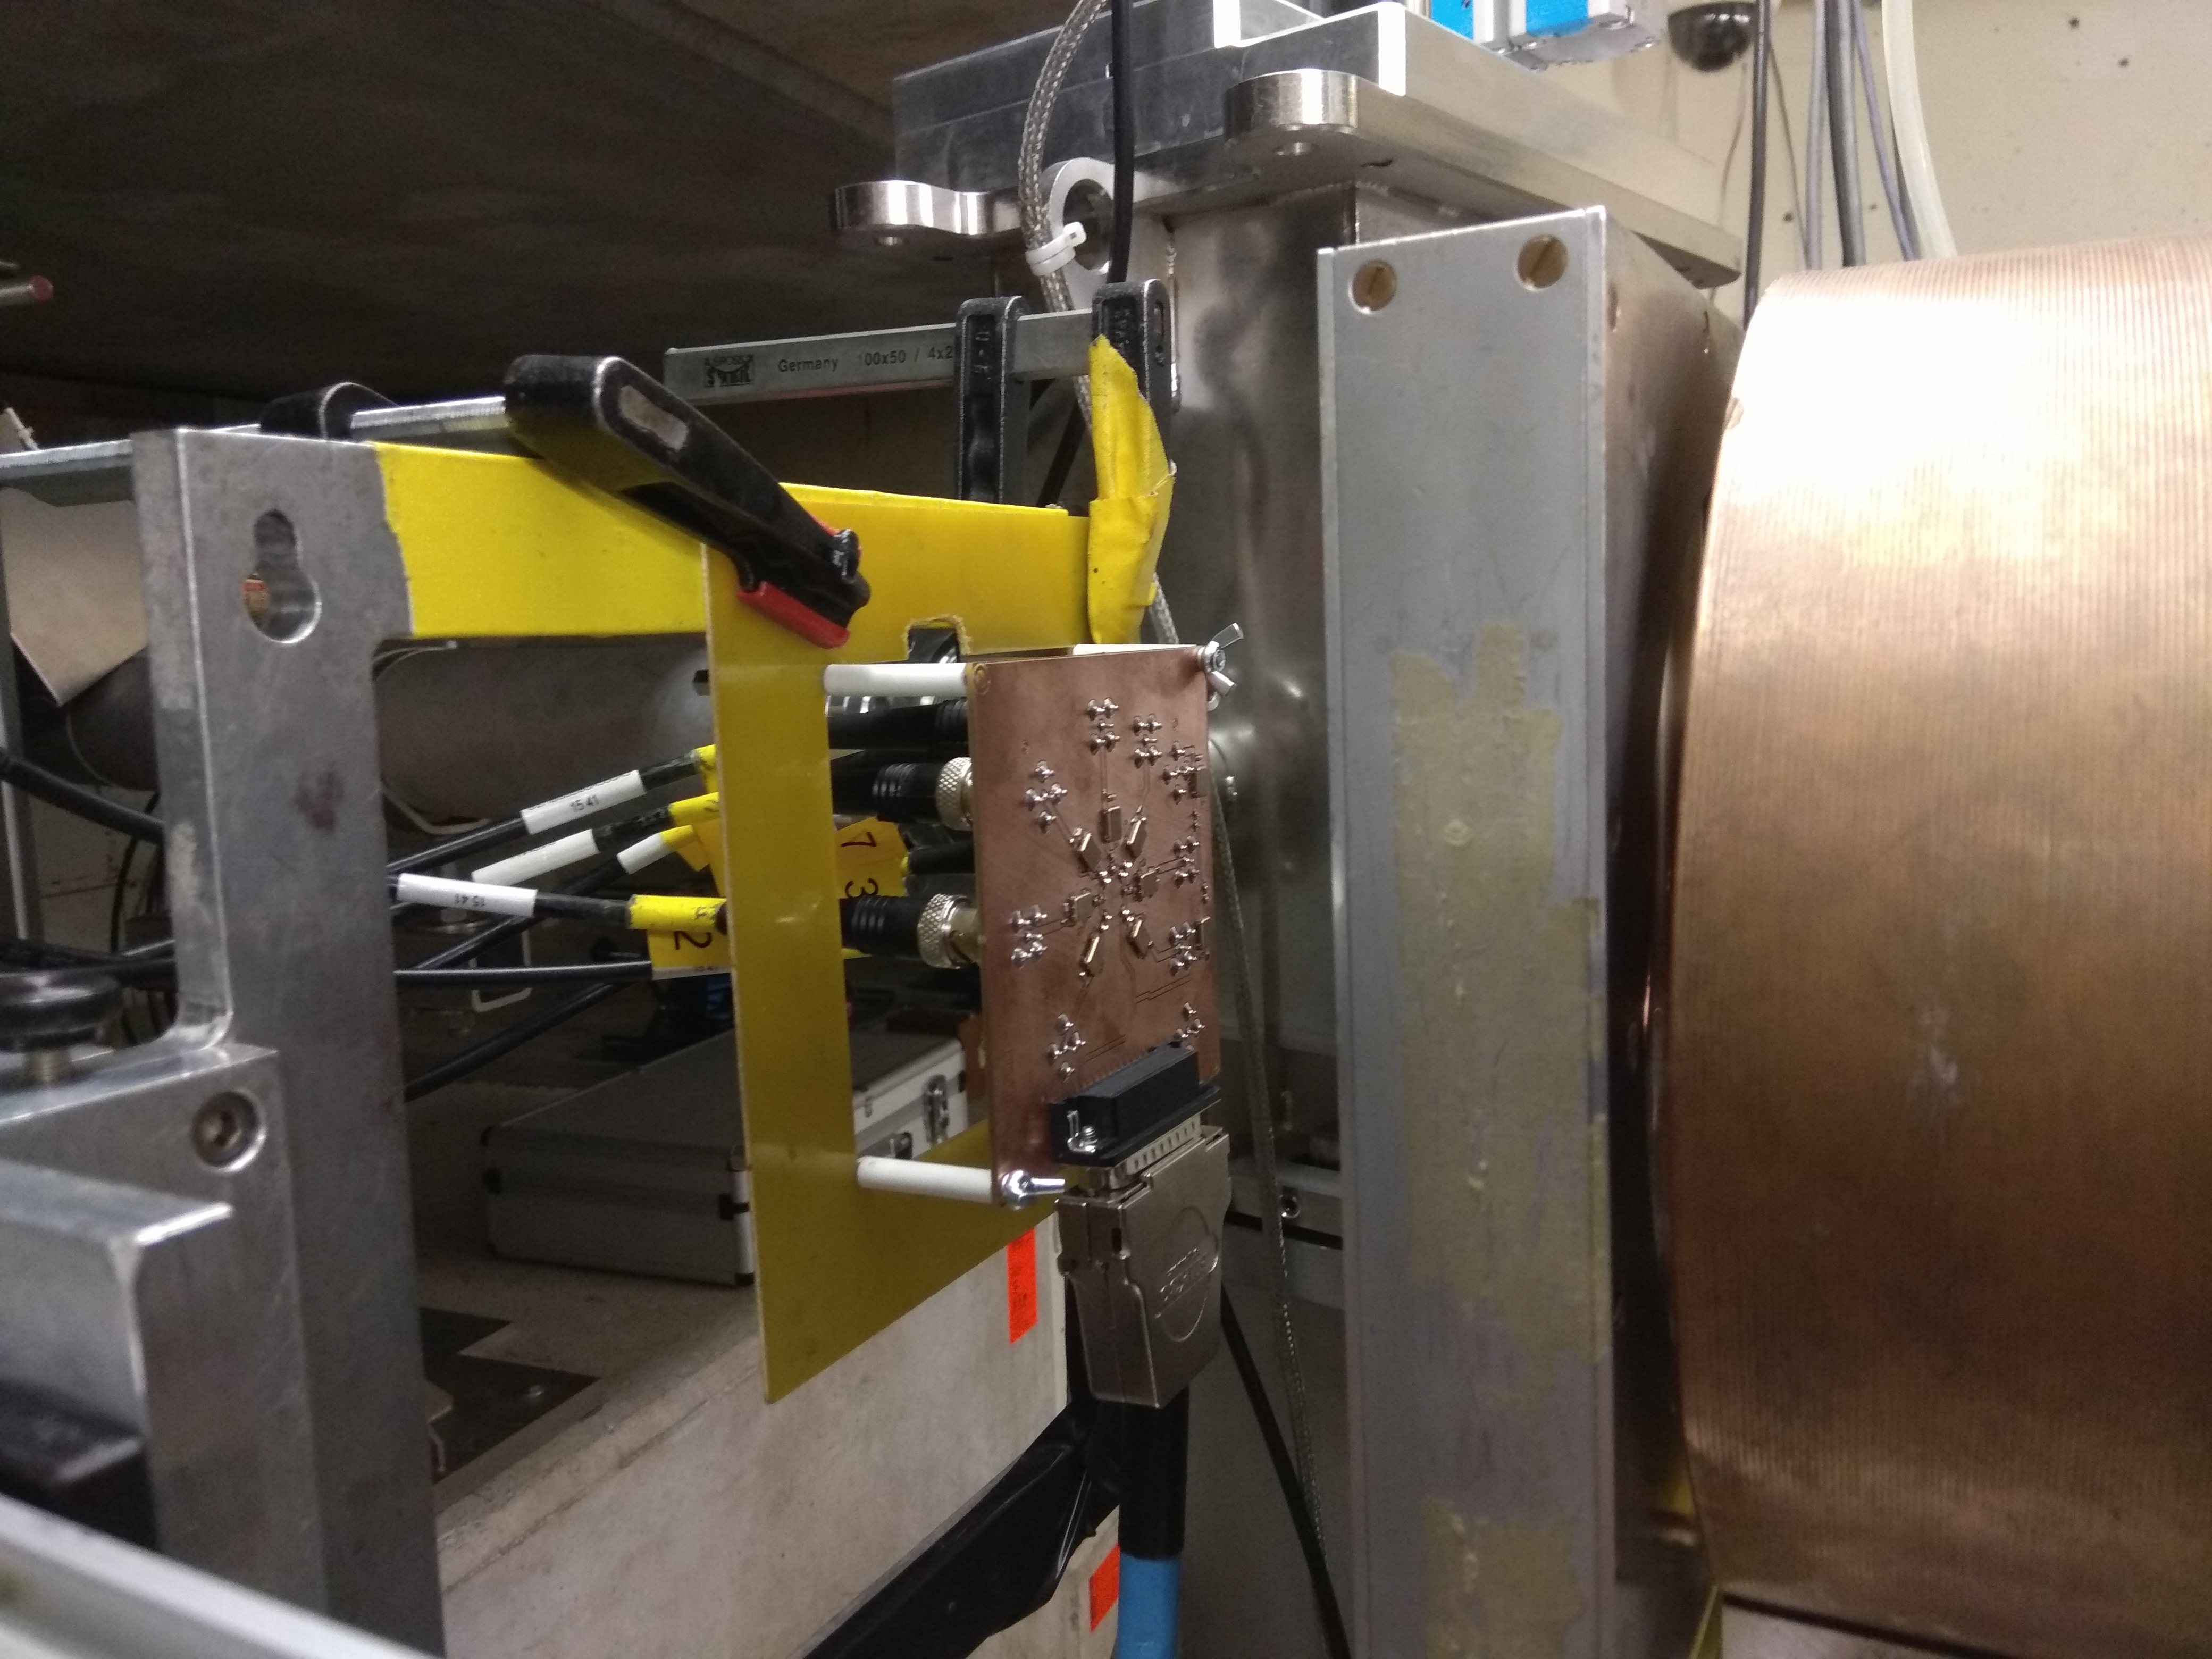
Radiation qualification of COTS components – Clocks Scheme
Irradiation test setup of crystal oscillator at Paul Scherrer Institute (PSI)

Slide 15
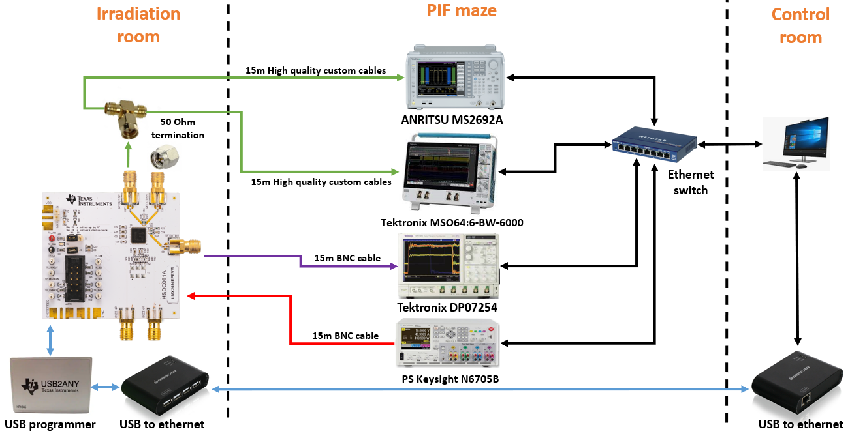

Radiation qualification of COTS components – Clocks Scheme
Clock Synthesizer
1 sample of 3 candidates
  LMX2694-EP
  LMX2594-EP
  LMX2592-EP
Radiation Test campaign carried out @PSI.
  total ionizing dose (TID): 500 Gy
  proton fluence: 8.60x10¹¹ p/cm⁻².
Monitored Parameters:
  Output Clock Frequency
  Duty Cycle
  Rise/Fall Times
  Phase Noise
  Current Consumption
  Register Status
Spectrum Analyzer
Oscilloscope
Oscilloscope
Power Analyzer
Figure: DUT Setup
DUT | TID (Gy) | $$σ_{SEU@DUT}$$ | $$N_{ARC@SEU}$$ | $$N_{RR@SUE}$$ | $$σ_{LOL@DUT}$$ | $$N_{ARC@LOL}$$ | $$N_{RR@LOL}$$
LMX2694-EP | 500 | <1.16E-12 | 0.05568 | 0.3248 | <1.40E-12 | 0.0672 | 0.392
Values extracted from the radiation test report (EDMS 2302154)

Slide 16
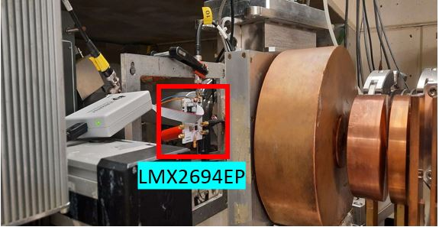
Radiation qualification of COTS components – Clocks Scheme
Irradiation test setup of clock synthesizer at Paul Scherrer Institute (PSI)

Slide 17
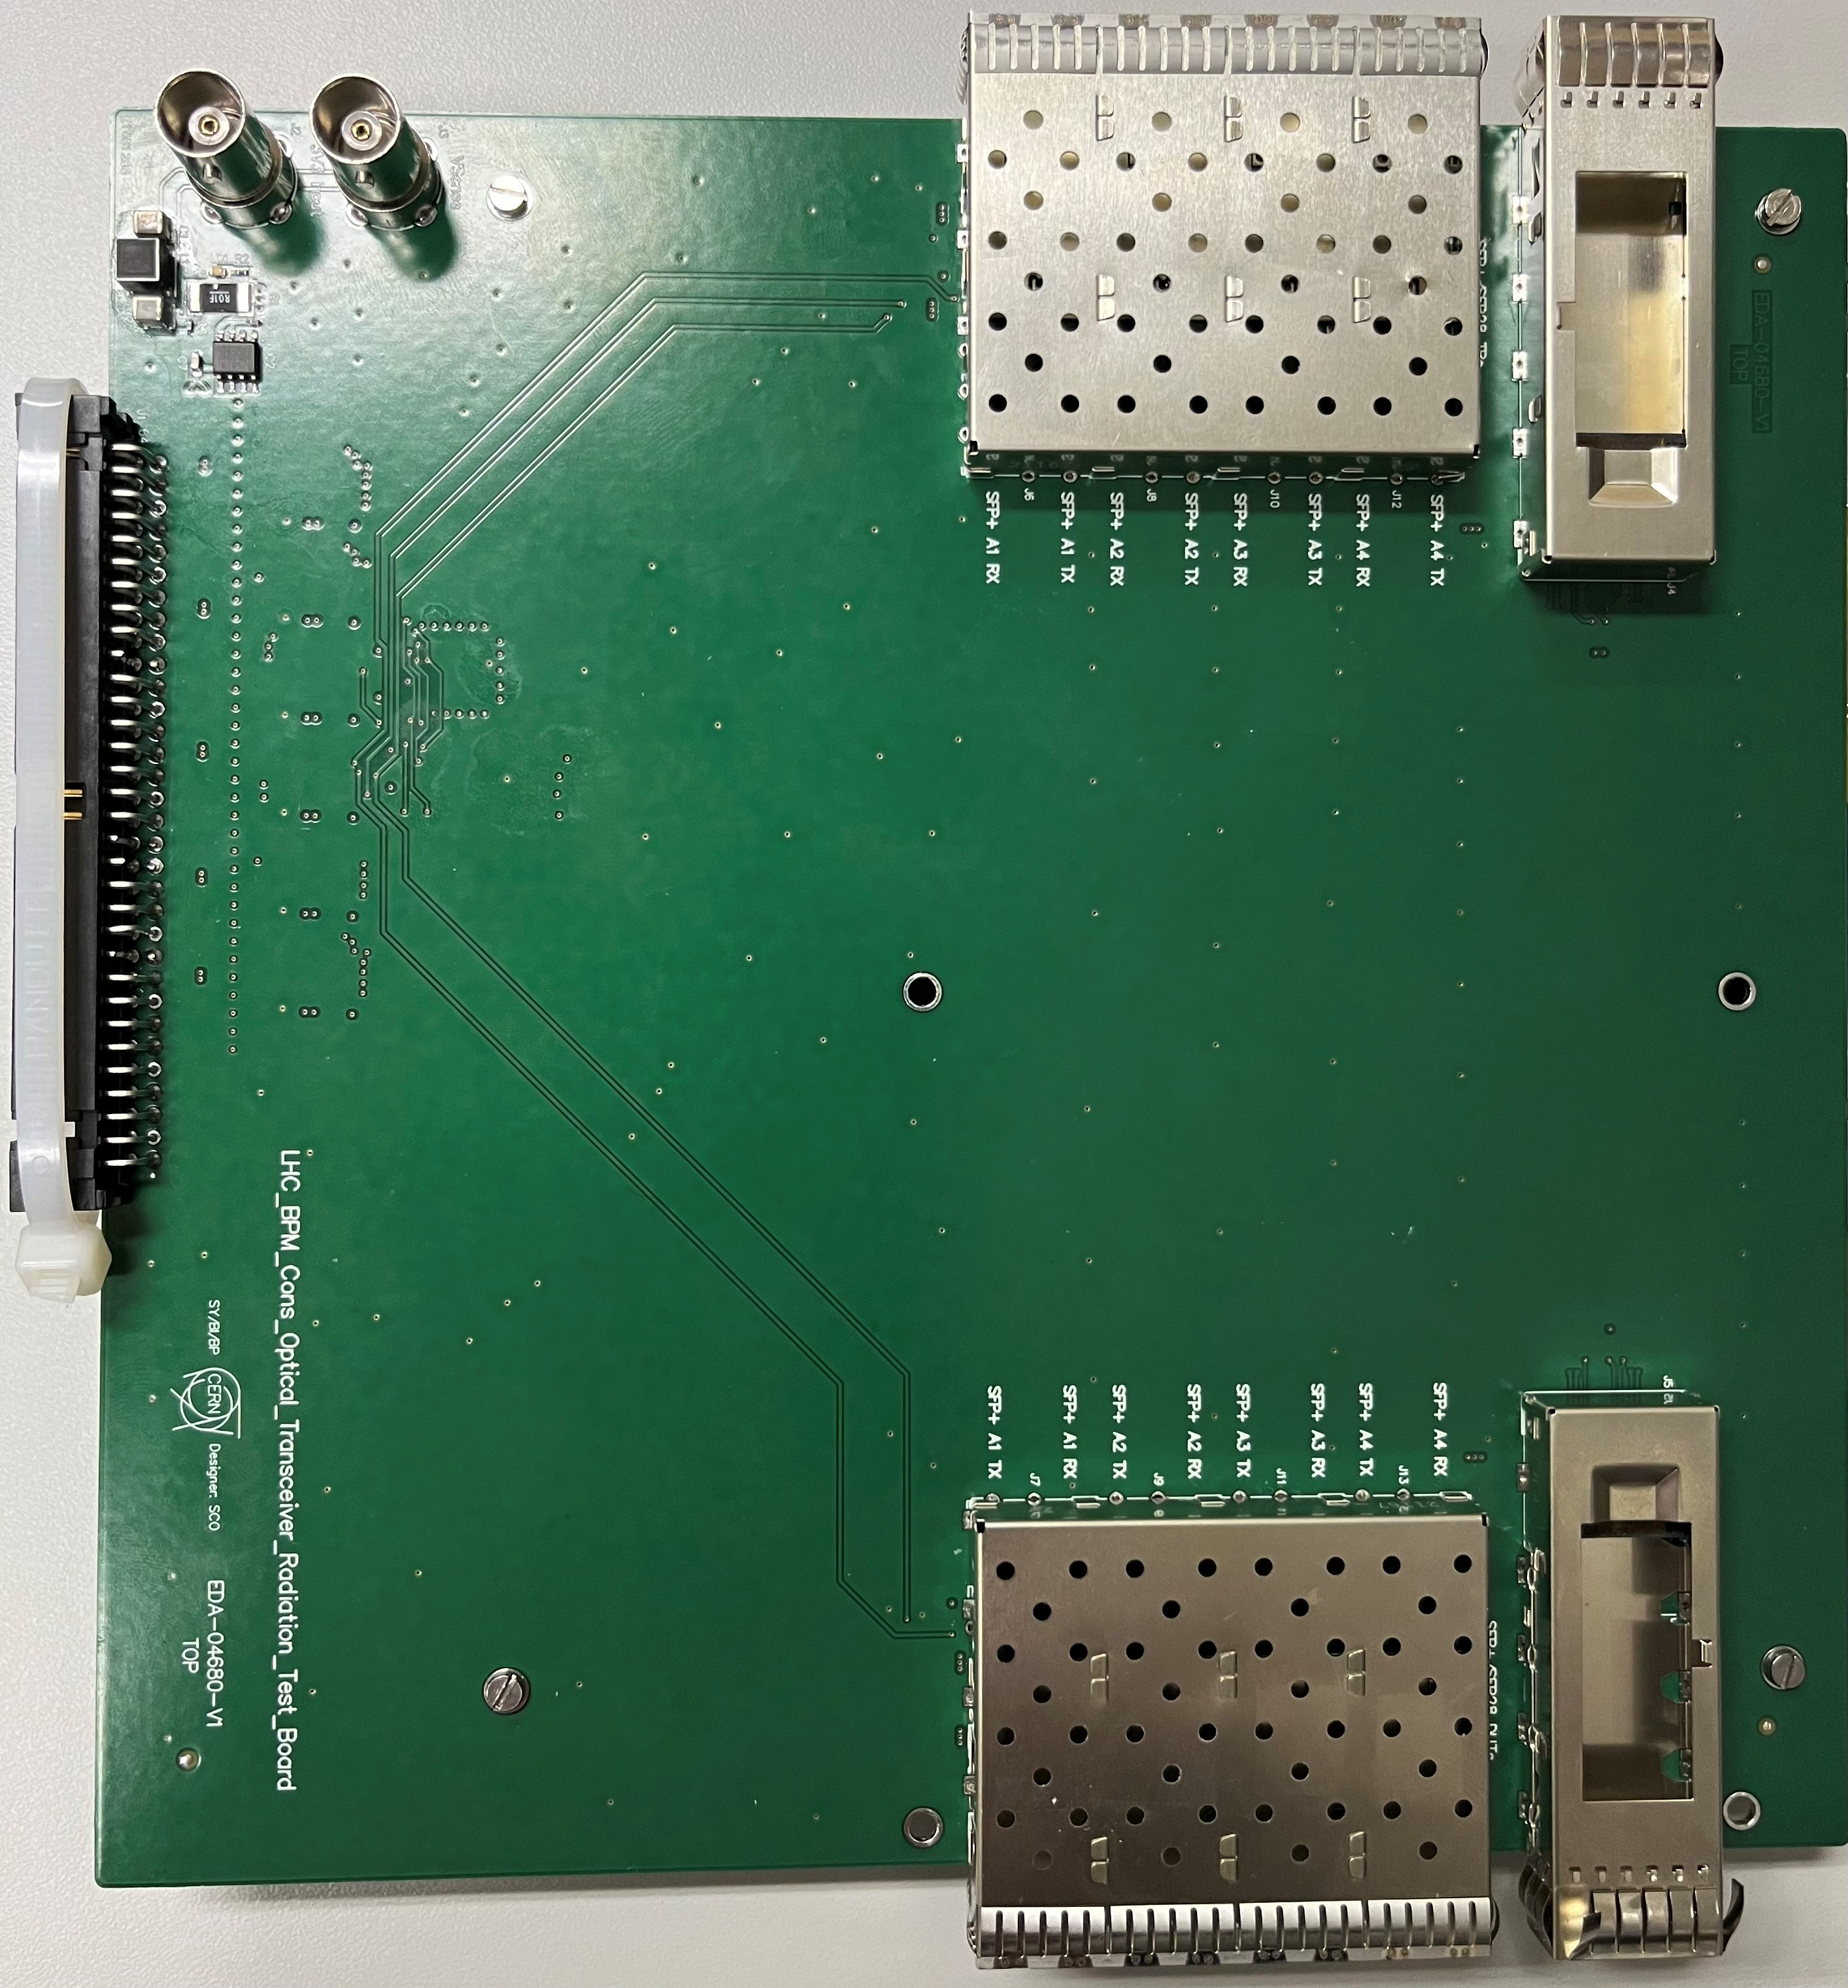
Radiation qualification of COTS components – Optical Link
COTS Optical Transceivers
4 Different type of DUTs
  Generic components
  All capable running @10Gbps
Radiation Test campaign carried out @PSI
  total ionizing dose (TID): 500 Gy
  proton fluence: 8.60x10¹¹ p/cm⁻²
Monitored Parameters:
  Offline Monitoring of:
    Tx Optical Power
  Real-time Monitoring of:
    Bit Error Rate (BER)
    Loss of Lock
    Register Status
    Current Consumption
Type | Nb Channels | Line Rate per Channel (Gbps) | Nb candidates
SFP+ | 1 | 10 | 2
SFP28 | 1 | up to 25 | 2
QSFP+ | 4 | 10 | 1
QSFP28 | 4 | up to 25 | 3
4 out of 8 candidates showed promising results
Waiting for radiation test report
Optical Transceiver
Test Board
Slow Control
(I2C)
DUT
Register Status
Monitor
DUT
Rx
Tx
Rx
Tx
Rx
Tx
DUT RX BER
Monitor
QSFP
QSFP
QSFP
Tx
Rx
Tx
Rx
Tx
Rx
Rx
Tx
DUT TX BER
Monitor
QSFP
Tx
Rx
4 x SFP
4 x SFP
Ethernet
Xilinx FPGA
DevKit
17

Slide 18
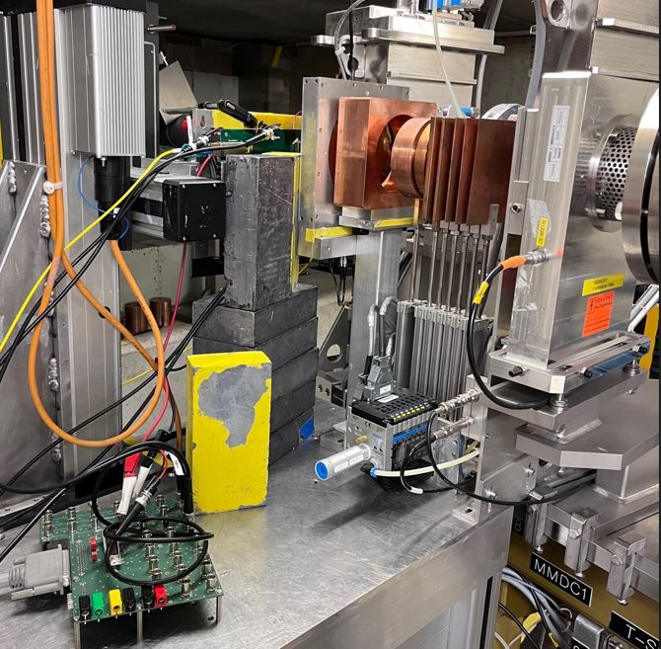
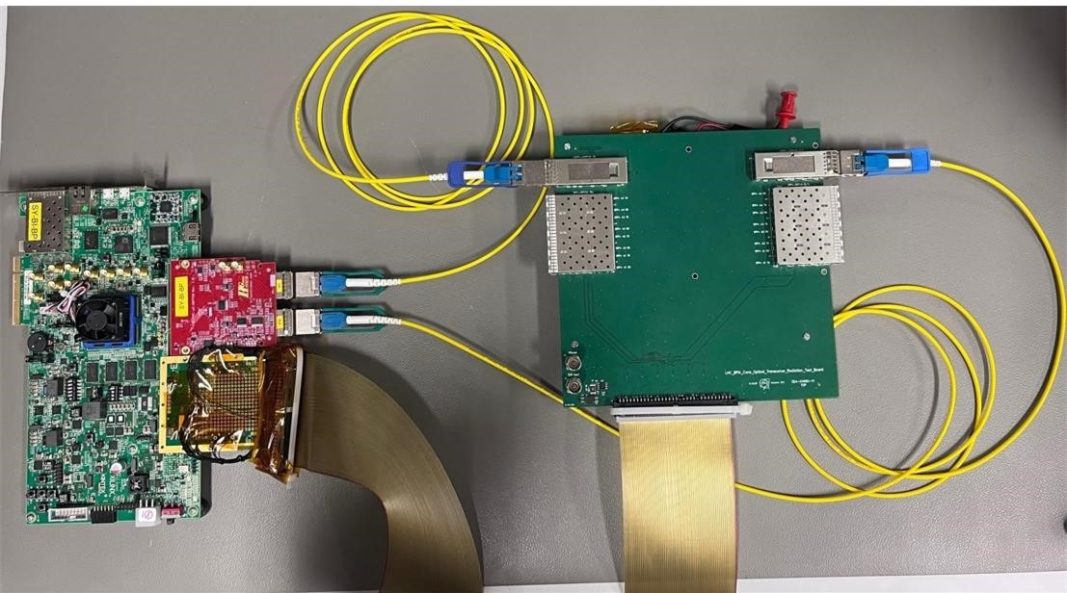
LHC BPM Consolidation - Radiation Qualification of COTS– Performed Activities
DUT
Test concept verification setup at lab
Irradiation test setup of optical transceivers at Paul Scherrer Institute (PSI)

Slide 19
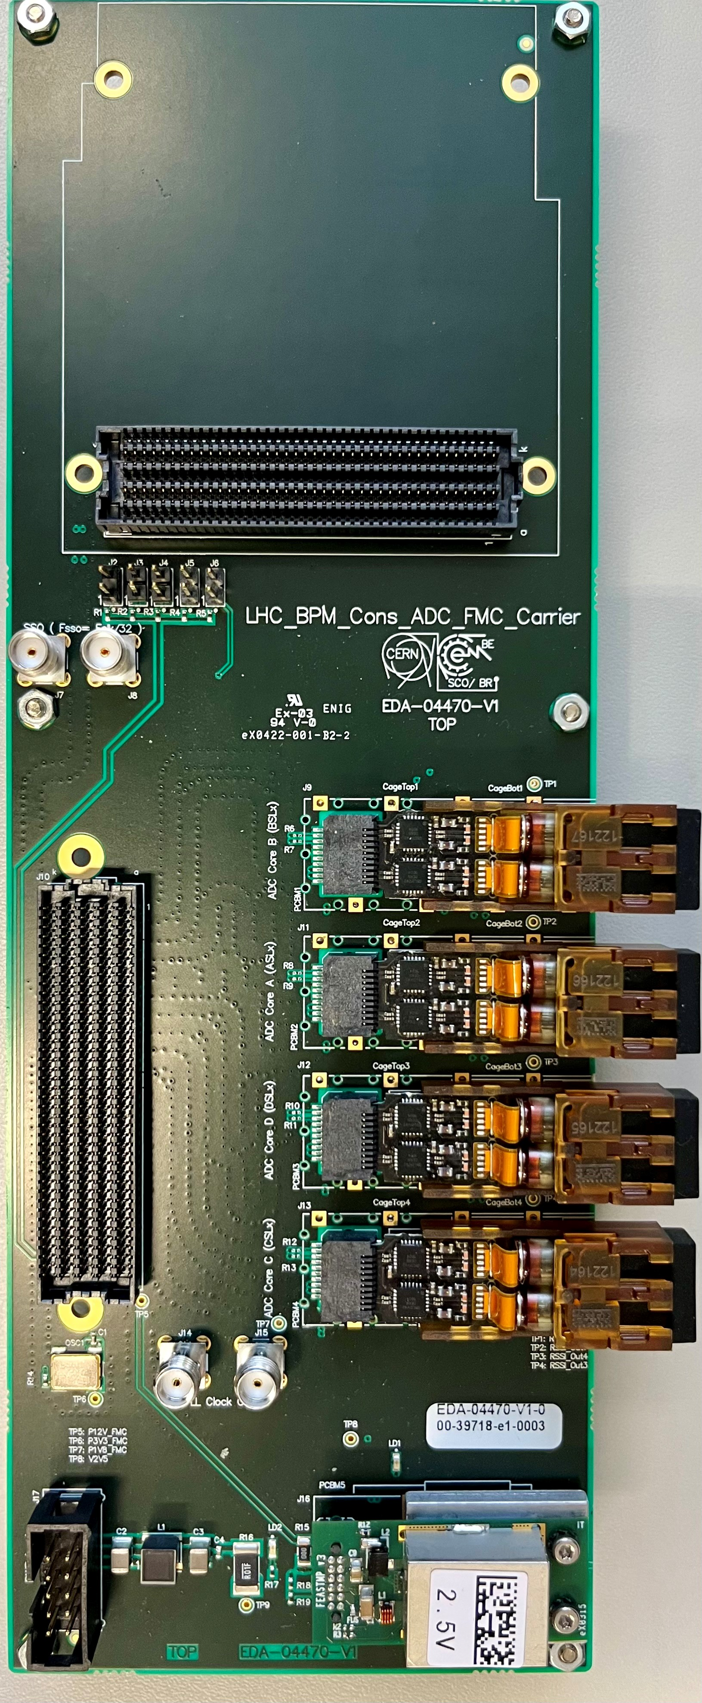
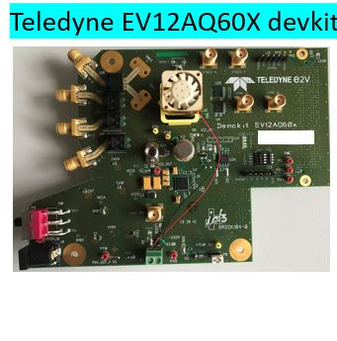
Radiation qualification of COTS components – ADC & Other COTSs
ADC
Two candidates to be tested
  Candidate 1: EV12AQ600 from Teledyne
    Rad-tol by design (tested with heavy ions)
  Candidate 2: TBD
Other COTSs
Analog Front-End COTSs selection still ongoing
Front-End powering
  PSU in collaboration with SY-BI-BL
  Selection of other components in collaboration with
    BE-CEM
    RADWG
4 x Optical
Transceiver / Transmitter
ADC & Optical Transmission
Test Board

Slide 20
Rad-Tol COTSs Qualification for LHC BPM CONS
Agenda
  Introduction & Motivation
  LHC BPM Consolidation project
  Radiation qualification of Commercial Off The Shelf (COTS) components
  Summary

Slide 21
Summary
Current LHC BPM system requires consolidation
Consolidation project is ongoing in collaboration with different teams
Radiation test required for Front-End components
3 candidates tested
1 candidate passed the test
8 candidates tested
4 candidates with promising results
1 candidate tested & showed promising results
2 more to be tested
Specifications to be finalized.
Tests foreseen in 2024
2 candidates to be tested in 2023
Tunnel
Surface
Digital Front-End
BPM1
LPF
ATT.
AMP.
ADC
Optical Transmitter
DELAY
Optical Transmitter
Optical
MUX
DELAY
Optical Transmitter
LPF
ATT.
AMP.
ADC
Optical Transmitter
Analog Front-End
Clock
Synth
Osc.
BPM2
DELAY
LPF
ATT.
AMP.
ADC
Optical Transmitter
Optical Transmitter
Optical
MUX
DELAY
LPF
ATT.
AMP.
ADC
Optical Transmitter
Optical Transmitter

Slide 22
Thanks to
Manoel Barros Marin from SY-BI-BP
&
RADWG:
Salvatore Danzeca
Rudy Ferraro
Antonio Scialdone

