Slide 1
SY-BI EDMS document management through the lenses of quality assurance
Presentation of the new structure
Radmila Govertsen
15/12/2022

Slide 2
Outline
A personal perspective on documentation
The starting point for BI EDMS documentation
Principles of quality management and BI EDMS
Highlights of BI EDMS documentation
Summary

Slide 3

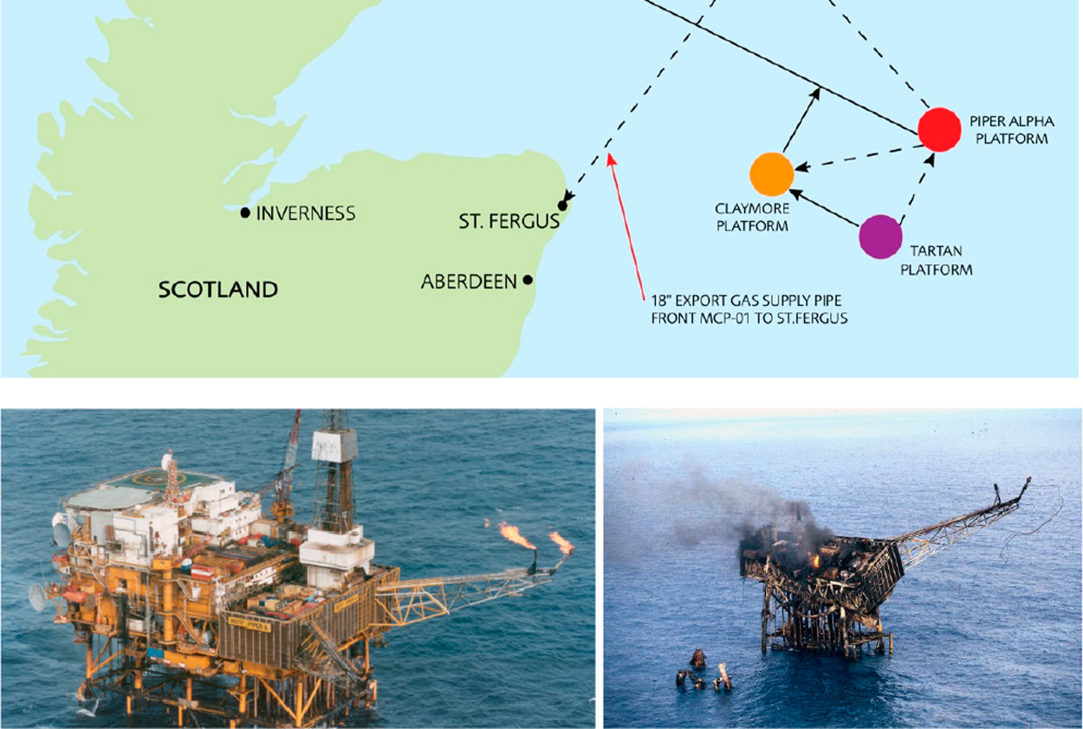
A personal perspective on documentation
Lessons learned- still valid
1. Management of change (design issues);
2. Personal safety over process safety (fire water pumps on manual start to protect divers);
3. Permit to work and isolation for maintenance (pump re-started before maintenance complete);
4. Handover (inadequate transfer of information between crews, shifts and disciplines);
5. Interconnection (no rig is an island…);
6. Emergency response - evacuation;
7. Safety culture (complacency - everything’s fine)
Piper Alpha 1988
167 men died
2 billions £ in financial loss

Slide 4
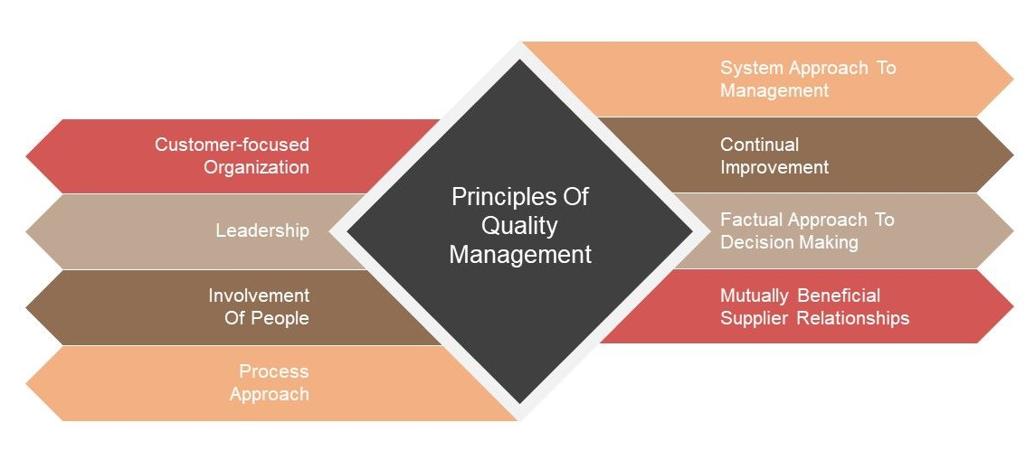
Starting Point for BI EDMS - Quality Assurance Management
Quality Assurance is seen as everyone’s job.
ISO 9001: the quality management process https://cds.cern.ch/record/1992061
https://quality.web.cern.ch/quality/

Slide 5
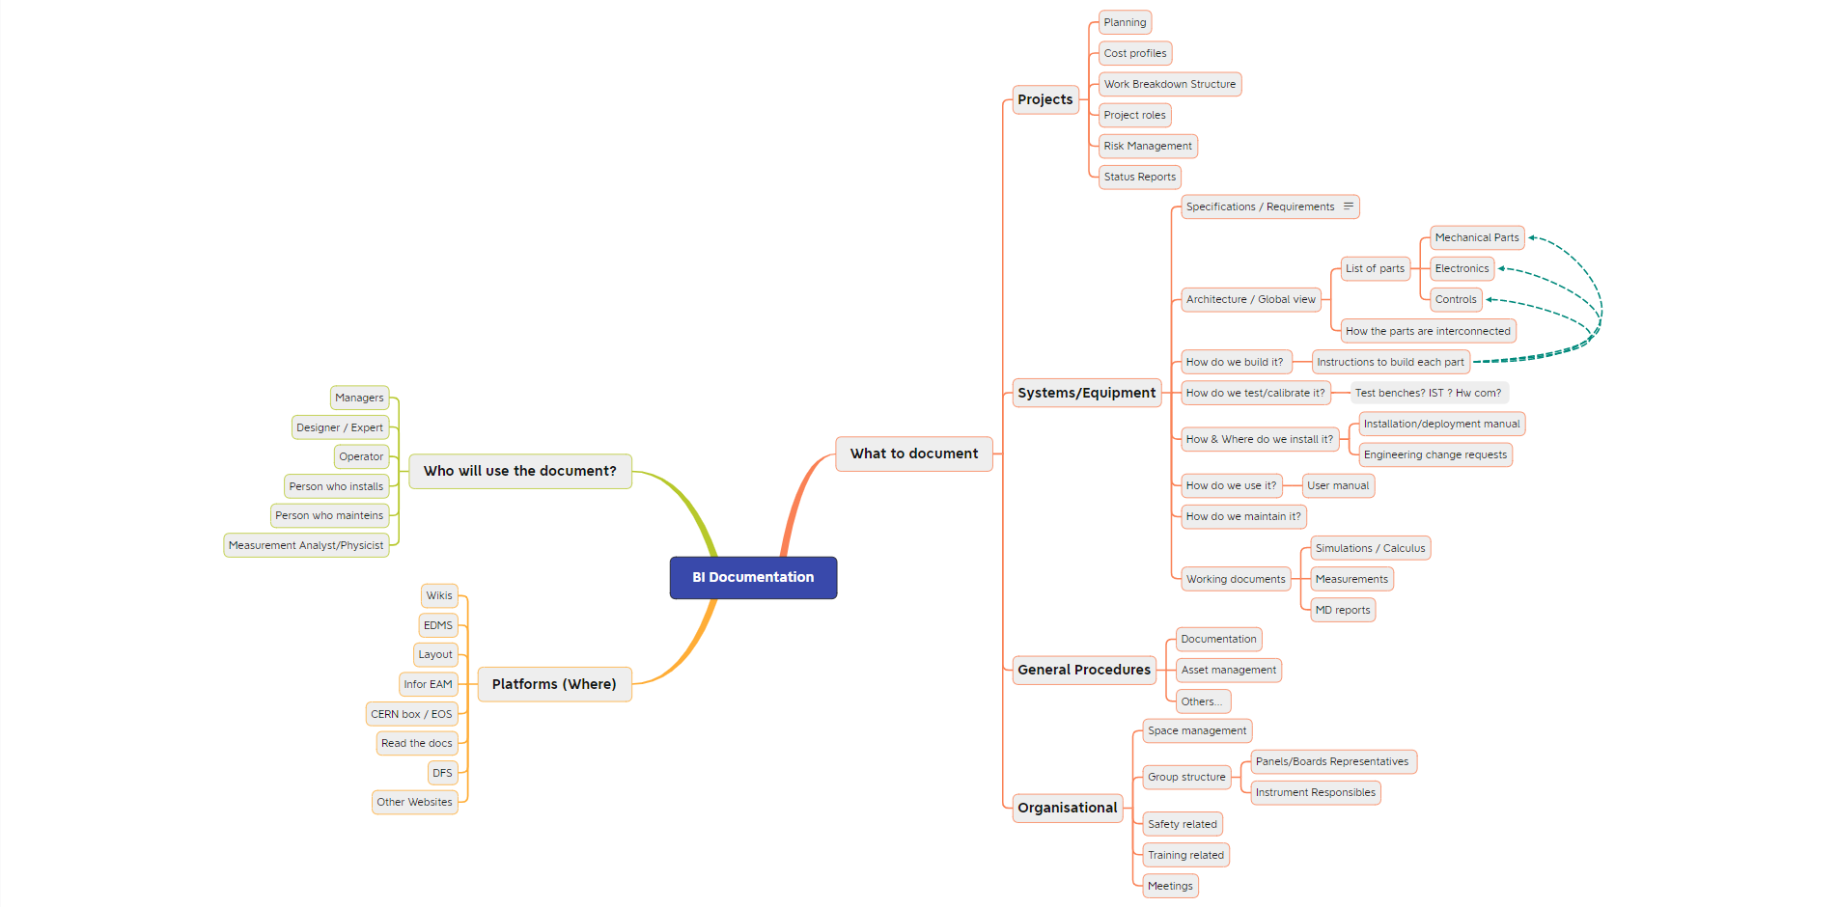

Slide 6
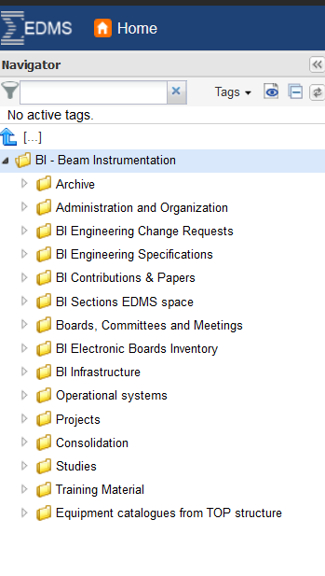
Customer-focused organisation
Taking into consideration who has to have access to the documents and who is the primary user:
Managers
Designers/Experts/Engineers
Operators
Installation responsible
Maintenance responsible
Measurement analysts/physicists

Slide 7
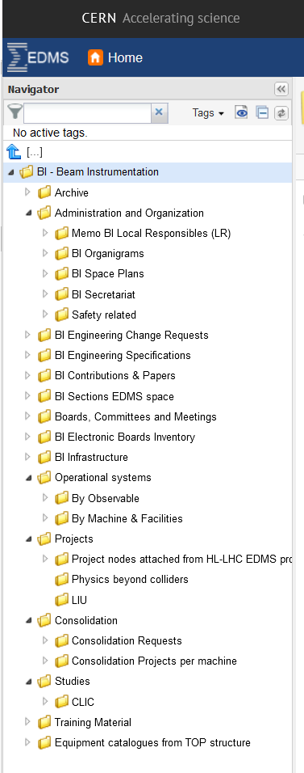
Leadership
An overall view of documentation across the group
1) Administrative and organisational documentation
2) Technical Information easily accessible across sections
Focus on:
Operational systems
Consolidations and Upgrades
Future systems
Organisational documentation
Technical documentation of operational systems
Project documentation of future systems, planned improvements of existing systems

Slide 8
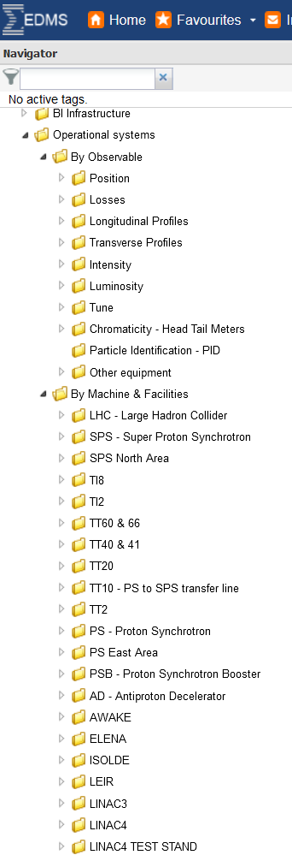
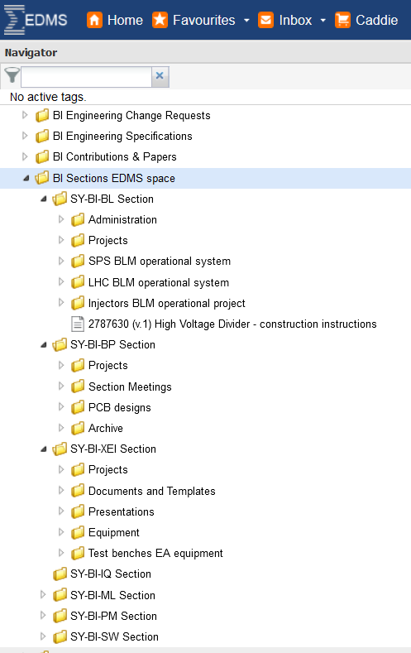
Involvement of people
Section structures based on the needs of each section
Structure rights were given to section members- individual approach
The main project node:
OPERATIONAL SYSTEMS
- By Observable
- By Machine & Facilities

Slide 9

Process approach – defining the workflow
There is no one ‘correct’ way.
Each section defined its documentation workflow
Documents for operational systems
Documents requiring a release procedure, such as ECRs
Documents which do not change that often
Some documents are better suited for dfs, wikis/read the docs, cernbox.

Slide 10

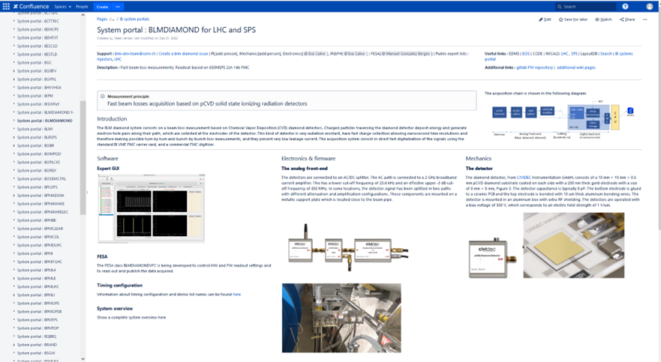

System approach
No BI section is an island.
Unless one lives in Svalbard.
The information available and accessible across sections
1) Metadata fields for EDMS documents: Title, description, keywords, external references, links to other platforms like Indico or CDN drawings
2) Linking EDMS and other platforms: Indico, Layout, Infor EAM
3) Creation of wiki pages in Confluence (BI-Portal)

Slide 11

Continual improvements

Slide 12
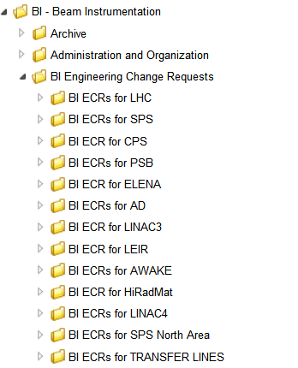
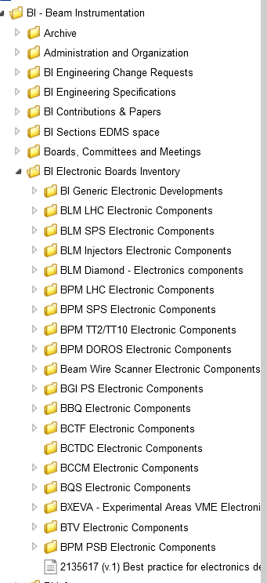
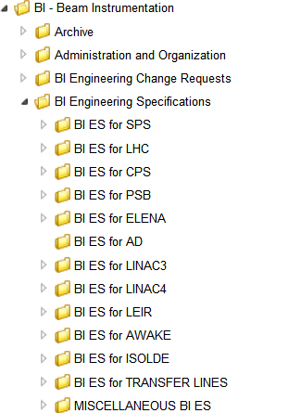
Factual approach- it has to make sense
Collection of the correct data (accurate and reliable)
Making documentation accessible to those who need it
Efficient retrieval
Creation of project nodes:
Engineering Change Requests (ECRs)
Engineering Specification (ES)
Electronic Boards Inventory

Slide 13
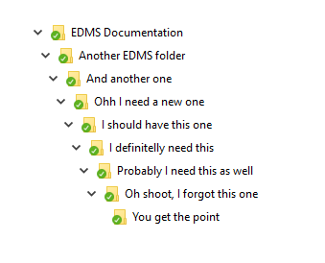

Mutually beneficial
Access to relevant information - Attach/detach without duplicating documents
Simplified retrieval of BI documentation concentrated in BI structure
Control over documentation and enhanced security
Better collaboration- Easier onboarding of new colleagues
Repository and shared knowledge

Slide 14

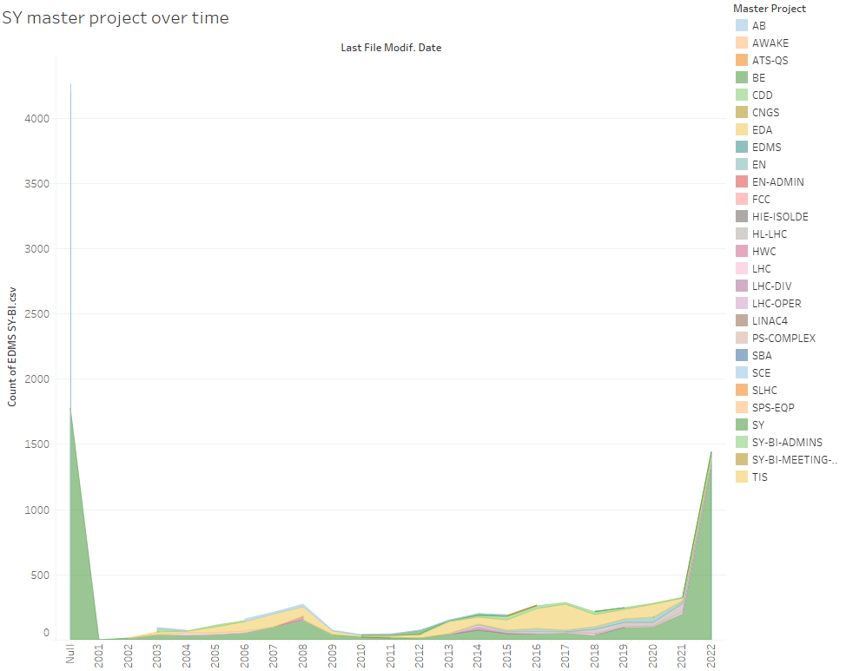
Highlights of SY-BI EDMS documentation
More than 9100 Project nodes, documents and items in the SY-BI project node

Slide 15





Summary

Slide 16

Thank you!
Merry Christmas and Happy New EDMS
This Photo by Unknown Author is licensed under CC BY

