Slide 1
2023 Configuration MD (MD7003) with unsafe beams
S. Fartoukh
Main results from MD1 & MD2
Main objectives for FMD4 & Beams required
MD steps

Slide 2
Main results from MD1+MD2 (1/2)
Demonstration of the mechanics
down to 30 cm
At 60 cm the settings are the same as for 2022, incl. OMC knobs, except
  (i) TCT settings in IR1/5/8
  (ii) X-plane in IR8
  (iii) X-angle in IR1/5 [145 μrad @ 60 cm ->160 μrad @ 30 cm]
→ At 30 cm the settings are strictly the same
Optics measurement all along the cycle, with one additional OMC knob @1.2 m (trimmed in in the mini-squeeze, and out in the first β* levelling segment)
Very good optics:
(i) 10-15% in the ramp, 5-10% in beta* levelling,
(ii) outstanding case of B1H @ 2 m reaching 20%
New combined ramp and anti-telescopic squeeze (as of 4.5 TeV)
LHCb rotation @ FT (2 m at IP1/2/8)
Mini-squeeze down to 1.2 m
Q-change & ADJUST
1^{rst} β*-levelling segment down to 60 cm
2nd β*-levelling segment down to 30 cm

Slide 3
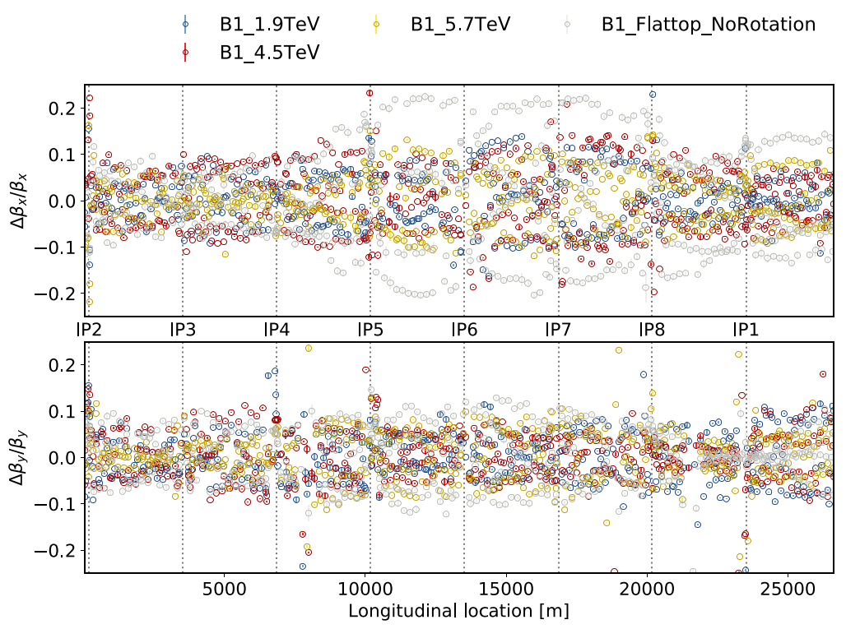
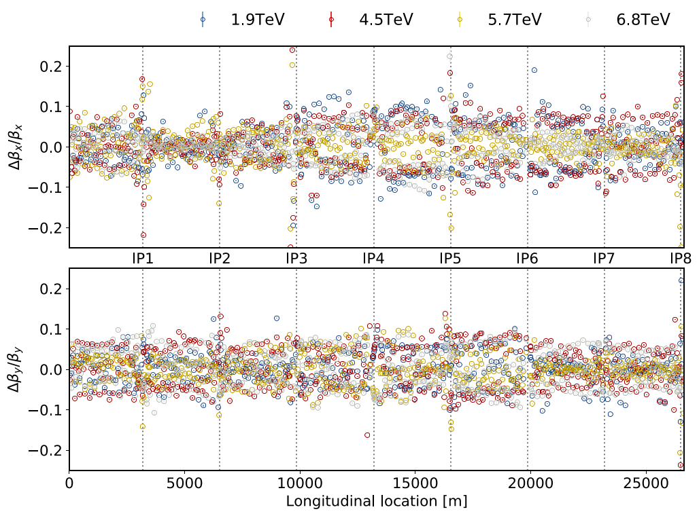
Beam 1 in the ramp
Beam 2 in the ramp
OMC team

Slide 4
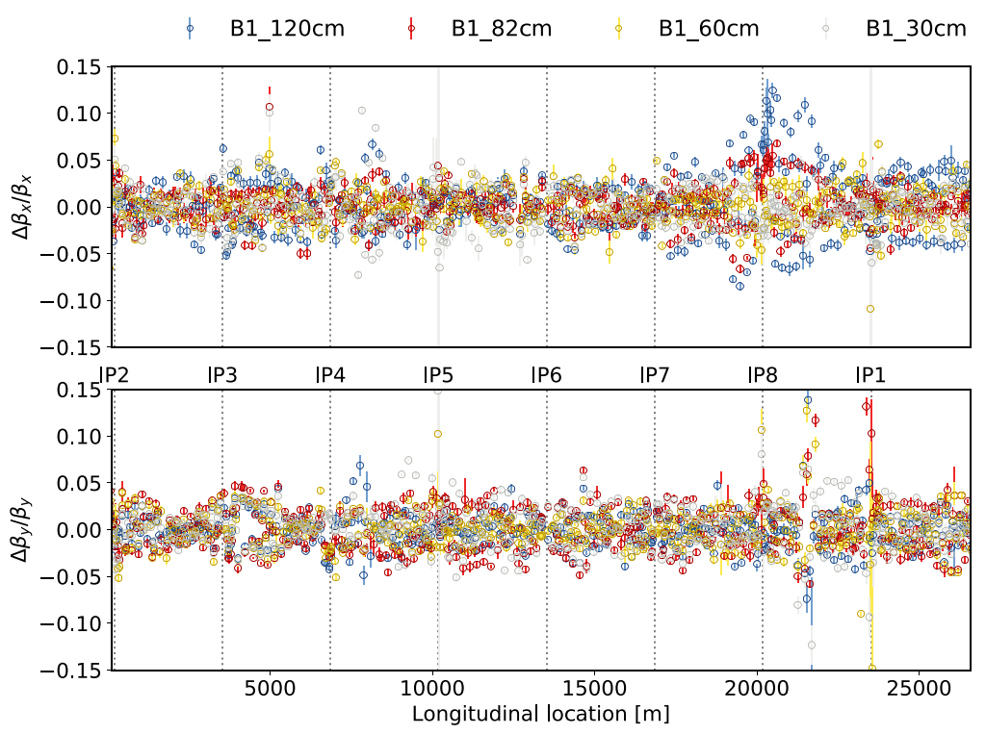
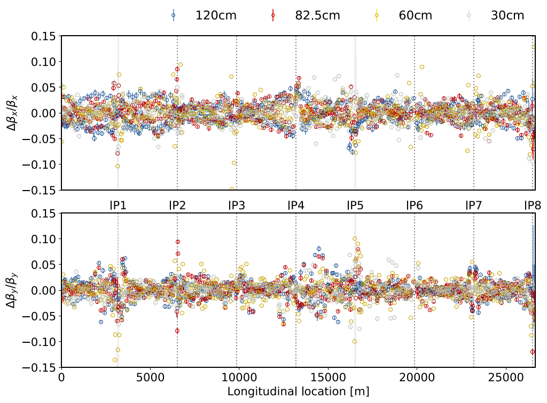
Beam 1 in β*-levelling
Beam 2 in β*-levelling
OMC team

Slide 5
Main results from MD1+MD2 (2/2)
Partial validation of the cycle (with 2 nom. + 10 probes per beam)
→ Successful ASD @ 1.2 m (worst case for MKD/TCDQ phase)
No off-momentum LMs yet, but most of on-momentum LMs till 60 cm
 | FT @ 2m before rot. | FT @ 2m after rot. | 1.2 m before coll. | 1.2 m in coll. | 60 cm In coll. | 30 cm In col.
On-momentum | √ | √ | √ | √ | × (B1) √ (B2) | ×
Off-momentum δ>0 | × | × | × | × | × | ×
Off-momentum δ<0 | × | × | × | × | × | ×
The cycle will be limited to 60 cm in FMD4

Slide 6
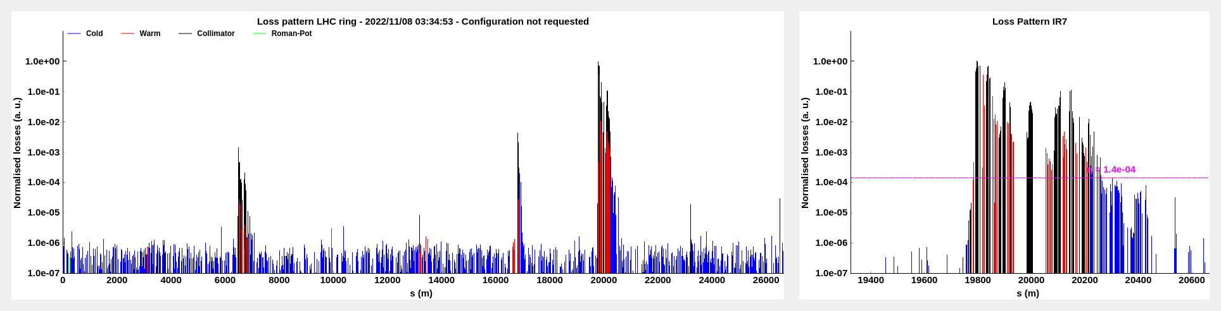
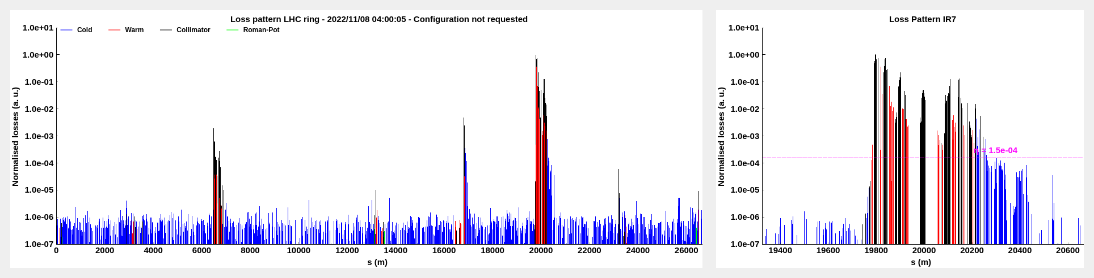
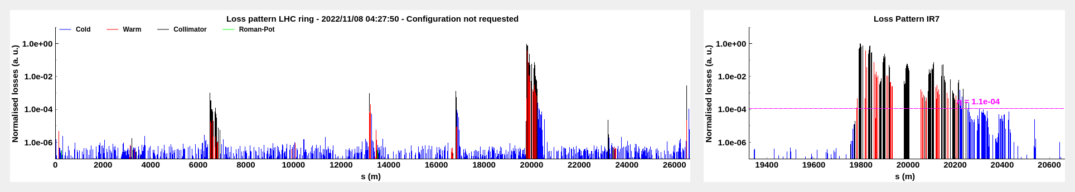
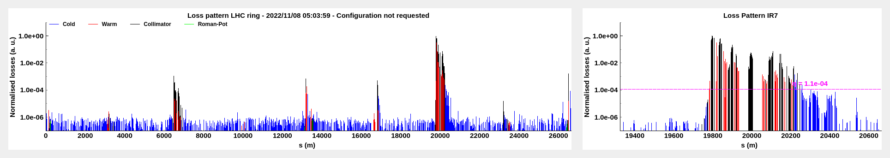
Example of B1H
Before LHCb
rotation @ 2 m
After LHCb
rotation @ 2 m
Before collision
@ 1.2 m
After collision
@ 1.2 m
Collimation team

Slide 7
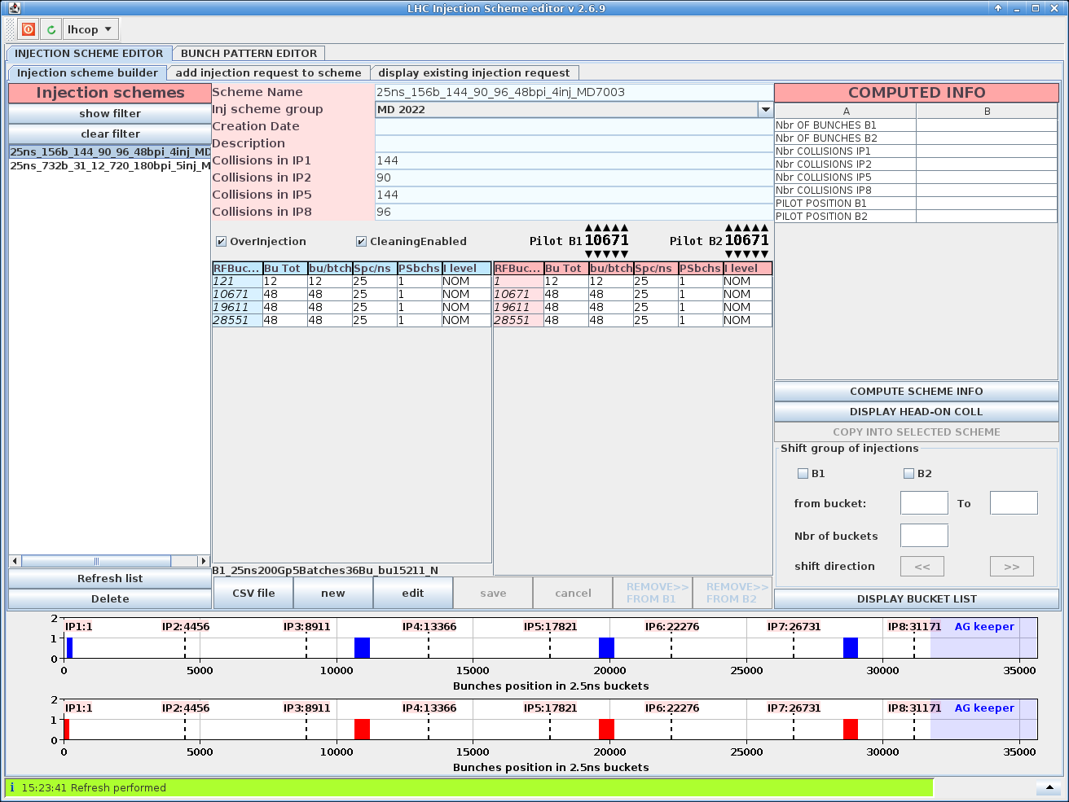
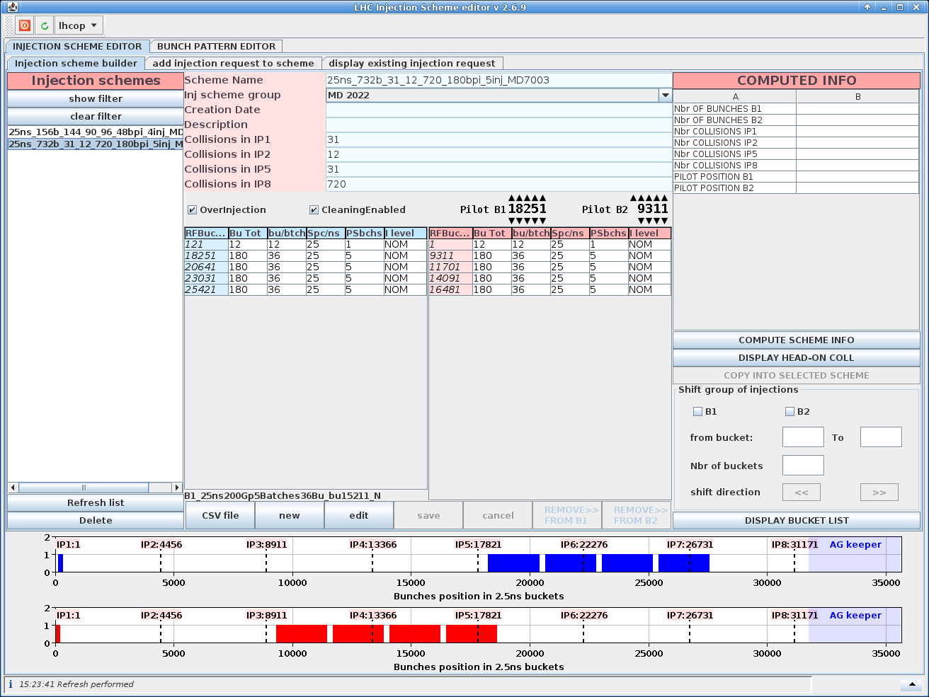
Objectives for MD4
Beam-beam studies @ 1.8e11 p/b, collisions at the 4 IPs, and external V-crossing in IR8
  25ns_156b_144_90_96_48bpi_4inj_MD7003
  The 48b trains are widely separated (3 SPS injection)
LHCb rotation in the presence of e-cloud @ 1.4e11 p/b
  25ns_732b_31_12_720_180bpi_5inj_MD7003
  The number of beam-beam interactions (BBLR+HO) is maximised in IR8

Slide 8
MD steps (1/2)
Fill # 1: validation fill with 2 nominal + 12 probes (<3e11 p/b)
  Selection of off-momentum LMs down to 60 cm + B1H/V @ 60 cm
  → 12 LMs for Beam1 and 10 LMs for Beam2
  De-squeeze from 60 cm up to 1.2 m
  Scrape the two nominal (is it needed ?)
  IR8 V-aperture measurement (expected to be 12.5-13 σ vs. 20σ ++ in IR1/5)
  Dump
 | FT @ 2m before rot. | FT @ 2m after rot. | 1.2 m before coll. | 1.2 m in coll. | 60 cm In coll. | 30 cm In col.
On-momentum | √ | √ | √ | √ | √ (B1) √ (B2) | ×
Off-momentum δ>0 | × | √ | × | √ | √ | ×
Off-momentum δ<0 | × | √ | × | √ | × | ×

Slide 9
MD steps (2/2)
Fill # 2: 1^{rst} intensity ramp-up step with 12b + 48b @ 1.4e11 p/b
  Run the cycle with no stop till 1.2 m
  Establish and optimize the collisions IP1/5 (no collisions at IP2/8)
  Tune optimization based on lifetime
  Beta* levelling down to 60 cm
  Lumi and tune optimization @ 60 cm
  Dump @ 60 cm
Fill # 3: 2nd step with 12b + 3×48b @ 1.8e11 p/b
  Run the cycle with no stop till 1.2 m
  Establish and optimize the collisions at all Ips
  (IP2 &IP8 separated)
  Tune optimization based on lifetime
  Beta* levelling in steps down to 60 cm
  (with lumi and tune optimization whenever needed)
  Dump @ 60 cm
Fill # 4: 3rd step with ~700 b @ 1.4e11 p/b
  Run the cycle with no stop till FT
  Run the LHCb rotation and monitor lifetime and losses
  Dump @ 2 m
Intermediate step
requested by rMPP
Expected Head-on Lumi [10³²]
 | β*=1.2 m | β*=60 cm
ATLAS & CMS | 11.9 | 20.0
Alice | 1.0
LHCb | 4.3
Very likely 3h00 will be missing !
Tiny risk that it does not work,
.. but sizeable impact (1 week) for the 2023 commissioning if actually it does not !

