Slide 1
Dynamic Deployment of Data Collection and Analysis Stacks
Dino Conciatore – System Engineer – HPC Ops
March 27th, 2023
HEPiX Spring 2023 Workshop – ASGC, Taipei, Taiwan

Slide 2
Introduction
200 billion online documents.
Ingestion rate of 45k documents per second.
RKE2 cluster with 100 physical nodes.
Multiple virtual Kubernetes clusters dynamically deployed to accommodate custom workflows or external customers.
Notes:
to dynamically deploying data collection stacks.
are some of the main component we are using to reach the flexibility required.
Main production stack

Slide 3
Monitoring the future HPC machine at CSCS
Motivation:
  CSCS is embracing the multi-tenancy paradigm for its infrastructure and gradually moving its computational resources to this new environment.
  Tue 28.03 - The WLCG Journey at CSCS: from Piz Daint to Alps - Dr Riccardo Di Maria
New Requirements:
Flexibility
  Multiple physical or virtual Kubernetes clusters dynamically deployed to accommodate custom workflows or external customers
Scalability
  Provides horizontal scalability to meet changing demands
GitOps
  Apply any changes to infrastructure and applications stored in a Git repository
Notes:
Tomorrow Riccardo will present our MIGRATION journey from Piz Daint [Cray XC50] to Alps anew Multi Tenant HPE Cray EX machine
As a multi tenant machine – New Requirements → Solutions [list]
Security: Some clusters will be exposed to customers

Slide 4
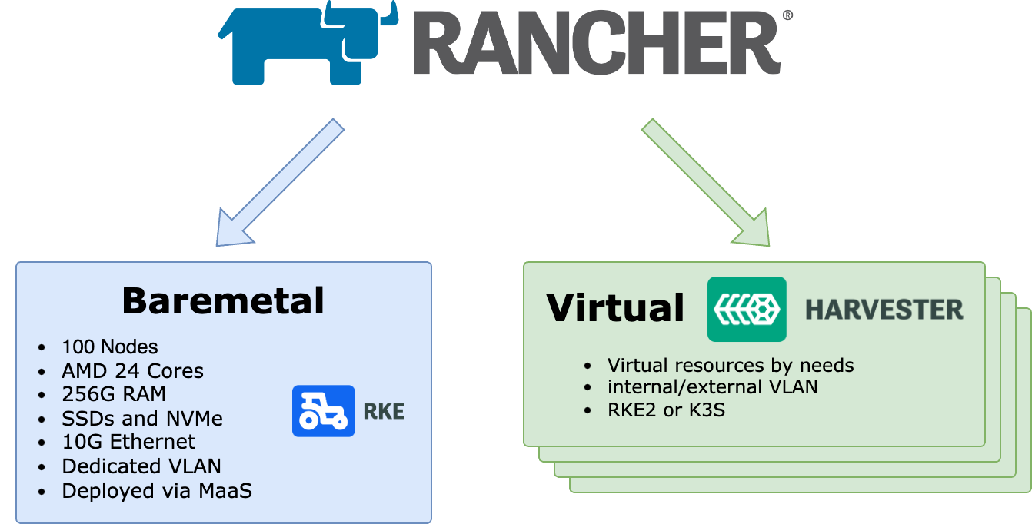
Observability clusters deployment
Notes:
How we deploy the kubernetes clusters
All new clusters at CSCS are deployed via Rancher
The Central observability cluster is baremetal
All other are virtual

Slide 5
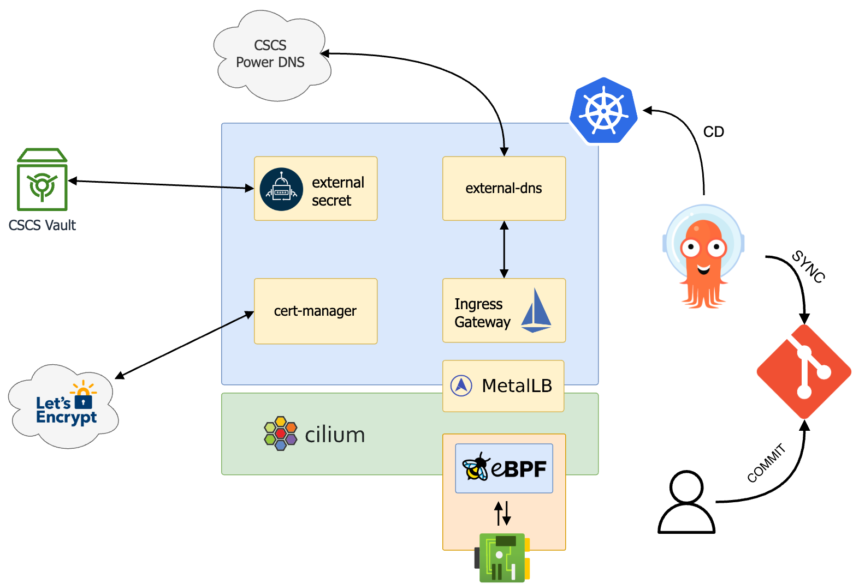
Central observability cluster: base configuration
CNI: Cilium
  Service mesh (eBPF)
  Hubble (observability UI)
Istio (only Ingress GWs)
  No sidecars
  Testing new API Gateway
MetalLB
  Currently still via ARP
  BGP in the future
Automated DNS and Certs
GitOps manages:
  Applications
  Base components
External Secret
Notes:
With cilium service mesh enabled
Cilium is based on eBPF
all the networking is done at kernel level without the need of sidecars
Cilium also come with a nice observability UI
Istio only for ingress gateway and in the future API gateway
IP assignment, DNS entry and Let’s Encrypt Certificates are automated
Triggered when a new association Istio GW ←→ k8s Service is made
Using ArgoCD for GitOps automation. All new changes are pushed to a git repo and ArgoCD will apply them
External secret to interface HashiCorp Vault

Slide 6

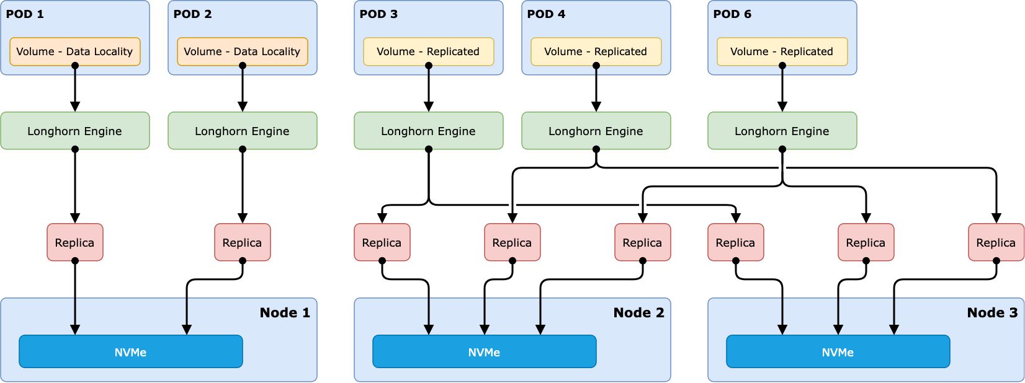
Central observability cluster: Storage overview
Notes:
Longhorn as a distributed block storage for Kubernetes
Very simple installation and configuration
100% opensource
View of replicated Volumes
A new volume created
A number of replicas are speeded on multiple nodes
Fault tolerant
View of Data Locality engine
Set data locality to Strict Local
Theoretically should benefit from the local storage

Slide 7
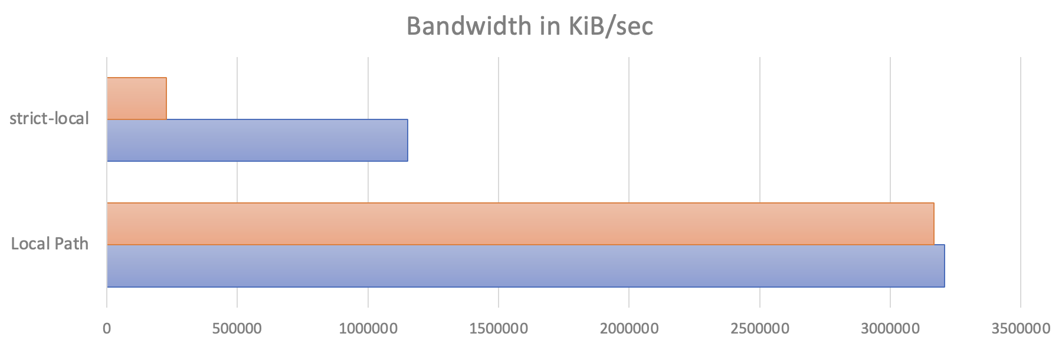
Longhorn performance
Data locality not working as expected
  NVMe and SSD performace are very bad, iSCSI bottlenek
  Nvme_tcp will drasticaly improove the performances in future versions of Longhorn
Rancher Local Path
Notes:
Longhorn developers are working to use NVME_TCP
Currently for performance and 0 fault tollerant storage we are using Rancher Local Path
Performa like baremetal

Slide 8
Elastic Cloud on Kubernetes (ECK)
Elastic Operator
  Stack applications deployed
    Elasticsearch ✔️
    Kibana ✔️
    Logstash ✔️
    APM Server ✔️
    Beats ✔️
  Next to be tested
    Elastic Agent Server
    For:
      standalone Elastic Agent
    OR
      Fleet-managed Elastic Agent
Notes:
Now talk about the Elastic Stack
Since some years Elastic developped ECK simplified way to deploy Elastic Application on kubernetes
Everything managed from an operator
Simplifies the configuration and deployment
We currently deployed
Es
K
…

Slide 9
Other apps
Strimzi operator to deploy Kafka
Helm chart for Grafana
Notes:
Other aplications like

Slide 10
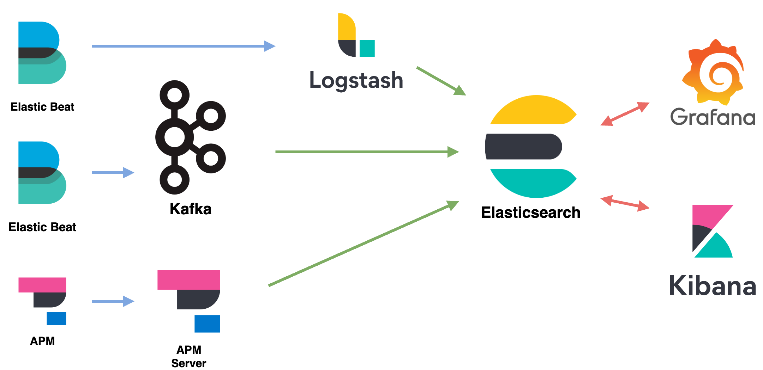
Elastic Stack flow view
Notes:
How the data is sent to Elasticsearch
Almos everything via Elastic Beats:
Clients are
Metricbeat
Filebeat
Auditbeat
The clients ingestion options:
Kafka (Preferred)
Logstash (depending on the requirements)
Application performance monitoring (APM) → APM Server → ES
Once everything is on ES we cand do analysis with Grafana or Kibana

Slide 11
Some Clients
Beats on Kubernetes (daemonset)
  Autodiscovery
    Triggered on New, Modified and Deleted pod
  Hint based
    Configure Beat modules via pod Annotations:
      co.elastic.logs/processors.10.add_fields.target: data_stream
      co.elastic.metrics.nordugrid-arc/hosts: ${data.host}:9091
      co.elastic.metrics.nordugrid-arc/metrics_path: /metrics
      co.elastic.metrics.nordugrid-arc/metricsets: collector
      co.elastic.metrics.nordugrid-arc/module: prometheus
      co.elastic.metrics.nordugrid-arc/period: 1m
Slurm
  Jobcomp (Accounting information): Job Completed → HTTP POST
  Slurmrestd (Telemetry): RestAPI ← Beat HTTP GET (5m intervall)
Notes:
beats deployed on k8s as a daemonset
Two nice features are autodiscovery and hint based configurations
This means that you have only one instance of Metricbeat, Filebeat as a daemonset on the k8s nodes that is automatically configured for New, Modified and Deleted pod
If you need some special config this can be added as annotation on the pod
Another main client is Slurm

Slide 12
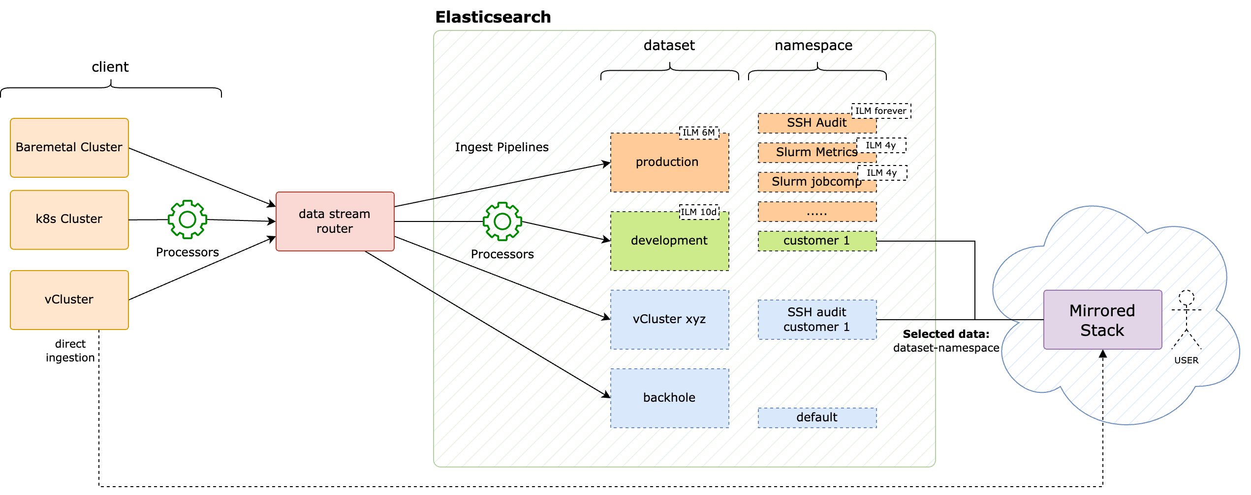
Data Streams workflow and data mirroring
Datastreams are a simplified routing tecnique with an index names abstraction
Notes:
HOW THE DATA IS ACTUALLY MANAGED
Ingested in Data Streams
Data is sent to a data stream router (Logstah or Kafka)
Configured with a special option on the output
Data is written to an hidden index and shown as a datastream in Elasticsearch
Helps
in keeping order
Retention
Mirror the data

Slide 13
Elasticsearch configuration in production
Phisical dedicated nodes for Elasticsearch data nodes
2 Pods per node deployed:
  Java heap size: 32G (not more )
  Keep Replica shards on different nodes
    cluster.routing.allocation.awareness.attributes: k8s_node_name
Virtual Memory
  vm.max_map_count to 262144 (sysctl)
  leave node.store.allow_mmap unset (Elasticsearch parameter)
Notes:
Tainted nodes for ES Data nodes
2 pods per node:
Exceed this 32 GiB border JVM will stop using compressed object pointers, effectively reducing the available memory.
In order to keep main replicas on different failure zone we use the awareness attribute set to the physical node name
Virtual memory parameters
Legend:
MMAP: memory mapping

Slide 14
Upgrade procedures
Node upgrade
  Done via Ansible playbook
    drain k8s nodes 1 by 1
Kubernetes upgrade
  simply done via Rancher UI or API
Elasticsearch via Operator
  The operator is taking care of all procedures to upgrade the Elasticsearch cluster
    stop shard relocation and re-start it at the end
Strimzi (kafka) via Operator
Helm values
  Grafana, and all base components

Slide 15
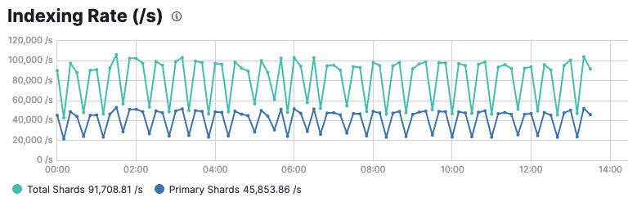
Production cluster numbers
Input | 45’000 doc/sec (Primary shards) | 90’000 doc/sec (Total shards)
Max throughput | 380’000 doc/sec (esrally Benchmark)
Total Online | 230 Bil docs (200 TB)
Archive and Backup | S3

Slide 16

Conclusions
A complex infrastructure simplifies the management of the monitoring stacks
GitOps simplifies the deployment workflow
Easy disaster recovery
  Reinstallation and redeploy of the full stack in 30 min
Separate clusters per purpose
  Custumer specific stack
  test new releases
Go for metal if needed
Notes:
Big initial effort in configuring and discover the right technology
Maintenances and support
GitOps dosesent need advertisement
The choice of putting also Base system components such externals-dns, meltalb etc… is a huge initial effort

Slide 17
Questions?

Slide 18
Thank you for your attention.

Slide 19
Longhorn benchmark: Local-Path vs Longhorn replicated
================================
FIO Benchmark Comparsion Summary
For: Local-Path vs Longhorn
CPU Idleness Profiling: disabled
Size: 30G
Parameters: dataLocality=disabled, numberOfReplicas=3
================================
Local-Path vs Longhorn : Change
IOPS (Read/Write)
Random: 250,150 / 173,601 vs 28,026 / 21,830 : -88.80% / -87.43%
Sequential: 260,310 / 177,843 vs 48,834 / 28,718 : -81.24% / -83.85%
Bandwidth in KiB/sec (Read/Write)
Random: 3,209,873 / 3,130,849 vs 988,534 / 219,959 : -69.20% / -92.97%
Sequential: 3,254,049 / 3,168,738 vs 226,560 / 219,498 : -93.04% / -93.07%
Latency in ns (Read/Write)
Random: 84,128 / 18,001 vs 662,408 / 512,302 : 687.38% / 2745.96%
Sequential: 15,223 / 17,955 vs 660,567 / 516,783 : 4239.27% / 2778.21%

Slide 20
Longhorn benchmark: Local-Path vs Longhorn data-locality
================================
FIO Benchmark Comparsion Summary
For: Local-Path vs Longhorn
CPU Idleness Profiling: disabled
Size: 30G
Parameters: dataLocality=best-effort,diskSelector=nvme,numberOfReplicas=1
================================
Local-Path vs Longhorn : Change
IOPS (Read/Write)
Random: 238,362 / 166,037 vs 28,841 / 29,132 : -87.90% / -82.45%
Sequential: 246,797 / 172,072 vs 49,896 / 39,139 : -79.78% / -77.25%
Bandwidth in KiB/sec (Read/Write)
Random: 3,212,776 / 3,155,759 vs 1,149,367 / 227,344 : -64.23% / -92.80%
Sequential: 3,253,045 / 3,169,461 vs 441,299 / 242,646 : -86.43% / -92.34%
Latency in ns (Read/Write)
Random: 84,603 / 18,647 vs 459,075 / 355,730 : 442.62% / 1807.71%
Sequential: 14,721 / 18,373 vs 360,598 / 354,439 : 2349.55% / 1829.13%

