Slide 1

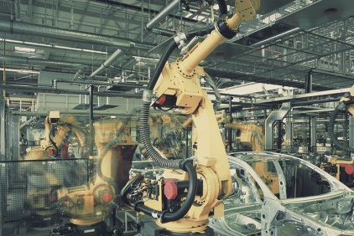


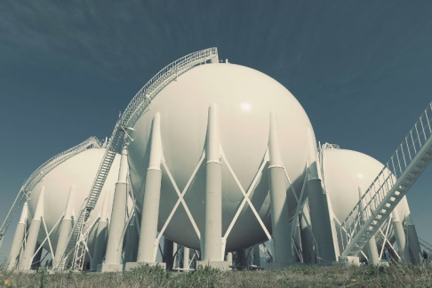

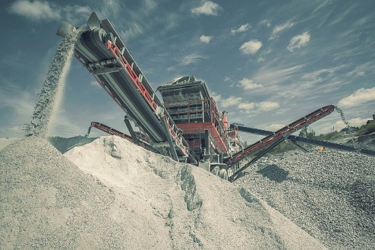
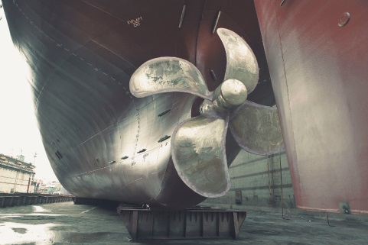


Schools of NTUA
Civil
Engineering
Mechanical Engineering
Electrical and Computer Engineering
School of Architecture
School of Chemical Engineering
School of Topography
and Surveying Engineering
School of Mining
and Metallurgical Engineering
School of Naval Architecture and Marine Engineering
SAMPS
School of
Applied Mathematical and
Physical Sciences (1999)

Slide 2

School of
Applied Mathematical
and Physical Sciences
FIVE (5) YEARS OF STUDIES
LEADING
THROUGH TWO DIFFERENT DIRECTIONS
APPLIED
MATHEMATICS
APPLIED
PHYSICS
TO A UNIQUE DIPLOMA EQUIVALENT
TO INTEGRATED MASTER
(300 ECTS)

Slide 3
School of
Applied Mathematical
and Physical Sciences
S.A.M.P.S.
∼ 70
Staff members
Division of
MATHEMATICS
Division of
PHYSICS
Division of
MECHANICS
Division of
HUMANITIES
Besides its own program of studies, the School offers courses
on Mathematics, Physics, Mechanics and Humanities
to all the other Schools of NTUA

Slide 4
School of
Applied Mathematical
and Physical Sciences
Research – Divisions of the Schools
Think as a Physicist,
Calculate as a Mathematician,
Act as an Engineer
and don’t forget:
«HUMAN is the measure of everything»
(Protagoras, 450 B.C.)

Slide 5
School of
Applied Mathematical
and Physical Sciences
Division of Mechanics
Mechanics of continua,
Elasticity - Plasticity,
Mechanics of rigid bodies,
Mechanics of deformable bodies,
Fracture Mechanics
Fluid mechanics,
Composite materials,
Computational Mechanics,
Biomechanics
Analytical, experimental and numerical methods are developed and applied.

Slide 6
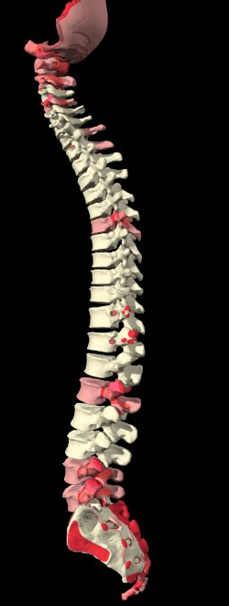
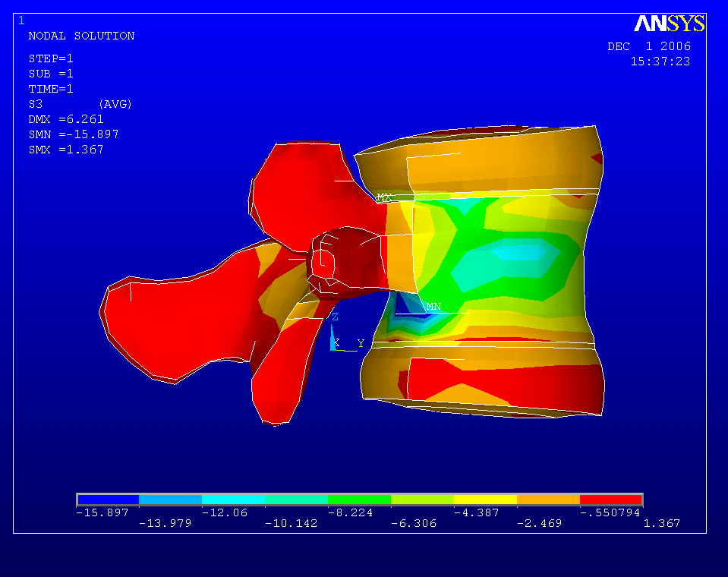
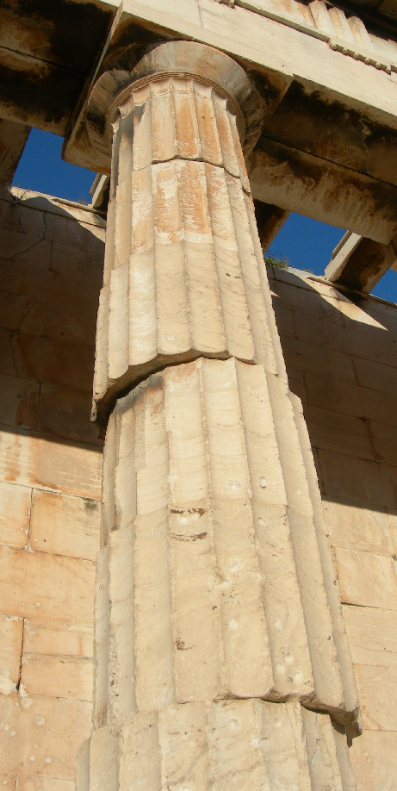
School of
Applied Mathematical
and Physical Sciences
Division of Mechanics
Restoration of stone monuments
Biomechanics of the musculo - skeletal system
Mechanical response
and mechanical properties
Stress distribution in the vertebrae

Slide 7
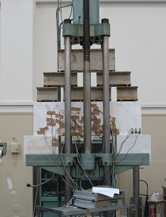
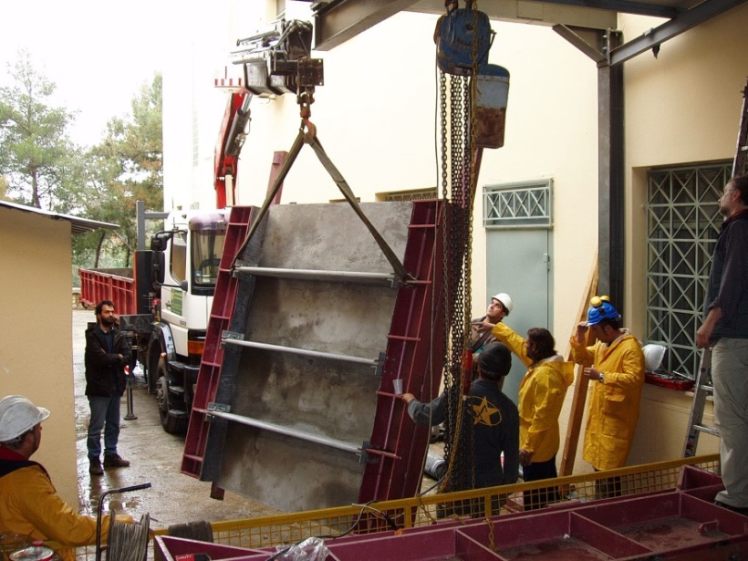
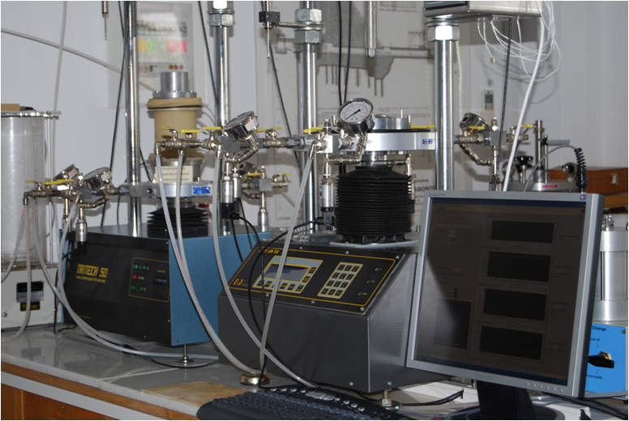
School of
Applied Mathematical
and Physical Sciences
Division of Mechanics
Laboratory for testing and materials (1892)
Testing structural elements without dimension scaling
Dynamic/fatigue loading

Slide 8
School of
Applied Mathematical
and Physical Sciences
Division of Physics
THEORY
Elementary Particles Theory
Condensed Matter Theory
EXPERIMENT
Experimental High-Energy Physics
Experimental Nuclear Physics
Laser Development and Applications
Optical Spectroscopy of Condensed Matter
Physics of Micro-Nano-electronics
Dielectric Spectroscopy - Polymers
CERN
N.C.S.R. Demokritos
Nanotechnology

Slide 9
NTUA – HEP Lab & CERN
School of
Applied Mathematical
and Physical Sciences
The NTUA HEP-Lab involvement at CERN dates back to the 70’s
  R806/R808 (ISR)
  NA14/NA14’ (SPS)
  DELPHI (LEP)
Today the NTUA HEP-Lab is involved in ATLAS & CMS experiments at LHC and the RD51 collaboration
  Contribution to the HW and running of the experiments
  Contributions to the Physics program of the experiments (Higgs, top, heavy flavours, SUSY…)
5 faculty members and many PhD & MSc students

Slide 10
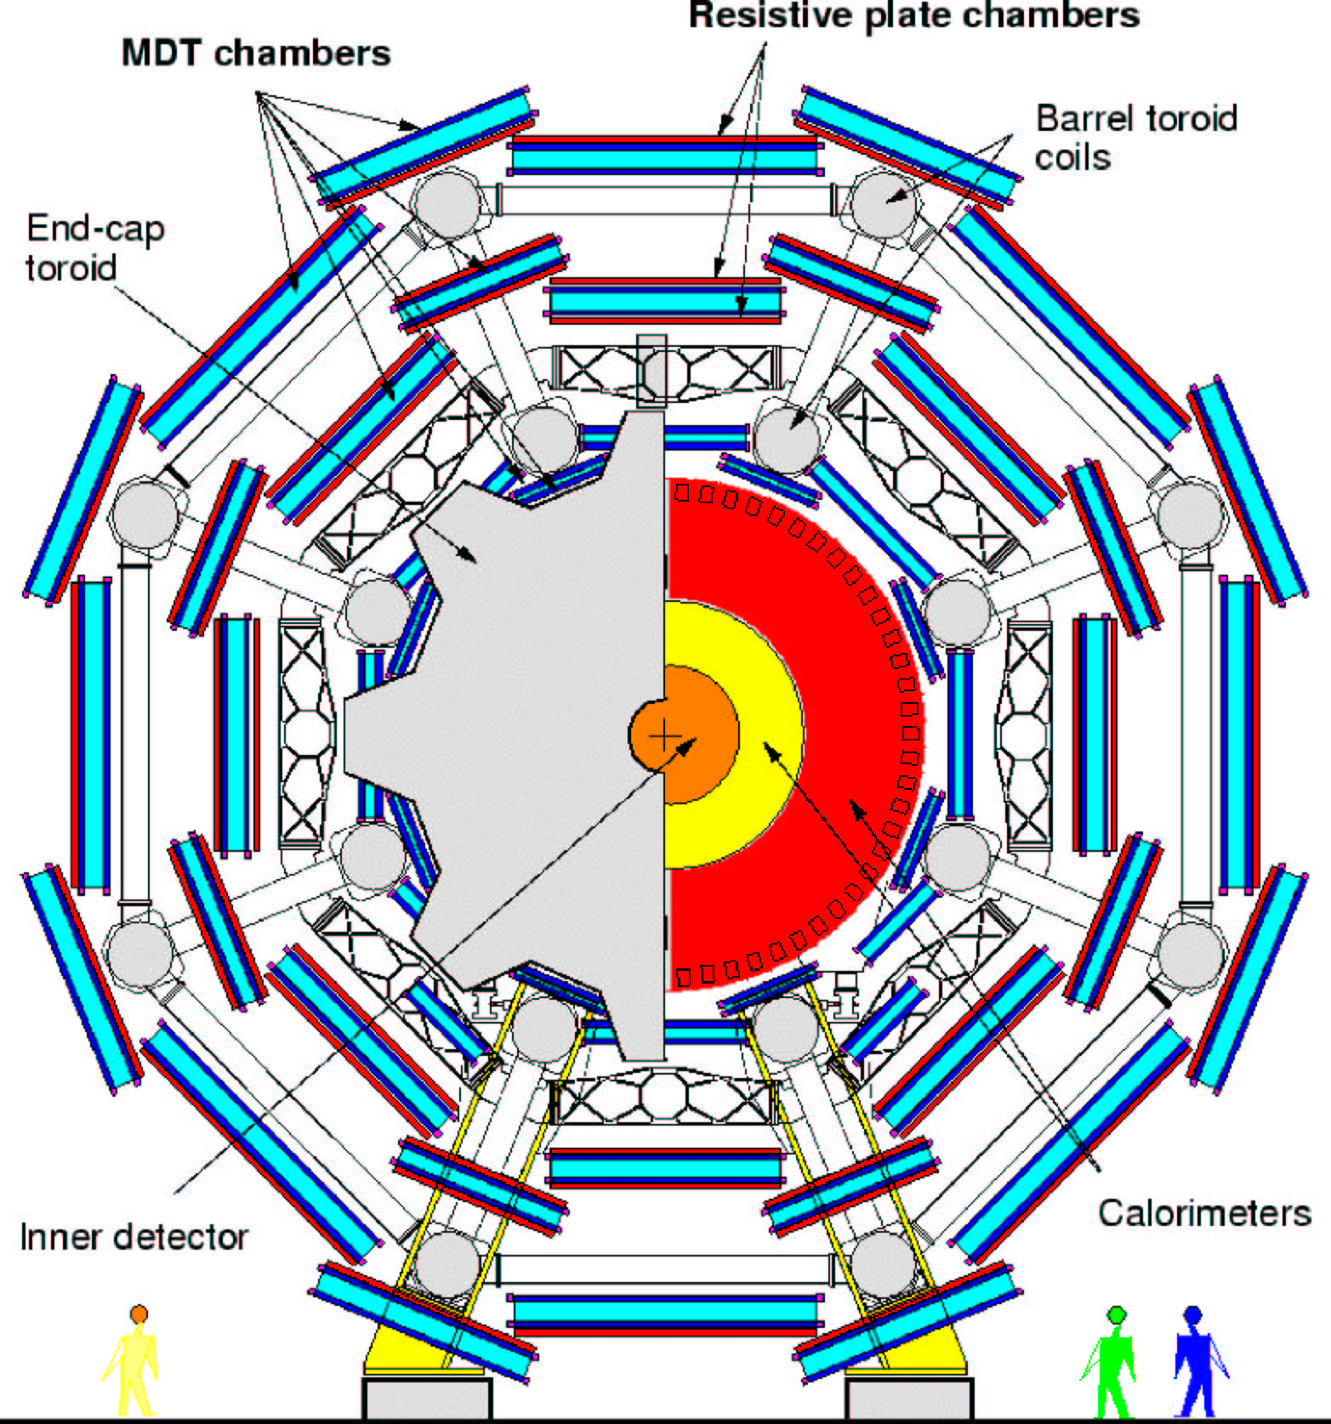
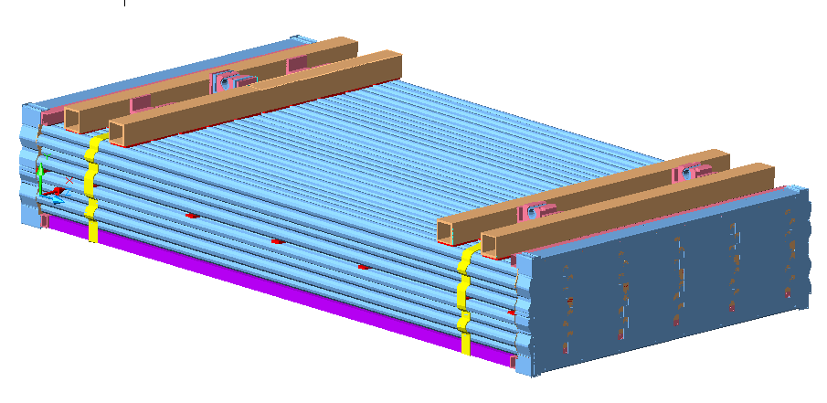
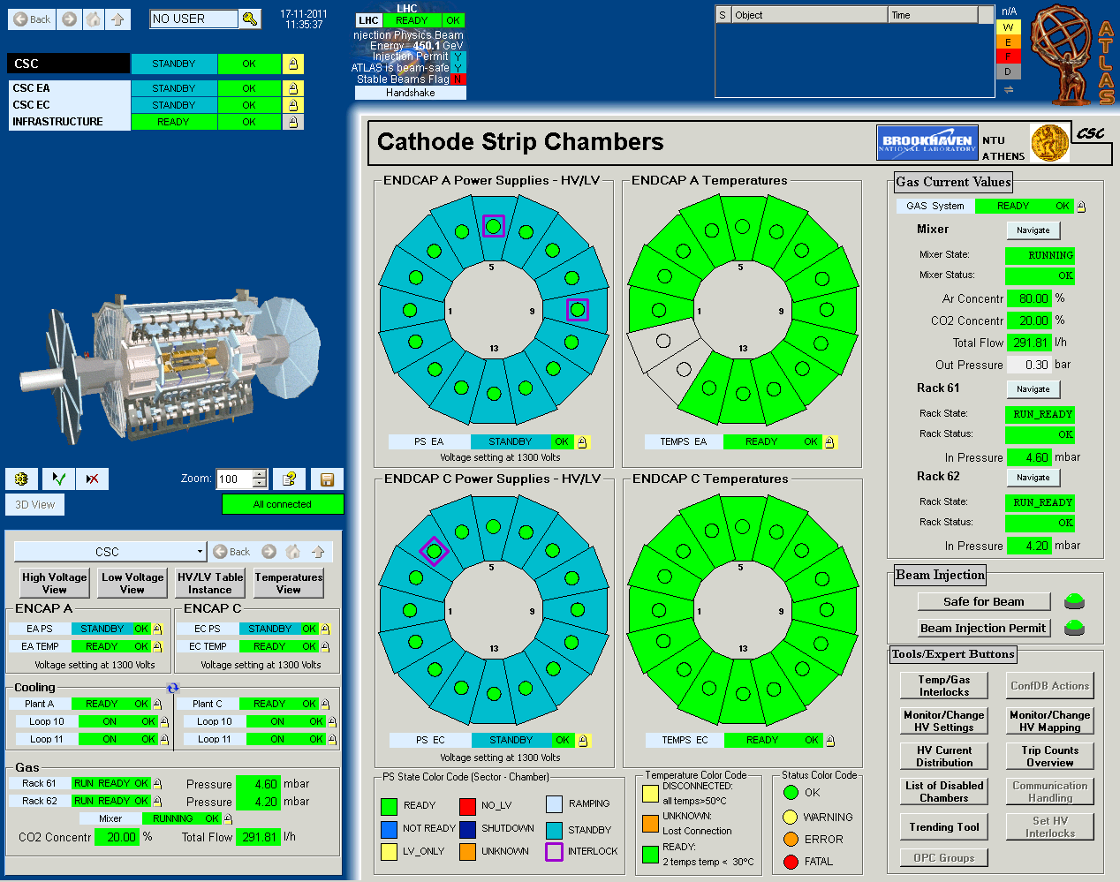
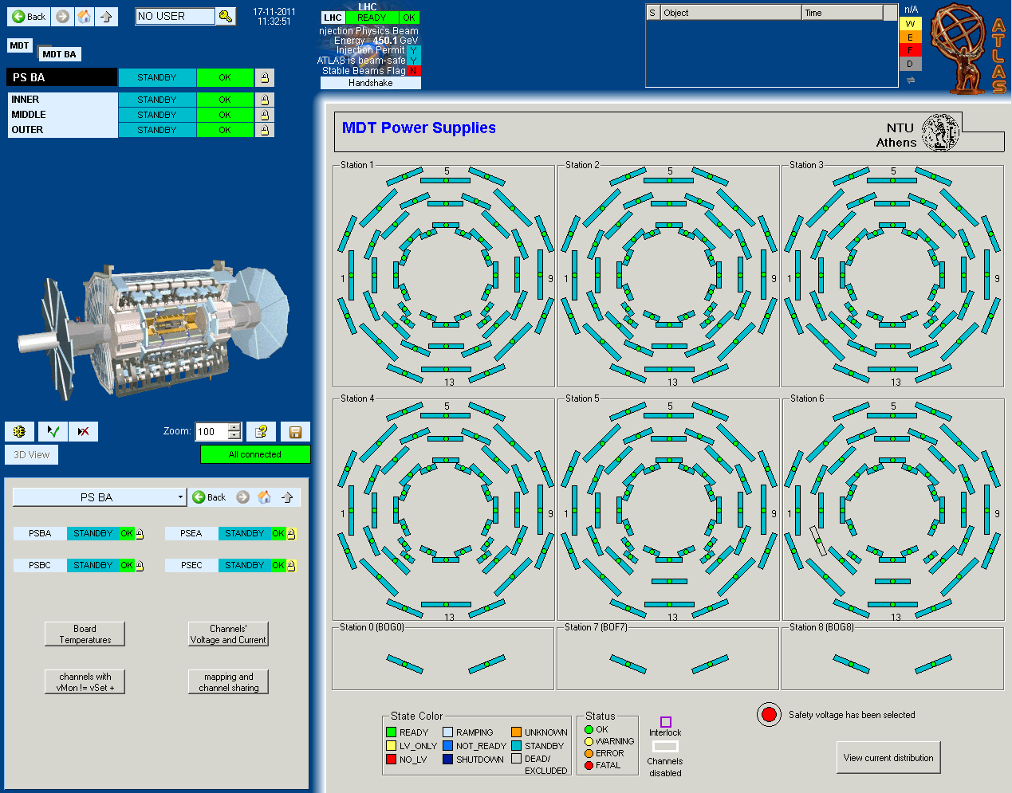
ATLAS (1999 – today)
School of
Applied Mathematical
and Physical Sciences
Construction & installation by a consortium of Greek Universities lead by NTUA
Development of the DCS of the MDT & CSC detectors of the muon system

Slide 11
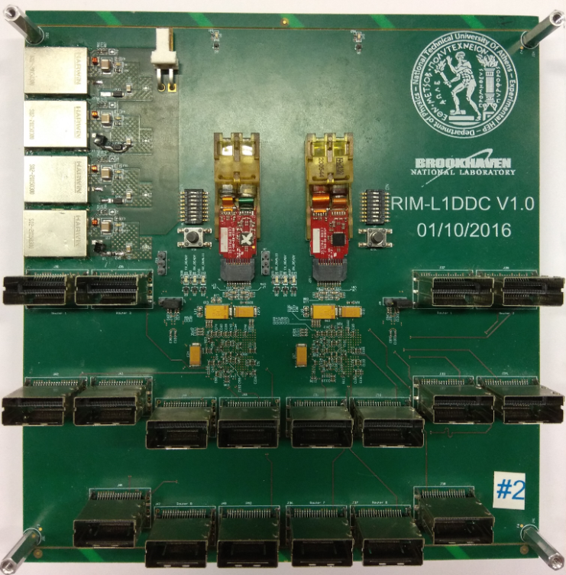
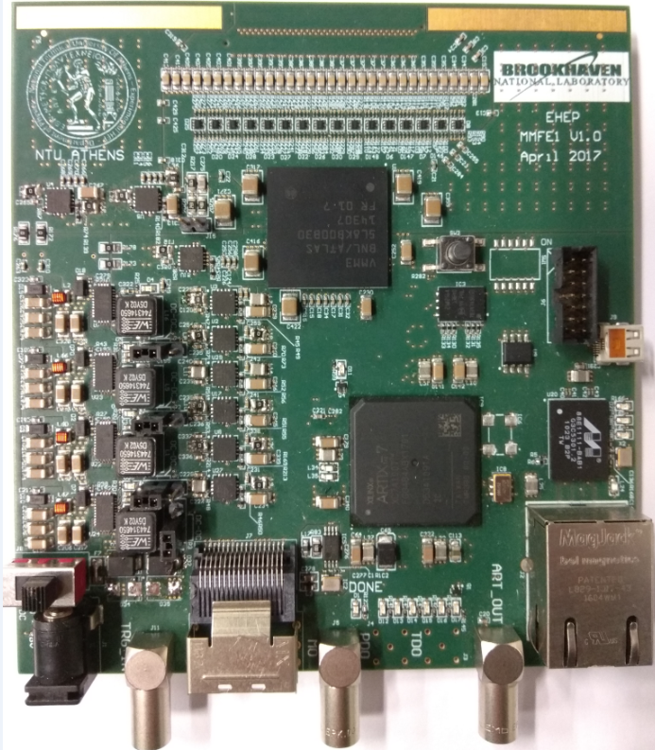
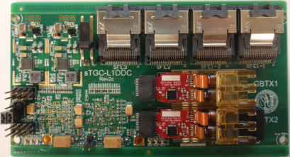
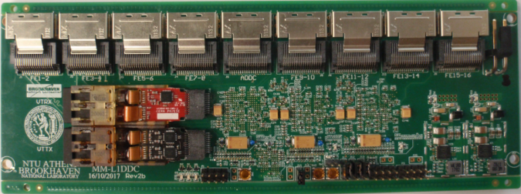
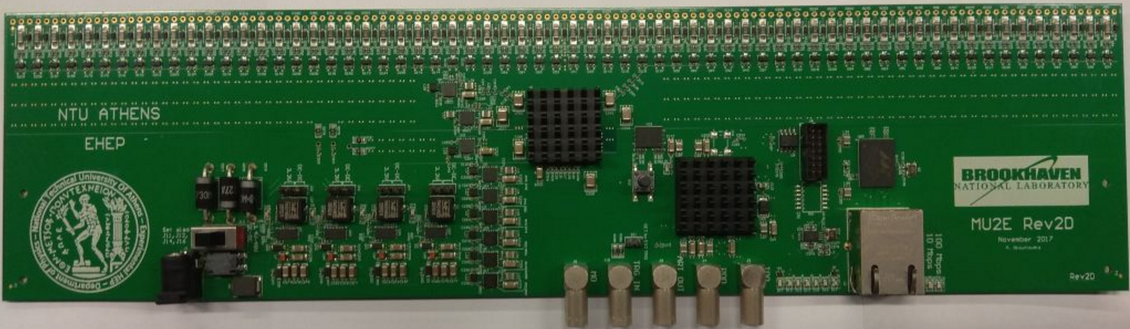
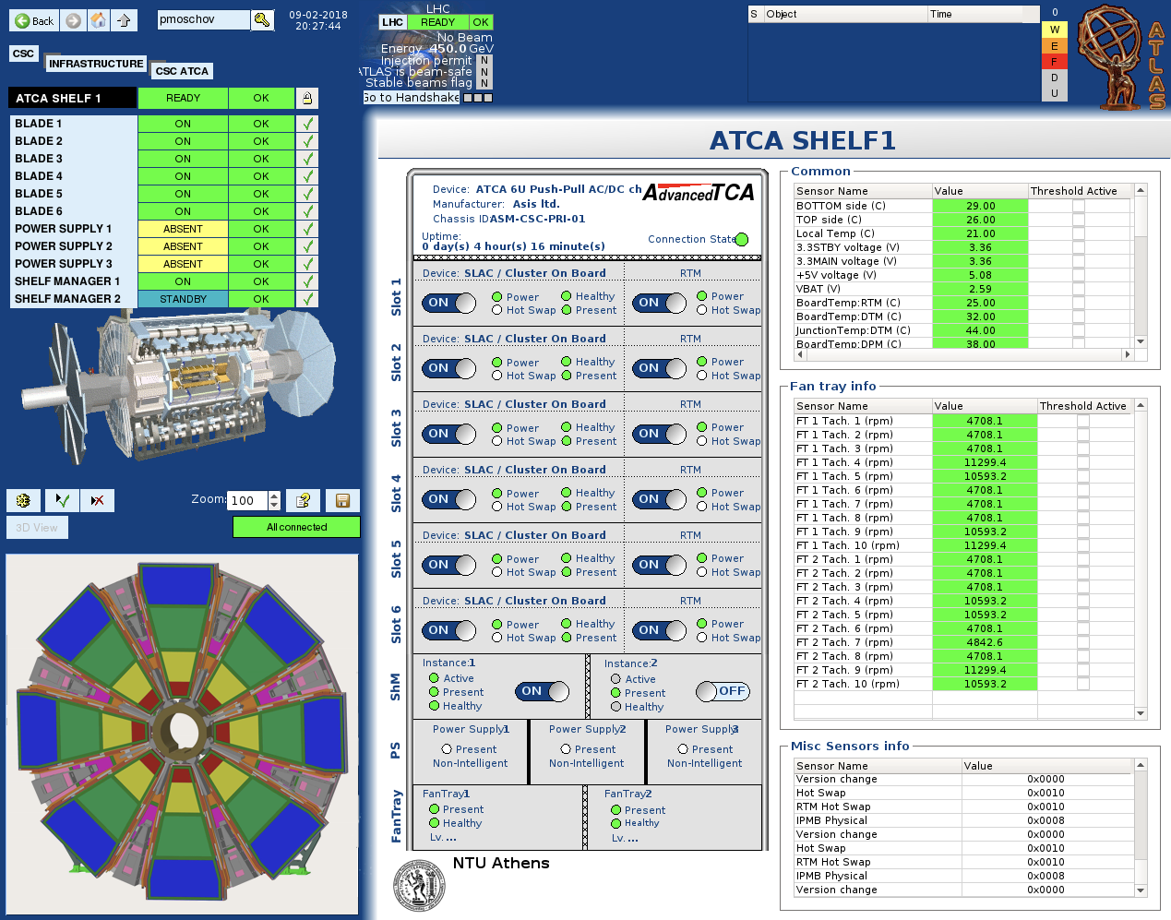
ATLAS (1999 – today)
School of
Applied Mathematical
and Physical Sciences
The ATLAS NSW project
Several electronics cards in collaboration with BNL
DCS of the NSW

Slide 12
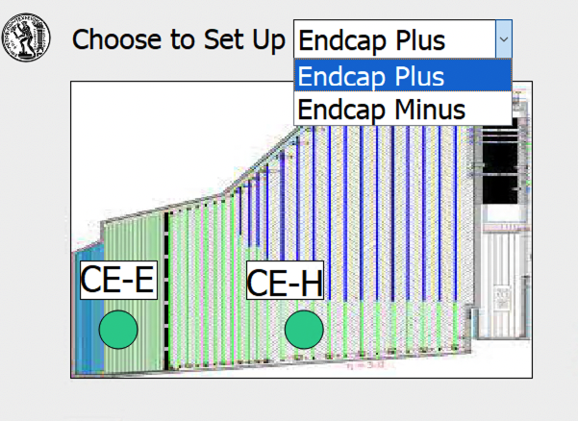
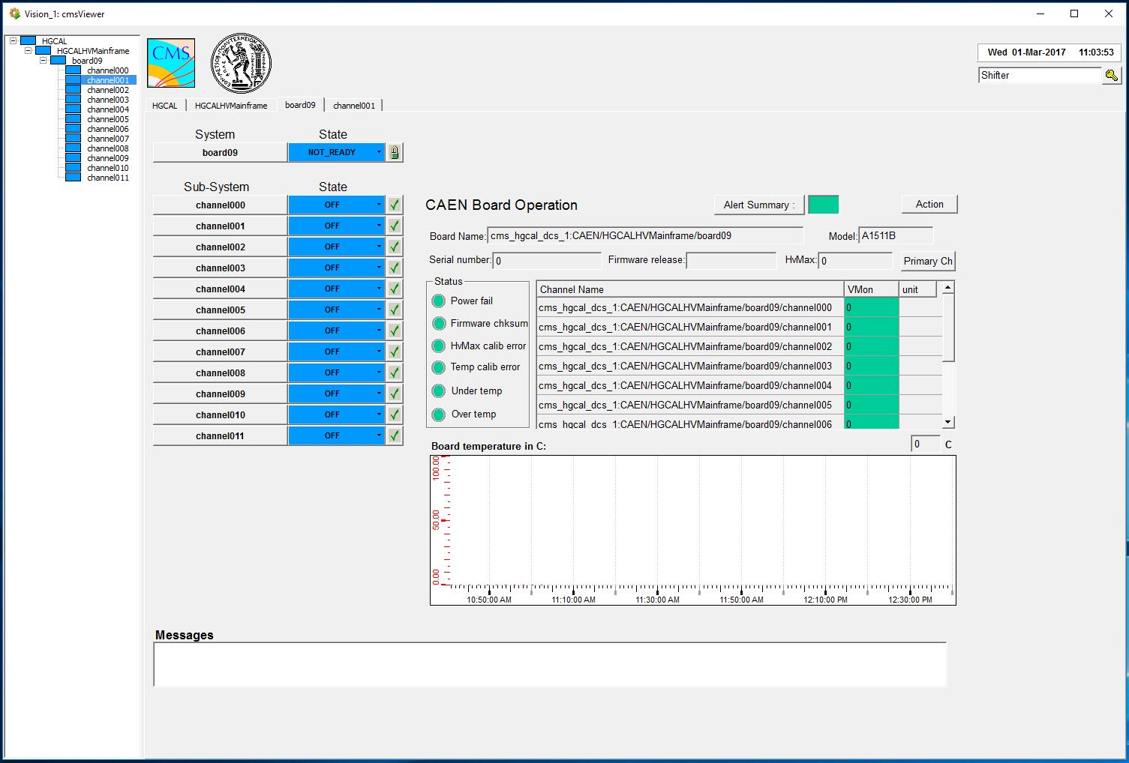
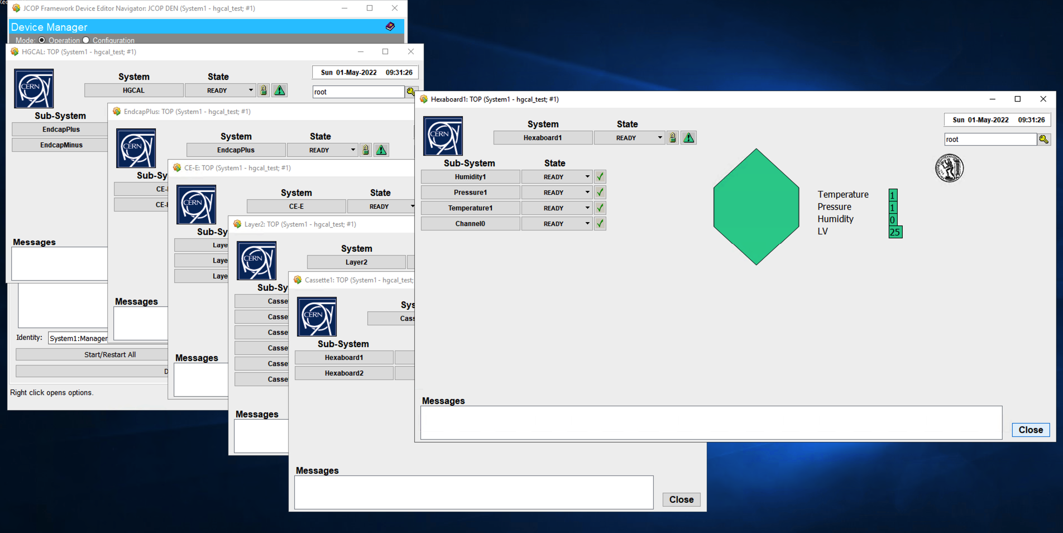
CMS (2016 – today)
School of
Applied Mathematical
and Physical Sciences
Contributions to the Central DCS of the experiment
Contribution to the HGCAL upgrade of CMS – responsibility of the DCS

Slide 13
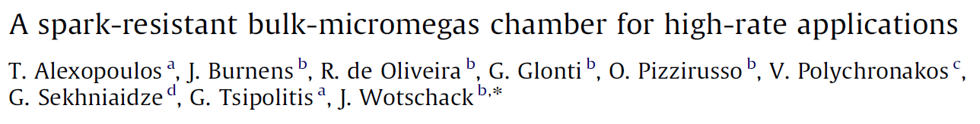
RD51 (2008 – today)
School of
Applied Mathematical
and Physical Sciences
Development of MPGD’s
Coordination of the Test Beams at SPS/NA
original type
resistive type
Drift mesh - Cathode
Drift mesh - Cathode
I. Giomataris & G. Charpak
E_{drift}
Charged track
E_{drift}
Charge track
5 mm
5 mm
Mesh support pillars
Mesh
Mesh
128 μm
Pillar
E_{ampl}
Pillar
128 μm
E_{ampl}
Pillar
Pillar
avalance
avalance
Anode Strips
Insulating layer
PCB
One of the two technologies used at the NSW upgrade of ATLAS
Anode Readout Cu Strips
0.15 mm x 100 mm
Resistive Strips
10 – 20 MΩ/cm

Slide 14
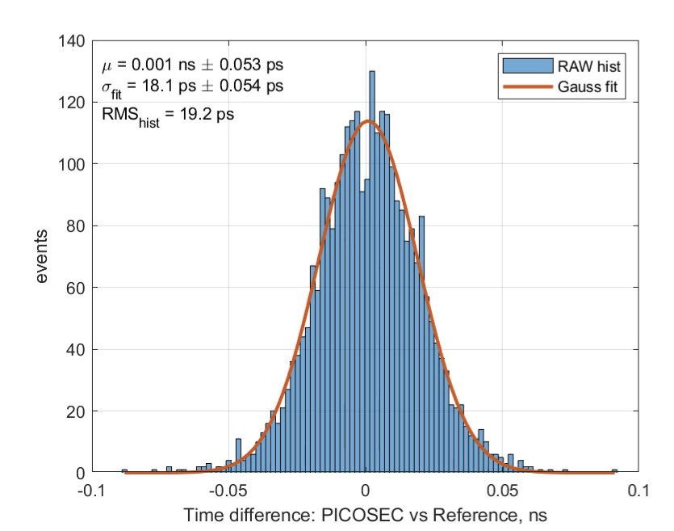
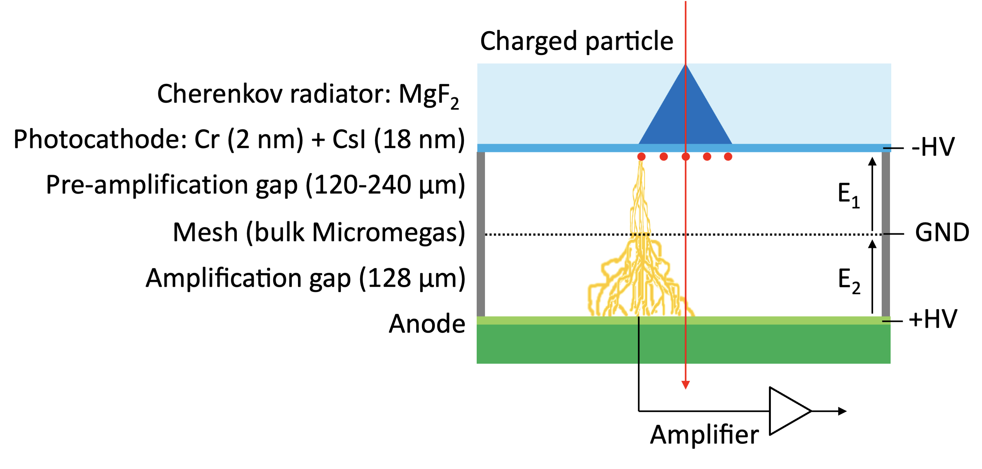
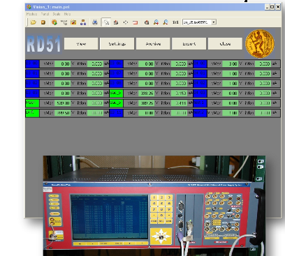
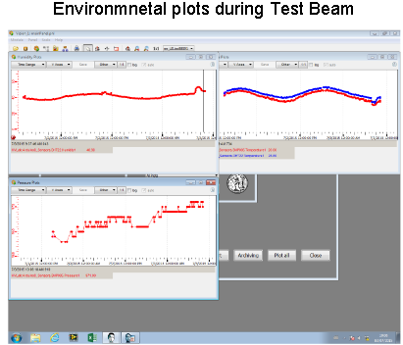
RD51 (2008 – today)
School of
Applied Mathematical
and Physical Sciences
Development of fast MPGD’s (PICOSEC)
RD51 DCS (Control and monitoring)

Slide 15
Thank you
for your patience ...

