Slide 1

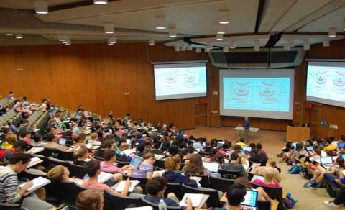
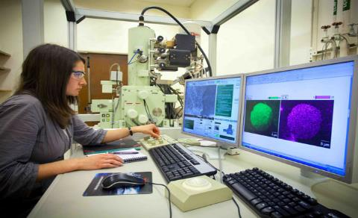
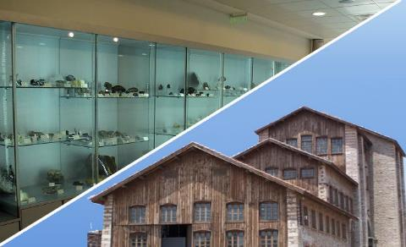
SMME – NTUA: Potential Contribution and Support to the FCC
Presentation:
Prof. Andreas Benardos
Prof. Pavlos Nomikos

Slide 2

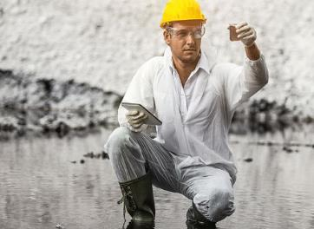
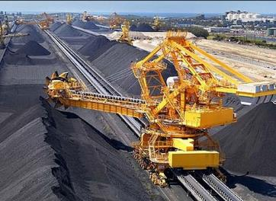
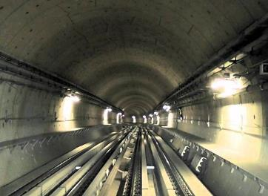
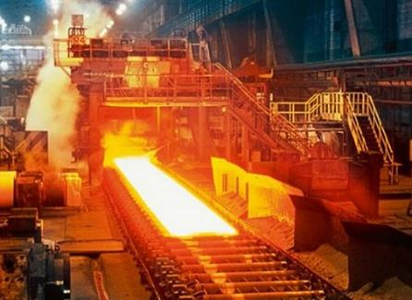

Main Disciplines
Environmental Engineering and Geo-Environment
Mining Engineering
Geotechnology
Metallurgical Processes
Materials Science and Engineering

Slide 3
Our School’s interest in FCC
Underground infrastructure (design, construction, operation):
  Field geological assessment and geotechnical characterization
  Rock Mechanics issues for tunnels, caverns and shafts
  Tunnel (and shaft) excavation and support
  Short and Long-Term Monitoring
  Feasibility and Cost-Benefit Assessment
  Assessment of structural stability in fire events
  Safety and evacuation assessment of underground structures

Slide 4

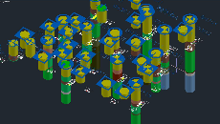
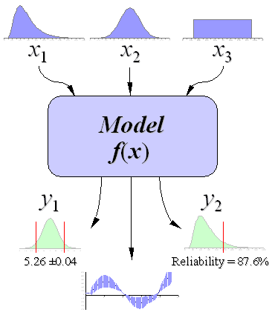
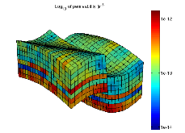
Geological / Geotechnical Investigations
Geological/ Geotechnical investigation campaign to acquire info and knowledge of the conditions of the underground medium
Probabilistic modelling of the parameters to incorporate the uncertainty issues and ground variability in the end result
Spatial modelling and correlation with other parameters to assess the distribution of the modelled parameter in space (and depth)
Uncertainty in ground properties
Data scatter (Aleatory)
Systematic error (Epistemic)
Actual spatial
variability
Random
testing errors
Statistical error
(of the mean)
Bias in measurement
procedures

Slide 5
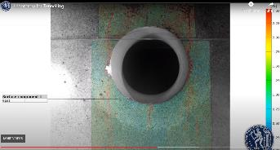
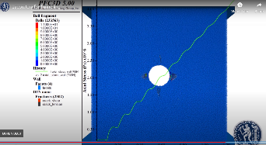
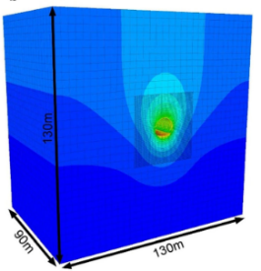
Rock Mechanics – Excavation Design and Support
Laboratory testing/assessment of samples to accurately characterize the ground properties (rocks/soils)
Numerical modeling for assessing the stability of the underground excavations for the optimum design (cross-section, excavation phases, support selection, etc.)
Excavation design (D&B, Road-Header, TBM’s) to assess the characteristics of the construction sequence, vibrations, TBM performance prediction, construction scheduling, etc.
Monitoring, back-analysis and assessment to ensure the stability conditions of the excavated infrastructure

Slide 6
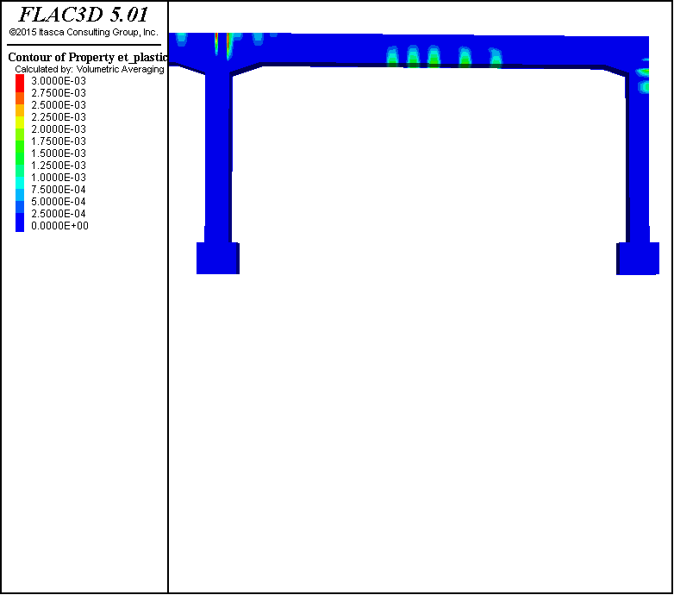
Risk and Emergency response
The emergency response management is required to estimate the egress time and overall behavior of the affected users in the event of an emergency scenario.
Assessment of structural stability in fire events
Testing and validation of evacuation plans
Options of testing different and complex scenarios
Possibility of integrating CFD
Damage evolution in the tunnel structure with time (expressed by the plastic tensile strain) for spalling rate 5 mm/min (0-30 min spalling)
Dimokratias Metro Station (Thessaloniki Metro) evacuation assessment

