Slide 1








FCC Feasibility Study Status
Michael Benedikt, CERN
on behalf of the FCC collaboration and FCCIS DS team
LHC
PS
SPS
FCC
http://cern.ch/fcc
Work supported by the European Commission under the HORIZON 2020 projects EuroCirCol, grant agreement 654305; EASITrain, grant agreement no. 764879; ARIES, grant agreement 730871, FCCIS, grant agreement 951754, and E-JADE, contract no. 645479
photo: J. Wenninger

Slide 2

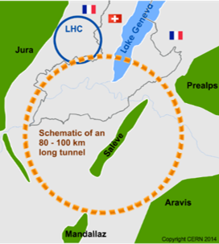
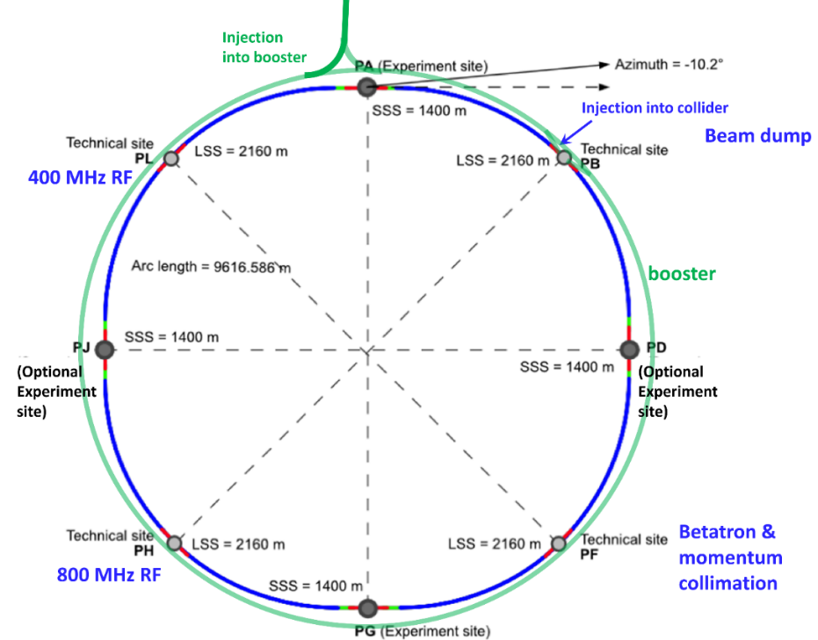
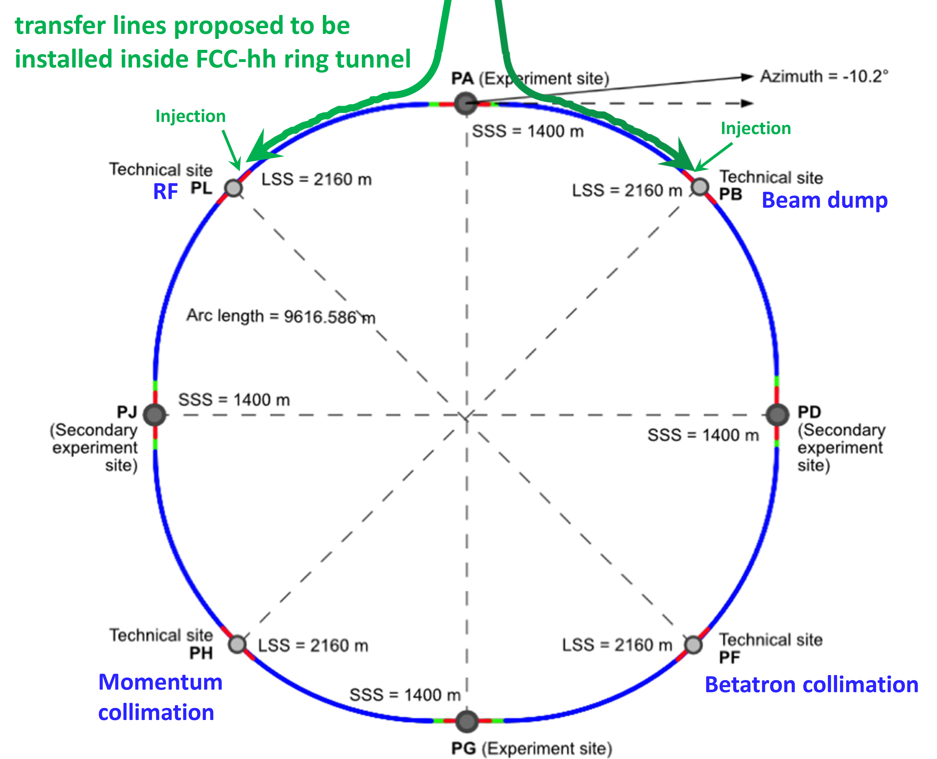
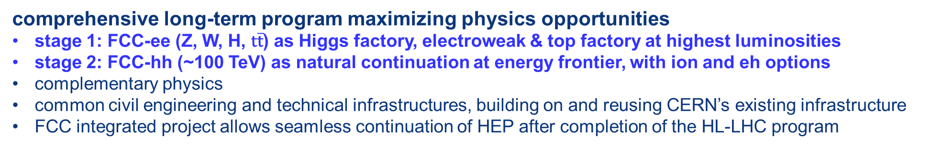
The FCC integrated program
inspired by successful LEP – LHC programs at CERN
comprehensive long-term program maximizing physics opportunities
stage 1: FCC-ee (Z, W, H, $\text{t}\overline{\text{t}}$) as Higgs factory, electroweak & top factory at highest luminosities
stage 2: FCC-hh (~100 TeV) as natural continuation at energy frontier, with ion and eh options
complementary physics
common civil engineering and technical infrastructures, building on and reusing CERN’s existing infrastructure
FCC integrated project allows seamless continuation of HEP after completion of the HL-LHC program
FCC-ee
FCC-hh
2020 - 2040
2045 - 2060
2065 - 2090
a similar two-stage project CEPC/SPPC is under study in China

Slide 3
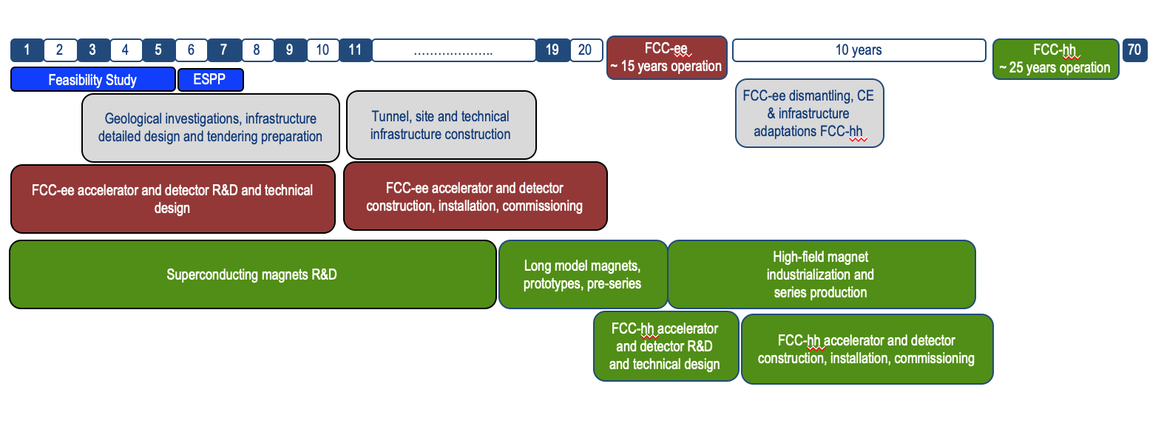
technical timeline of FCC integrated programme
Feasibility Study: 2021-2025
If project approved before end of
decade → construction can start
beginning 2030s
FCC-ee operation ~2045-2060
FCC-hh operation 2070-2090++
F. Gianotti

Slide 4
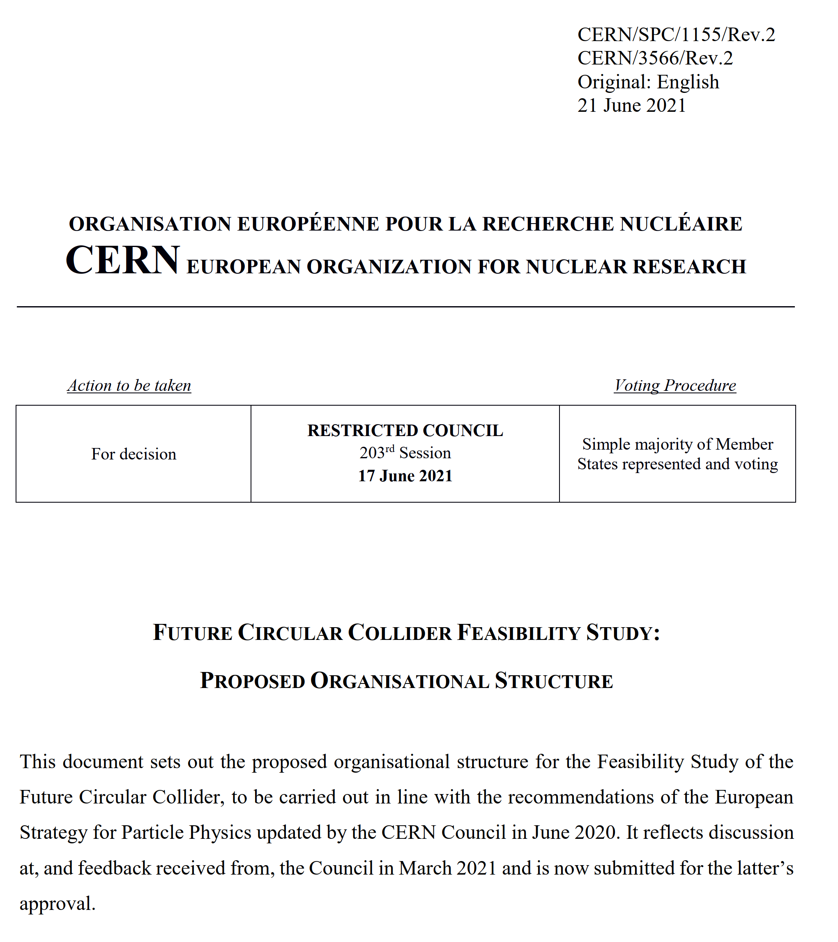
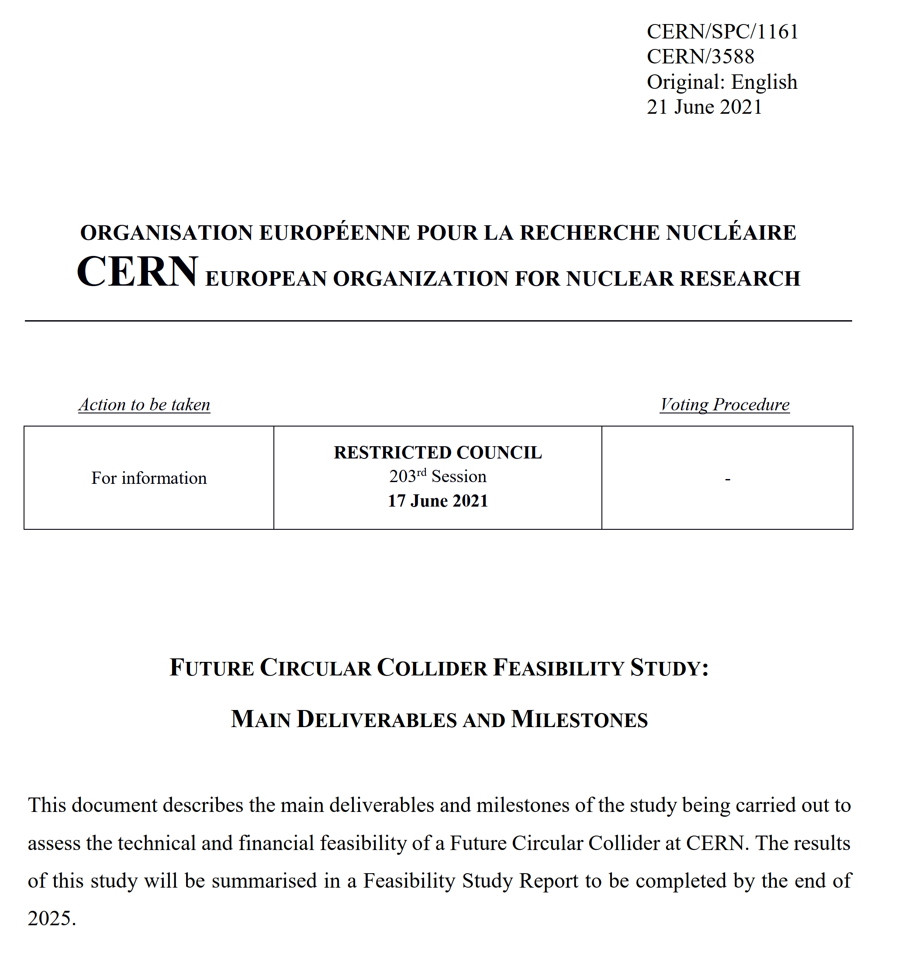
FCC Feasibility Study (FS)
Organisational Structure of the FCC Feasibility Study
http://cds.cern.ch/record/2774006/files/English.pdf
Main Deliverables and Timeline of the FCC Feasibility Study
http://cds.cern.ch/record/2774007/files/English.pdf
2013 ESPPU requested FCC Conceptual Design four-volume report → 4 volumes delivered in 2018/19, describing the physics cases, the design of the lepton and hadron colliders, and the underpinning technologies and infrastructures. Fol-
2020 ESPPU→ 2021 Launch of FCC Feasibility Study (FCC FS) by CERN Council
Feasibility Study Report (FSR) expected by the end of 2025 , not only the technical design, but also numerous other key feasibility aspects, including tunnel construction, financing, and environment
FSR will be an important input to the next ESPPU expected in 2026/27.
FCC FS is organized as an international collaboration.
The FCC FS and a possible future project will profit from CERN’s decade-long experience with successful large international accelerator projects, e.g., the LHC and HL-LHC, and the associated global experiments, such as ATLAS and CMS.

Slide 5



Feasibility Study Timeline
2021 |  |  |  | 2022 |  |  |  | 2023 |  |  |  | 2024 |  |  |  | 2025
Q1 | Q2 | Q3 | Q4 | Q1 | Q2 | Q3 | Q4 | Q1 | Q2 | Q3 | Q4 | Q1 | Q2 | Q3 | Q4 | Q1 | Q2 | Q3 | Q4
CDR baseline design adaptations for
new implementation scenario
Status reports &
study planning ,
FCC Week & Review : implementation, baseline design, organisation, communication
high-risk areas site investigations, territorial integration & environmental initial state studies with host states
FCCW followed by mid-term review:
general coherency, cost update
Total CERN funding for the Feasibility Study 2021 - 2025: 100 MCHF material & personnel
H2020 FCCIS Design Study
Swiss CHART programme
FCC collaboration resources
detailed design towards FS report
FCC Week & Review: key technology R&D programs
FS Report
Release FSR
Project cost update

Slide 6
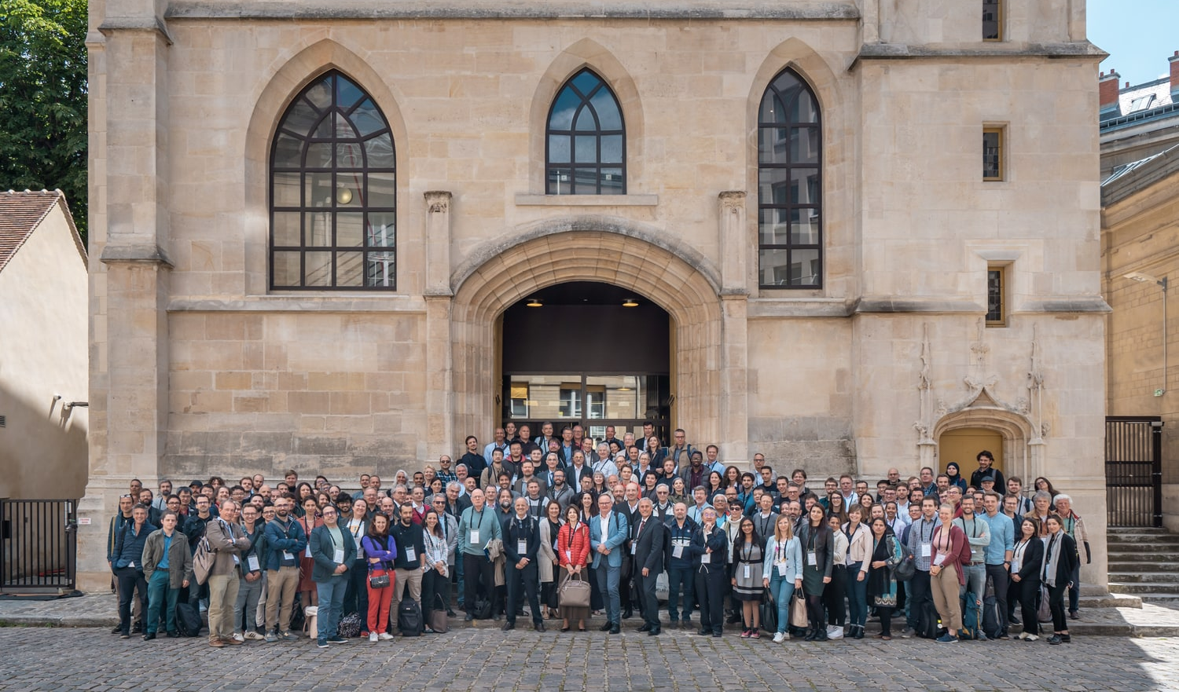
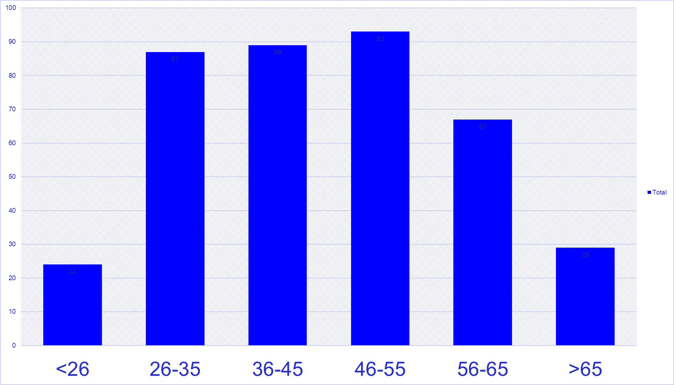
FCC Week 2022, Sorbonne, Paris, 30 May – 3 June 2022
483 participants
269 in person and 214 remote
Distribution of participants by age group
45 sessions,
202 presentations,
+ 20 posters

Slide 7
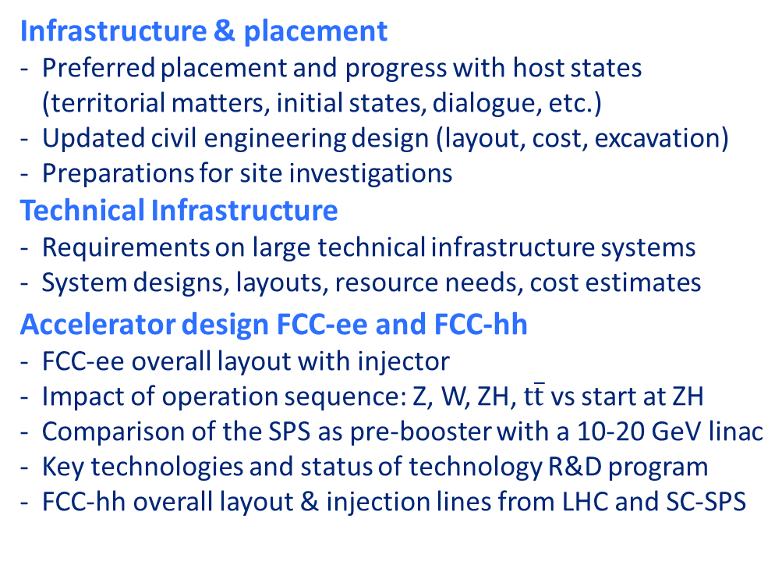
Mid-Term Review & Cost Review, autumn ‘23
Mid-term review report, supported by additional documentation on each deliverable, will be submitted to review committees and to Council and its subordinate bodies, as input for the review.
Results of both general mid-term review and the cost review should indicate the main directions and areas of attention for the second part of the Feasibility Study
Infrastructure & placement
Preferred placement and progress with host states (territorial matters, initial states, dialogue, etc.)
Updated civil engineering design (layout, cost, excavation)
Preparations for site investigations
Technical Infrastructure
Requirements on large technical infrastructure systems
System designs, layouts, resource needs, cost estimates
Accelerator design FCC-ee and FCC-hh
FCC-ee overall layout with injector
Impact of operation sequence: Z, W, ZH, $\text{t}\overline{\text{t}}$ vs start at ZH
Comparison of the SPS as pre-booster with a 10-20 GeV linac
Key technologies and status of technology R&D program
FCC-hh overall layout & injection lines from LHC and SC-SPS
Physics, experiments, detectors:
Documentation of FCC-ee and FCC-hh physics cases
Plans for improved theoretical calculations to reduce theoretical uncertainties towards matching FCC-ee statistical precision for the most important measurements.
First documentation of main detector requirements to fully exploit the FCC-ee physics opportunities
Organisation and financing:
Overall cost estimate & spending profile for stage 1 project
Environmental impact, socio-economic impact:
Initial state analysis, carbon footprint, management of excavated materials, etc.
Socio-economic impact and sustainability studies

Slide 8
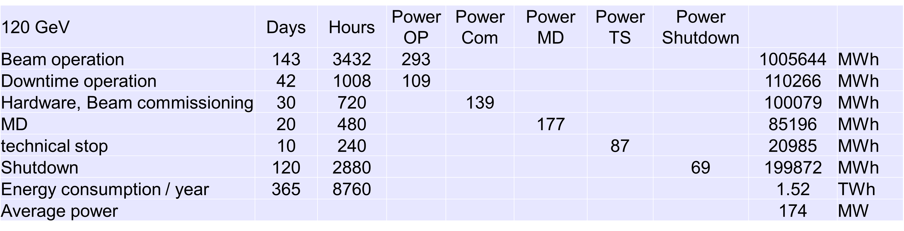
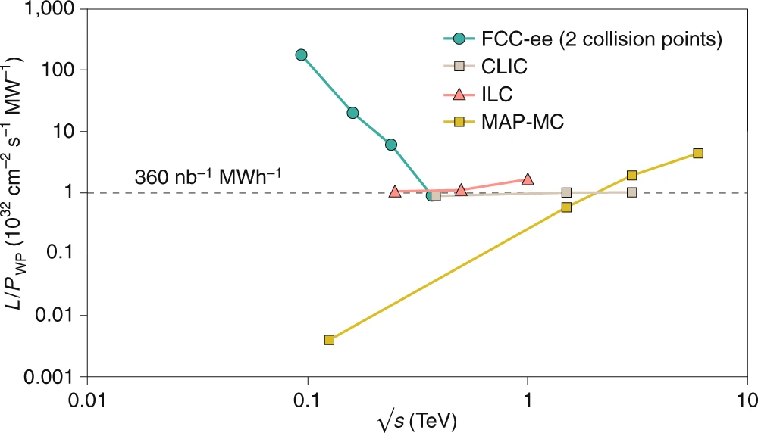
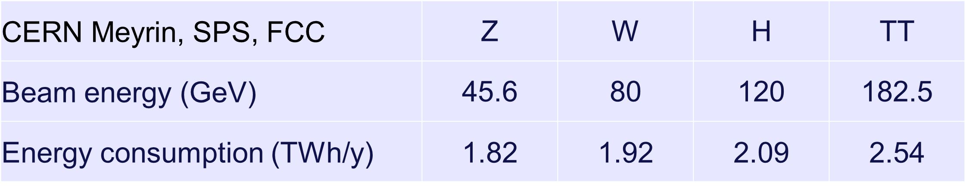
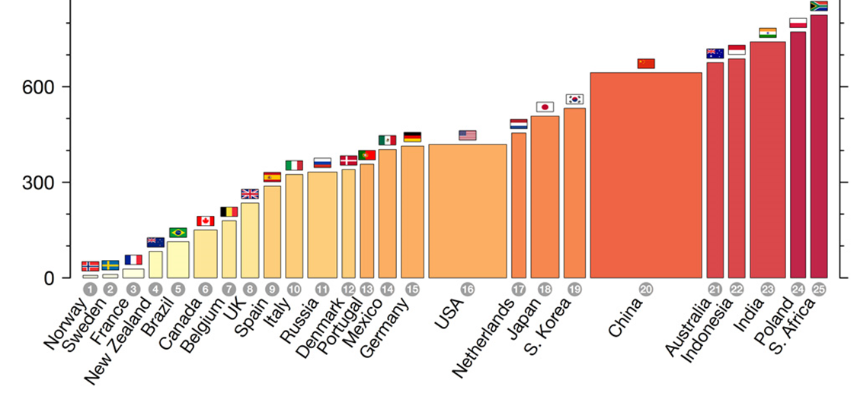


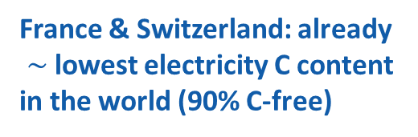
sustainability and carbon footprint studies
highly sustainable Higgs factory
FCC-ee annual energy consumption $\sim$ LHC/HL-LHC
luminosity vs. electricity consumption
J.-P. Burnet, FCC Week 2022
incl. CERN site & SPS
powered by mix of renewable & other C-free sources
France & Switzerland: already
$\sim$lowest electricity C content
in the world (90% C-free)
Thanks to twin-aperture magnets, thin-film SRF, efficient RF power sources, top-up injection
optimum usage of excavation material
int’l competition “mining the future®”
https://indico.cern.ch/event/1001465/
https://www.carbonbrief.org/

Slide 9
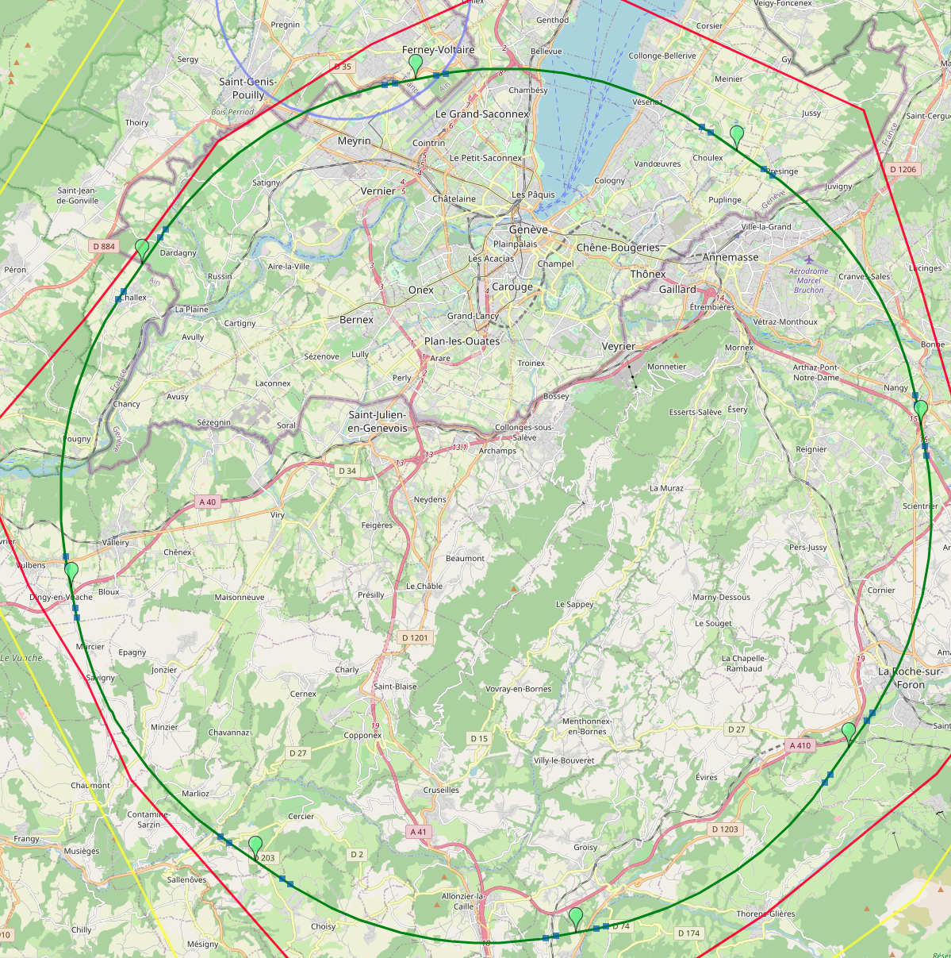
8-site baseline “PA31”
optimized placement and layout
PA: Experiment
Number of surface sites | 8
LSS@IP (PA, PD, PG, PJ) | 1400 m
LSS@TECH (PB, PF, PH, PL) | 2143 m
Arc length | 9.6 km
Sum of arc lengths | 76.9 m
Total length | 91.1 km
PB: technical
PL: technical
PD: experiment
8 sites – less use of land, <40 ha instead 62 ha
Possibility for 4 experiment sites in FCC-ee
All sites close to road infrastructures (< 5 km of new road constructions for all sites)
Vicinity of several sites to 400 kV grid lines
Good road connection of PD, PF, PG, PH suggest operation pole around Annecy/LAPP
Exchanges with ~40 local communes in preparation
PJ: experiment
PF: technical
PH: technical
PG: experiment
J. Gutleber

Slide 10
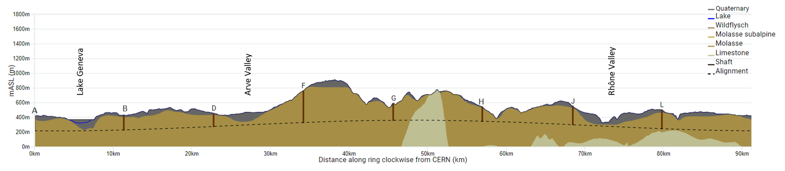
FCC Long Section – PA31-1.0
FCC inclined at 0.5% gradient to minimise depth of point F
Limestone unavoidable between G-H
FCC passes below Lake Geneva moraines
FCC passes above limestone
Shaft depth:
A: 202 m
B: 200 m
D: 177 m
F: 399 m
G: 228 m
H: 139 m
J: 251 m
L: 253 m
John Osborne

Slide 11
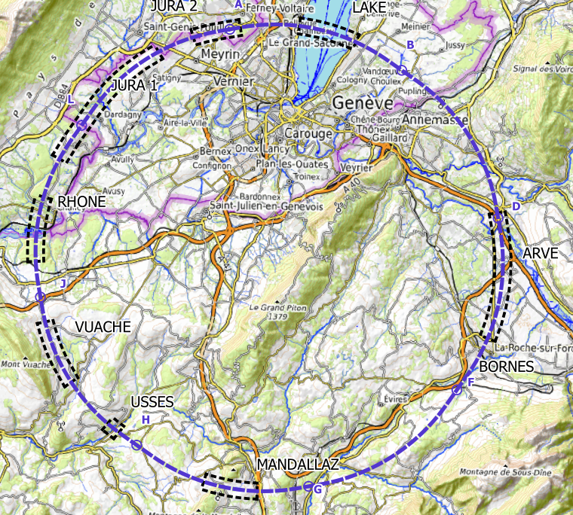
plans for high-risk area site investigations
  Jura, Vuache (3 Areas)
  Top of limestone
  Karstification and filling-in at the tunnel depth
  Water pressure
  Lake, Rhône, Arve and Usses Valley (4 Areas)
  Top of the molasse
  Quaternary soft grounds, water bearing layers
  Mandallaz (1 Areas)
  Water pressure at the tunnel level
  Karstification
  Bornes (1 Area)
  High overburden molasse properties
  Thrust zones
  Site investigations planned for 2024 – 2025:
  ~40-50 drillings, some 100 km of seismic lines

Slide 12

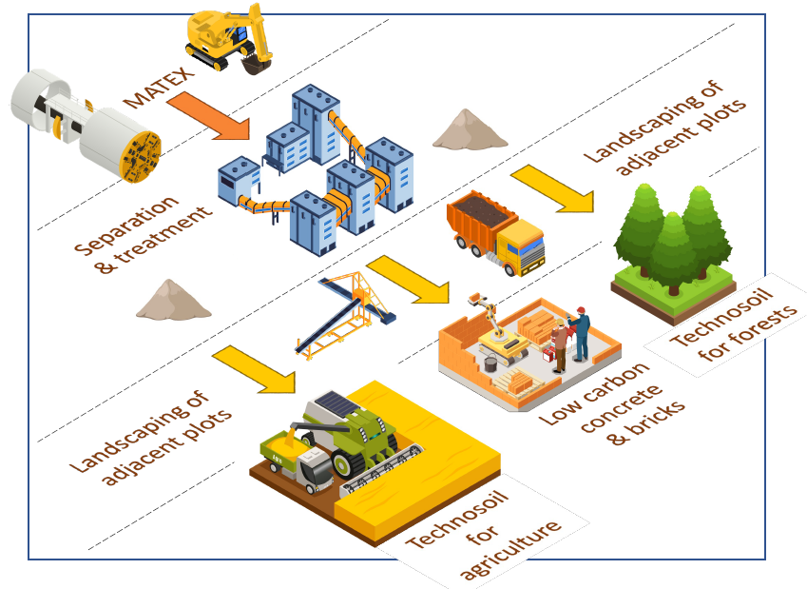
Mining the future – excavation material reuse
AMBERG Konsortium: In-situ characterisation (Crossbelt elemental analyzer) and preparation for use as construction material on site (Spritzbeton, Bindemittel aus Bio-Mineralstoffen), Production of construction elements withouth cement/concrete.
BG Konsortium: Online-analysis and preparation of Molasse for construction elements from sandstone, sabd, filing material for concrete, low-carbon concrete, terra cotta bricks, etc.
ARCADIS Konsortium: Molasse combined with some stabilisation material for production of construction bricks via high mechanical pressure. Replacing high-carbon construction materials. Mobile production plants directly on site.
EDAPHOS Konsortium: Combining mineral (Molasse) material and organic material to produce fertile soil with on-site production plants by using mikrobiology to accelerate humus creation. Fertile soil as top layer for agricultural use, recultivation.

Slide 13

new layouts & preliminary assignments of straight sections
injection-tunnel near PA; 400 MHz RF in PL; 4 exp. caverns for both
FCC-ee
4-fold periodicity, synergies ee & hh
FCC-hh

Slide 14
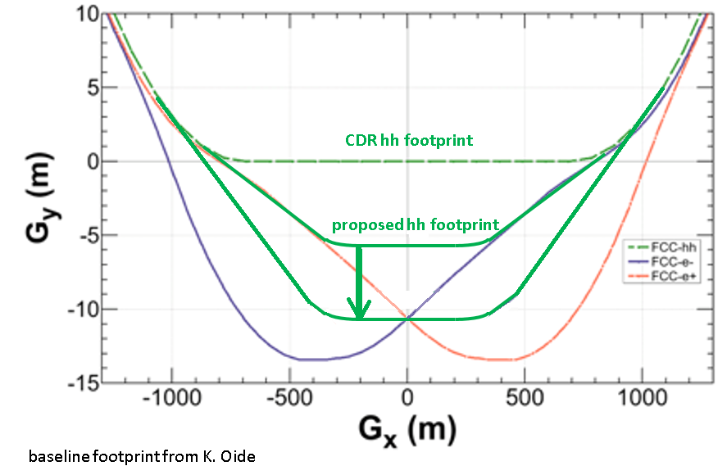
layout optimisation of high-luminosity insertions
In CDR:
  Due to FCC-ee asymmetric IR layout, transverse displacement of IPs for FCC-ee and FCC-hh.
  FCC-hh footprint compatible with FCC-ee injector
F. Zimmermann
Massimo Giovannozzi & Thys Risselada
Implementation of an improved layout with FCC-ee & FCC-hh IPs with same transverse positions
Advantages:
  Transverse size of detector cavern reduced
  Tunnel width reduced over 2 x 500 m
  Potential re-use of FCC-ee detector magnets for FCC-hh
(m)
T. Risselada
(m)

Slide 15
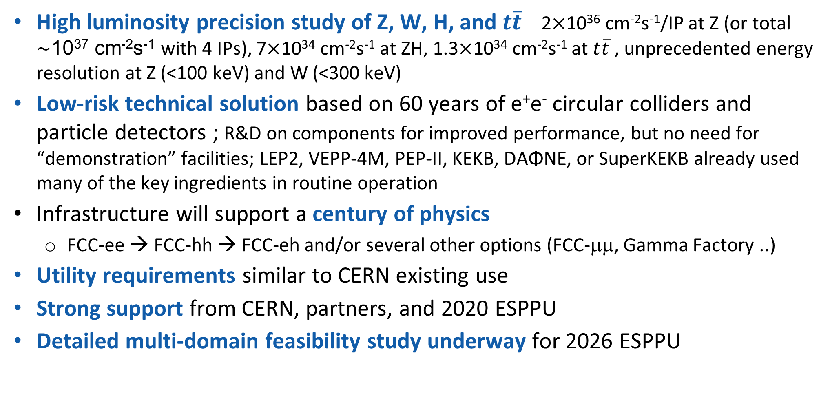
FCC-ee in a nutshell
High luminosity precision study of Z, W, H, and $t\overline{t}$ 2$×$10³⁶ cm⁻²s⁻¹/IP at Z (or total $\sim$10³⁷ cm⁻²s⁻¹ with 4 IPs), 7$×$10³⁴ cm⁻²s⁻¹ at ZH, 1.3$×$10³⁴ cm⁻²s⁻¹ at $t\overline{t}$, unprecedented energy resolution at Z (<100 keV) and W (<300 keV)
Low-risk technical solution based on 60 years of e⁺e⁻ circular colliders and particle detectors ; R&D on components for improved performance, but no need for “demonstration” facilities; LEP2, VEPP-4M, PEP-II, KEKB, DAΦNE, or SuperKEKB already used many of the key ingredients in routine operation
Infrastructure will support a century of physics
  FCC-ee → FCC-hh → FCC-eh and/or several other options (FCC-μμ, Gamma Factory ..)
Utility requirements similar to CERN existing use
Strong support from CERN, partners, and 2020 ESPPU
Detailed multi-domain feasibility study underway for 2026 ESPPU

Slide 16
Stage 1: updated parameters
K. Oide, D. Shatilov,
Parameter [4 IPs, 91.2 km,T_{rev}=0.3 ms] | Z | WW | H (ZH) | ttbar
beam energy [GeV] | 45 | 80 | 120 | 182.5
beam current [mA] | 1280 | 135 | 26.7 | 5.0
number bunches/beam | 10000 | 880 | 248 | 36
bunch intensity [10¹¹] | 2.43 | 2.91 | 2.04 | 2.64
SR energy loss / turn [GeV] | 0.0391 | 0.37 | 1.869 | 10.0
total RF voltage 400/800 MHz [GV] | 0.120/0 | 1.0/0 | 2.08/0 | 4.0/7.25
long. damping time [turns] | 1170 | 216 | 64.5 | 18.5
horizontal beta* [m] | 0.1 | 0.2 | 0.3 | 1
vertical beta* [mm] | 0.8 | 1 | 1 | 1.6
horizontal geometric emittance [nm] | 0.71 | 2.17 | 0.64 | 1.49
vertical geom. emittance [pm] | 1.42 | 4.34 | 1.29 | 2.98
horizontal rms IP spot size [μm] | 8 | 21 | 14 | 39
vertical rms IP spot size [nm] | 34 | 66 | 36 | 69
beam-beam parameter ξ_{x} / ξ_{y} | 0.004/ .159 | 0.011/0.111 | 0.0187/0.129 | 0.096/0.138
rms bunch length with SR / BS [mm] | 4.38 / 14.5 | 3.55 / 8.01 | 3.34 / 6.0 | 2.02 / 2.95
luminosity per IP [10³⁴ cm⁻²s⁻¹] | 182 | 19.4 | 7.3 | 1.33
total integrated luminosity / year [ab⁻¹/yr] | 87 | 9.3 | 3.5 | 0.65
beam lifetime rad Bhabha + BS [min] | 19 | 18 | 6 | 9
preliminary – example parameters
for present layout & with 4 IPs

Slide 17
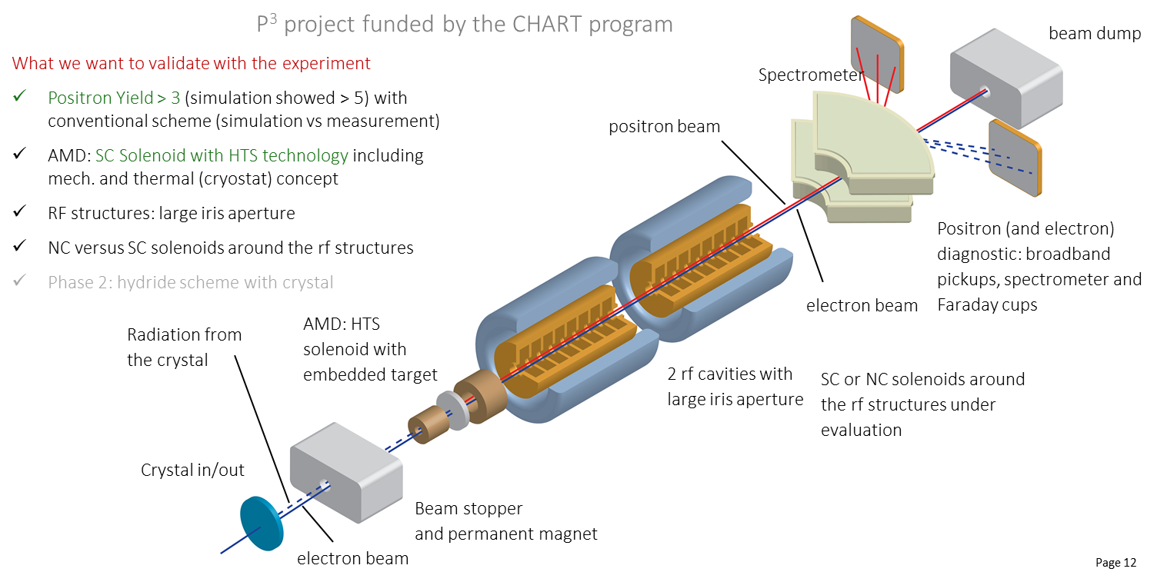
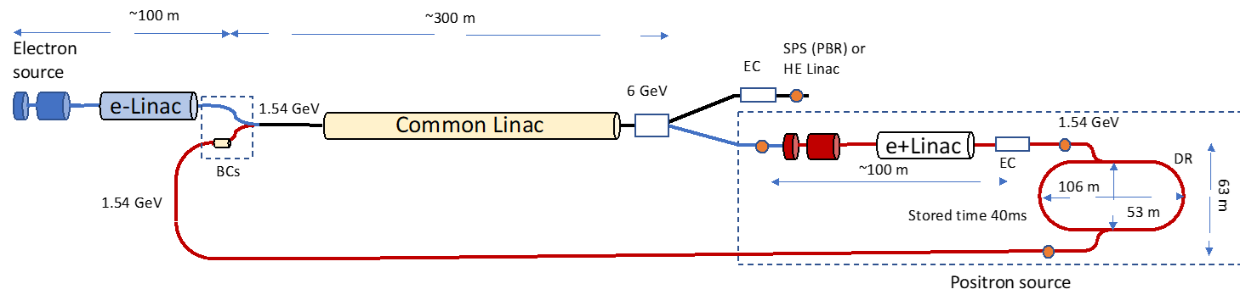
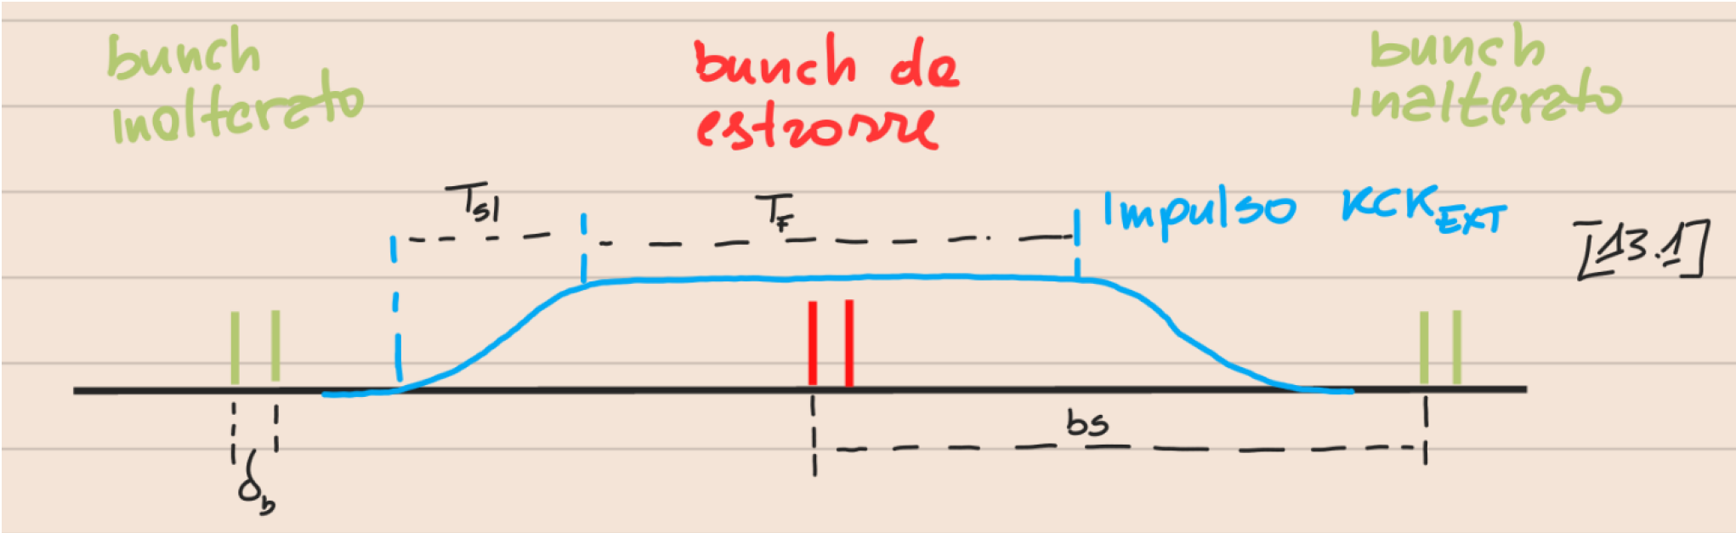
FCC-ee Pre-Injector - Swiss CHART 2 program
Collaboration between PSI and CERN with external partners: CNRS-IJCLab (Orsay), INFN-LNF (Frascati), KEK/SuperKEKB as observer, INFN-Ferrara – radiation from crystal
P³: PSI e⁺ production experiment with HTS solenoid at SwissFEL
planned for 2024/25
Latest FCC-ee pre-injector layout
location? transfer lines?
P. Craievich, A. Grudiev, C. Milardi, A. De Santis, et al.

Slide 18

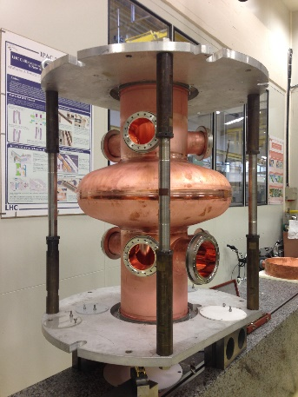
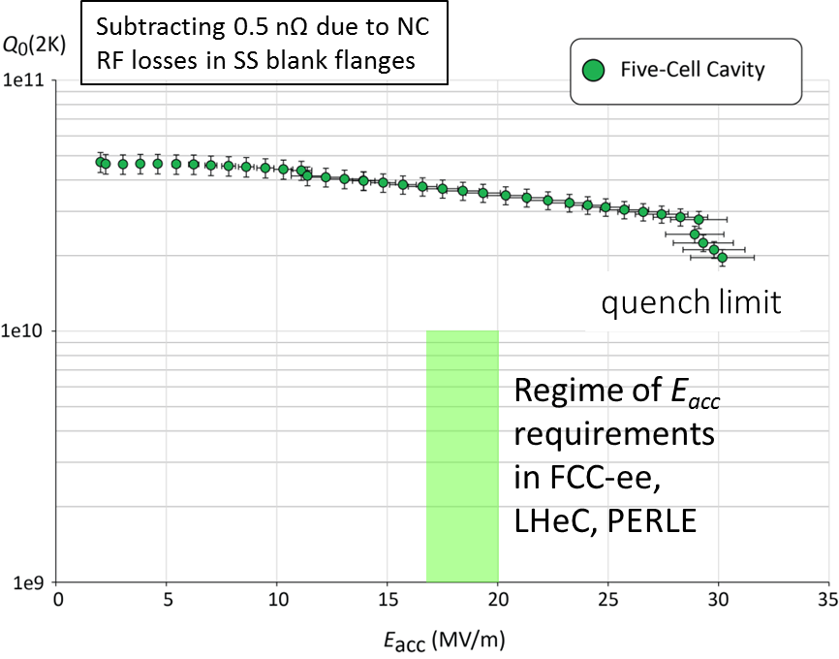
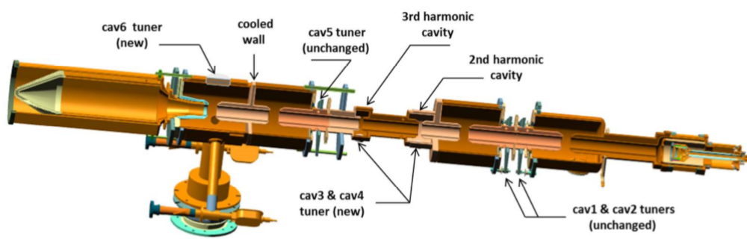
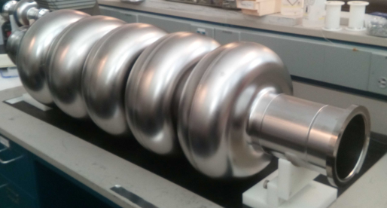
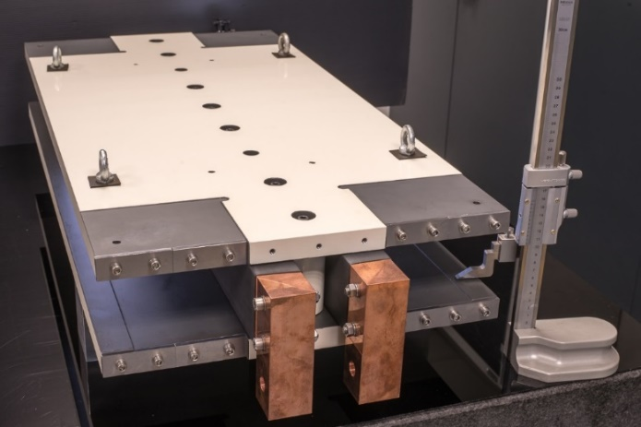
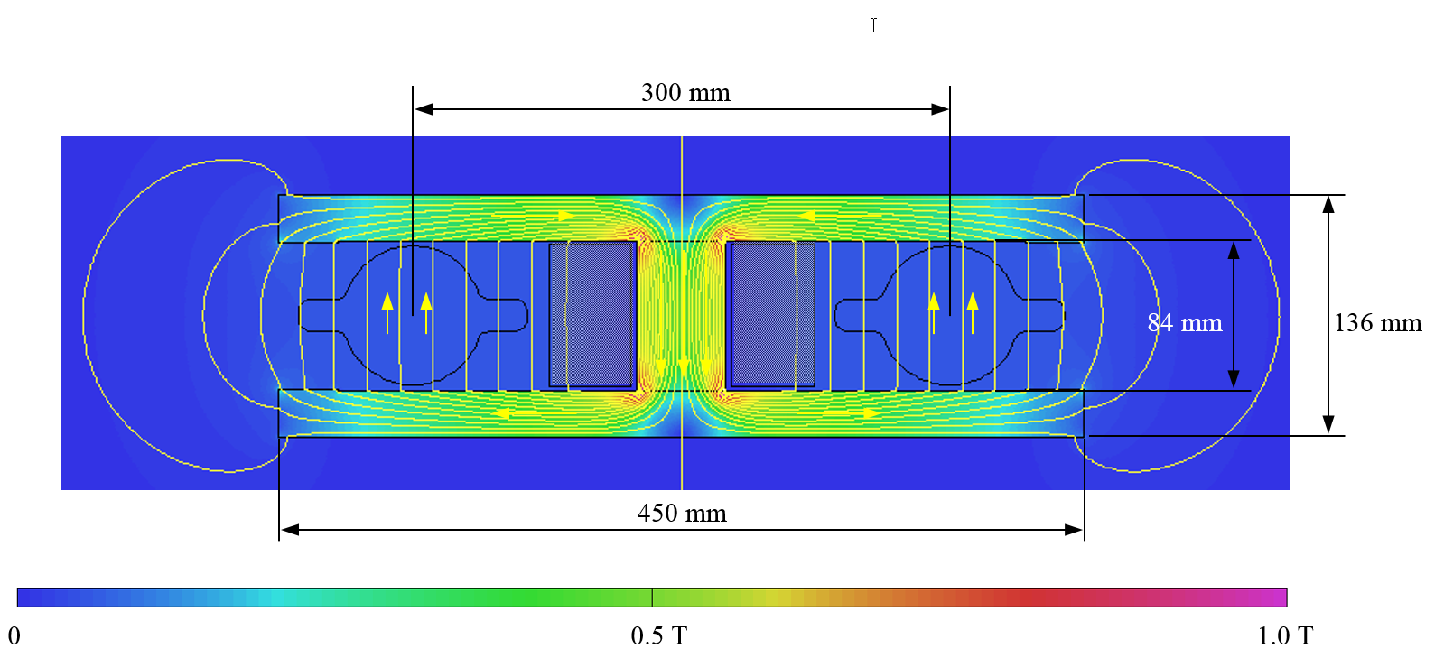

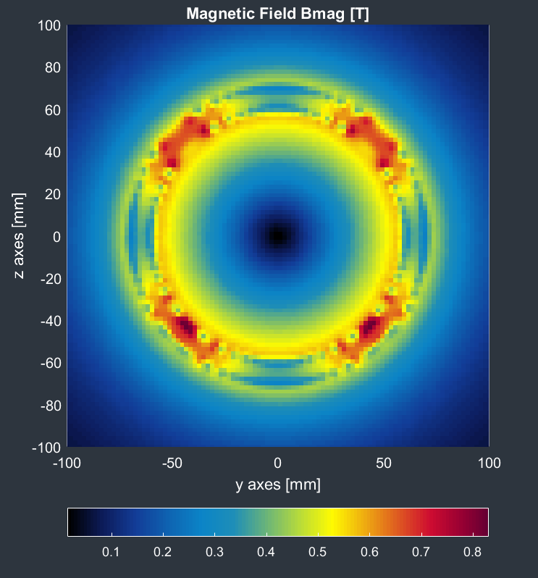
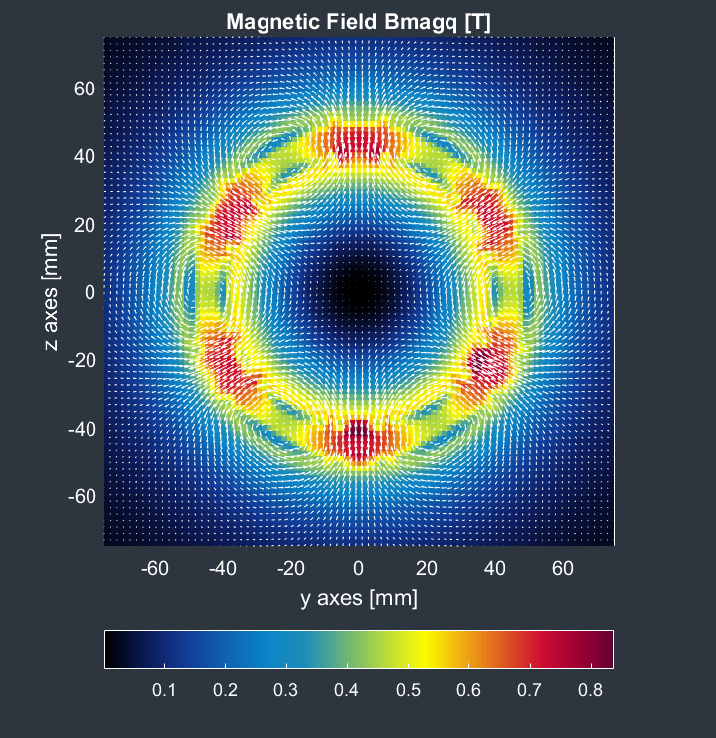
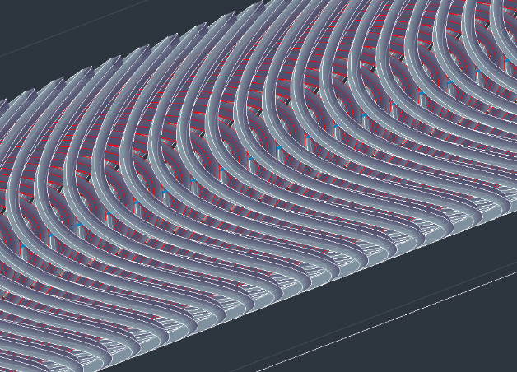

accelerator R&D examples
efficient RF power sources
(400 & 800 MHz)
efficient SC cavities
I. Syratchev
400 MHz 1-,2- & 4-cell Nb/Cu , 4.5 K
F. Marhauser
800 MHz 5-cell Nb
prototype / JLAB, 2 K
FPC & HOM coupler, cryomodule, thin-film coatings…
energy efficient twin aperture arc dipoles
under study: CCT HTS quad’s & sext’s for arcs
A. Milanese
M. Koratzinos

Slide 19
Stage 2: FCC-hh (pp) collider parameters
parameter | FCC-hh |  | HL-LHC | LHC
collision energy cms [TeV] | 100 |  | 14 | 14
dipole field [T] | ~17 (~16 comb.function) |  | 8.33 | 8.33
circumference [km] | 91.2 |  | 26.7 | 26.7
beam current [A] | 0.5 |  | 1.1 | 0.58
bunch intensity [10¹¹] | 1 | 1 | 2.2 | 1.15
bunch spacing [ns] | 25 | 25 | 25 | 25
synchr. rad. power / ring [kW] | 2700 |  | 7.3 | 3.6
SR power / length [W/m/ap.] | 32.1 |  | 0.33 | 0.17
long. emit. damping time [h] | 0.45 |  | 12.9 | 12.9
beta* [m] | 1.1 | 0.3 | 0.15 (min.) | 0.55
normalized emittance [μm] | 2.2 |  | 2.5 | 3.75
peak luminosity [10³⁴ cm⁻²s⁻¹] | 5 | 30 | 5 (lev.) | 1
events/bunch crossing | 170 | 1000 | 132 | 27
stored energy/beam [GJ] | 7.8 |  | 0.7 | 0.36

Slide 20
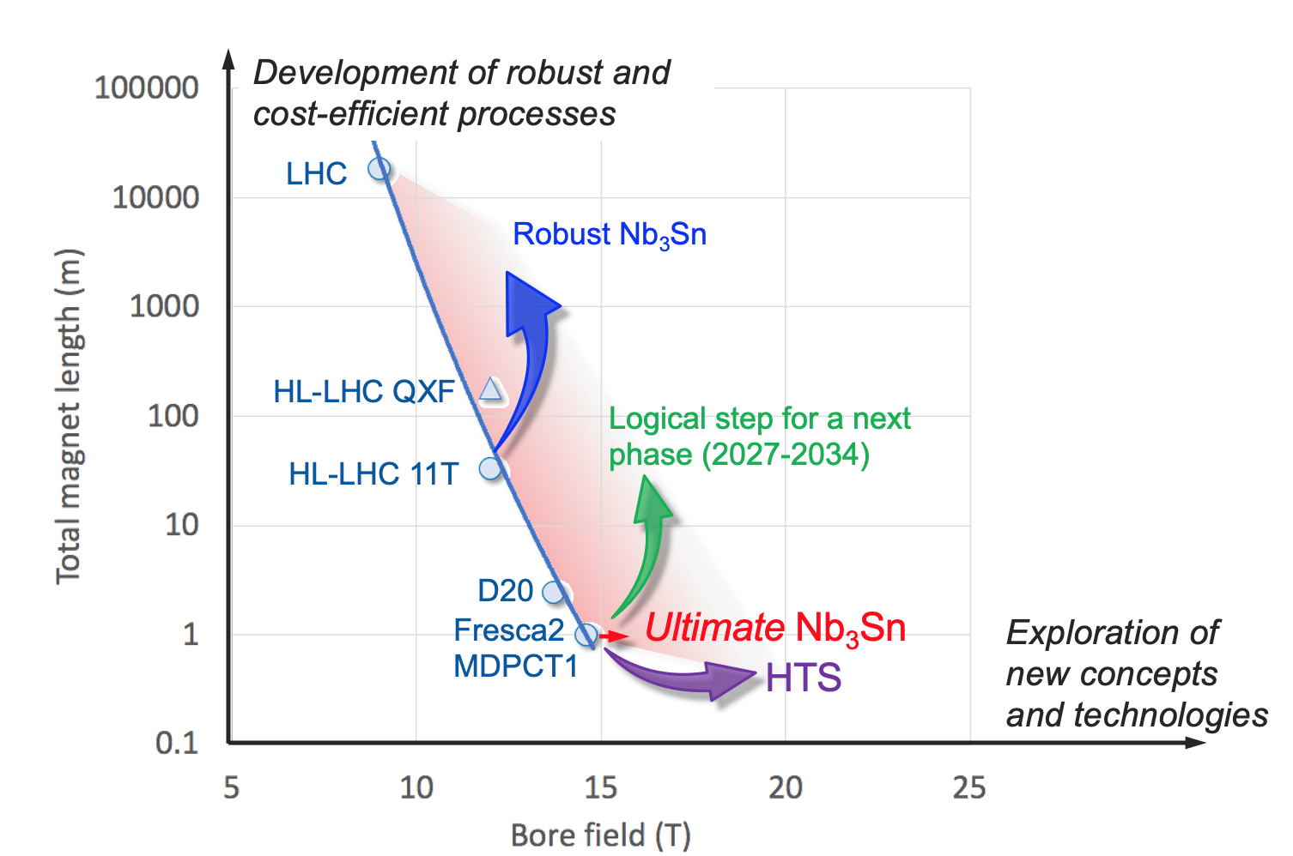
preparing for FCC stage 2 (FCC-hh)
In parallel to FCC studies,
High Field Magnet development program as long-term separate R&D project
CERN budget for high-field magnets doubled in 2020 Medium-Term Plan (~ 200 MCHF over ten years)
Main R&D activities:
materials: goal is ~16 T for Nb₃Sn, at least ~20 T for HTS inserts
magnet technology: engineering, mechanical robustness, insulating materials, field quality
production of models and prototypes: to demonstrate material, design and engineering choices,
industrialisation and costs
infrastructure and test stations: for tests up to ~ 20 T and 20-50 kA
Detailed deliverables and timescale being defined through Accelerator R&D roadmap under development
L. Bottura, F. Gianotti, A. Siemko

Slide 21

FCC Feasibility Study
EU Projects
NN
Study Support Unit
IT: Sylvain Girod
Procurement: Adam Horridge
Quality management: NN
Resources: Sylvie Prodon
Scheduling: NN
Secretariat: Julie Hadre
Collaboration building
Emmanuel Tsesmelis
Study Support and Coordination
Study Leader: Michael Benedikt
Deputy Study Leader: Frank Zimmermann
Communications
Panagiotis Charitos, James Gillies
Physics, Experiments and Detectors
Patrick Janot, Christophe Grojean
Physics programme
Matthew McCullough, Frank Simon
Accelerators
Tor Raubenheimer
Frank Zimmermann
Project organisation model
NN
Technical Infrastructures
Klaus Hanke
Host State processes and civil engineering
Timothy Watson
Organisation and financing models
Paul Collier (interim), Florian Sonnemann
FCC-ee collider design
Katsunobu Oide
FCC-hh design
Massimo Giovannozzi
Technology R&D
Roberto Losito
FCC-ee booster design
Antoine Chancé
FCC-ee injector
Paolo Craievich, Alexej Grudiev
FCC-ee energy calibration polarization
Alain Blondel, Jorg Wenninger
FCC-ee MDI
Manuela Boscolo, Mike Sullivan
Integration
Jean-Pierre Corso
Geodesy & survey
Hélène Mainaud Durand
Electricity and energy management
Jean-Paul Burnet
Cooling and ventilation
Guillermo Peon
Cryogenics systems
Laurent Delprat
Computing and controls infrastructure, communication and network
Pablo Saiz
Safety
Thomas Otto
Operation, maintenance, availability, reliability
Jesper Nielsen
Transport, installation concepts
Roberto Rinaldesi
Administrative processes
Friedemann Eder
Placement studies
Johannes Gutleber, Volker Mertens
Environmental evaluation
Johannes Gutleber
Tunnel, subsurface design
John Osborne
Surface sites layout, access and building design
LD opening
Detector concept
Mogens Dam
Physics performance
Patrizia Azzi, Emmanuel Perez
Software and computing
Gerardo Ganis, Clément Helsens
Financing model
Florian Sonnemann
Procurement strategy and rules
NN
In-kind contributions
NN
Operation model
Paul Collier, Jorg Wenninger

Slide 22

Status of Global FCC Collaboration
Increasing international collaboration as a prerequisite for success:
links with science, research & development and high-tech industry will be essential to further advance and prepare the implementation of FCC
147
Institutes
30
Companies
34
Countries
EC
H2020
FCC Feasibility Study: 58 fully-signed previous members, 17 new members, MoU renewal of remaining CDR participants in progress

Slide 23
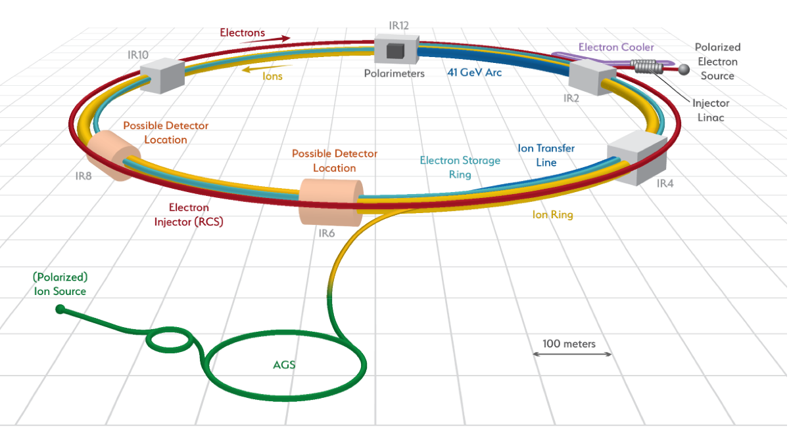
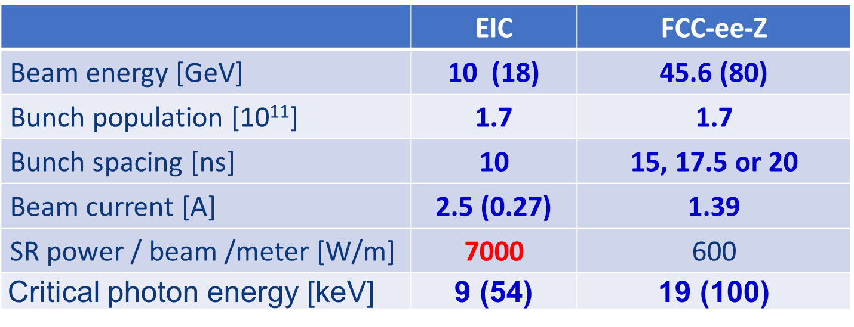
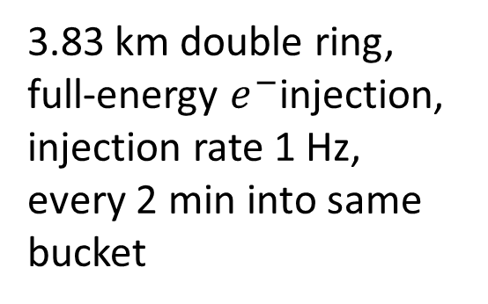
Electron Ion Collider (EIC)
US EIC Electron Storage Ring similar to, but more challenging than, FCC-ee
beam parameters almost identical, but twice the maximum electron beam current, or half the bunch spacing, and lower beam energy
~10 areas of common interest identified by the FCC and EIC design teams, addressed through joint EIC-FCC working groups.
EIC will start beam operation about a decade prior to FCC-ee
The EIC will provide another invaluable opportunity to train the next generation of accelerator physicists on an operating collider, to test hardware prototypes, beam control schemes, etc.
3.83 km double ring,
full-energy $e^{−}$injection,
injection rate 1 Hz,
every 2 min into same bucket

Slide 24
Outlook
Comprehensive R&D program and implementation preparation is presently being carried out in the frameworks of FCC FS, the EU co-financed FCC Innovation Study, the Swiss CHART program, and the CERN High-Field Magnet Programme. Goal: demonstrate FCC feasibility by 2025/26
Plenty of opportunities for collaborations and for joint innovative developments with int’l partners !
The first stage of FCC could be approved within a few years after the 2027 European Strategy Update, if the latter is supportive. Tunnel construction could then start in the early 2030s and FCC-ee physics program begin in the second half of the 2040s, a few years after the completion of the HL-LHC physics runs expected by 2041.
Long term goal: world-leading HEP infrastructure for 21st century to push particle-physics precision and energy frontiers far beyond present limits

Slide 25

FCC FS status summary
Following 2020 European Strategy Update, organisation structure and major milestones & deliverables for the FCC Feasibility Study (FCC FS) approved by CERN Council in June 2021. Entire FCC government structure (members of SC, CB, SAC, CG) established by now (summer 2022).
Main activities: developing & confirming concrete implementation scenario, in collaboration with host state authorities, including environmental impact analysis, and accompanied by machine optimisation, physics studies and technology R&D - via global collaboration, supported by EC H2020 Design Study FCCIS and Swiss CHART. Goal: demonstrate feasibility by 2025/26
Long term goal: world-leading HEP infrastructure for 21st century to push particle-physics precision and energy frontiers far beyond present limits

Slide 26

FCC Week 2023
5 – 9 June
From 5 to 9 June 2023 in London

