Slide 1
FCC Civil Engineering and Tunnelling
FCC Feasibility Study
Tim WATSON SCE Department
18 January 2023

Slide 2
Overview of Civil Engineering for FCC
As with the previous accelerators SPS, LEP and LHC, the FCC accelerator will require significant civil engineering infrastructure to house the machine, experiments and associated supporting systems.
A large proportion of this civil engineering infrastructure will be located underground with the remaining surface works located at discrete sites around the circumference of the accelerator.
The new underground infrastructure will extend over a 91 km circumference (compared to 27km for the LHC) and will require access shafts to depths of up to 400m (compared to 145m for LHC).
The siting and alignment of the FCC is largely constrained by a handful of natural features including lake Geneva, the Jura Mountain range, the Saleve mountain and the foothills of the Alps.
Importantly, the civil engineering infrastructure will be located in areas of France and Switzerland where CERN has not historically been present.
The current aim is to determine the technical feasibility, cost and schedule for the civil engineering aspects
Notes:
LEP 7 communes
FCC 35 communes

Slide 3
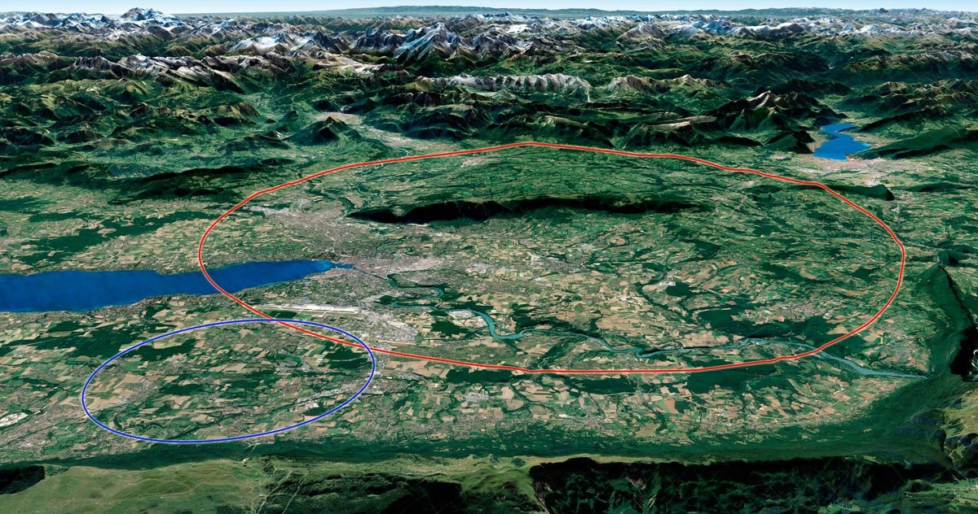

Arve River
Mandallaz
Saleve
Vuache
Rhone River
Jura
Artist’s impression of LHC (blue) and FCC (red)

Slide 4
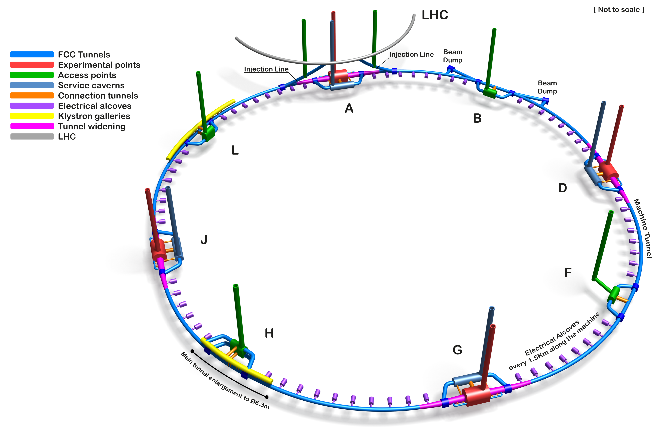
FCC 2022
91 km
8 Surface Sites
4 Experimental Areas
4 Technical Areas
14 shafts
Klystron Galleries at Point H and L
Point H tunnel widening to 6.3 m diameter
Tunnel widening at experiment sites
Beam dump at point B

Slide 5
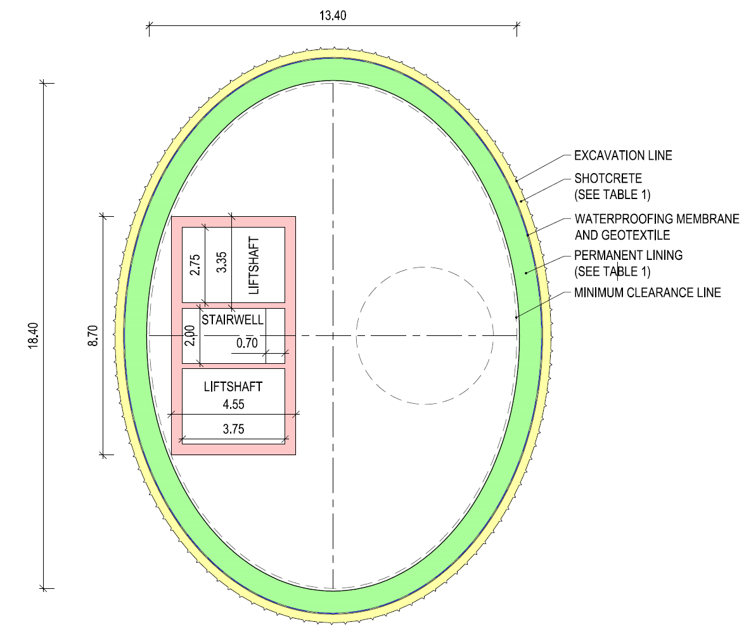
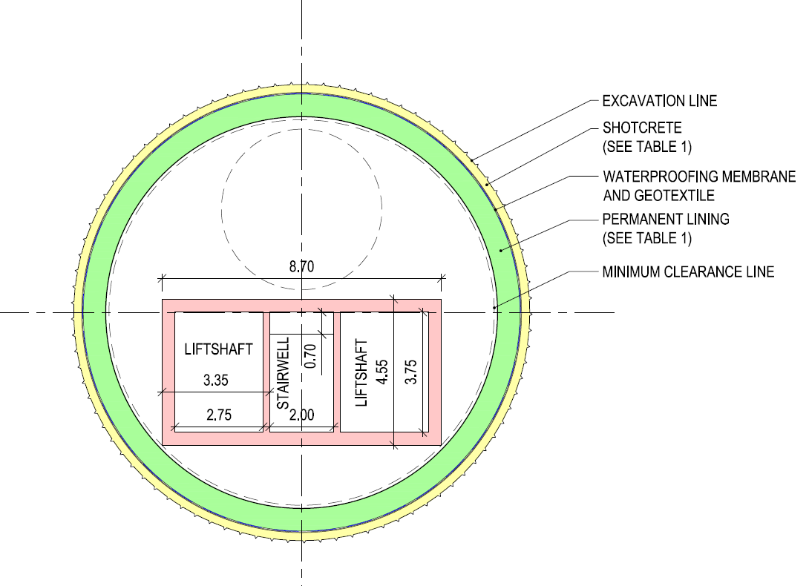
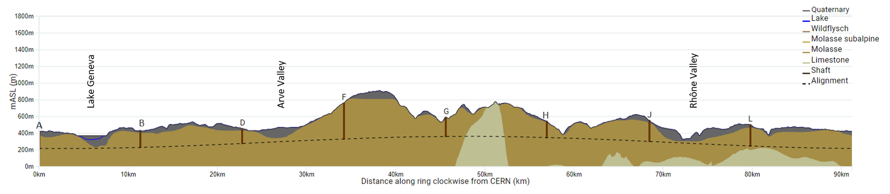
Shafts
12 m circular
18 m elliptical
Shaft depths:
A: 202 m
B: 200 m
D: 177 m
F: 399 m
G: 228 m
H: 139 m
J: 251 m
L: 253 m

Slide 6
Main Features of the Underground Civil Engineering
The main feature of the civil engineering works is the 91 km beam tunnel. This will have an internal diameter of 5.5m and will be excavated using up to 8 tunnel boring machines and possibly “drill and blast” in the limestone areas.
In many areas the tunnel will need to be widened to larger diameters in order to house equipment and/or the beam line. For example for the Radio-Frequency systems, the beam dump and at the entry and exist to the large caverns where the experiments will be housed.
14 shafts will be required with two at each of the four experimental points and one at each of the four technical points. One shaft per injection line is assumed for construction. The shafts will be between 170m and 400m deep.
The most complex areas of the civil engineering will certainly be the four so called “Experimental Areas”. These require two large caverns to be constructed in proximity to each other along with a number of connecting tunnels and caverns.
Other underground structures are required at various locations around the circumference.
Some civil engineering my be deferred to after the ee machine has been removed (eg beam dump).
Notes:
LEP 7 communes
FCC 35 communes

Slide 7
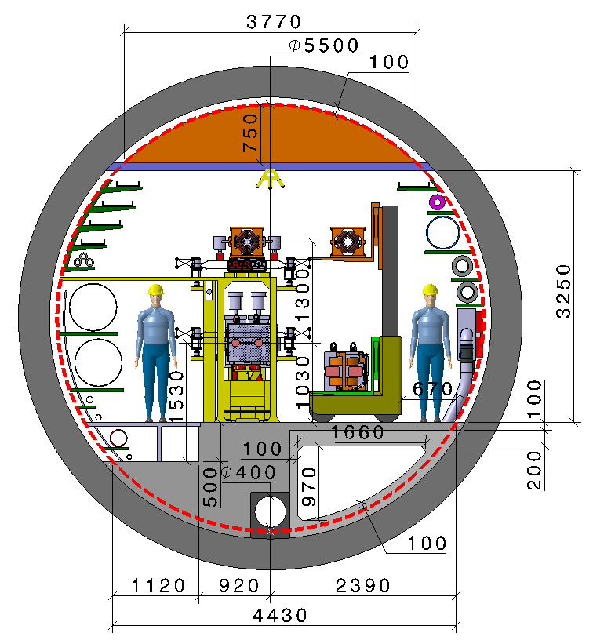
Main Tunnel Cross Section
Smoke extraction duct
Precast concrete tunnel segments
Tunnel monitoring / maintenance robot
In-situ concrete floor
100mm tolerance boundary
Tunnel invert drainage
Ventilation duct
Credit: Fani Valchkova-Georgieva

Slide 8
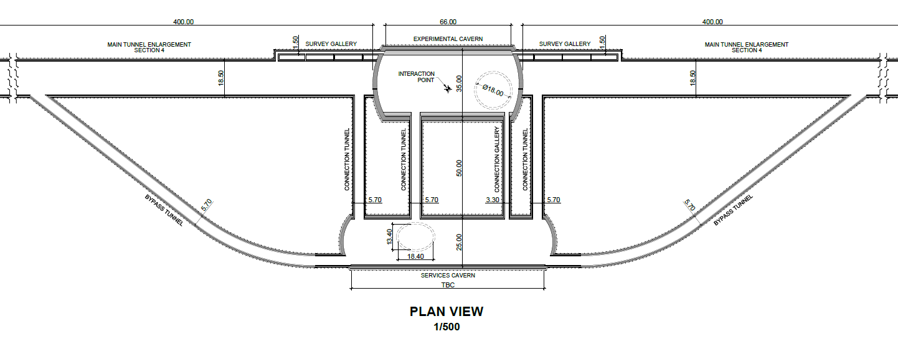
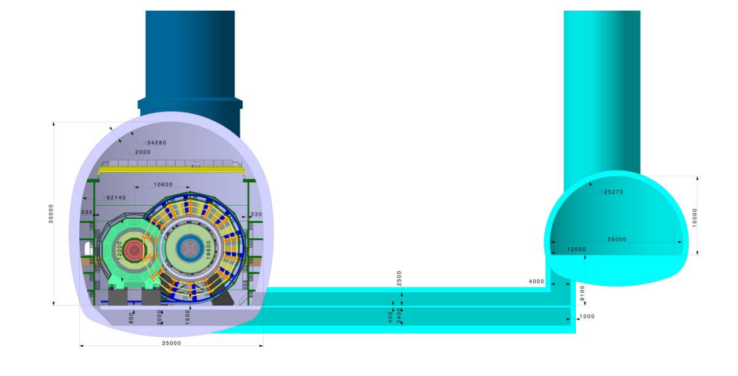
Typical Layout of Large Experimental Area
(A & G)
UX Cavern
H35 x W35 x L66 m
PX Shaft
Credit: Angel Navascues Cornago
PM Shaft
Service Cavern
80 – 100 m length
25 m width
Credit: Fani Valchkova-Georgieva

Slide 9
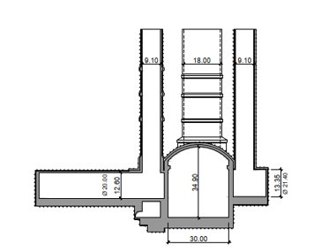
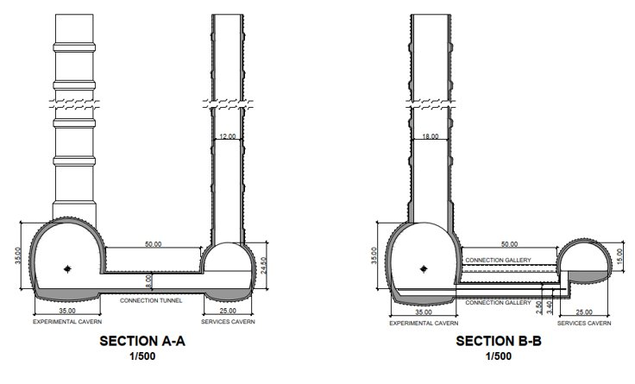
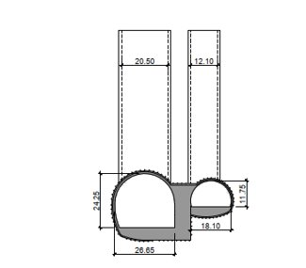
Large Experimental Area
(A & G)
ATLAS
FCC
Credit: Angel Navascues Cornago
CMS

Slide 10
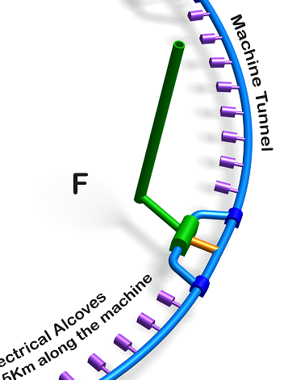
Offset Shaft - Point F
Offset will probably be required due to surface access constraints.
Shaft offset 400 m inside ring
Approx. 400 m access tunnel from shaft to service cavern
430m anticlockwise
Credit: Angel Navascues Cornago

Slide 11
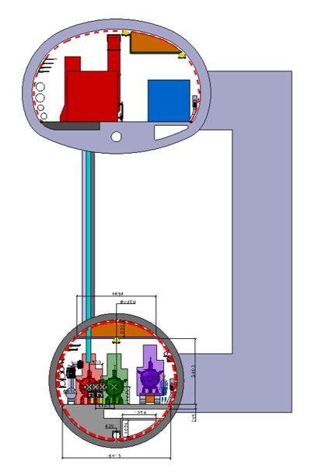
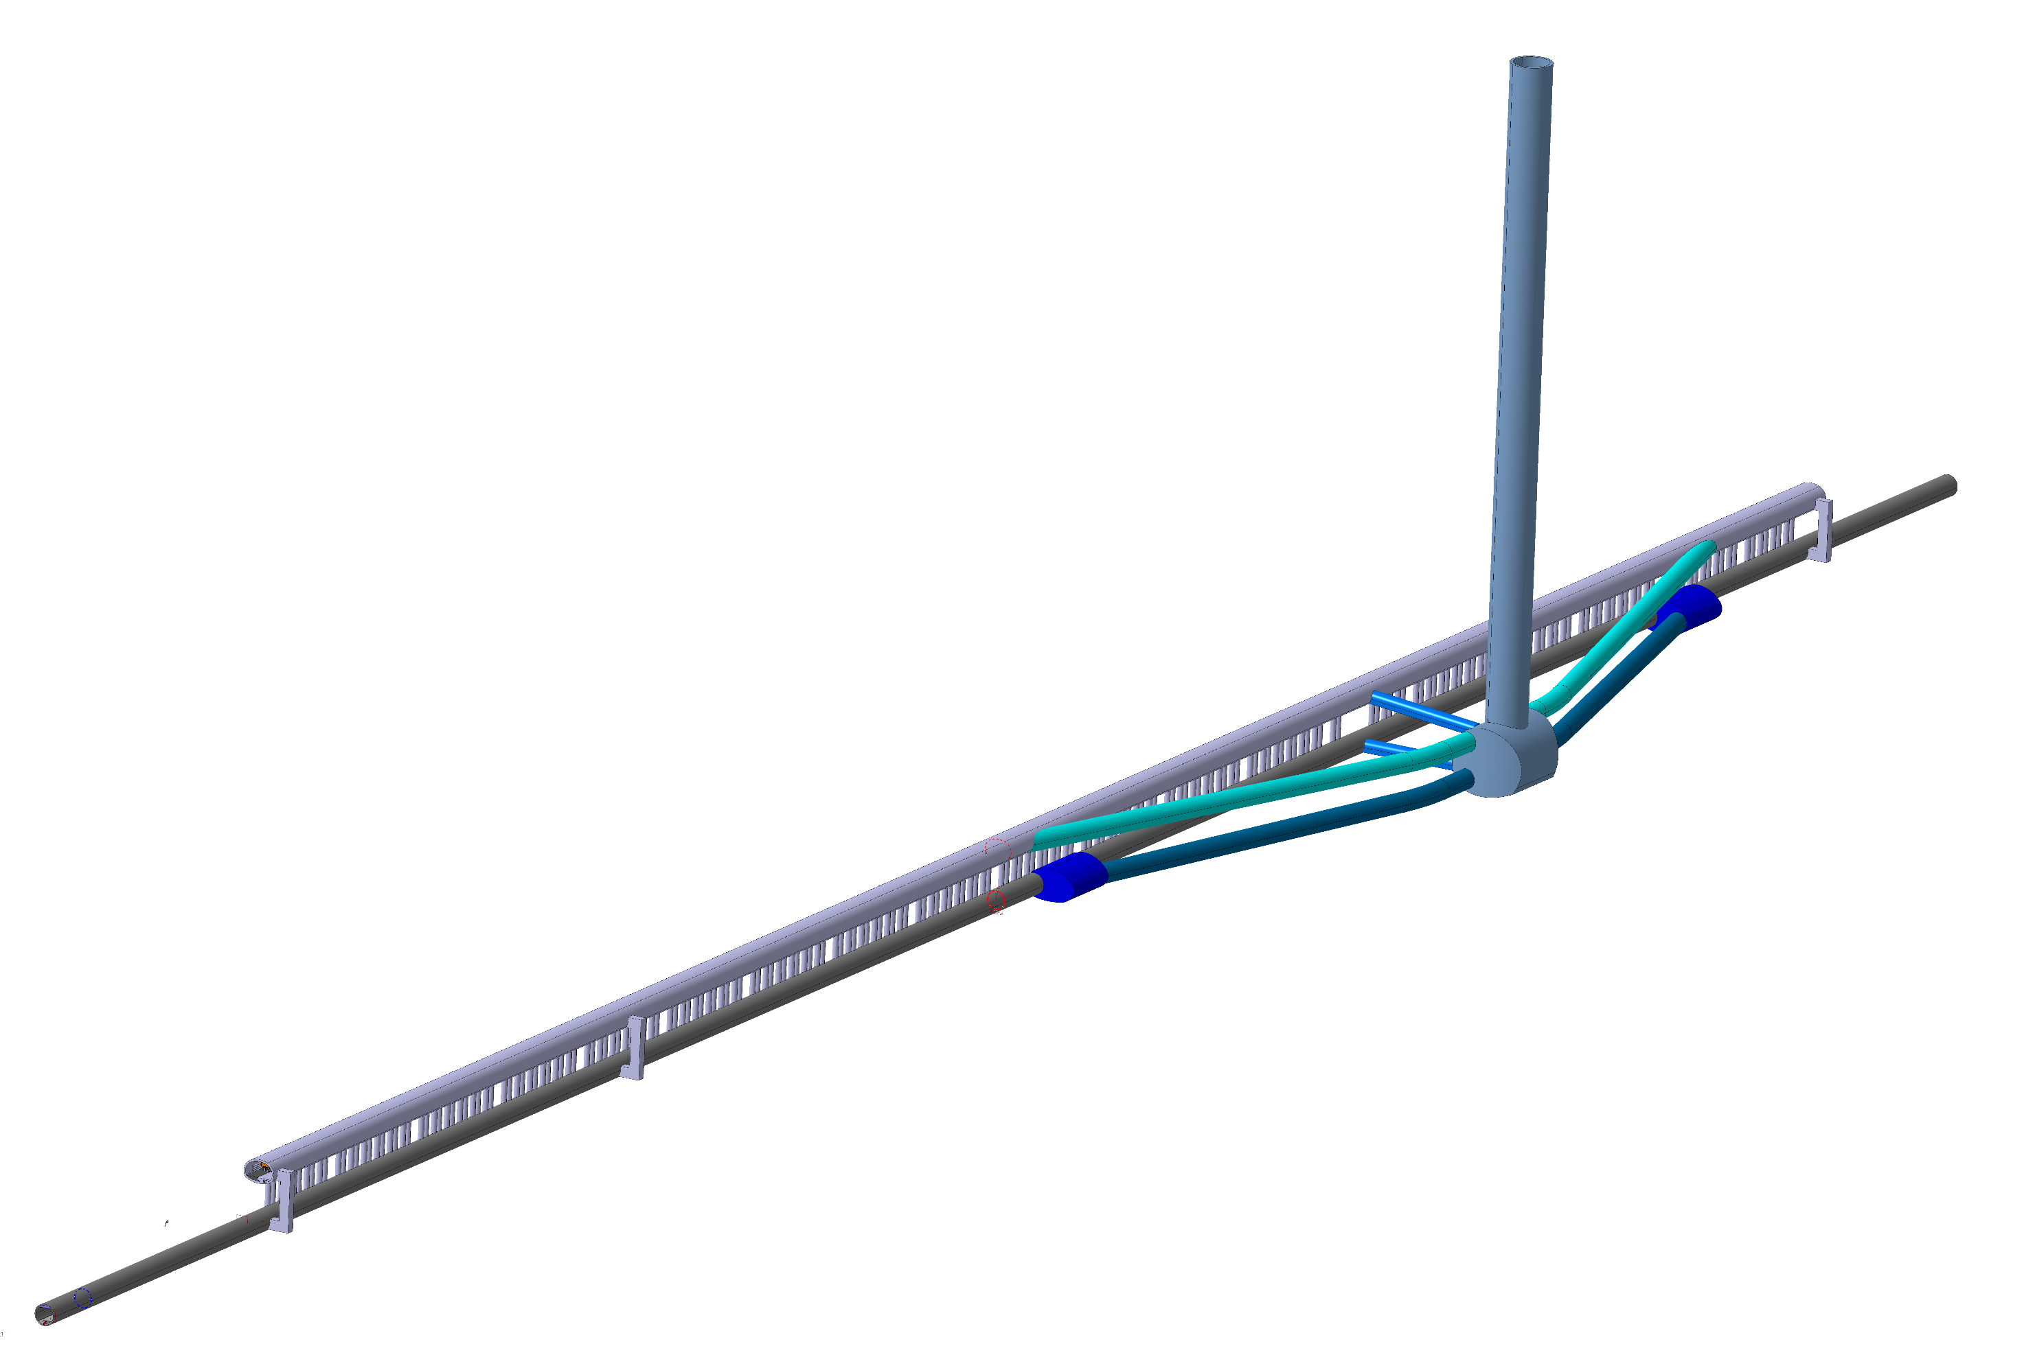
Klystron Gallery - Point H
Klystron gallery
9.8 x 5.4 m
Service staircase
1078 m length Klystron gallery
Service cavern offset 800 m from centre of FCC straight section
5.5 m diameter service tunnels to both Klystron gallery and machine tunnel
Waveguide duct
Klystron gallery
1078 m
220 waveguide ducts
Machine tunnel, 6.3 m dia
Credit: Fani Valchkova-Georgieva
Machine tunnel 6.3 m

Slide 12
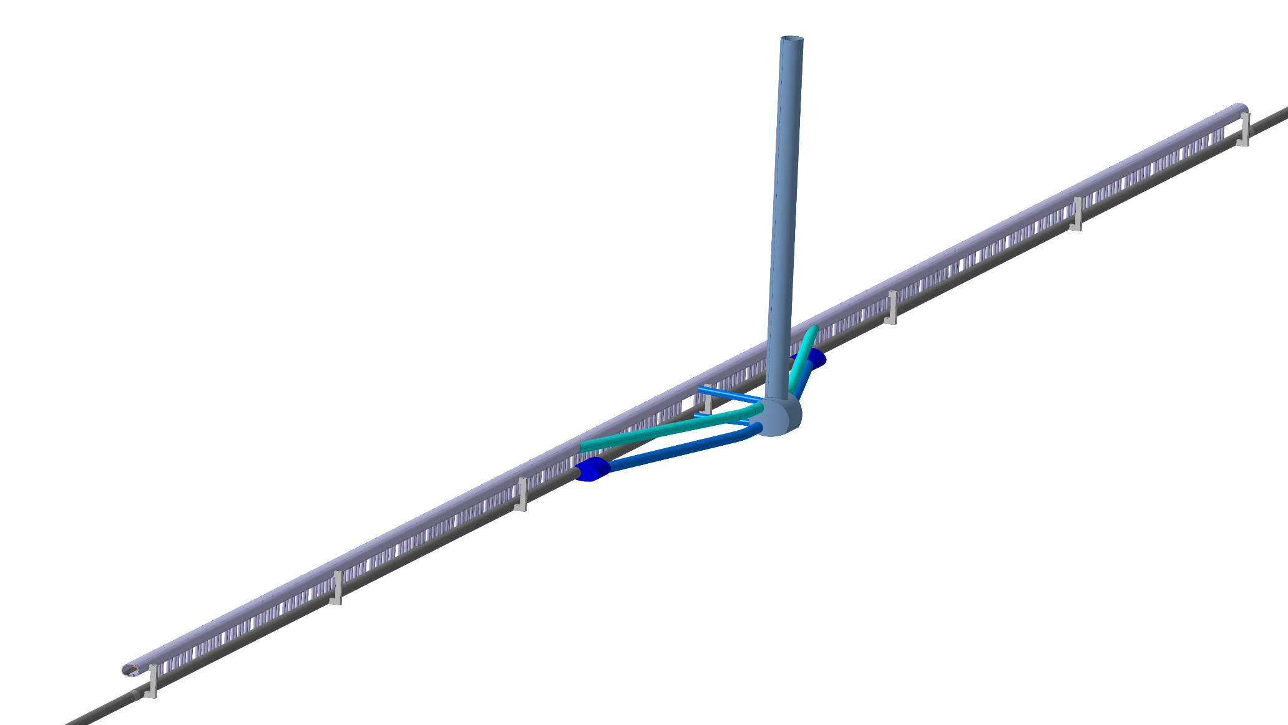
Klystron Gallery - Point L
Klystron gallery
9.8 x 5.4 m
Service staircase
1990 m length Klystron gallery
Service tunnels to both Klystron gallery and machine tunnel
Waveguide duct
Klystron gallery
1990 m
Service cavern in centre of straight section
Machine tunnel, 5.5 m dia
Credit: Fani Valchkova-Georgieva
Machine tunnel

Slide 13
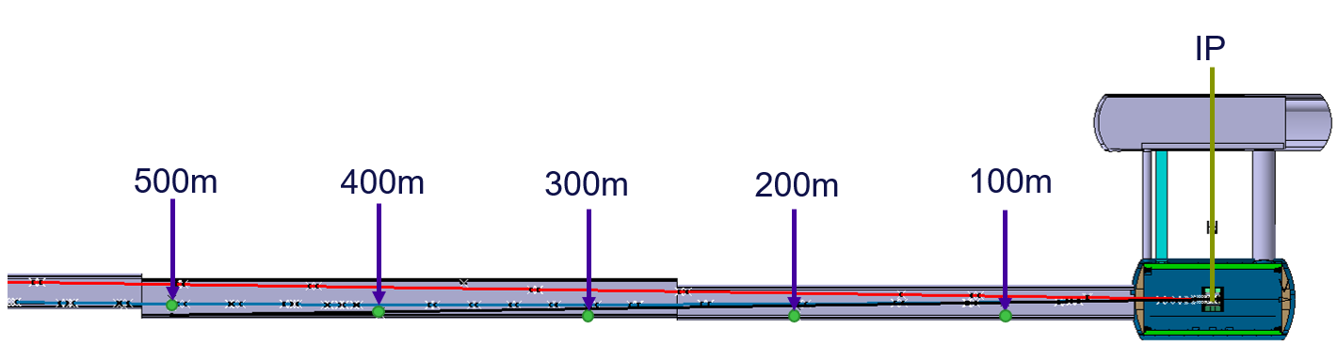
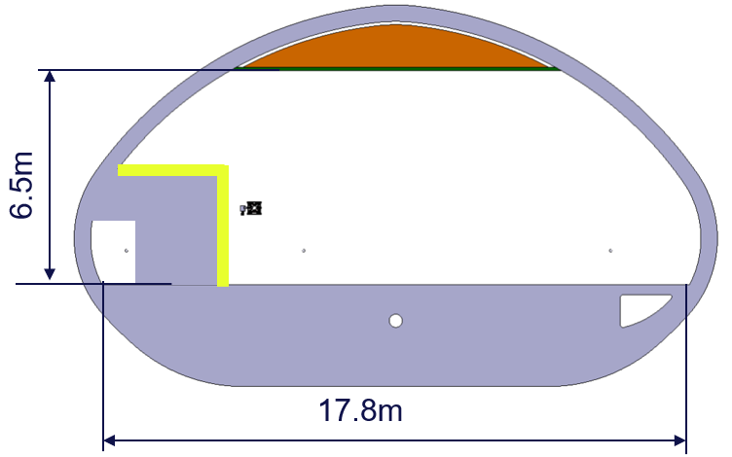
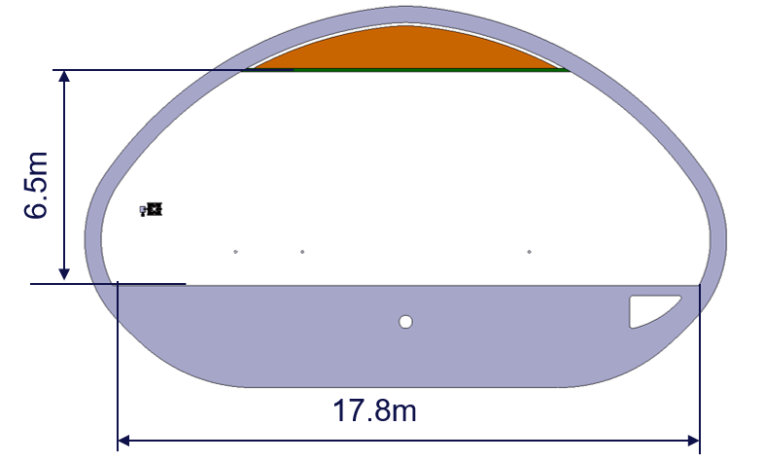
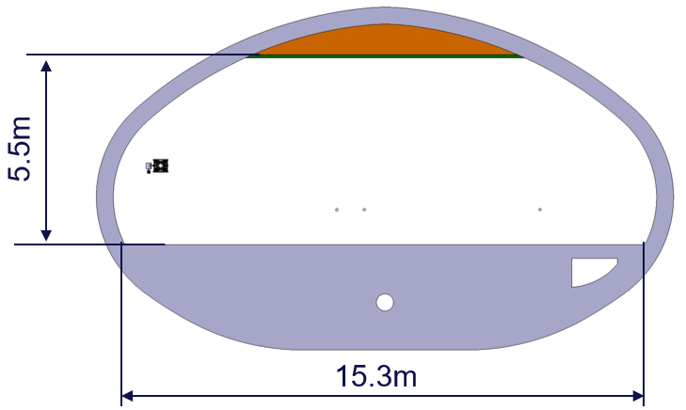
Tunnel widening at Experimental Points

Slide 14
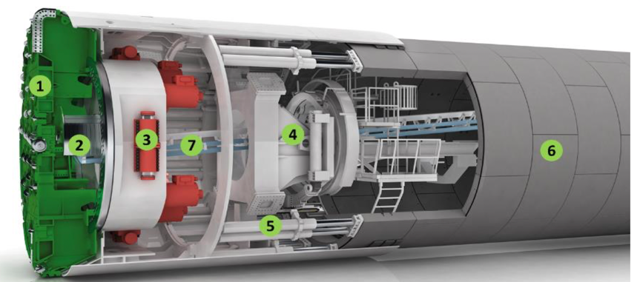
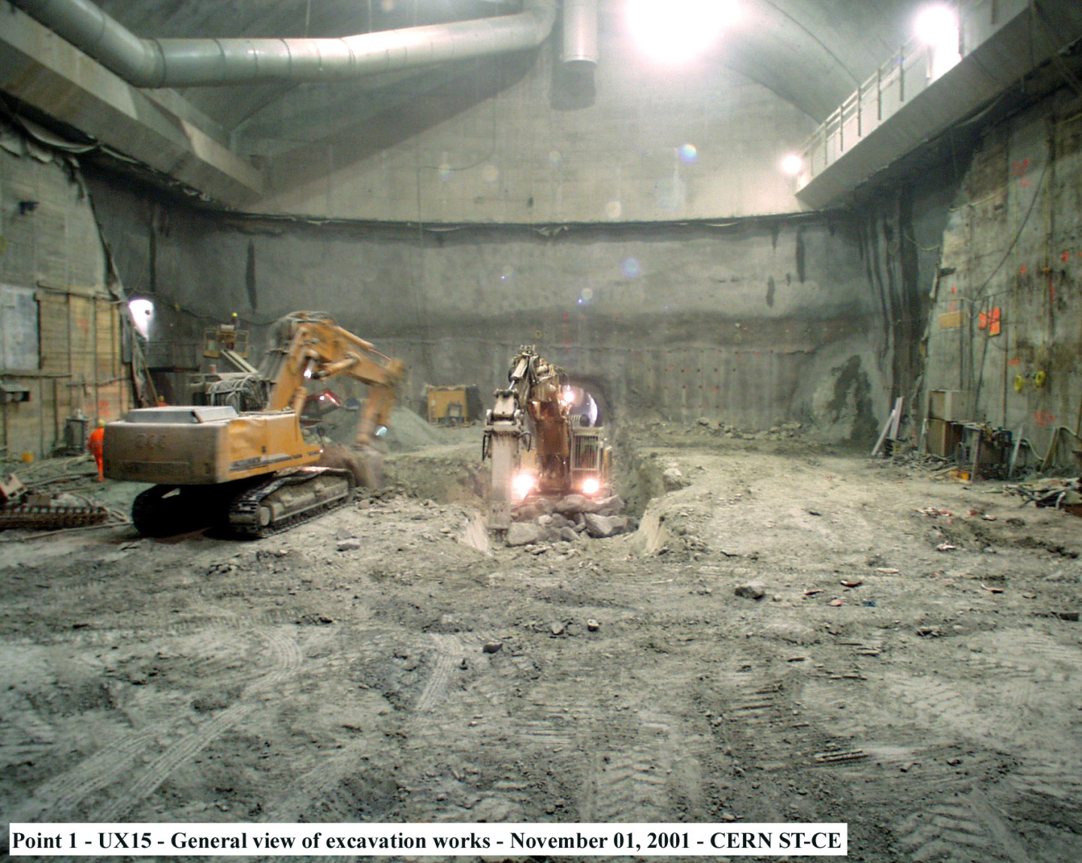
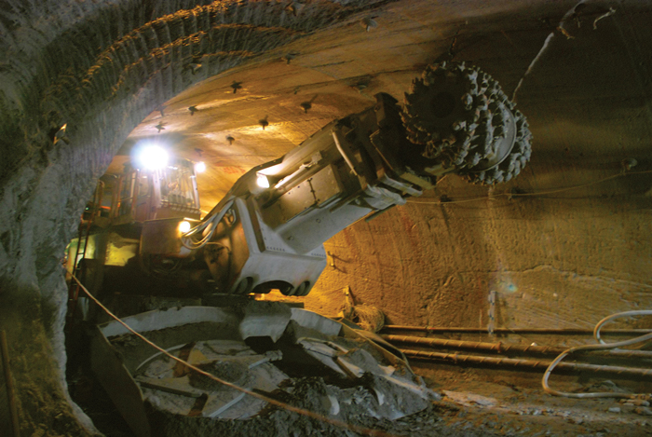
Construction Techniques
As mentioned most of the main accelerator tunnel will be constructed using Tunnel Boring Machines. These allow for fast fully automated construction in safe conditions.
Unlike previous tunnels at CERN, we aim to use a single pass segmental lining for most of the tunnel.
Other excavation techniques will include roadheaders and hydraulic rock breakers.
Notes:
LEP 7 communes
FCC 35 communes

Slide 15
Excavated Spoil
Possible TBM arrangement
TBM Direction
Total Spoil: 8,100,000 m³
Excavation Quantities | Extraction Point
 | A | B | D | F | G | H | J | L
TBM | - | 585,199 | 1,170,399 | - | 657,743 | - | 1,267,957 | 617,719
Drill & Blast | - | - | - | - | 228,076 | - | - | -
Road Header/Rock Breaker | 263,109 | 319,347 | 193,980 | 158,064 | 635,152 | 227,573 | 218,820 | 726,300
Mined Shaft | 93,739 | 231,227 | 82,137 | 114,426 | 105,804 | 25,865 | 116,477 | 47,078
Totals | 356,847 | 1,135,773 | 1,446,516 | 272,491 | 1,626,775 | 253,438 | 1,603,254 | 1,391,098

Slide 16
Current Status of the Feasibility Study
The Civil engineering team at CERN is currently working on a number of critical items that are needed in order to complete the mid-term review in Q3 2023 and the Final Feasibility Study Report in 2025.
Updates of the Concepts designs and associated schedules and cost estimates for the underground works are ongoing in conjunction with an external consultant (ILF).
Site Investigations in areas where there is a low level of geological data are being planned in conjunction with the external consultant QUANTUM with the aim being to undertake in-field investigations from early 2024.
Concept and preliminary designs of two of the eight surface sites are ongoing in conjunction with Fermilab and in-house for the other six surface sites
Cost estimating and construction schedules will be developed in the coming months
Optimisation is continuously ongoing to ensure the best possible configuration of the civil engineering will be incorporated into the final Feasibility Study Report.
Notes:
LEP 7 communes
FCC 35 communes

Slide 17
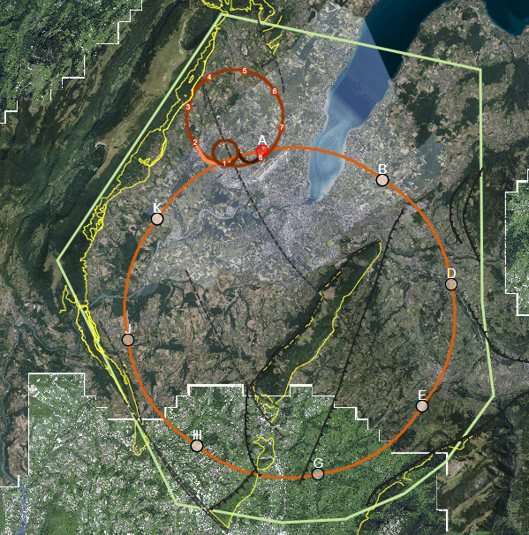
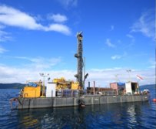
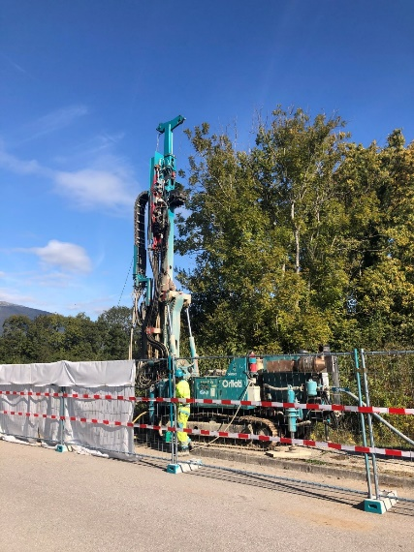
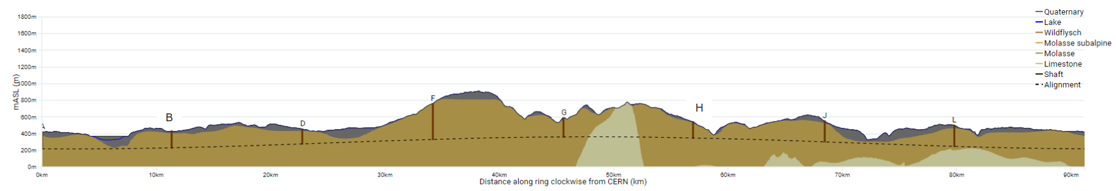
Areas with highest geological uncertainty
17
On-site investigation works 2024-25
Good knowledge of the ground (e.g information near to CERN from LEP/LHC projects)
Good confidence that the tunnel alignment is in molasse
Lac Léman
Moraine/molasse interface uncertain
Soils and rock properties uncertain
High uncertainty in the hydrogeological conditions and water pressure
Jura
Limestone/molasse interface uncertain.
Risk of karts and high water pressures
A
B
L
Vallée de l‘Arve
Moraine/molasse interface uncertain.
Lack of reliable boreholes
Le Rhône
Moraine/molasse interface not certain.
Proximity to protected area
D
Bornes
Insufficient deep boreholes information
Complex faulted region, thrust zone.
Quality of molasse is uncertain. High overburden. Large span experimental caverns should be constructed in good molasse.
J
Vuache
Limestone/molasse interface not certain.
Risk of karts and high water pressures
Proximity to main active fault
J
F
H
Les Usses
Moraine/molasse interface not certain.
Low tunnel rock cover
G
Mandallaz
Fractured limestone formations, characteristics and locations of karsts unknown.
High water pressures
Vallée de l‘Arve
Bornes
Les Usses
Lac Léman
Mandallaz
Le Rhône

Slide 18
Surface Works
Most of the surface sites are located in areas outside the historical boundaries of CERN.
About 25% of the tunnel will be located on Swiss Territory and 75% on French Territory
5 of the 8 surface sites will be located in the French Department of Haute Savoie which has never previously housed CERN infrastructure.
Preliminary layouts / designs for the surface works commenced in 2022
Two surface points are being developed under a cooperation agreement with Fermilab.
The other six surface points will be developed to preliminary design level using in-house resources
Cost estimates will be developed and included in the Feasibility Study Report
Notes:
LEP 7 communes
FCC 35 communes

Slide 19
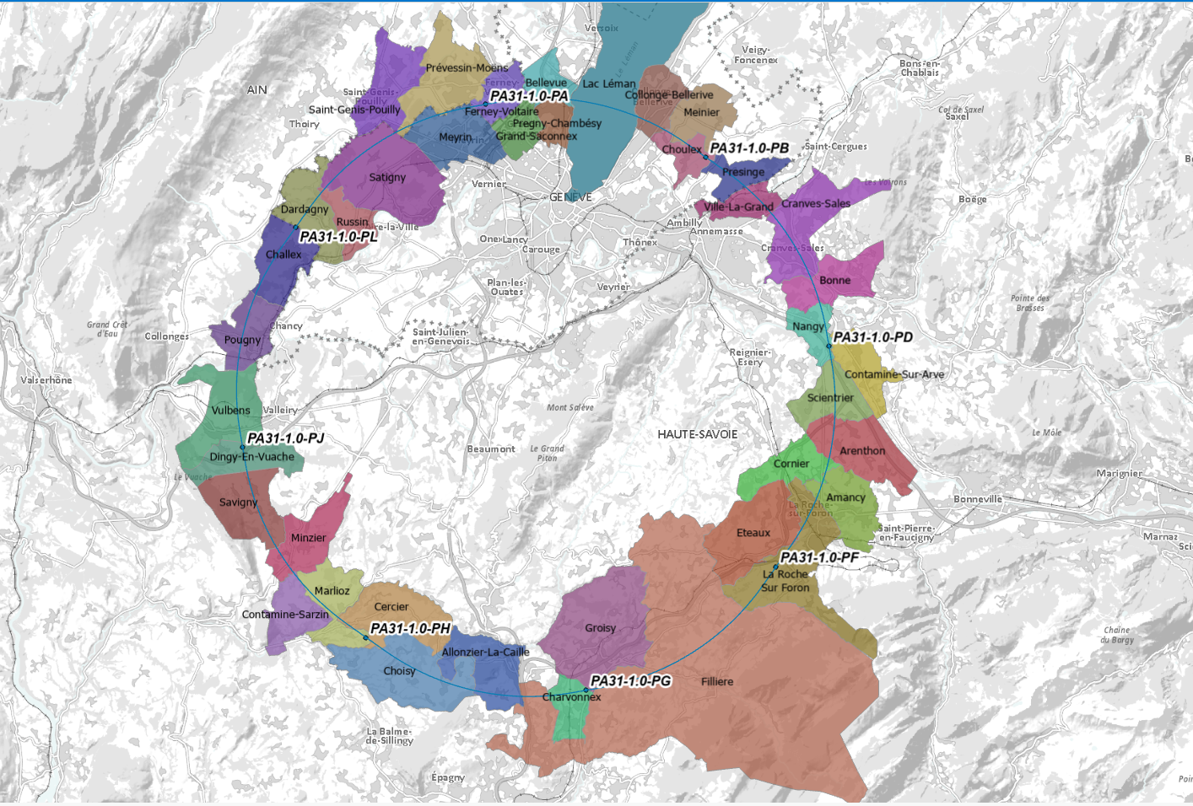
FCC Location
PA
PB
PL
PD
PJ
PF
PH
PG

Slide 20
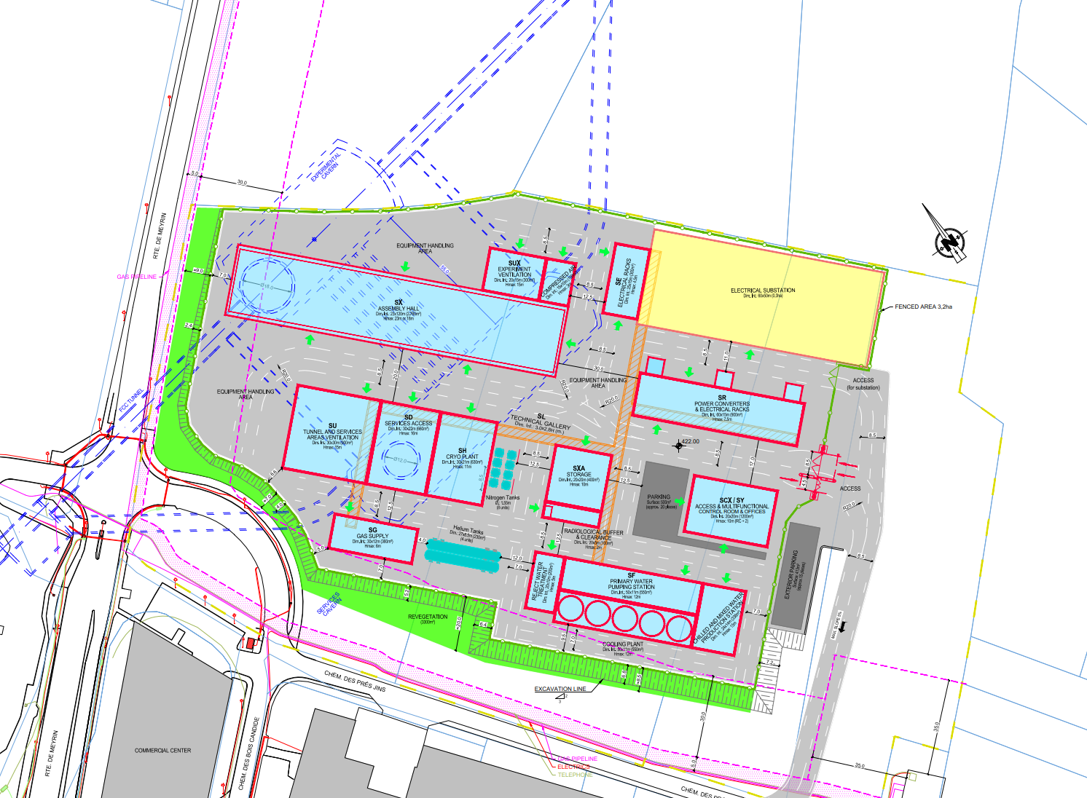
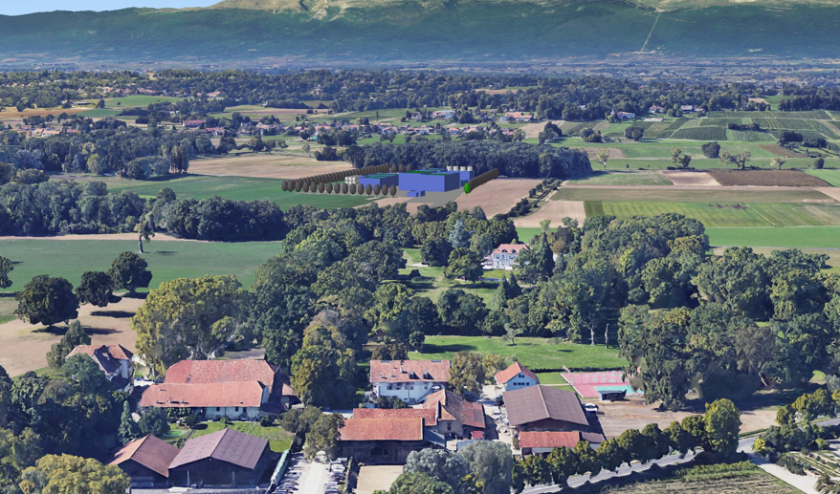
Preliminary Layout of a Typical Experimental Site
Implantation of a Technical Site in the Environment

Slide 21
Post Feasibility Study
If a green light is given for the FCC project to proceed, civil engineering will be a critical path activity.
A number of years will be needed to complete additional site investigations and undertake detailed design of the all the underground and surface works.
Contracts will need to be put in place for civil works design, architectural studies, supervision of underground and surface works etc
Contractors will need to be selected, this is expected to be a long process given the complexity and value of the works.
Given the scale of the project it is likely that the works will be divided into a number of packages and awarded to several contractors or groups of contractors
Notes:
LEP 7 communes
FCC 35 communes

Slide 22
Technical Topics to be addressed
Some of the technical challenges that will need to be addressed prior to construction include:
Assessment of in-situ ground stresses at the large cavern locations
Assessment of rock stability around the larger caverns at greater depth noting the FCC is beyond CERN prior experience.
Assessment of how to tunnel through potentially karstic limestone with possible high water pressures
Use of environmentally sustainable material (eg so called “ green concrete) and how to design with such innovative materials
Protection of surface sites during construction phase to minimize nuisance to local environment
Assessment of water inflow into tunnel drainage system
Integration of surface sites into their local environments taking account of local stakeholders requests where possible
Notes:
LEP 7 communes
FCC 35 communes

Slide 23
Thank you for your attention
23

