Slide 1

AD/ELENA FACILITY
ADTC Meeting
23rd March 2023
YETS works follow-up

Slide 2
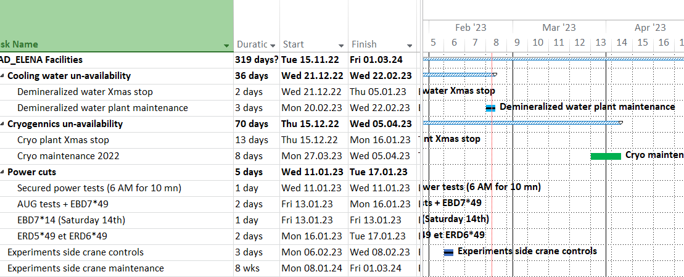
Planned services disruptions
Planning is at AD/ELENA planning
https://oss-coordination.web.cern.ch/gantt/latest?facilities=AD/ELENA&scale=week&worktypeproject=

Slide 3
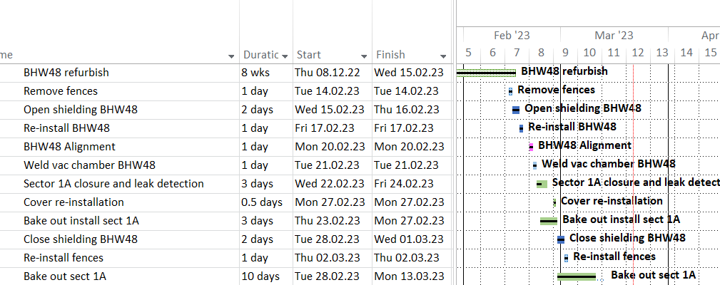
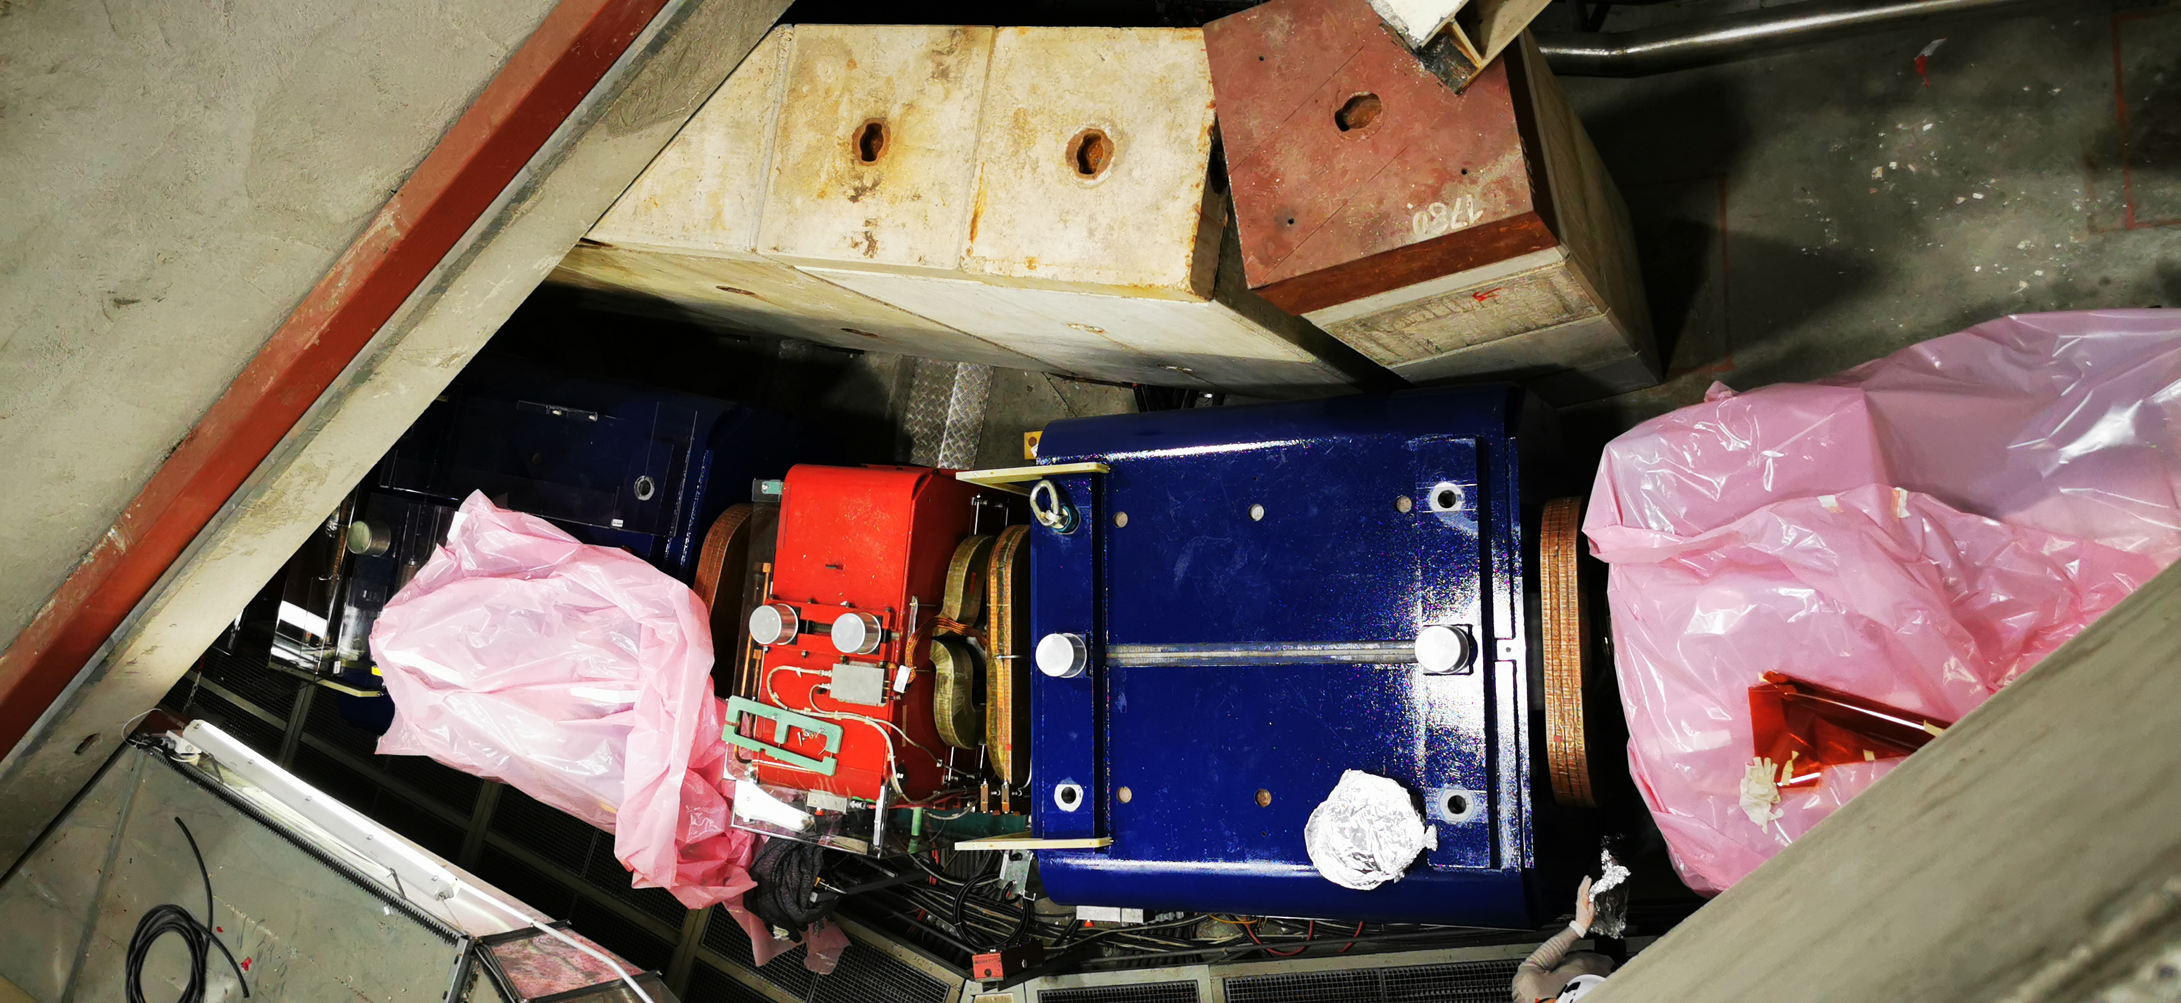
AD Sector 1A – BHW48

Slide 4
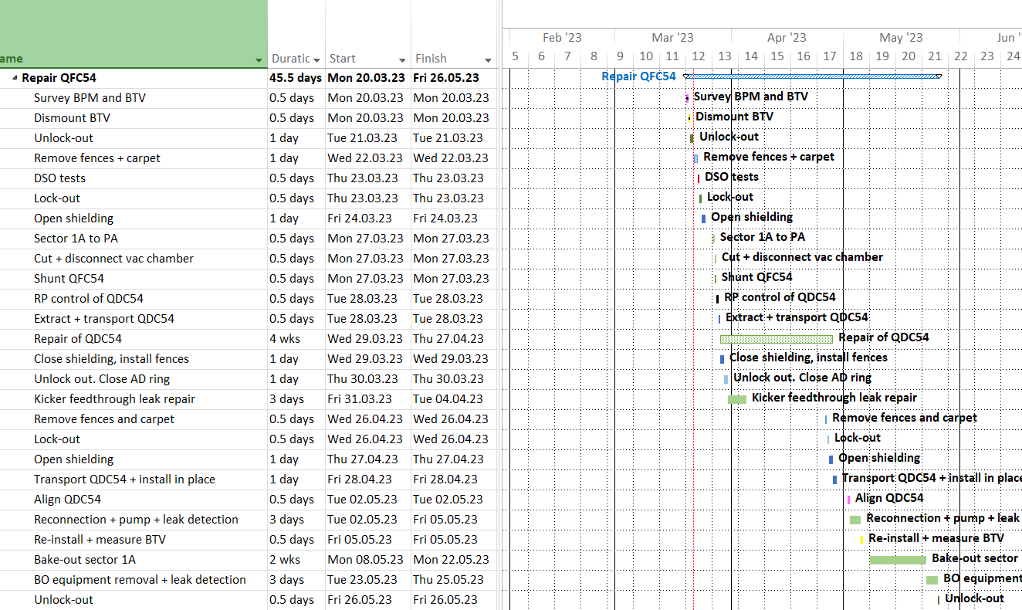
Sect 1A – QDC54
No change

Slide 5
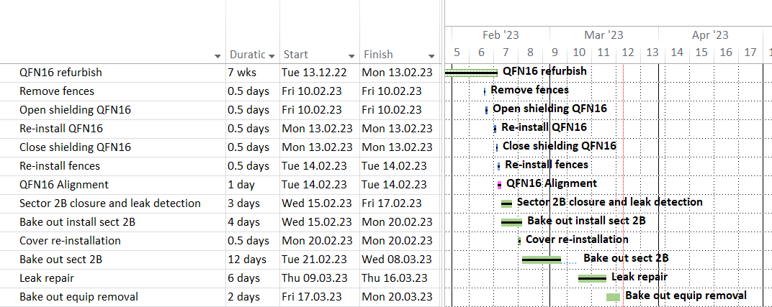
AD sector 2B

Slide 6
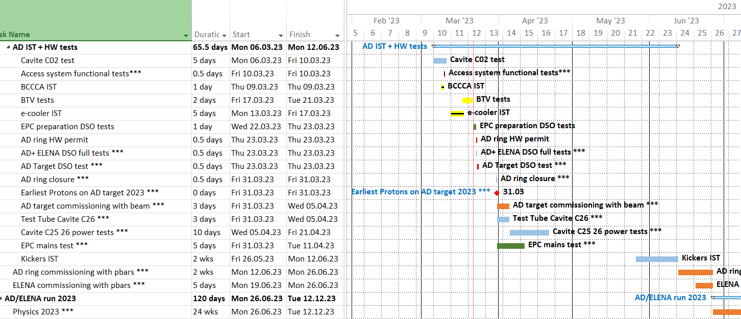
Machines restart: IST + HW tests
New dates

