Slide 1
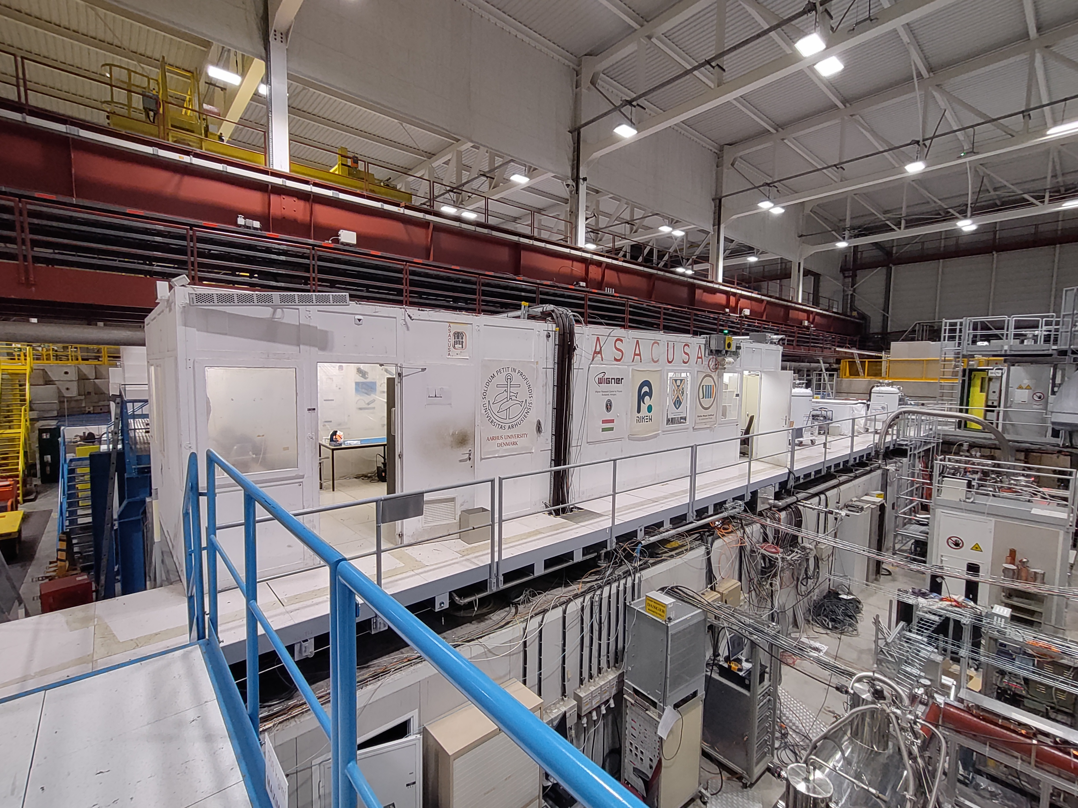
ASACUSA Barrack replacement
YETS 22-23
ADTC 23/03/2023
Maud Wehrle

Slide 2
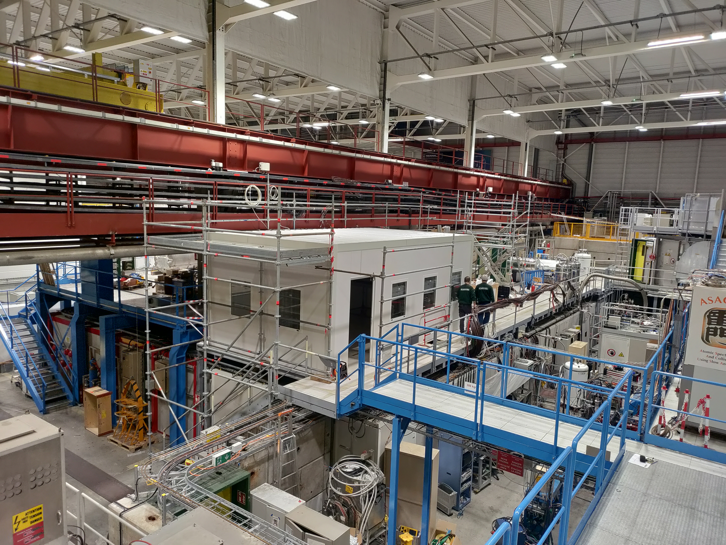
Refurbishment project
  Work planned for YETS 22-23
  Slightly shorter dimensions, racks will be located outside of the new control room – better comfort, less noise
  Better acoustic and thermic insulation
  New electrical installation
Get the control room up to standards

Slide 3
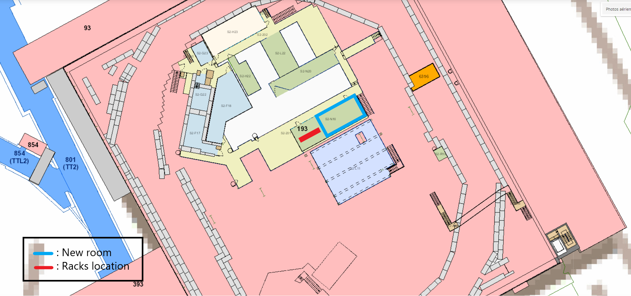
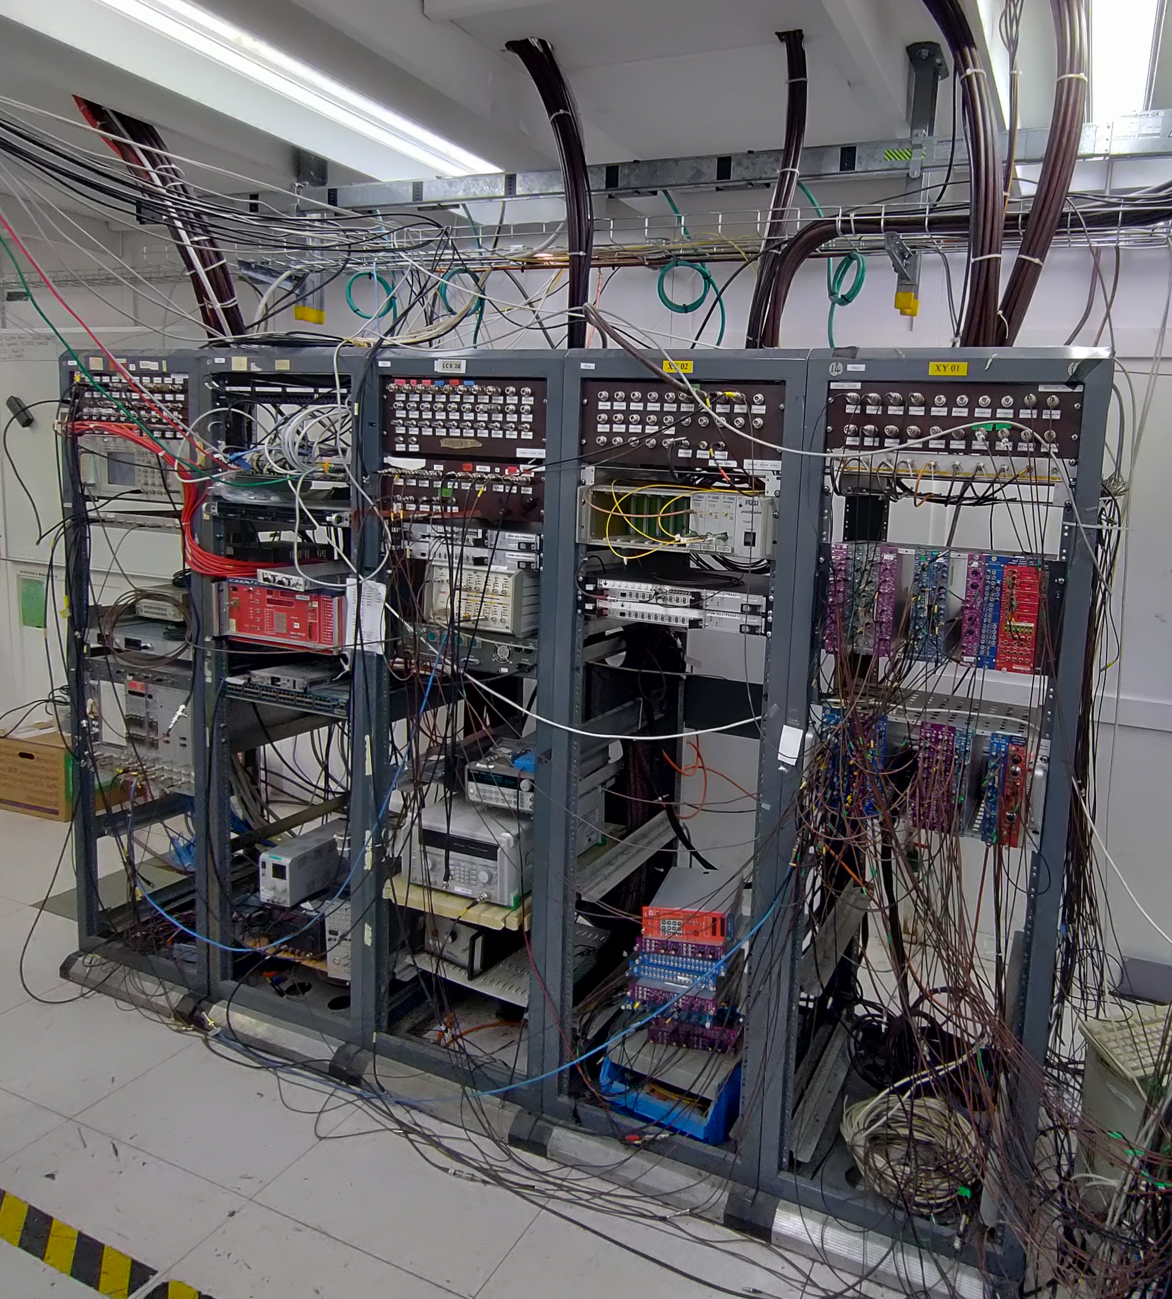

Slide 4
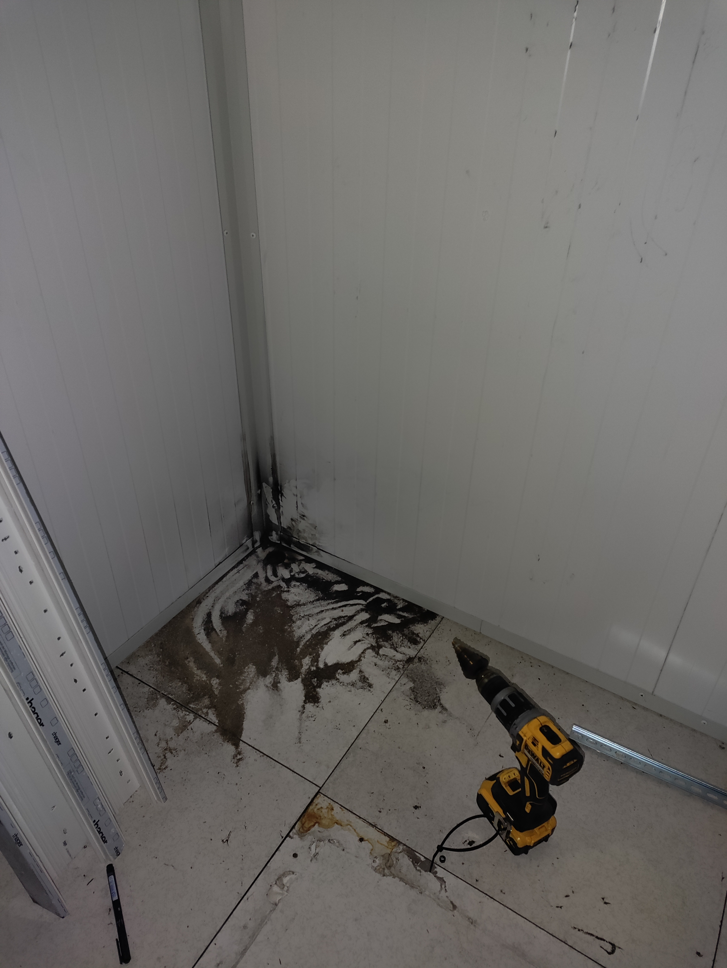
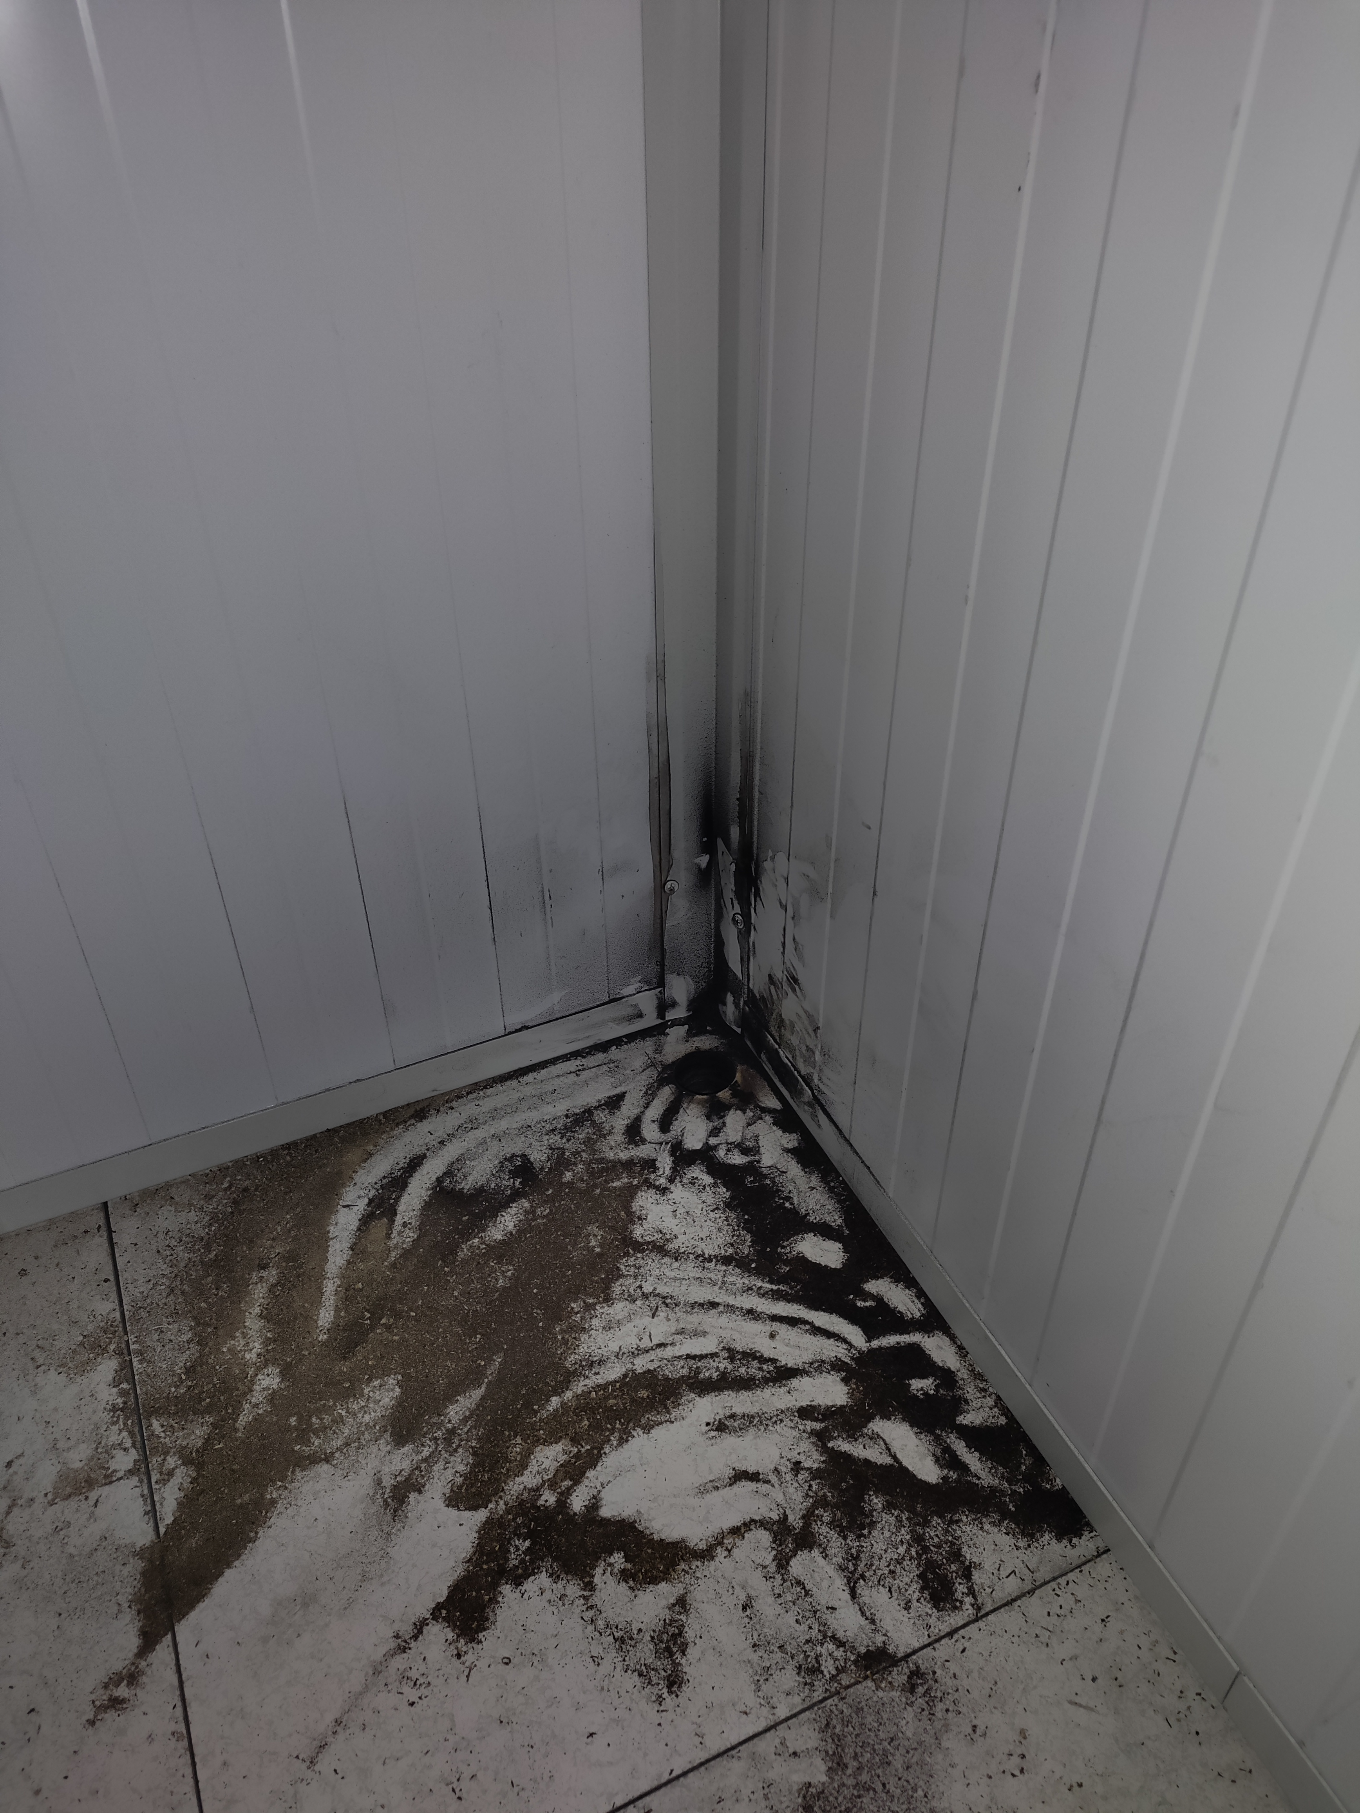
Incident on the 28/02/23
  A fire ignition occurred on the first day of cabling works.
  This was caused by a hole which was unintentionally drilled in the wooden flooring with the wrong equipment.
  Because the cabling works had just started, no fire detection devices were connected in the barrack.
  A significant amount of smoke was produced which alarmed the ASACUSA team.
  The firefighters were called by the ASACUSA users and AD was evacuated.
In case of doubt, always call the firefighters !

Slide 5
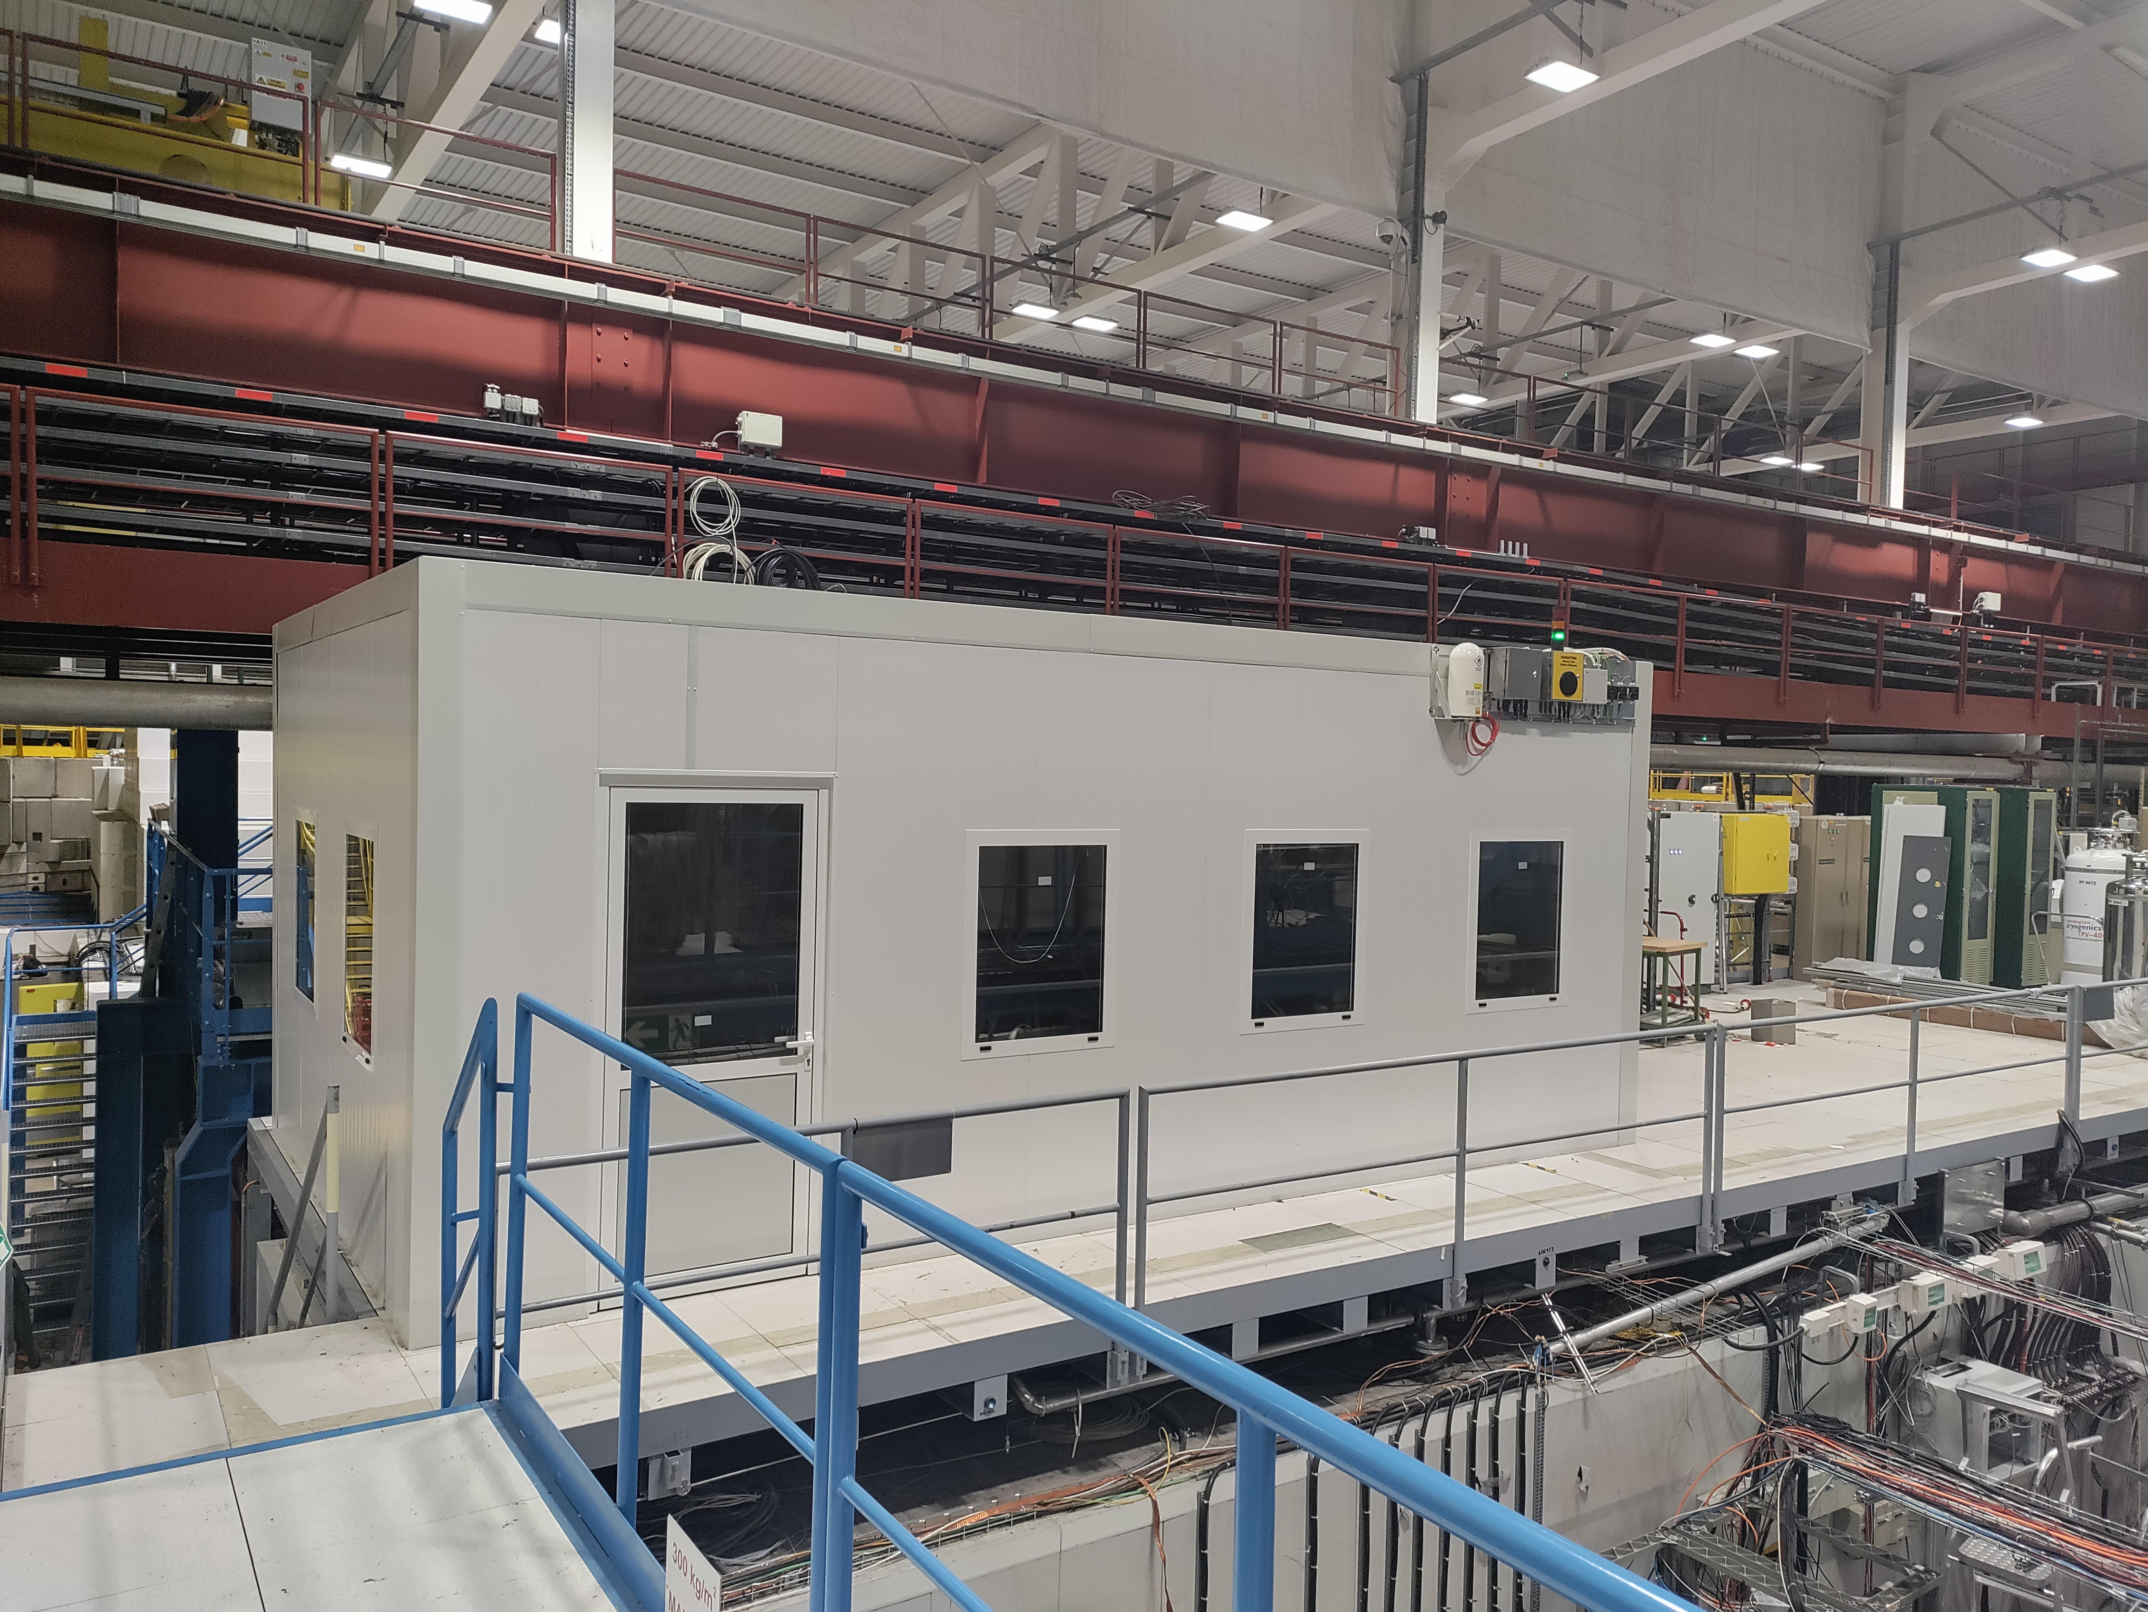
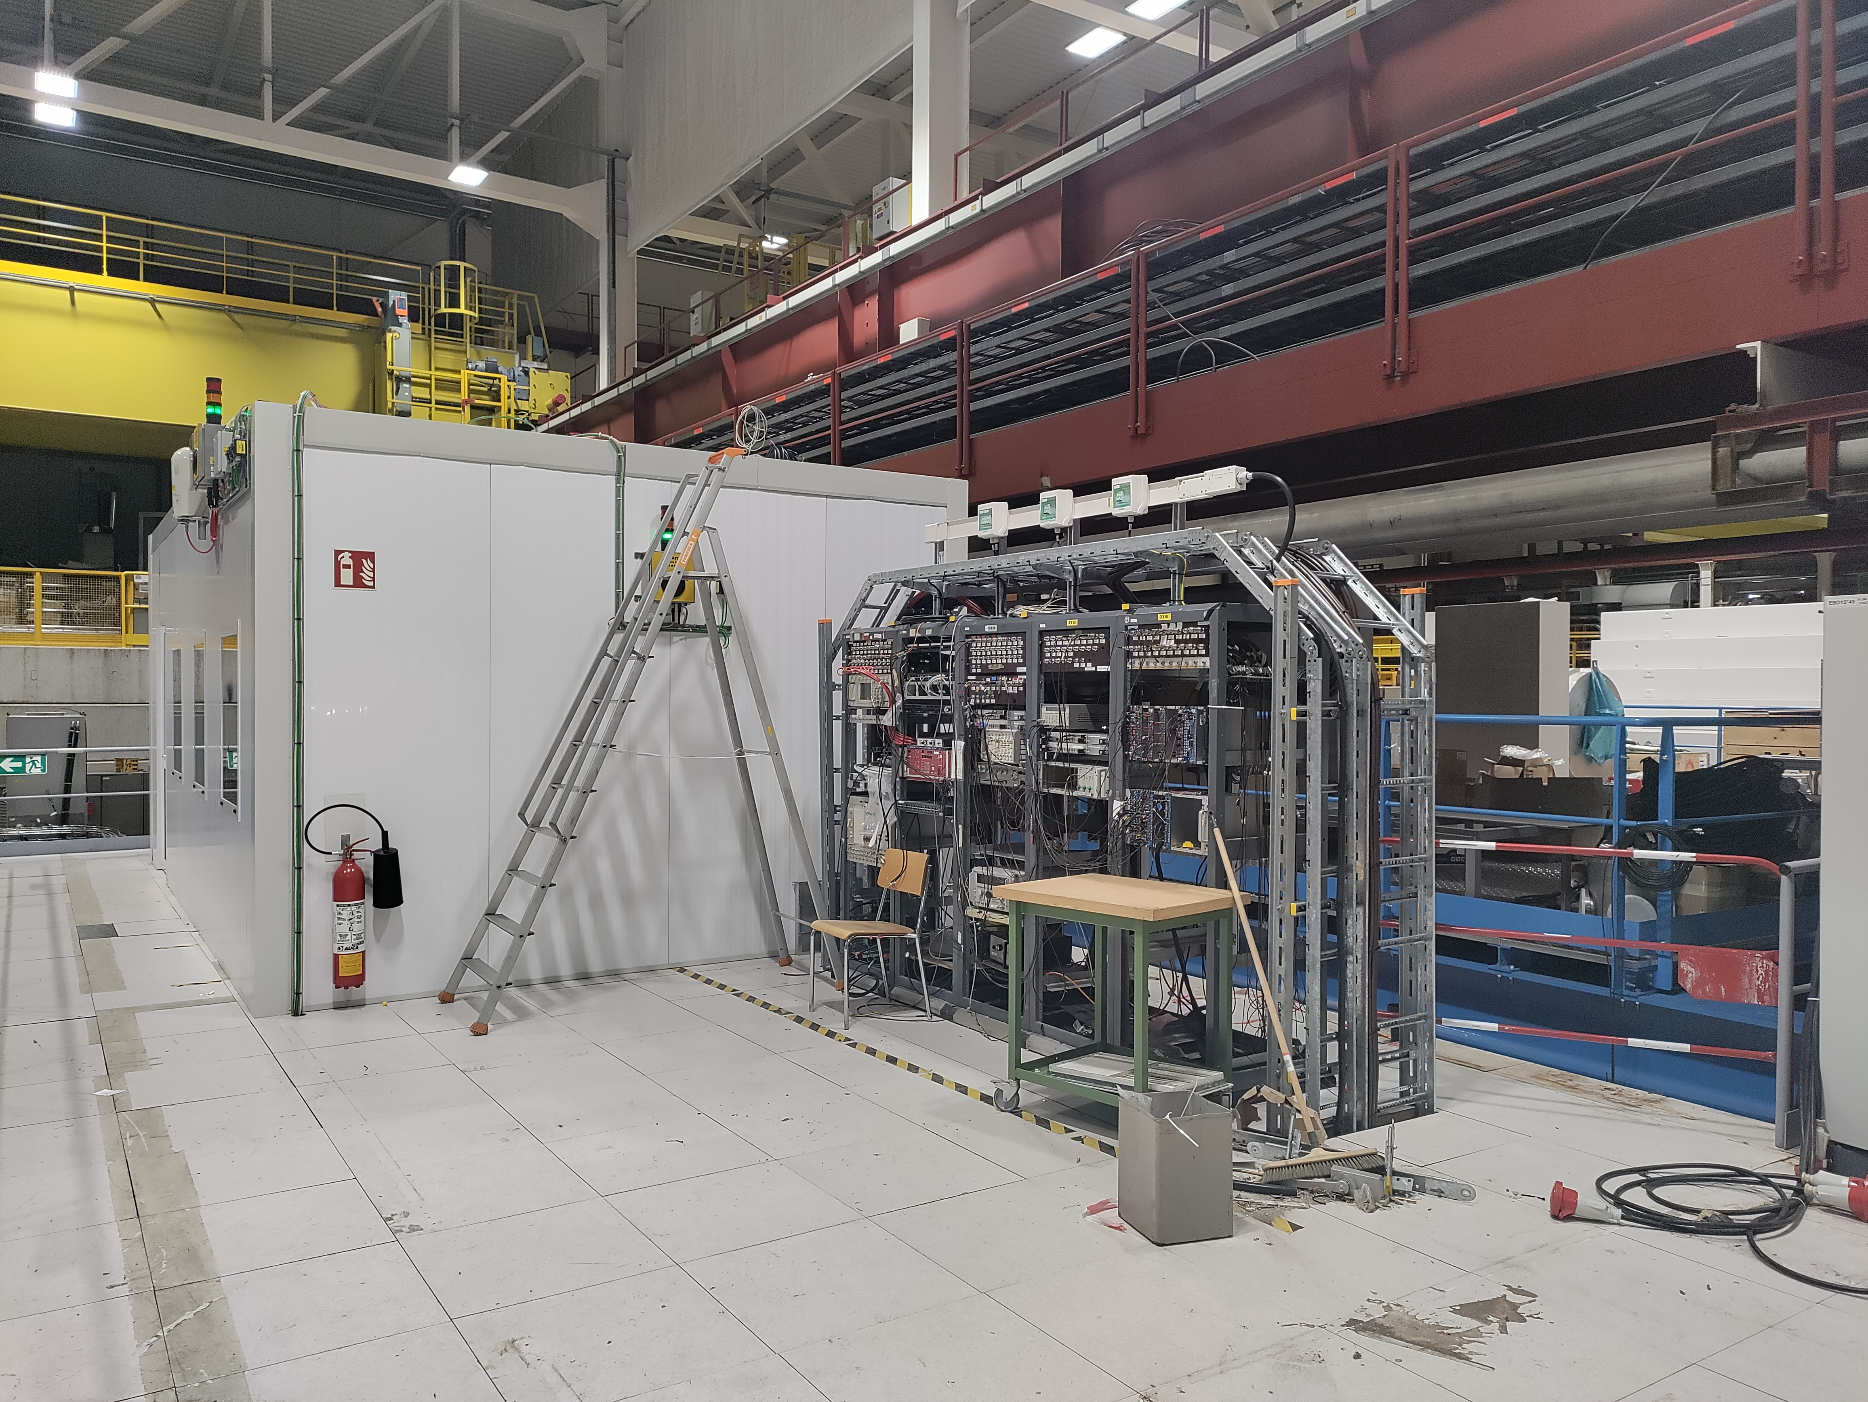
Project progress
  Week 9 and 10 : Recabling of entire control room
    Lights
    Sockets
    Ethernet ports
  Week 11 :
    Reinstallation RP equipment. AC to be reinstalled after YETS.
  Week 12 :
  Dismantling of scaffolding.
  Fire detection installation.
  Cleaning of the area.
  From Week 13 :
  The house is yours !
  Reinstallation of furniture and PCs
  Recabling of racks

Slide 6
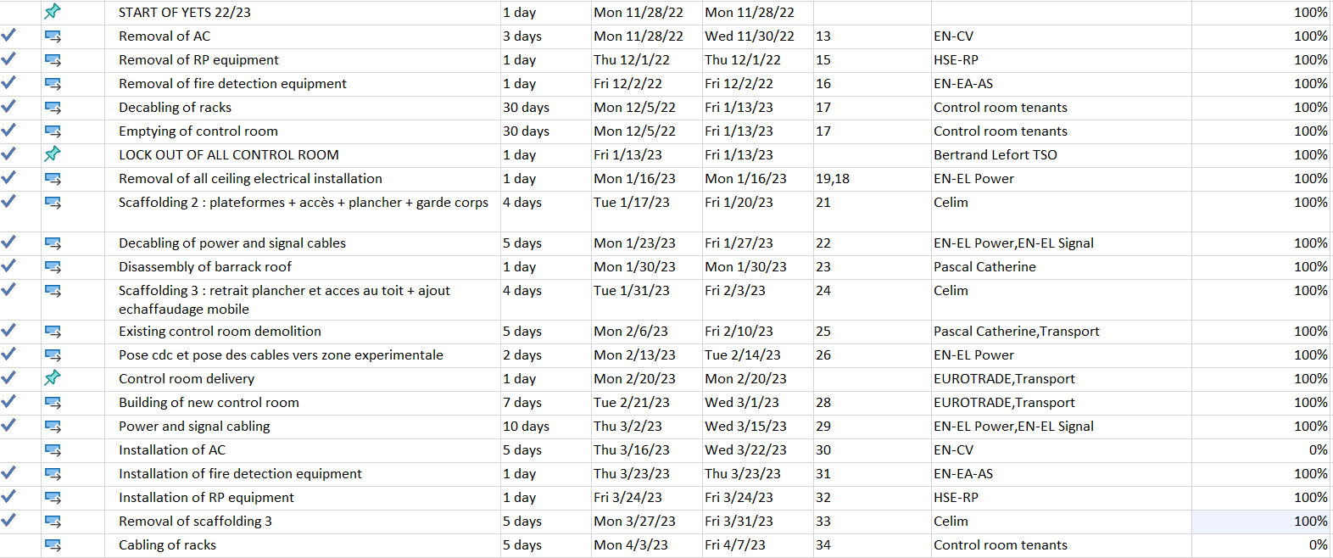
Provisional schedule YETS 22-23

