Slide 1
EDMS 2579972

Slide 2
Radiological control of materials transferred from the experimental areas of b.193 to b.393
C. Ahdida, M. Marcandella
20/04/2023
ADTC meeting
EDMS 2884418

Slide 3
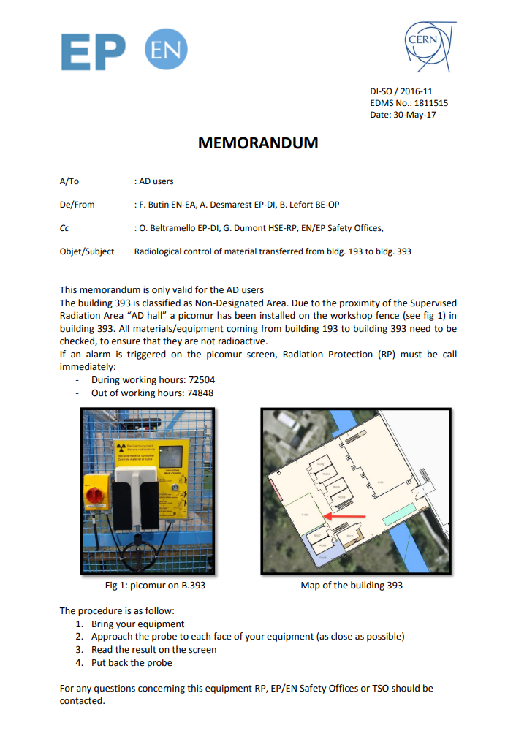
Introduction
Up to now, the memorandum “Radiological control of material transferred from bldg. 193 to bldg. 393” issued by DI-SO / 2016-11 on 30/05/2017 (EDMS 1811515) was in place
According to this procedure any equipment transferred from b.193 to b.393 had to be controlled with a material control detector (picomur) to verify the absence of activation
Legal exemption limits for radioactive isotopes were significantly reduced for many isotopes in recent years (not only at CERN), e.g. factor 100 for Mn-54 and a factor 30 for Na-22
Therefore, the verification with a picomur cannot simply be applied anymore and instead other requirements have to used (see next slide)
However, under given conditions materials from the AD experimental areas are subject to global radiological control in accordance with the procedure for “Radiological Control of Material from CERN’s Radiation Areas” (EDMS 942171)

Slide 4
Global radiological control at AD
The materials falling under the global radiological control category must fulfil all of the following conditions:
Material type | Antiproton beam intensity | Cool-down after beam operation | Distance to annihilation point | Distance to non-loss point¹
Aluminum, copper, stainless steel, concrete, titanium, electronics PCB | < 2.5E+05 pbar/s (e.g. < 2.5E+07 pbar per 100 s cycle) | ≥ 12 hours | ≥ 40 cm | ≥ 15 cm
Unknown or highly complex material compositions |  |  | ≥ 65 cm | ≥ 25 cm
1. A “non-loss point” is defined as a point where on average less than 10% of the beam intensity is lost (EDMS 1863646)
The given conditions are based on:
1) calculations and estimates obtained from simulation tools and codes (C. Theis, “Activation zoning of the AD experimental areas in view of the new Swiss LL limits (2018)”, EDMS 1863646),
2) the return on operating experience from measurements made on equipment coming from the AD experimental areas

Slide 5
New procedure
A new procedure for transfer of equipment from the experimental areas of b.193 to b.393 will soon come in place
According to this procedure, equipment fulfilling the global radiological control conditions (slide 4) will no longer be subject to mandatory radiological “self-checks” by their owner as long as it is only transferred to B.393
In case the equipment does not fulfil the conditions or it is transferred outside of B.393 or B.193, the owner must request, via the TREC system, that the equipment is measured by the RP group
Following these new instructions, the wall-mounted PCM detectors (see Figure 1) located at B.393, and previously used by equipment owners to conduct radiological checks of their equipment, will be removed as soon as the new procedure is released
The new procedure will soon be put into effect with the release of a memorandum that will be shared with the AD Users, EP Safety office, TSO and BE-OP

