Slide 1
AD kickers vacuum leak issue
Vasco Namora
08-06-2023

Slide 2
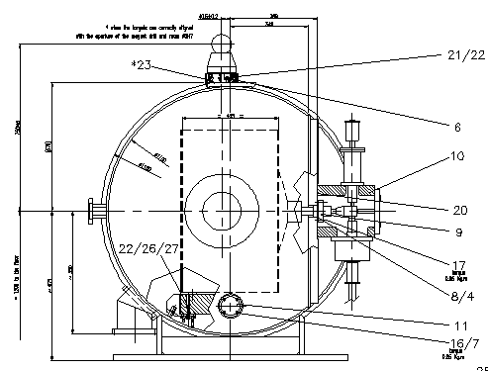
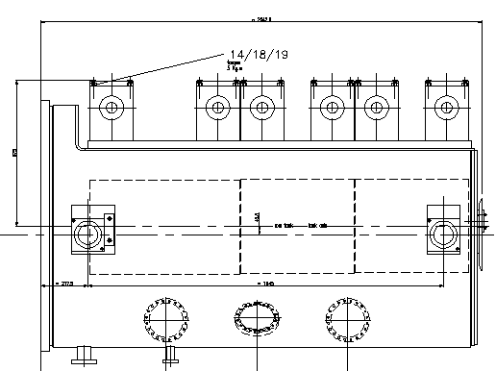
Vacuum leaks - summary
Last years, several vacuum leaks have appeared in the AD injection kickers feedthroughs, following the sector bake-outs (without CB and/or installing the Connection Boxes)

Slide 3
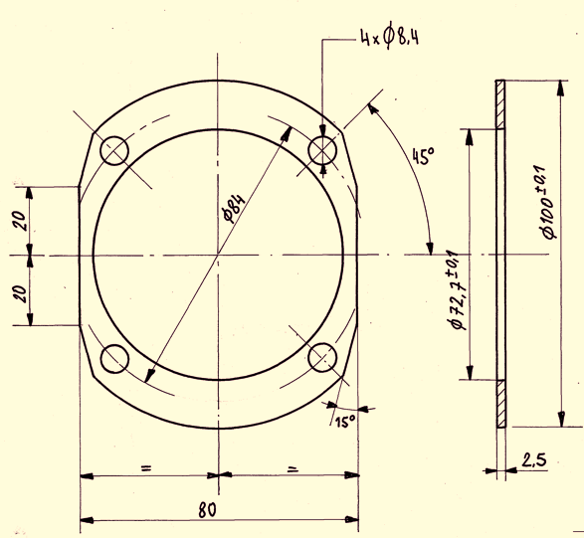
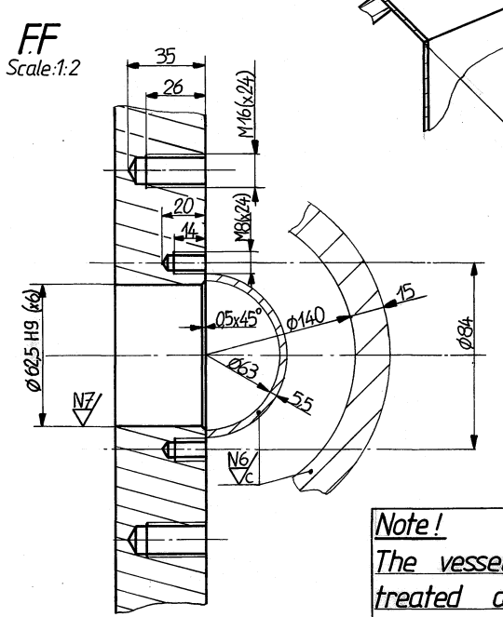
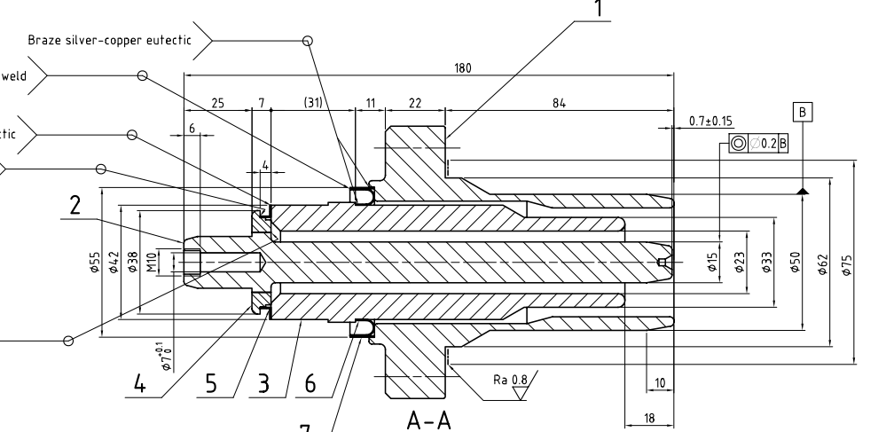
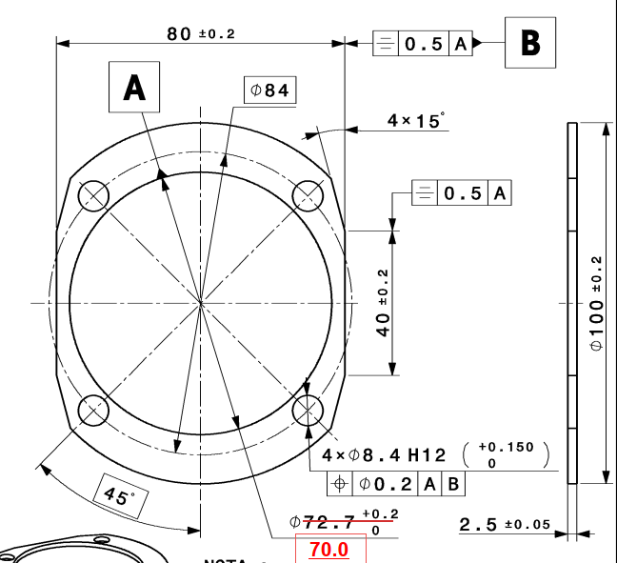
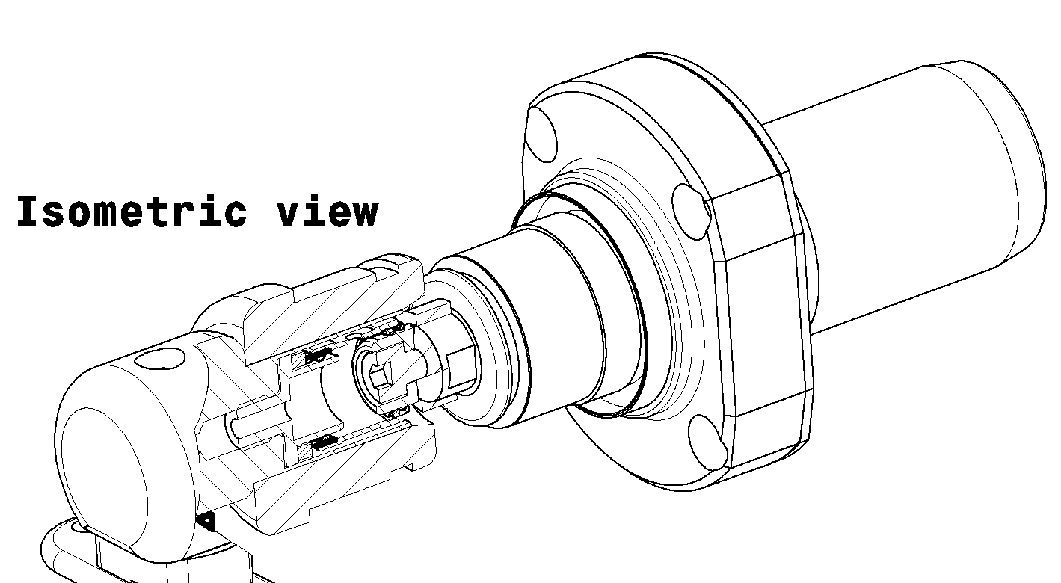
Vacuum leaks - summary
Last YETS we decided to change the design of the spacer/centering guide of the feedthrough seal. -> reduced tolerance between the seal and the centering part, as result only one vacuum leak after bake-out (existing leak before B.O., already exchanged seal twice)
Old Spacer
New Spacer

Slide 4
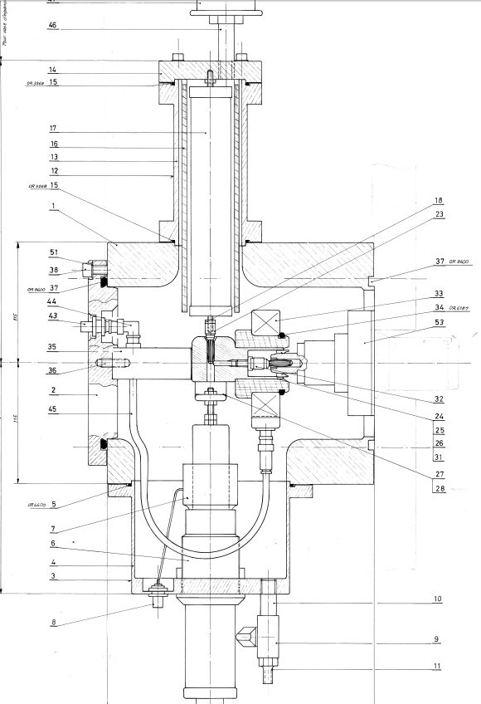
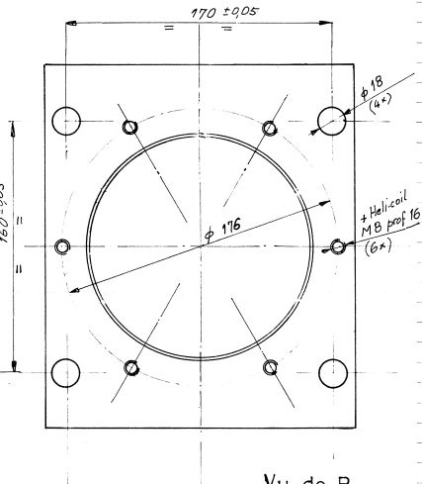
Vacuum leaks - summary
When installing connection boxes, 5 vacuum leaks appeared
Suspicion of possible misalignment between connection boxes and feedthrough due to the weight of the box, which forces the feedthrough.

Slide 5
Vacuum leaks - Plan
  Ideas to be considered:
    Verify tank surface
    Verify feedthrough surface
    Verify use of another seal
    Modify the electrical connection to avoid
    transferring the weight to the feedthrough
    Re-use old KFE35 and spare connection boxes
    to study any other solutions

