Slide 1


Latest results on RSD2 performances, a lab update
LUCA MENZIO
UNIVERSITÀ DI TORINO-INFN
UFSD group – LISS
18th Trento Workshop on Advanced Silicon Radiation Detectors

Slide 2
Outline
Introduction
  Motivations
  Resistive Silicon Detectors
  RSD 2 production by FBK
Experimental setup
Analysis and results
  Spatial Resolution
  Temporal Resolution
Conclusions

Slide 3
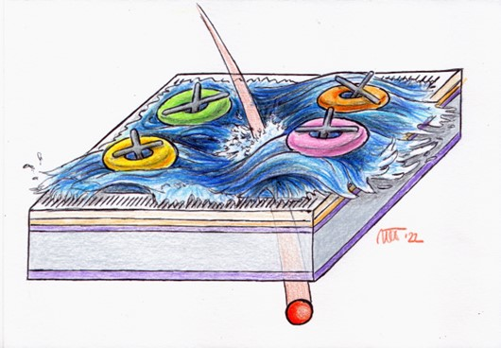
Introduction

Slide 4
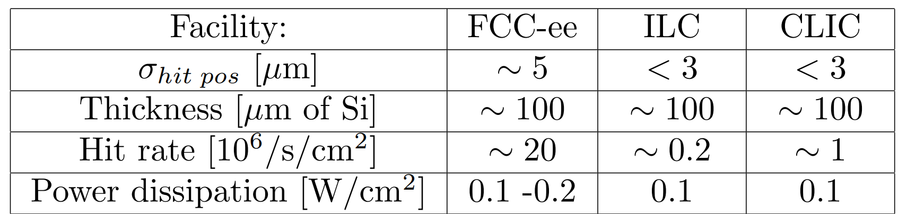
Motivations
Need for spatial information in future HEP experiments⁽¹⁾
Plus timing information, 5-25 ps depending on the facility.
Traditional sensors have difficulties in fulfilling these tasks:
5 µm obtainable with 25x25 µm², but the number of channels is too high
Better resolutions are possible with charge sharing due to external magnetic field, but sensors become too thick
A new solution is needed
Luca Menzio – INFN Torino
1st March 2023
18th TREDI Workshop

Slide 5

Resistive Silicon Detectors
Change in silicon sensors paradigm: Resistive Silicon Detector (RSD)
With
Contained channels number
Thin sensors
Charge sharing over silicon surface
Excellent position resolution with large pads
Luca Menzio – INFN Torino
Internal gain (LGAD)
Timing
Low power consumption
Low material budget
+ 100 % intrinsic fill factor!
1st March 2023
18th TREDI Workshop
Notes:
Aggiungere la questione radiation resistance

Slide 6
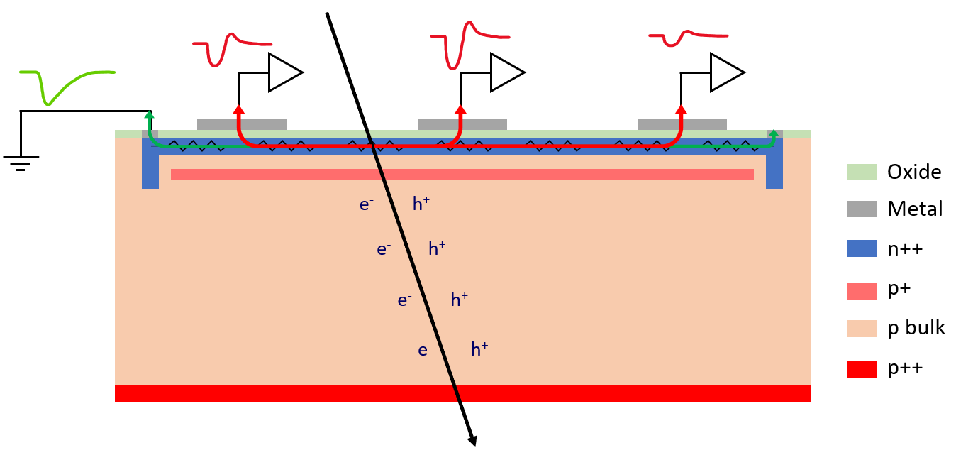
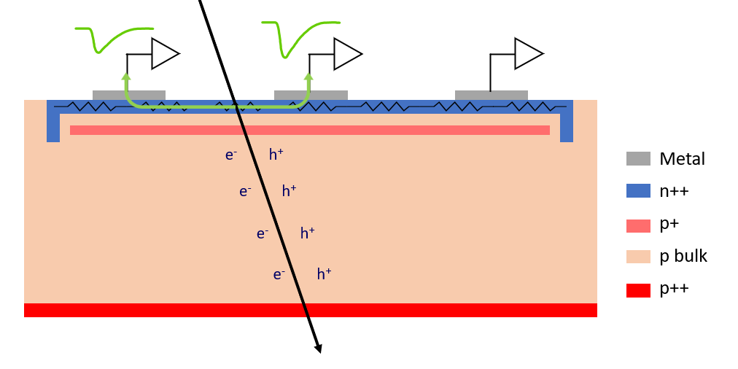
Resistive Silicon Detectors
RSD can be AC or DC coupled to their readout
Luca Menzio – INFN Torino
(AC-)RSD
DC-RSD
RSD 1
RSD 2
Propedeutic for
DC-RSD 1
Productions by FBK
Focus of his talk
1st March 2023
18th TREDI Workshop

Slide 7
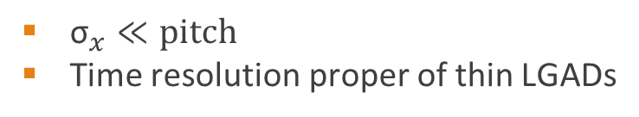

(AC-)RSD Principles of Operation
e-h pairs are produced by the impinging particle in the sensor volume
In normal pixel detectors ${\text{σ}}_{x}=k\frac{ pitch}{\sqrt{12}}$ with $k\sim 0.5−1$
(AC-)RSD have
Charge is induced in the n+ layer (1 ns)
Nearby AC pads see a fast signal thanks to capacitive coupling
Charges in the n+ flow to ground
50 μm
Signal sharing
Luca Menzio – INFN Torino
${\text{σ}}_{x}≪pitch$
Time resolution proper of thin LGADs
1st March 2023
18th TREDI Workshop

Slide 8
Standard Silicon Detector vs RSD
Pixel size
~ 25 x 25 μm²
Electronics
Pixel size
~ 250 x 250 μm²
~ 150 μm
Contacts
~ 50 μm
Luca Menzio – INFN Torino
--
---
- --
+
++
+++
---
- --
++
+++
Resistive implant
Silicon bulk
Gain implant
Standard Silicon Detector
Resistive Silicon Detector
1st March 2023
18th TREDI Workshop

Slide 9
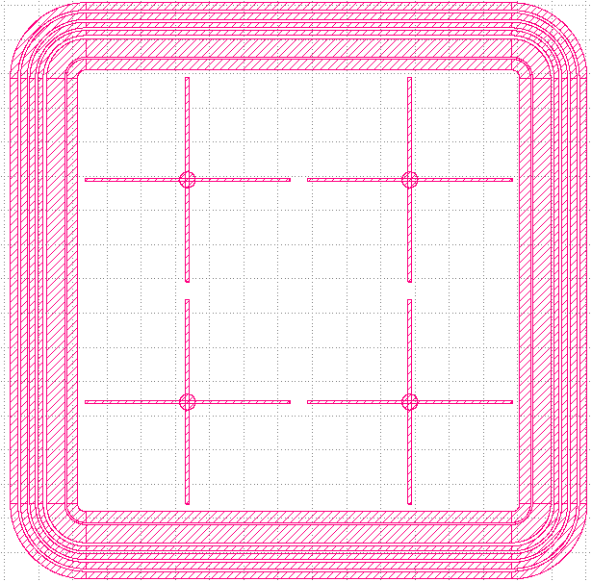
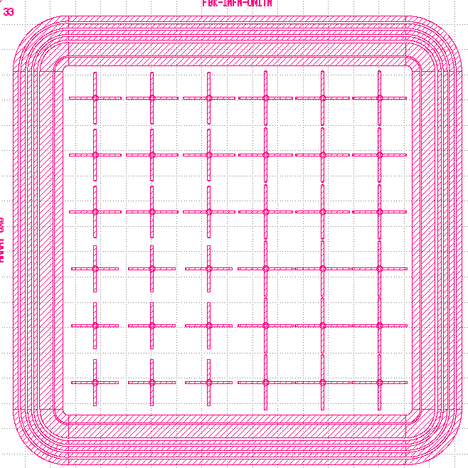
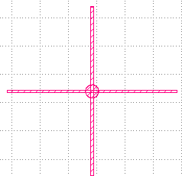
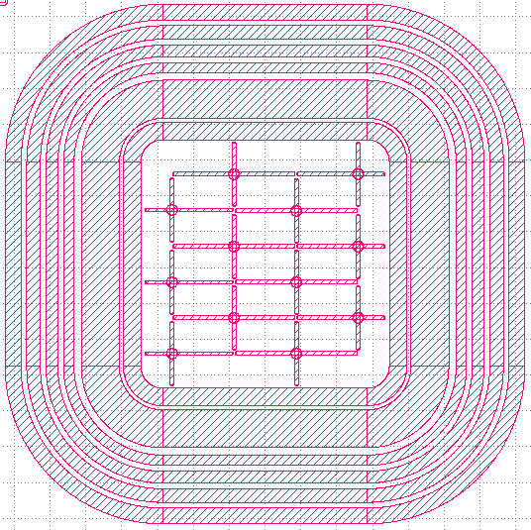
Devices Under Test
From the RSD 1 production, we learned that for optimal results:
Not too many pads should be involved – S/N ratio worsens
The number of pads involved should be the same over the sensor surface
Careful tuning of the pads capacitance – less metal on the pads
Ideas implemented in RSD 2 and various electrodes shapes implemented
Luca Menzio – INFN Torino
Our best results have been obtained employing the crosses layout
1.3 x 1.3 mm²
450 x 450 µm²
200 x 340 µm²
1st March 2023
18th TREDI Workshop

Slide 10
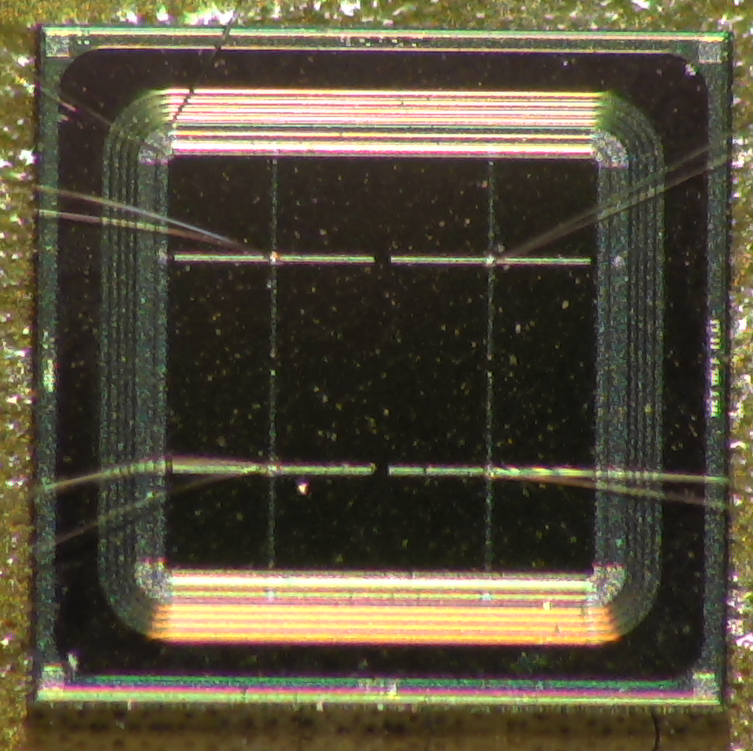
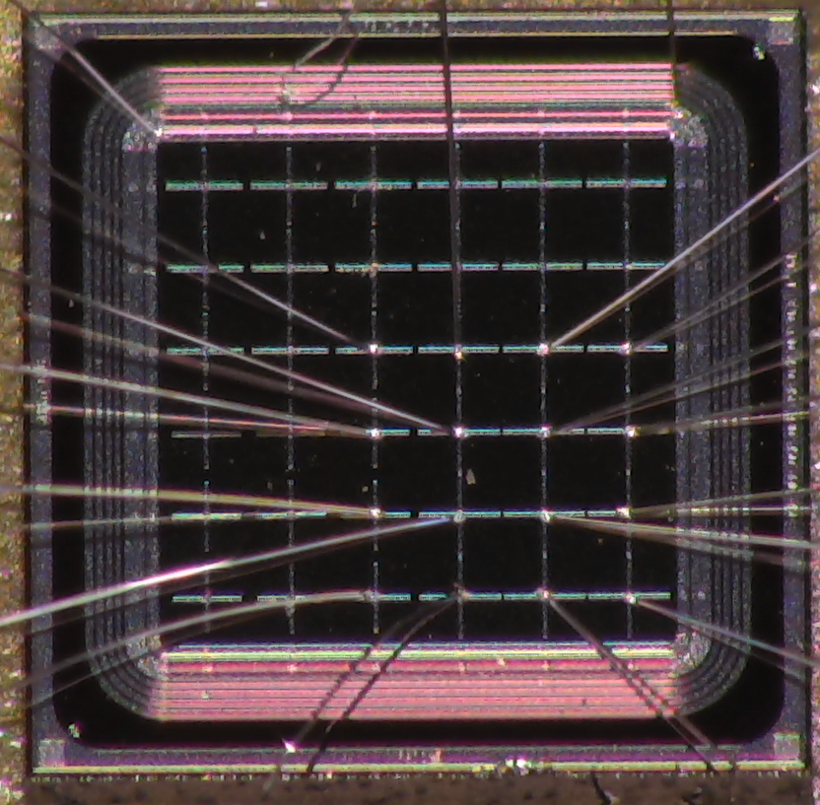
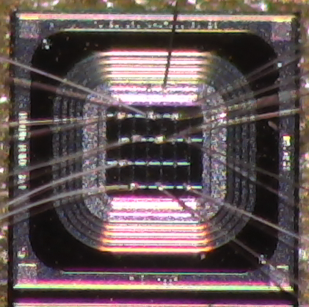
RSD 2 DUTs in Photos
Luca Menzio – INFN Torino
1st March 2023
18th TREDI Workshop

Slide 11
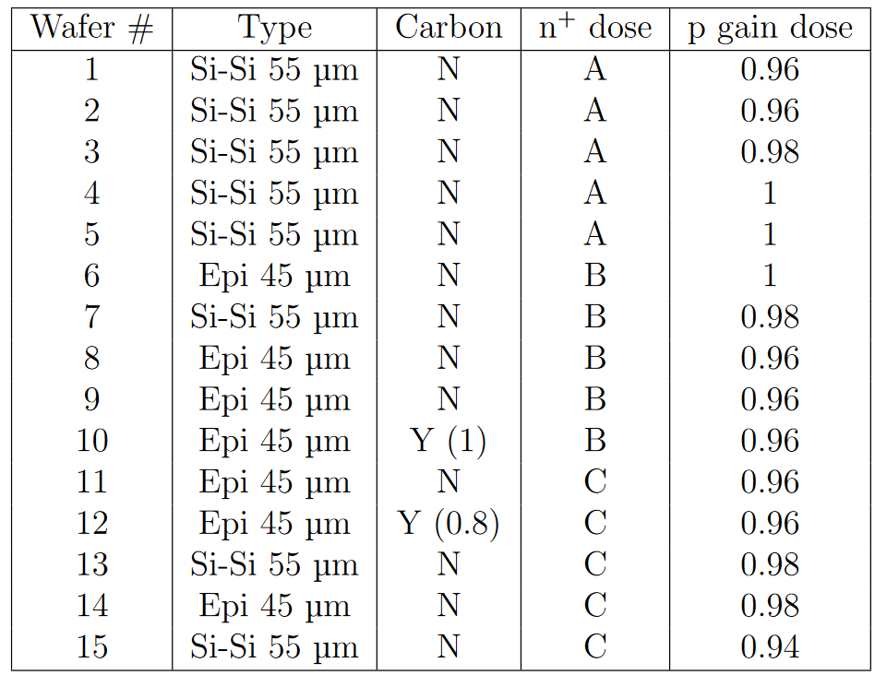
RSD 2 by FBK
RSD 2 consists of 15 wafers with different characteristics.
n⁺ dose (A < B < C)
Gain
Wafer type (Epitaxial and Floating Zone)
Pad capacitance
Electrostatics measurements were performed on all wafers⁽²⁾
On a selection of these
Fine TCT inspection
Test beam @ DESY
Luca Menzio – INFN Torino
This presentation
F. Siviero (next talk)
1st March 2023
18th TREDI Workshop

Slide 12
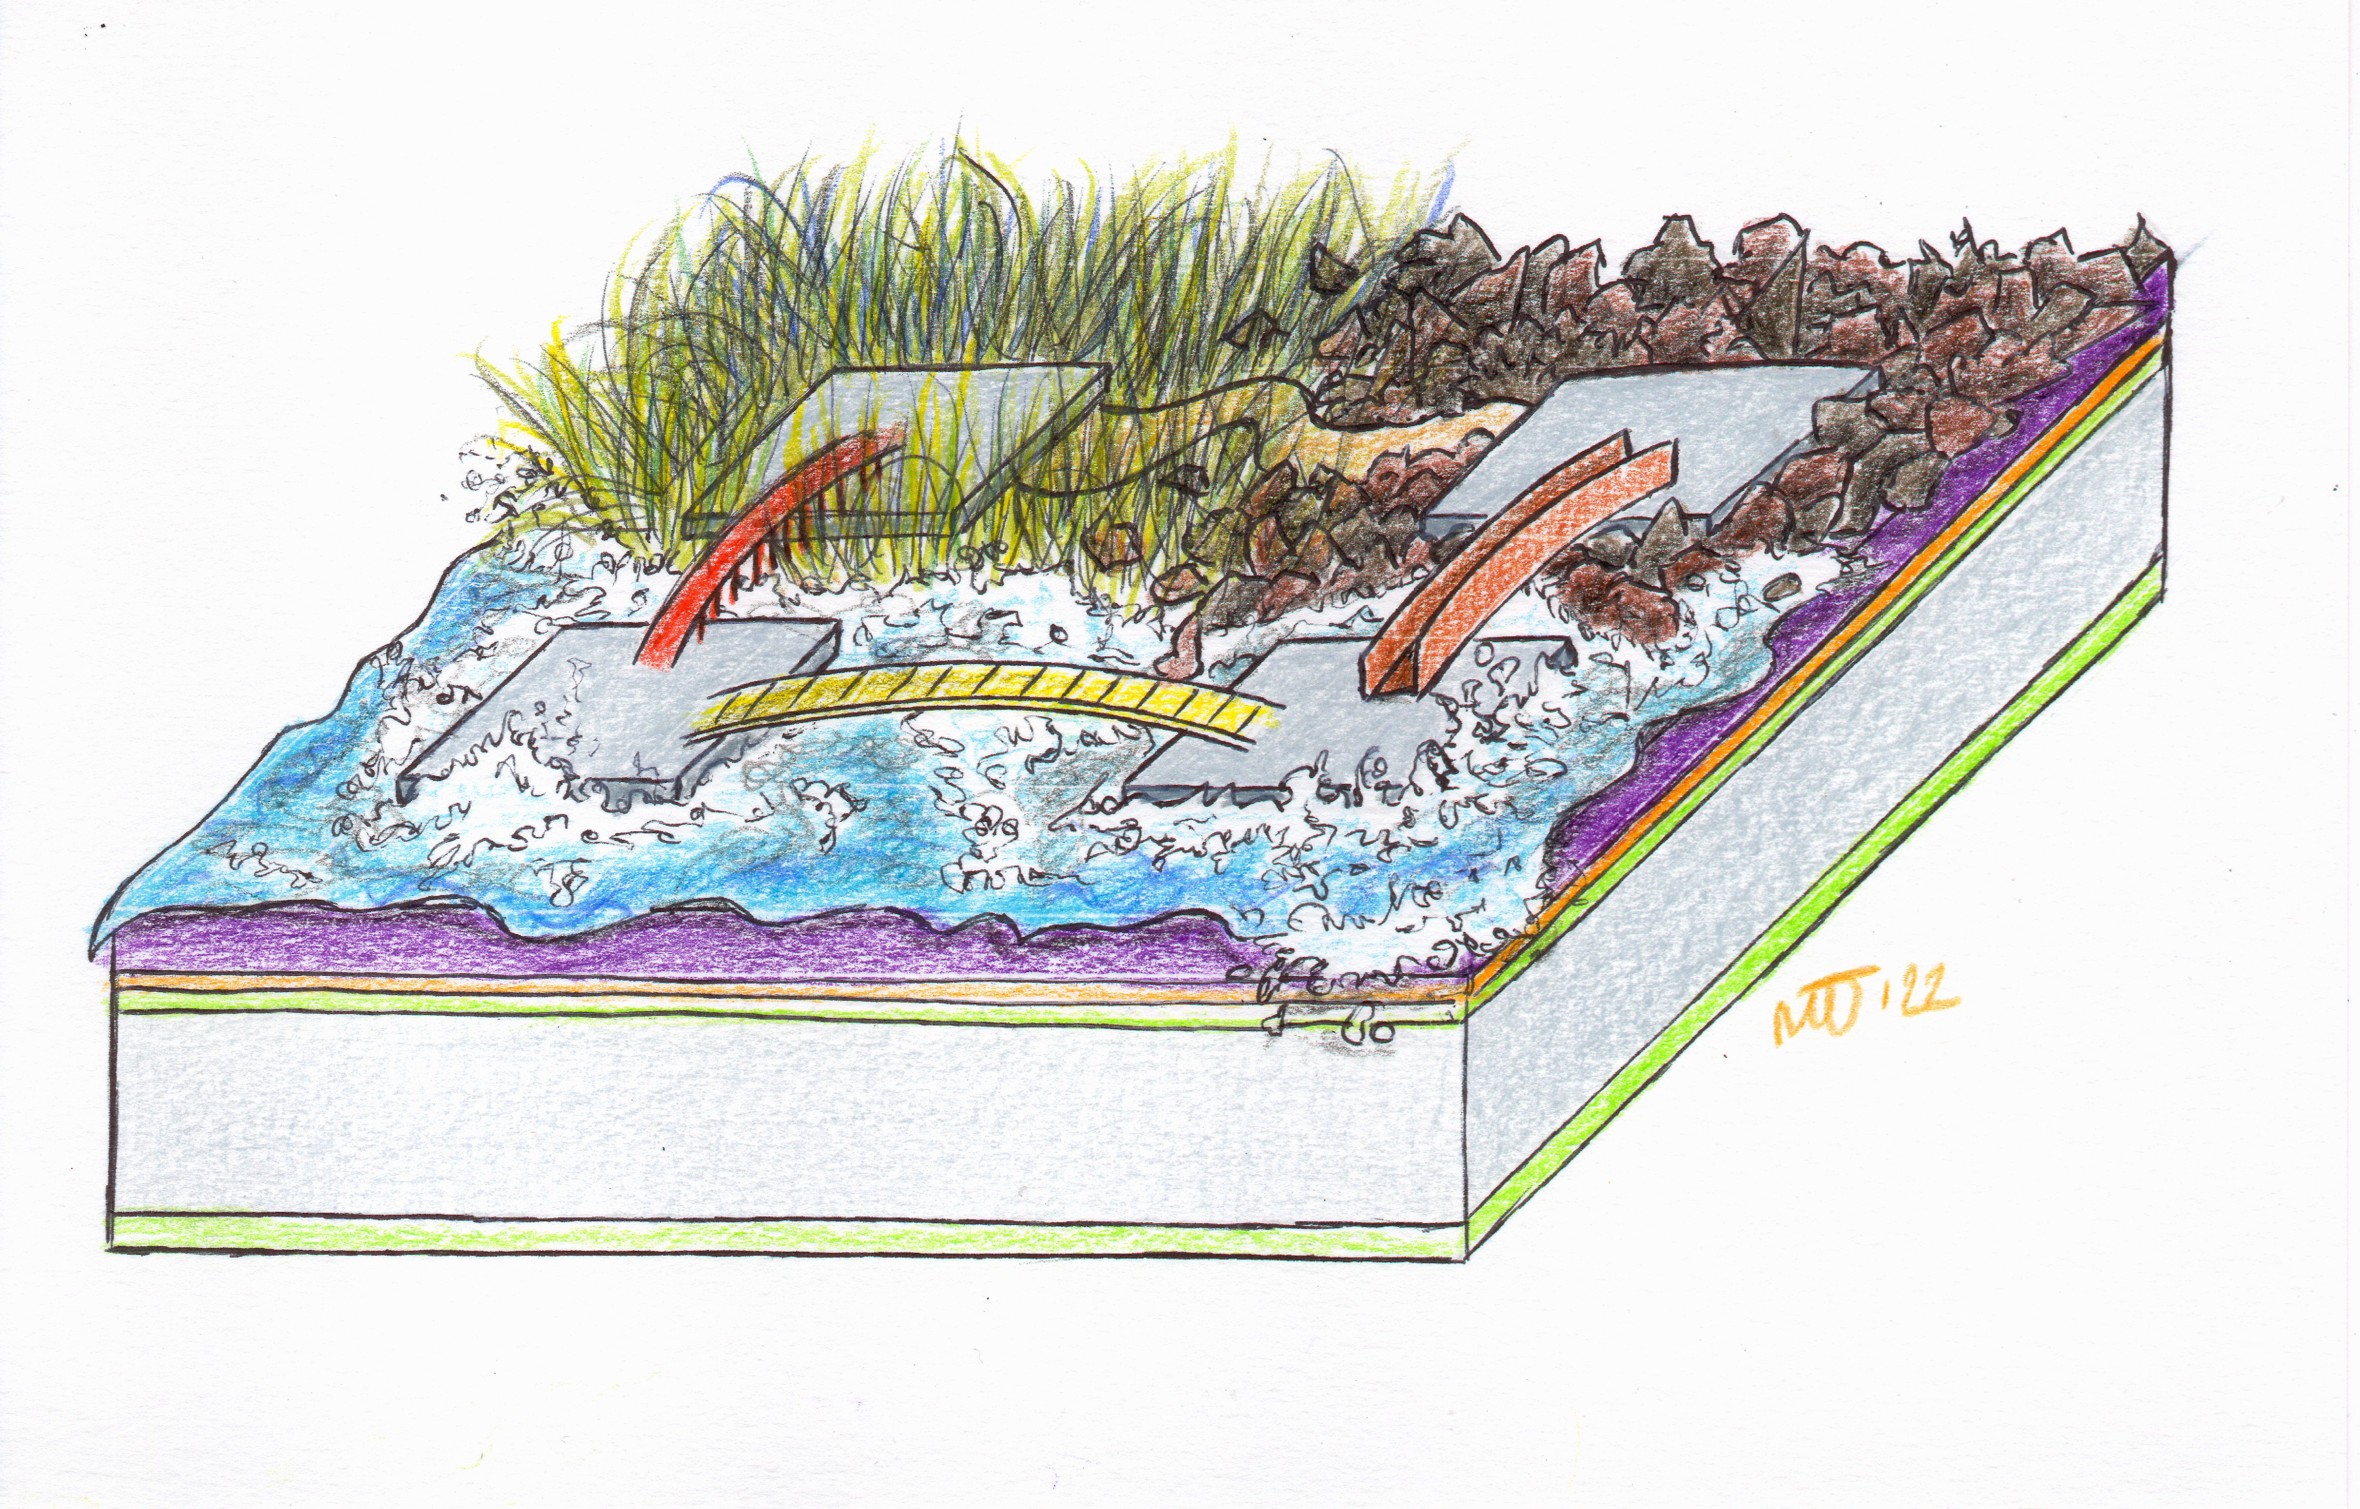
Experimental setup

Slide 13
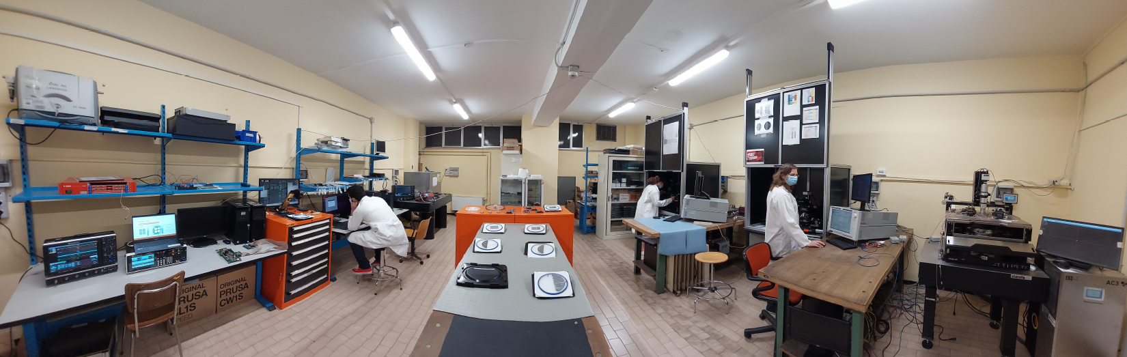
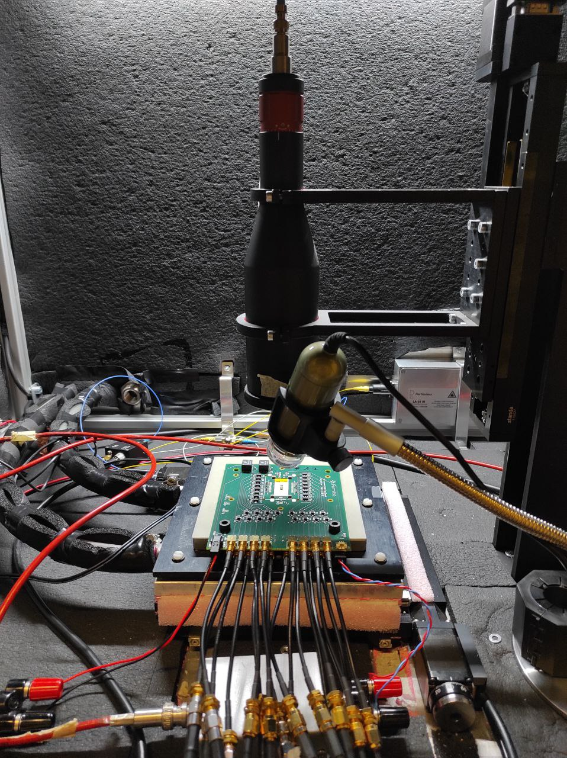
Experimental Setup
All measurements were performed in the Torino Laboratory for Innovative Silicon Sensors (LISS)
The setup consists of a TCT by Particulars equipped with a
IR laser simulating the passage of 1-3 MIP(s)
Laser spot size of ~10 μm FWHM
Luca Menzio – INFN Torino
A precise x-y stepper provides reference positions of the laser on the sensor surface
σ_{step} ~ 2 μm
Multiple signals (50-100) are produced and recorded at each point
The whole active area is scanned with 10-20 μm steps
y
x
1st March 2023
18th TREDI Workshop

Slide 14
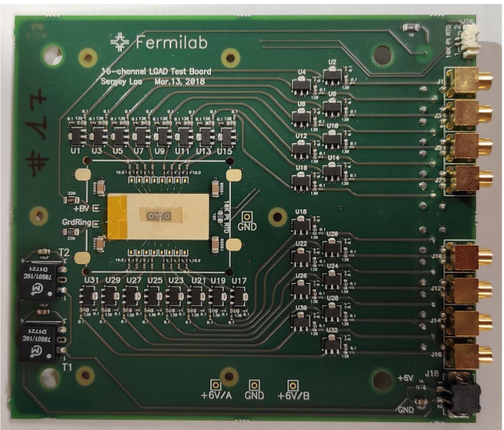
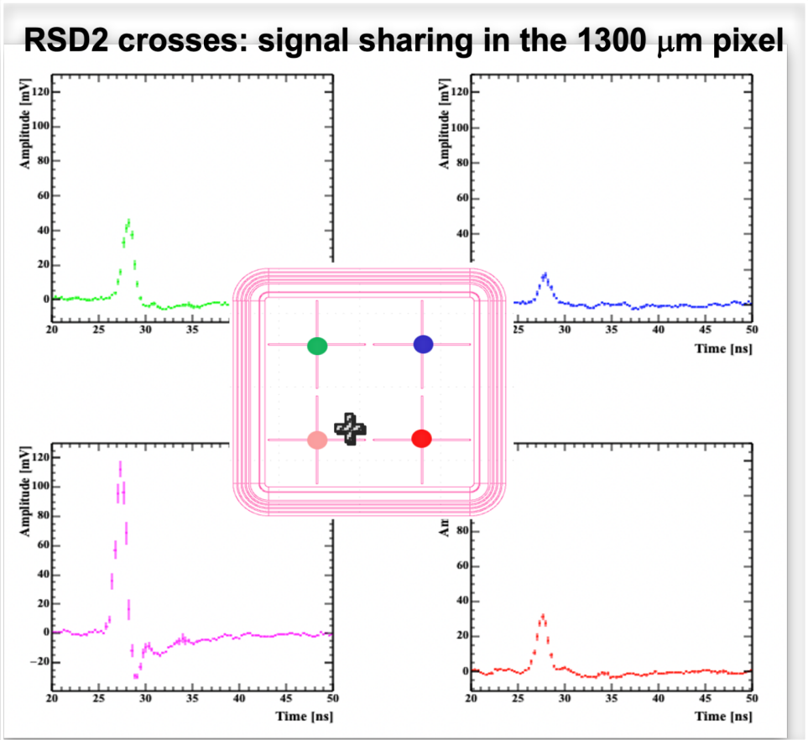
Experimental Setup
All sensors were bonded on a 16-ch Fermilab board
Double-stage amplifiers
RMS noise @roomT ~ 2-3 mV
The output signals are read out employing a 5 GS/s 16-ch digitizer
An output rootfile containing positions and sampled waveforms is produced and undergoes
“standard” c++ analysis³
Machine Learning-based approach^{4,5}
Luca Menzio – INFN Torino
1st March 2023
18th TREDI Workshop

Slide 15
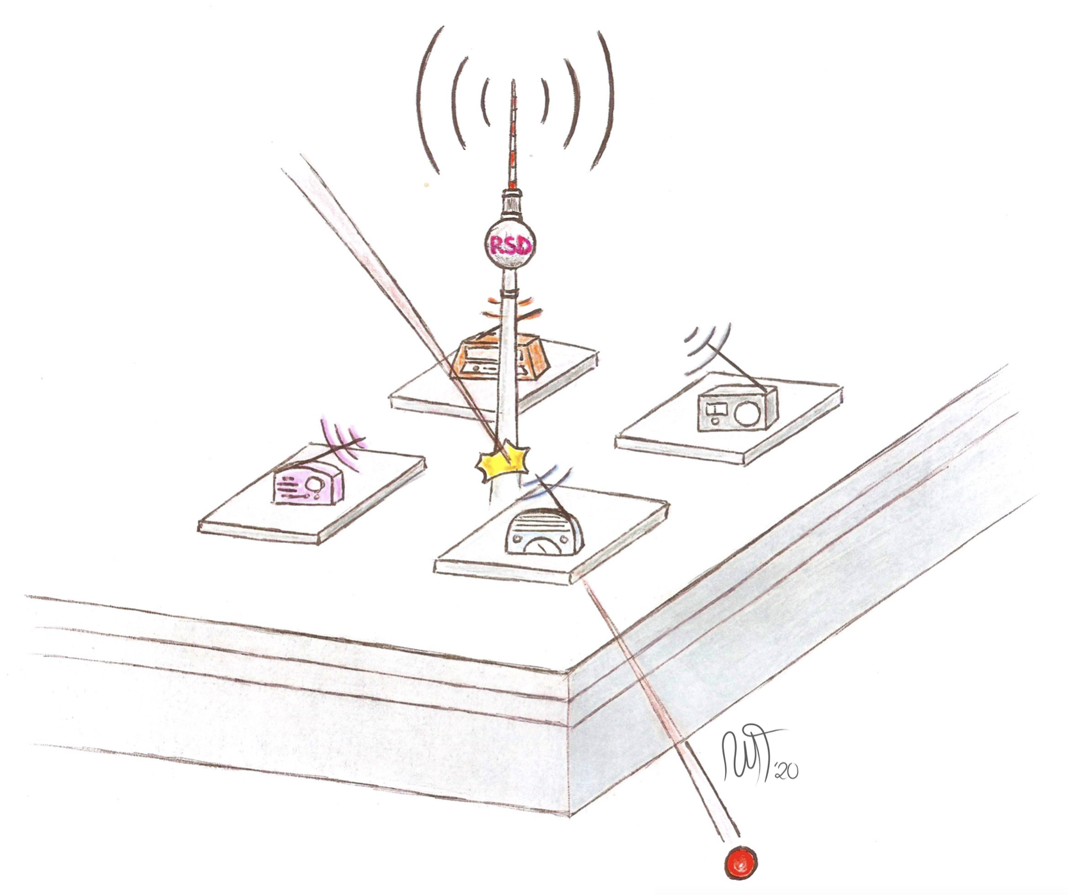
Analysis and Results

Slide 16
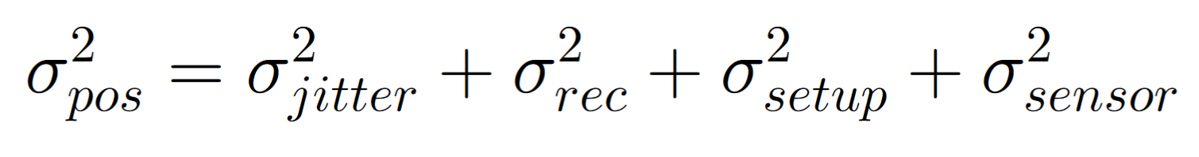
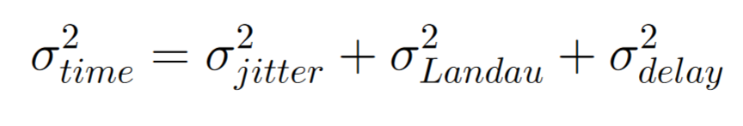
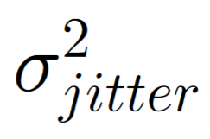
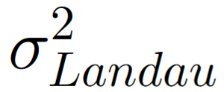
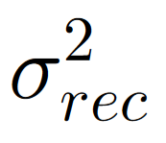
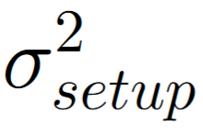
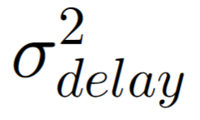
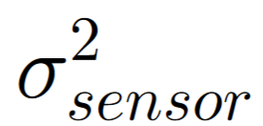
Resolutions parametrization
Space
Time
due to the variation in the signal amplitude caused by the electronic noise ~ noise/amplitude
accuracy of the reconstruction method
related to eventual variations in the signal sharing due to the experimental setup (i.e. amplifiers)
all sensor imperfections that could contribute to differences in signal sharing
similar as before, ~ noise/(dV/dt)
non-uniform ionization contributes with ~30 ps in 50 μm thick sensors
propagation time from the impact point to the read-out pad. It is correlated to the precision of the hit position reconstruction
Luca Menzio – INFN Torino
1st March 2023
18th TREDI Workshop

Slide 17
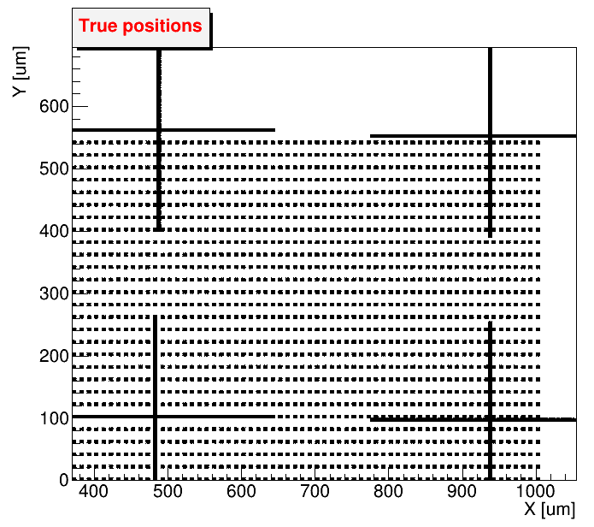
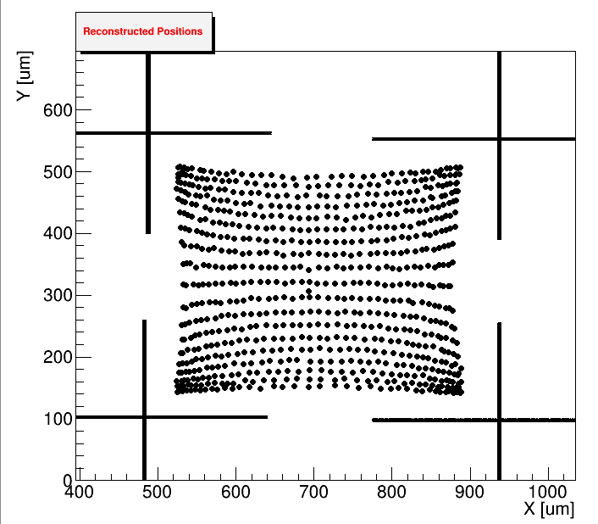
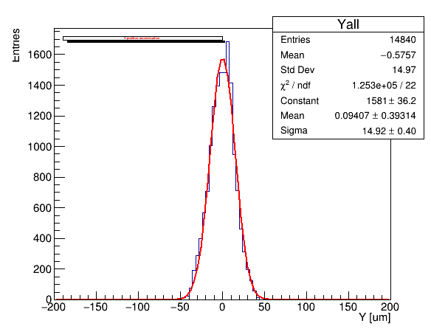


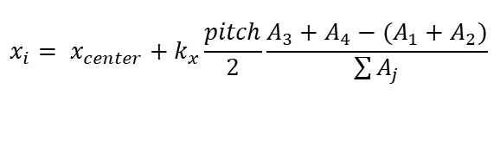
Space Reconstruction
Considering a sensor with 450 μm pitch
In RSD 2, spatial coordinates (x-y) are reconstructed with the method of the “charge asymmetry”
1
1
3
$$σ_{pos}\sim \frac{pitch}{\sqrt{12}}\sim 130 μm$$
2
4
Luca Menzio – INFN Torino
$$x_{i}= x_{center}+k_{x}\frac{pitch}{2}\frac{A_{3}+A_{4}−(A_{1}+A_{2})}{\sum{A_{j}}}$$
$$y_{i}= y_{center}+k_{y}\frac{pitch}{2}\frac{A_{1}+A_{3}−(A_{2}+A_{4})}{\sum{A_{j}}}$$
15 μm
We employed the amplitude A
y_rec – y_true [um]
1st March 2023
18th TREDI Workshop

Slide 18
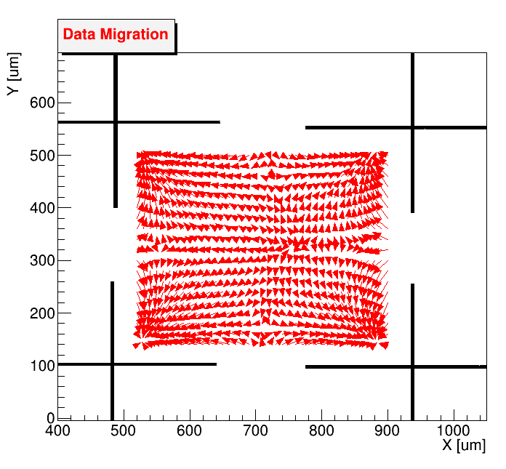
Correction Matrix
A correction matrix is generated with the highest amplitudes dataset.
The migration of the data is then applied to all datasets, bringing the average point position to (almost) overlap with the true one.
This correction drastically improves the accuracy of the reconstruction method, especially in cases of low amplitudes
Before correction
After correction
Reconstructed points
Reconstructed points
True position
True position
Luca Menzio – INFN Torino
Correction Matrix
1st March 2023
18th TREDI Workshop

Slide 19
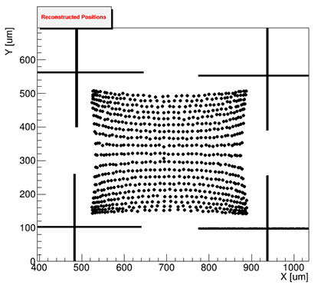
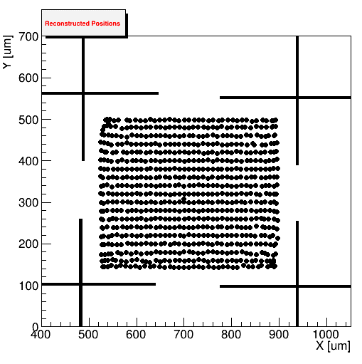

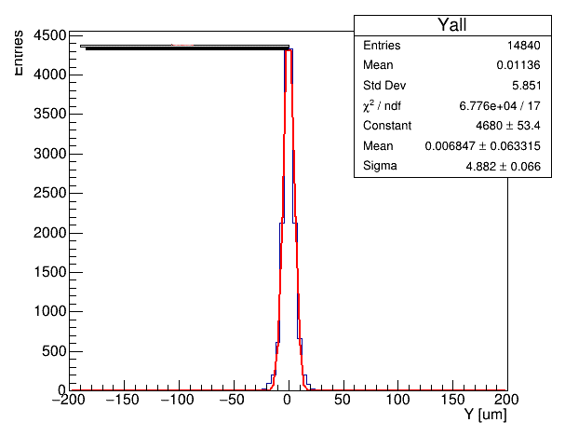
Space Reconstruction
After the correction with the migration matrix, the results improve
The same correction matrix is applied to the lower-gain datasets.
~ 15 μm ~ 5 μm
Before correction
After correction
Luca Menzio – INFN Torino
y_rec – y_true [um]
y_rec – y_true [um]
y_rec – y_true [um]
1st March 2023
18th TREDI Workshop

Slide 20
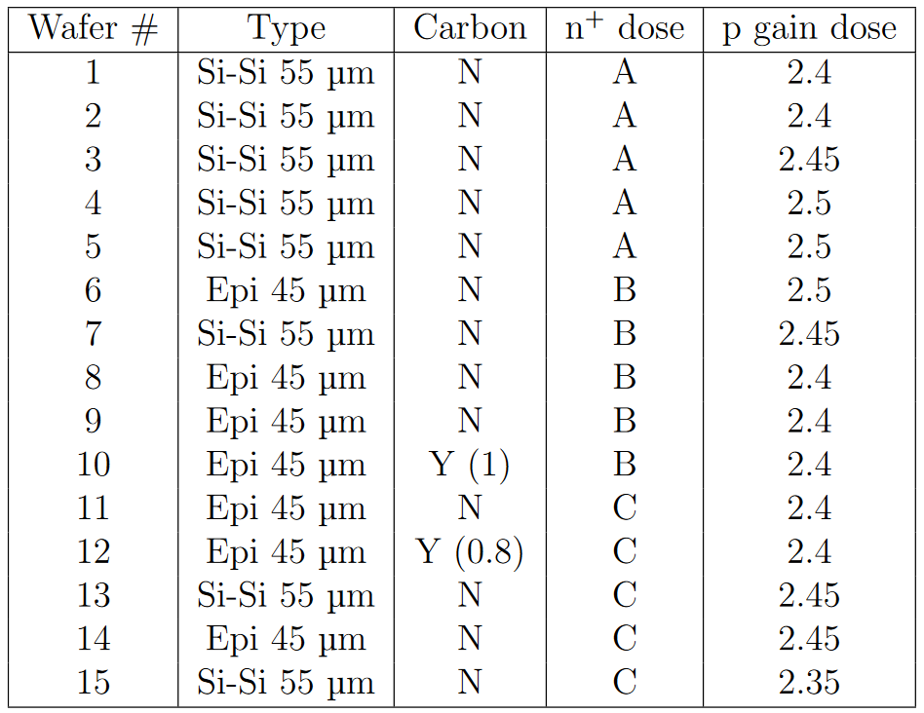
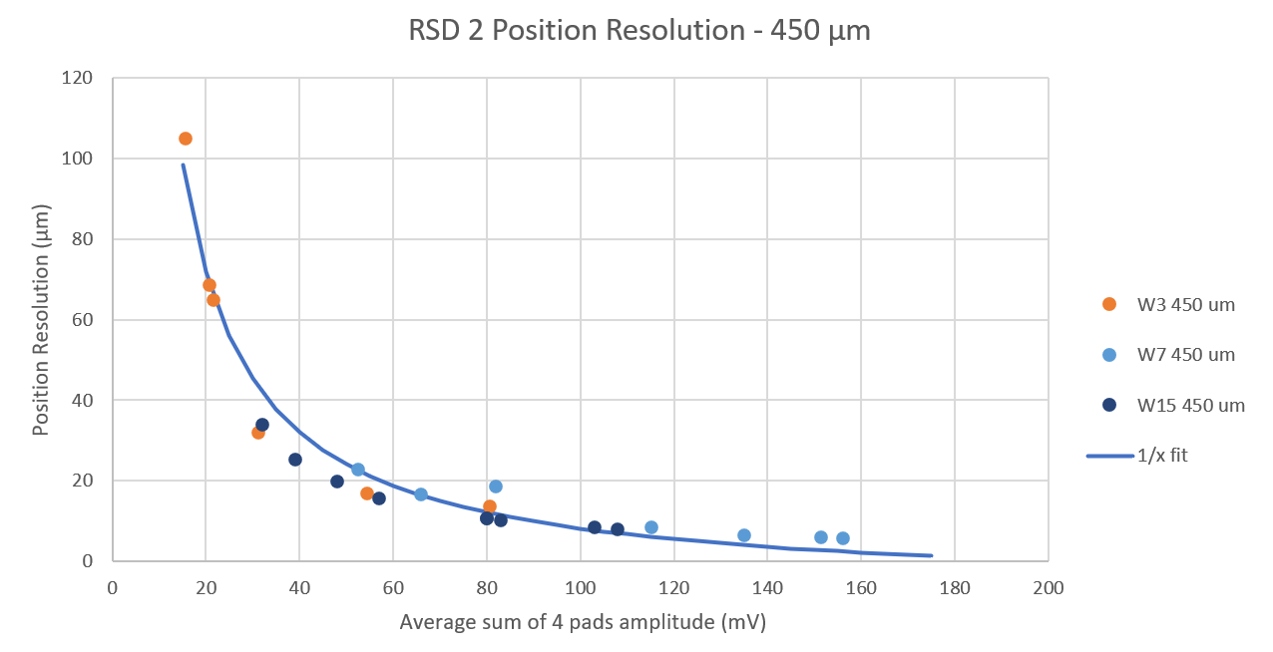


Space Reconstruction Results
Different wafers can be studied with a fixed geometry – 450 μm pitch
The different wafers behave in the same way
The jitter term depends on the amplitude as 1/A.
Since the data agrees quite well with the 1/A behavior, the resolution is dominated by the jitter term
Luca Menzio – INFN Torino
1st March 2023
18th TREDI Workshop

Slide 21
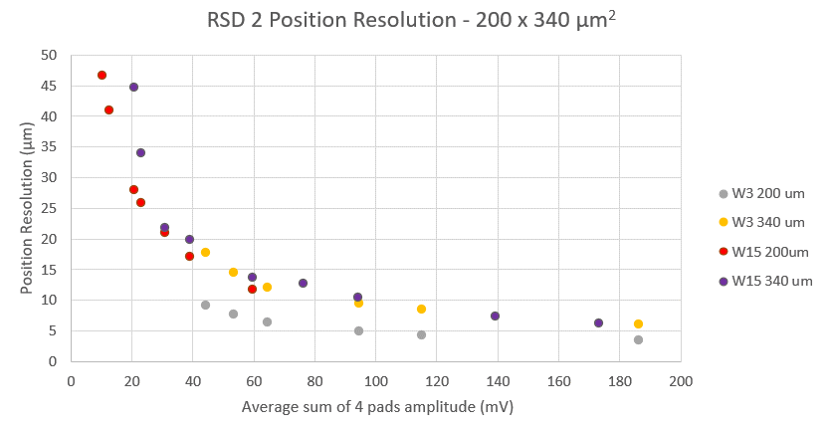
Space Reconstruction Results
The smallest DUT - 200 x 340 μm²
For the smallest pitch, the wafer with the highest n+ resistivity (W3) achieves the best resolution.
This is expected since at lower resistivities the signal is spread on too many electrodes
Luca Menzio – INFN Torino
1st March 2023
18th TREDI Workshop

Slide 22
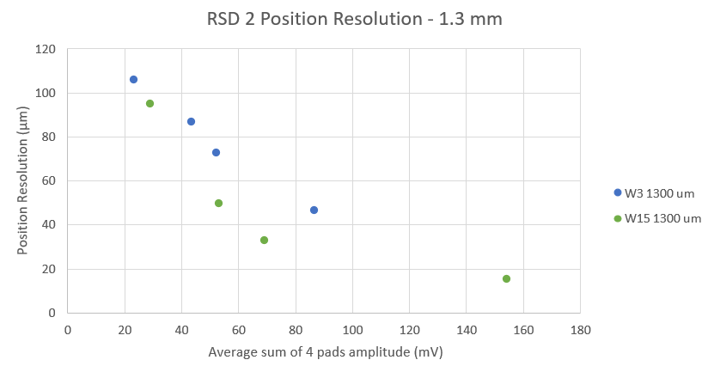
Space Reconstruction Results
Largest DUT - 1.3 mm pitch
Resistivity seems to play an important role also in big sensors
Lower resistivity helps the signal travel longer distances
W7 measurements are currently undergoing
Luca Menzio – INFN Torino
1st March 2023
18th TREDI Workshop

Slide 23
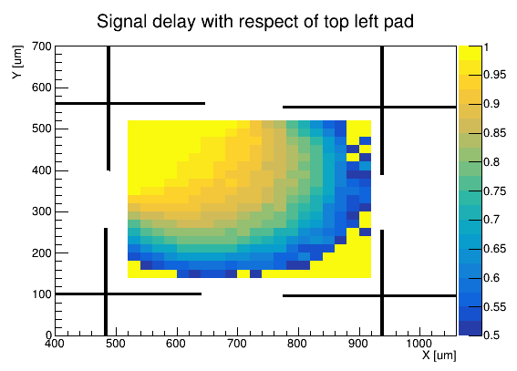
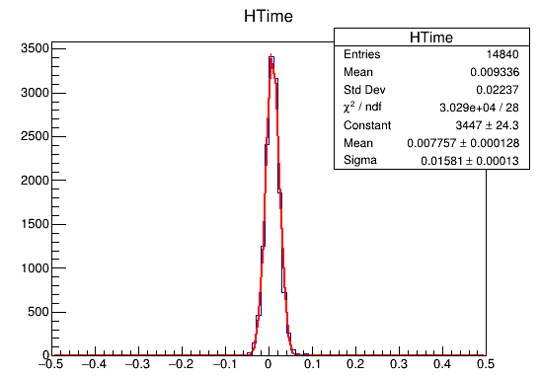

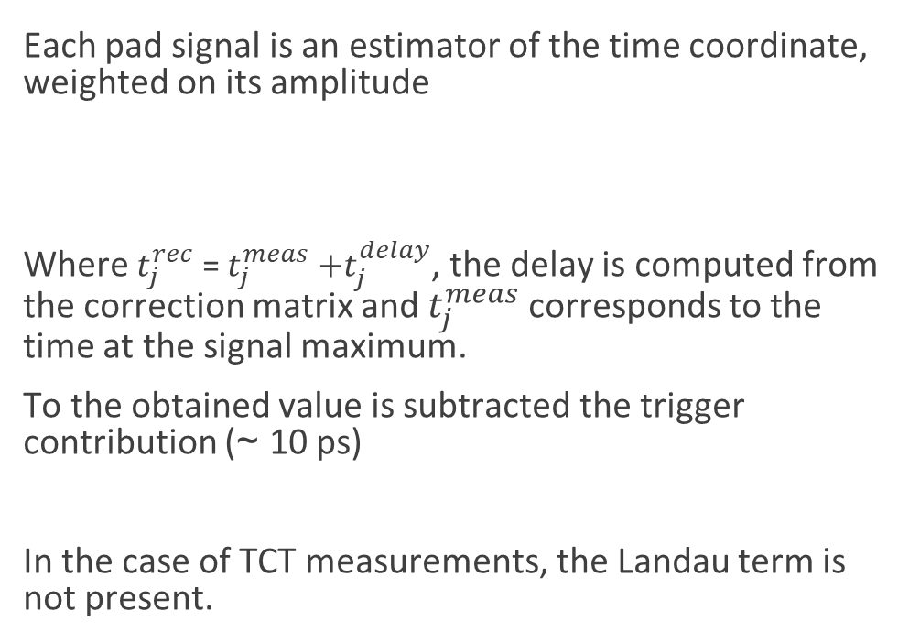
Time Reconstruction
Each pad signal is an estimator of the time coordinate, weighted on its amplitude
Where $t_{j}^{rec}$ = $t_{j}^{meas}$ $+t_{j}^{delay}$, the delay is computed from the correction matrix and $t_{j}^{meas}$ corresponds to the time at the signal maximum.
To the obtained value is subtracted the trigger contribution (~ 10 ps)
In the case of TCT measurements, the Landau term is not present.
$$t_{i}=\frac{\sum_{j}^{4}{t_{j}^{rec}A_{j}^{2}}}{\sum_{j}^{4}{A_{j}^{2}}}$$
Luca Menzio – INFN Torino
~ 16 ps
t_{rec} – t_{trigger} [ns]
1st March 2023
18th TREDI Workshop

Slide 24
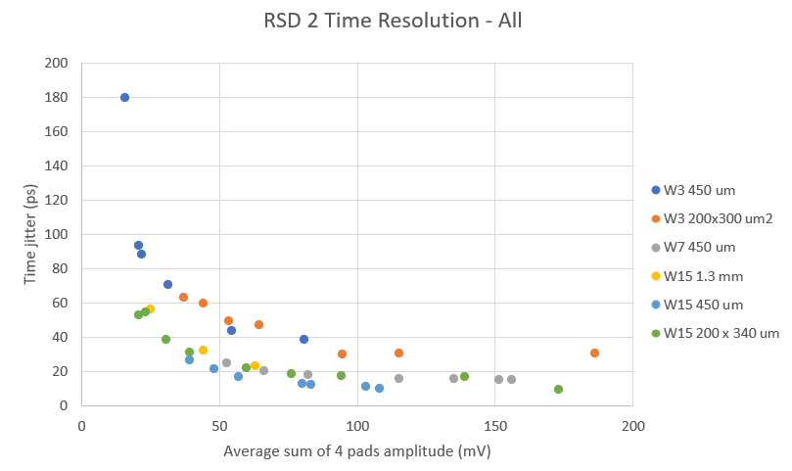

Time Resolution Results
Very uniform performance
W3 has worse timing due to the broader signal shape and the choice of t^{meas}
Luca Menzio – INFN Torino
1st March 2023
18th TREDI Workshop

Slide 25
Conclusions

Slide 26
Conclusions
RSD technology has proven to be a promising candidate as a 4D detector, combining LGADs timing and the innovative charge sharing in silicon for position reconstruction
Position resolution is better than in standard sensors
  The n+ layer resistivity is to be tuned on the pixel size
Time resolution of “standard” LGADs is maintained
  Time jitter is lower for sensors with lower resistivity due to the signals shape
Very useful information for future developments on DC-RSD
More on RSD 2 results (test beam @Desy) in the next talk
Luca Menzio – INFN Torino
1st March 2023
18th TREDI Workshop

Slide 27
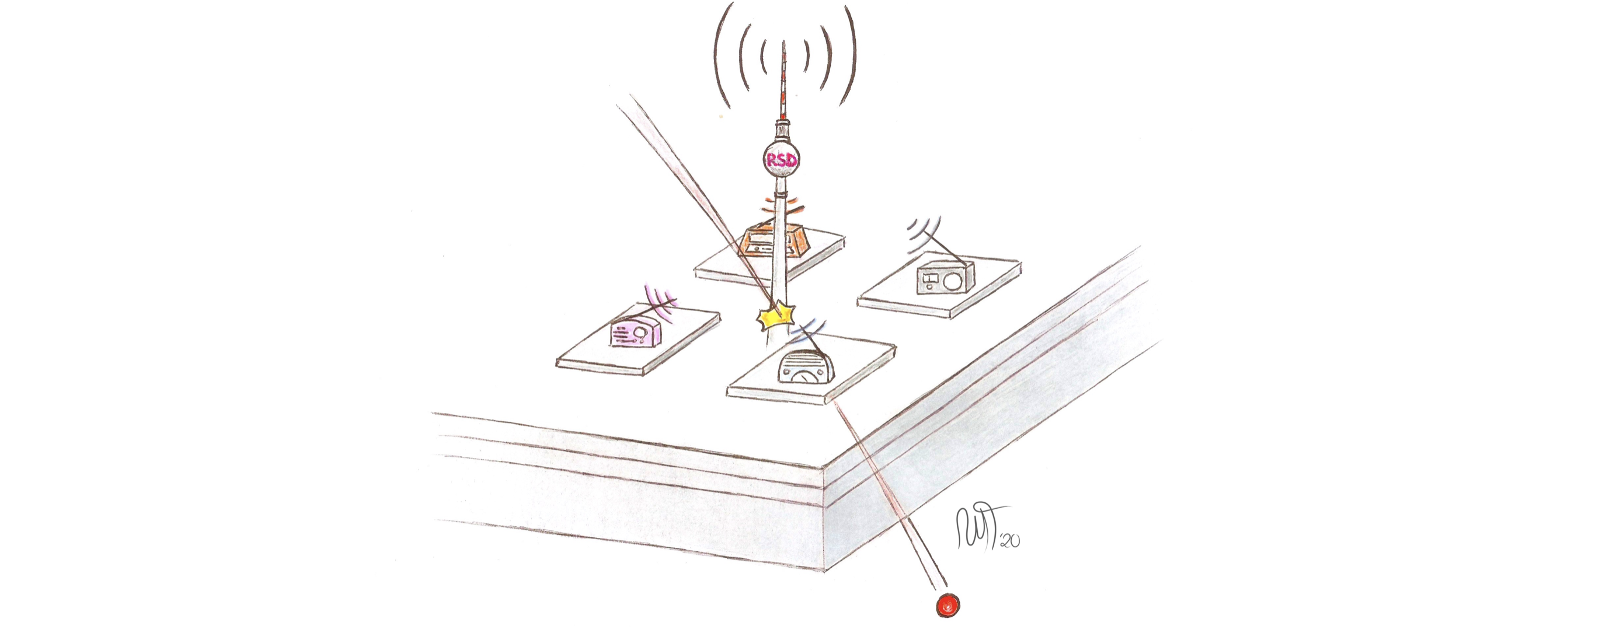
Thank you!

Slide 28
Special Thanks to
We kindly acknowledge the following funding agencies and collaborations:
INFN - Gruppo V, UFSD and RSD projects
INFN – FBK agreement on sensor production (convenzione INFN-FBK)
Horizon 2020, grant UFSD669529
Dipartimenti di Eccellenza, Univ. of Torino (ex L. 232/2016, art. 1, cc. 314, 337)
Ministero della Ricerca, Italia , PRIN 2017, progetto 2017L2XKTJ – 4DinSiDe
Ministero della Ricerca, Italia, FARE, R165xr8frt_fare
Marta Tornago for all the nice drawings
Luca Menzio – INFN Torino
1st March 2023
18th TREDI Workshop

Slide 29
References
E. D. R. R. P. Group, The 2021 ECFA detector research and development roadmap, Tech. rep., Geneva (2020). doi:10.17181/CERN.XDPL.W2EX.
M. Mandurrino, et al., The second production of RSD (AC-LGAD) at FBK, JINST 17 (08) (2022) C08001. arXiv:2111.14235, doi:10.1088/1748-0221/17/08/C08001.
"High precision 4D tracking with large pixels using thin resistive silicon detectors". R. Arcidiacono et al.
"First experimental results of the spatial resolution of RSD pad arrays, readout wit a 16-ch board", F. Siviero et al., arxiv.org/abs/2204.06388.
"Silicon sensors with resistive read-out: ML techniques for ultimate spatial resolution", M. Tornago et al.
Luca Menzio – INFN Torino
1st March 2023
18th TREDI Workshop

Slide 30
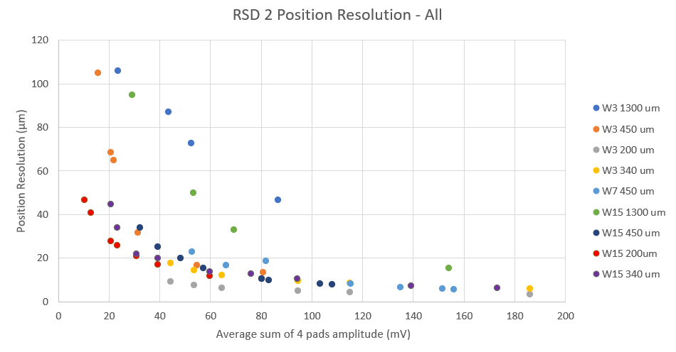
Space Reconstruction Results
Different wafers can be studied with a fixed geometry
Luca Menzio – INFN Torino
1st March 2023
18th TREDI Workshop

Slide 31
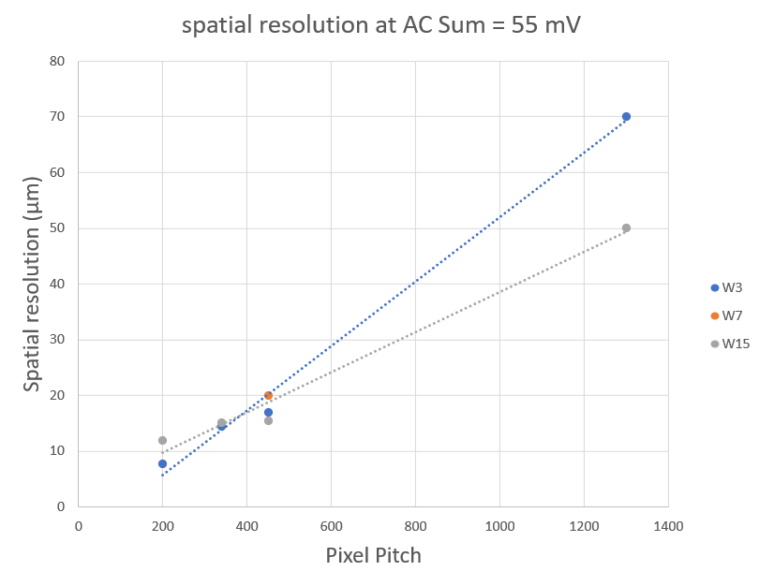
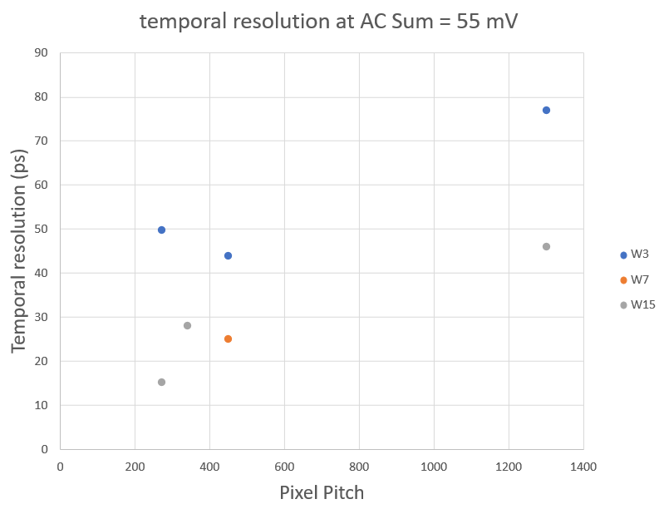
Performances at a fixed amplitudes sum
Luca Menzio – INFN Torino
1st March 2023
18th TREDI Workshop

