Slide 1
SpacePix3
SOI MAPS detector for space radiation monitoring
P. Vančura, J. Gečnuk, Z. Janoška, J. Jirsa, V. Kafka, A. Kostina, D. Lednický, M. Marčišovská, M. Marčišovský, L. Tomášek, P. Staněk, P. Švihra

Slide 2
Motivation
Monitoring space radiation is important for:
  on-earth and space technological infrastructure (especially electronic systems)
  human health protection
  space radiation research
Detector has to be able to measure:
  flux variations
  linear energy transfer (LET), pattern recognition, particle identification
Other important detector parameters for space:
  large dynamic range
  low power consumption

Slide 3
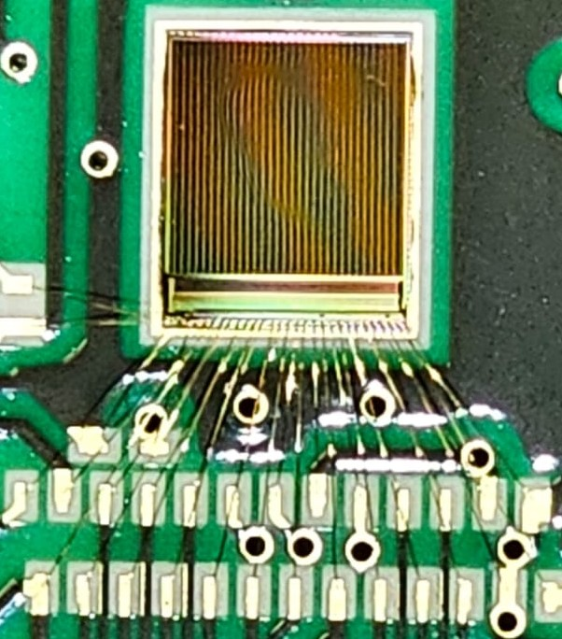
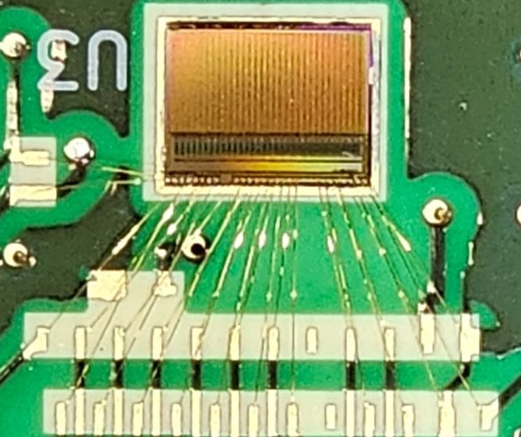
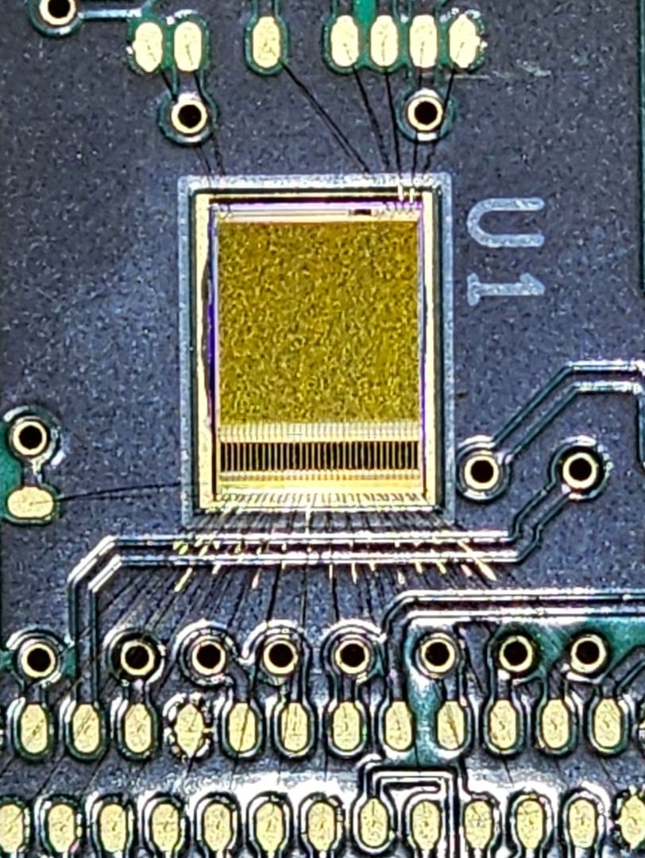
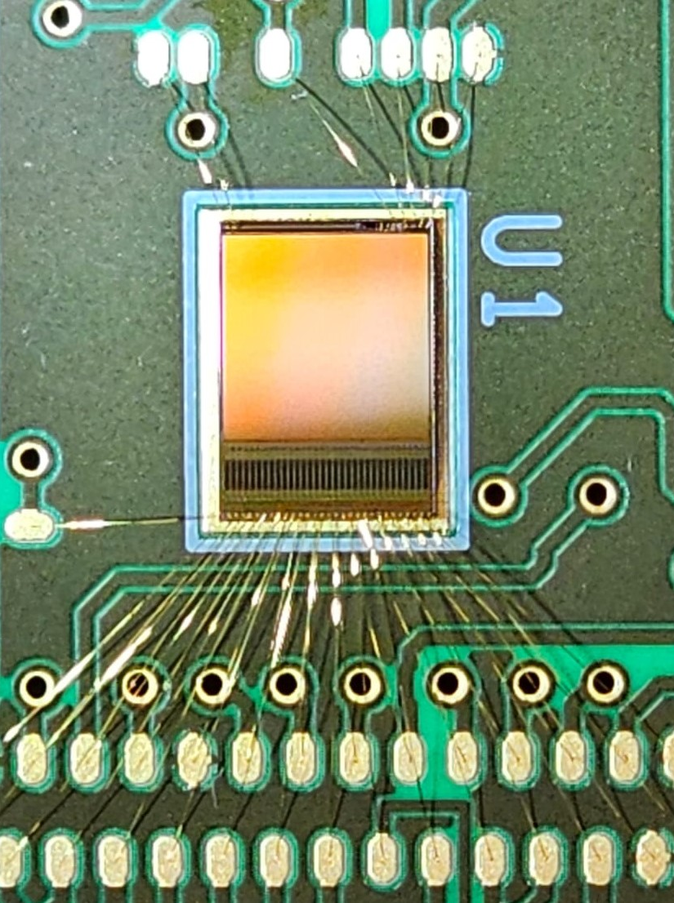
Development history of SpacePix detectors
XCHIP-03
SpacePix1
SpacePix2
SpacePix3
2018
2020
2022
2023
180 nm SOI CMOS process
1 - 10 ke⁻ signal range
10-bit single-ended
column-parallel SAR
ADCs
Soft X-ray imaging
The first SpacePix test chip
Extended dynamic range 1 ke⁻ - 65 ke⁻
8 – bit asynchronous column-parallel SAR ADCs with differential architecture
Digitization signal from backside channel extending signal range up to 30 Me⁻
10 – bit asynchronous column-parallel SAR ADCs with differential architecture
Improved version of SpacePix2
SAR ADC bugfix
New feature: used defined data sampling at falling or rising edge

Slide 4
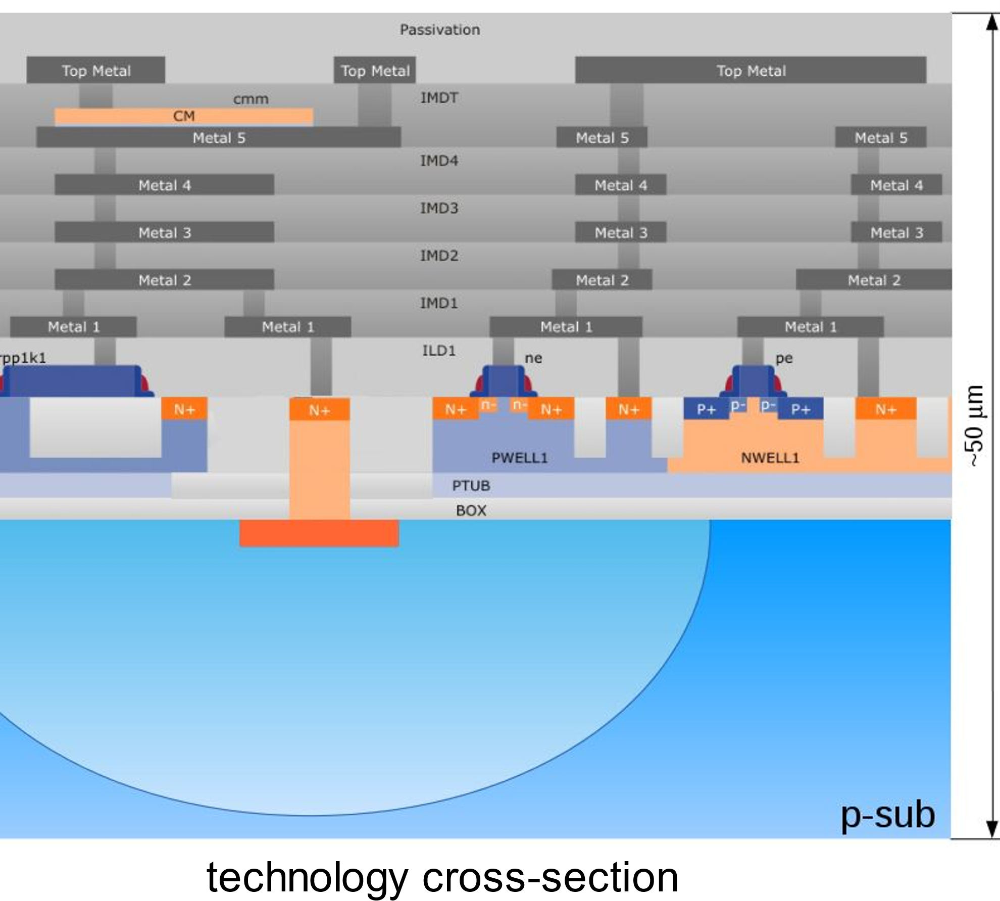
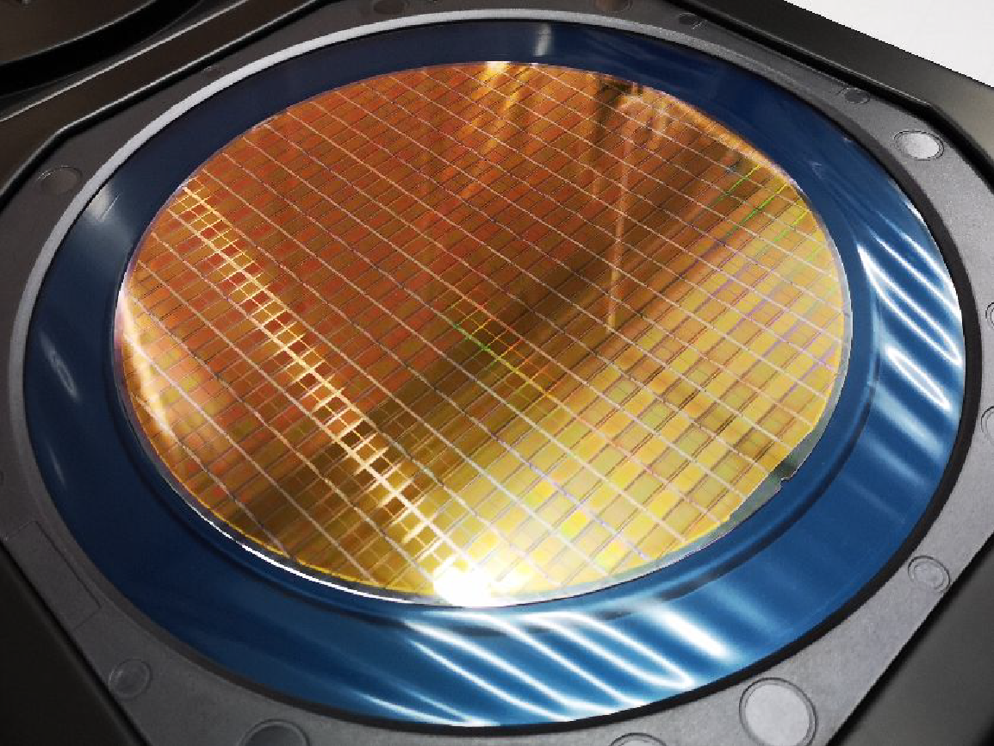
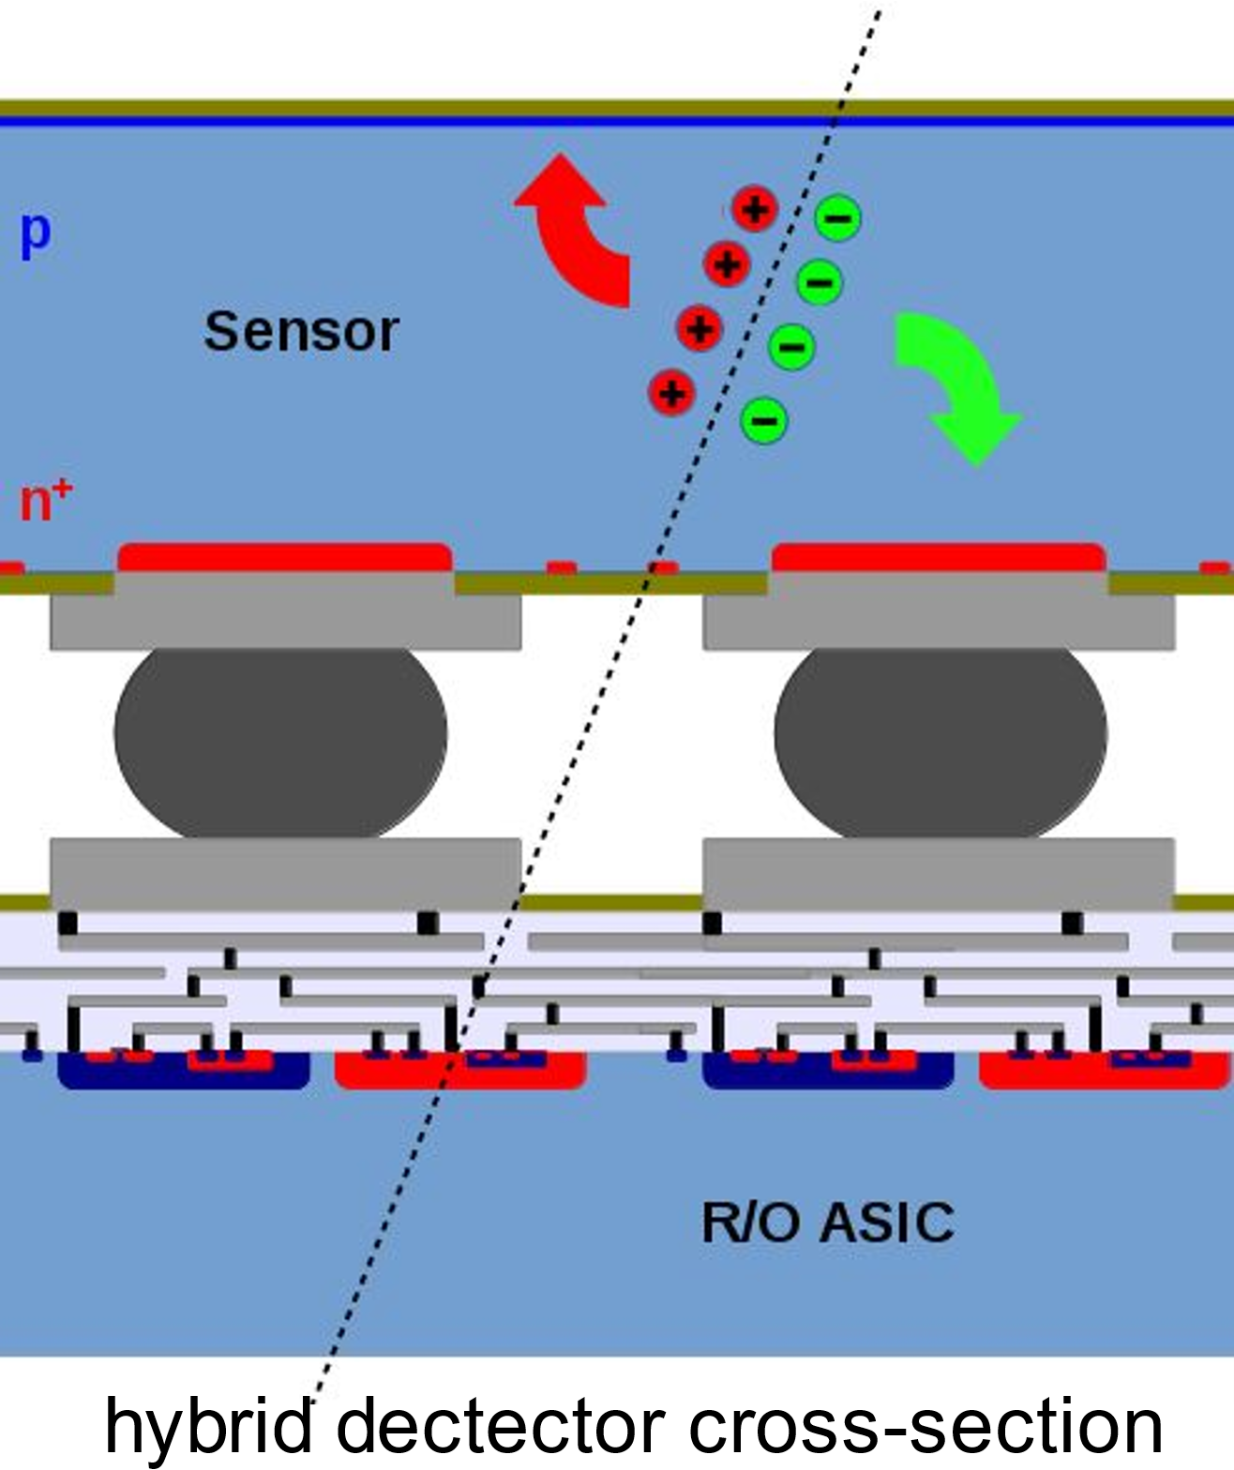
SOI 180 nm technology
Sensor part and readout electronics are integrated on the common substrate.
Particles are detected in handle wafer.
Depletion region is approximately 37 µm at bias voltage -150 V.
Bit flip cross-section was found to be low compared to a bulk CMOS, TID threshold is 1.6 kGy [1] for dose rate 16.2 Gy/min.
Handle wafer thickness is 300 µm. We have done 50 µm thinning on single wafer, untested so far.
Hybrid detectors have sensor part and readout electronics separated
Absence of sensor off-chip contact makes SOI process more reliable in space.
180 nm SOI wafer
[1] MARCISOVSKA, M., et al. TID and SEU testing of the novel X-CHIP-03 monolithic pixel detector.
Journal of Instrumentation, 2020.

Slide 5
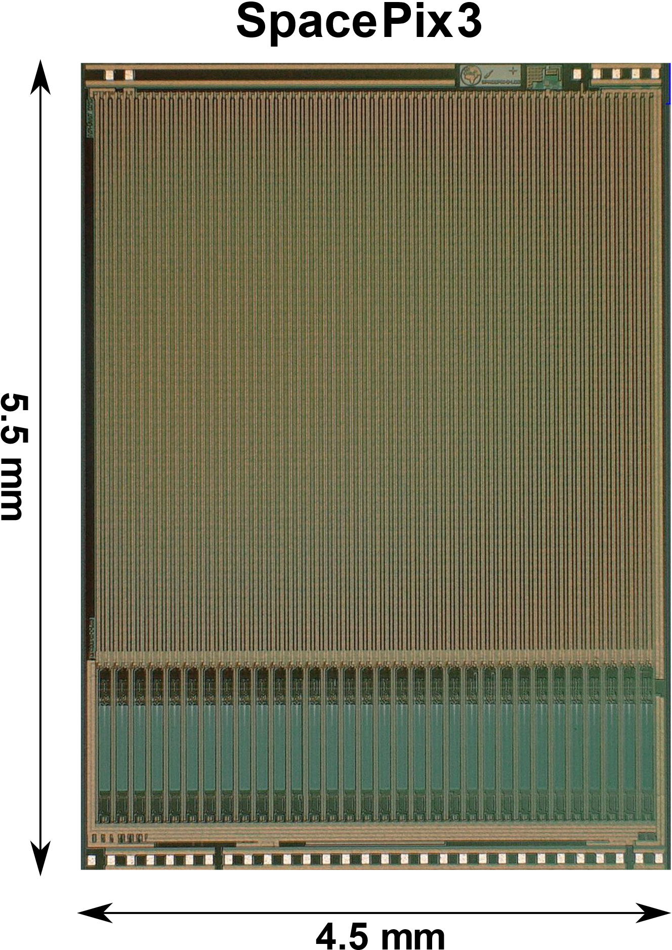
SpacePix3 – parameters
SOI MAPS detector for monitoring space radiation
180 nm process
64 x 64 pixels
with pixel pitch 60 µm
chip size 4.5 x 5.5 mm²
10-bit fully differential asynchronous column-parallel SAR ADCs
signal range: 1 ke⁻ – 65 ke⁻
backside channel digitization extending signal range up to 30 Me⁻
SPI (50 MHz) a LVDS (400 MHz) readout modes
current consumption: 43 mA
radiation hardened by design:
  asynchronous SAR ADC controller
  triplicated logic in configuration registers and row selector
special functions:
  integrated thermometer
  testing structures
  chip select pin

Slide 6
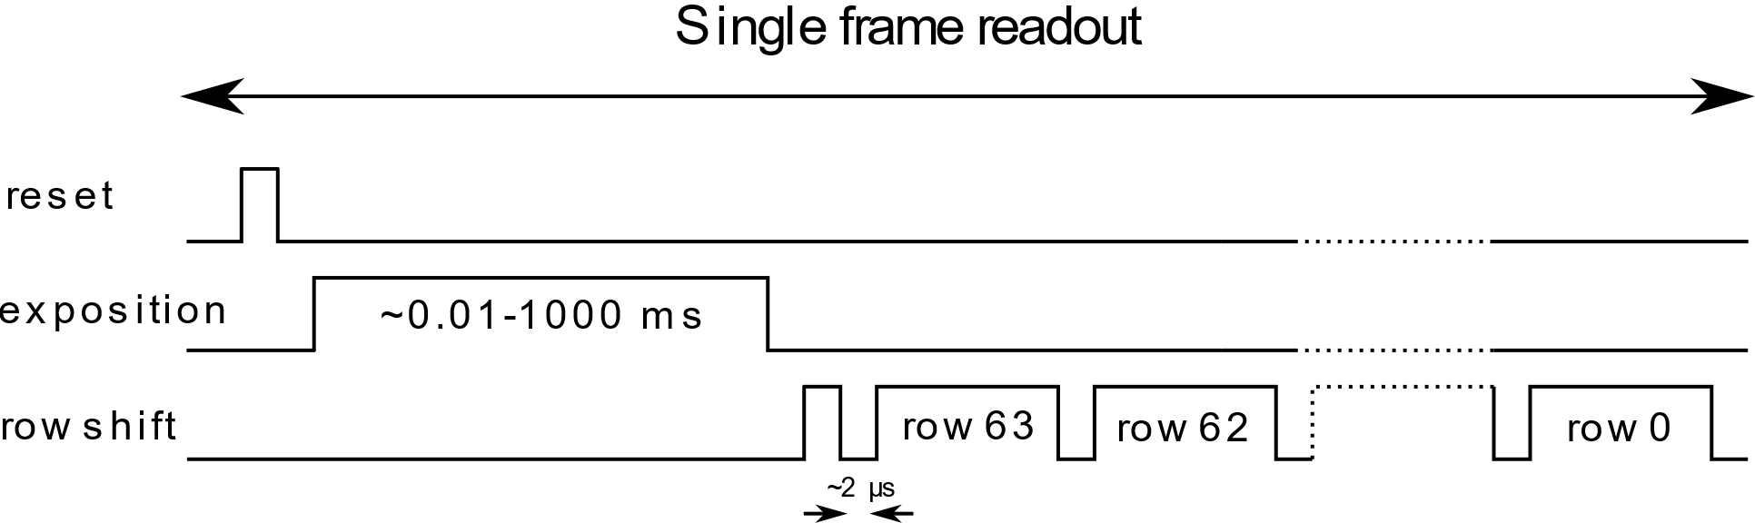
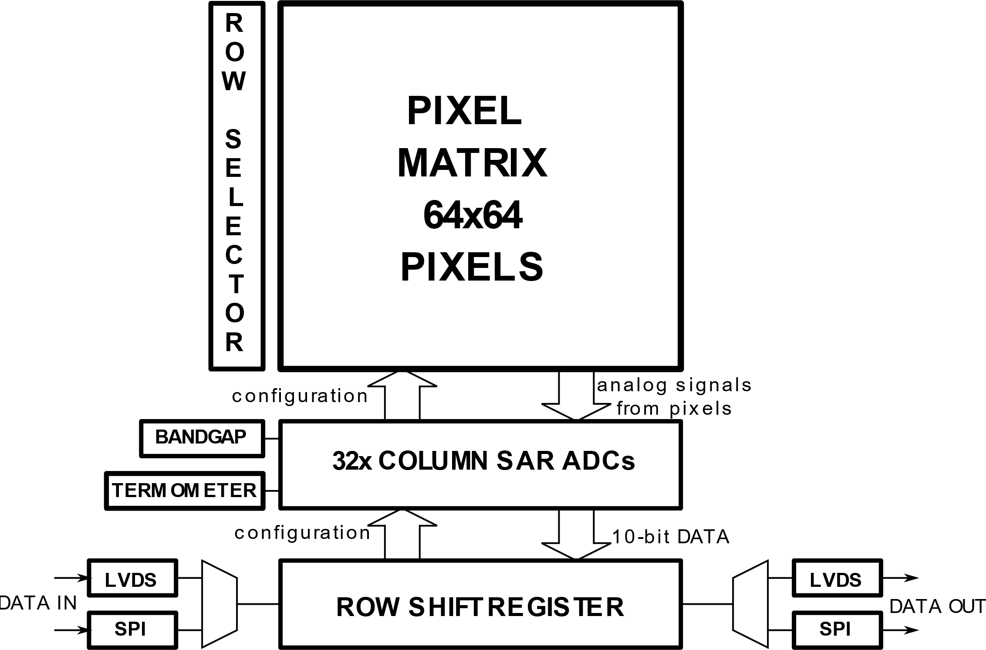
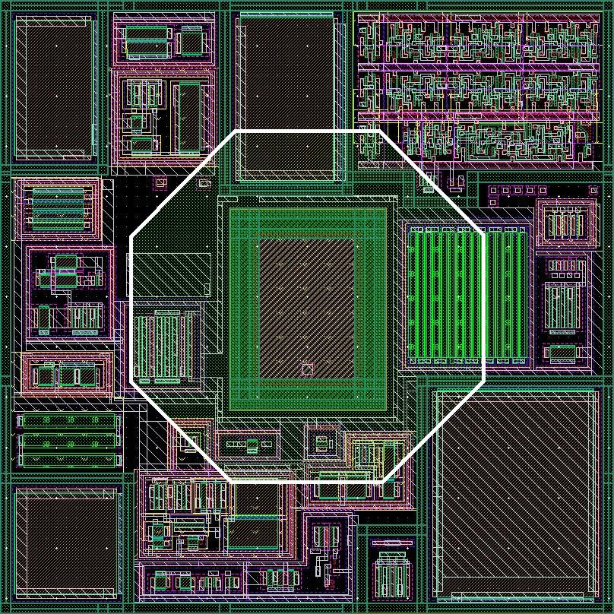
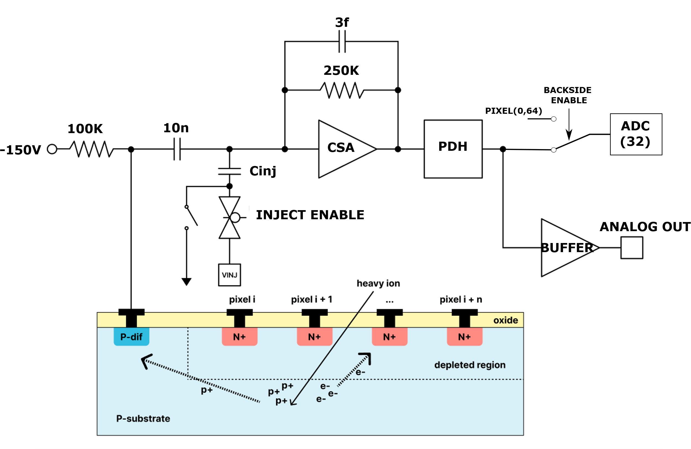
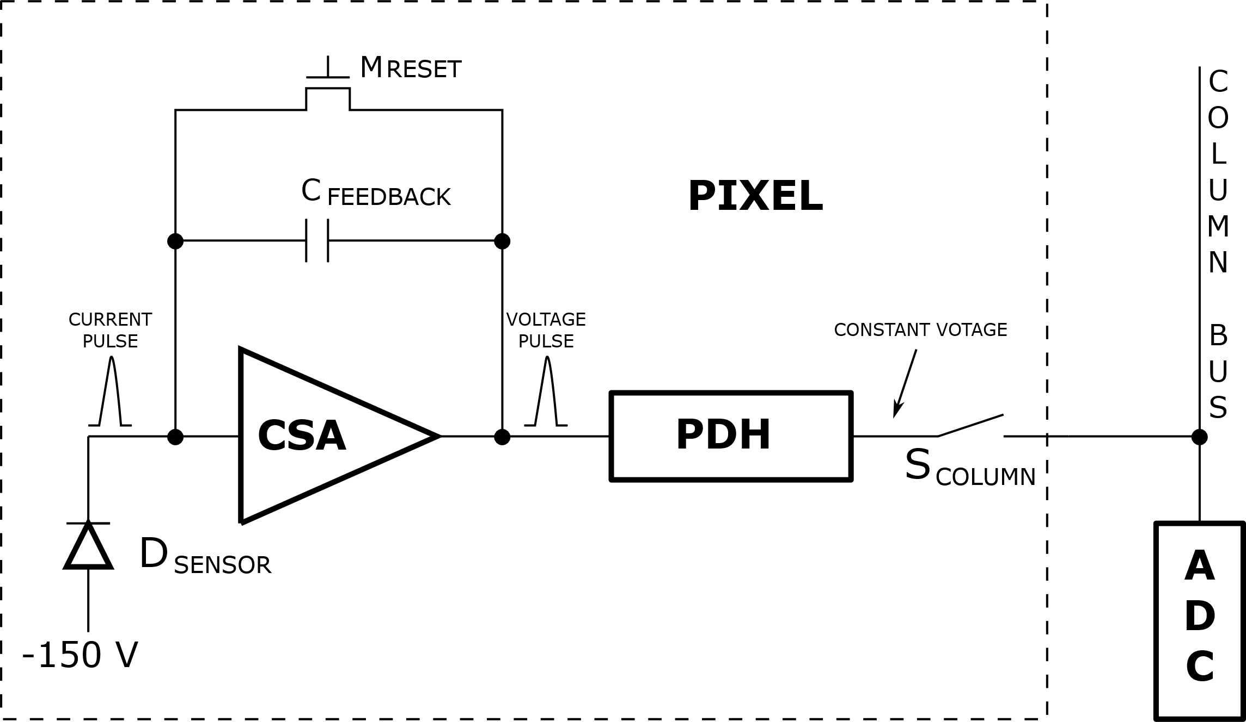
SpacePix3 - architecture
Frame based readout
Exposition time 0.01-1000 ms
Max. 5000 frames/s
Max. flux 10⁵-10⁶ particles/cm².s
Block diagram
Pixel layout
CSA gain: 9.5 µV/e⁻
Noise: 110 e⁻
C_{FEEDBACK}: 9.1 fF
Range: 1 ke⁻ - 65 ke⁻
Functional diagram of SpacePix3 backside channel
Block diagram of SpacePix3 pixel

Slide 7
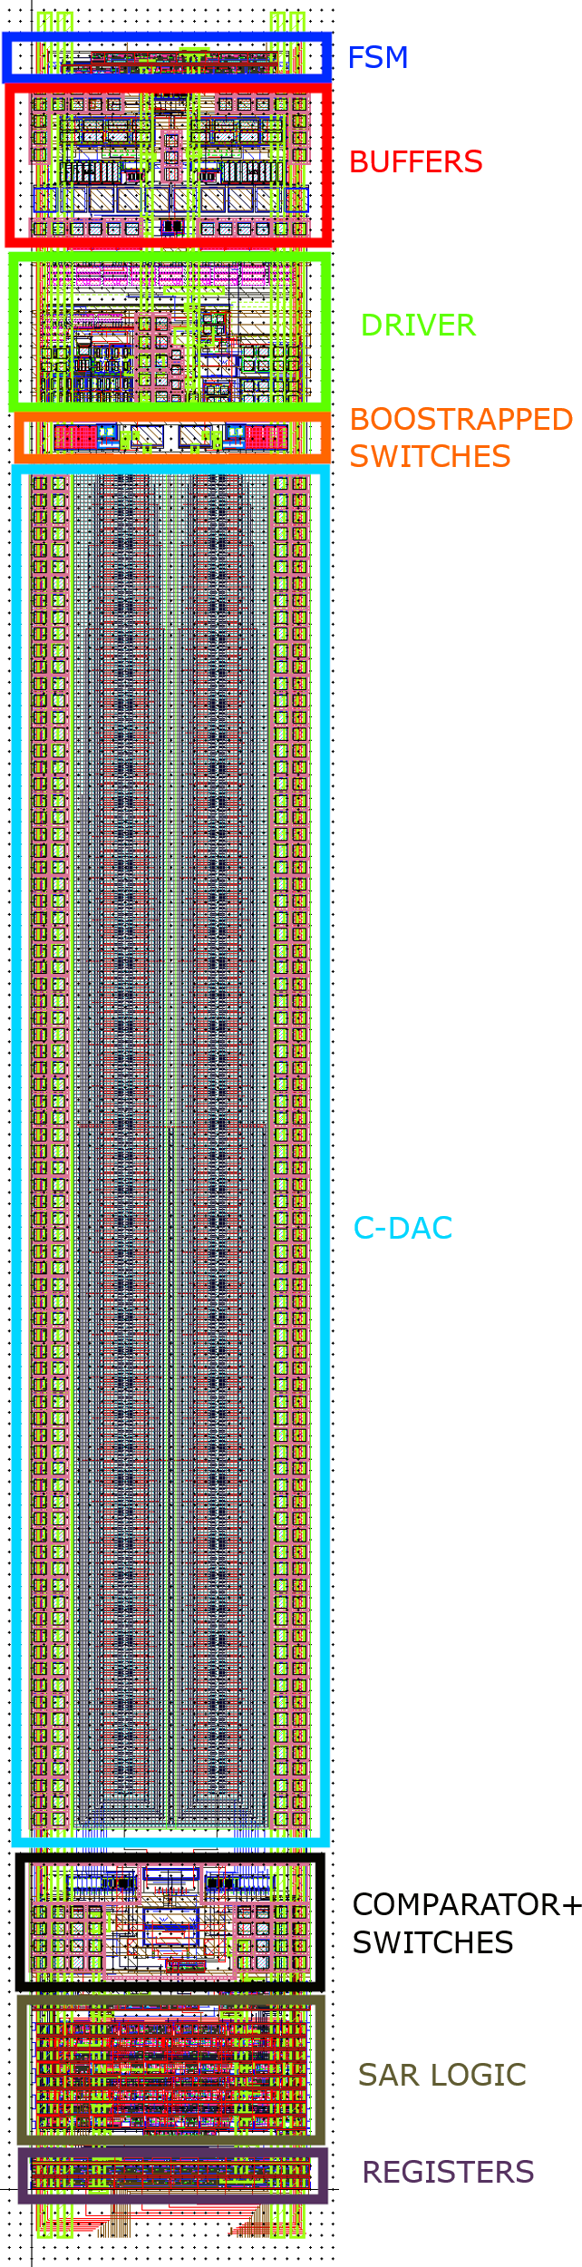
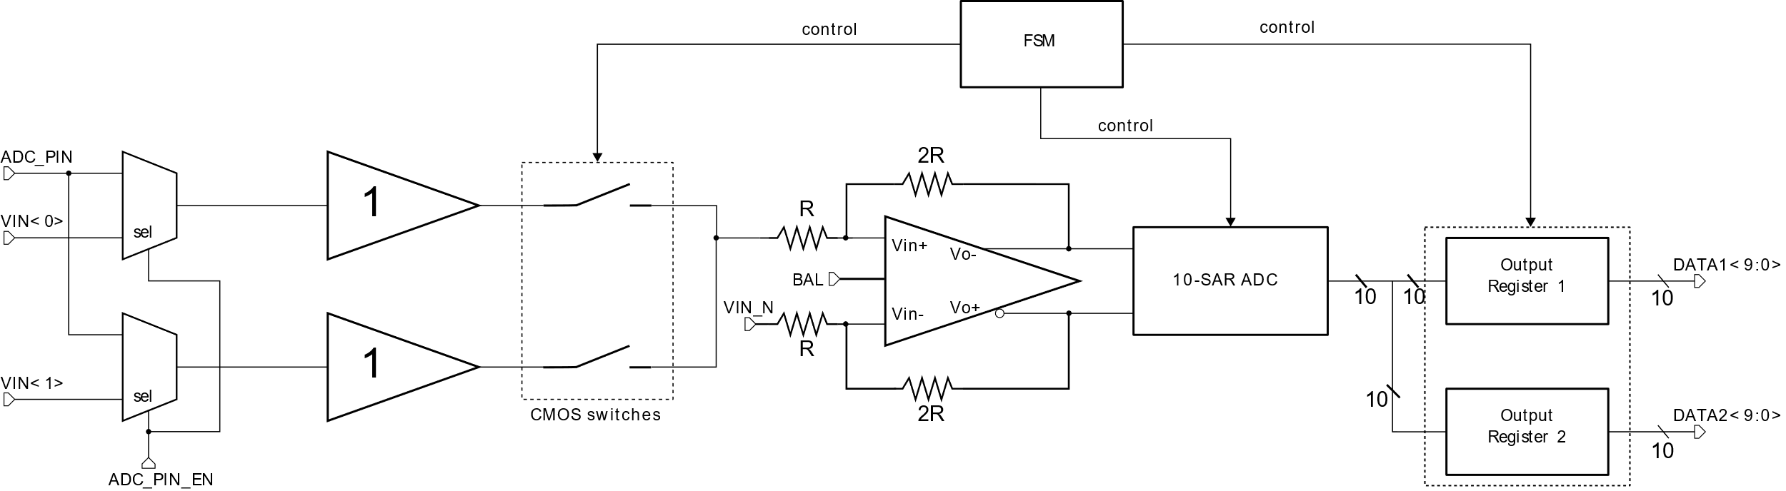
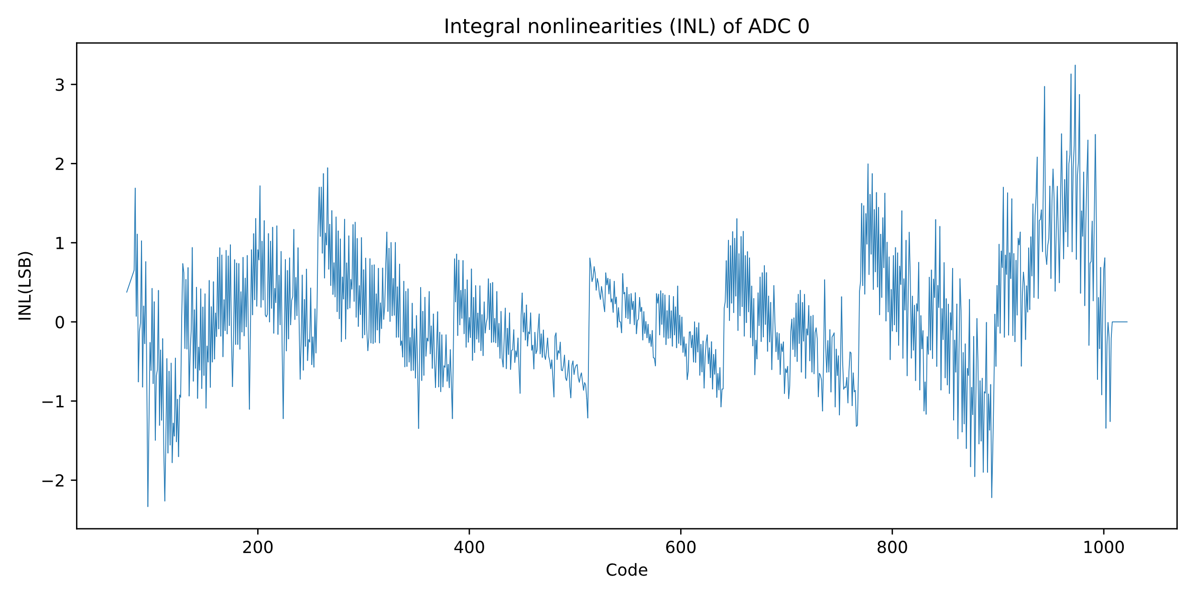
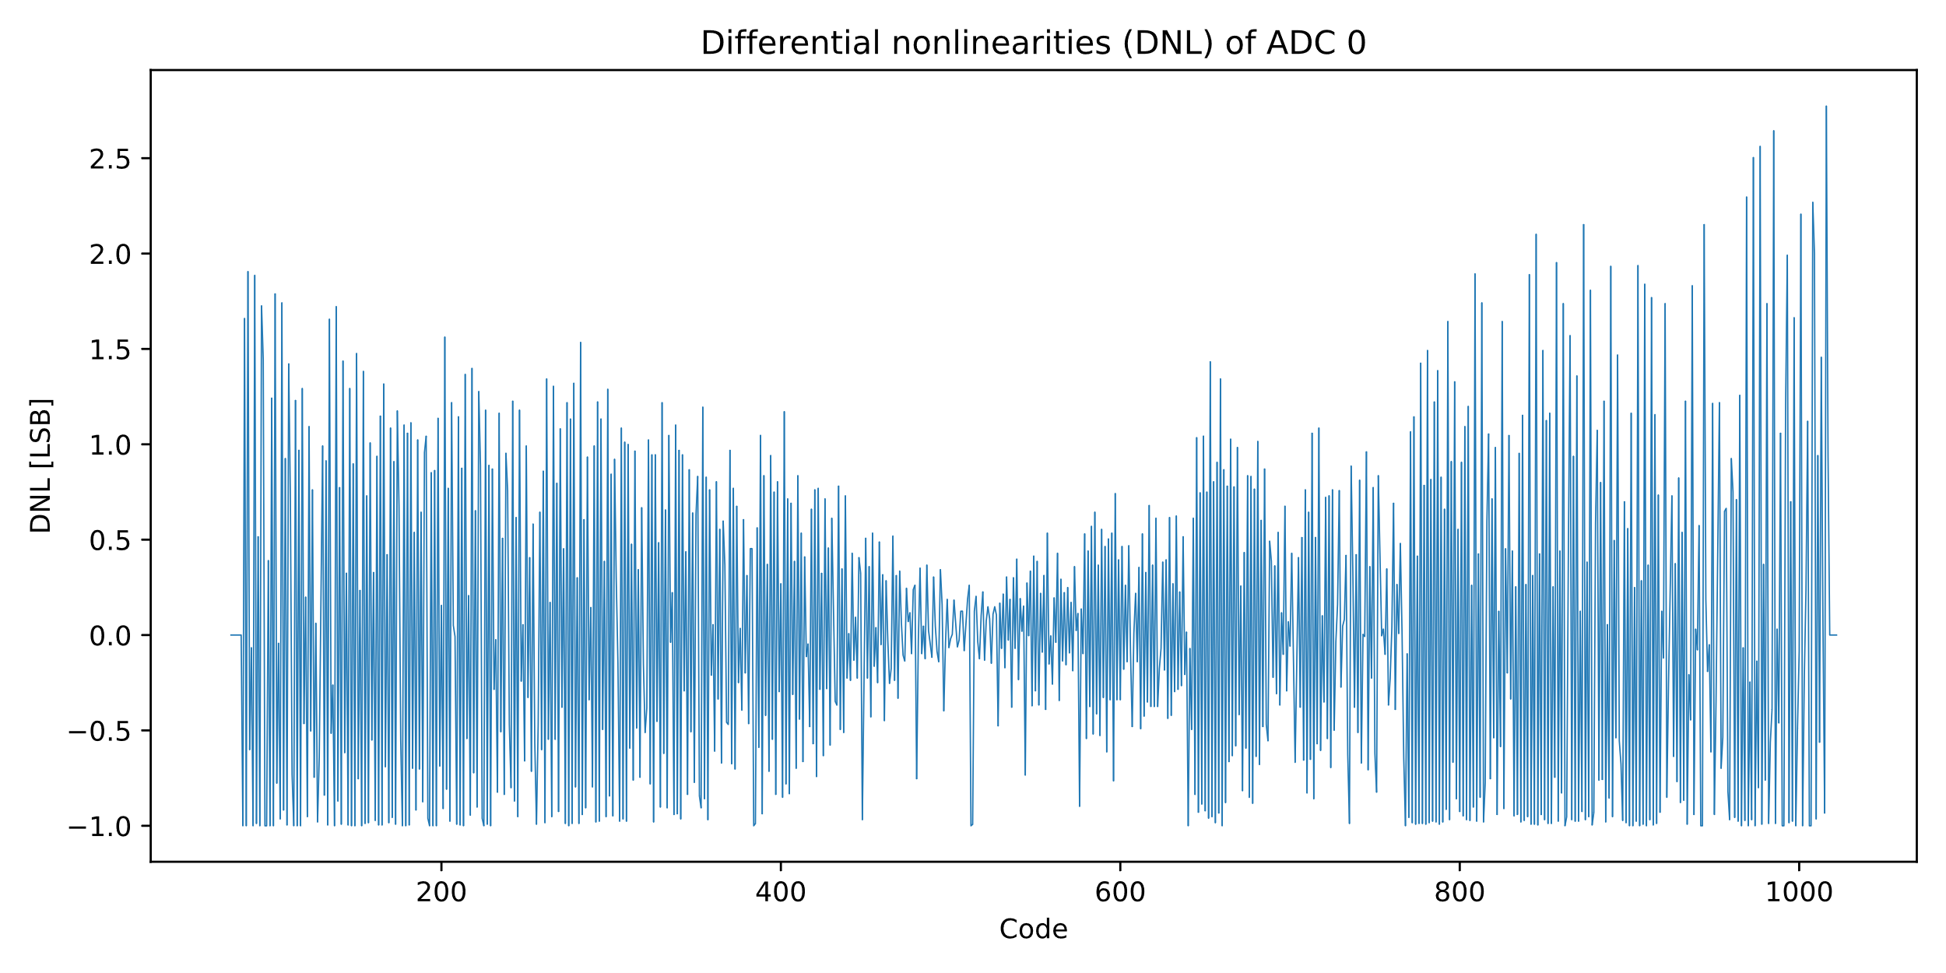
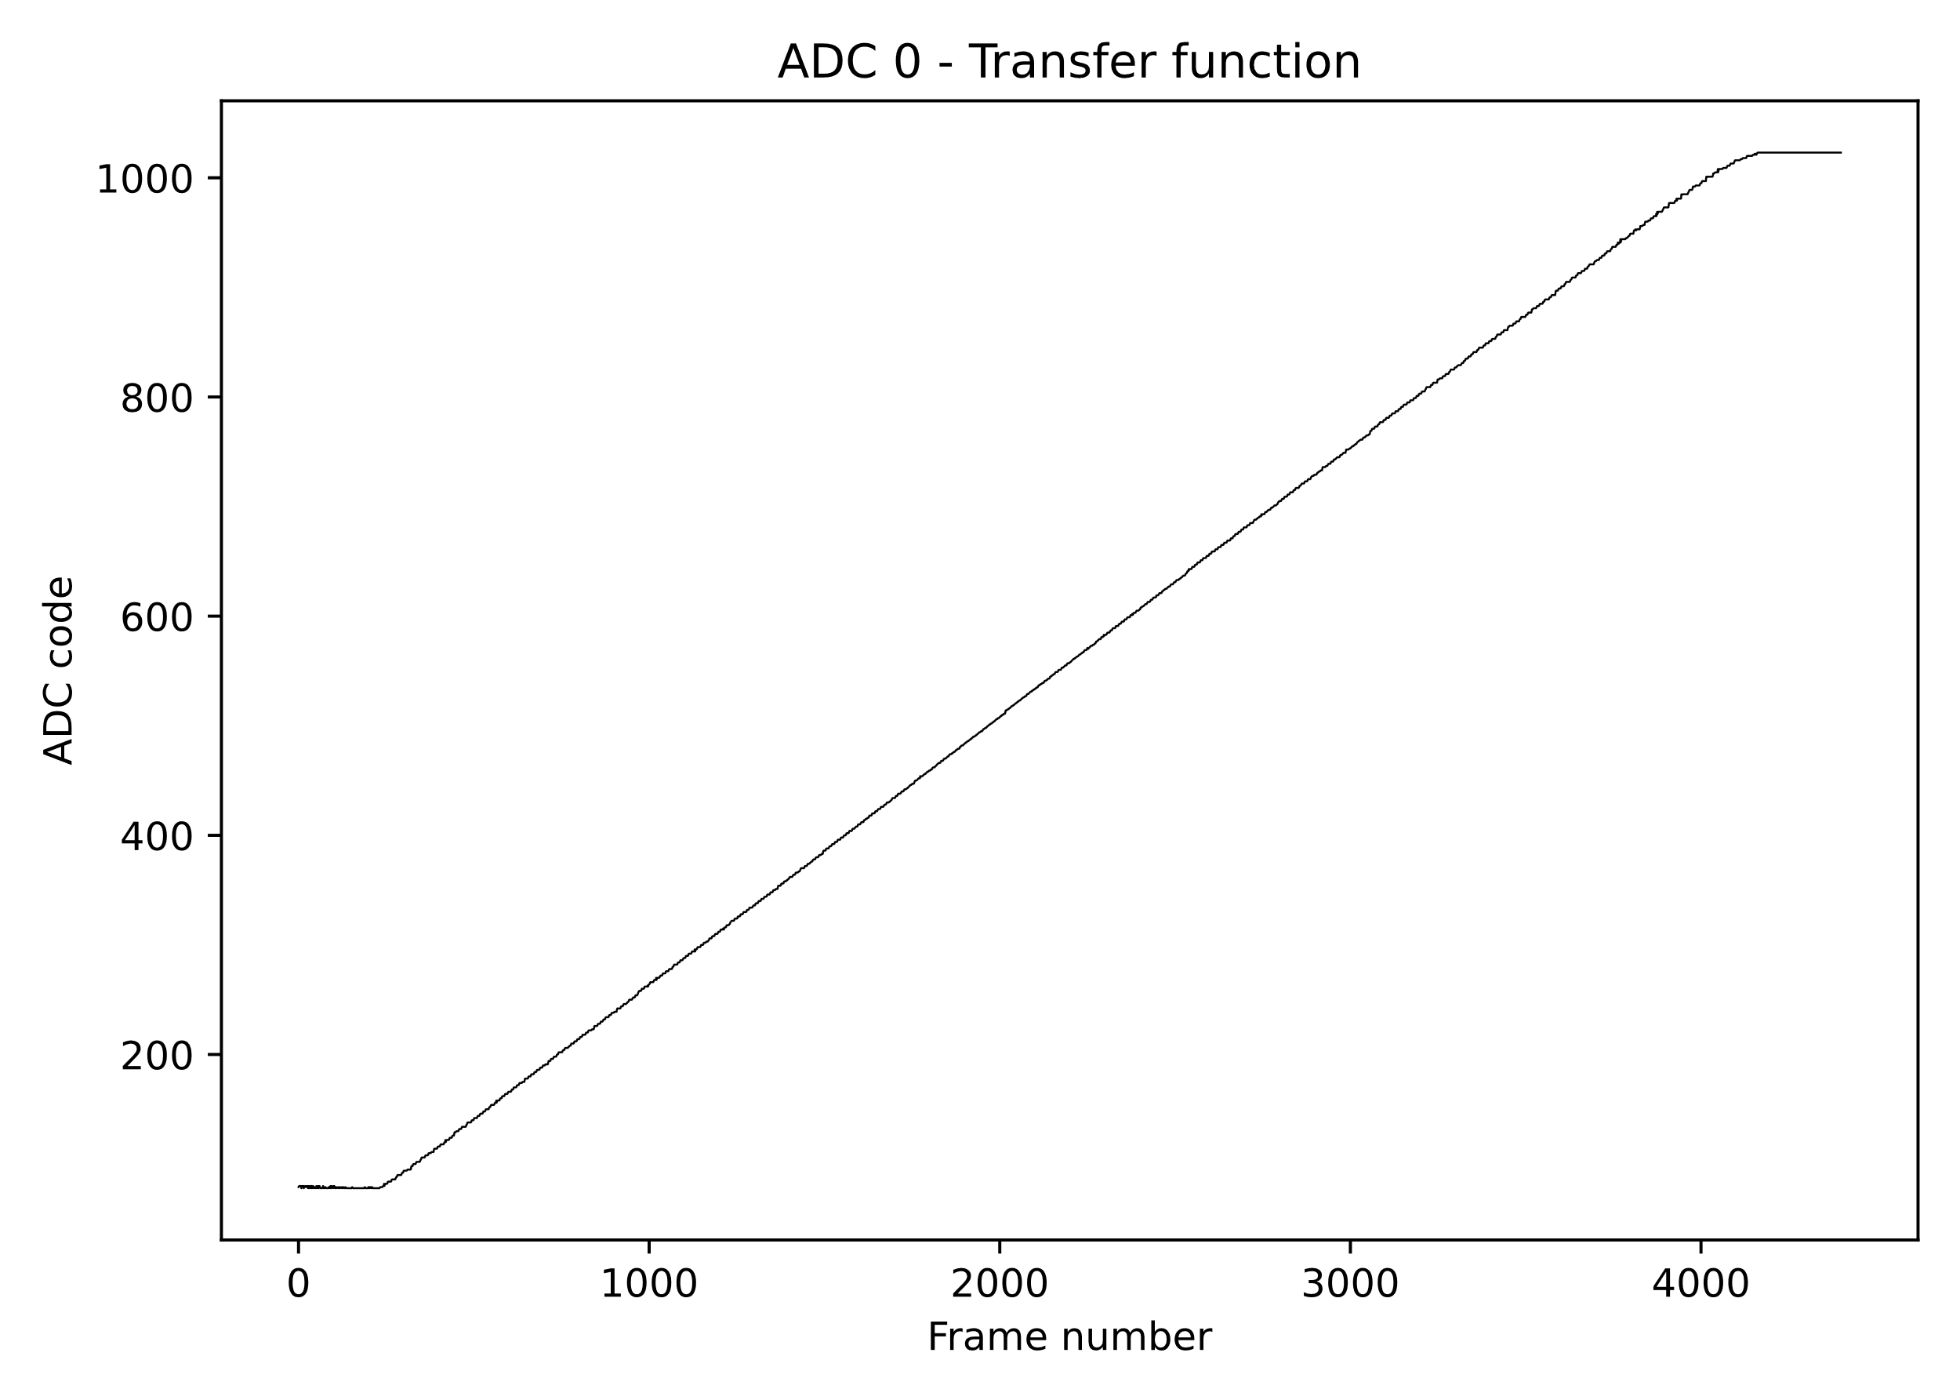
SpacePix3 – column SAR ADC
SpacePix3 column SAR ADC - Block diagram
Measured typical INL
Measured typical DNL
parameter | SpacePix2 | Spacepix3
DNL (LSB) | 5 | 2
INL (LSB) | 6 | 3
ENOB | 7.13 | 8.8
Speed (MS/s) | 4
Number of bits | 10
Area (µm²) | 120 x 923
Architecture | differential
Comparison table between SpacePix2 and SpacePix3 ADCs
Measured typical transfer function
Layout design
[ 2] VANČURA, P., et al. A low power asynchronous column-parallel 10-bit analog to digital converter with a high input impedance. Journal of Instrumentation, 2022, 17.05: T05016.

Slide 8
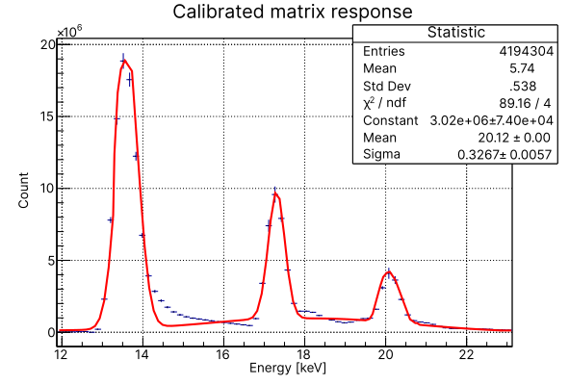
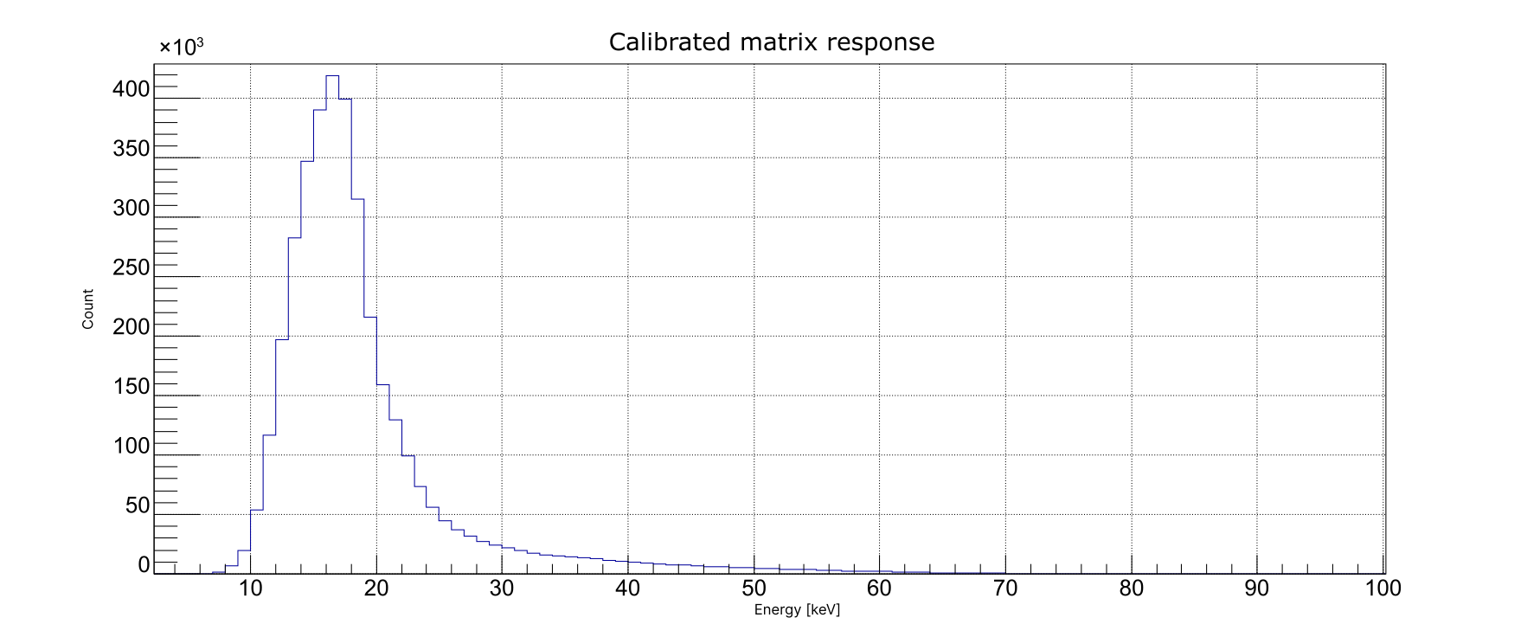
Spectrum measurement examples
Pu-238 measured with SpacePix3
L𝛂 - 13.6 keV
L𝛃 - 17.06 keV
L𝛄 - 20.3 keV
Sr-90 measured with SpacePix3

Slide 9

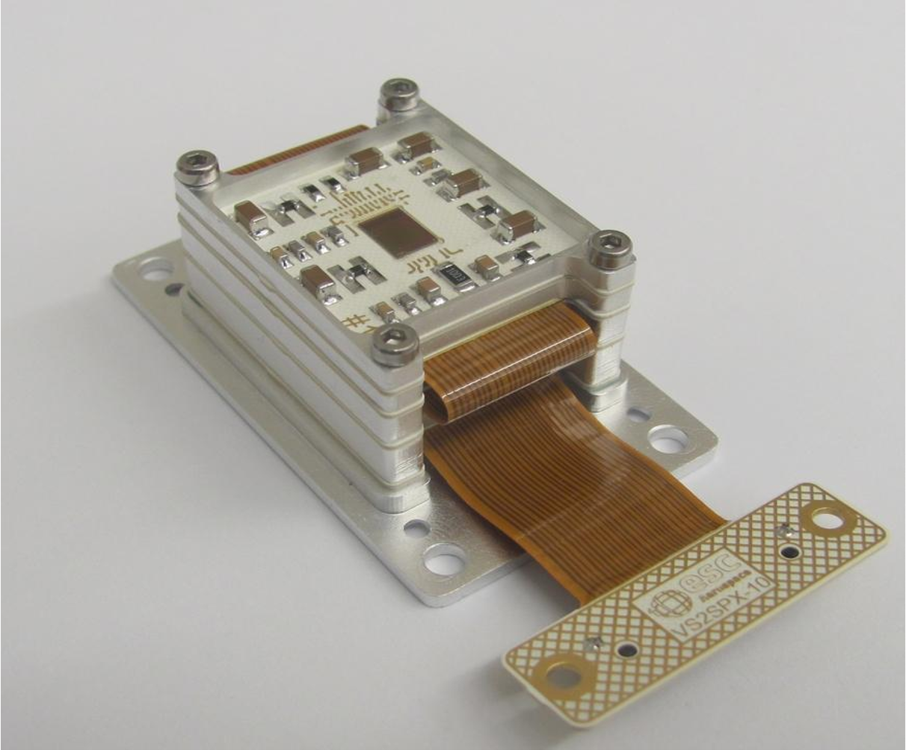
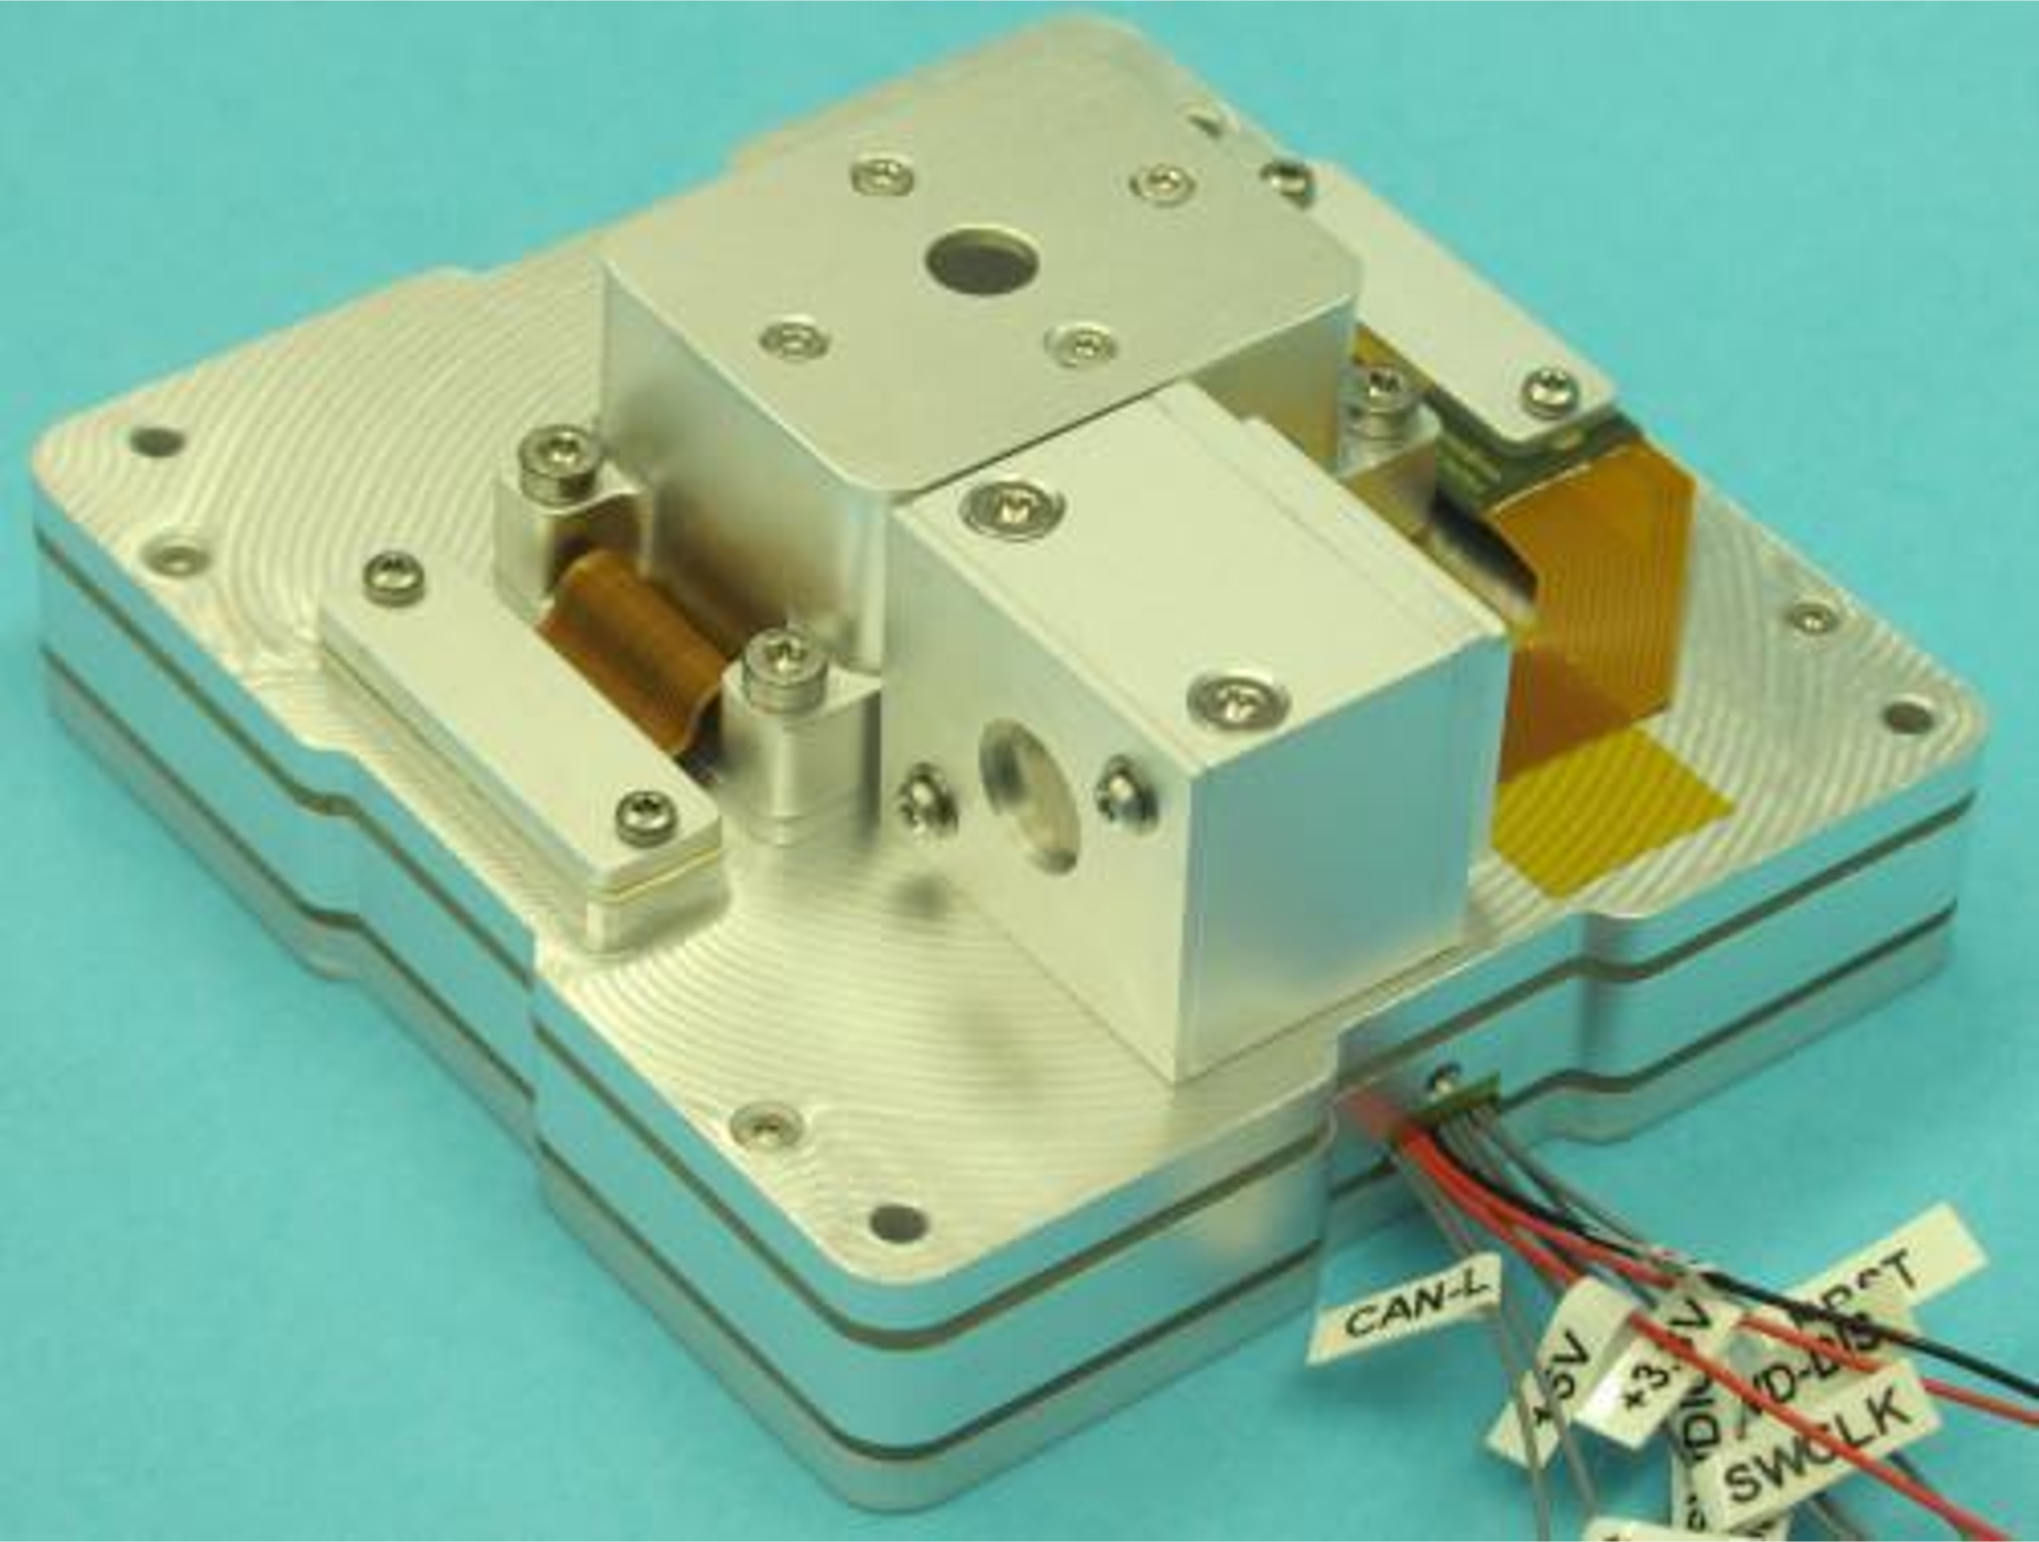
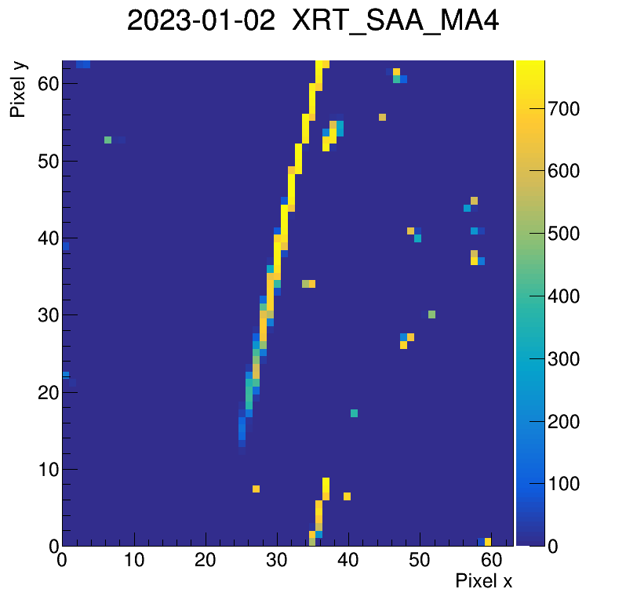
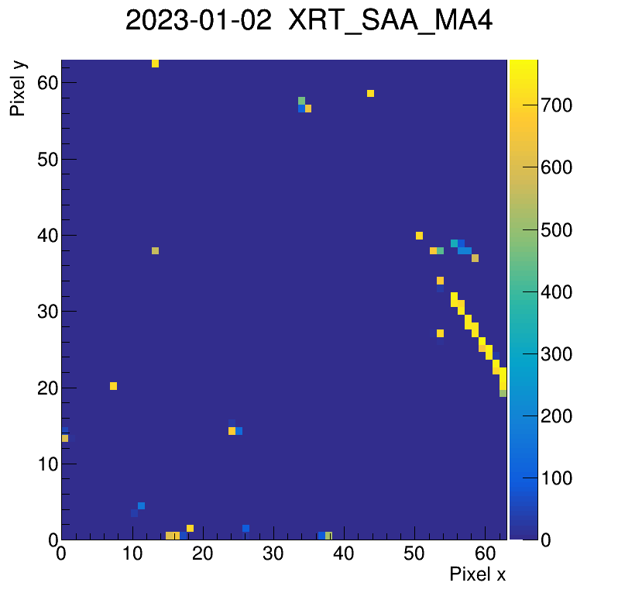
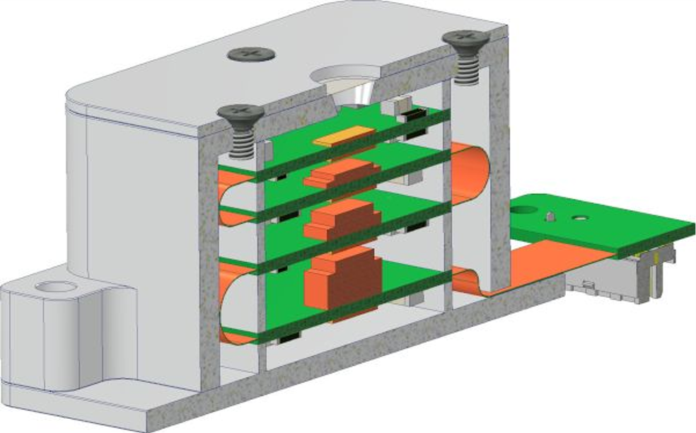
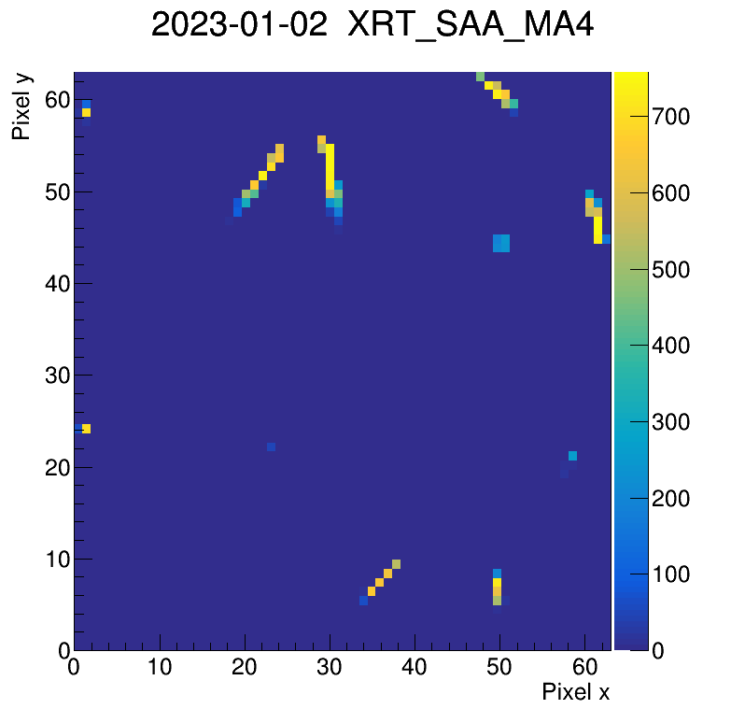
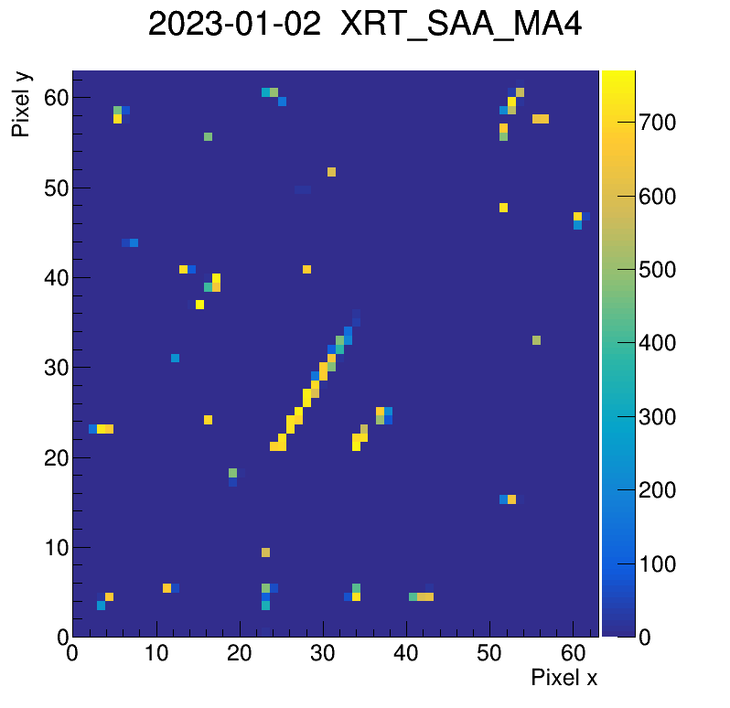
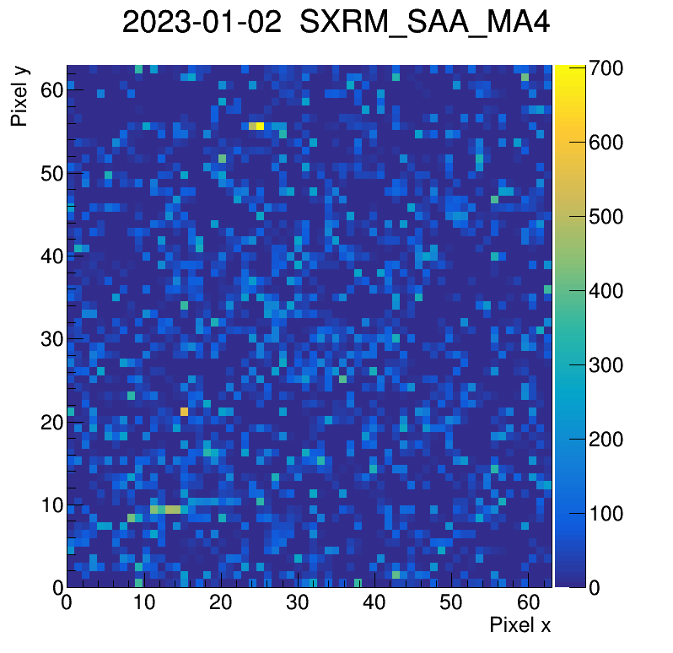
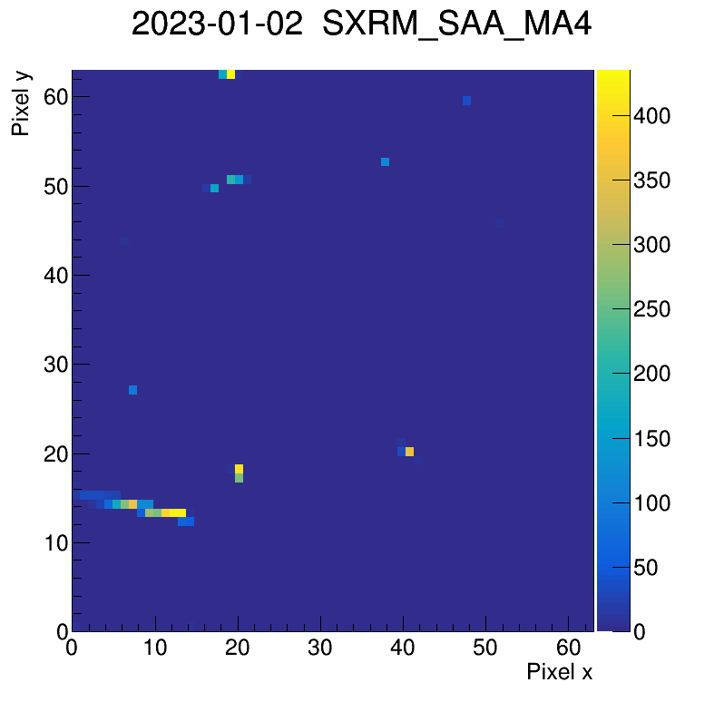
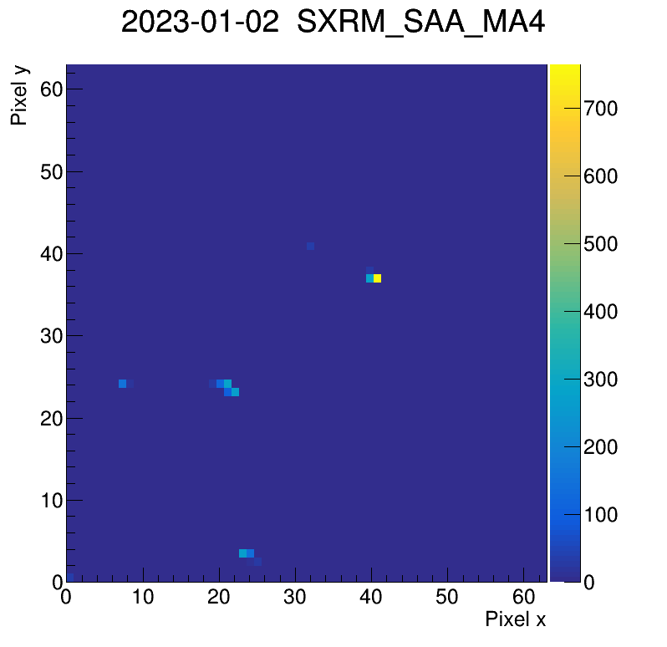

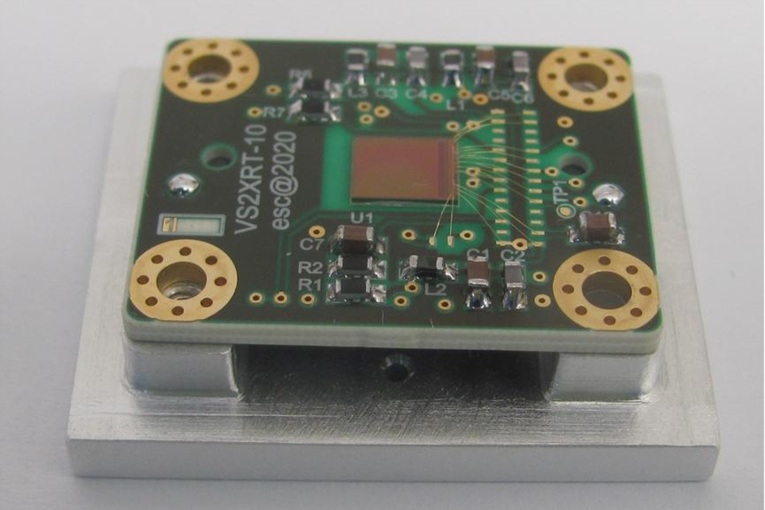




SpacePix2 on VZLUSAT-2 cubesat
Spacepix Radiation Monitor (SXRM)
2SDTM space dosimetry demostrator
flythrough SAA 02/23 (XRT)
flythrough SAA 02/23 (SXRM), layers L0, L2, L3, L4
X-CHIP-03 (XRT) PCB

Slide 10
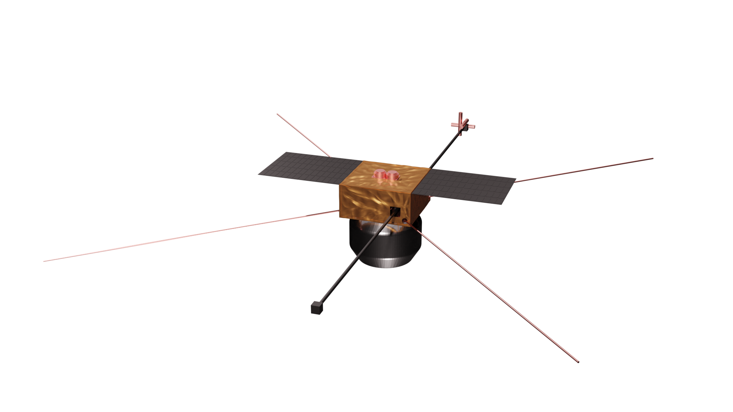

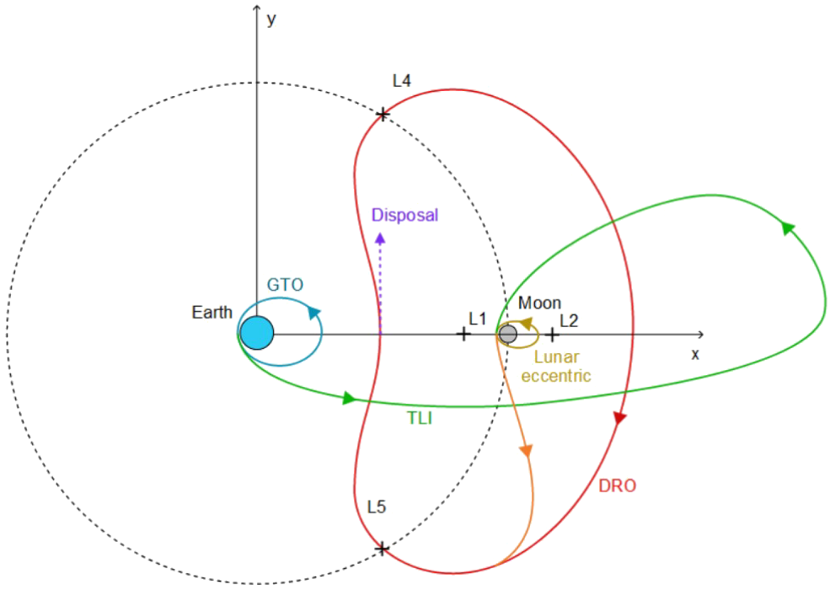
LVICE² – Lunar Vicinity Complex Environmental Explorer
Dimensions: 55×55×60 cm³ in compact state
Weight: ≅ 50 kg dry, 100 kg wet
1500 m/s 𝚫v
Launch in 2027
Mission brief
Launch to GTO
TLI and lunar ballistic capture
1 year on LEEO to study Lunar wake
Transfer to DRO
2 year study of Kordylewski clouds
Disposal to heliocentric orbit
Search coil magnetometer
Four electric antennas
Faraday cup analyser
Two deployable solar panels
Monopropellant Fuel Tank
Two deployable booms
Fluxgate magnetometer
Thrusters – main and altitude
Solar wind study
Faraday Cup Analyzer - measurement of solar wind ion flux
Fluxgate magnetometer - precise vector measurement of the solar wind magnetic field
Search coil magnetometer - study of plasma turbulence at low frequencies
Electric antennae - study of plasma turbulence at high frequencies
AMR magnetometer - a secondary instrument for Fluxgate magnetometer calibration and measurement of CME events
Study of interplanetary dust
Foil dust detector (FDD) - study of micrometeoroid and dust fluxes in the Kordylewski clouds, based on several layers of PVDF piezoelectric foils
Piezoelectric dust detector (PDD) - a vibration detector on the spacecraft body to study impact of larger particles
Study of ionising radiation
PARDAL² - composed of two parts: RADIVA (inorganic and plastic scintillators for photon and neutron measurements) and the SXRM (SpacepiX Radiation Monitor, measuring properties of electrons, protons and heavy ions) based on developed Spacepix3 ASICs
SPACEDOS - a silicon LET spectrometer measuring energetic deposition of particles and their biological effects

Slide 11
Conclusions
SpacePix3 is new MAPS detector for space radiation monitoring designed in 180 nm SOI process.
Benefits of SpacePix3 detector are:
  low power consumption
  large signal range, 1-65 ke- pixel, up to 30 Me- backside.
SpacePix2 is active detection element of Spacepix Radiation Monitor currently on orbit on VZLUSAT-2 cube-satellite.
Next mission: The LVICE² scientific satellite, manufactured entirely in the Czech Republic, will study the space environment around the Moon and at Lagrange's L4 point, from 2027.
SpacePix3 and X-CHIP-04 ASICs are available free of charge for non-commercial R&D purposes.

Slide 12



Slide 13
References
[1] MARCISOVSKA, M., et al. TID and SEU testing of the novel X-CHIP-03 monolithic pixel detector. Journal of Instrumentation, 2020, 15.01: C01043.
[2] VANČURA, P., et al. A low power asynchronous column-parallel 10-bit analog to digital converter with a high input impedance. Journal of Instrumentation, 2022, 17.05: T05016.
[3] VANČURA, P., et al. SpacePix2: SOI MAPS detector for space radiation monitoring. Journal of Instrumentation, 2023, 18.01: C01002.

