Slide 1
Winner-Leader-Follower
a novel charge summing and hit allocation algorithm
J. Jirsa, J. Gečnuk, Z. Janoška, V. Kafka, A. Kostina, D. Lednický, M. Marčišovská, M. Marčišovský, L. Tomášek, P. Staněk, P. Švihra, P. Vančura

Slide 2
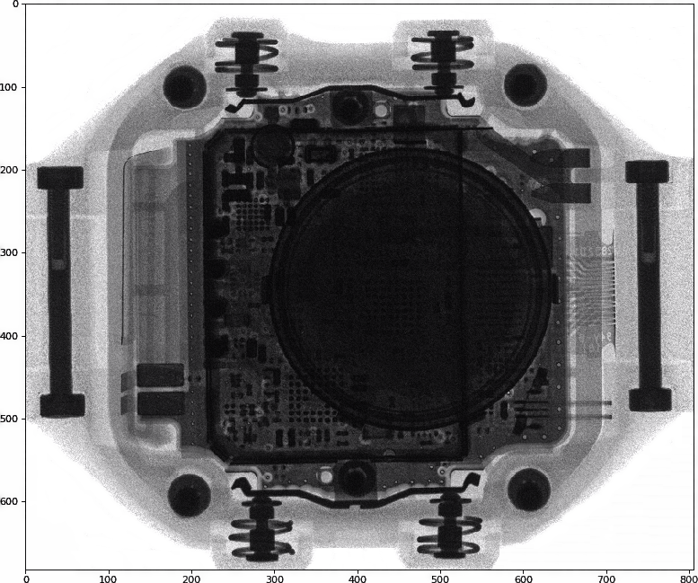
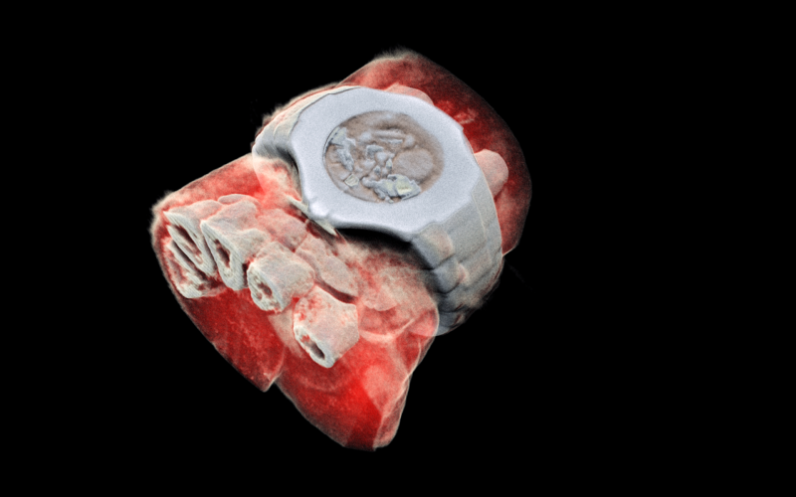
Motivation
X-ray color imaging
  Hybrid photon counting pixel detectors
  Energy binning
  High absorption efficiency (CdTe/CdZnTe)
  High spatial resolution of the detectors
X-CHIP – wristwatch X-ray image
M. Havranek et al., "X-CHIP-03: SOI MAPS radiation sensor
with hit-counting and ADC mode," 2018
MARS Bioimaging – wristwatch
www.marsbioimaging.com

Slide 3
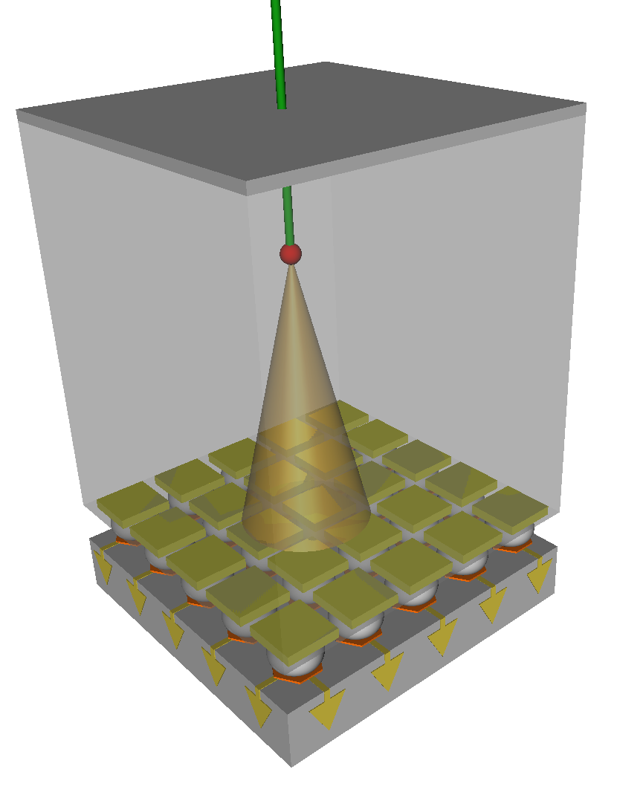
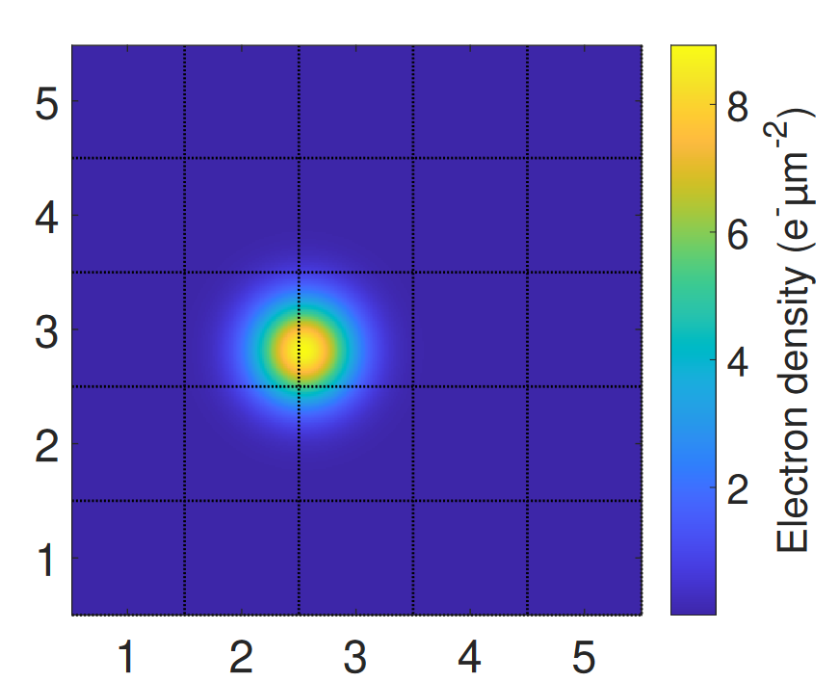
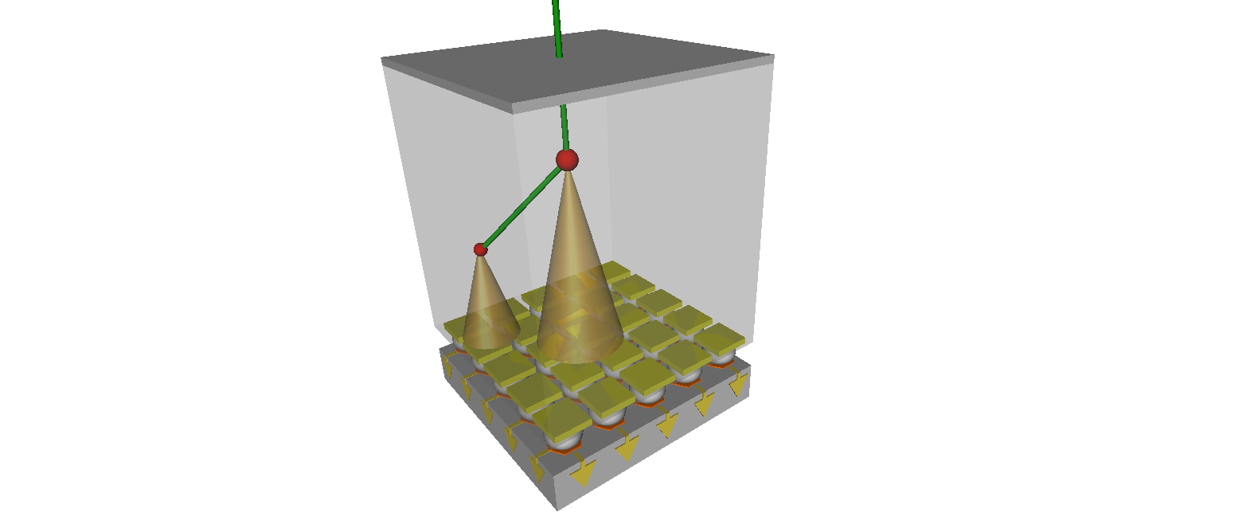
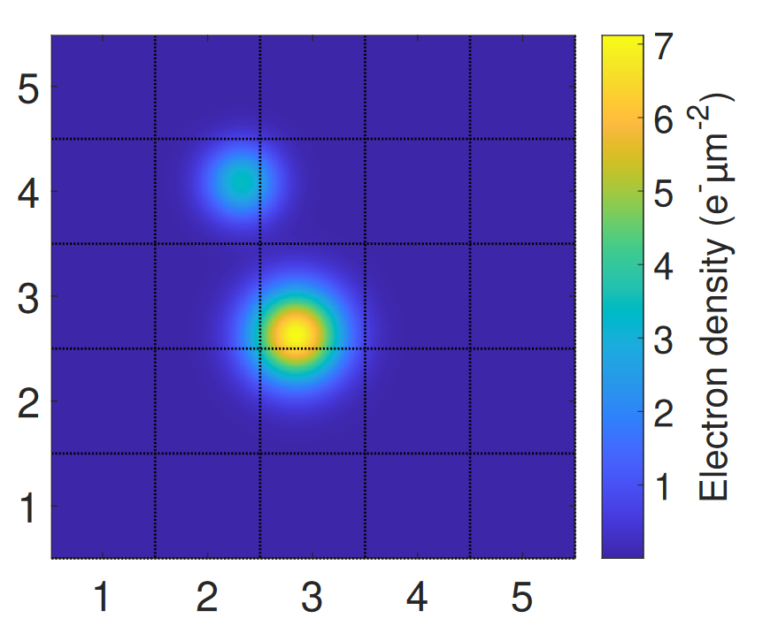
CdTe/CZT – charge sharing, fluorescent photons
Charge-sharing effect
  e-h cloud diffuse according to Fick law
  Electrostatic repulsion
CdTe/CdZnTe fluorescent photons
  Photons with energy higher then
  K-edge
  High fluorescent yield ~ 85%
  Te - K_{α} mean free path 64 µm
  Cd - K_{α} mean free path 128 µm

Slide 4
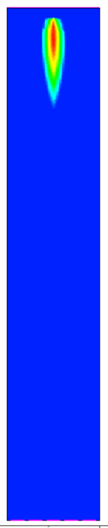
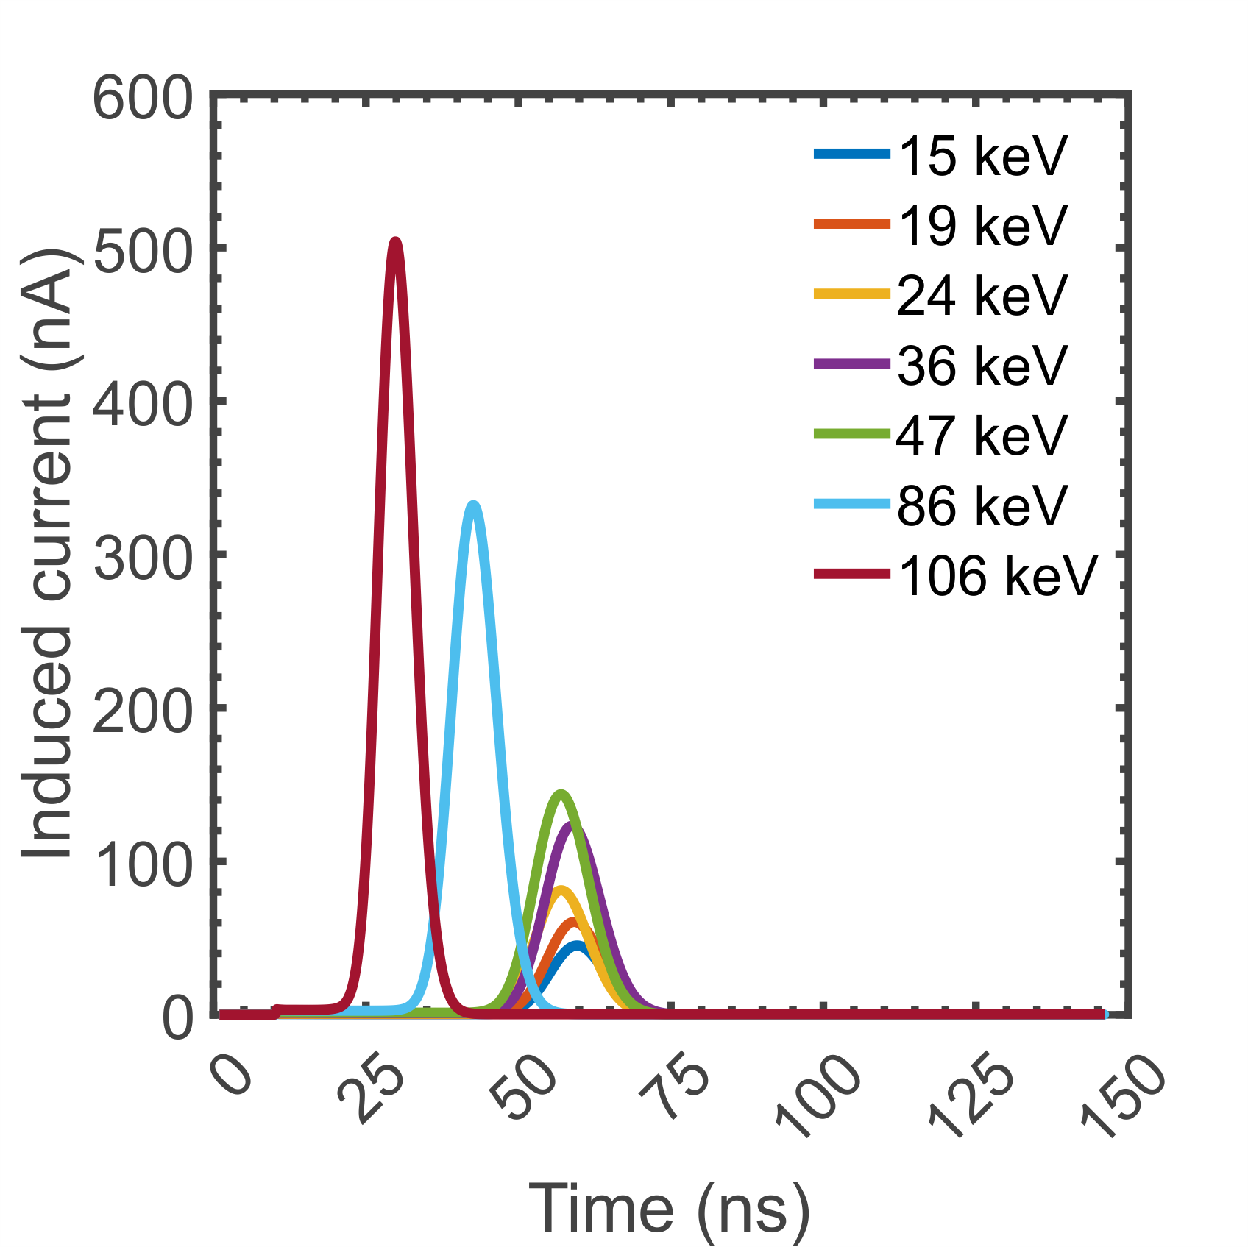
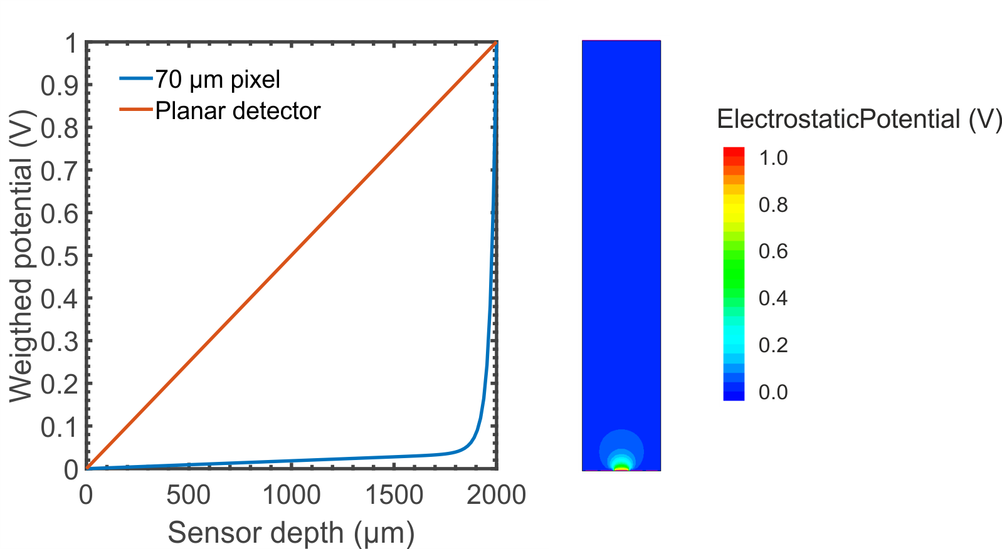
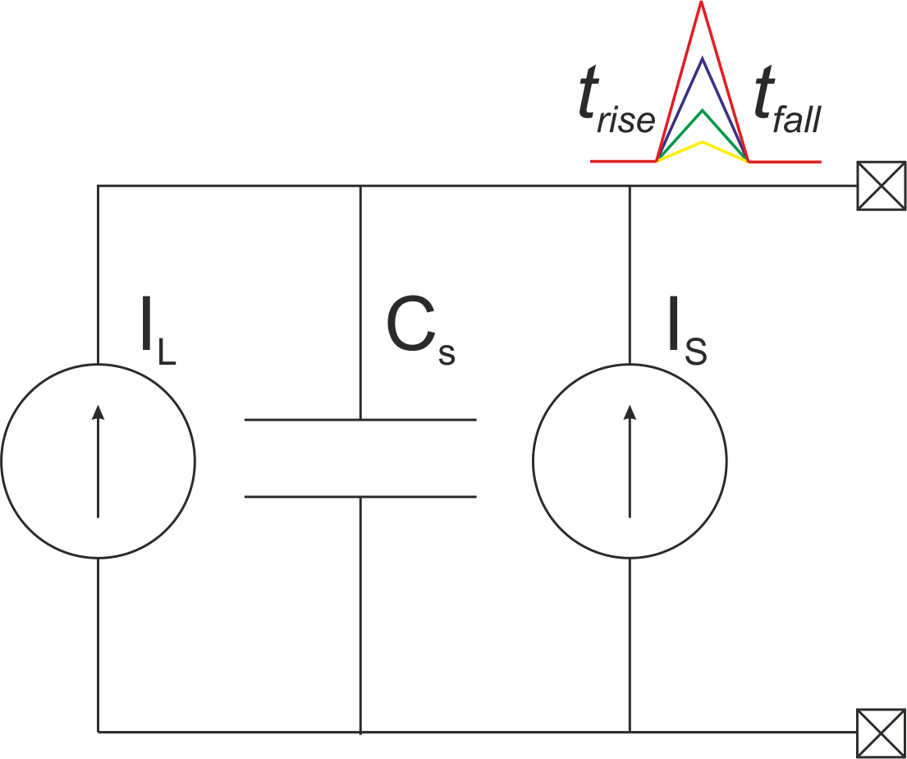
Sentaurus TCAD – Sensor model
Simulation parameters:
  2 mm thick CdTe
  5 x 5 pixels
  70 µm pixel pitch
  Bias voltage -1000 V
  w-value 4.43 eV
2.5 ns
80 ns
Jirsa, J. Simulation of charge sharing effects in 70 μm pixelated CdTe sensor
In: Journal of Physics: Conference Series (JPCS), 1742-6596

Slide 5
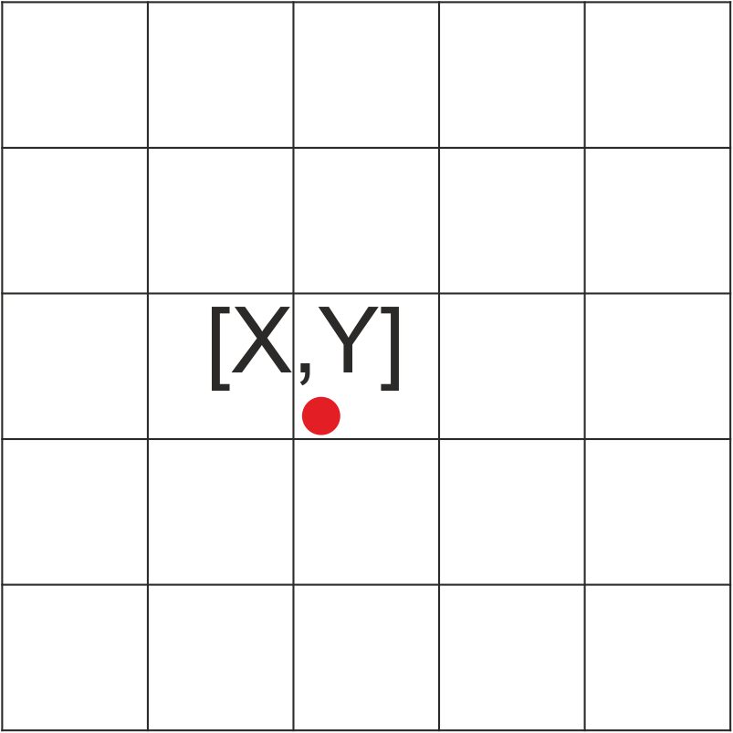
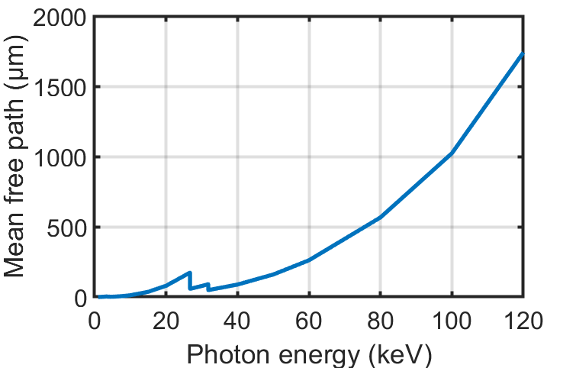

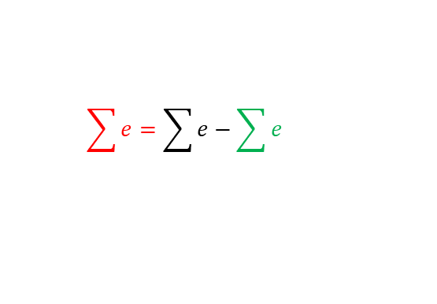

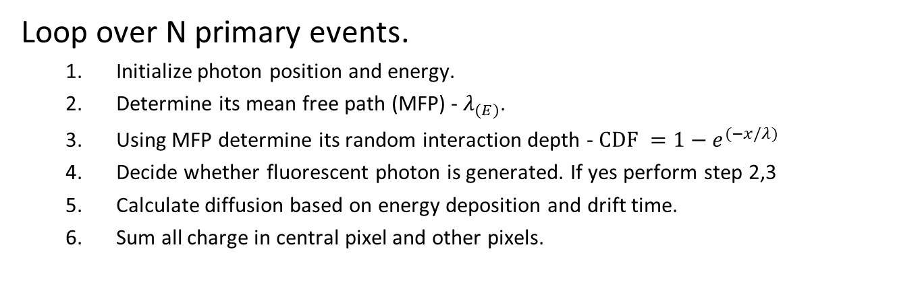

Monte-Carlo simulation
Loop over N primary events.
  Initialize photon position and energy.
  Determine its mean free path (MFP) - $λ_{(E)}$.
  Using MFP determine its random interaction depth - $CDF =1−e^{⁡(−x/λ) }$
  Decide whether fluorescent photon is generated. If yes perform step 2,3
  Calculate diffusion based on energy deposition and drift time.
  Sum all charge in central pixel and other pixels.
  $$σ=\sqrt{\frac{2kTt_{drift}}{e}}$$
$$\sum{e=\sum{e−\sum{e }}}$$
$$\sum{e}$$
$$\sum{e}$$
1.
2.
3. & 4.
5.
6.
Jirsa, J. Monte-Carlo simulation of charge sharing in 2 mm thick pixelated CdTe sensor,
Journal of Instrumentation, Volume 18, February 2023

Slide 6
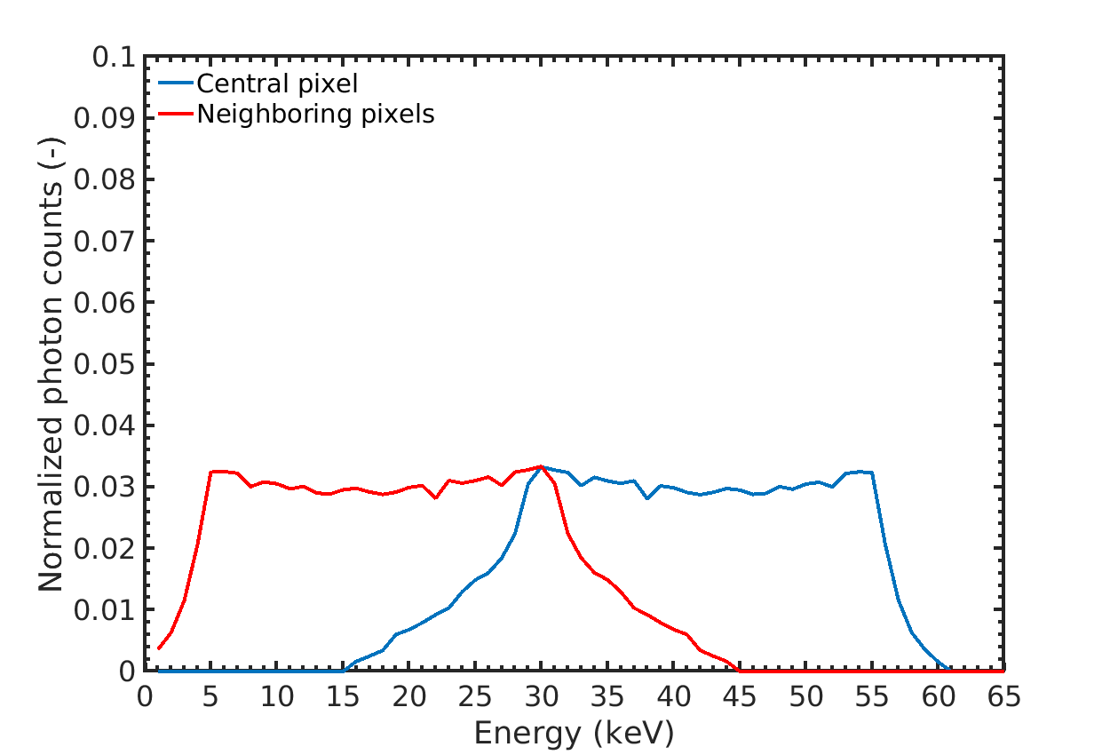
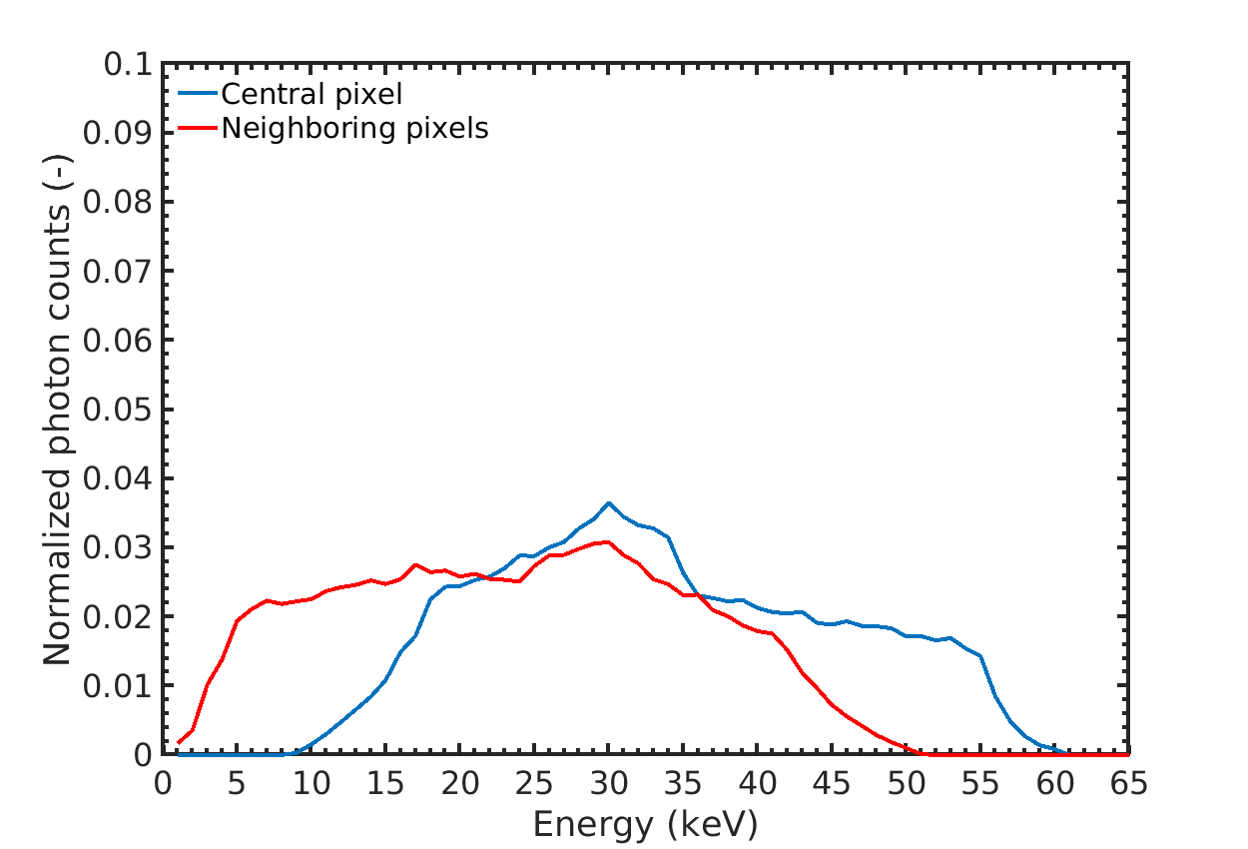
Monte-Carlo simulation result 60 keV
Charge-sharing effect
  No fluorescent photons are generated
  Energy is “conserved” in the sensor
CdTe/CdZnTe fluorescent photons
  Photons with energy higher then
  K-edge can cause generation of
  fluorescent photons
  Part of the energy is lost dew to
  Around 30 keV escape peak
  + fluorescent photon peak

Slide 7
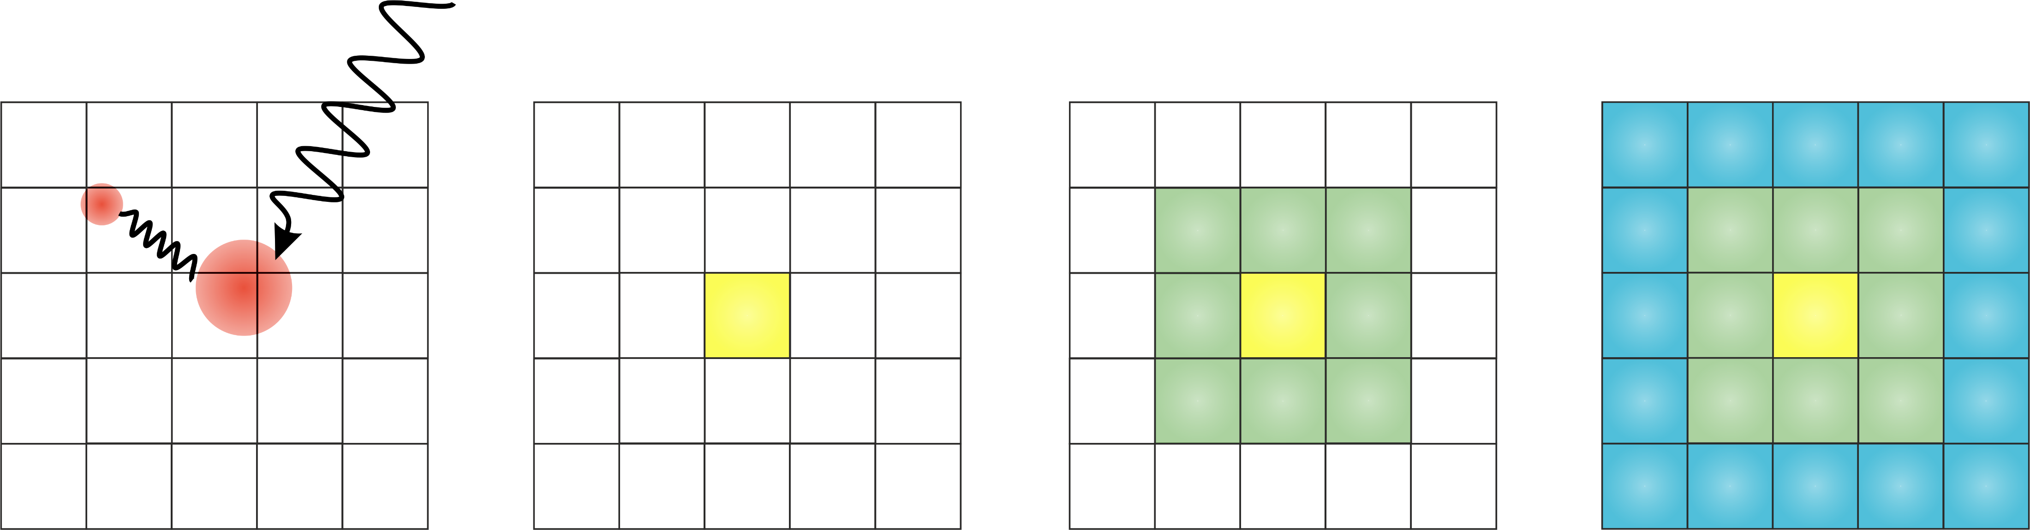
Winner-Leader-Follower algorithm concept
X-ray
Algorithm is performed in three steps:
  Pick winner node
  Create cluster
  Sum cluster charge
WMS consists of three types of pixels:
  Winner (sum total charge)
  Leader (surrounds winner)
  Follower (At the border of the cluster)
Interaction
1
2
3

Slide 8
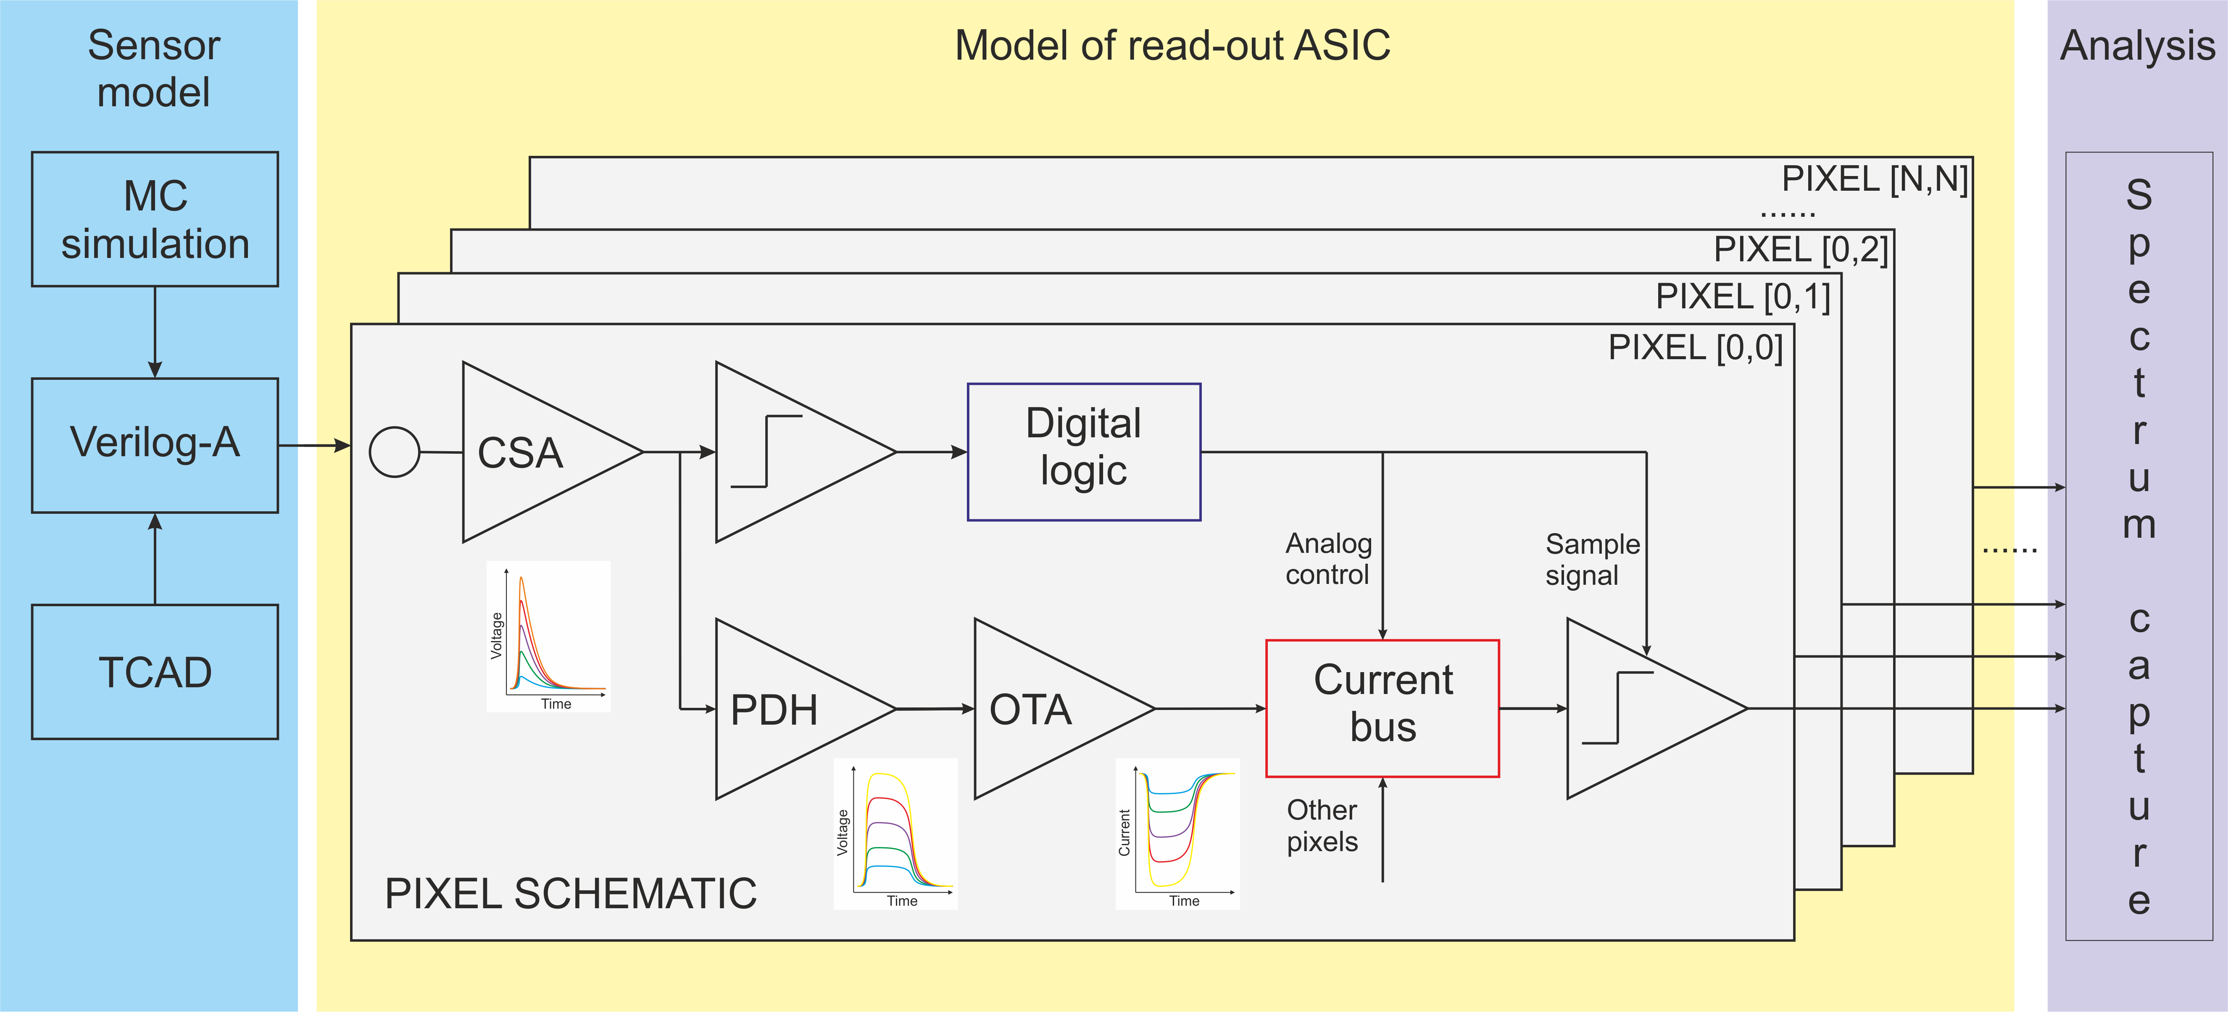
WLF simulation methodology

Slide 9
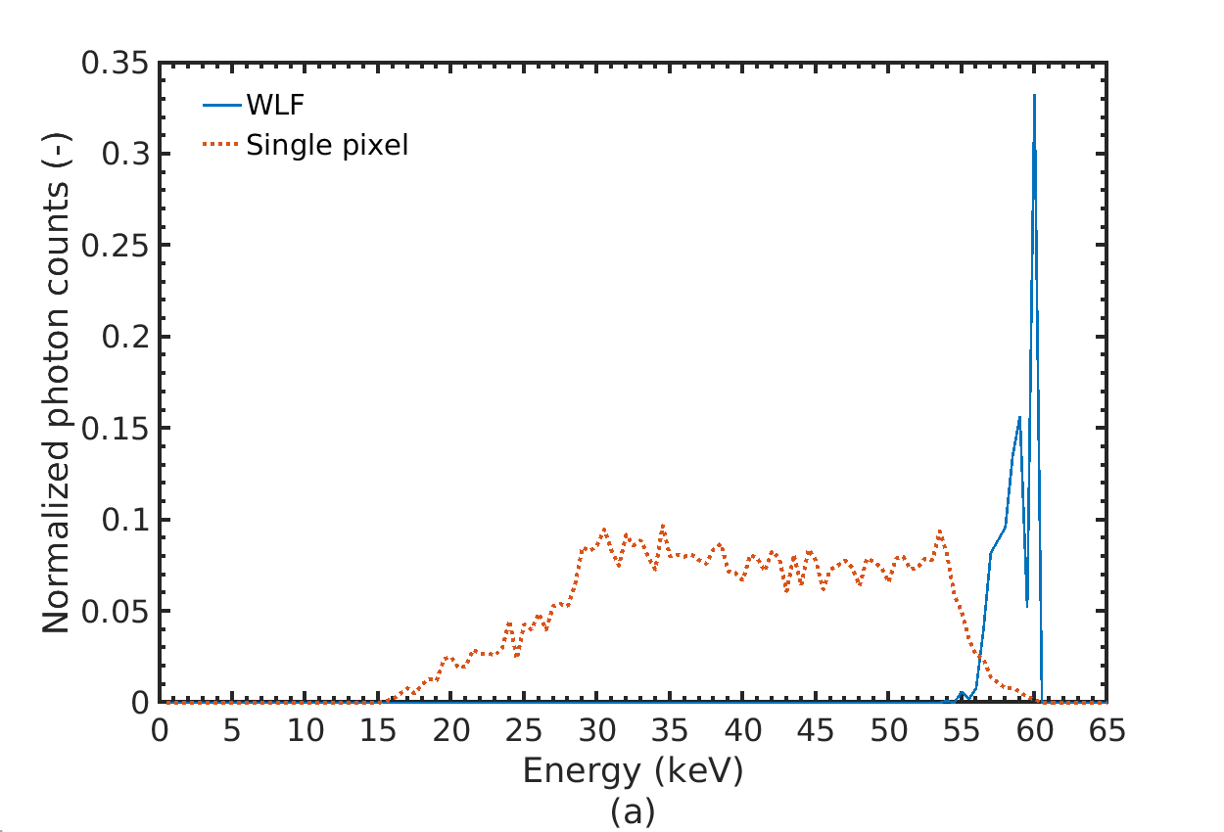
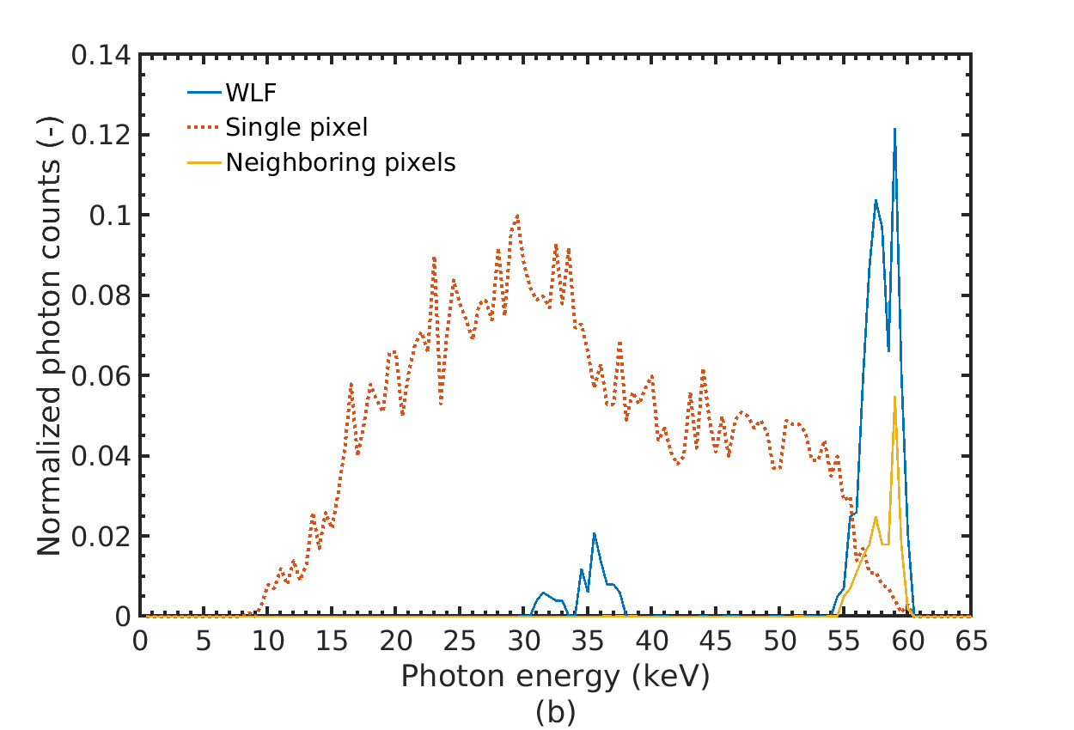
WLF simulated response to 60 keV
Charge diffusion
  Dip caused by the threshold voltage
  No additional pixels selected as winners
Fluorescent photons
  Characteristic escape peaks
  (33 keV and 37 keV)
  No fluorescent peaks
  Surrounding pixels selected as winners,
  causing incorrect hit allocation

Slide 10
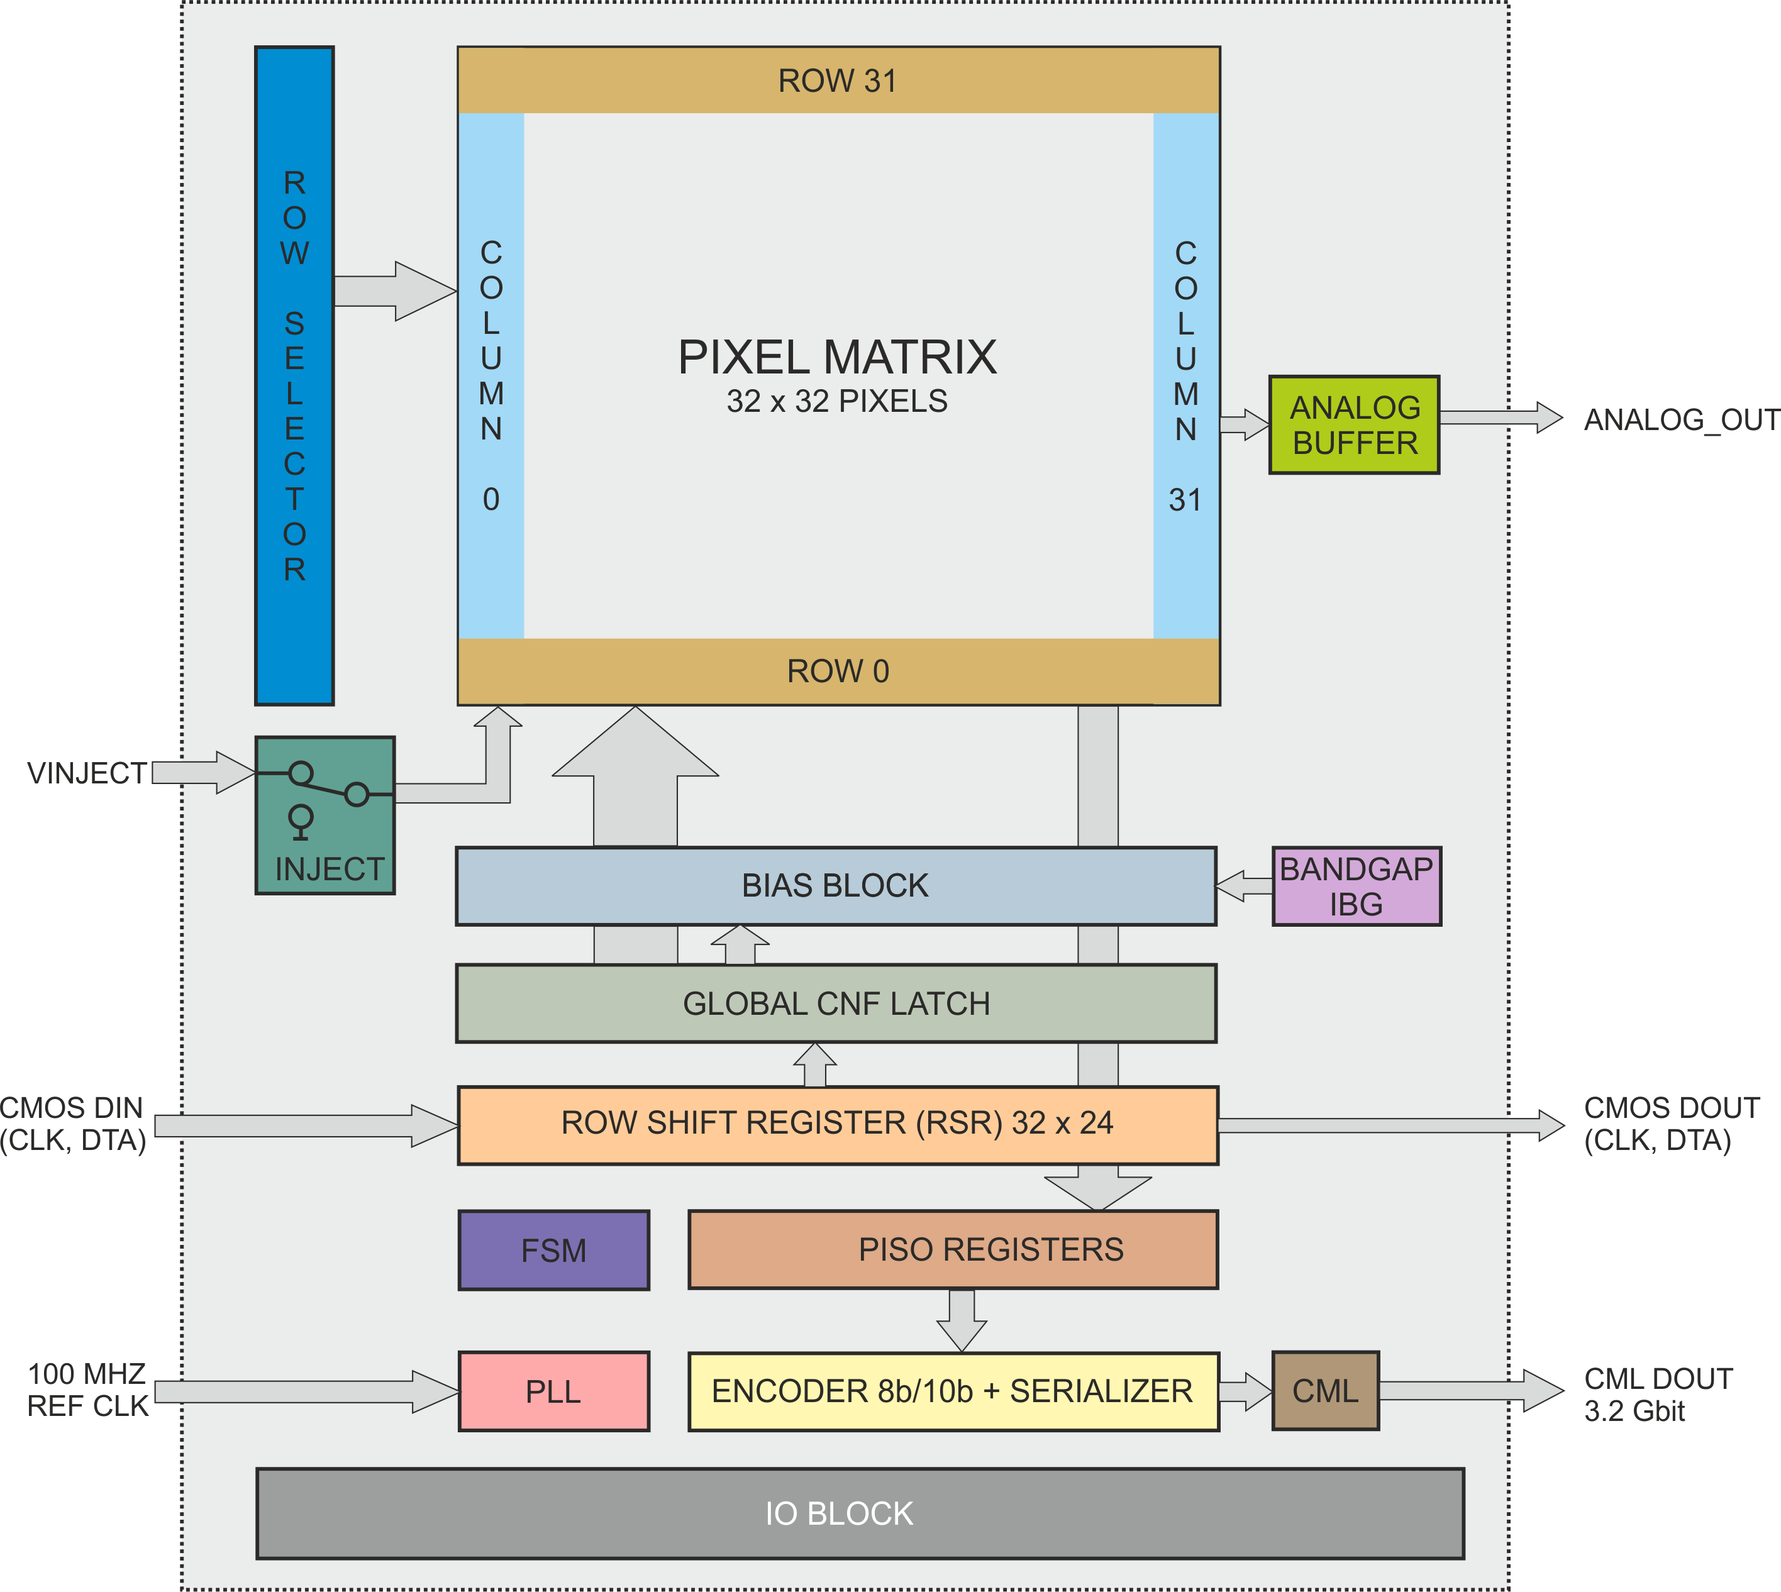
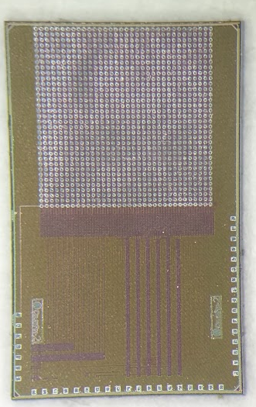
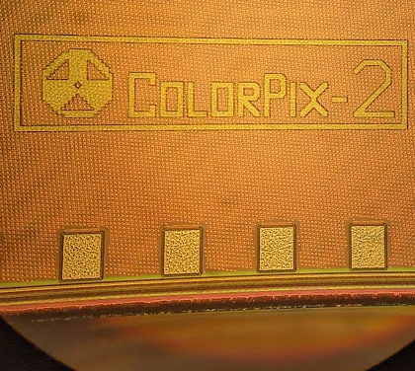
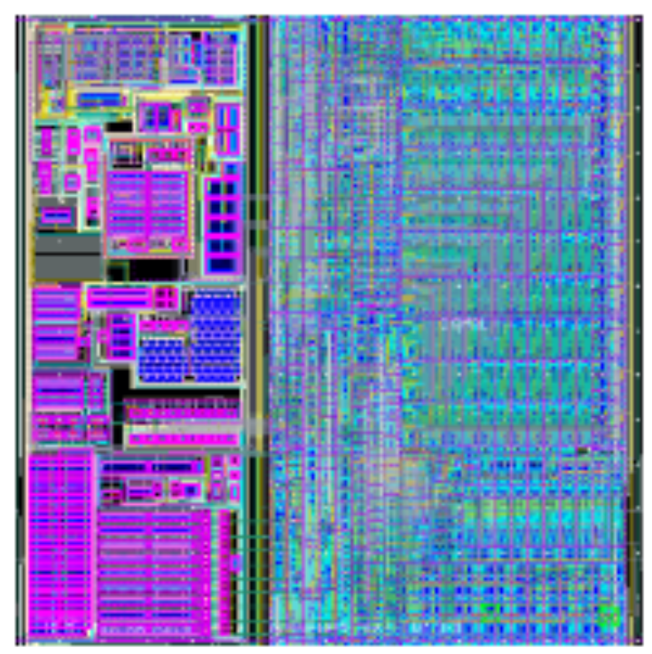
ColorPix – testing ASIC
ColorPix-2 ASIC:
  65 nm CMOS
  32 x 32 pixels
  WLF algorithm implemented
  Scan chain for debugging
  Integrated PLL
  3.2Gbit/s readout
3 mm
5 mm

Slide 11
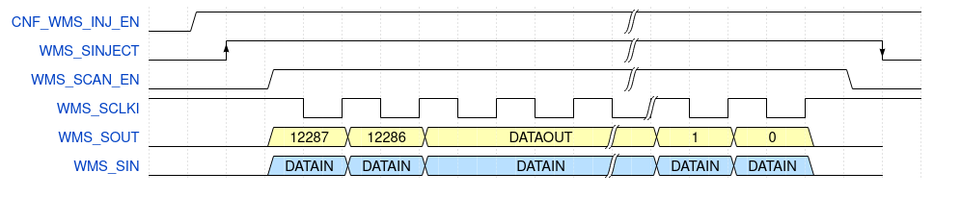
ColorPix – WLF testing

Slide 12
Conclusions
2 mm thick CdTe sensor was developed based on Sentaurus TCAD simulations.
Monte-Carlo simulation was done in order to investigate charge sharing and fluorescent photons in CdTe.
A novel algorithm WLF was developed and simulated in order to allocate the interaction to one pixel.
The algorithm was tested using the sensor model and Monte-Carlo simulation.
A new testing ASIC – ColorPix was designed for on-silicon testing.
The chip was received and was sent for bonding, the test will follow in Spring/Summer 2023

Slide 13



