Slide 1



TCAD analysis of leakage current and breakdown voltage in small pitch 3D pixel sensors
Jixing Ye, Abderrezak Boughedda, Gian-Franco Dalla Betta
University of Trento
TIFPA INFN
Fondazione Bruno Kessler

Slide 2
Content
Introduction
Simulation of Existing Detectors
Influence of Geometrical Parameters
Summary
1

Slide 3
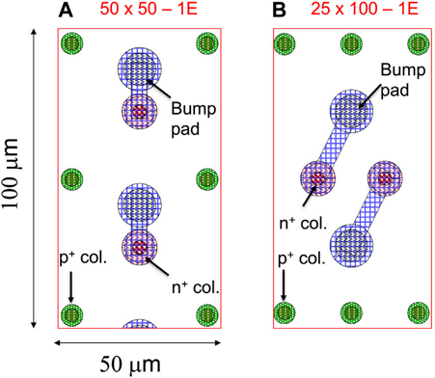
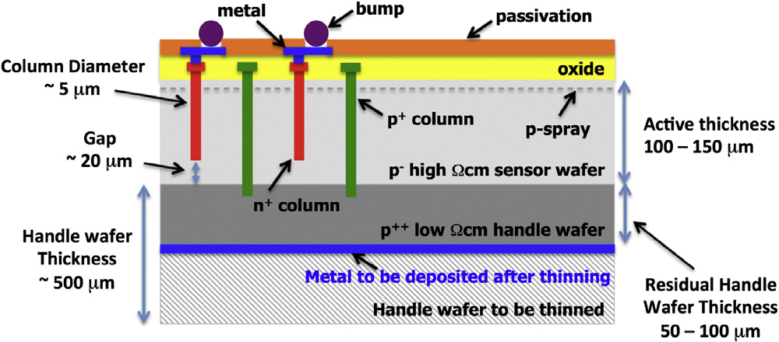
1. Introduction
ATLAS ITk specifications:
Radiation tolerance up to 2*10¹⁶n_{eq}/cm²;
Operation voltage V_{op} < 250 V;
Power dissipation < 10 mW/cm²;
Hit efficiency > 97%.
Smaller inter-electrode distance translates into:
lower event pile up;
stronger radiation hardness.
Geometrical parameters of small-pitch 3D detectors:
active thickness 150 μm;
nominal radius ~2.5 μm;
effective gap ~20 μm.
2

Slide 4
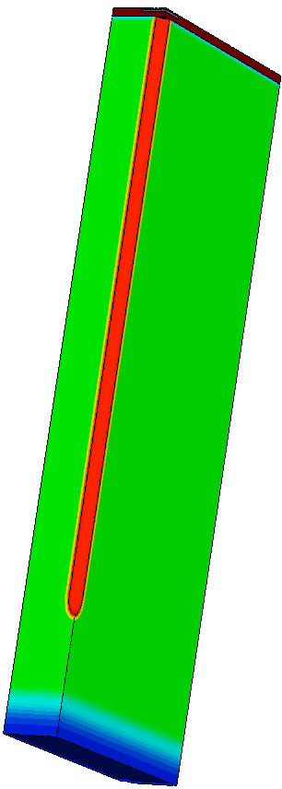
1. Introduction
Beam Test Results:
At 10¹⁶ n_{eq}/cm² a hit efficiency of 96% reached below 100V with perpendicular beam incidence;
Larger voltages (~150 V) required at 1.8x10¹⁶ n_{eq}/cm².
Problem:
Breakdown voltage not large enough compared with the required voltage for the worst cases;
Power dissipation.
Objective:
Locate the origin of the breakdown;
Improve the breakdown voltage from geometry point of view.
Model Used | Temp
Perugia Surface Damage Model | -25 ℃
Perugia Bulk Damage Model | -25 ℃
CERN Bulk Damage Model | -38 ℃
Effective Gap
TCAD Simulation
Simulation domain
25×100-1E
3

Slide 5
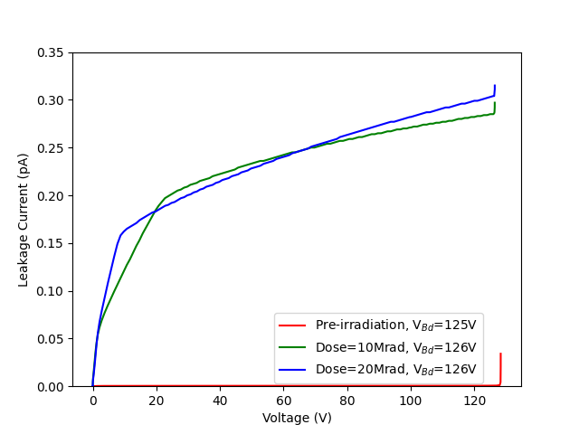
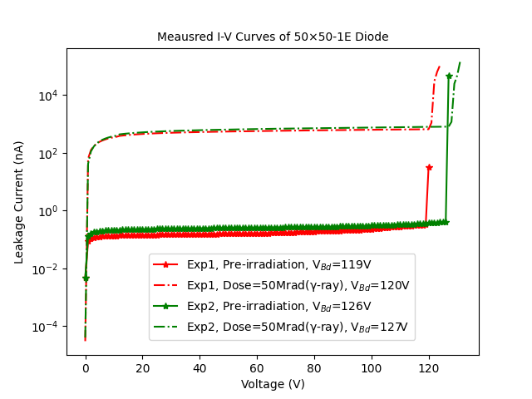
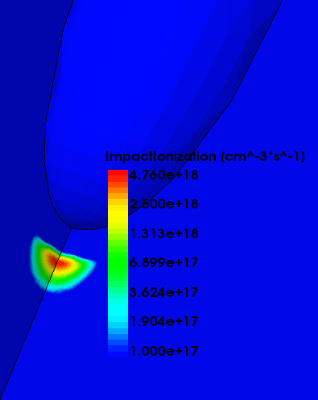

2. Simulation of Existing Detectors
Same breakdown voltage with/without surface damage.
Structure | 50×50-1E
Column radius | 2.5 μm
Effective gap | 20 μm
Temp | -25 ℃
Model Used | Perugia Surface Damage Model
Simulation in agreement with experiment before and after surface damage.
I-V simulation based on Perugia Surface Model
Breaks down at the Tip with/without surface damage.
k(I,V) = $\frac{∆I}{∆V} . \frac{V}{I}$ , k_{bd} $≥4$
4

Slide 6
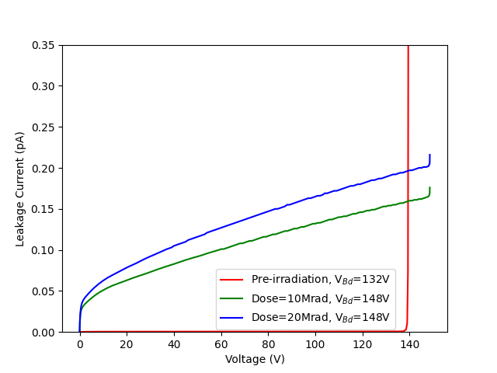
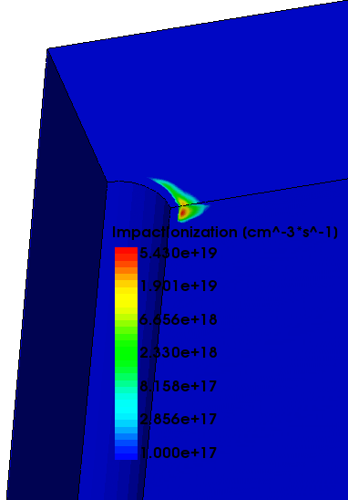
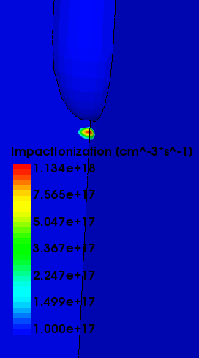
2. Simulation of Existing Detectors
Deviation from experiment probably due to column depths uncertainty of the fabrication.
Breakdown shifts from the surface
to the Tip after surface damage
Structure | 25×100-1E
Column radius | 2.5 μm
Effective gap | 20 μm
Temp | -25 ℃
Model Used | Perugia Surface Damage Model
Before surface damage: Max impact ionization on the surface
After surface damage: Max impact ionization on the tip
I-V simulation based on Perugia Surface Model
Simulation in agreement with experiment (breakdown voltage ~130V).
5

Slide 7
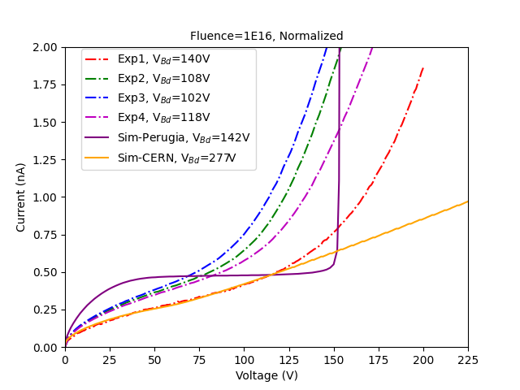
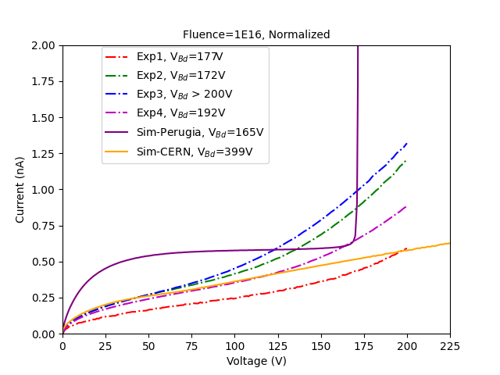
Always breaks down at the Tip regardless of the bulk damage model used or the structure.
Simulation based on the CERN Bulk Damage Model used Temp=-38 ℃, the leakage current was then scaled to -25 ℃ using the SRH model.
2. Simulation of Existing Detectors
Structure | 25×100-1E
Temp | -25 ℃
Structure | 50×50-1E
Temp | -25 ℃
Comparison between simulation & experiments
Calculated Damage Rate at V_{b}=100V, T=20℃
Irradiation | Fluence (n_{eq}/cm²) | Structure | α* Experiment (10⁻¹⁷A/cm) | α* Perugia Model (10⁻¹⁷A/cm) | α* CERN Model (10⁻¹⁷A/cm)
Neutron | 1.0×10¹⁶ | 50×50-1E | 6.92±1.14 | 5.54 | 4.87
 |  | 25×100-1E | 4.25±0.91 | 6.69 | 4.22
6

Slide 8
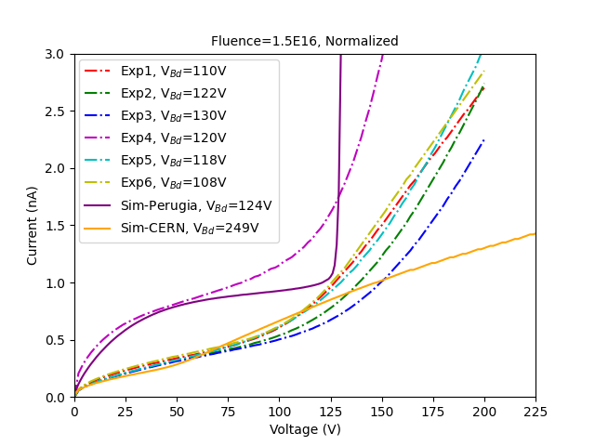
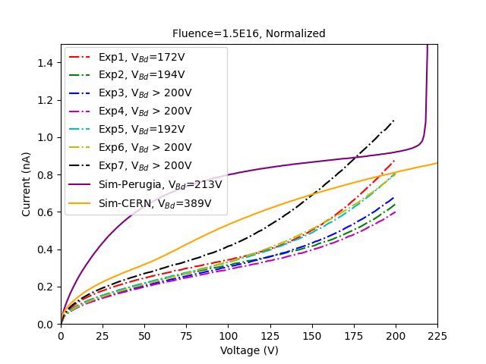
Always breaks down at the Tip regardless of the bulk damage model used or the structure.
2. Simulation of Existing Detectors
Structure | 25×100-1E
Temp | -25 ℃
Structure | 50×50-1E
Temp | -25 ℃
Comparison between simulation & experiments
Calculated Damage Rate at V_{b}=100V, T=20℃
Irradiation | Fluence (n_{eq}/cm²) | Structure | α* Experiment (10⁻¹⁷A/cm) | α* Perugia Model (10⁻¹⁷A/cm) | α* CERN Model (10⁻¹⁷A/cm)
Neutron | 1.5×10¹⁶ | 50×50-1E | 7.79± 2.53 | 10.74 | 7.65
 |  | 25×100-1E | 3.87±0.43 | 9.25 | 6.13
7

Slide 9
2. Simulation of Existing Detectors
Perugia Model:
predicted breakdown voltage of both layouts before and after surface damage;
the prediction of breakdown voltage is still in good agreement with experiment after bulk damage;
the shape of the leakage current is different from the measured I-V curve.
CERN Model:
leakage current well predicted at low reverse bias when the fluence is low;
leakage current starts to deviate from measured results at high fluence;
over-estimates the breakdown voltage for all simulated scenarios, including different layouts and fluences.
8

Slide 10
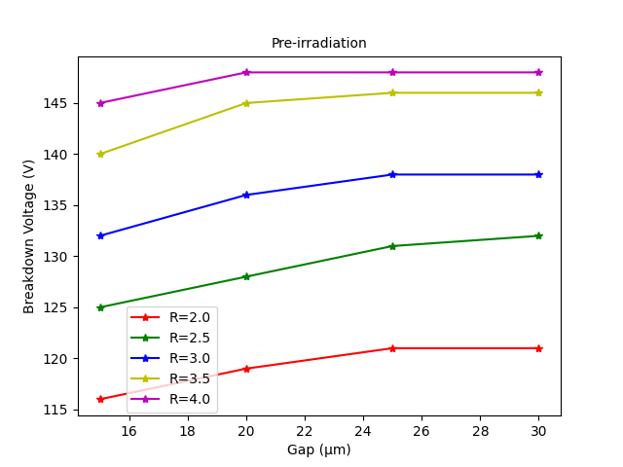
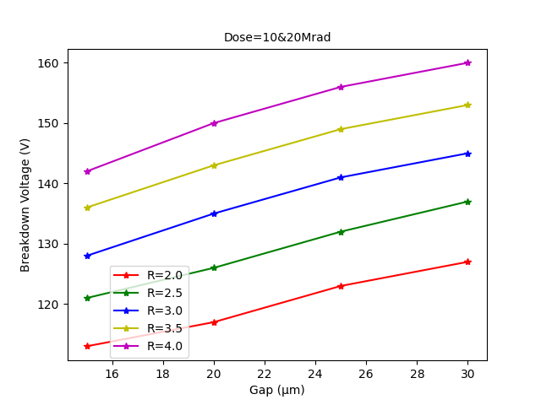
3. Influence of Geometrical Parameters
Designed Value
Structure | 50×50-1E
Model Used | Perugia Surface Damage Model
Structure | 50×50-1E
Temp | 20 ℃
Conclusion:
Breakdown voltage increases with the Radius and the Gap;
Always breaks down at the Tip, contribution from the surface gets more and more important;
The Radius & the Gap effect saturates.
Conclusion:
Always breaks down at the Tip;
Same breakdown voltage for both Doses due to long distance of the Tip from the surface;
Breakdown voltage increases with the Radius & the Gap.
9

Slide 11
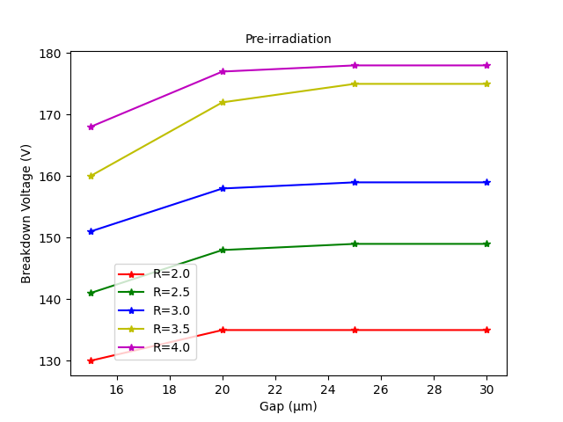
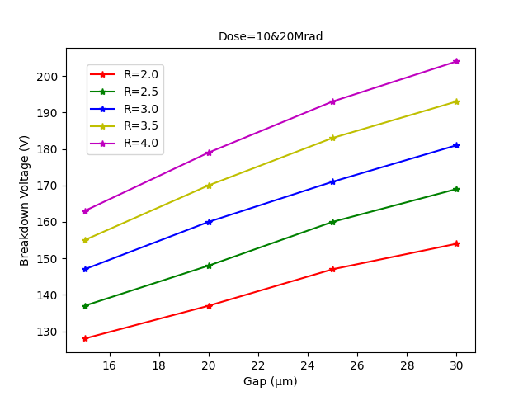
3. Influence of Geometrical Parameters
Designed Value
Structure | 25×100-1E
Temp | 20 ℃
Structure | 25×100-1E
Model Used | Perugia Surface Damage Model
Conclusion:
1): Breakdown voltage increases with the Radius;
2): The Radius & the Gap effect saturates.
Conclusion:
1): Breakdowns at the Tip after surface damage, thus same breakdown voltage for both Doses;
2): Breakdown voltage increases with the Radius & the Gap.
10
Notes:
The origin of the breakdown for the 25X100-1E structure is quite different from the 50X50-1E for pre-irradiation cases, we can see that the breakdown always happens at the surface when the Gap is large, this is reasonable since the inter-electrode is larger than that of the 50X50 ones. Thus the breakdown voltage only increases with the radius and the effect saturates.
After surface damage, the breakdown shifts from the surface to the Tip, and we can see a clear dependence of the breakdown voltage on the Radius and the Gap.

Slide 12
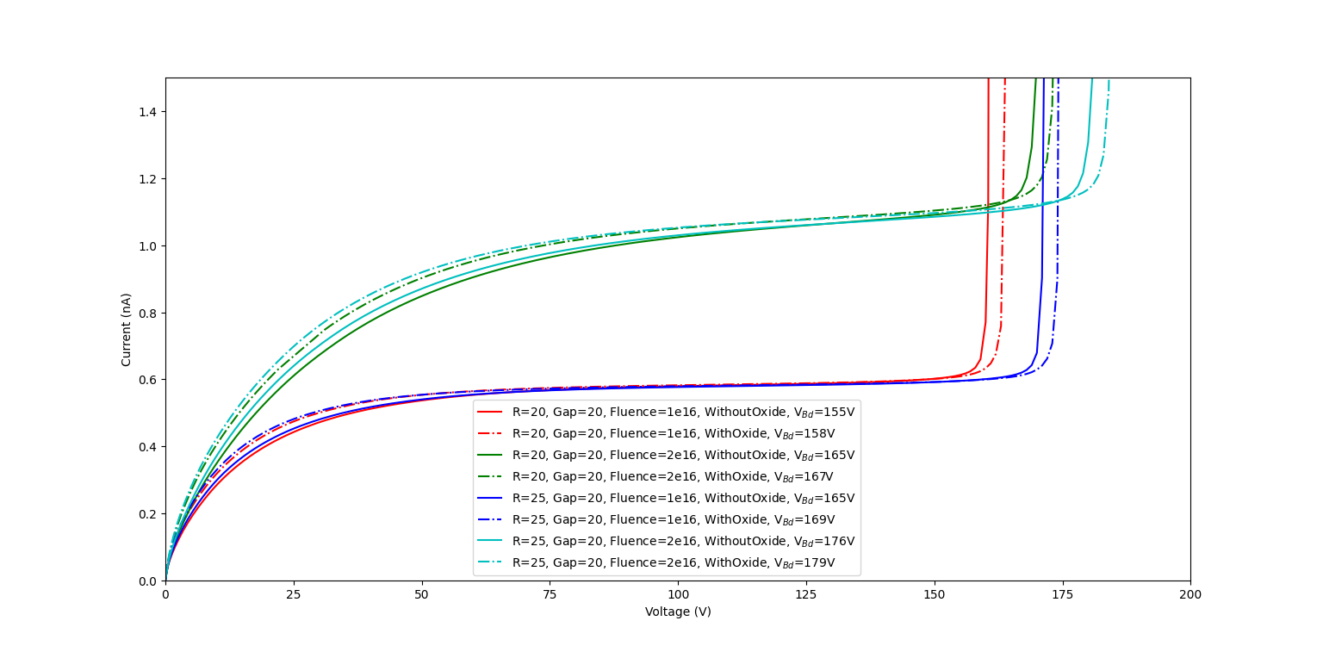
3. Influence of Geometrical Parameters
Structure | 25×100-1E
TID | 20Mrad
Model Used | Perugia Surface&Bulk Damage Model
Difference in the breakdown voltage with/without Oxide is negligible;
The trend applies for the CERN Model as well.
Safe to use only the bulk for breakdown prediction after radiation damage to boost the simulation.
Breakdown simulation With/Without Oxide
11

Slide 13
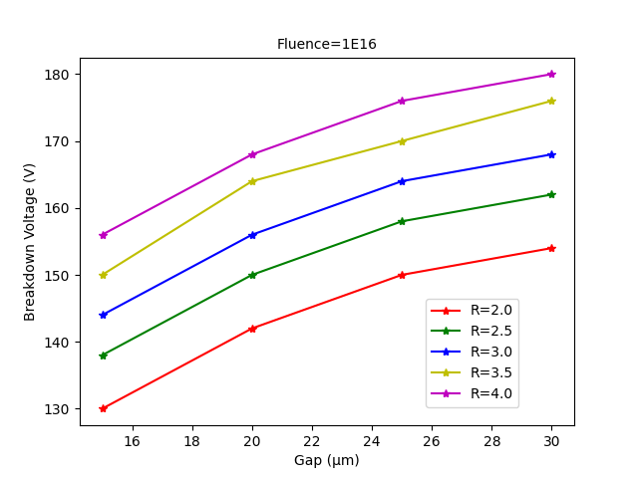
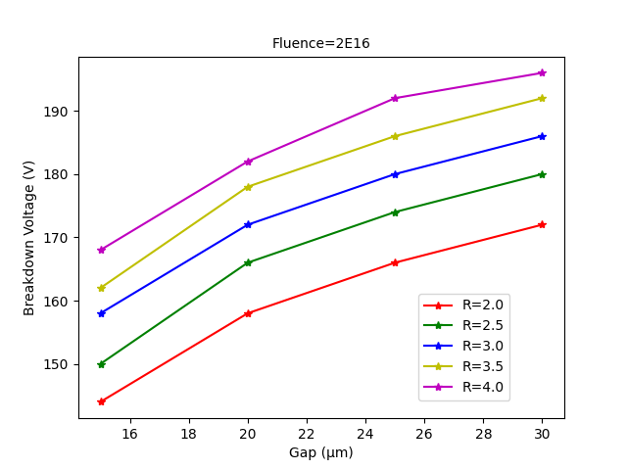
Only the Bulk
3. Influence of Geometrical Parameters
Structure | 50×50-1E
Model Used | Perugia Bulk Damage Model
Structure | 50×50-1E
Model Used | Perugia Bulk Damage Model
Designed Value
Breakdown voltage increased 12V by increasing the radius for 1μm
Conclusion:
1): Higher Fluence leads to higher breakdown voltage;
2): Breakdown voltage increases with the Radius & the Gap;
3): The Radius & the Gap effect saturates.
12

Slide 14
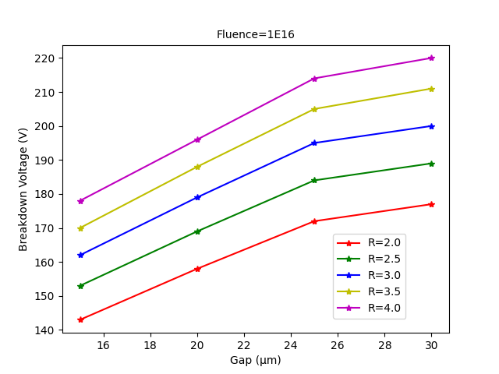
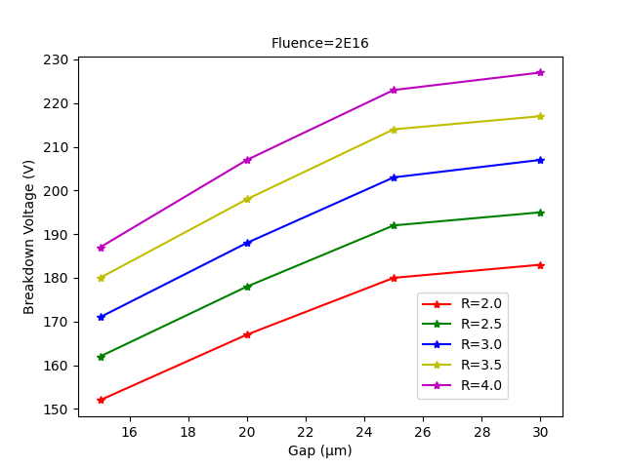
Only the Bulk
3. Influence of Geometrical Parameters
Structure | 25×100-1E
Model Used | Perugia Bulk Damage Model
Structure | 25×100-1E
Model Used | Perugia Bulk Damage Model
Breakdown voltage increased 20V by increasing the radius for 1μm
Designed Value
Conclusion:
1): Higher Fluence leads to higher breakdown voltage;
2): Breakdown voltage increases with the Radius & the Gap;
3): The Radius & the Gap effect saturates.
13

Slide 15
4. Summary
The Tip limits the breakdown voltage, especially after radiation damage;
25×100-1E has higher breakdown voltage due to larger inter-electrode distance;
Perugia Bulk Damage Model can predict the breakdown quite accurately, CERN Bulk Damage Model is better at predicting the leakage current;
It is possible to increase the breakdown voltage of both designs by increasing the Radius/Gap, but the Radius & the Gap effect saturates.
14

Slide 16
Thank you for your time!

Slide 17
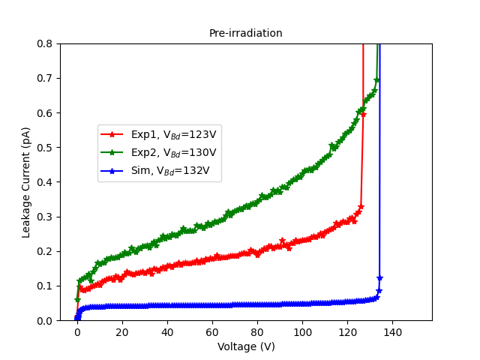
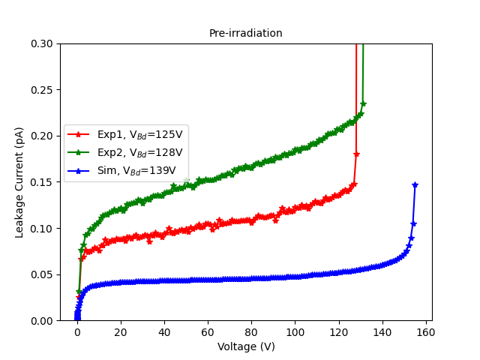
Backup – Pre-irradiation
Structure | 50×50-1E
Column radius | 2.5 μm
Effective gap | 20 μm
Temp | 20 ℃
Structure | 25×100-1E
Column radius | 2.5 μm
Effective gap | 20 μm
Temp | 20 ℃

Slide 18
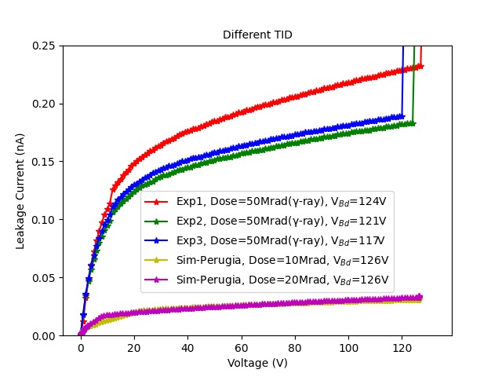
Back – Surface Damage
Structure | 50×50-1E
Column radius | 2.5 μm
Effective gap | 20 μm
Temp | 20 ℃

Slide 19
Backup - Power dissipation
At the voltages of interest for a high hit efficiency, the power dissipation is still low
S. Terzo et al., Frontiers in Physics 9:624668
FBK
CNM

Slide 20
Back – Efficiency of irradiated modules at beam test
RD53A assemblies with different 3D sensor geometries
At 10¹⁶ n_{eq}/cm² a hit efficiency of 96% at normal beam incidence reached below 100 V
Larger voltages (~150 V) required at 1.8x10¹⁶ n_{eq}/cm²
S. Terzo et al., Frontiers in Physics 9:624668
G. Bardelli et al., IWORID 2022
25x100-1E

