Slide 1
More possibilities for decreasing the CM energy spread
November 24st, 2022

Slide 2
Further exotic possibilities that I have not seen considered so far (or have been already excluded/trashed before I joined the FCCee):
Reduce espread induced by beamstralung:
There are correlations of the average eloss with the beam phase space. In theory such correlations could be
Compensated.
- eloss vs z: the central part of the bunch loses more energy (about 0.16photons/collision, 1 photon in 6 turns)
a THz like cavity could recover such loss? ~few% potential gain
- eloss vs y: this is probably even trickier, any ideas? High order modes cavities? ~fewmore% potential gain
=> Plasma or beam lenses?
Presented at the polarization workshop

Slide 3
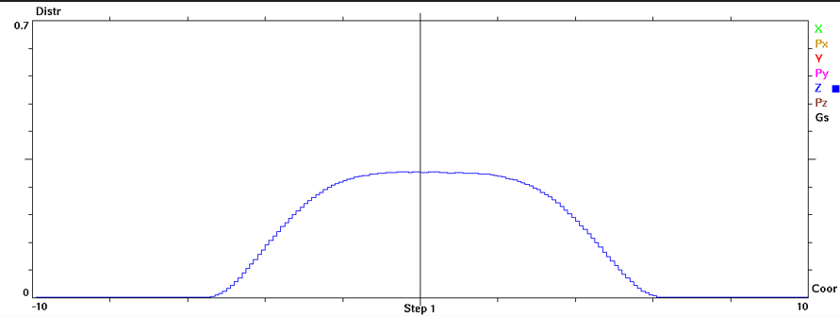
This looked very ambitious/futuristic but in fact could be achieved with much simpler/clever method.
If we install a high harmonic cavity (3.5HC or higher) the longitudinal charge distribution can be modified and
In particular could be very close to a rectangular one.
D Shatilov is studying this possibility and at some point we will be able to assess if it is worth to further explore
In fact we need a M.X cavity were X=n*1/m, n (range 1...m-1) free and m the minimum number of empty buckets foreseen)
n cannot be 0 because we need buckets with high synchrotron tune for the pilot bunches
What (we hope could) happens:
a (RBD) rectangular bunch with a bunch length (half end of the rectangle) = sqrt(2)*gaussian_bunch_length (GBD)
produces the same luminosity with these differences:
RBD peak vertical tune shift = 1/sqrt(2) wrt GBD and uniform along the bunch
RBD Beamstralung power same as in GBD, but beamstralung uniform along the bunch
RBD critical photon energy 1/sqrt(2) (or 1/2?) wrt GBD
2+3 might lead to a decrease of the BB induced energy spread probably by a factor 1/sqrt(2) (or 1/2?) as well
The synchrobetatron resonances will be greatly reduced (vanish at first order)
It would be interesting to see if a set-up/parameter-set could be found were the equilibrium bunch length/distribution
would be much more similar with/without collisions (for all cases), this requires more extensive beambeam simulations/studies.
Hopefully we will have some results in a few weeks.
To be noted that an RF system that has control of the RF phase for both frequencies and for all the bunches has to be assessed/developed as well.
At ESRF this system is being developed and an active HC cavity has been chosen to better meet this requirement

Slide 4
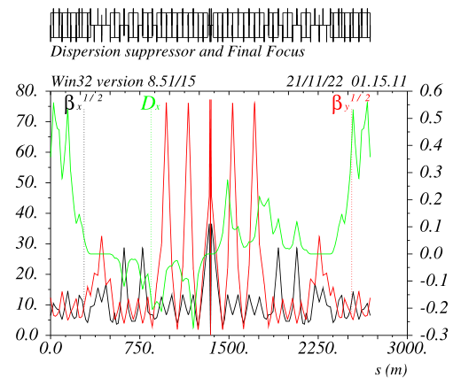
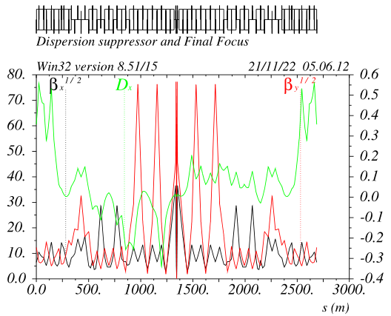
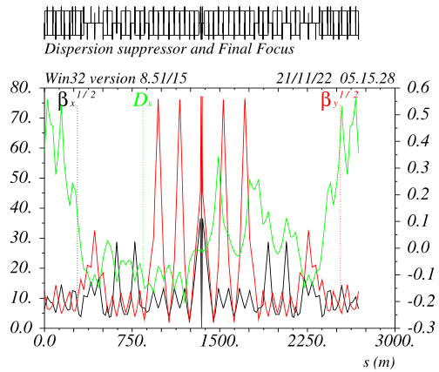
Generating etax at the IP:
An intriguing possibility to generate horizontal dispersion at the IP without changing the FF optics is by
simply generating the dispersion before the FF (in the DS+BM section) with the proper phase,
it will then be propagated through the FF and finally show up at the IP.
This is true for any FF or transport line optical system, the following one is just an example to show how it works
Crab sextupole without and with +/-etax. Etax is generated by just rematching the quads in the DS region
For this case etax = 4mm is generated at the IP (no impact on DA&MA).
It has to be studied how far we can go (also lower betax* could be considered as well) =>~few cm?

Slide 5
Chromatic-waist monochromatization:
As shown by Angeles at last workshop, unbalancing the FF-left-right y-chromaticities we can effectively lower the luminosity of the off-energy CM collisions.
The waist of an off-energy electron will be offset longitudinally (at will) and can be at the same location of the “–”off-energy positron.
The luminosity will decrease since the point of maximum charge density will not be correspondingly shifted.
Again with the help of the crab waist, if we generate the right dispersion in the crab-sextupole,
we could also realize the condition where this location does correspond also to the point of maximum charge density for these electrons&positrons pairs
(In fact the crab sextupoles do move the vertical waist to the point of maximum charge density of the other beam)
I had no time to figure out the math yet since it just occurred to me after looking at the plots in the previous page.
In the next few weeks we will further explore this possibility, and if promising we could do some guinea-pig run first and
then D Shatilov could check how this setup withstands to BB.
A factor 2 reduction in CM-espread would already be significative if associated to a small degradation <10% in the other beam parameters (luminosity, lifetimes etc)

Slide 6
Finally:
Angeles and Zhang are working of optimizing the parameters for collisions with etax in both cases:
30mrad or head-on.
Head-on case in principle achieves large monochromatization, however it requires very large etax to maintain small tuneshifts and not lose much in luminosity.
Luminosity will anyway decrease because betay* must be set equal to the bunch_length => at least a factor 2-3
In addition the horizontal size at the IP will be larger and “Final-Focus-coupling-related” vertical size might be practically affected as well.
With 30mrad collisions gain is more limited, however it might be that the schemes mentioned in the previous slide might lessen the requirement on the value of etax.

